Slide 1
Deadlock detection in the Java-API using static-analysis
-- initial findings
Vivek K. Shanbhag
Adviser: Prof K. V. Dinesha
International Institute of Information Technology -- Bangalore

Slide 2
Structure of the Talk
Introduction
  Problem & its discussion
  Literature survey
Our work
  A brief description of the algorithm
  An example to illustrate the steps of the algorithm
Initial results
  Some statistics
  A non-trivial result from ‘jre’ analysis
Conclusions & future work

Slide 3
Sample Deadlocking program
(JVM Version1.4.2_04)
public class DeadlockTest {
public static void main (String[] args) {
new Thread() {
public void run() {
java.util.TimeZone.getTimeZone ("PST");
};
}.start();
new Thread() {
public void run() {
try {
System.getProperties().store (System.out, null);
} catch (java.io.IOException e) {
System.out.println ("IOException : " + e);
}
};
}.start();
}
}

Slide 4
Analysing the Deadlock
Thread-1
Thread-2
Method: Java.util.TimeZone.getTimeZone()
Object: Class java.lang.TimeZone
Method: Java.util.Properties.Store()
Object: java.util.Properties
Method: Java.util.Hashtable.get()
Object: java.util.Properties
Method: Java.util.TimeZone.getDefault()
Object: Class java.lang.TimeZone
Deadlock Reached !!

Slide 5
Literature Survey
Studies that view this problem as a ‘programming error / bug’:
  “Finding bugs is easy”, Bill Pugh, OOPSLA 2004 (http://findbugs.sourceforge.net/)
    Such instances detected heuristically, and treated like bugs
  Concurrency JSR-166, Doug Lee, and others
    Introduces an alternative construct for developing concurrent code. However, the existing problem persists, both in legacy code, as well as in the form of an essential language feature.
Study that views this problem at a library level
  “Static deadlock detection for Java Libraries”, Amy Williams, William Thies, and Michael Ernst
    Detects errors within small-medium sized API-subsets
    Reports inconclusively on the (larger) jdk; quotes ‘out of memory’
    Suggests alternative language constructs like ‘lock-ordering’, ‘fat-locks’, and ‘alternative synchronized construct with multiple-lock semantics’ which are all not-applicable to correct legacy-library-implementations.

Slide 6
Literature Survey (cont.)
Studies that view the problem at application level:
  The Bandera group, SAnToS Lab., Kansas State Univ., M. B. Dwyer, J. Hatcliff, J. C. Corbett, and others
    Elaborate framework for verifying properties of Java Programs
    Operates on entire applications; not appropriate for libraries
  NASA: The Java Pathfinder – A Java Model-Checker
Study that views it as a Language level problem
  “The Problem with Threads” Edward A Lee, IEEE Computer, May 2006.
    The first time it being observed that the ‘Threads’ abstraction of programming languages is possibly hindering the development of reliable software.
    The motivational example in this paper is a java program.
    It derives from the Ptolemy II Project, EECS Dept., UC-Berkley.

Slide 7
Approximate Procedural analysis of Object-Oriented Libraries
Analysis is approximate:
  We ignore the use of Synchronized code-blocks
It is Procedural:
  We discount the polymorphism feature of Java
2-Lock 2-thread deadlocks reported:
  We minimize reporting by restricting it in this manner
Ignoring native methods:
  We parse only the byte-code generated from Java-compilation
Data is conservatively abstracted away:
  Variable values are not tracked: if there appears a (conditional or unconditional) call to method T from the byte-code corresponding to method C, then we have an edge (in our graph) to represent this possibility.

Slide 8
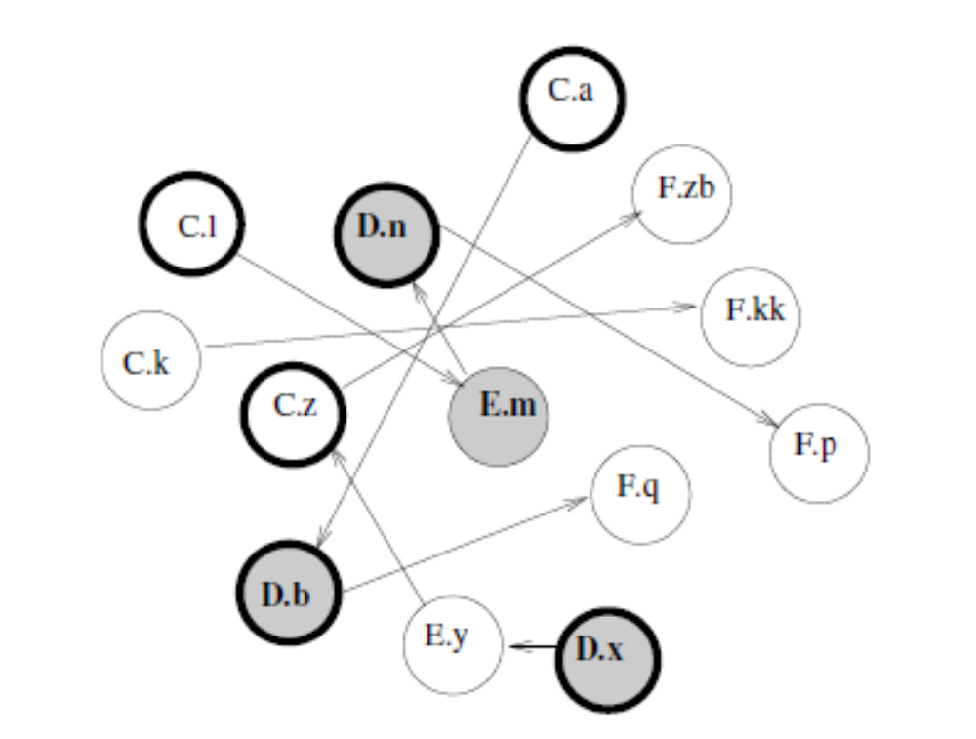
An illustrative example: Source
public class C {
public synchronized void l() { E.m(); };
public void k() { F.kk(); };
public synchronized void a(D d) { d.b(); };
public synchronized void z() { F.zb(); };
}
public class D {
public static synchronized void n() { F.p(); };
public synchronized void b() { F.q(); };
public static synchronized void x(E e, C c) { e.y(c); }
}
public class E {
public static void m() { D.n(); };
public void y(C c) { c.z(); };
}
Bold circle ➔ Synchronized methods; Gray circle ➔ static methods

Slide 9
The Code-Graph after our Step-1
Bold circle ➔ Synchronized methods; Gray circle ➔ static methods

Slide 10
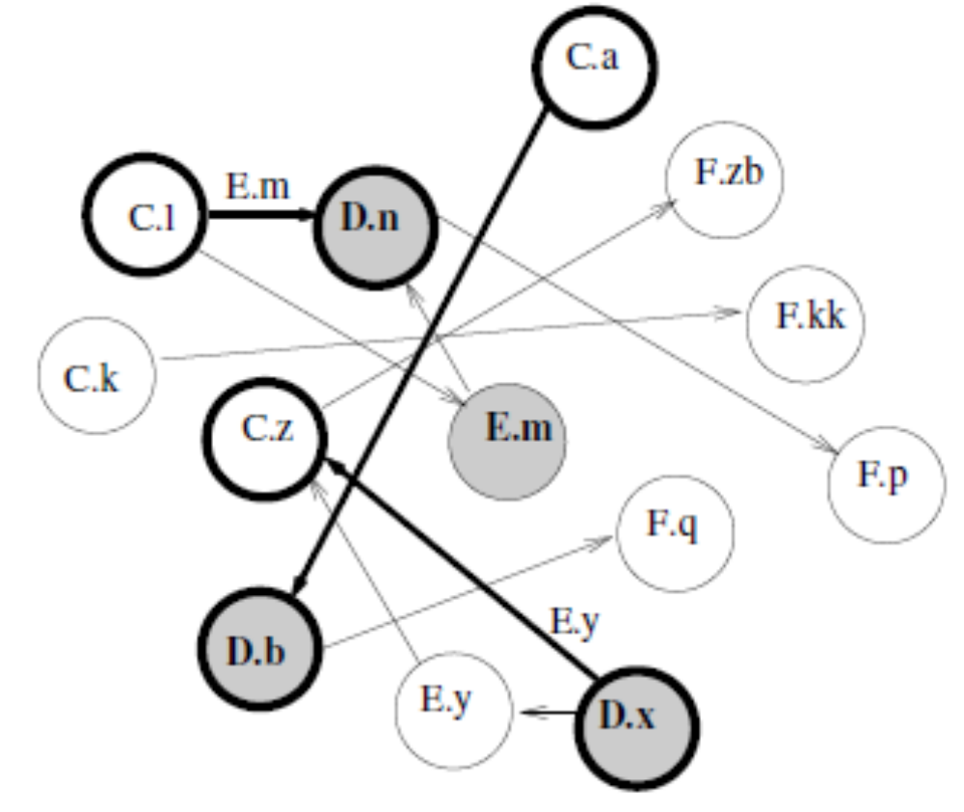
The Code-Graph after our Step-2
Bold circle ➔ Synchronized methods; Gray circle ➔ static methods;
Bold edges ➔ possible nested invocation, amongst synchronized methods

Slide 11
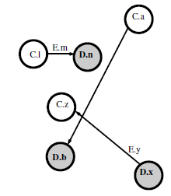
The Code-Graph after our Step-3
Bold circle ➔ Synchronized methods; Gray circle ➔ static methods;
Bold edges ➔ possible nested invocation, amongst synchronized methods

Slide 12
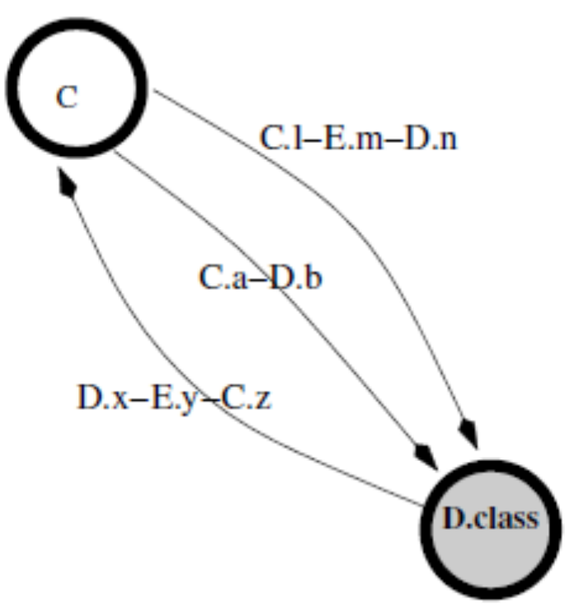
The Object-Graph after our Step-4
Node ➔ Java Object; Node-name ➔ Type of Object;
Directed Edge ➔ ‘From’-node is locked, before possible nested locking of ‘to’-node;
Edge-legend ➔ the sequence of method invocations on the path ‘from’ until the ‘to’ lock-acquiry

Slide 13
Text-output from our analysis
<2-Cycle C D.class>
<Thread-1 Option>C.l E.m D.n<\Thread-1 Option>
<Thread-1 Option>C.a D.b<\Thread-1 Option>
<Thread-2 Option>D.x E.y C.z<\Thread-2 Option>
<\2-Cycle C D.class>

Slide 14
Observations on the way forward
Multi-threaded program with at-least 2 threads
The threads should share objects so as to actually realize the deadlock
  Studying the relevant Java source seems necessary
  This is easier if at-least one of the objects involved is a ‘class’ object, locked by a static synchronized method
  If the objects involved in such a deadlock are all created by the library, (and since all the code involved is also provided by the library implementation) then the fault lies with the Library
  Else, one may not be so sure.

Slide 15
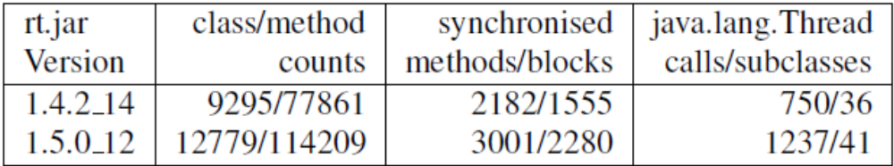
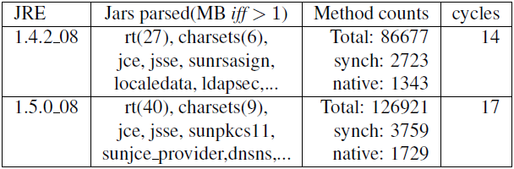
Size of the input, analysis & output

Slide 16
Deadlock-possibility predicted by the analysis
<2-Cycle java/lang/Class sun/reflect/annotation/AnnotationType.class >
<Thread-1 Option>
java/lang/Class.initAnnotationsIfNecessary:( )V
sun/reflect/annota...tionParser.parseAnnotations:([BLsun/reflect/ConstantPool;Ljava/lang/Class;)Ljava/util/Map;
sun/reflect/annota...tionParser.parseAnnotations2:([BLsun/reflect/ConstantPool;Ljava/lang/Class;)Ljava/util/Map ;
sun/reflect/annotation/AnnotationType.getInstance:(Ljava/lang/Class;)Lsun/reflect/annotation/AnnotationType;
<\Thread-1 Option>
<Thread-1 Option>...<\Thread-1 Option>
<Thread-1 Option>...<\Thread-1 Option>
<Thread-2 Option>
sun/reflect/annotation/AnnotationType.getInstance:(Ljava/lang/Class;)Lsun/reflect/annotation/AnnotationType;
sun/reflect/annotation/AnnotationType."<init >":(Ljava/lang/Class;)V
java/lang/Class.isAnnotationPresent:(Ljava/lang/Class;)Z
java/lang/Class.getAnnotation:(Ljava/lang/Class;)Ljava/lang/annotation/Annotation;
java/lang/Class.initAnnotationsIfNecessary:()V
<\Thread-2 Option>
<\2-Cycle java/lang/Class sun/reflect/annotation/AnnotationType.class>

Slide 17
A simple program that managed to realize the predicted deadlock-possibility
import java.lang.annotation.Annotation;
import sun.reflect.annotation.*;
public class Dl {
public static void main(String[] args) {
final String c = args[0];
new Thread() {
public void run() {
try {
for (Annotation a: Class.forName(c).getAnnotations())
System.out.println (a);
} catch (Exception e) {
System.out.printf ("T1: %s", e.getCause());
}
};
}.start();
new Thread() {
public void run() {
try {
System.out.println (AnnotationType.getInstance(Class.forName(c )));
} catch (Exception e) {
System.out.printf ("T2: %s", e.getCause());
}
};
}.start();
}
}
Sun Bug-id: bugs.sun.com/view_bug.do?6588239

Slide 18
Conclusions & Future work
Conclusions
  Simple ‘text-book’ approach is able to detect legacy problems in large code-bases
  Can be incorporated into the regression-testing tool-chain to ensure no new deadlocks have been introduced
Future work
  Accurate procedural analysis of OO Libraries
    Handle Synchronized blocks
    Report n-lock m-thread cycles
  OO (static) analysis of OO Libraries
    Appropriate handling of abstract functions using object-type info
  …

Slide 19
Thank you
Any Questions ?

