Slide 1
Locating Lock-Order Violations in the Java Standard Library
PhD Thesis defense
Vivek K. Shanbhag
(Ph2006905)
Thesis Supervisor: Prof. K V Dinesha
IIIT-Bangalore
17th June 2015

Slide 2
The Problem
The Problem: Executions of completely well-formed, multi-threaded, Java Programs that make legitimate invocations into the Standard Library may occasionally lead to deadlock !
It is Current: This is true even today !
The Reason: Uncoordinated interaction between the programmers' use of locking primitives and the JVM's implementation of locking constructs is responsible for this class of anomalous behavior.

Slide 3
Sample Deadlocking program
(JVM Version1.4.2_04)
public class DeadlockTest {
public static void main (String[] args) {
new Thread() {
public void run() {
java.util.TimeZone.getTimeZone ("PST");
};
}.start();
new Thread() {
public void run() {
try {
System.getProperties().store (System.out, null);
} catch (java.io.IOException e) {
System.out.println ("IOException : " + e);
}
};
}.start();
}
}

Slide 4
The deadlocked JVM
"Thread-1":
at java.util.Hashtable.get(Hashtable.java:332)
- waiting to lock <0x44740560> (a java.util.Properties)
at java.util.Properties.getProperty(Properties.java:563)
at java.lang.System.getProperty(System.java:575)
at sun.security.action.GetPropertyAction.run(GetPropertyAction.java:66)
at java.security.AccessController.doPrivileged(Native Method)
at sun.util.calendar.ZoneInfoFile.readZoneInfoFile(ZoneInfoFile.java:900)
at sun.util.calendar.ZoneInfoFile.createZoneInfo(ZoneInfoFile.java:520)
at sun.util.calendar.ZoneInfoFile.getZoneInfo(ZoneInfoFile.java:499)
- locked <0x48849078> (a java.lang.Class)
at sun.util.calendar.ZoneInfo.getTimeZone(ZoneInfo.java:524)
at java.util.TimeZone.getTimeZone(TimeZone.java:448)
at java.util.TimeZone.getTimeZone(TimeZone.java:444)
- locked <0x48844c50> (a java.lang.Class)
at DeadlockTest$Thread2.run(DeadlockTest.java:36)
"Thread-0":
at java.util.TimeZone.getDefault(TimeZone.java:498)
- waiting to lock <0x48844c50> (a java.lang.Class)
at java.text.SimpleDateFormat.initialize(SimpleDateFormat.java:500)
at java.text.SimpleDateFormat.<init>(SimpleDateFormat.java:443)
at java.util.Date.toString(Date.java:981)
at java.util.Properties.store(Properties.java:531)
- locked <0x44740560> (a java.util.Properties)
at DeadlockTest$Thread1.run(DeadlockTest.java:27)

Slide 5
Analysing the Deadlock
Thread-1
Thread-2
Method: Java.util.TimeZone.getTimeZone()
Object: Class java.lang.TimeZone
Method: Java.util.Properties.Store()
Object: java.util.Properties
Method: Java.util.Hashtable.get()
Object: java.util.Properties
Method: Java.util.TimeZone.getDefault()
Object: Class java.lang.TimeZone
Deadlock Reached !!

Slide 6
Uncoordinated Programmers' use
& JVM's Implementation of
'synchronized'
Collection of some Java files are compiled as a single compilation unit to generate a few “Class” files that contain the corresponding bytecode.
Many such executions of the compiler generates all the Java Class files that comprise the standard library: rt.jar.
When executing an application program that invokes into the rt.jar, the JVM lazily loads only those classes that are referenced, and only when actually referenced !!
Therefore the “Global view” of all the Library Classes is not taken either by the Compiler, nor be the JVM (runtime).

Slide 7
Can we do something about it ?
Fortunately Yes.
A global static analysis of the entire Java Standard Library can identify cycles in lock-ordering that is necessary for deadlock occurrence.
If the source is corrected to remove the cycles in the lock order graph, then the possibility of deadlocks can be removed by design.
Alternatively, a deadlock avoidance policy can be developed on the basis of reliable lock-order cycles predicated by the analysis.

Slide 8
A 3-lock deadlock: TzZiPsDeadlock
public class TzZiPsDeadlock {
public static void main(String[] args) {
new Thread() {
public void run() {
try { (new sun.rmi.server.UnicastServerRef (77)).dispatch (null, null); }
catch (java.io.IOException e) { System.out.println ("Exception thrown: " + e); };
};
}.start();
new Thread() {
public void run() {
try { (new com.sun.java.util.jar.pack.PackerImpl()).pack ((java.util.jar.JarFile) null, null); }
catch (java.io.IOException e) { System.out.println ("Exception thrown: " + e); };
};
}.start();
new Thread() {
public void run() {
sun.util.calendar.ZoneInfo.getAliasTable();
};
}.start();
}
}

Slide 9
A 3-lock deadlock: as predicted
Java stack information for the threads listed above:
===================================================
"Thread-2":
at java.io.PrintStream.println(PrintStream.java:806)
- waiting to lock <0xa49cf5f8> (a java.io.PrintStream)
at sun.util.calendar.ZoneInfoFile.getZoneInfoMappings(ZoneInfoFile.java:1023)
at sun.util.calendar.ZoneInfoFile.getZoneAliases(ZoneInfoFile.java:798)
at sun.util.calendar.ZoneInfo.getAliasTable(ZoneInfo.java:838)
- locked <0xa4b1d0e0> (a java.lang.Class for sun.util.calendar.ZoneInfo)
at TzZiPsDeadlock$3.run(TzZiPsDeadlock.java:102)
"Thread-1":
at sun.util.calendar.ZoneInfo.getAliasTable(ZoneInfo.java:836)
- waiting to lock <0xa4b1d0e0> (a java.lang.Class for sun.util.calendar.ZoneInfo)
at sun.util.calendar.ZoneInfo.getTimeZone(ZoneInfo.java:667)
at java.util.TimeZone.getTimeZone(TimeZone.java:571)
at java.util.TimeZone.setDefaultZone(TimeZone.java:668)
- locked <0xa4b1d000> (a java.lang.Class for java.util.TimeZone)
at java.util.TimeZone.getDefaultRef(TimeZone.java:635)
at java.util.TimeZone.getDefault(TimeZone.java:622)
at com.sun.java.util.jar.pack.PackerImpl.pack(PackerImpl.java:89)
at TzZiPsDeadlock$2.run(TzZiPsDeadlock.java:95)
"Thread-0":
at java.util.TimeZone.getDefaultInAppContext(TimeZone.java:734)
- waiting to lock <0xa4b1d000> (a java.lang.Class for java.util.TimeZone)
at java.util.TimeZone.getDefaultRef(TimeZone.java:630)
at java.util.Date.normalize(Date.java:1193)
at java.util.Date.toString(Date.java:1027)
at java.lang.String.valueOf(String.java:2854)
at java.lang.StringBuilder.append(StringBuilder.java:128)
at sun.rmi.server.UnicastServerRef.logCallException(UnicastServerRef.java:484)
- locked <0xa49cf5f8> (a java.io.PrintStream)
at sun.rmi.server.UnicastServerRef.dispatch(UnicastServerRef.java:346)
at TzZiPsDeadlock$1.run(TzZiPsDeadlock.java:88)
Found 1 deadlock.

Slide 10
A 3-lock deadlock: as predicted
Java stack information for the threads listed above:
===================================================
"Thread-2":
at java.io.PrintStream.println(PrintStream.java:806)
- waiting to lock <0xa49cf5f8> (a java.io.PrintStream)
at sun.util.calendar.ZoneInfoFile.getZoneInfoMappings(ZoneInfoFile.java:1023)
at sun.util.calendar.ZoneInfoFile.getZoneAliases(ZoneInfoFile.java:798)
at sun.util.calendar.ZoneInfo.getAliasTable(ZoneInfo.java:838)
- locked <0xa4b1d0e0> (a java.lang.Class for sun.util.calendar.ZoneInfo)
at TzZiPsDeadlock$3.run(TzZiPsDeadlock.java:102)
1.1
1.4
1.4
"Thread-1":
at sun.util.calendar.ZoneInfo.getAliasTable(ZoneInfo.java:836)
- waiting to lock <0xa4b1d0e0> (a java.lang.Class for sun.util.calendar.ZoneInfo)
at sun.util.calendar.ZoneInfo.getTimeZone(ZoneInfo.java:667)
at java.util.TimeZone.getTimeZone(TimeZone.java:571)
at java.util.TimeZone.setDefaultZone(TimeZone.java:668)
- locked <0xa4b1d000> (a java.lang.Class for java.util.TimeZone)
at java.util.TimeZone.getDefaultRef(TimeZone.java:635)
at java.util.TimeZone.getDefault(TimeZone.java:622)
at com.sun.java.util.jar.pack.PackerImpl.pack(PackerImpl.java:89)
at TzZiPsDeadlock$2.run(TzZiPsDeadlock.java:95)
"Thread-0":
at java.util.TimeZone.getDefaultInAppContext(TimeZone.java:734)
- waiting to lock <0xa4b1d000> (a java.lang.Class for java.util.TimeZone)
at java.util.TimeZone.getDefaultRef(TimeZone.java:630)
at java.util.Date.normalize(Date.java:1193)
at java.util.Date.toString(Date.java:1027)
at java.lang.String.valueOf(String.java:2854)
at java.lang.StringBuilder.append(StringBuilder.java:128)
at sun.rmi.server.UnicastServerRef.logCallException(UnicastServerRef.java:484)
- locked <0xa49cf5f8> (a java.io.PrintStream)
at sun.rmi.server.UnicastServerRef.dispatch(UnicastServerRef.java:346)
at TzZiPsDeadlock$1.run(TzZiPsDeadlock.java:88)
Found 1 deadlock.
1.1
1.1
1.5
1.5
1.1

Slide 11
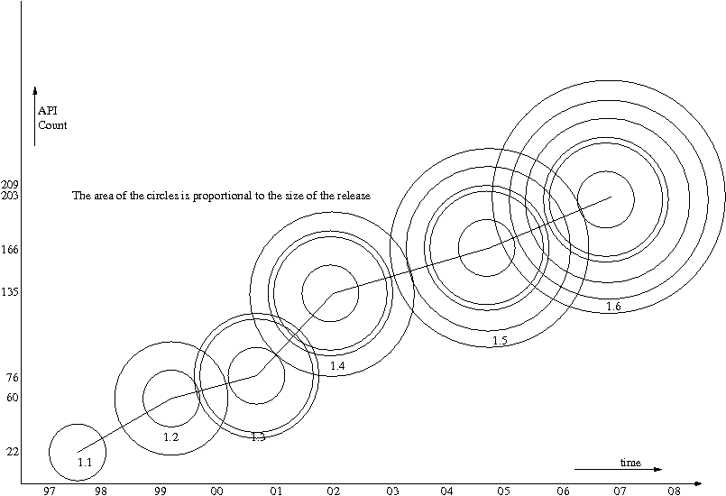
Java over the years

Slide 12
Our Analysis creates an
Invocation Graph
It is not a conventional call-graph based analysis
Why is it interesting
  Synchronized statements
Why is it challenging
  Dynamic dispatch of Java
The Invocation graph is an attempt to capture the behavior of code during execution, rather than merely the structure of its definition.
We'll look at a couple of simple examples ...

Slide 13
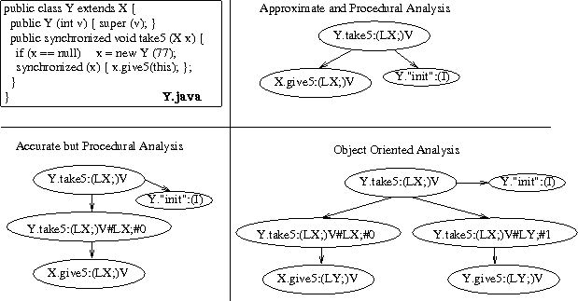
Intuition about the Invocation graph

Slide 14
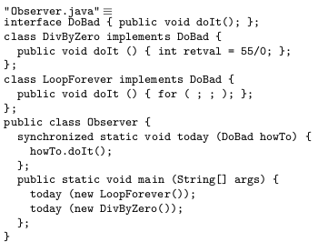
Code vs Behavior – part 1

Slide 15
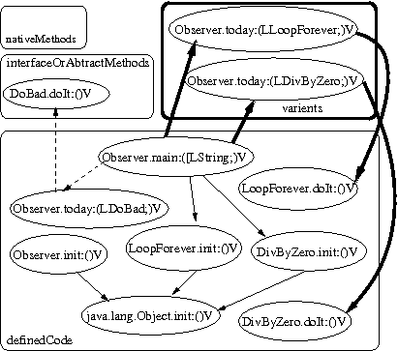
Code vs Behavior – part 2

Slide 16
Results: Size of the analysis
Defined classes: 16,513 | Defined Interfaces: 2294
 | Defined methods: 1,58,333 | Analysed methods: 2,15,942
 | Defined Synchronised code: 6,310 | Analysed Synchronized Behaviours: 16,096
 | Defined LockTypes: 1,425 | Actual Lock Types: 1,689
Nested Synchronized behaviours: 7,200,45 | Cycles detected: 97,914 | Deadlock Predictions: 324

Slide 17
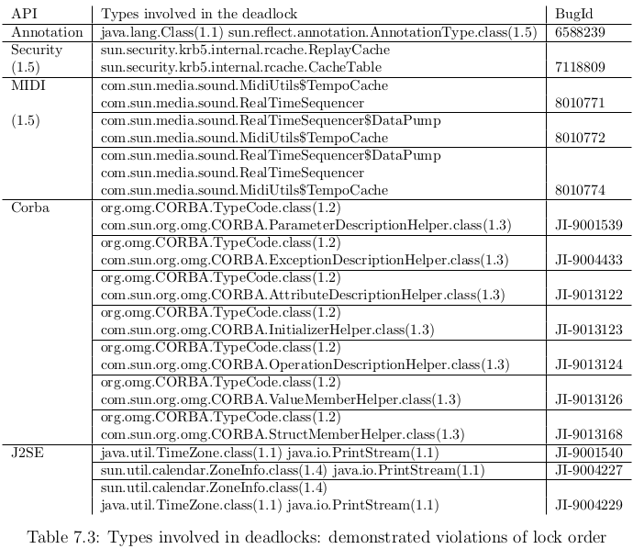
Results: Deadlocks demonstrated

Slide 18
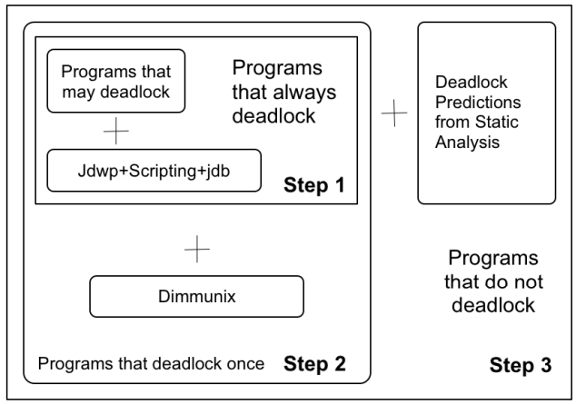
Results: Demonstrating avoid-ability of predicted deadlocks using Dimmunix

Slide 19
Related work
Static methods: Amy, Von Praun, Jlint, BugFinder, …
Model Checking tools based approaches: Mayur Naik, Jyotirmoy, JPF, …
Dynamic methods: Pallavi, Muralikrishna, …
Avoidance techniques: Fancong Zeng, Dimmunix, …
Synthesizing deadlock Programs: Muralikrishna, …

Slide 20
Thank You
Questions ?

Slide 21
Question 1
"Submitted research work is to address the problem of deadlock detection in large Java libraries. Is this technique also applicable to whole programs?”
Author Response: Yes. With appropriate modifications to the manner in which it is configured to proceed, the analysis can be applied to whole programs. Furthermore, the whole program analysis may choose to either include the sub-model for the referenced subset of the standard Library into the analysis, or to ignore it.

Slide 22
Question 2
"How do you relate the well-known state explosion problem to the analysis presented in the thesis?”
Author Response: The analysis described in the thesis uses approaches like the ones used by language Compilers; Scalability of the analysis is very comparable to the scalability of typical compilers. The size of the referenced subset Invocation Graph created by the analysis is comparable/proportional to the size of the input. Since the modeling is conducted at the level of types defined in the input, rather than at the level of (collections of) objects (as is the case in alias analysis based approaches), or at the level of (collections of abstract) values assigned to them (as is the case in conventional model checking), the analysis is quite tractable. The same cannot be said of neither alias analysis based methods nor model checking based approaches, when employed to investigate inputs of comparable sizes. They run into the proverbial state explosion problem. We do not.

Slide 23
Question 3
(What is the) "Candidate's views on: how to distinguish between two calls of the same procedure in different contexts?"
Author Response: Our invocation graph distinguishes between two invocations to the same method body if either the types of the two target objects involved in the two calls are different, or if there is any difference between the actual types of any of their respective arguments. Otherwise, the behavior fetched from the two invocations are represented by a single node of the invocations graph. Note that the complete behavior corresponding to an invoked method is represented by the entire directed sub-tree rooted at the node that correspondingly represents the invocation.

