Slide 1


SMART INDIA HACKATHON 2025
TITLE PAGE
Problem Statement ID - 25104
Problem Statement Title - Language Agnostics CHATBOT
Theme - Smart Education
PS Category- Software/Hardware - Software
Team ID -
Team Name (Registered on portal) -

Slide 2
IDEA TITLE
LOGIC 404
PROPOSED SOLUTION 
Web based chatbot for English,hindi,regional language
Answer common campus queries ex-fee,timetable,subject teacher
Built with HTML/CSS/JS for frontend and python backend , SQL for database.
DETAILED EXPLANATION:-
Frontend: Chat interface (HTML/CSS/JS)
Backend: Python + SQL for FAQs
Multilingual: Rule-based + Google Translate API
Fallback: Connects to staff if answer not found
PROBLEM ADDRESS:-
Reduce staff workload by answering repetitive student queries.
Provides instant answer in multiple language for al student.
INNOVATION AND :- UNIQUENESS
Answer form FAQS and document with multiple language
Learns from failed queries

Slide 3
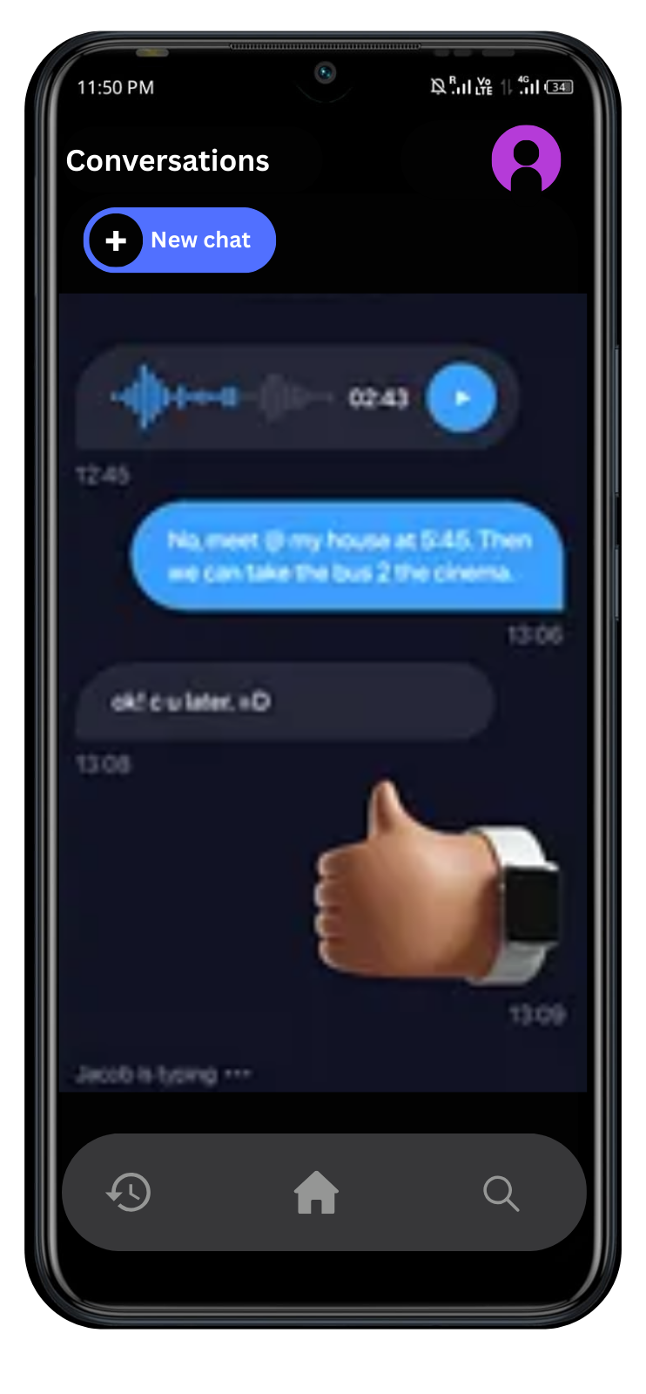
TECHNICAL APPROACH
LOGIC 404
CHATBOT 🤖
FRONTED 📱
BACKEND
HTML
CSS
JS
PYTHON
REACT
SQL
User types question in English/Hindi/Haryanvi
Backend detects language & searches answer in SQL/MongoDB
Google Translate API handles multilingual queries

Slide 4
FEASIBILITY AND VIABILITY
LOGIC 404
Feasibility | Visibility
Use - HTML/CSS/JS, Python, SQL | Students can access anytime, any device
Small dataset prototype | No required any knowledge
easy to implement | Multiple Language functionality
Low-cost / free hosting possible | Easy to use
POTENTIAL CHALLENGES
Language accuracy for Haryanvi & mixed queries.
Limited dataset may not cover all questions.
Handling complex or unusual queries.
Integrating frontend, backend & database properly.
POTENTIAL RISKS
Wrong answers may confuse students.
Student data privacy must be protected.
Google Translate API limits.
High user load may slow responses.

Slide 5
IMPACT AND BENEFITS
LOGIC 404
IMPACT:
Student gets instead answer In multiple language
And reduces staff’s workload
Social : Saved staff time increases productivity.
Environment : reduce paper uses (digital information)
Scalable : Can be used in other department

Slide 6
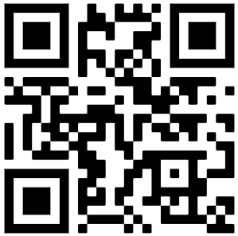
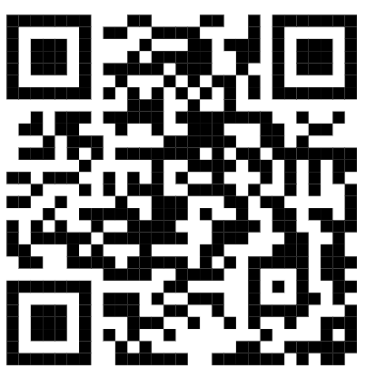
RESEARCH AND REFERENCES
LOGIC 404
https://www.sih.gov.in/sih2025PS
https://jktech.com/blogs/multilingual-chatbot/

