Slide 1
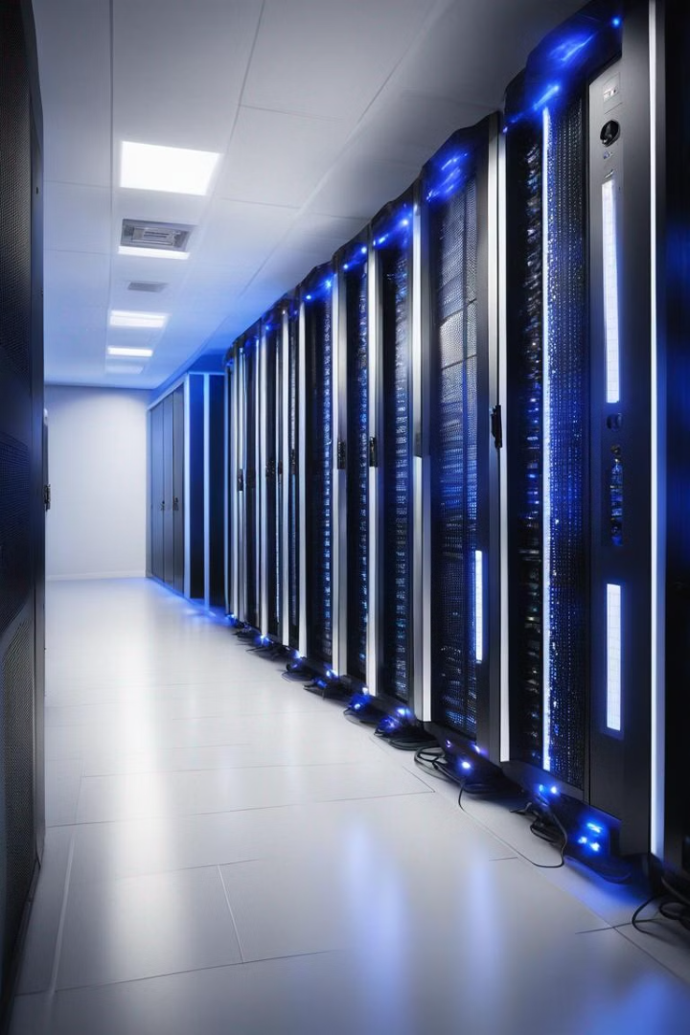


Definition of a Batch Operating System
A batch operating system is a type of operating system that processes and executes a series of tasks in 'batches' without the need for user interaction. It collects programs and data together and processes them in groups, allowing for efficient and organized handling of tasks. This system is particularly useful for repetitive and time-consuming tasks that can be executed without user intervention.
by Vivek Adroja

Slide 2

History and Evolution of Batch Operating Systems
1
Early Developments
Batch processing dates back to the early days of computing, where punch cards and paper tape were used to input data and instructions. This method was used for running large-scale jobs and became the foundation for batch operating systems.
2
Mainframe Era
In the mainframe era, batch operating systems were prevalent, handling tasks such as payroll processing and accounting. These systems were capable of automating repetitive data processing tasks, significantly improving efficiency.
3
Evolution to Time-sharing Systems
With the advancement of technology, batch systems evolved into modern time-sharing systems, allowing for greater interactivity and multitasking capabilities.

Slide 3
Key Features and Characteristics of Batch Operating Systems
Offline Processing
Job Scheduling
Error Recovery
Batch systems are designed for processing tasks without direct user interaction, allowing for the efficient use of resources and scheduling of jobs.
Batch operating systems have robust job scheduling capabilities, enabling the prioritization and seamless execution of various tasks in a structured and organized manner.
These systems include mechanisms for error recovery, ensuring that processes can resume from the point of failure without impacting the overall batch.

Slide 4
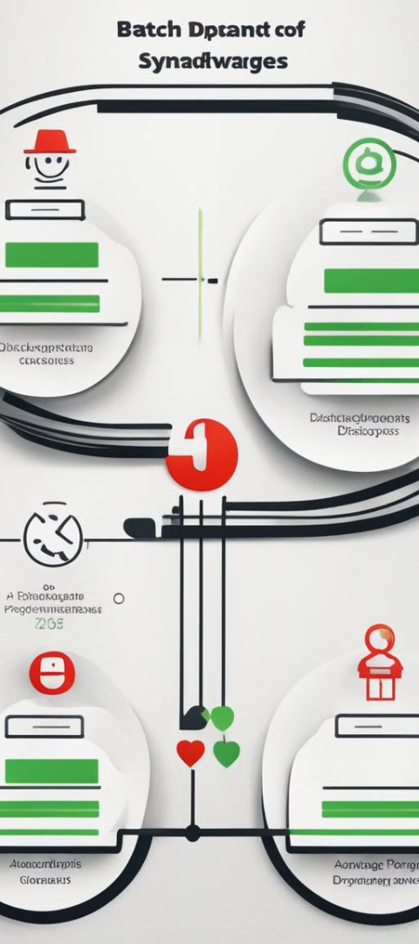
Advantages and Disadvantages of Using Batch Operating Systems
1
Advantages
2
1. Resource Optimization: Batch systems make efficient use of computing resources by processing tasks in bulk.
3. Repetitive Tasks: Ideal for automating repetitive tasks, improving productivity.
2. Error Detection: They have built-in error-checking mechanisms to identify and address issues.
3
Disadvantages
1. Lack of Interactivity: Limited user interaction, not suitable for real-time applications.
2. Processing Delays: Processes may wait in a queue, causing delays in task execution.

Slide 5



Examples of Batch Operating Systems in Use Today
Databases
Financial Systems
Manufacturing
Many database maintenance and backup processes are executed using batch operating systems.
Batch systems are used for financial reporting and payroll processing in various organizations.
Batch systems control production processes and manage inventory in manufacturing facilities.

Slide 6
Common Applications and Industries Benefiting from Batch Processing
Data Processing
Healthcare
Telecommunications
Batch systems are extensively used in large-scale data processing, such as customer billing and transaction processing in banking.
In healthcare, these systems handle patient record management, insurance claims, and billing processes.
Batch processing supports activities like call data record analysis and billing in the telecommunications sector.

Slide 7




Challenges and Limitations of Batch Operating Systems
Processing Delays
Resource Allocation
Real-time Requirements
Jobs may experience delays due to waiting in the queue for execution.
Efficient allocation of resources is crucial to prevent system bottlenecks and performance issues.
These systems are not suitable for real-time tasks and interactive applications.

Slide 8
Future Trends and Advancements in Batch Operating Systems
AI Integration
Cloud Migration
Enhanced Security
AI Integration
Cloud Migration
Enhanced Security
Advancements in AI will lead to more intelligent job scheduling and resource allocation within batch operating systems.
The shift toward cloud-based batch processing will bring enhanced scalability and flexibility to these systems.
Future systems will focus on improving security measures to protect batch processes and data integrity.

