Slide 1
Welcome
Live Cricket Score Project
By vivekanand

Slide 2

Introduction
The project is about showing lives scores of the cricket match
The system has an admin account where the scores are constantly updated by the admin
Many people don’t have television or cable connection at their place or if they are travelling then they may view the scores live.

Slide 3
Used
Angular Framework
Node Js, Npm modules.
Languages : HTML, JavaScript, Typescript.
Charts modules, Angular material, etc.
Json server
CRUD ( Create, Read, Update, Delete ) operations.

Slide 4
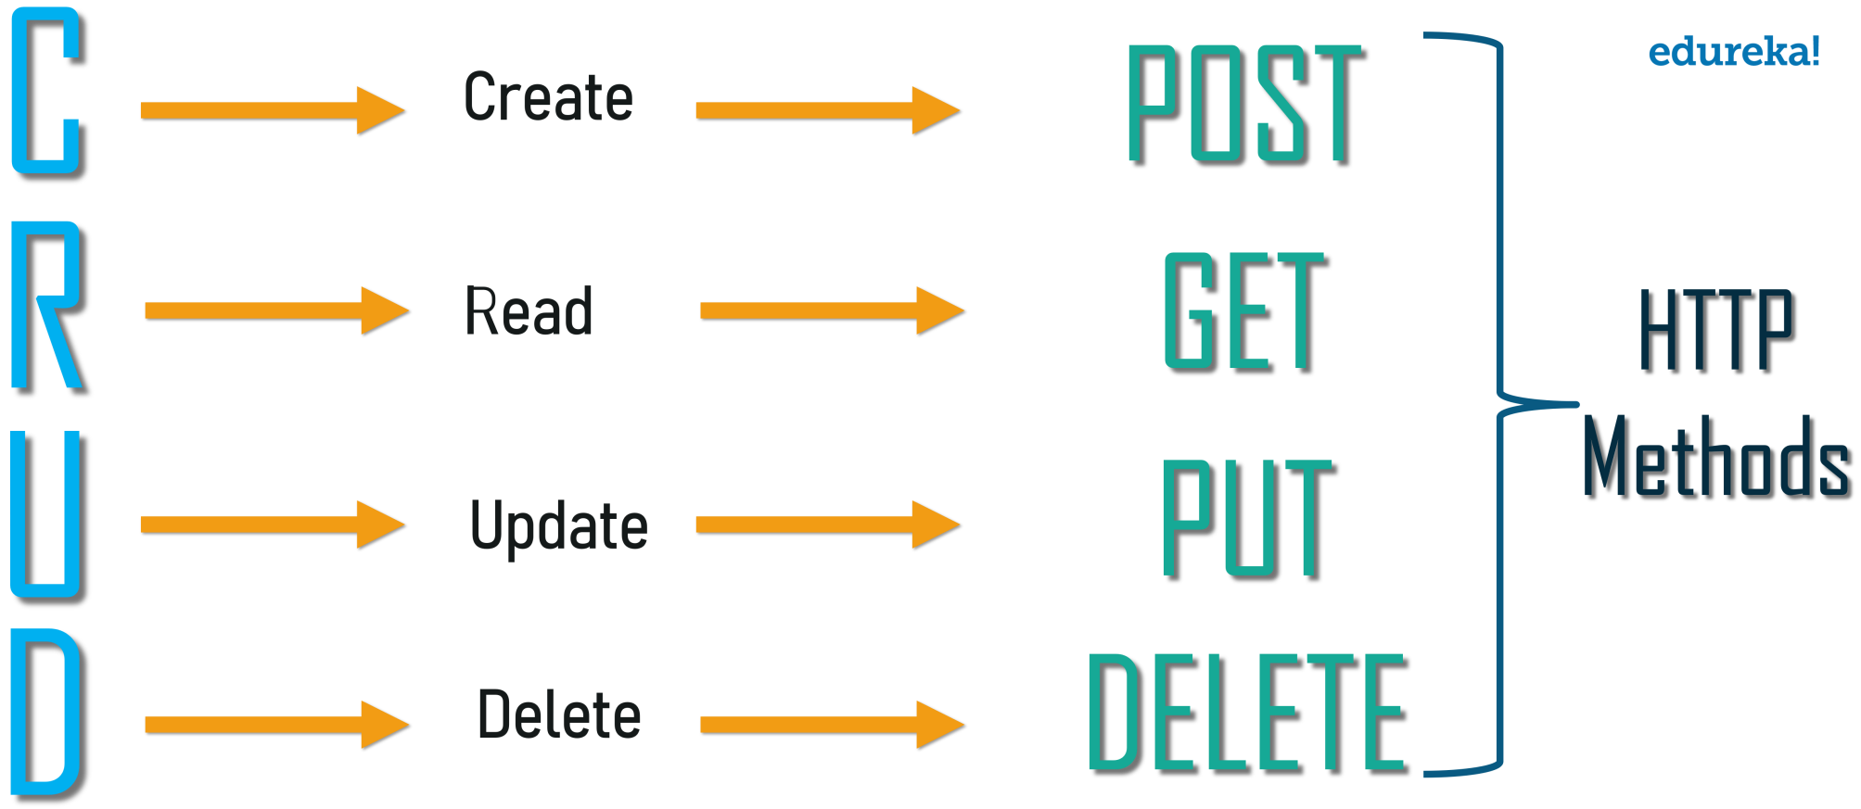

Slide 5
Modules
Live Matches
Previous Matches
Scorecard
Match Statistics
Admin Login & Dashboard
Create Match
Edit Match, Change Status
Finish Match
Logout

Slide 6
User Interface
User can view the Live Matches with their scores live.
User can also view the Previous Matches.
User can see the summary in Score card.
User can view the overall Statistics of the Match.
The user can view the scores from anywhere through this web application Live.
User has access privilege of only Read operation to get Match details.

Slide 7
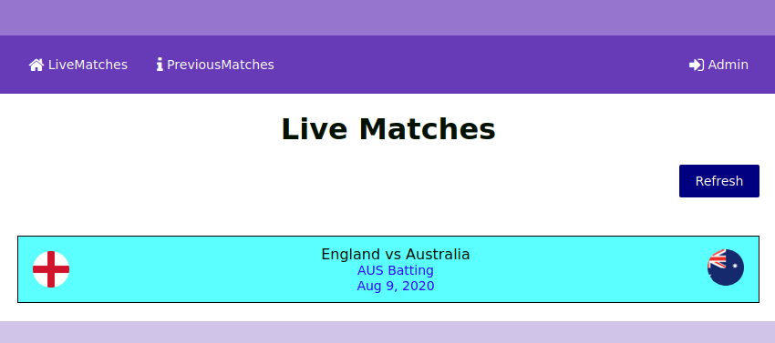
User Interface

Slide 8
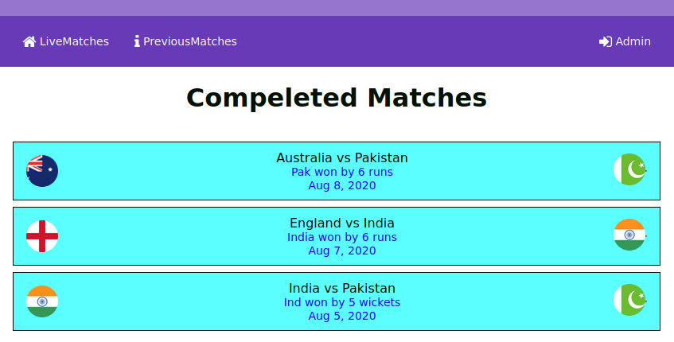
Previous matches

Slide 9
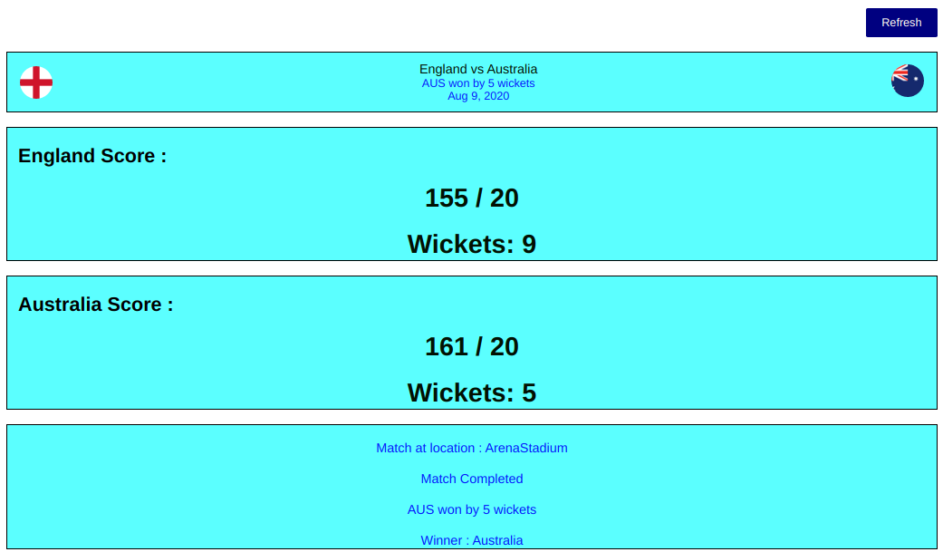
Scoreboard

Slide 10
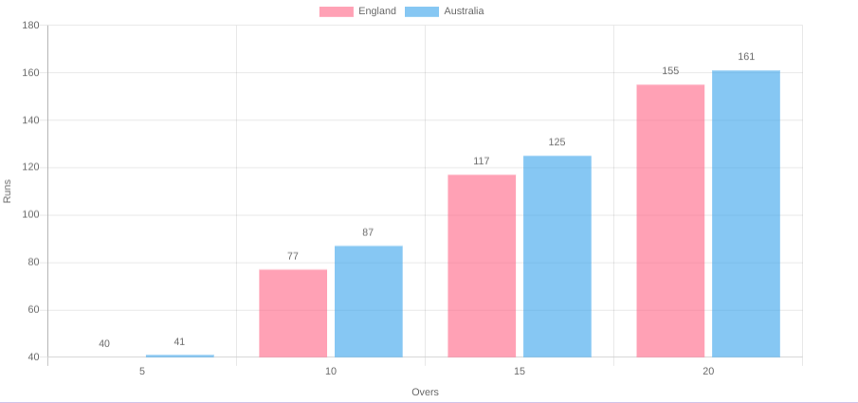
Statistics :
Runs
overs

Slide 11
Admin Interface
Admin has login from where he can login to Admin dashboard.
Admin can Create matches between two teams.
Admin can Edit Scores, where he keeps updating the Status and score.
Admin can logout after finishing match.
Admin has access privilege of Post, Put operations to Create and Edit score of Match.

Slide 12
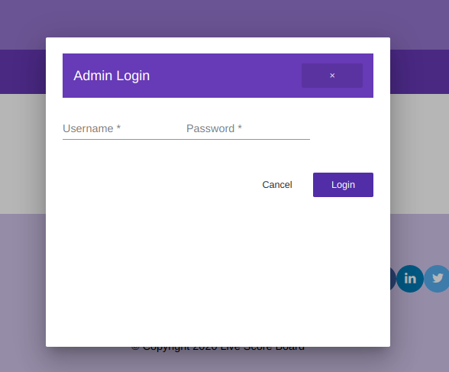
Admin login

Slide 13
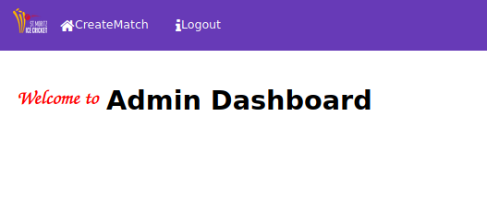
Administrator Dashboard

Slide 14
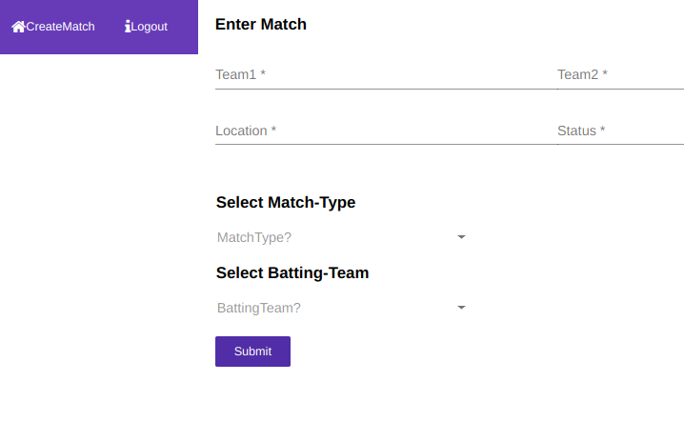
Creating Match

Slide 15
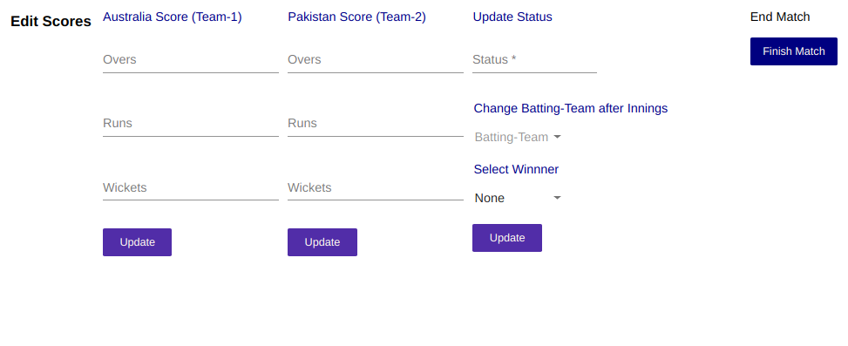
Update Score & Finish Match

Slide 16
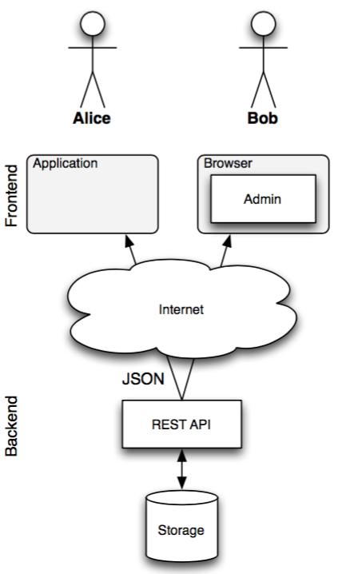
Architecture
Server

Slide 17
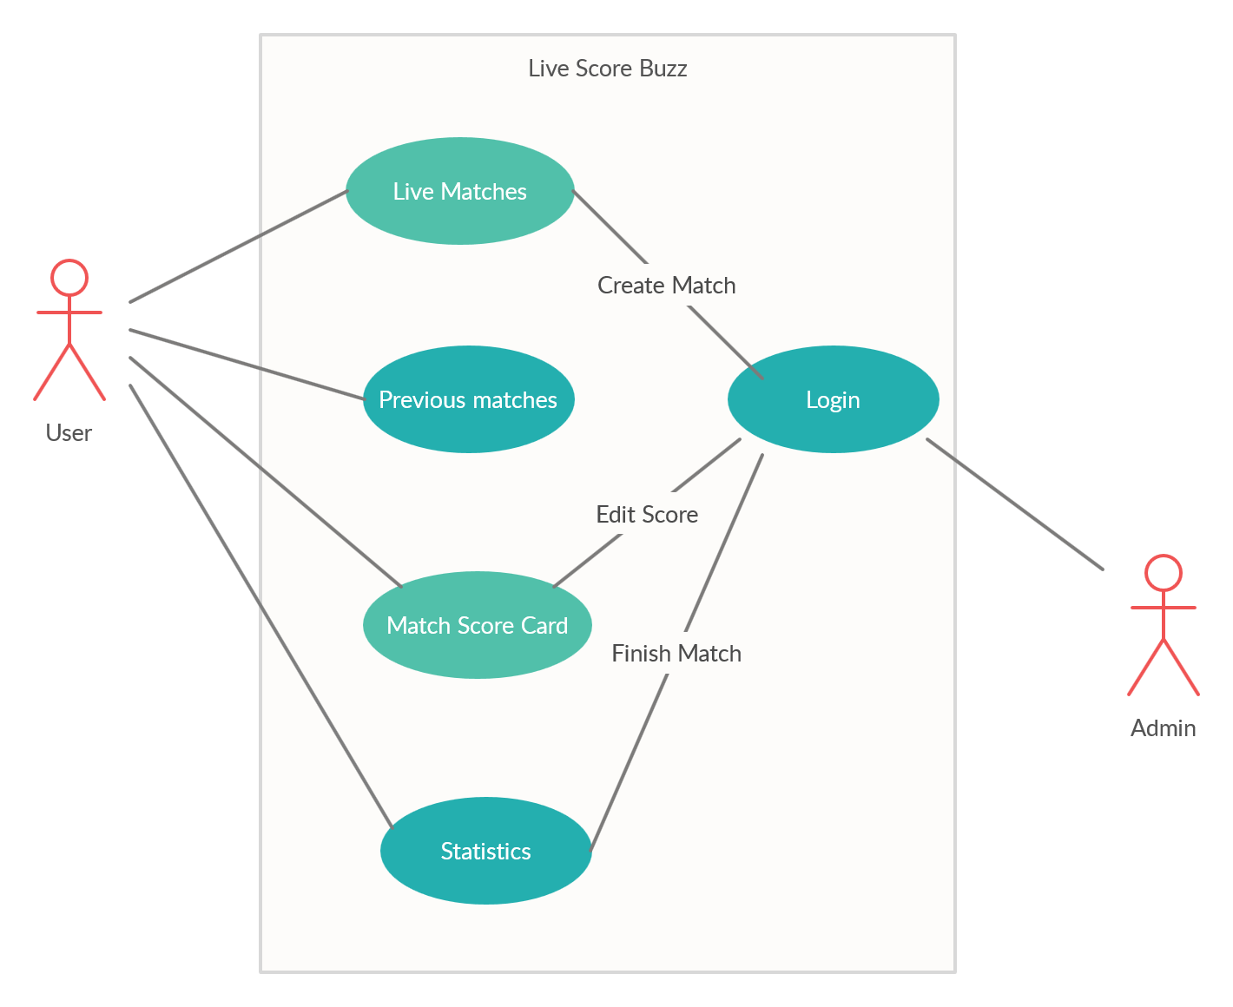

Slide 18
Conclusion
The application developed is designed in such a way that any future enhancements can be done with ease.
New modules can be added to existing system with less effort.
Easily build and test using built in Angular features.
Thus User can view Live Score with new updates.

Slide 19
THANK YOU

