Slide 1
Aerofoil designs for fixed wing UAV
UANS (Assignment-1)
1602-21-737-191
P.Vivekananda

Slide 2
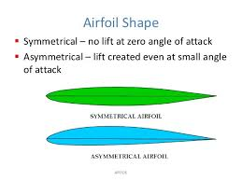
Types of Aerofoil Designs
Symmetrical Aerofoils: Aerofoil designs with identical shapes on the top and bottom, providing zero lift at zero angle of attack.
Asymmetrical Aerofoils: Aerofoil designs with different shapes on the top and bottom, generating lift even at zero angle of attack.

Slide 3
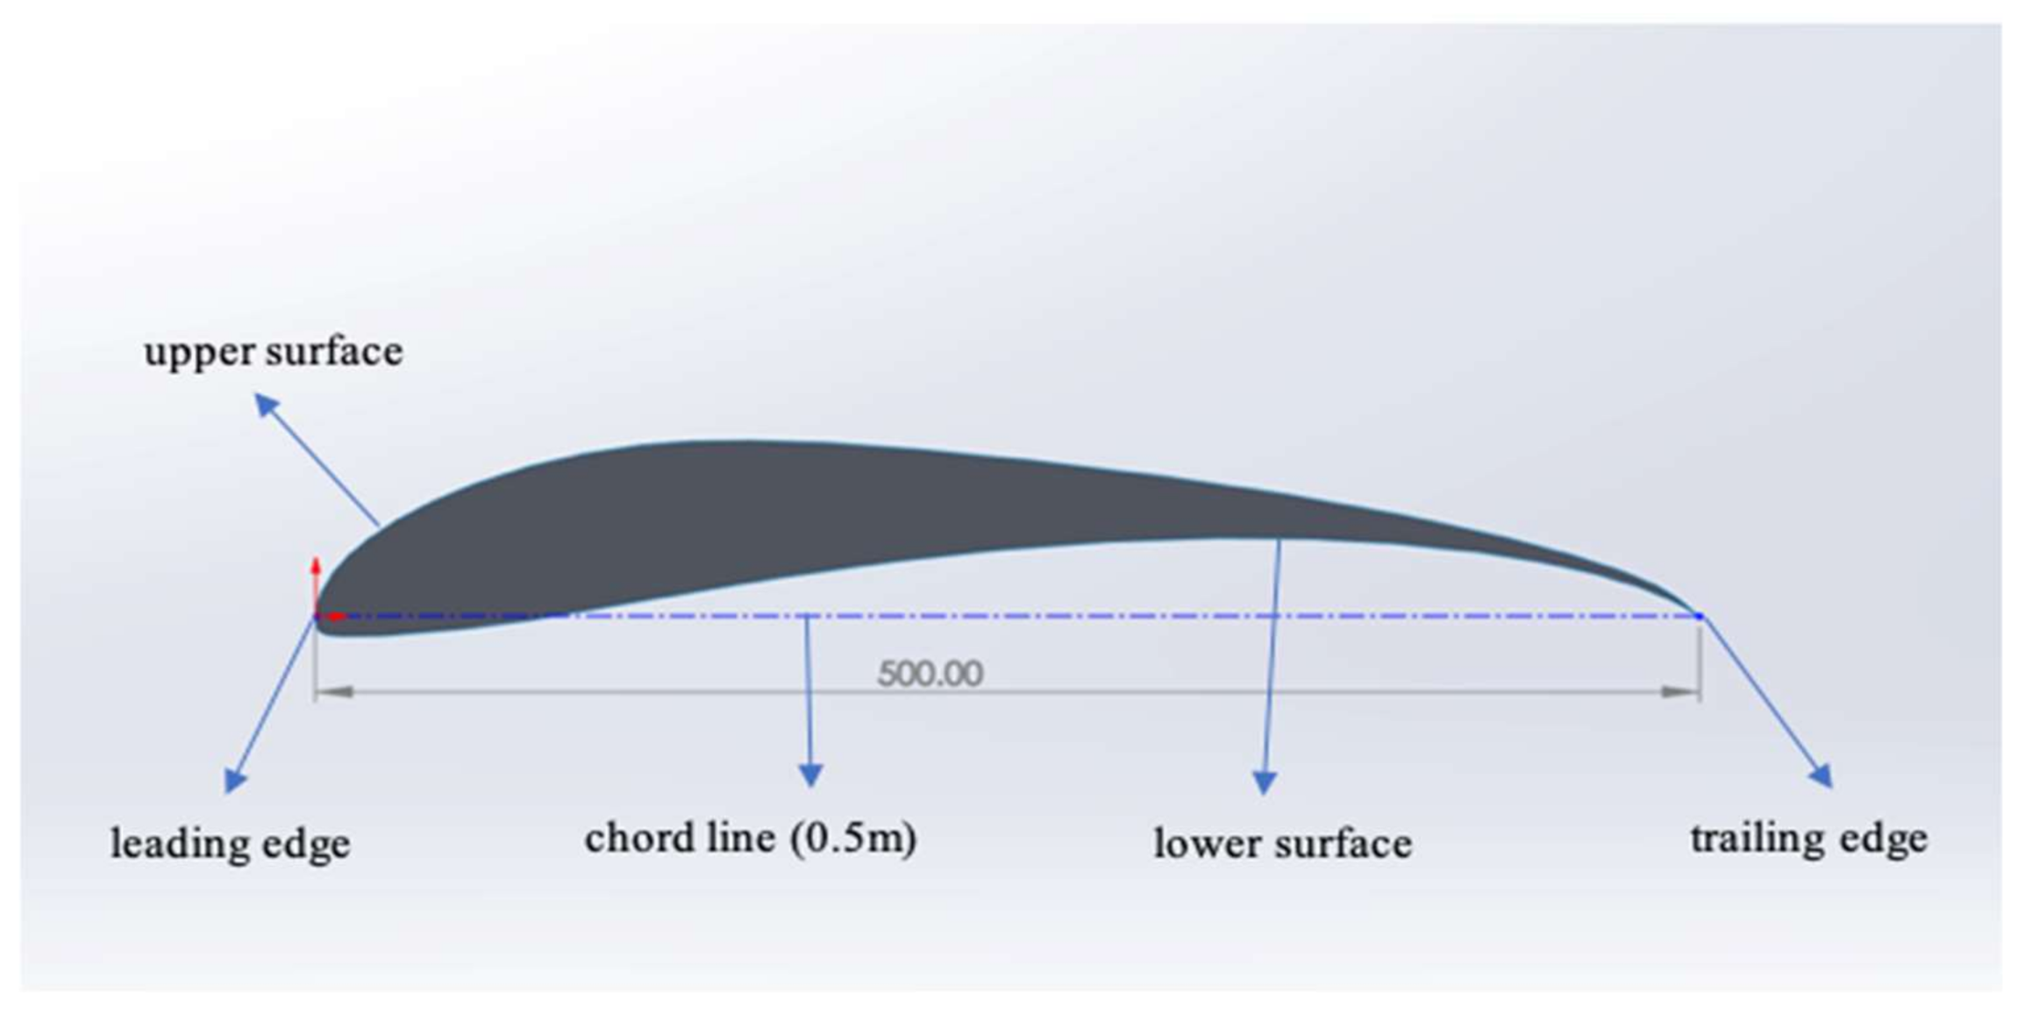
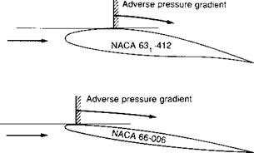
Types of Aerofoil Designs
High-Lift Aerofoils: Aerofoil designs engineered to produce increased lift, often used in applications requiring short takeoff and landing distances.
Low-Drag Aerofoils: Aerofoil designs optimized to minimize drag, enhancing fuel efficiency and maximizing speed.

Slide 4
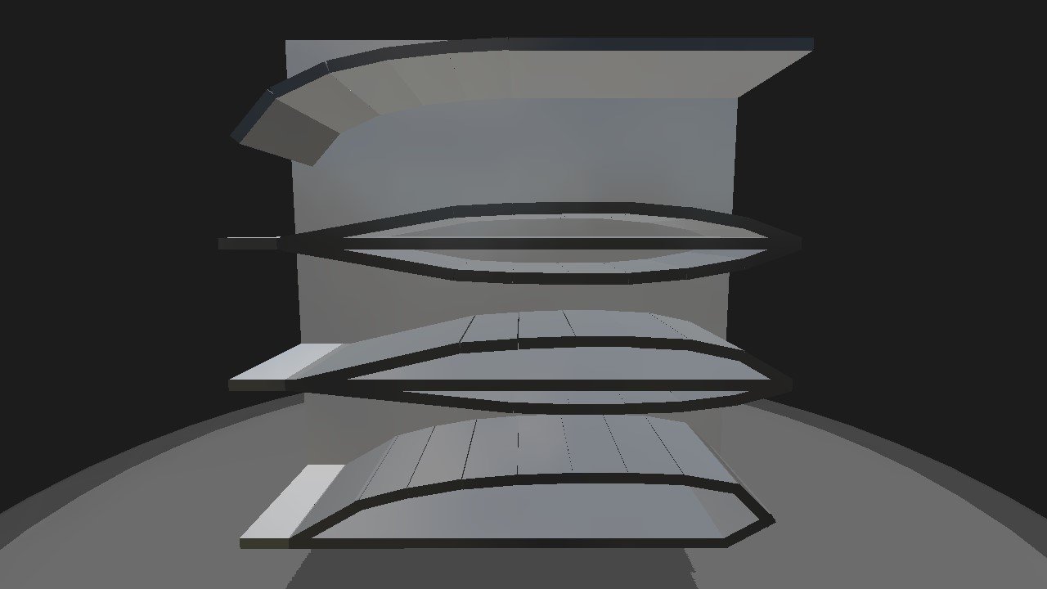
Types of Aerofoil Designs
Custom Aerofoils: Aerofoil designs tailored to specific performance requirements or constraints of a particular UAV application. Custom Aerofoils are specifically designed for individual UAV applications, optimizing performance factors like lift, drag, and stability to meet unique mission requirements. They undergo thorough analysis, simulation, and testing to ensure efficiency, maneuverability, and adaptability, enhancing overall UAV performance.

Slide 5
Case Study
The Design Improvement of Airfoil for Flying Wing UAV.
This paper intends to presents the design improvement of airfoil for flying wing UAV (Unmanned Aerial Vehicle) when the Author works with University Putra Malaysia. The design was performed using XFOIL code (an interactive program for the design and analysis of subsonic isolated airfoils) and the wind tunnel test results for verification. Eppler E334 (thickness to chord ratio, t/c = 11.93%) is used as a based airfoil. The final design was using Eppler E334 with t/c = 13.5%. It was shown from this work that the result from XFOIL is fairly accurate. Regarding to the usage of XFOIL program, from the results, the Author found that XFOIL program is only valid up to a certain range of angle of attack. Hence, when using this program, ones should be careful with the results. However, there are still many part inside XFOIL program are remain unexplored in this project, such as the boundary layer profile and the skin friction coefficient. The Author believed the accuracy of the results can be improved if all the remaining parameter is taken into account.

Slide 6
Thank YOU Link to Case study : https://www.researchgate.net/publication/236657704_The_design_improvement_of_airfoil_for_flying_wing_UAV

