Slide 1
INVESTMENT ASSIGNMENT SUBMISSION
Name: Vivek A V

Slide 2
Data Analysis For Spark Funds
Spark Funds, an Investment Company, wants to widen their business into the field of funding startups.
The goal of this assignment is to find the best investment horizon for Spark Funds.
We’re provided with the following data :-
company.csv : A dataset of all the startups around the globe with their basic details.
rounds2.csv : A list of all the fundings these startups received during a course of time.
mapping.csv : A one hot encoded mapping of the primary sector of a startup to 8 main sectors we need to deal with.
The basic strategy is to Invest where most investments are occurring.
Spark Funds wants to Invest in a range of 5 million USD to 15 million USD.
Spark Funds wants to Invest in English Speaking Countries.

Slide 3
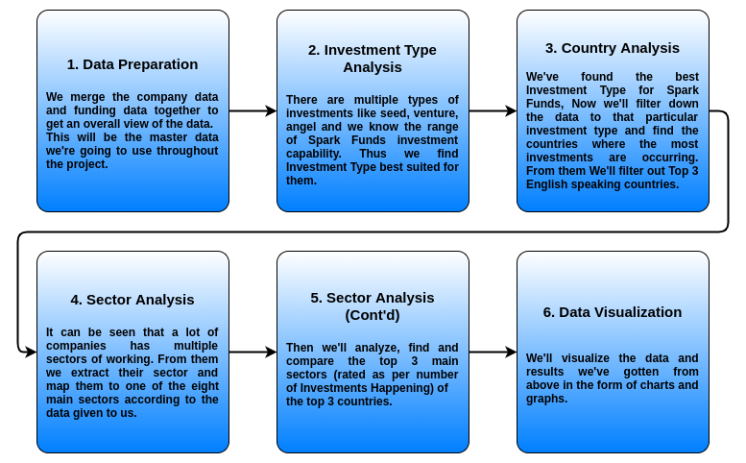
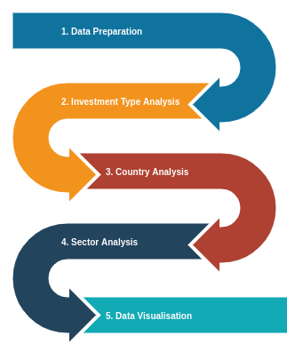
Methodology

Slide 4
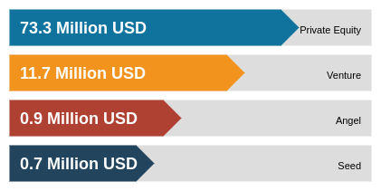
Investment Type Analysis
The average investment in each funding type show that Venture Funding is most suitable for Spark Funds.

Slide 5
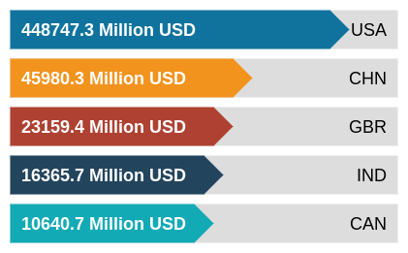
Country Analysis
The countries receiving highest venture fundings.

Slide 6
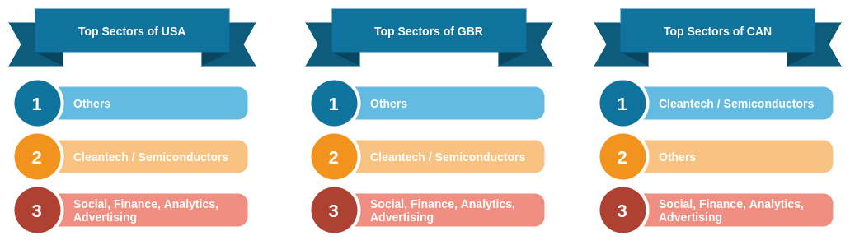
Sector Analysis
Rated by Number Of Investmnets occuring in the sector

Slide 7
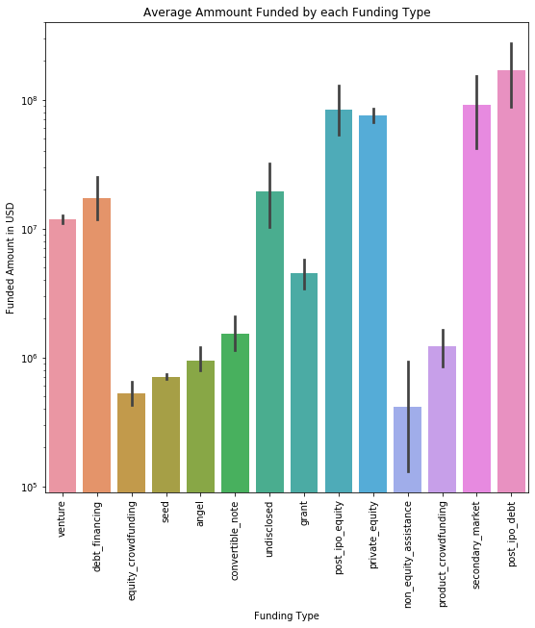
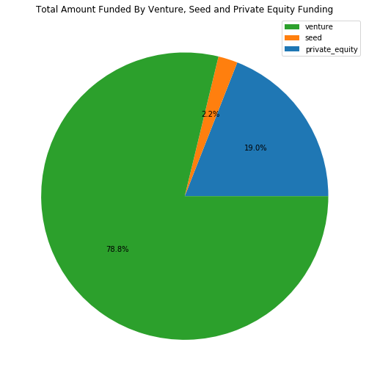
The percentile of Venture, Seed and Private Equity Funding

Slide 8
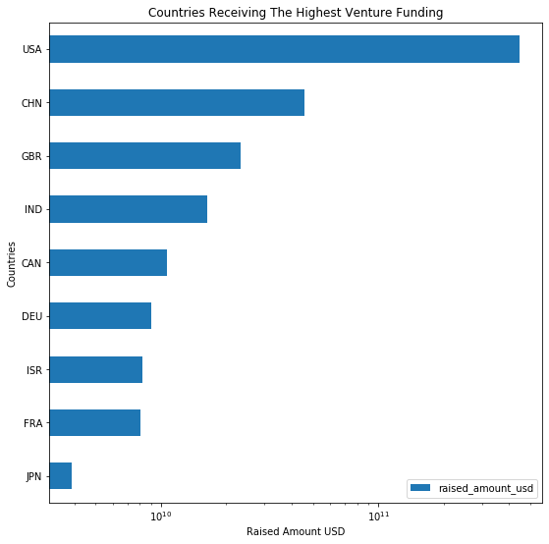
Countries Receiving Highest Venture Funding.

Slide 9
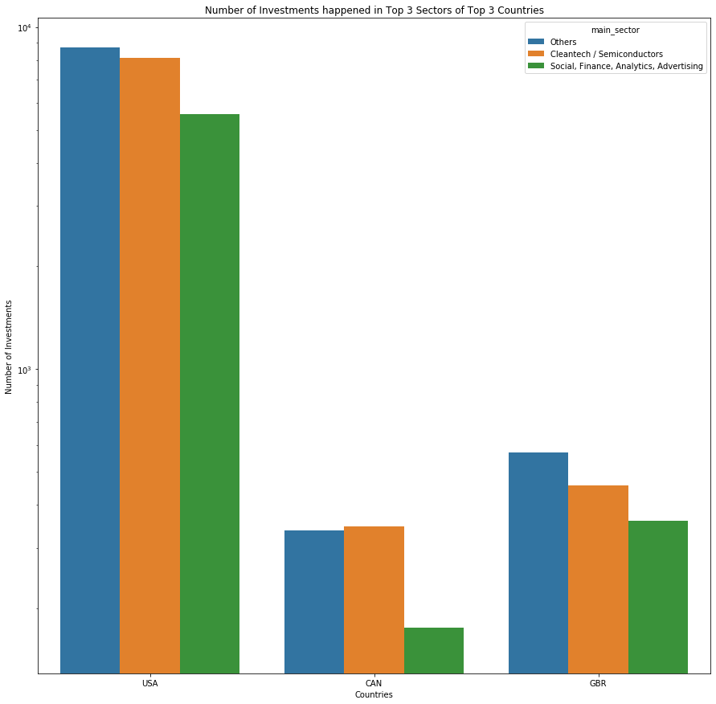
Number of Investments happened in Top 3 Sectors of Top 3 countries

Slide 10
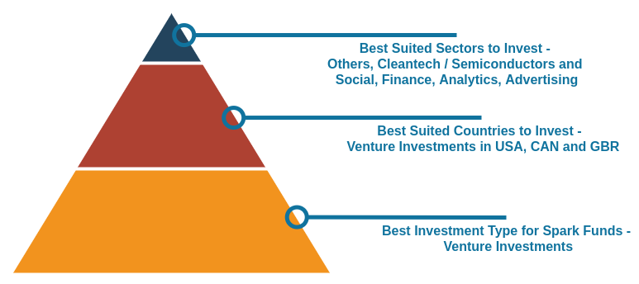
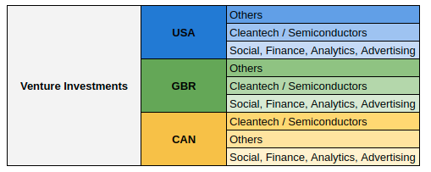
Conclusions

