Slide 1

ePAL did not terminate
Configuration Control

Slide 2

MONRP
POM3
XOMO

Slide 3


Slide 4


Slide 5
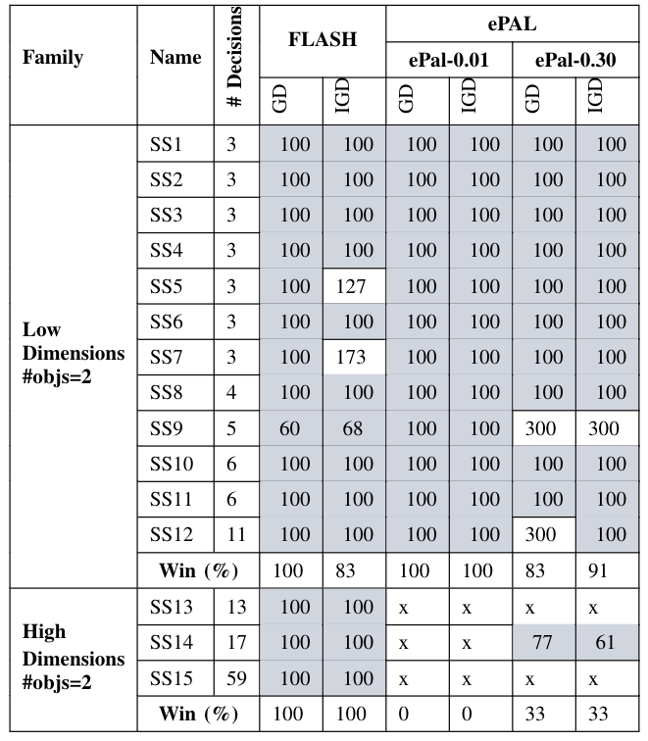
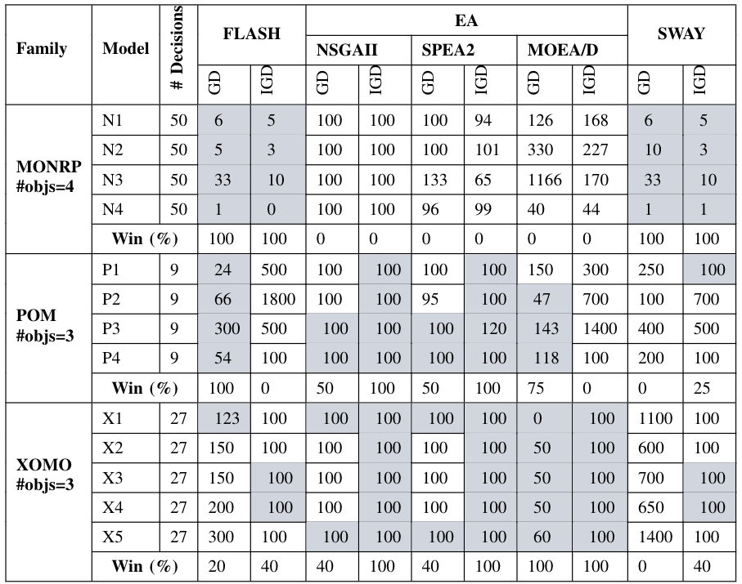

Slide 6
