Slide 1


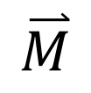
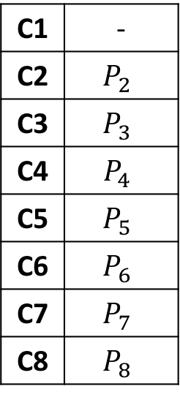
Model
C1
$$\overset{⃑}{M}$$
C1 | -
C2 | $$P_{2}$$
C3 | $$P_{3}$$
C4 | $$P_{4}$$
C5 | $$P_{5}$$
C6 | $$P_{6}$$
C7 | $$P_{7}$$
C8 | $$P_{8}$$

Slide 2
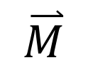
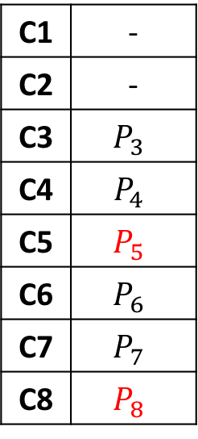
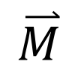
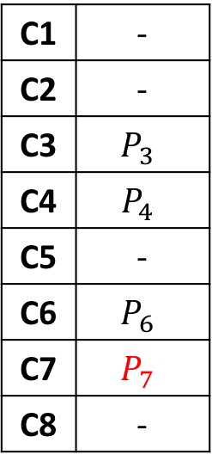
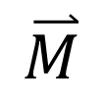
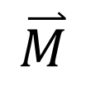
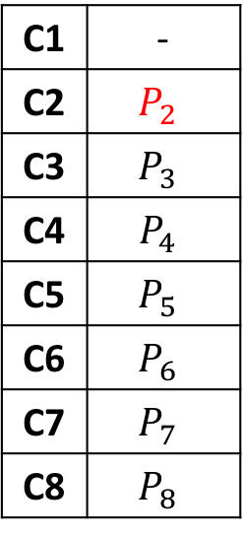
①
②
③
④
C1
$$\overset{⃑}{M}$$
C2
$$\overset{⃑}{M}$$
C5
$$\overset{⃑}{M}$$
C7
$$\overset{⃑}{M}$$
C1 | -
C2 | $$P_{2}$$
C3 | $$P_{3}$$
C4 | $$P_{4}$$
C5 | $$P_{5}$$
C6 | $$P_{6}$$
C7 | $$P_{7}$$
C8 | $$P_{8}$$
C1 | -
C2 | -
C3 | $$P_{3}$$
C4 | $$P_{4}$$
C5 | $$P_{5}$$
C6 | $$P_{6}$$
C7 | $$P_{7}$$
C8 | $$P_{8}$$
C1 | -
C2 | -
C3 | $$P_{3}$$
C4 | $$P_{4}$$
C5 | -
C6 | $$P_{6}$$
C7 | $$P_{7}$$
C8 | -
C1 | -
C2 | -
C3 | -
C4 | -
C5 | -
C6 | -
C7 | -
C8 | -

Slide 3


Recommendation Engine
Prediction Model Builder
Routing Policy Generator
Open
Performance Database
Search Optimizer
Performance Monitor
Cloud Controller
Cloud Platforms

Slide 4
Recommendation Engine
Prediction Model Builder
Routing Policy Generator
Open
Performance Database
Search Contoller
Performance Monitor
Cloud Controller
Cloud Platforms

Slide 6
t1 | t2 | t3 | t4
M1 | M2 | M3 | M4
t1 | t2 | t3 | t4 | t5 | t6

Slide 7
 |  | To
 |  | S1 | S2 | S3 | S4
From | S1 |  | 0.8 | 0.2 | 0.1
 | S2 | 0.2 |  | 0.4 | 0.3
 | S3 | 0.7 | 0.8 |  | 0.4
 | S4 | 0.7 | 1.0 | 0.4

Slide 8
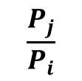
$$\frac{P_{j}}{P_{i}}$$
-T2
-T1
+T1
+T2
Class 0 | Class 1 | Class 2 | Class 3 | Class 4
better++
better
fair
worse
worse++

Slide 9
c4.large | c4.xlarge | c4.2xlarge
4 x 2 | 4 x 4 | 4 x 8
6 x 2 | 6 x 4 | 6 x 8
8 x 2 | 8 x 4 | 8 x 8
10 x 2 | 10 x 4 | 10 x 8
12 x 2 | 12 x 4 | 12 x 8
16 x 2 | 16 x 4
 | 20 x 4
24 x 2 | 24 x 4
32 x 2
40 x 2
48 x 2
scale up
scale out
same core counts

Slide 10
0.8
C2
0.5
0.8
C1
C3
C3
0.1
0.6
C4
C4

Slide 11
$15
0.8
C2
0.5
$10
0.8
C1
C3
C3
0.4
0.1
0.2
C4
C4
0.1

Slide 12
workload, objective, constraints
Search Controller
Cloud Controller
user
ranking
resource provisioning
performance monitoring
① | m4.large | 8
② | c4.2xlarge | 6
③ | c4.large | 12
④ | c4.large | 10
Prediction Model
Architecture
to
Evaluate
training
update
evaluated architecture
Open
Performance Database
share
update
community
https://github.com/oxhead/scout

Slide 13
workload, objective, constraints
Search Controller
Cloud Controller
user
ranking
resource provisioning
performance monitoring
① | m4.large | 8
② | c4.2xlarge | 6
③ | c4.large | 12
④ | c4.large | 10
Prediction Model
Architecture
to
Evaluate
training
update
evaluated architecture
Open
Performance Database
share
update
community
https://github.com/xxxxxx/xxxxx

