Slide 1
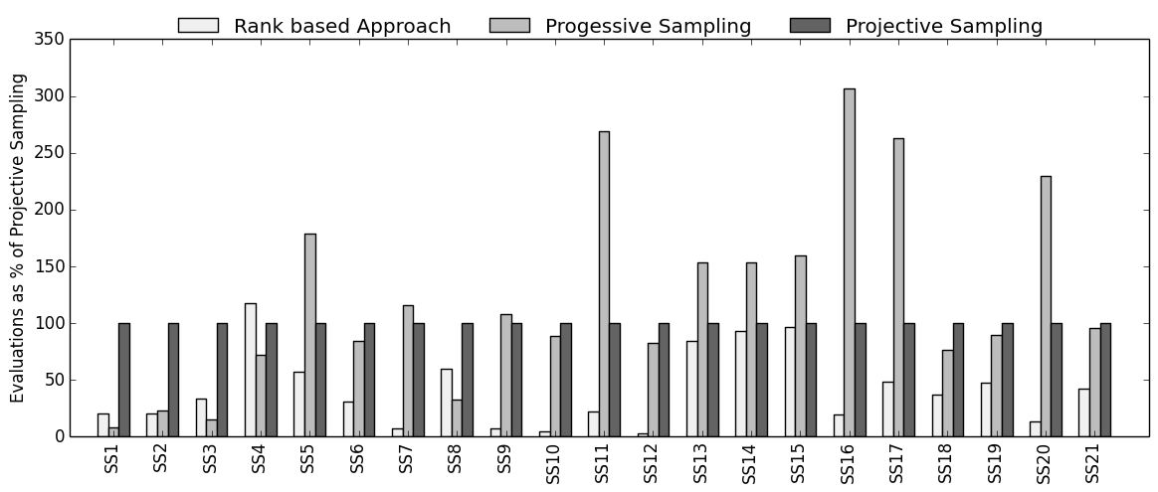
<5%
5%<x<10%
>10%

Slide 2
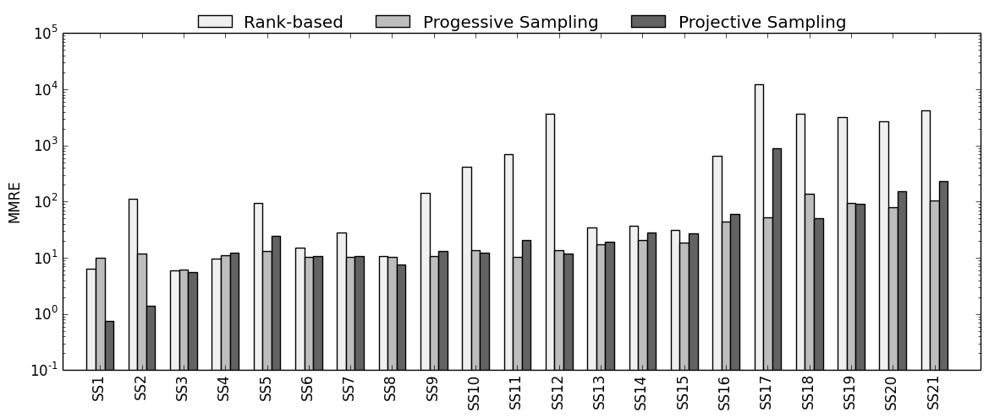
<5%
5%<MMRE<10%
>10%

Slide 3
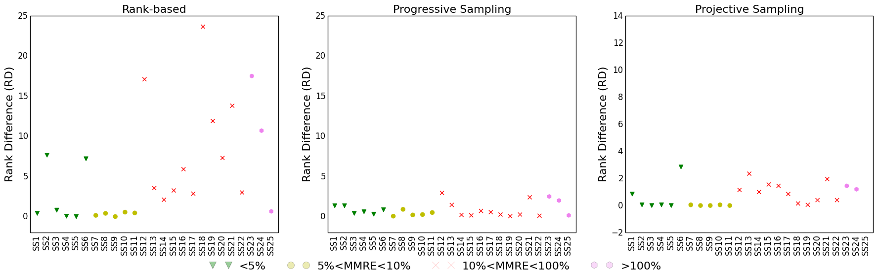

Slide 4
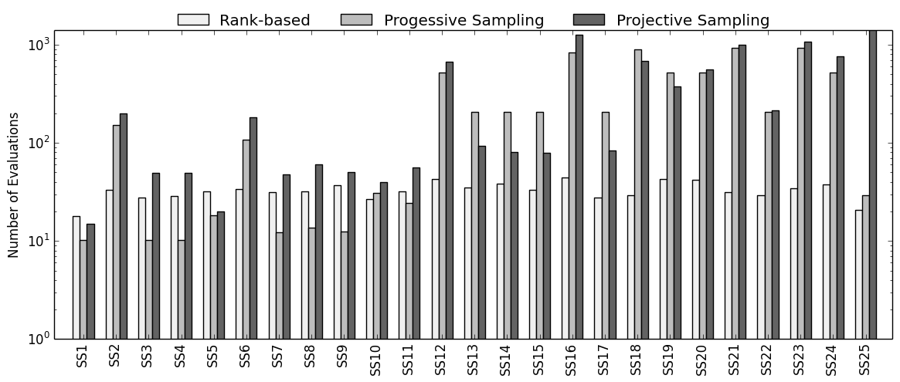
<5%
5%<MMRE<10%
10%<MMRE<100%
>100%

Slide 5
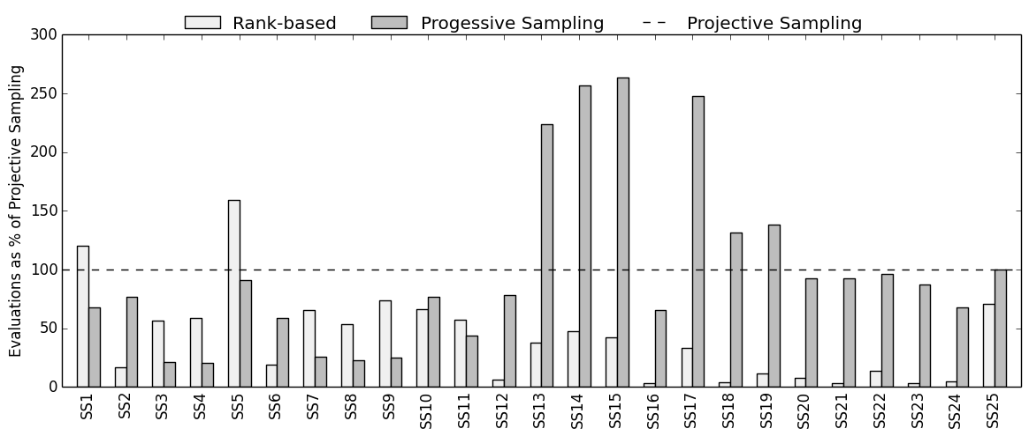
<5%
5%<MMRE<10%
10%<MMRE<100%
>100%

