Slide 1
ENERGY AWARE TASK SCHEDULING IN CLOUD
Supervised by:
Dr. Ritu Garg
Sargam Pahuja (1130595)
Navin Budania(1130608)
Vivek Bindal(1130547))

Slide 2
Index
Introduction and Motivation
Problem definition
Literature Review
Proposed methodology
Software tools
Analysis
References

Slide 3
Introduction & Motivation
Cloud computing provides shared computing resources and data on demand.Cloud Computing has emerged as a powerful component of the internet in recent time
Cloud has certain benefits:
Elasticity demand
Cost saving
Speed
Research issues in a cloud computing environment: VM Migration, Server Consolidation, Security of Data, Energy Consumption,Data Management
The increase in power densities has led to a decrease in system reliability, thus leading to lost productivity.
Need - Effective utilization of the resources and minimization of energy consumption.

Slide 4
Problem definition
The aim is to design a task scheduling algorithm that minimizes the total energy consumed in the system and the makespan (total time taken by system to complete all tasks) of the tasks.
Attributes of each task provided by Directed Acyclic Graph(DAG) and middleware.
TE=TE_{com}+TE_{cop}
TE_{com}=Communication energy
TE_{cop}=Computational Energy

Slide 5
Literature Survey
In [1] VM placement algorithm to reduce energy consumption is proposed.
Phase I- Switching off the nodes or hosts which do not meet the VM resource requirements and ranking nodes based on their resource availability.
Phase II- VMs are sorted in increasing order of power requirements.VM from the sorted list which provides least increase in power consumption is allocated to the node with higher rank
No way to describe the priority of one VM over another on a machine.

Slide 6
Continue…
In [2] Heterogeneous Earliest Finish-Time (HEFT) algorithm is described. HEFT executes in two phases –
Prioritizing tasks – Each task is given a priority. The priority of each task is calculated using w_{i} which is computational cost of task t_{i} and c_{i,j} is communication cost of between task t_{i} and t_{j}.
Assigning tasks to processors – Highest priority task for which all dependent tasks have finished is scheduled on the processor which will result in the earliest finish time of that task.
No focus on energy conservation.

Slide 7
Continued..
In reference[3] a method for energy optimization in heterogeneous embedded multiprocessor systems is divided into 2 parts.
Task scheduling and voltage scaling (TSVS),
Task Mapping (TM)
A schedule is first generated based on an initial TM. In each optimization step, a task is remapped to a new processor and/or voltage level such that to reduce the total energy consumption while decreasing the slack.
This algo was able to reduce average energy consumption by 9%-10%.
This algorithm does not communication cost.

Slide 8
Proposed Method :DETS Algorithm
The DETS algorithm consists of two phases:
Task Clustering and Scheduling:
To reduce communicational cost,the tasks are grouped into clusters on the basis of their priorities.
Each cluster is scheduled to a processor that provides minimum finish time.
Finish time of a cluster= maximum of Finish Times of all tasks
b. Voltage Scaling
Execution Time=(Earliest Finish Time - Earliest Start Time) of task t_{i}
Execution Time= CPI*(length of task)/Frequency
If there is slack time , reduce frequency to increase execution time.

Slide 9
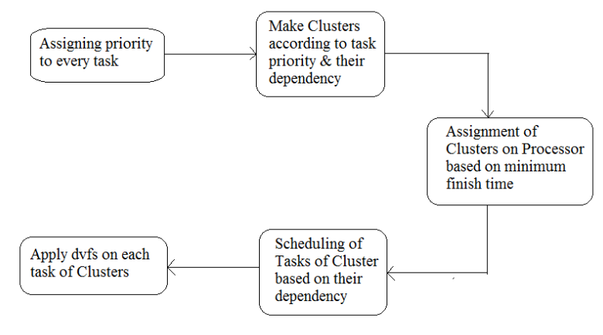
Flow Chart

Slide 10
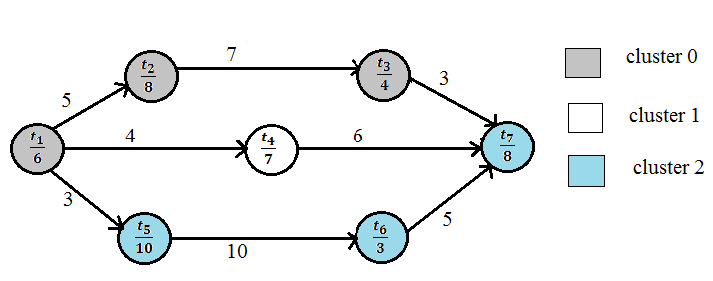
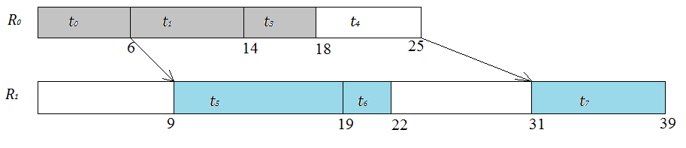

Slide 11
Software tools
Netbeans/Eclipse Integrated Development Environment.
Cloudsim: Framework for cloud virtualization
Developments Platform: Java JDK 1.8
Supported OS - Windows XP (32-bit), windows 7 (32 or 64 – bit) and higher version

Slide 12
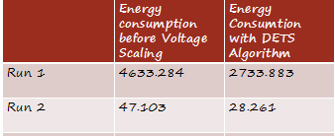
Analysis of algorithm
For two sets of data ,one of 16 tasks and the other of 8 tasks , the energy conservation has been found to be 41.25% and 40% respectively
Complexity of algorithm = (n+ c) + n + (p*n) + n ~ (p*n)
n=number of tasks
p=number of processors
c=number of communicational link
Future Scope- Can be extended for multiple workflows and variable communicational to computational cost.

Slide 13
References
[1] M. &. B. Dhanalakshmi, "Task Scheduling Techniques for minimizing Energy Consumption on Response Time in Cloud Computing," International General of Engineering Research and Technology, vol. 3, no. 7, pp. 547-557, 2014.
[2] Z. &. S. W. Yu, "An adaptive rescheduling strategy for grid workflow applications," IEEE International Parallel and Distributed Processing Symposium, vol. 3, no. 4, pp. 1-8, 2007.
[3] L. K. V. B. &. V. S. Goh, "Design of fast and efficient energy-aware gradient-based scheduling algorithms heterogeneous embedded multiprocessor systems," IEEE Transactions on Parallel and Distributed Systems, vol. 20, no. 1, pp. 1-12, 2009.

Slide 14
Thank You
Thank You

