Slide 1
STRESS DETECTION IN AUTOMOBILE DRIVERS USING PHYSIOLOGICAL FEATURES
Supervised by-
Mr. Utkarsh Srivastava
Project Manager
Ebizon Noida
Submitted by-
Vivek Bindal (2018HT12641)

Slide 2
CONTENTS
INTRODUCTION
LITERATURE REVIEW
METHODOLOGY
REQUIREMENTS
RESULTS

Slide 3
INTRODUCTION
Stress :-
Stress is mainly of two types, "eustress" and "distress"
EDA:-
Electrodermal Activity (EDA) is a measure of variation in conductivity of the skin.
Physionet Dataset

Slide 4
LITERATURE REVIEW
LITERATURE REVIEW
LITERATURE REVIEW
J. Healey and R. Picard, “Detecting Stress During Real-World Driving Tasks Using Physiological Sensors,” ​IEEE Transactions on Intelligent Transportation Systems​, vol. 6, no. 2, pp. 156–166, 2005.
R. R. Singh, S. Conjeti, and R. Banerjee, “Biosignal based on-road stress monitoring for automotive drivers,” ​2012 National Conference on Communications (NCC)​, pp. 1-5, 2012.
D. S. Lee, T. W. Chong, and B. G. Lee, “Stress Events Detection of Driver by Wearable Glove System,” ​IEEE Sensors Journal​, pp. 194–204, 2016.

Slide 5
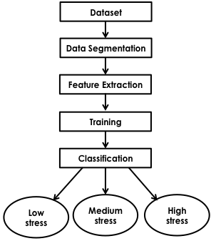
OVERVIEW OF PROPOSED METHODOLOGY
STRESS DETECTION

Slide 6
PROPOSED METHODOLOGY
Identify all pairs of local minima and next subsequent maxima from the given signal.
Select pairs with slope more than the given threshold.
Count number of such pairs.
Find the sum of difference in magnitude of minima and maxima pairs (​∑​O​m )​ .
Find the sum of duration gap between minima and maxima pairs (​∑​O​d )​ .

Slide 7
PROPOSED METHODOLOGY
Calculate the summation of area under the minima-maxima pairs ( ​∑​(1 ⁄ 2)×O​m×​ O​d )​ .
Determine mean and variance of the signal.
Calculate the total energy of the signal.
Determine PSD of given signal.
Calculate standard deviation of PSD.
Then ANN and SVM are trained to get desired results.

Slide 8
REQUIREMENTS
Python is used for coding.
Numpy and sklearn libraries of Python have been used.
Anaconda IDE is used for code simulation.
Physionet dataset has been used.

Slide 9
RESULTS
Accuracy from different classifiers
S. No. | Classifier | Accuracy
1. | Artificial Neural Network | 71.11%
2. | Support Vector Machine | 86.66%

Slide 10
THANK YOU

