Slide 1
AUTONOMOUS GROUND VEHICLE

Slide 2
USE…?
Mobility for non-drivers (as it has the capability for autonomous traversal)
Reduced time for travelling (as using path-planning technology)
Increased Road capacity
Reduced Pollution (as it is electric)
Increased Safety
Better traffic management.
Can be implemented for indoor traversal (Home Cleaners, Warehouse Automation, Trollies, etc.)

Slide 3
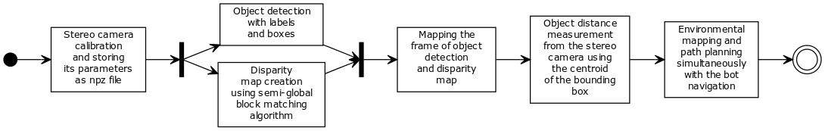
IMPLIMENTATION
1.Stereo-Vision
UML Diagram

Slide 4
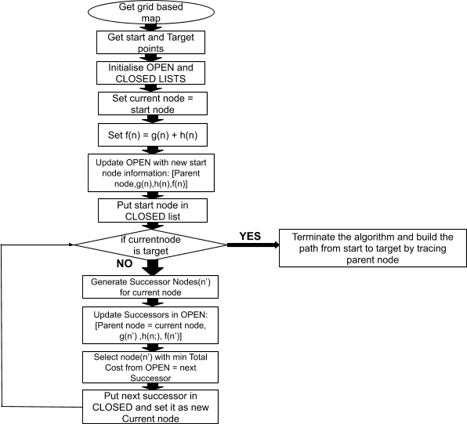
IMPLIMENTATION
2.Path-Planning
Flow Chart

Slide 5
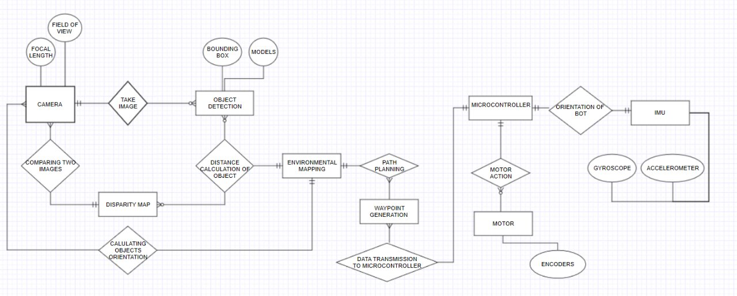
ENTITY-RELATIONSHIP DIAGRAM

Slide 6
_{WHAT PROBLEM WE ARE SOLVING}
The major advantages of using Stereo-Vision based system over Lidar’s are: -
Cameras are much cheaper than lidars. Googles system originally accumulated a cost of over 75,000$. currently low resolution lidars cost up to 1000$ which are less effective than high resolution cameras at same cost.
cameras can see colour so you can use them for detecting traffic lights and detection of road signs is much more superior in cameras as compared to lidars.
Velodyne a company that studies lasers claims that constant emission of laser at 1550 nm can potentially damage human cornea.
Also many lidars cannot work in synchronisation as photons emitted by one can interfere with other lidars potentially blinding the vehicle.
Studies also show that lidars have poor performance as compared to cameras in foul weather conditions like fog and rain.

Slide 7
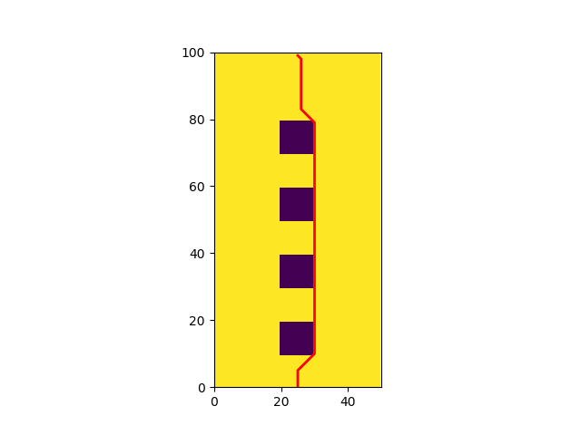
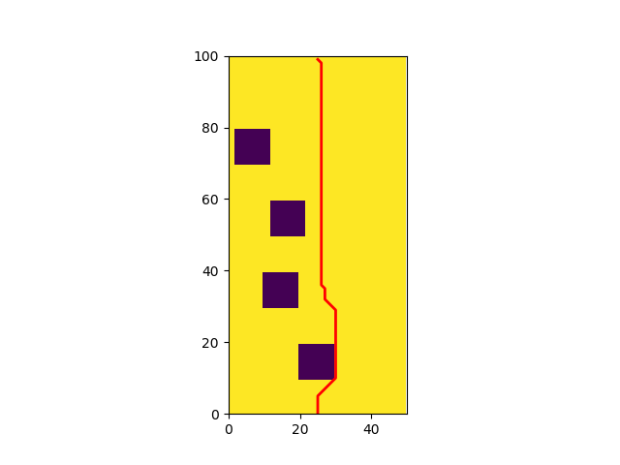
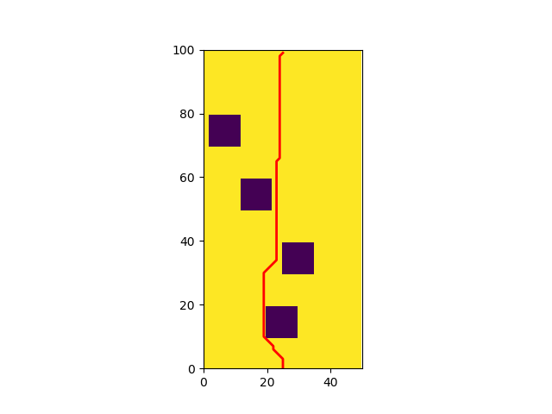
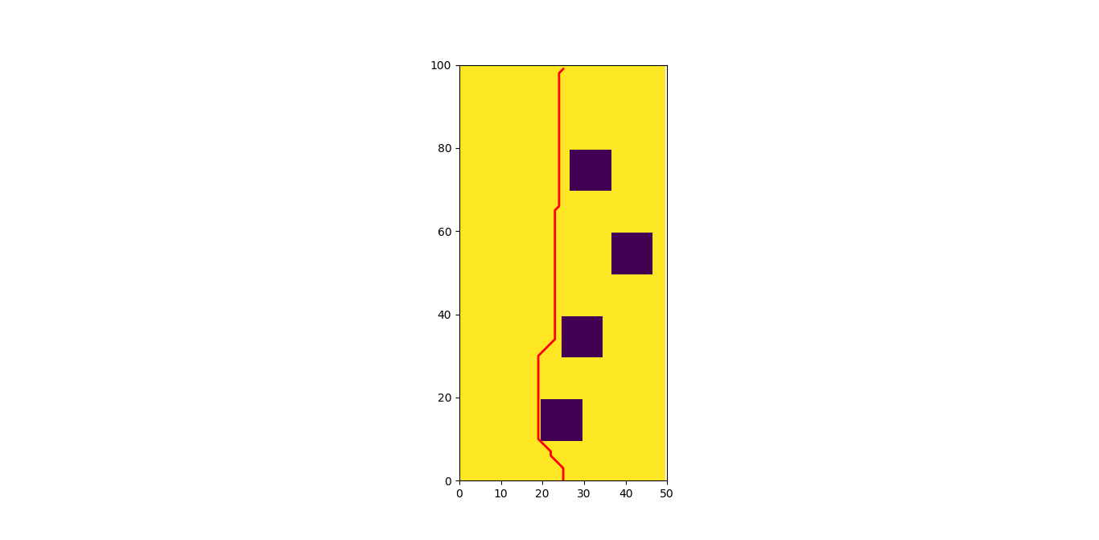
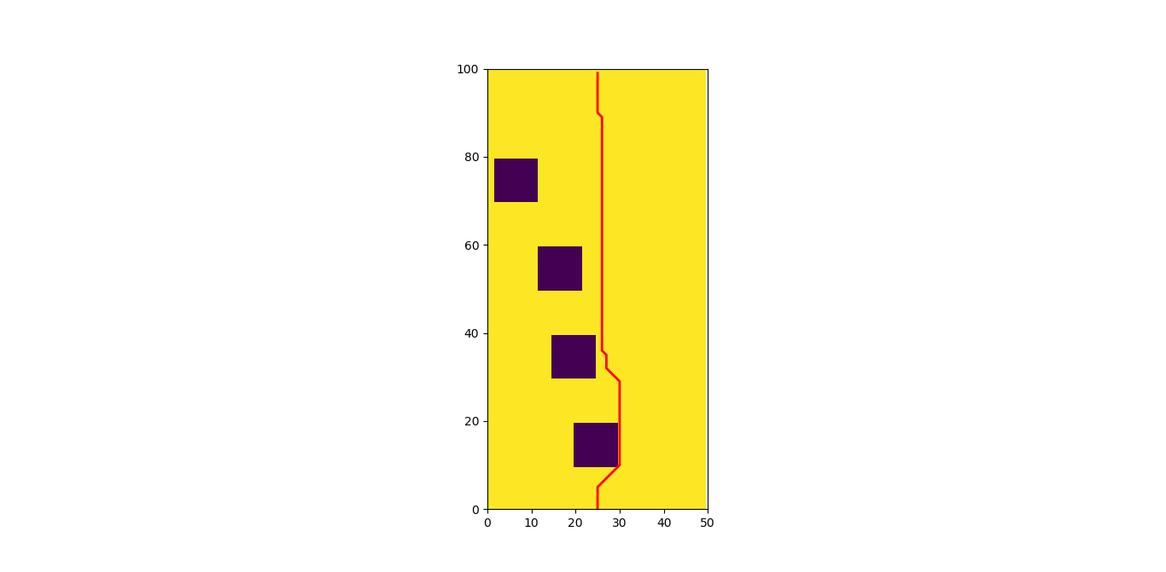

Slide 8
_{UNIQUENESS.}
Our system generates a local map with help of data collected through depth estimation which can be fused with a larger map or customised according to indoor traversal

Slide 9
RESULTS

Slide 10
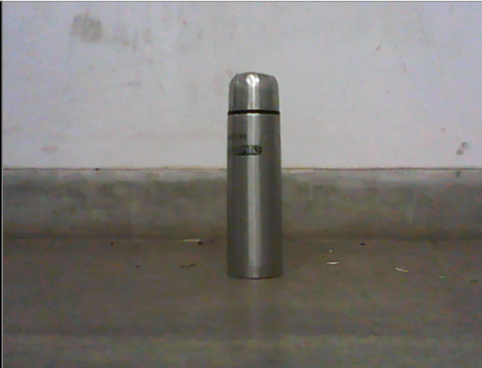
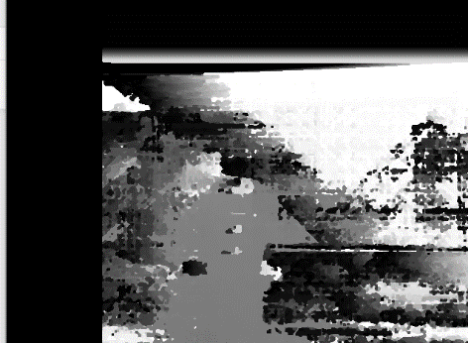
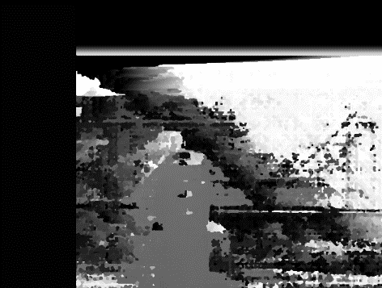
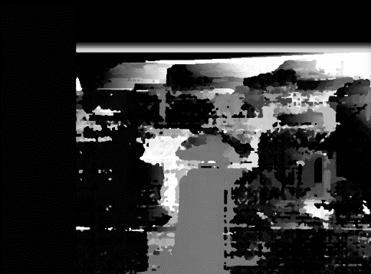
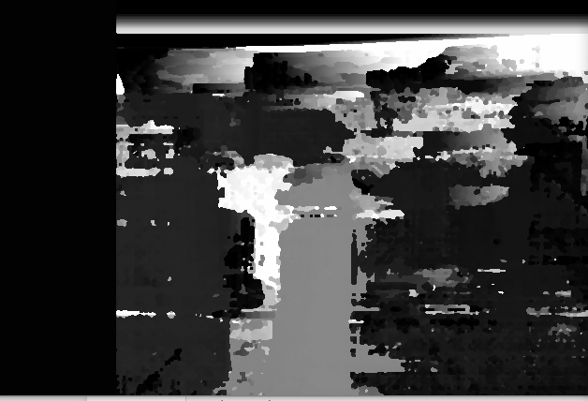
VARIATION IN PARAMETERS
A
B
C
D

Slide 11
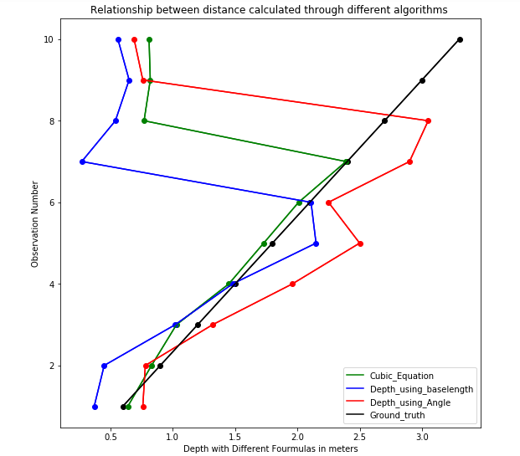
ACCURACY OF DEPTH ESTIMATION
METHOD | ACCURACY (TILL 2.5 meters)
Formula1 (USING FOCAL LENGTH) | 52.22%
Formula2 (USING FIELD OF VIEW) | 55.32%
Formula3 (USING CUBIC EQUATION) | 98.04%

Slide 12
EFFICIENCY IN PATH-PLANNING
Name of algorithm | No. of iterations in one obstacle | No. of iterations in four obstacles
A* | 289 | 718
Dijkstra | 2240 | 2100
Breadth First Search | 2311 | 2100
Table of comparisons between three algorithms

Slide 13
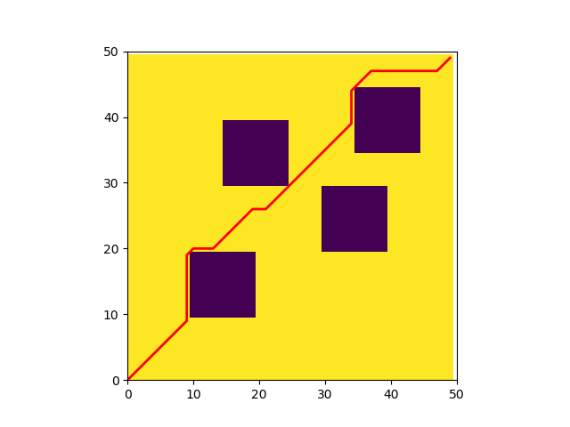
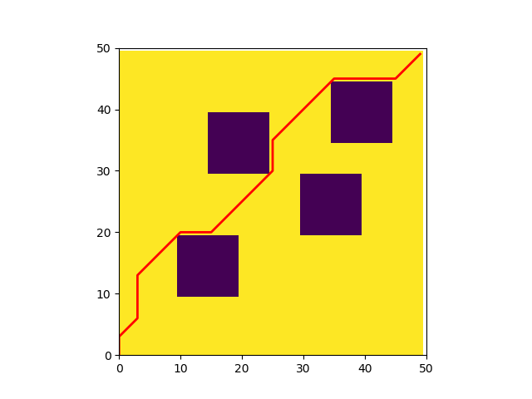

PICTORIAL REPRESENTATION
Map of Dijkstra Algorithm with four obstacles
Map of A* Algorithm with four obstacles
Map of BFS Algorithm with four obstacles

Slide 14
FUTURE SCOPE
The quality of the webcam used are a very major factor effecting the performance of the experiment. Good quality cameras can give better result in object detection due to better resolution also they time at which both the camera frames open together determines the accuracy of disparity generated.
The computational speed has also to do a lot with accuracy in object detection.There is a need to develop a model that requires low computational power and provide with high accuracy.
The Computational speed in implementing A* algorithm is very less hence that remains an area of improvement in future.
The way in which the map is formed can be improved in terms of dimensions like 3D map can be generated for better functioning of the bot .

