Slide 1


Slide 2


Slide 3
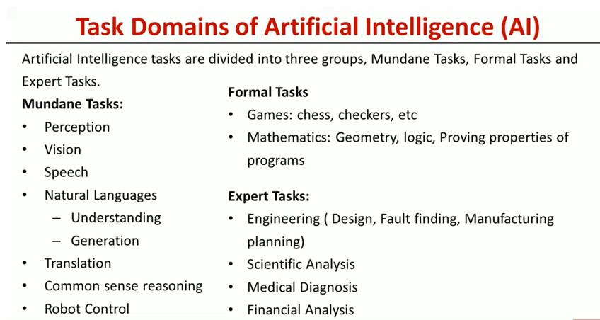

Slide 5
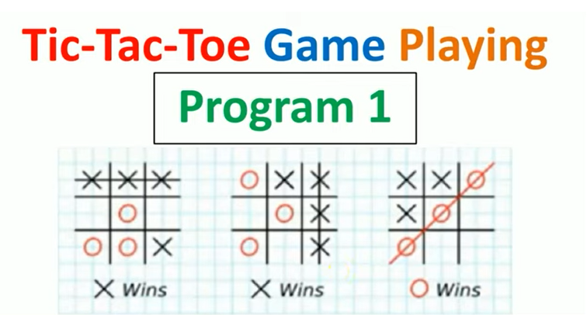

Slide 6
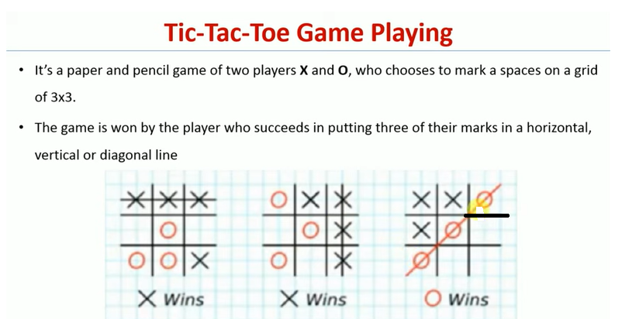

Slide 7
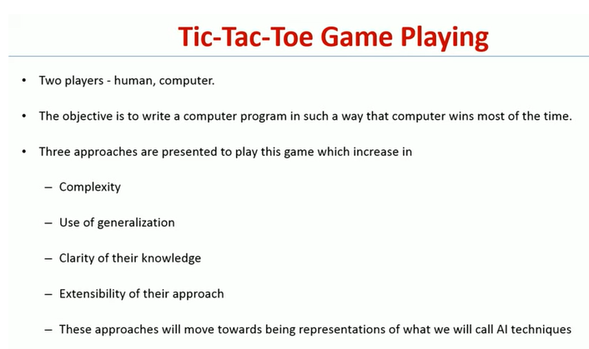

Slide 8
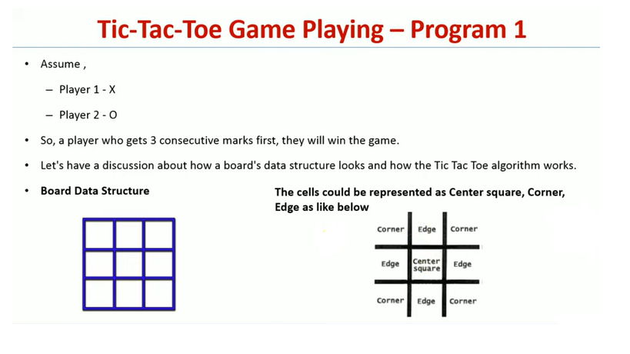

Slide 9
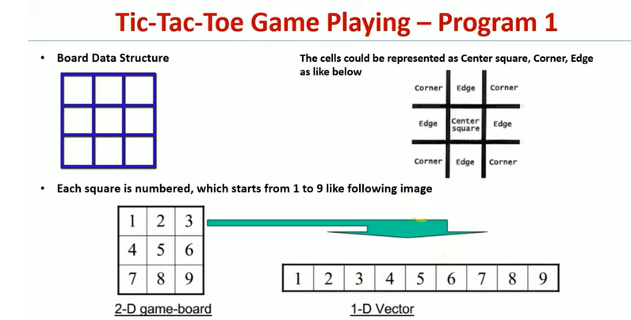

Slide 10
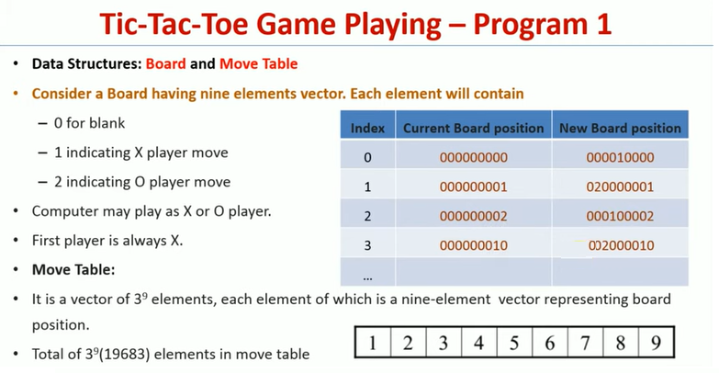
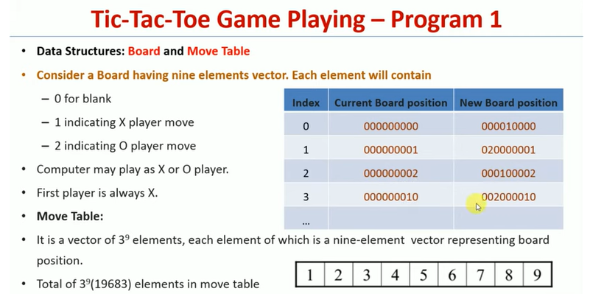
Data Structures: Board and Move Table
Consider a Board having nine elements vector. Each element will contain
0 for blank
1 indicating X player move
2 indicating O player move
The computer may play as an X or O player.
The first player is always X.
Move Table:
It is a vector of 3⁹ elements, each element of which is a nine-element vector representing board position.

Slide 11
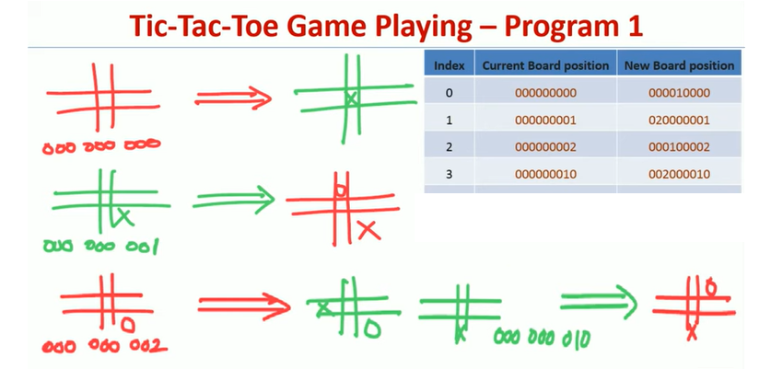

Slide 12
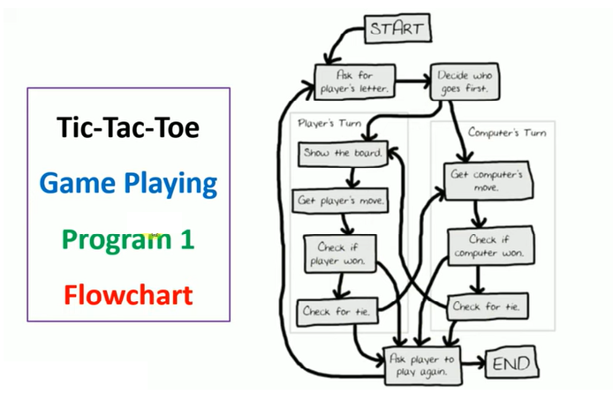

Slide 13
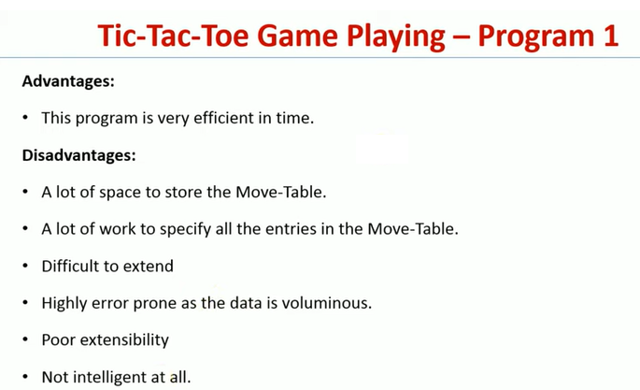

Slide 14
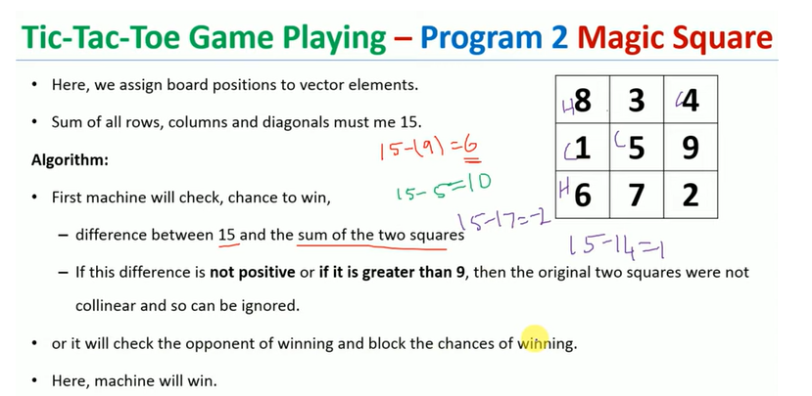

Slide 15
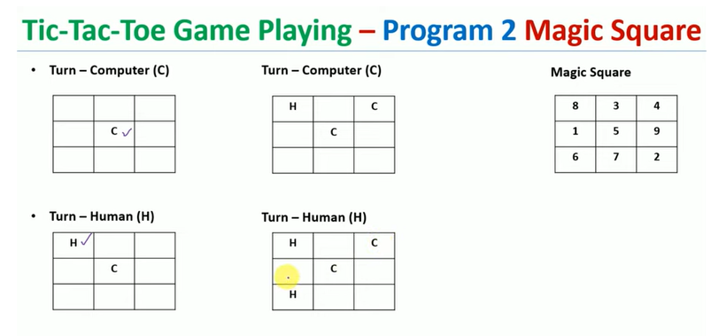

Slide 16
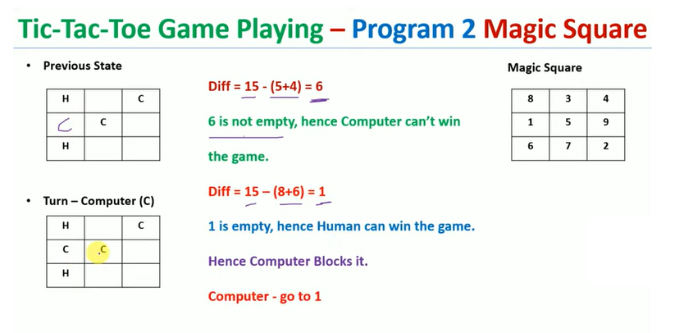

Slide 17
