Slide 1
Quantum Algorithms
Notes:
- Jennifer Mifflin
- Master’s presentation Quantum Algorithms for Moving-Target TSP
- Since most people don’t know much about quantum computing, the outline of my talk will be a brief introduction to Quantum Physics. Then, we will move into a quick introduction to Quantum Computing and finally I’ll discuss my algorithm for the Moving-Target TSP

Slide 2
Qubit measurement

Slide 3
Two qubits
Represented as vectors in a 2-dimensional Hilbert space with four basis vectors
When we measure a pair of qubits we decide that the system it is in one of four states
with probabilities

Slide 4
Measuring two qubits
Before a measurement the state of the system consisting of two qubits is uncertain (it is given by the previous equation and the corresponding probabilities).
After the measurement the state is certain, it is
00, 01, 10, or 11 like in the case of a classical two bit system.

Slide 5
Measuring two qubits (cont’d)
What if we observe only the first qubit, what conclusions can we draw?
We expect that the system to be left in an uncertain sate, because we did not measure the second qubit that can still be in a continuum of states. The first qubit can be
0 with probability
1 with probability

Slide 6
Bell state
1/sqrt(2) |0> + 1/sqrt(2) |1>
Measurement of a qubit in that state gives
50% of time logic 0, 50% of time logic.
Can also be denoted as |+>

Slide 7
Entanglement
Entanglement is an elegant, almost exact translation of the German term Verschrankung used by Schrodinger who was the first to recognize this quantum effect.
An entangled pair is a single quantum system in a superposition of equally possible states. The entangled state contains no information about the individual particles, only that they are in opposite states.
The important property of an entangled pair is that the measurement of one particle influences the state of the other particle. Einstein called that “Spooky action at a distance".

Slide 8
Operations on Qubits - Reversible Logic
Due to the nature of quantum physics, the destruction of information in a gate will cause heat to be evolved which can destroy the superposition of qubits.
Ex.
The AND Gate
Input
Output
In these 3 cases, information is being destroyed
A | B | C
0 | 0 | 0
0 | 1 | 0
1 | 0 | 0
1 | 1 | 1
A
C
B
This type of gate cannot be used. We must use Quantum Gates.

Slide 9
Quantum Gates
Quantum Gates are similar to classical gates, but do not have a degenerate output. i.e. their original input state can be derived from their output state, uniquely. They must be reversible.
This means that a deterministic computation can be performed on a quantum computer only if it is reversible. Luckily, it has been shown that any deterministic computation can be made reversible.(Charles Bennet, 1973)

Slide 11
One qubit gates
I ➔ identity gate; leaves a qubit unchanged.
X or NOT gate➔ transposes the components of an input qubit.
Y gate.
Z gate ➔ flips the sign of a qubit.
H ➔ the Hadamard gate.

Slide 12
Quantum Gates - Hadamard
Simplest gate involves one qubit and is called a Hadamard Gate (also known as a square-root of NOT gate.) Used to put qubits into superposition.
H
H
State |0>
State |0> + |1>
State |1>
Note: Two Hadamard gates used in succession can be used as a NOT gate

Slide 13
Quantum Gates - Controlled NOT
A gate which operates on two qubits is called a Controlled-NOT (CN) Gate. If the bit on the control line is 1, invert the bit on the target line.
Input
Output
A - Target
A’
A | B | A’ | B’
0 | 0 | 0 | 0
0 | 1 | 1 | 1
1 | 0 | 1 | 0
1 | 1 | 0 | 1
B - Control
B’
Note: The CN gate has a similar behavior to the XOR gate with some extra information to make it reversible.

Slide 14
Example Operation - Multiplication By 2
We can build a reversible logic circuit to calculate multiplication by 2 using CN gates arranged in the following manner:
Input
Output
Carry Bit | Ones Bit | Carry Bit | Ones Bit
0 | 0 | 0 | 0
0 | 1 | 1 | 0
0
Carry Bit
H
Ones Bit

Slide 15
Quantum Gates - Controlled Controlled NOT (CCN)
A gate which operates on three qubits is called a Controlled Controlled NOT (CCN) Gate. Iff the bits on both of the control lines is 1,then the target bit is inverted.
Input
Output
A | B | C | A’ | B’ | C’
0 | 0 | 0 | 0 | 0 | 0
0 | 0 | 1 | 0 | 0 | 1
0 | 1 | 0 | 0 | 1 | 0
0 | 1 | 1 | 1 | 1 | 1
1 | 0 | 0 | 1 | 0 | 0
1 | 0 | 1 | 1 | 0 | 1
1 | 1 | 0 | 1 | 1 | 0
1 | 1 | 1 | 0 | 1 | 1
A - Target
A’
B - Control 1
B’
C - Control 2
C’

Slide 16
A Universal Quantum Computer
The CCN gate has been shown to be a universal reversible logic gate as it can be used as a NAND gate.
A - Target
A’
Input
Output
A | B | C | A’ | B’ | C’
0 | 0 | 0 | 0 | 0 | 0
0 | 0 | 1 | 0 | 0 | 1
0 | 1 | 0 | 0 | 1 | 0
0 | 1 | 1 | 1 | 1 | 1
1 | 0 | 0 | 1 | 0 | 0
1 | 0 | 1 | 1 | 0 | 1
1 | 1 | 0 | 1 | 1 | 0
1 | 1 | 1 | 0 | 1 | 1
B - Control 1
B’
C - Control 2
C’
When our target input is 1, our target output is a result of a NAND of B and C.

Slide 17
Classical and quantum systems
Probabilistic states:
Quantum states:
Dirac notation: |000⟩, |001⟩, |010⟩, …, |111⟩ are basis vectors,
so

Slide 18
Dirac bra/ket notation
Ket: |ψ⟩ always denotes a column vector, e.g.
Convention:
Bra: ⟨ψ| always denotes a row vector that is the conjugate transpose of |ψ⟩, e.g. [ α*₁ α*₂ … α*_{d} ]
Bracket: ⟨φ|ψ⟩ denotes ⟨φ|⋅|ψ⟩, the inner product of |φ⟩ and |ψ⟩

Slide 19
Basic operations on qubits (I)
(0) Initialize qubit to |0⟩ or to |1⟩
Recall
(1) Apply a unitary operation U (formally U†U = I )
Examples:
conjugate transpose
Rotation by θ:
Maps |0⟩ → |1⟩
|1⟩ → |0⟩
NOT (bit flip):
Phase flip:
Maps |0⟩ → |0⟩
|1⟩ → −|1⟩

Slide 20
Basic operations on qubits (II)
|1⟩
More examples of unitary operations: (unitary ≈ rotation)
H|0⟩
Reflection about this line
Hadamard:
|0⟩
H|1⟩

Slide 21
Basic operations on qubits (III)
|ψ₁⟩
|1⟩
(3) Apply a “standard” measurement:
|ψ₀⟩
|β|²
α|0⟩ + β|1⟩
|0⟩
|α|²
… and the quantum state collapses
to |0⟩ or |1⟩
(∗) There exist other quantum operations, but they can all be “simulated” by the aforementioned types
Example: measurement with respect to a different orthonormal basis {|ψ₀⟩, |ψ₁⟩}

Slide 22
Distinguishing between two states
Let be in state or
Question 1: can we distinguish between the two cases?
Distinguishing procedure:
apply H
measure
This works because H |+⟩ = |0⟩ and H |−⟩ = |1⟩
Question 2: can we distinguish between |0⟩ and |+⟩?
Since they’re not orthogonal, they cannot be perfectly distinguished … but statistical difference is detectable

Slide 23
Operations on n-qubit states
Unitary operations:
(U†U = I )
Measurements:
⎧
⎨
⎩
… and the quantum state collapses

Slide 24
Entanglement
Suppose that two qubits are in states:
The state of the combined system their tensor product:
Question: what are the states of the individual qubits for
1. ?
2. ?
Answers: 1.
2.
??
... this is an entangled state

Slide 25
Structure among subsystems
qubits:
time
U
W
#1
V
#2
#3
#4
unitary operations
measurements

Slide 26
Quantum circuits
|0⟩
1
|1⟩
0
|1⟩
1
|0⟩
0
|1⟩
1
|0⟩
1
Computation is “feasible” if circuit-size scales polynomially

Slide 28
One qubit gates

Slide 29
Identity transformation, Pauli matrices, Hadamard

Slide 30
Tensor products and ``outer’’ products

Slide 31
CNOT a two qubit gate
Two inputs
Control
Target
The control qubit is transferred to the output as is.
The target qubit
Unaltered if the control qubit is 0
Flipped if the control qubit is 1.

Slide 33
The two input qubits of a two qubit gates

Slide 34
Two qubit gates

Slide 35
Two qubit gates

Slide 36
Final comments on the CNOT gate
CNOT preserves the control qubit (the first and the second component of the input vector are replicated in the output vector) and flips the target qubit (the third and fourth component of the input vector become the fourth and respectively the third component of the output vector).
The CNOT gate is reversible. The control qubit is replicated at the output and knowing it we can reconstruct the target input qubit.

Slide 37
Example of a one-qubit gate applied to a two-qubit system
(do nothing)
U
The resulting 4x4 matrix is
Maps basis states as:
|0⟩|0⟩ → |0⟩U|0⟩ |0⟩|1⟩ → |0⟩U|1⟩ |1⟩|0⟩ → |1⟩U|0⟩ |1⟩|1⟩ → |1⟩U|1⟩
Question: what happens if U is applied to the first qubit?

Slide 38
Controlled-U gates
U
Resulting 4x4 matrix is controlled-U =
Maps basis states as:
|0⟩|0⟩ → |0⟩|0⟩ |0⟩|1⟩ → |0⟩|1⟩ |1⟩|0⟩ → |1⟩U|0⟩ |1⟩|1⟩ → |1⟩U|1⟩

Slide 39
Controlled-NOT (CNOT)
|a⟩
|a⟩
≡
X
|b⟩
|a⊕b⟩
Note: “control” qubit may change on some input states!
|0⟩ + |1⟩
|0⟩ − |1⟩
H
H
≡
|0⟩ − |1⟩
|0⟩ − |1⟩
H
H

Slide 40
SHOR’S ALGORITHM
Shor's algorithm is a quantum computer algorithm for finding the prime factors of an integer.
It was developed in 1994 by the American mathematician Peter Shor.
The efficiency of Shor's algorithm is due to the efficiency of the quantum Fourier transform, and modular exponentiation by repeated squarings.

Slide 41
Shor’s Algorithm
Shor’s algorithm shows (in principle,) that a quantum computer is capable of factoring very large numbers in polynomial time.
The algorithm is dependant on
Modular Arithmetic
Quantum Parallelism
Quantum Fourier Transform

Slide 42
Shor’s Algorithm - Periodicity
An important result from Number Theory:
F(a) = x mod N is a periodic function
a
Choose N = 15 and x = 7 and we get the following:
0
7 mod 15 = 1
7 mod 15 = 7
7 mod 15 = 4
7 mod 15 = 13
7 mod 15 = 1
1
2
3
4
.
.
.

Slide 43
Shor’s Algorithm - In Depth Analysis
To Factor an odd integer N (Let’s choose 15) :
Determine if the number n is a prime, a even number, or an integer power of a prime number. If it is we will not use Shor's algorithm. There are efficient classical methods for determining if a integer n belongs to one of the above groups, and providing factors for it if it is. This step would be performed on a classical computer.
Choose an integer q such that N²< q < 2N² let’s pick 256
Choose a random integer x such that GCD(x, N) = 1 let’s pick 7
2
2

Slide 44
Shor’s Algorithm - In Depth Analysis
Create two quantum registers (these registers must also be entangled so that the collapse of the input register corresponds to the collapse of the output register)
Input register: must contain enough qubits to represent numbers as large as q-1. up to 255, so we need 8 qubits
Output register: must contain enough qubits to represent numbers as large as N-1. up to 14, so we need 4 qubits

Slide 45
Shor’s Algorithm - Preparing Data
Load the input register with an equally weighted superposition of all integers from 0 to q-1. 0 to 255
Load the output register with all zeros.
The total state of the system at this point will be:
1
255
∑ |a, 000>
√256
a=0
Output Register
Note: the comma here denotes that the registers are entangled
Input Register

Slide 46
Shor’s Algorithm - Modular Arithmetic
a
Apply the transformation x mod N to each number in the input register, storing the result of each computation in the output register.
Note that we are using decimal numbers here only for simplicity.
a
Input Register | 7 Mod 15 | Output Register
|0> | 7 Mod 15 | 1
|1> | 7 Mod 15 | 7
|2> | 7 Mod 15 | 4
|3> | 7 Mod 15 | 13
|4> | 7 Mod 15 | 1
|5> | 7 Mod 15 | 7
|6> | 7 Mod 15 | 4
|7> | 7 Mod 15 | 13
0
1
2
3
4
5
6
7
.
.

Slide 47
Shor’s Algorithm - Superposition Collapse
Now take a measurement on the output register. This will collapse the superposition to represent just one of the results of the transformation, let’s call this value c.
Our output register will collapse to represent one of the following:
|1>, |4>, |7>, or |13
For sake of example, lets choose |1>

Slide 48
Shor’s Algorithm - Entanglement
Now things really get interesting !
Since the two registers are entangled, measuring the output register will have the effect of partially collapsing the input register into an equal superposition of each state between 0 and q-1 that yielded c (the value of the collapsed output register.)
Since the output register collapsed to |1>, the input register will partially collapse to:
|0> + |4> + |8> + |12>, . . .
The probabilities in this case are since our register is now in an equal superposition of 64 values (0, 4, 8, . . . 252)
1
1
1
1
√64
√64
√64
√64
1
√64

Slide 49
Shor’s Algorithm - QFT
We now apply the Quantum Fourier transform on the partially collapsed input register. The fourier transform has the effect of taking a state |a> and transforming it into a state given by:
1
q-1
∑ |c> * e
2πiac / q
√q
c=0
Fourier Transform is a mathematical model which helps to transform the signals between two different domains, such as transforming signal from frequency domain to time domain or vice versa. Fourier transform has many applications in Engineering and Physics, such as signal processing, RADAR, and so on.

Slide 50
Shor’s Algorithm - QFT
1
∑ |a> , |1>
√64
a ∈ A
1
255
∑ |c> * e
2πiac / 256
√256
c=0
a
Note: A is the set of all values that 7 mod 15 yielded 1. In our case A = {0, 4, 8, …, 252}
So the final state of the input register after the QFT is:
1
1
255
∑ |c> * e
2πiac / 256
∑ , |1>
√64
√256
c=0
a ∈ A

Slide 51
Shor’s Algorithm - QFT
The QFT will essentially peak the probability amplitudes at integer multiples of q/r , where r is the desired period in our case r is 4.
|0>, |64>, |128>, |192>, …
So we no longer have an equal superposition of states, the probability amplitudes of the above states are now higher than the other states in our register.
Measure the state of register one, call this value m, this integer m has a very high probability of being a multiple of q/r
With our knowledge of q, and m, there are methods of calculating the period (one method is the continuous fraction expansion of the ratio between q and m.)

Slide 52
Shor’s Algorithm - The Factors :)
Now that we have the period, the factors of N can be determined by taking the greatest common divisor of N with respect to x ^ (P/2) + 1 and x ^ (P/2) - 1. The idea here is that this computation will be done on a classical computer.
We compute:
Gcd(7 + 1, 15) = 5
Gcd(7 - 1, 15) = 3
We have successfully factored 15!
4/2
4/2

Slide 53
What to do if Shor's algorithm failed to produce factors of n
The QFT comes up short and reveals the wrong period. This probability is actually dependant on your choice of q. The larger the q, the higher the probability of finding the correct probability.
The period of the series ends up being odd
Fourier transform could be measured to be 0, making the post processing in the next step impossible.
The algorithm will sometimes find factors of 1 and n, which is not useful either.
If either of these cases occur, we go back to the beginning and pick a new x.

Slide 54
Multiplication problem
Input: two n-bit numbers (e.g. 101 and 111)
Output: their product (e.g. 100011)
“Grade school” algorithm takes O(n²) steps
Best currently-known classical algorithm costs O(n log n loglog n)

Slide 55
Factoring problem
Input: an n-bit number (e.g. 100011)
Output: their product (e.g. 101, 111)
Trial division costs ≈ 2^{n/2}
Best currently-known classical algorithm costs O(2^{n⅓ log⅔ n} )
Hardness of factoring is the basis of the security of many cryptosystems (e.g. RSA)
Shor’s quantum algorithm costs ≈ n² [ O(n² log n loglog n) ]
Implementation would break RSA and other cryptosystems

Slide 56
Grover’s Search Algorithm
• Search in a database with N names.
• Names are randomly entered.
• Classically on average N/2 search is required.
O(N) operations is required.
• Quantum computation requires O(√N) operations

Slide 57
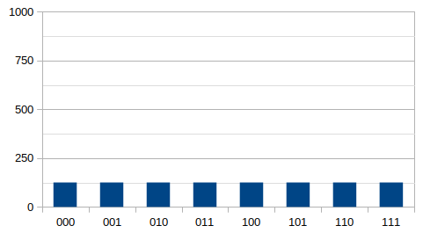
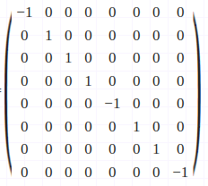
Suppose, we have to find the smallest element from the array [3, 4, 6, 9, 1, 8, 4, 2] and let’s say y=4.
So, the number of qubits = log₂8 = 3, so the combinations are [000, 001, … , 111].
After applying the hadamard gate on the initial qubits, we get all the combinations with equal probabilities as seen in the given figure.
Applied Hadamad Gate
Oracle Unitary Matrix

Slide 58
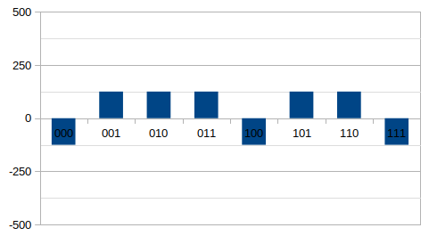
Create the Oracle with the indices which has less value than the y. For this case, we see that 0th, 4th and 7th index has the less value than y (=4) which are 3, 1 and 2 respectively.
We apply phase shift operation while creating the oracle for this array in the 0, 4 and 7th position i.e. we apply -1 to these positions and rest are 1.
After applying the operator you can see the result as given figure.
Phase Shift applying Oracle

Slide 59
Diffuser Operator: It uses to amplify the required states, i.e. whichever states had a phase flip to -1, this operator simply amplifies their probabilities to higher and other states probability automatically goes lower.
Applying Diffuser Operator, we can see the results as figure shown.(Next Slide)
After getting the results, we take the maximum amplitudes value as the result and compare that index value to y, and if it’s smaller we change the value of y, to the index value.
We repeat the whole process until we find the minimum value.

Slide 60
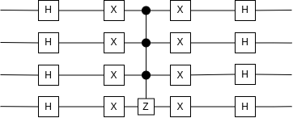
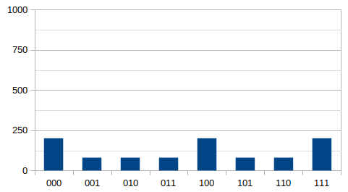
Diffuser Operator
Amplitude Amplification applying Oracle

Slide 61
How do quantum algorithms work?
Given a polynomial-time classical algorithm for f :{0,1}^{n} → T, it is straightforward to construct a quantum algorithm that creates the state:
This is not performing “exponentially many computations at polynomial cost”
The most straightforward way of extracting information from the state yields just (x, f (x)) for a random x∈{0,1}^{n}
But we can make some interesting tradeoffs:
instead of learning about any (x, f (x)) point, one can learn something about a global property of f

Slide 62
Deutsch’s problem
Let f : {0,1} → {0,1}
f
There are four possibilities:
x | f₁(x)
0 1 | 0 0
x | f₂(x)
0 1 | 1 1
x | f₃(x)
0 1 | 0 1
x | f₄(x)
0 1 | 1 0
Goal: determine f(0) ⊕ f(1)
Any classical method requires two queries
What about a quantum method?

Slide 63
Reversible black box for f
a
U_{f}
a
alternate notation:
f
b
b ⊕ f(a)
A classical algorithm: (still requires 2 queries)
0
f
f
1
0
f(0) ⊕ f(1)
2 queries + 1 auxiliary operation

Slide 64
Quantum algorithm for Deutsch
2
3
|0⟩
H
f
H
f(0) ⊕ f(1)
|1⟩
H
1
1 query + 4 auxiliary operations
How does this algorithm work?
Each of the three H operations can be seen as playing a different role ...

Slide 65
Quantum algorithm (1)
2
3
|0⟩
H
f
H
|1⟩
H
1
1. Creates the state |0⟩ – |1⟩, which is an eigenvector of
NOT with eigenvalue –1
I with eigenvalue +1
This causes f to induce a phase shift of (–1) ^{f(x)} to |x⟩
|x⟩
f
(–1) ^{f(x)}|x⟩
|0⟩ – |1⟩
|0⟩ – |1⟩

Slide 66
Quantum algorithm (2)
2. Causes f to be queried in superposition (at |0⟩ + |1⟩)
|0⟩
H
f
(–1) ^{f(0)}|0⟩ + (–1) ^{f(1)}|1⟩
|0⟩ – |1⟩
|0⟩ – |1⟩
x | f₁(x)
0 1 | 0 0
x | f₂(x)
0 1 | 1 1
x | f₃(x)
0 1 | 0 1
x | f₄(x)
0 1 | 1 0
±(|0⟩ + |1⟩)
±(|0⟩ – |1⟩)

Slide 67
Quantum algorithm (3)
3. Distinguishes between ±(|0⟩ + |1⟩) and ±(|0⟩ – |1⟩)
H
±(|0⟩ + |1⟩) ±|0⟩
H
±(|0⟩ – |1⟩) ±|1⟩

Slide 68
Summary of Deutsch’s algorithm
Makes only one query, whereas two are needed classically
produces superpositions of inputs to f : |0⟩ + |1⟩
extracts phase differences from
(–1) ^{f(0)}|0⟩ + (–1) ^{f(1)}|1⟩
2
3
|0⟩
H
f
H
f(0) ⊕ f(1)
|1⟩
H
1
constructs eigenvector so f-queries induce phases: |x⟩ → (–1) ^{f(x)}|x⟩

Slide 69
One-out-of-four search
Let f : {0,1}² → {0,1} have the property that there is exactly one x ∈ {0,1}² for which f (x) = 1
Four possibilities:
x | f₀₀(x)
00 01 10 11 | 1 0 0 0
x | f₀₁(x)
00 01 10 11 | 0 1 0 0
x | f₁₀(x)
00 01 10 11 | 0 0 1 0
x | f₁₁(x)
00 01 10 11 | 0 0 0 1
Goal: find x ∈ {0,1}² for which f (x) = 1
What is the minimum number of queries classically? ____
Quantumly? ____

Slide 70
Quantum algorithm (I)
Black box for 1-4 search:
|x₁⟩
|x₁⟩
f
|x₂⟩
|x₂⟩
|y⟩
|y ⊕ f(x₁,x₂)⟩
Start by creating phases in superposition of all inputs to f:
|0⟩
H
f
Input state to query?
|0⟩
H
(|00⟩ + |01⟩ + |10⟩ + |11⟩)(|0⟩ – |1⟩)
|1⟩
H
Output state of query?
((–1) ^{f(00)}|00⟩ + (–1) ^{f(01)}|01⟩ + (–1) ^{f(10)}|10⟩ + (–1) ^{f(11)}|11⟩)(|0⟩ – |1⟩)

Slide 71
Quantum algorithm (II)
|0⟩
← Apply the U that maps
← |ψ₀₀⟩, |ψ₀₁⟩, |ψ₁₀⟩, |ψ₁₁⟩ to
← |00⟩, |01⟩, |10⟩, |11⟩ (resp.)
H
f
U
|0⟩
H
|1⟩
H
Output state of the first two qubits in the four cases:
Case of f₀₀?
|ψ₀₀⟩ = – |00⟩ + |01⟩ + |10⟩ + |11⟩
Case of f₀₁?
|ψ₀₁⟩ = + |00⟩ – |01⟩ + |10⟩ + |11⟩
Case of f₁₀?
|ψ₁₀⟩ = + |00⟩ + |01⟩ – |10⟩ + |11⟩
Case of f₁₁?
|ψ₁₁⟩ = + |00⟩ + |01⟩ + |10⟩ – |11⟩
What noteworthy property do these states have? → Orthogonal

Slide 72
Grover’s Search Algorithm
Search a phone book for a specific number without rearranging the numbers.
Idea: magnify amplitude of the “choosen” number:
Flip the amplitude of the selected item and rotate all amplitudes around the average
Repeat this until the selected item’s probability of being read is greater than 1/2
Notes:
In Quantum Computing, two main algorithms have been discovered. One is Shor’s factoring algorithm. The other is Grover’s Searching algorithm. Grover’s search algorithm is used in my final algorithm, so I will explain it. The best way to state the problem is to search a phone book for a specific phone number without ordering the phone numbers.
The idea in a quantum computer is to magnify the desired number until the probability that we will read it is greater than 1/2. To do this, we negate the amplitude of the selected item and then rotate all the amplitudes around the average. This is repeated just until the desired amplitude is reached. This can be better explained graphically.

Slide 73
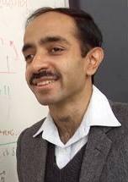



Grover’s search algorithm
1996
Problem: Given a function $f(x)$ mapping $n$ bits to $1$ bit $f\left(x\right):{\left\{0,1\right\}}^{n}→\{0,1\}$, determine the value of $x$ such that $f\left(x\right)=1$. We have a promise that the value is unique.
Classically we need to evaluate $O\left(N\right)$ values, ${N=2}^{n}$.
Lov Grover
Grover’s algorithm enables a search with $O\left(\sqrt{N}\right)$ queries.
Quantum algorithm has two crucial steps:
Calculate the function on all values simultaneously.
Reflect about the equal superposition state.
These steps are repeated $O\left(\sqrt{N}\right)$ times.

Slide 74
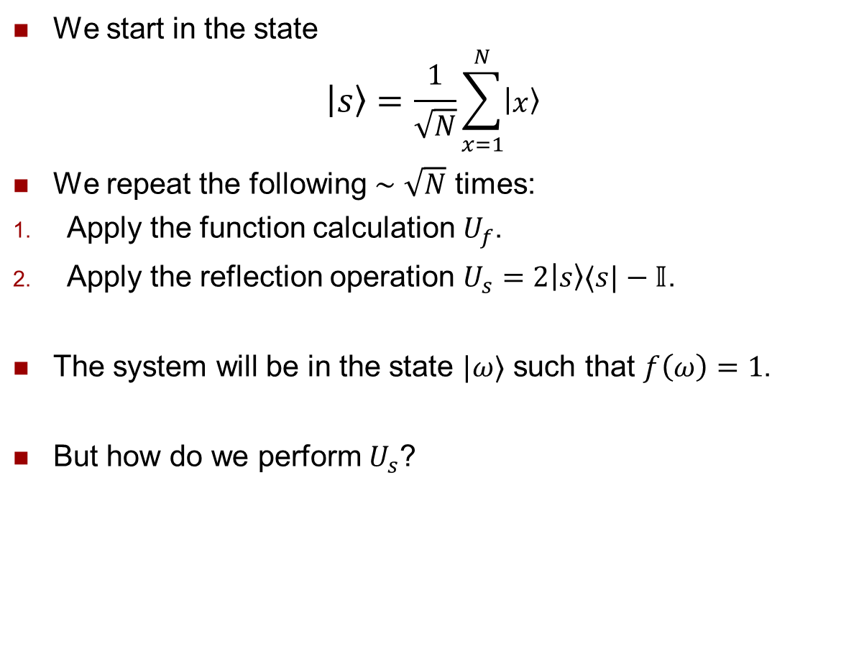
Grover’s search algorithm
1996
We start in the state
$$|s〉=\frac{1}{\sqrt{N}}\sum_{x=1}^{N}{|x〉}$$
We repeat the following $∼\sqrt{N}$ times:
Apply the function calculation $U_{f}$.
Apply the reflection operation $U_{s}=2|s〉〈s|−𝕀$.
The system will be in the state $|ω〉$ such that $f\left(ω\right)=1$.
But how do we perform $U_{s}$?
Lov Grover

Slide 75



















Grover’s search algorithm
1996
But how do we perform $U_{s}$?
First, invert the operation that prepares $|s〉$ - just Hadamards on all qubits.
Then, reflect about $|0〉$; i.e. apply $2|0〉〈0|−𝕀$.
Lastly, repeat the operation that prepares $|s〉$.
Lov Grover
$$H$$
$$H$$
$$H$$
$$H$$
$$H$$
$$H$$
$$H$$
$$H$$
$$H$$
$$H$$
$$H$$
$$H$$
$$H$$
$$H$$
$$H$$
$$H$$
$$|1〉$$
$$H$$

Slide 76
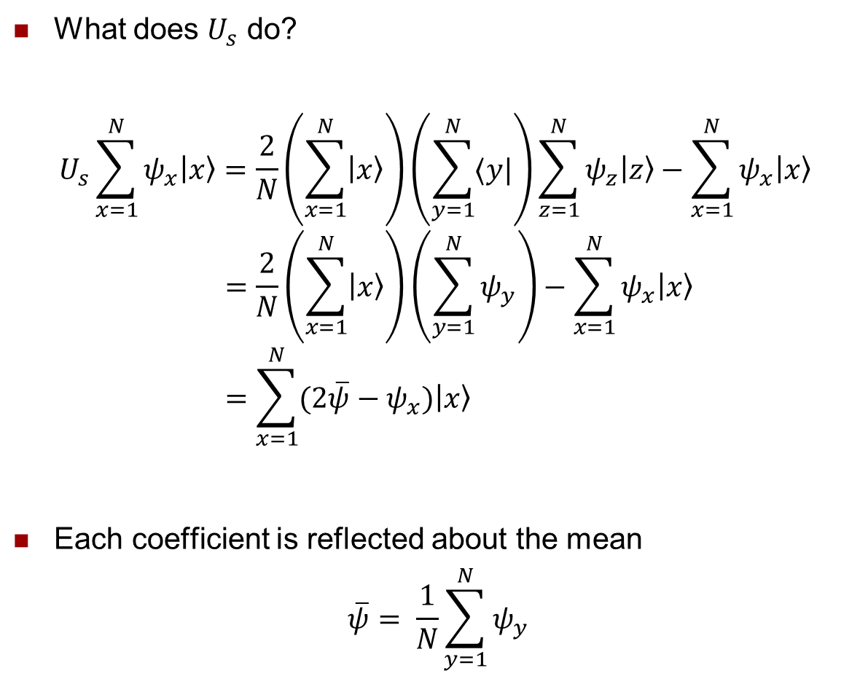
Grover’s search algorithm
1996
What does $U_{s}$ do?
$$U_{s}\sum_{x=1}^{N}{ψ_{x}|x〉}=\frac{2}{N}\left(\sum_{x=1}^{N}{|x〉}\right)\left(\sum_{y=1}^{N}{〈y|}\right)\sum_{z=1}^{N}{ψ_{z}|z〉}−\sum_{x=1}^{N}{ψ_{x}|x〉} \\ =\frac{2}{N}\left(\sum_{x=1}^{N}{|x〉}\right)\left(\sum_{y=1}^{N}{ψ_{y}}\right)−\sum_{x=1}^{N}{ψ_{x}|x〉} \\ =\sum_{x=1}^{N}{(2\overline{ψ}−ψ_{x})|x〉}$$
Each coefficient is reflected about the mean
$$\overline{ψ}= \frac{1}{N}\sum_{y=1}^{N}{ψ_{y}}$$
Lov Grover

Slide 77

Grover’s search algorithm
1996
Example: Take $N=4$, with solution $x=3$.
We start in the state
$$|s〉=\frac{1}{2} (|1〉+|2〉+|3〉+|4〉)$$
Apply the function calculation $U_{f}$, giving
$$\frac{1}{2}(|1〉+|2〉−|3〉+|4〉)$$
The mean is
$$\overline{ψ}=\frac{1}{4}(\frac{1}{2}+\frac{1}{2}−\frac{1}{2}+\frac{1}{2})=\frac{1}{4}$$
Lov Grover

Slide 78
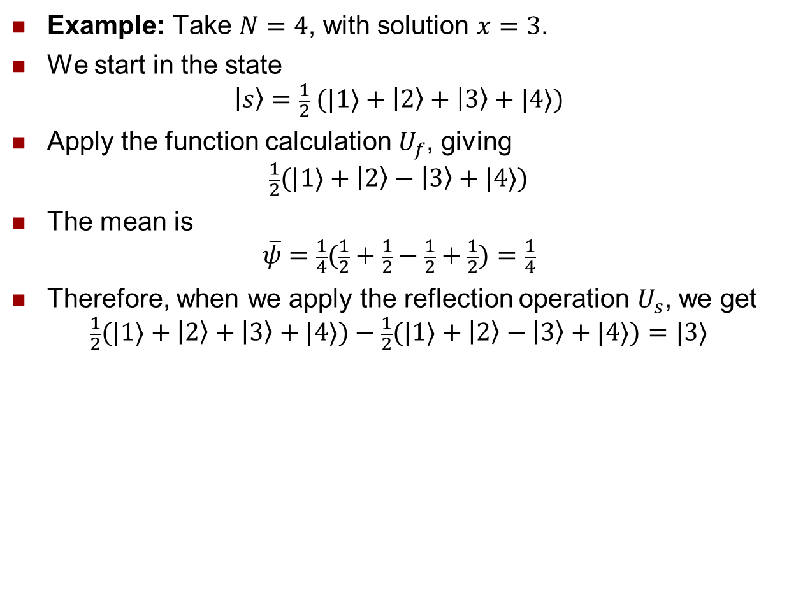
Grover’s search algorithm
1996
Example: Take $N=4$, with solution $x=3$.
We start in the state
$$|s〉=\frac{1}{2} (|1〉+|2〉+|3〉+|4〉)$$
Apply the function calculation $U_{f}$, giving
$$\frac{1}{2}(|1〉+|2〉−|3〉+|4〉)$$
The mean is
$$\overline{ψ}=\frac{1}{4}(\frac{1}{2}+\frac{1}{2}−\frac{1}{2}+\frac{1}{2})=\frac{1}{4}$$
Therefore, when we apply the reflection operation $U_{s}$, we get
$$\frac{1}{2}(|1〉+|2〉+|3〉+|4〉)−\frac{1}{2}(|1〉+|2〉−|3〉+|4〉)=|3〉$$
Lov Grover

Slide 79

Grover’s search algorithm
1996
Example: Take $N=9$, with solution $x=6$.
Reflecting target…
The mean is $7/27$.
Lov Grover

Slide 80
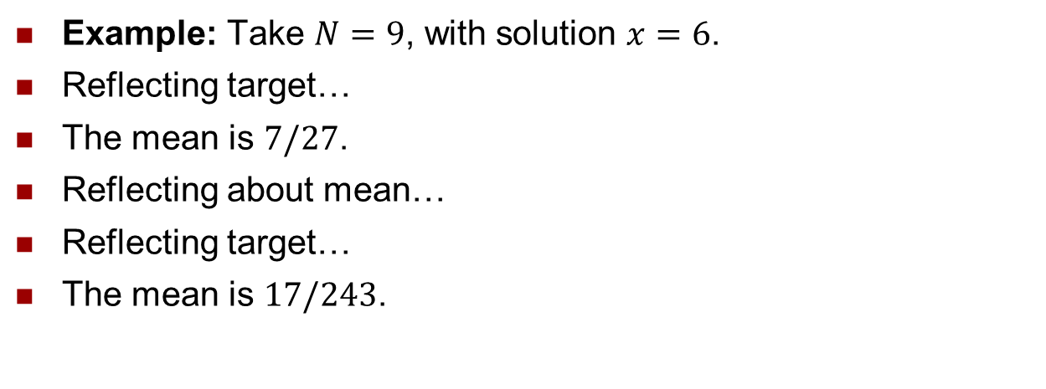
Grover’s search algorithm
1996
Example: Take $N=9$, with solution $x=6$.
Reflecting target…
The mean is $7/27$.
Reflecting about mean…
Reflecting target…
The mean is $17/243$.
Lov Grover

Slide 81
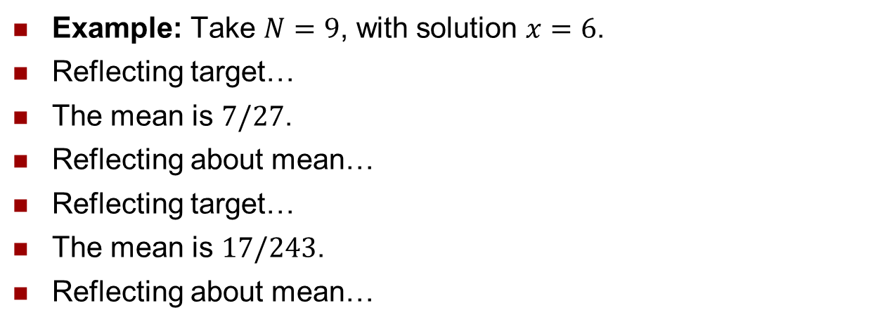
Grover’s search algorithm
1996
Example: Take $N=9$, with solution $x=6$.
Reflecting target…
The mean is $7/27$.
Reflecting about mean…
Reflecting target…
The mean is $17/243$.
Reflecting about mean…
Lov Grover
Solution with high probability.

Slide 82
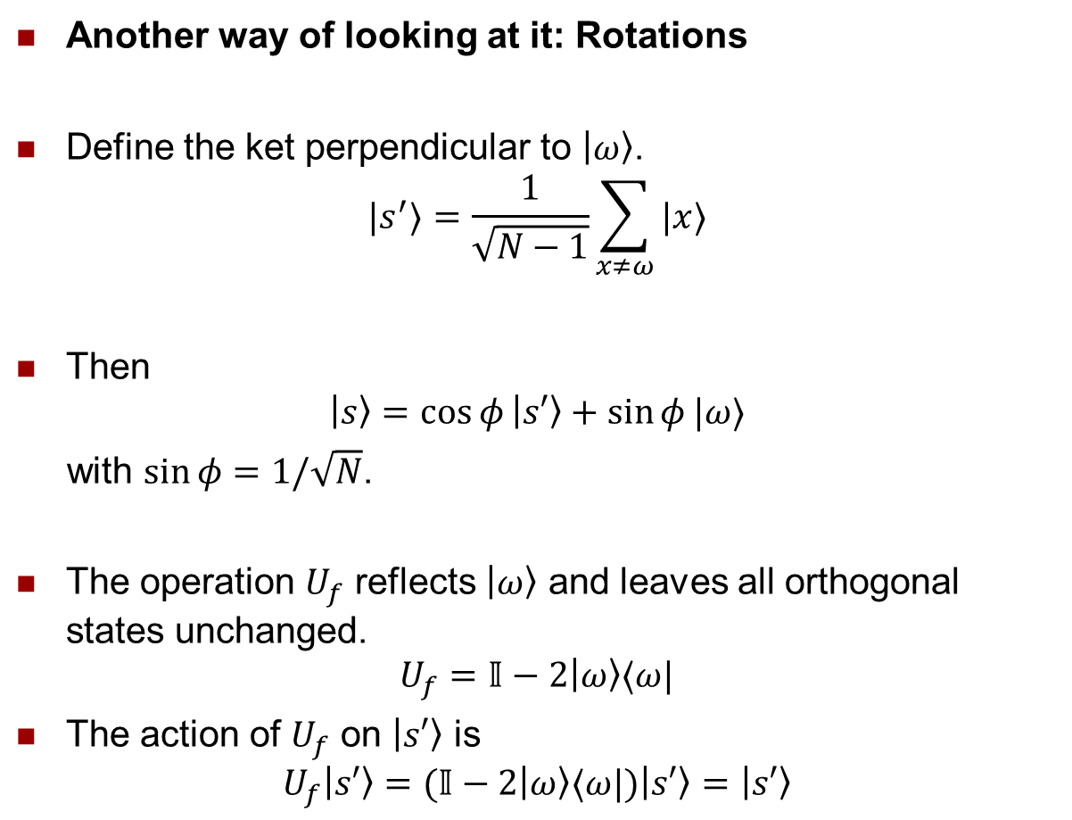
Grover’s search algorithm
1996
Another way of looking at it: Rotations
Define the ket perpendicular to $|ω〉$.
$$|s^{′}〉=\frac{1}{\sqrt{N−1}}\sum_{x≠ω}{|x〉}$$
Then
$$|s〉=\cos{φ}|s′〉+\sin{φ}|ω〉$$
with $\sin{φ}=1/\sqrt{N}$.
The operation $U_{f}$ reflects $|ω〉$ and leaves all orthogonal states unchanged.
$$U_{f}=𝕀−2|ω〉〈ω|$$
The action of $U_{f}$ on $|s′〉$ is
$$U_{f}|s′〉=(𝕀−2|ω〉〈ω|)|s′〉=|s′〉$$
Lov Grover

Slide 83
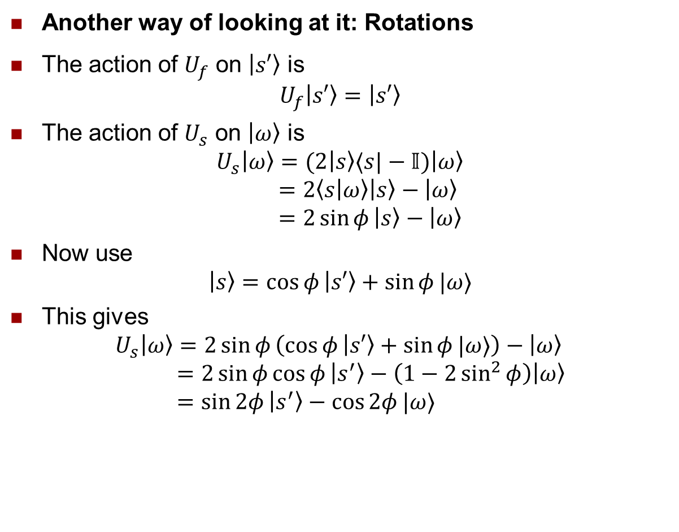
Grover’s search algorithm
1996
Another way of looking at it: Rotations
The action of $U_{f}$ on $|s′〉$is
$$U_{f}|s′〉=|s′〉$$
The action of $U_{s}$ on $|ω〉$ is
$$U_{s}|ω〉=(2|s〉〈s|−𝕀)|ω〉 \\ =2〈s | ω〉|s〉−|ω〉 \\ =2\sin{φ}|s〉−|ω〉$$
Now use
$$|s〉=\cos{φ}|s′〉+\sin{φ}|ω〉$$
This gives
$$U_{s}|ω〉=2\sin{φ}\left(\cos{φ}|s′〉+\sin{φ}|ω〉\right)−|ω〉 \\ =2\sin{φ}\cos{φ}|s^{′}〉−\left(1−2\sin^{2}{φ}\right)|ω〉 \\ =\sin{2φ}|s^{′}〉−\cos{2φ}|ω〉$$
Lov Grover

Slide 84
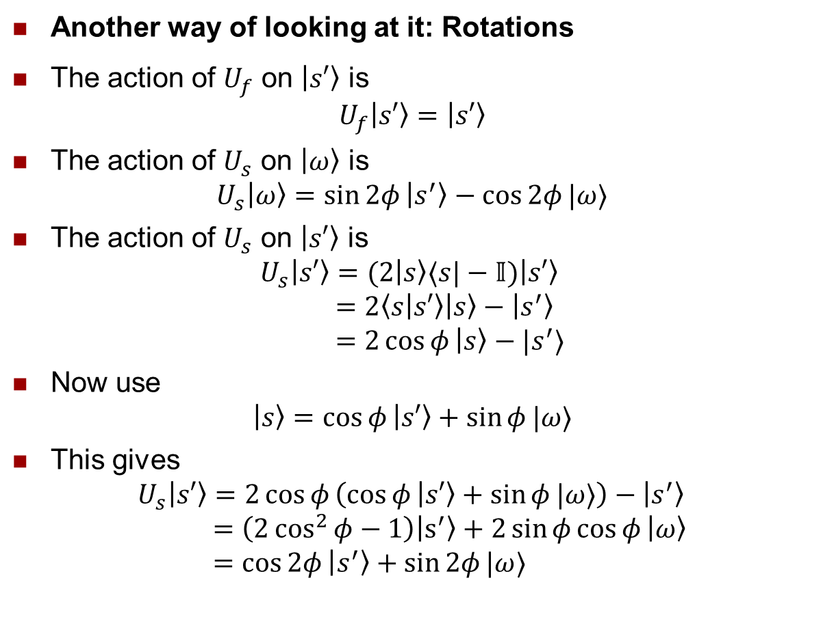
Grover’s search algorithm
1996
Another way of looking at it: Rotations
The action of $U_{f}$ on $|s′〉$is
$$U_{f}|s′〉=|s′〉$$
The action of $U_{s}$ on $|ω〉$ is
$$U_{s}|ω〉=\sin{2φ}|s^{′}〉−\cos{2φ}|ω〉$$
The action of $U_{s}$ on $|s′〉$is
$$U_{s}|s′〉=(2|s〉〈s|−𝕀)|s′〉 \\ =2〈s | s′〉|s〉−|s^{′}〉 \\ =2\cos{φ}|s〉−|s^{′}〉$$
Now use
$$|s〉=\cos{φ}|s′〉+\sin{φ}|ω〉$$
This gives
$$U_{s}|s′〉=2\cos{φ}\left(\cos{φ}|s′〉+\sin{φ}|ω〉\right)−|s^{′}〉 \\ =\left(2\cos^{2}{φ}−1\right)|s^{′}〉+2\sin{φ}\cos{φ}|ω〉 \\ =\cos{2φ}|s^{′}〉+\sin{2φ}|ω〉$$
Lov Grover

Slide 85
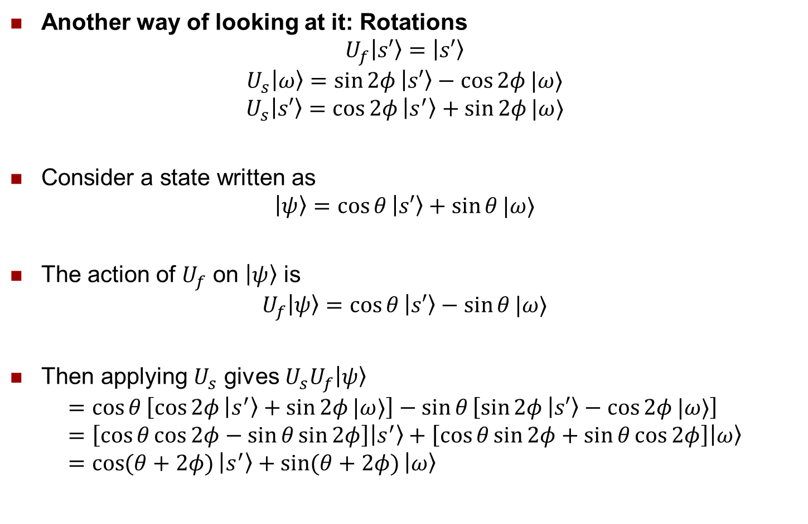
Grover’s search algorithm
1996
Another way of looking at it: Rotations
$$U_{f}|s′〉=|s′〉$$
$$U_{s}|ω〉=\sin{2φ}|s′〉−\cos{2φ}|ω〉$$
$$U_{s}|s′〉=\cos{2φ}|s^{′}〉+\sin{2φ}|ω〉$$
Consider a state written as
$$|ψ〉=\cos{θ}|s′〉+\sin{θ}|ω〉$$
The action of $U_{f}$ on $|ψ〉$is
$$U_{f}|ψ〉=\cos{θ}|s′〉−\sin{θ}|ω〉$$
Then applying $U_{s}$ gives $U_{s}U_{f}|ψ〉$
$$=\cos{θ}\left[\cos{2φ}|s^{′}〉+\sin{2φ}|ω〉\right]−\sin{θ}\left[\sin{2φ}|s′〉−\cos{2φ}|ω〉\right] \\ =\left[\cos{θ}\cos{2φ}−\sin{θ}\sin{2φ}\right]|s^{′}〉+\left[\cos{θ}\sin{2φ}+\sin{θ}\cos{2φ}\right]|ω〉 \\ =\cos{(θ+2φ)}|s^{′}〉+\sin{(θ+2φ)}|ω〉$$
Lov Grover

Slide 86






Grover’s search algorithm
1996
Another way of looking at it: Rotations
$$U_{f}|s′〉=|s′〉$$
$$U_{s}|ω〉=\sin{2φ}|s′〉−\cos{2φ}|ω〉$$
$$U_{s}|s′〉=\cos{2φ}|s^{′}〉+\sin{2φ}|ω〉$$
The Grover iteration gives
$$|ψ〉=\cos{θ}|s′〉+\sin{θ}|ω〉$$
$$U_{s}U_{f}|ψ〉=\cos{(θ+2φ)}|s^{′}〉+\sin{(θ+2φ)}|ω〉$$
$$|ω〉$$
Lov Grover
$$|s〉$$
$$φ$$
$$|s′〉$$
$$U_{f}|s〉$$

Slide 87



Grover’s search algorithm
1996
Another way of looking at it: Rotations
$$U_{f}|s′〉=|s′〉$$
$$U_{s}|ω〉=\sin{2φ}|s′〉−\cos{2φ}|ω〉$$
$$U_{s}|s′〉=\cos{2φ}|s^{′}〉+\sin{2φ}|ω〉$$
The Grover iteration gives
$$|ψ〉=\cos{θ}|s′〉+\sin{θ}|ω〉$$
$$U_{s}U_{f}|ψ〉=\cos{(θ+2φ)}|s^{′}〉+\sin{(θ+2φ)}|ω〉$$
$$|ω〉$$
Lov Grover
$$U_{s}U_{f}|s〉$$
$$3φ$$
$$|s〉$$
$$φ$$
$$|s′〉$$
$$U_{f}|s〉$$

Slide 88



Grover’s search algorithm
1996
Another way of looking at it: Rotations
$$U_{f}|s′〉=|s′〉$$
$$U_{s}|ω〉=\sin{2φ}|s′〉−\cos{2φ}|ω〉$$
$$U_{s}|s′〉=\cos{2φ}|s^{′}〉+\sin{2φ}|ω〉$$
The Grover iteration gives
$$|ψ〉=\cos{θ}|s′〉+\sin{θ}|ω〉$$
$$U_{s}U_{f}|ψ〉=\cos{(θ+2φ)}|s^{′}〉+\sin{(θ+2φ)}|ω〉$$
$$|ω〉$$
Lov Grover
$${\left(U_{s}U_{f}\right)}^{2}|s〉$$
$$U_{s}U_{f}|s〉$$
$$5φ$$
$$|s〉$$
$$φ$$
$$|s′〉$$
$$U_{f}|s〉$$

Slide 89



Grover’s search algorithm
1996
Another way of looking at it: Rotations
$$U_{f}|s′〉=|s′〉$$
$$U_{s}|ω〉=\sin{2φ}|s′〉−\cos{2φ}|ω〉$$
$$U_{s}|s′〉=\cos{2φ}|s^{′}〉+\sin{2φ}|ω〉$$
The Grover iteration gives
$$|ψ〉=\cos{θ}|s′〉+\sin{θ}|ω〉$$
$$U_{s}U_{f}|ψ〉=\cos{(θ+2φ)}|s^{′}〉+\sin{(θ+2φ)}|ω〉$$
$$|ω〉$$
Lov Grover
$${\left(U_{s}U_{f}\right)}^{3}|s〉$$
$${\left(U_{s}U_{f}\right)}^{2}|s〉$$
$$U_{s}U_{f}|s〉$$
$$7φ$$
$$|s〉$$
$$φ$$
$$|s′〉$$
$$U_{f}|s〉$$

Slide 90



Grover’s search algorithm
1996
Another way of looking at it: Rotations
$$U_{f}|s′〉=|s′〉$$
$$U_{s}|ω〉=\sin{2φ}|s′〉−\cos{2φ}|ω〉$$
$$U_{s}|s′〉=\cos{2φ}|s^{′}〉+\sin{2φ}|ω〉$$
The Grover iteration gives
$$|ψ〉=\cos{θ}|s′〉+\sin{θ}|ω〉$$
$$U_{s}U_{f}|ψ〉=\cos{(θ+2φ)}|s^{′}〉+\sin{(θ+2φ)}|ω〉$$
$$|ω〉$$
Lov Grover
$${\left(U_{s}U_{f}\right)}^{4}|s〉$$
$${\left(U_{s}U_{f}\right)}^{3}|s〉$$
$${\left(U_{s}U_{f}\right)}^{2}|s〉$$
$$9φ$$
$$U_{s}U_{f}|s〉$$
$$|s〉$$
$$φ$$
$$|s′〉$$
$$U_{f}|s〉$$

Slide 91


Grover’s search algorithm
1996
Another way of looking at it: Rotations
$$U_{f}|s′〉=|s′〉$$
$$U_{s}|ω〉=\sin{2φ}|s′〉−\cos{2φ}|ω〉$$
$$U_{s}|s′〉=\cos{2φ}|s^{′}〉+\sin{2φ}|ω〉$$
The Grover iteration gives
$$|ψ〉=\cos{θ}|s′〉+\sin{θ}|ω〉$$
$$U_{s}U_{f}|ψ〉=\cos{(θ+2φ)}|s^{′}〉+\sin{(θ+2φ)}|ω〉$$
$$|ω〉$$
Lov Grover
$${\left(U_{s}U_{f}\right)}^{5}|s〉$$
$${\left(U_{s}U_{f}\right)}^{3}|s〉$$
$${\left(U_{s}U_{f}\right)}^{2}|s〉$$
$$11φ$$
$$U_{s}U_{f}|s〉$$
$$|s〉$$
$$φ$$
$$|s′〉$$
$$U_{f}|s〉$$

Slide 92
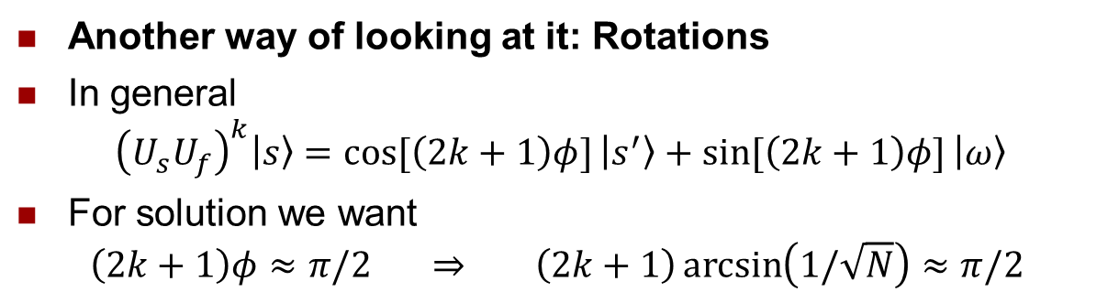
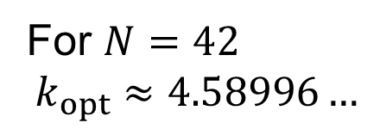
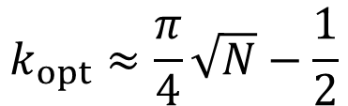
Grover’s search algorithm
1996
Another way of looking at it: Rotations
In general
$${\left(U_{s}U_{f}\right)}^{k}|s〉=\cos{[\left(2k+1\right)φ]}|s^{′}〉+\sin{[\left(2k+1\right)φ]}|ω〉$$
For solution we want
$$\left(2k+1\right)φ≈π/2 ⇒ \left(2k+1\right)\arcsin\left(1/\sqrt{N}\right)≈π/2$$
$$|ω〉$$
Lov Grover
$${\left(U_{s}U_{f}\right)}^{5}|s〉$$
$${\left(U_{s}U_{f}\right)}^{3}|s〉$$
$${\left(U_{s}U_{f}\right)}^{2}|s〉$$
$$k_{opt}≈\frac{π}{4}\sqrt{N}−\frac{1}{2}$$
$$11φ$$
$$U_{s}U_{f}|s〉$$
For $N=42$
$$k_{opt}≈4.58996…$$
$$|s〉$$
$$φ$$
$$|s′〉$$
$$U_{f}|s〉$$

Slide 93
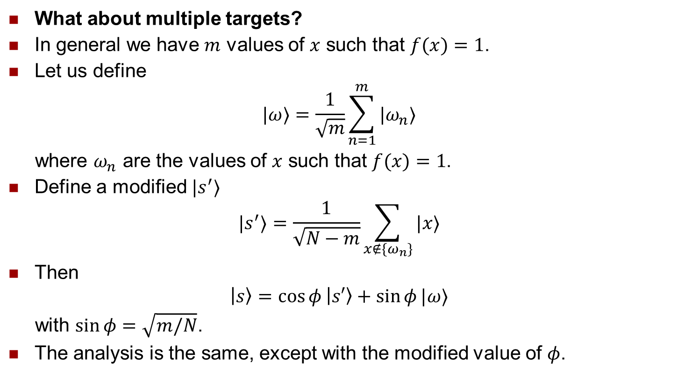


Grover’s search algorithm
1996
What about multiple targets?
In general we have $m$ values of $x$ such that $f(x)=1$.
Let us define
$$|ω〉=\frac{1}{\sqrt{m}}\sum_{n=1}^{m}{|ω_{n}〉}$$
where $ω_{n}$ are the values of $x$ such that $f(x)=1$.
Define a modified $|s^{′}〉$
$$|s^{′}〉=\frac{1}{\sqrt{N−m}}\sum_{x∉\{ω_{n}\}}{|x〉}$$
Then
$$|s〉=\cos{φ}|s′〉+\sin{φ}|ω〉$$
with $\sin{φ}=\sqrt{m/N}$.
The analysis is the same, except with the modified value of $φ$.
Lov Grover
Define projector
$$P_{ω}=\sum_{n=1}^{m}{|ω_{n}〉〈ω_{n}|}$$
and reflector
$$U_{f}=𝕀−2P_{ω}$$
$$k_{opt}≈\frac{π}{4}\sqrt{N} becomes k_{opt}≈\frac{π}{4}\sqrt{\frac{N}{m}}$$

Slide 94
What makes a quantum algorithm potentially faster than any classical one?
Quantum parallelism: by using superpositions of quantum states, the computer is executing the algorithm on all possible inputs at once
Dimension of quantum Hilbert space: the “size” of the state space for the quantum system is exponentially larger than the corresponding classical system
Entanglement capability: different subsystems (qubits) in a quantum computer become entangled, exhibiting nonclassical correlations

Slide 95
Quantum algorithms research
Require more quantum algorithms in order to: solve problems more efficiently
understand the power of quantum computation
make valid/realistic assumptions for information security
Problems for quantum algorithms research:
requires close collaboration between physicists and computer scientists
highly non-intuitive nature of quantum physics
even classical algorithms research is difficult

Slide 96
Summary of quantum algorithms
It may be possible to solve a problem on a quantum system
much faster (i.e., using fewer steps) than on a classical computer
Factorization and searching are examples of problems where quantum algorithms are known and are faster than any classical ones
Implications for cryptography, information security
Study of quantum algorithms and quantum computation is important in order to make assumptions about adversary’s algorithmic and computational capabilities
Leading to an understanding of the computational power of quantum vs classical systems

Slide 97
Summary
Extended Hamiltonian path algorithm for cubic bipartite graphs [Rudolph’s]
For TSP and Moving-Target TSP, paths superposition can be obtained in linear time
Grover’s search algorithm works in time SQRT of # of objects in superposition
2^{n} different paths: total time is O(2^{n/2} )
Notes:
In conclusion, I extended Rudolph’s algorithm to work for all graphs. The algorithm can then be altered to find hamiltonian cycles, the solution to TSP and the solution to Moving-Target TSP. For all three of these, the superposition can be obtained in linear time. But, since Grover’s search algorithm works in SQRT of # of object in superposition, and the total number of object in the superposition is 2^N, the total time is O(2^{N/2})

Slide 98
Conclusion
In 2001, a 7 qubit machine was built and programmed to run Shor’s algorithm to successfully factor 15.
What algorithms will be discovered next?
Can quantum computers solve NP Complete problems in polynomial time?

Slide 99
Future Work
Faster algorithm for (Moving-Target) TSP
Improve Grover’s search algorithm
P=NP for quantum computation?
Notes:
Future work that will be beneficial would be to find a faster algorithm for TSP and M-T TSP. This could be done by improving Grover’s search algorithm, or it is probably likely that there is a “trick” or something that would eliminate most of the paths that were not going to lead to anywhere. Finally, it is still unknown if P=NP for a quantum computer. It seems that this should be true since the number of paths that can be followed is exponential. But, if there is no way to read out the paths that are desired, it doesn’t really matter how many different paths you can travel.

Slide 100
Circuit
j
i
a
V
A
b
c
a
j+1
b
c
a,b,c are the nodes adjacent to I
A is the register keeping track of which nodes
have been traversed
Notes:
This is the circuit Rudolph created for each step. I is the Node that we’re interested in. A,b,c are the nodes that are adjacent to I. Register A is the parity register and register j and register j+1 are the registers holding which nodes were visited on that step. This circuit is the reason that this algorithm only works for cubic bipartite graphs.

Slide 101
Finding the Minimum
Measure the lengths register (M)
Create superposition again
Now search for all paths < M
On average, do this log(k) times
k is the number of items in the superposition
Notes:
This slide simply describes how to find the minimum it could probably be removed.

Slide 102
Sound Waves
Bullets
Electrons
Observed Electrons
Notes:
Here I just want to recap the whole experiment. When electrons are not observed, they act as waves- they traverse both slits at the same time. But, when we do observe the electrons, they act as bullets.

