Slide 1









AZORIAN DPWH027

Slide 2


Thermal Sentinel
Vision: To eliminate "Energy Vampires" in the global supply chain, ensuring every refrigerated container (reefer) moving through a DP World terminal operates at peak thermal efficiency.
Team Roles:
ML Architect: Developing the YOLOv8 and Anomaly Detection pipeline.
Full-Stack Developer: Building the Streamlit control center and FastAPI integration.
Logistics Strategist: Aligning the solution with EU CBAM and DP World Ocean Strategy 2024–2030.
Hardware/Simulation Lead: Crafting the physical "Smart Gate" demo.
2

Slide 3


PROBLEM STATEMENT
The Invisible Leak: Refrigerated containers (Reefers) are the most energy-intensive assets in a port. A single worn-out door gasket or a microscopic structural fissure causes "thermal bypass," forcing cooling units to consume up to 40% more electricity to maintain internal temperatures.
Regulatory & Financial Pressure: EU CBAM (2026): Importers will soon pay heavy taxes on the "embedded carbon" of their cargo. Inefficient reefers directly inflate these costs.
Maintenance Blind Spots: Manual inspections are slow, subjective, and physically impossible to perform on every unit in a high-volume terminal like Jebel Ali or London Gateway.
Target: DP World Terminal Operators and "Blue-Chip" shipping partners looking to hit Scope 3
emissions targets.
3

Slide 4

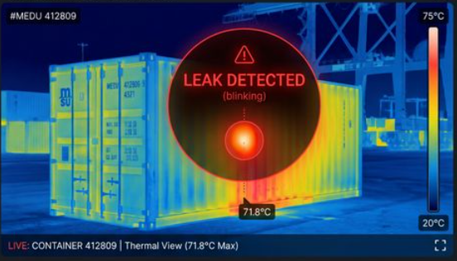
PROPOSED SOLUTION/SOLUTION OVERVIEW
The "Smart Gate" Audit: We propose an automated thermal imaging corridor integrated into DP World’s existing "Smart Gates".
How it Works:
Automated Capture: As a truck passes, long-wave infrared (LWIR)
sensors capture a high-resolution thermal signature of the container.
Computer Vision Filtering: Machine Learning (YOLOv8)
isolates the container from the truck and identifies key "Leak Zones"
such as door seals, T-bar floors, and cooling unit vents.
Real-Time Analytics: The system compares the thermal signature
against a "Digital Twin" of a perfect reefer. Any temperature delta (ΔT)
exceeding 5°C at the seals triggers an alert.
4

Slide 5
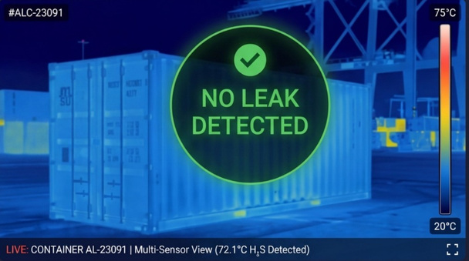
PROPOSED SOLUTION/SOLUTION OVERVIEW
Autonomous Maintenance Triggers: The solution doesn't just display data; it acts. The "Thermal Sentinel" API pushes a repair ticket directly to DP World’s CARGOES ZMS (Zone Management System).
Secondary Safety Feature (The Firewall):
By scanning dry containers for internal "hot spots," the system
detects thermal runaway in Lithium-ion battery shipments before
they ignite, preventing catastrophic port fires and protecting marine
life from chemical runoff.
Customer Value:
Shippers receive a "Green Certificate" proving their
cargo was transported in a thermally optimized vessel, providing a
competitive advantage in the European market.
5

Slide 6
TECHNOLOGY STACK
1. Computer Vision & Machine Learning (The "Brain")
* Python: The core programming language for the entire project.
* Ultralytics YOLOv8: The AI object detection model (used to instantly identify the shipping container doors in a video feed).
* OpenCV (cv2): The computer vision library. You will use it to turn your normal 1080p webcam video into a simulated thermal "heatmap" and to calculate the mathematical threshold of "hot pixels" (the leak).
* *NumPy: Used for the fast mathematical array calculations on the video frames.
2. The Backend Server (The "Engine")
* FastAPI: A lightning-fast modern Python framework used to create the API endpoint that receives the leak warning from the camera.
* Uvicorn: The web server that runs FastAPI.
* SQLite: A lightweight database (built completely into Python) to keep a history log of every truck that passes the gate, so your dashboard has data to pull from.
3. The Frontend Dashboard (The "Face")
* Streamlit: An amazing Python library that lets you build incredibly professional, dark-mode web dashboards with charts
and metrics without needing to write a single line of HTML, CSS, or React.
* Pandas: Used strictly to format the SQLite database history logs into beautiful tables on the Streamlit dashboard.
6

Slide 7
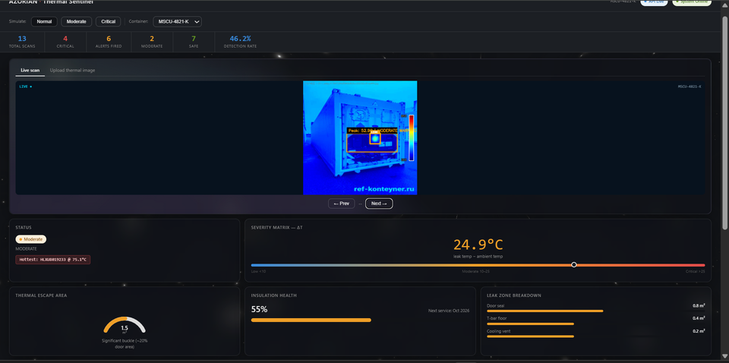
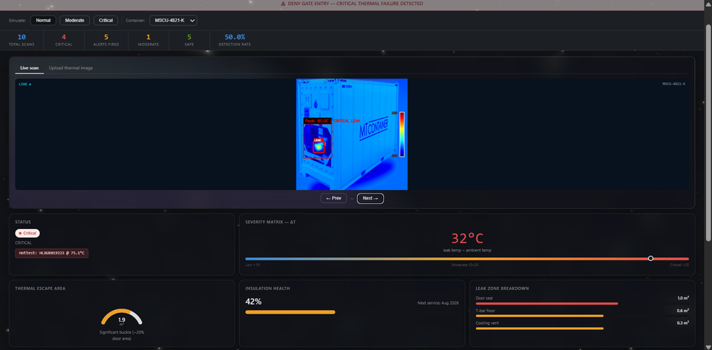
WORKING PROTOTYPE
YOLOv8-Driven Thermal Signature Analysis
Autonomous Edge Processing: The prototype utilizes YOLOv8 to instantly isolate refrigerated containers from transport vehicles in a live video feed.
Leak Zone Identification: The computer vision model identifies high-risk "Energy Vampire" zones, specifically focusing on door seals, T-bar floors, and cooling unit vents.
Thermal Mapping & Thresholds:
Converts standard video feeds into a simulated high-resolution LWIR (Long-Wave Infrared) signature.
Calculates "hot pixel" mathematical thresholds to detect microscopic structural fissures.
Digital Twin Comparison: The system live-compares the current thermal signature against a "Digital Twin" of a baseline efficient reefer to determine efficiency loss
7

Slide 8
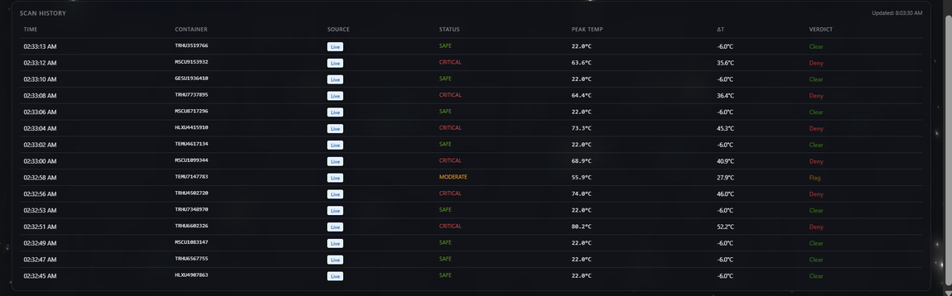
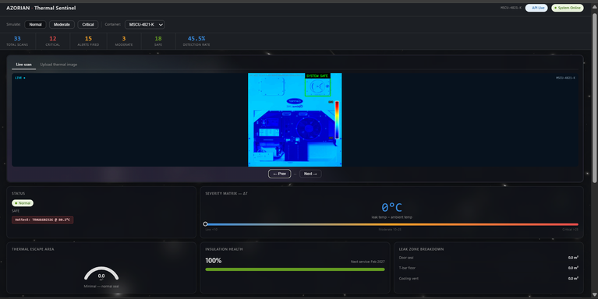
WORKING PROTOTYPE
Streamlit Dashboard & Automated Maintenance Workflow
Comprehensive Telemetry Dashboard: A dark-mode Streamlit frontend provides terminal operators with real-time visibility into port-wide thermal health.
Critical Metrics & Severity Matrix:
$\Delta T$ (Temperature Delta): Tracks the difference between leak temperature and ambient temperature, triggering alerts when the delta exceeds $5^{\circ}\text{C}$.
Thermal Escape Area: Quantifies physical energy loss (e.g., $1.9\text{ m}^2$ "Significant Buckle" alert).
Data-Driven Maintenance (Logistics Engine):
Scan History Logs: A FastAPI backend and SQLite database maintain a permanent audit trail of every container passing the "Smart Gate".
Automated Ticketing: Triggers autonomous repair tickets directly to the CARGOES ZMS when critical insulation health (e.g., $<45\%$) is detected.
Sustainability Tracking: Calculates detection rates and insulation health to provide the "Green Audit Trail" required for EU CBAM (2026) compliance.
7

Slide 9
MARKET ANALYSIS
1. Capturing High-Growth Corridors
The Surge: Global reefer market scaling to $900B+ by 2030.
Regional Play: Securing the India-Africa-Europe corridors for high-value Pharma and Food exports.
The Moat: High "Perishability Risk" in these regions makes Thermal Shield a must-have reliability standard, not an option.
2. Monetizing the "Sustainability Gap"
The Demand: 81% of shippers prioritize Green Logistics but lack granular efficiency data.
The Pivot: Shifting from "Port Operator" to "Efficiency-as-a-Service" (EaaS).
The Value: Providing the "Green Audit Trail" shippers need to justify Net-Zero compliance to stakeholders.
3. Regulatory Defense (EU CBAM 2026)
The Hammer: EU Carbon Border Adjustment Mechanism (CBAM) now taxes "Embedded Carbon" in 2026.
The Edge: Thermal Shield minimizes carbon-tax liabilities for importers.
Preferred Partner: Positions DP World as the #1 compliant gateway for carbon-conscious global trade.
4. First-Mover Advantage
Beyond the Visible: Moving from "Physical Damage" checks to "Invisible Energy Waste" detection.
The Tech Barrier: Proprietary ML models trained on unique port-gate thermal signatures.
The Lock-in: Creating a high-entry barrier that traditional logistics competitors cannot easily replicate.
8

Slide 10
BUSINESS CASE
Investment: Low-cost infrastructure using standard thermal sensor arrays combined with cloud-based software.
The $2M Saving Narrative:
Energy Recovery: By identifying the most inefficient 5% of refrigerated containers (reefers), companies can save around 720 kWh per long-haul journey, significantly reducing energy costs.
Carbon Tax Mitigation: Lowering “embedded carbon” emissions helps reduce exposure to carbon taxes like the EU’s CBAM, ultimately saving money for DP World’s clients.
Preventive Maintenance: A simple $10 gasket replacement today can prevent a $10,000 cargo spoilage loss, making early detection extremely cost-effective.
9

Slide 11
INNOVATIVE ASPECTS
Non-Intrusive: The system works without interrupting operations—thermal scans are performed while trucks move at speeds up to 20 km/h, ensuring zero downtime.
Scalable: The solution can be rolled out across all 70+ DP World terminals through a simple software deployment, making expansion fast and cost-effective.
Multi-Purpose: A single machine learning model supports multiple use cases, including energy efficiency optimization, carbon emission reporting, and fire risk detection.
10

Slide 12
THANK YOU
11

