Slide 1
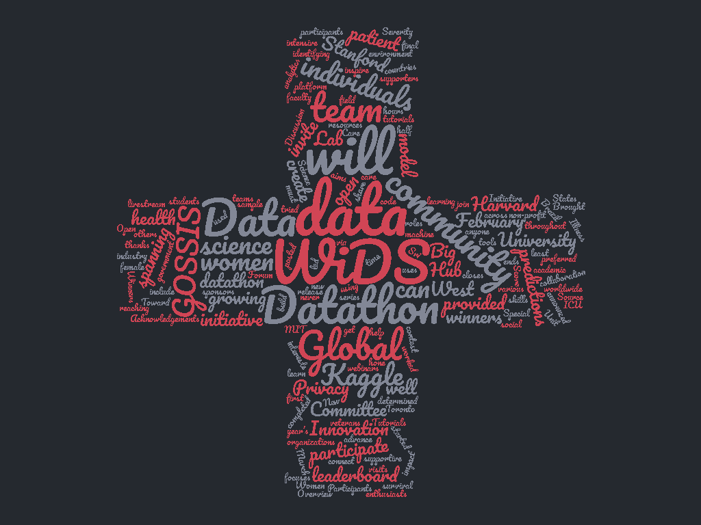

Slide 2







What were we solving?
WiDS Datathon 2020
focused on patient health
through data from
MIT’s GOSSIS (Global Open Source Severity of Illness Score) initiative.
The challenge was to create a model that uses data from
the first 24 hours of intensive care to predict
patient survival.

Slide 3
Research Questions
• What features influence the survival of the patients the most ?
• How does age affect patient survival ?
Are older patients at higher risk irrespective of the condition?
• Is there any strong correlation between disease/Condition and the number of fatalities ?
• Is there a correlation between disease/Condition and patient
admissions and readmissions?

Slide 4

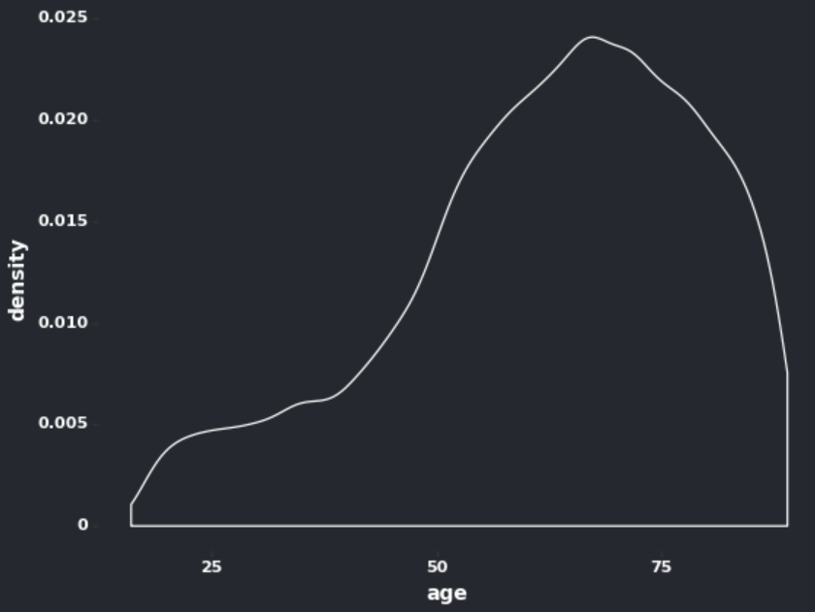
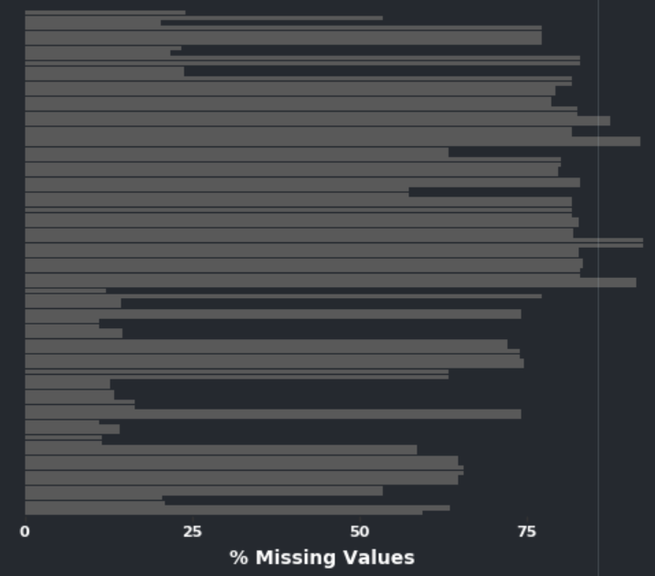
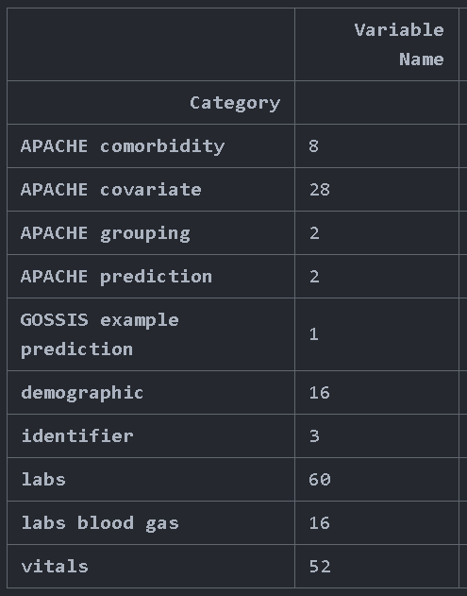
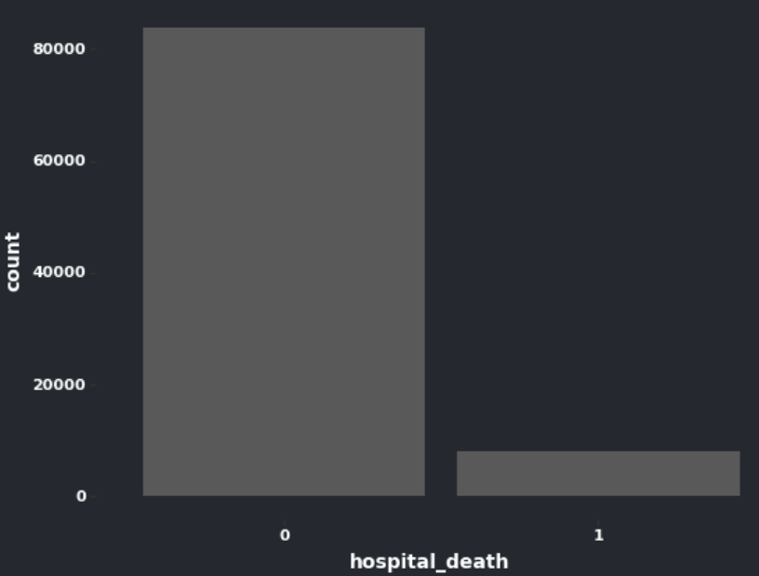
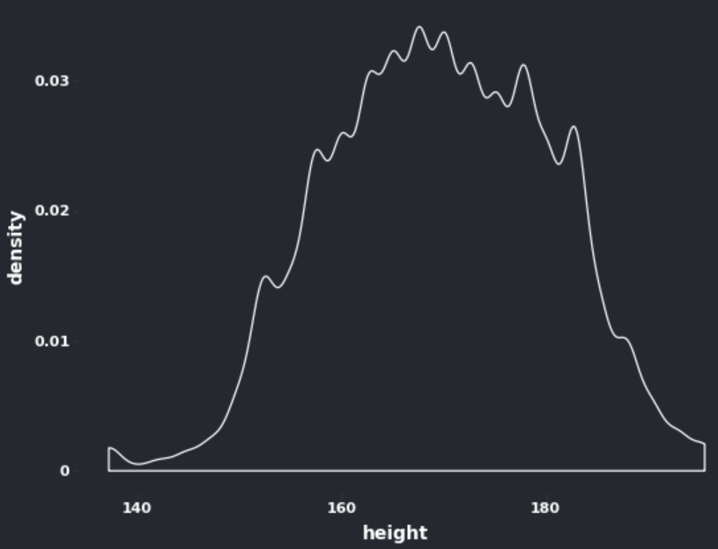
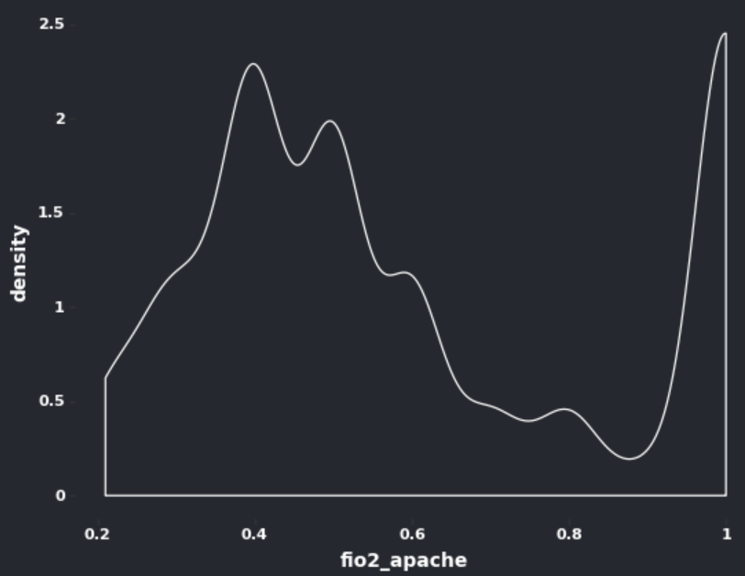
Data
Messiness
Shape
Skews
Missing Values
Column Categories
Target Variable

Slide 5
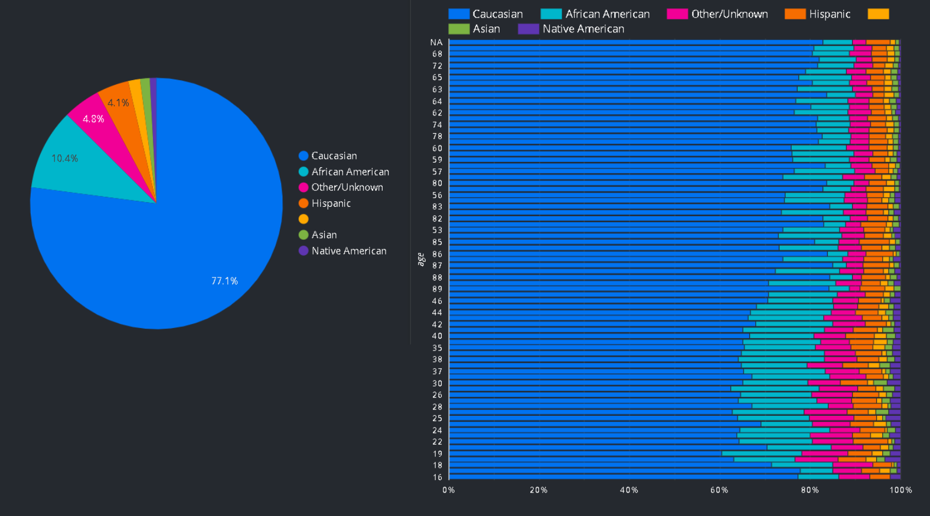
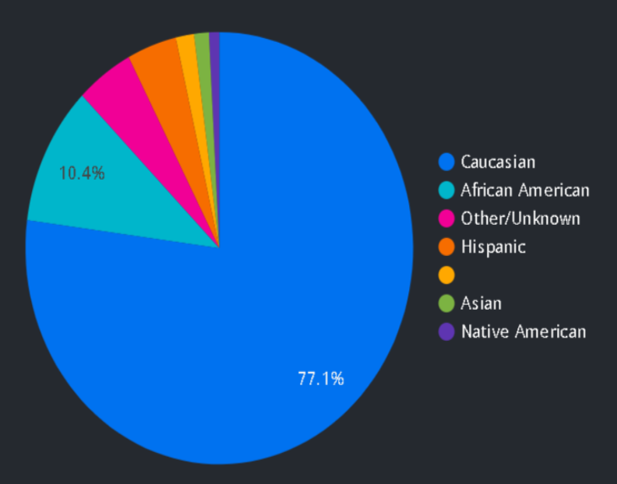
EDA

Slide 6
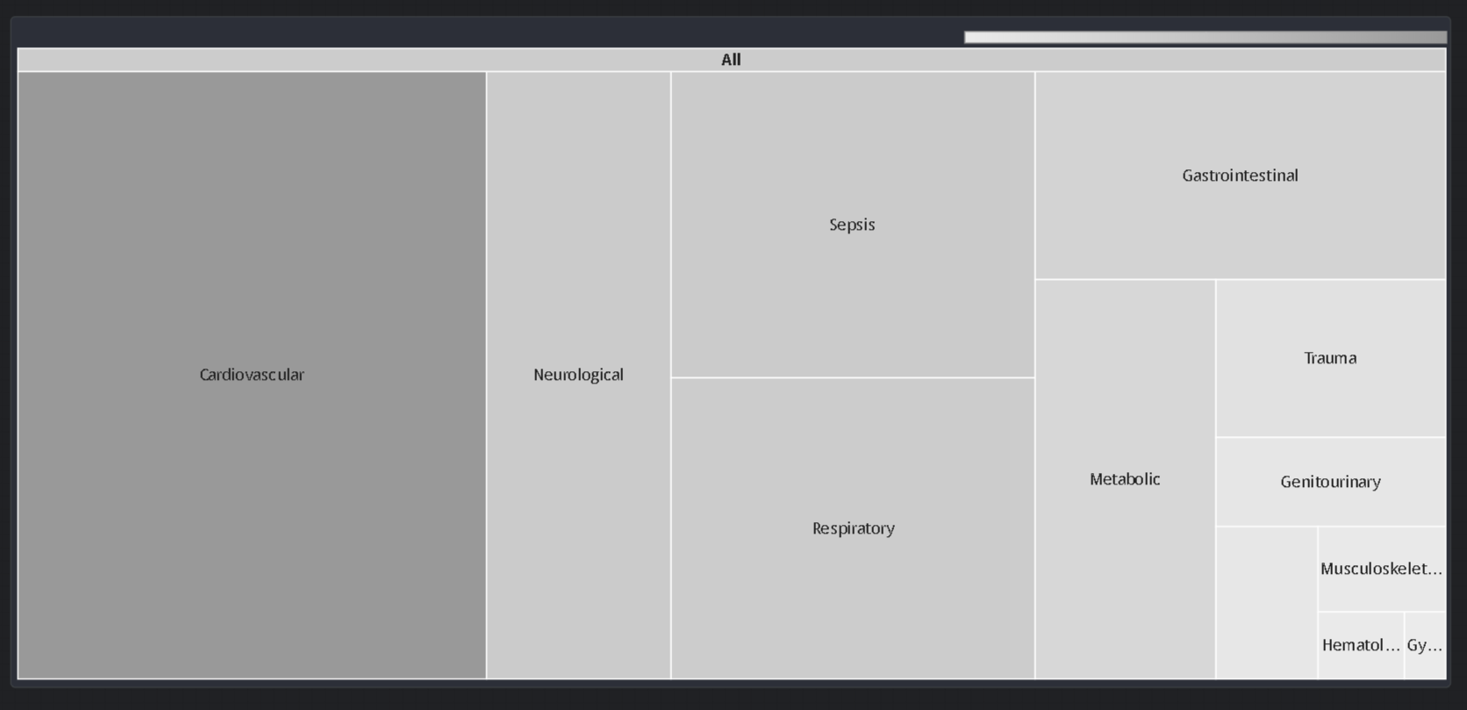
EDA

Slide 7
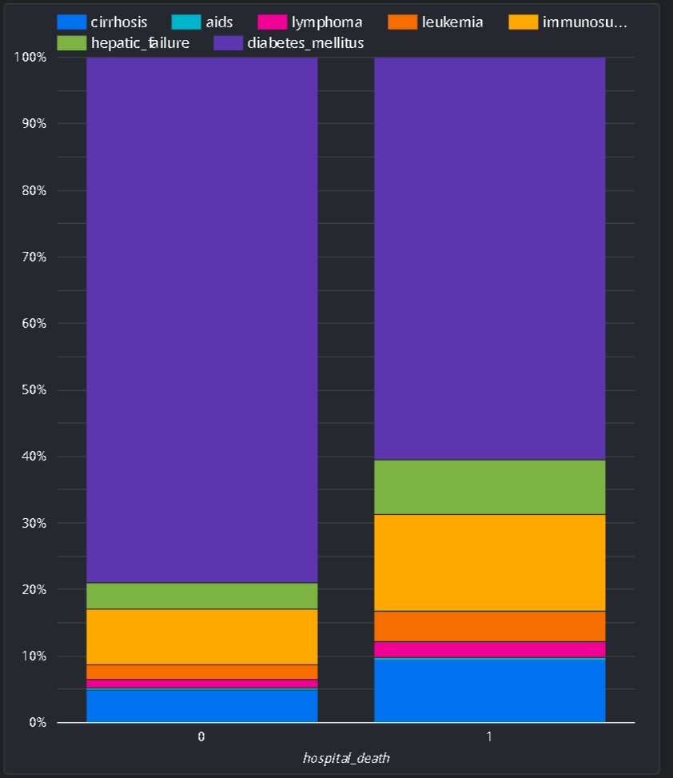
EDA

Slide 8
Major Challenges/Concerns
Challenge | Solution
Data missing at random | Imputation Approaches
High Dimensionality | Feature Engineering
Correlated features | Feature Engineering
Computational time | Cloud
Imbalanced data | Resampling
Different approaches involved going back and forth to data preprocessing, imputation and feature selection
Cost involved in use of cloud resources

Slide 9

What all we tried
Imputation Approaches | Feature Engineering | Modelling
Simple Imputation | PCA | Random Forest
Knn Imputation | Agglomerative Clustering | NNet
KDTree | ANNOVA Feature selection | XGBoost , LGB
Random Forest Imputation | Random Forest Feature selection | Stacking - Sequential and SVM
Variance Based Drop Column | Genetic Algorithm | Logistic Regression Keras Sequential Model
Outlier Detection

Slide 10
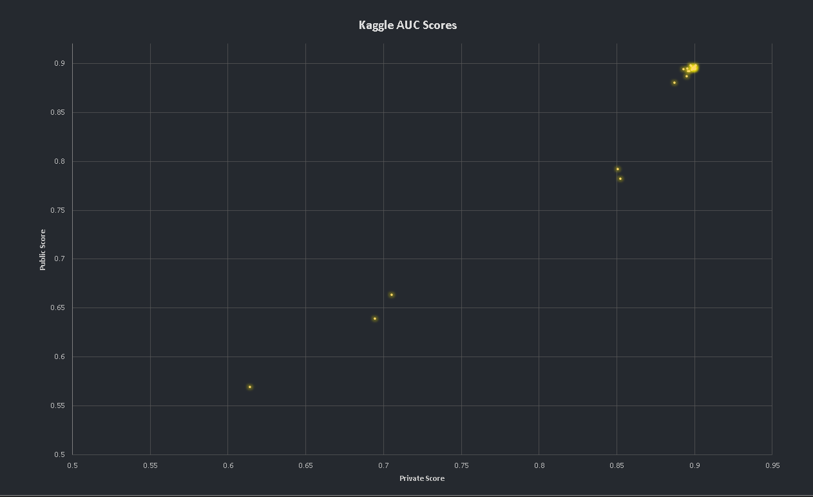
How close we came?
0.914947
Top Kaggle score
Notes:
Vivek add your score in "How close we came"
score and rank

Slide 11
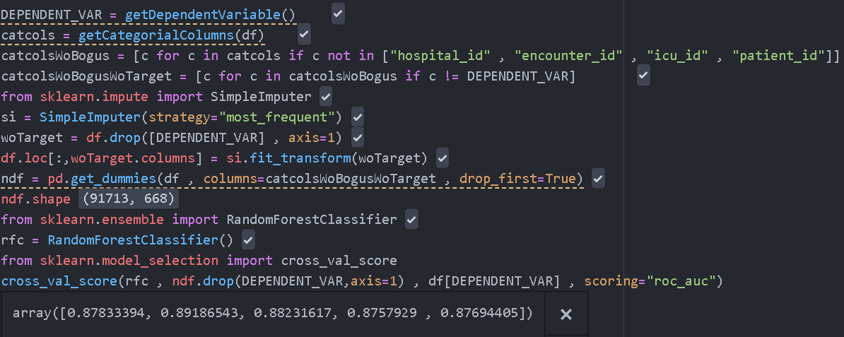
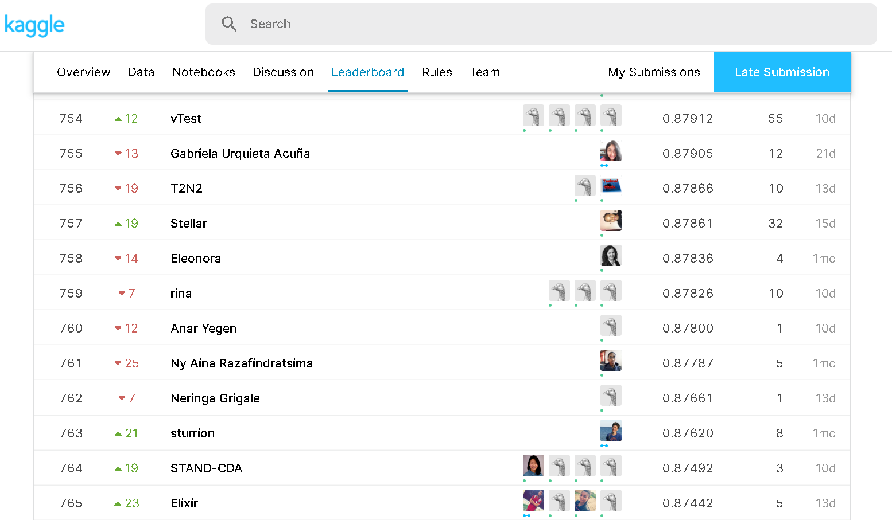
Baseline
Missing values
Categorical Columns
Modelling
Score
0.878
760/940

Slide 12
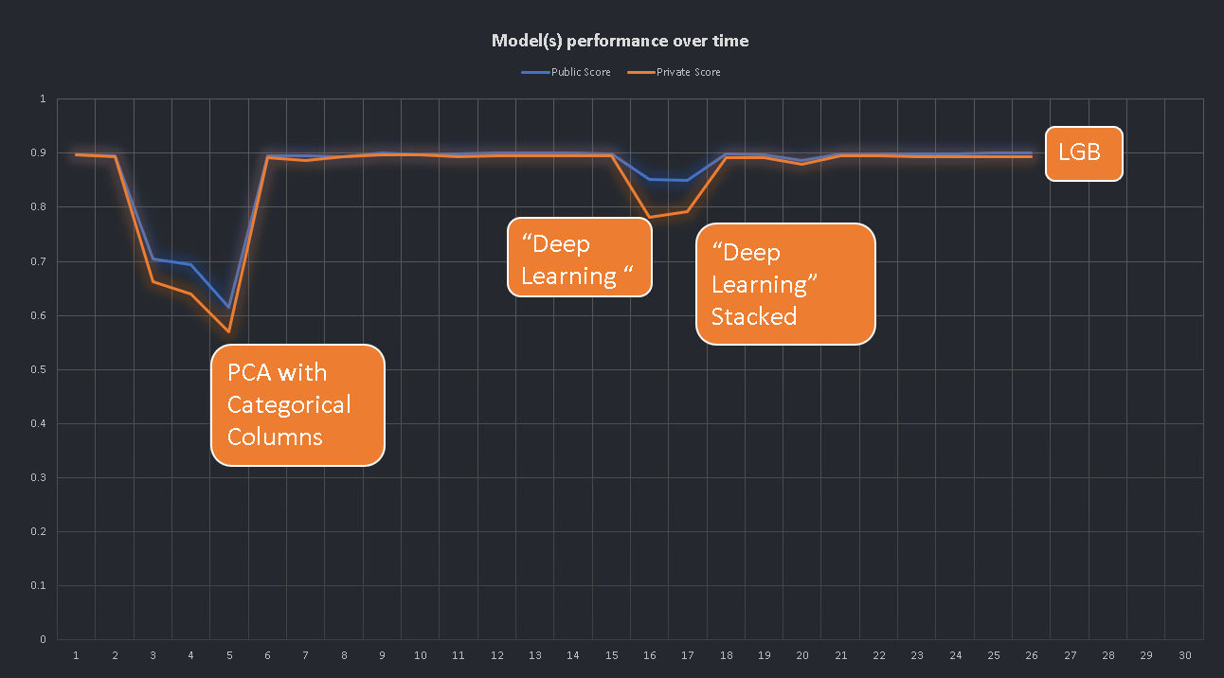
Notes:
Vivek add your score in "How close we came"
score and rank

Slide 13
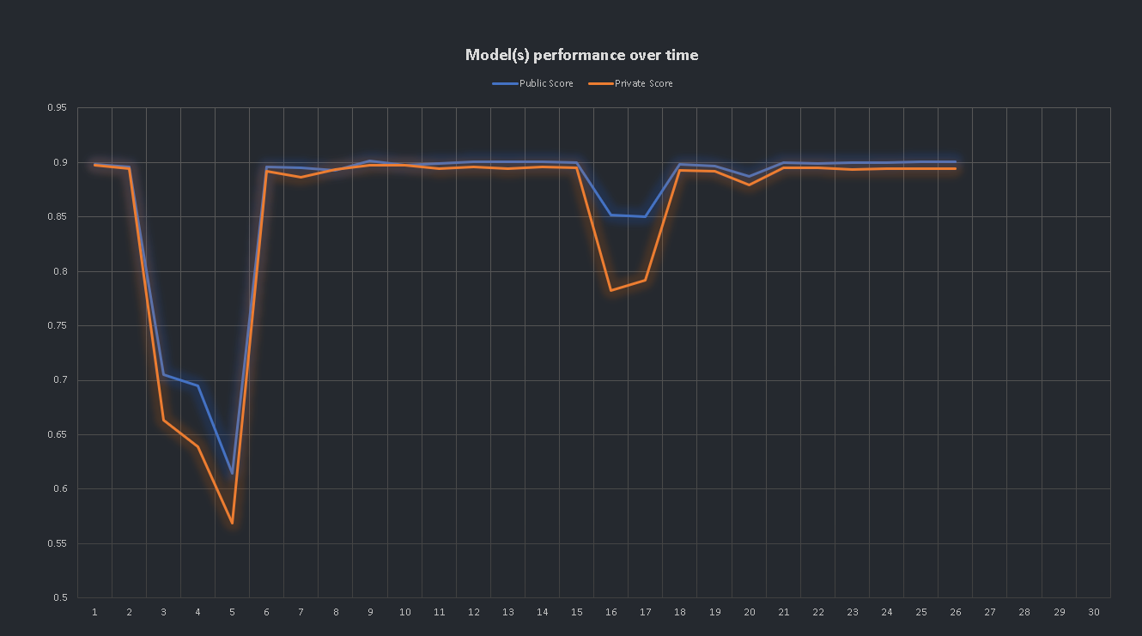
Notes:
Vivek add your score in "How close we came"
score and rank

Slide 14
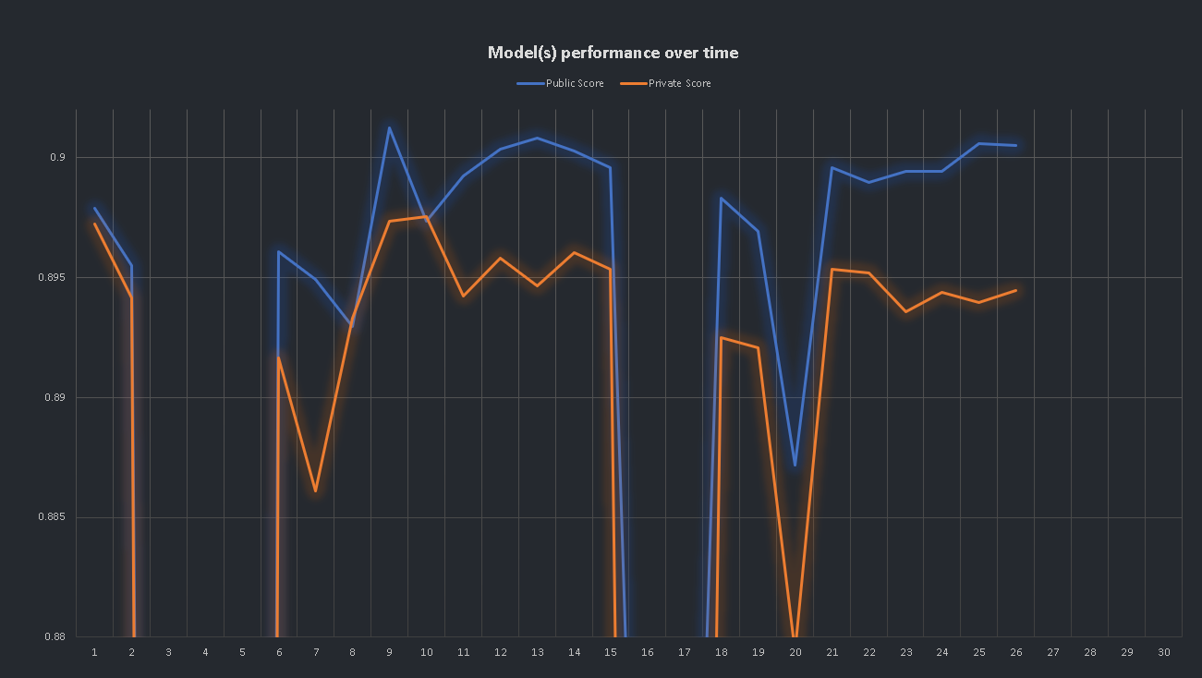
Notes:
Vivek add your score in "How close we came"
score and rank

Slide 15
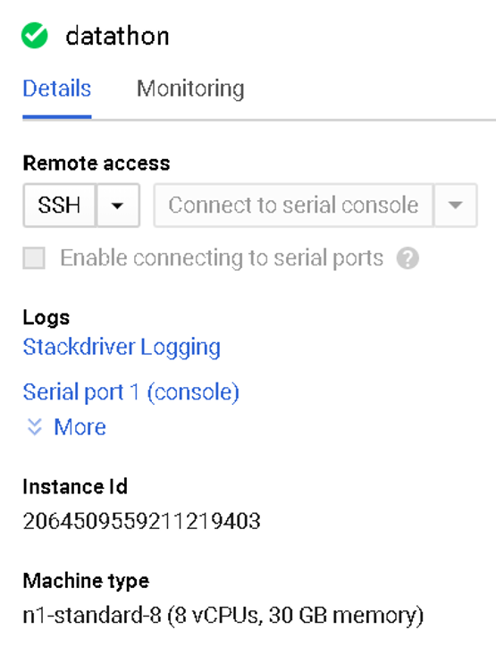
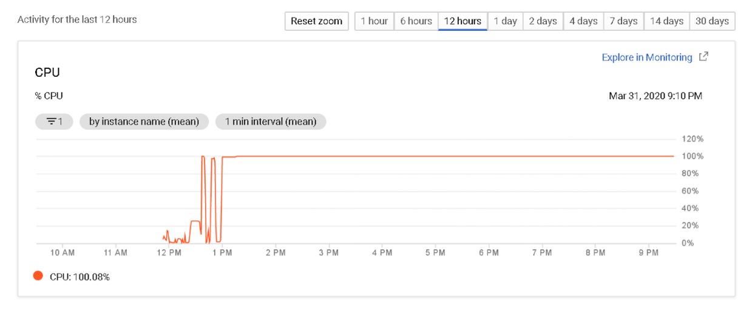

Cloud

Slide 16
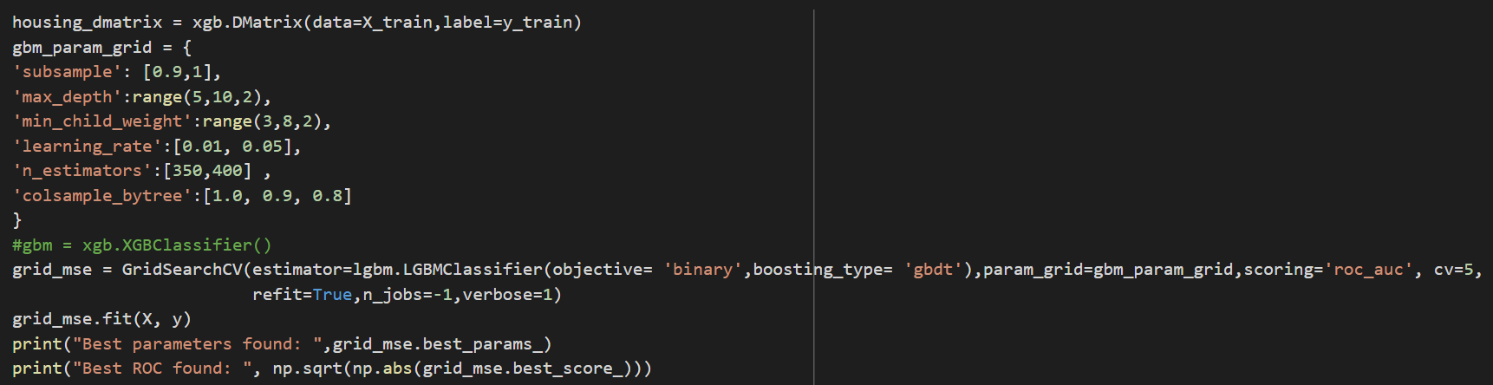
Best Model
The best model obtained so far was using LightGBM with hyperparameter tuning
Notes:
Vivek can you make it “grey” background ?

Slide 17
What we learnt the hard way
Feature Engineering is the Key
Hyper-parameter tuning is blah
Debugging your model as important as for any software

Slide 18
What we learnt the hard way
Feature Engineering is the Key
Data issues
We don’t know what we don’t know
Missing values are a pain
Correlation doesn’t mean you drop features
“Apes together strong”
Common Sense and Occam’s Razor
Cycle Time becomes important when testing different approaches

Slide 19
What we learnt the hard way
Hyper-parameter tuning is blah
Telescopic Search
Eliminate large search spaces
Zoom in later
Cloud is your new best friend
Combinatorial Explosion
Better to use Better hardware when brute forcing your way through

Slide 20
What we learnt the hard way
Debug your model
Confusion Matrix
Try to see why it’s confused
Learning Curves
Is it a bias issue or a variance issue ?

Slide 21
Key Takeaways
Consult your doctor before taking any medicine
Don’t underestimate the importance of data preprocessing, imputation,feature selection/extraction.
While modelling is important, techniques to take advantage of distributed computing is equally important, especially when it comes to hyper parameter tuning.
Issue of Data leakage
It is important to create process pipeline since lot of times we may have to go back and make changes.
Importance of creating dumps of trained model.

Slide 22
What worked/ didn’t work ?
Missing values | Feature Engineering | Modelling
Simple Imputation | PCA | Random Forest
Knn Imputation | Agglomerative Clustering | NNet
KDTree | ANNOVA Feature selection | XGBoost , LGM
Random Forest Imputation | Random Forest Feature selection | Stacking
Variance Based Drop Column |  | Logistic Regression
Notes:
Add why it worked or didn’t work. Reason why

