Slide 1
LENDING CLUB CASE STUDY SUBMISSION
Name : Arpitha Upadhyaya
Vivek Reddy Chinasani

Slide 2
Abstract
The idea of this presentation is to show the patterns which can help the firm to provide a loan to a person or not. The objective of the firm is to analyse the past data (between 2007 to 2011) of the customers and see if any patterns in the data which can help us find out if any customer can default a loan. Borrowers who default cause the largest amount of loss to the lenders. In this case, the customers labelled as 'charged-off' are the 'defaulters’.
The following presentation, the company wants to understand the driving factors behind loan default, i.e. the variables which are strong indicators of default. The company can utilize this knowledge for its portfolio and risk assessment.

Slide 3
Data Understanding
Data Cleanup
Remove null columns
Data Analysis
.Identify driving factors using Univariate and bivariate analysis with various plots to identify predictors of defaults
Read the csv file and do the initial check for data.
Conclusions
Identify predictors of default using the various analysis points.
Check for datatypes
Identify the target columns.
Remove columns with high percentage of null values.
Remove rows with null values.
Remove outlier data.
Get rid off Current variables.
Ignore customer behavior Variables

Slide 4
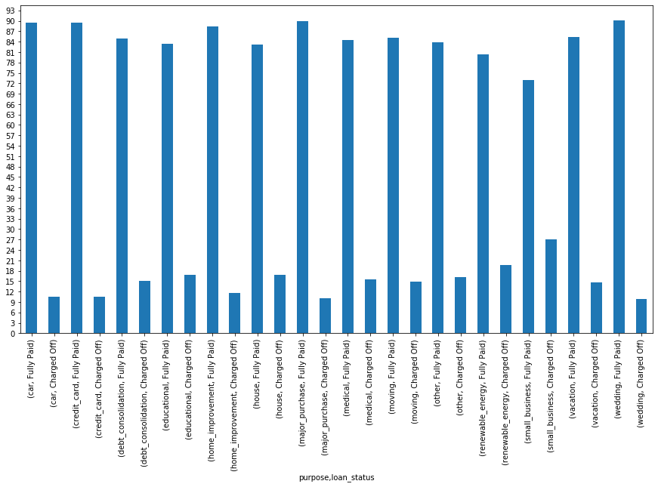
Analysis
Purpose and
Charged off
percentage
Small business
Have high defaulters

Slide 5
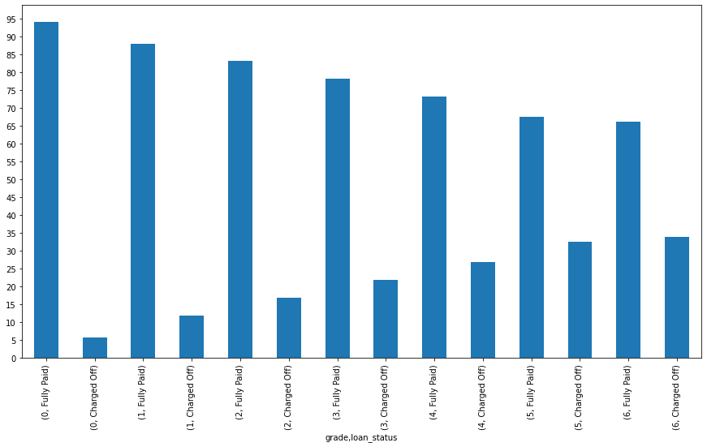
Analysis
Grade and Loan Status
Grade (0-6 is A-G 0 is A and G is 6)
A is having least charged off people
F and G have highest charged off people.

Slide 6
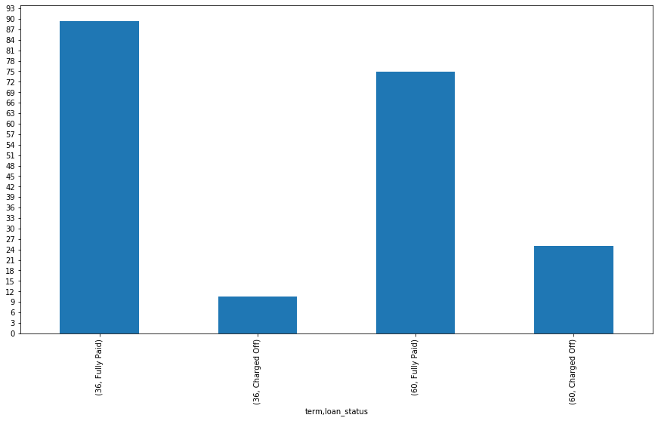
Analysis
Term and Loan Status
Term 36 and 60 months
60 months have 25 % charged off people
36 months people have 10 %charged off.

Slide 7
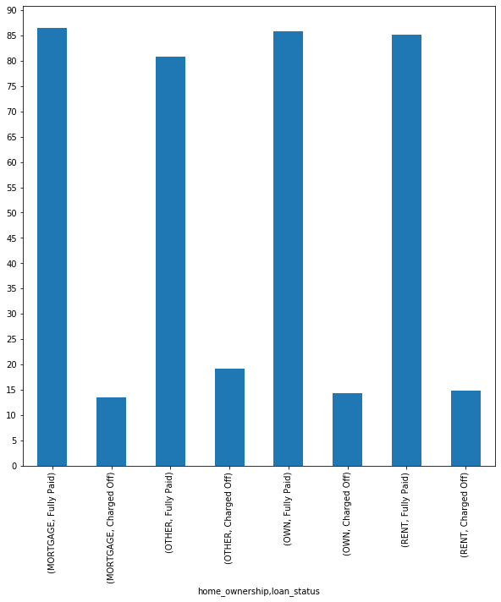
Analysis
Home Ownership and Loan Status
Not a great difference in values .

Slide 8
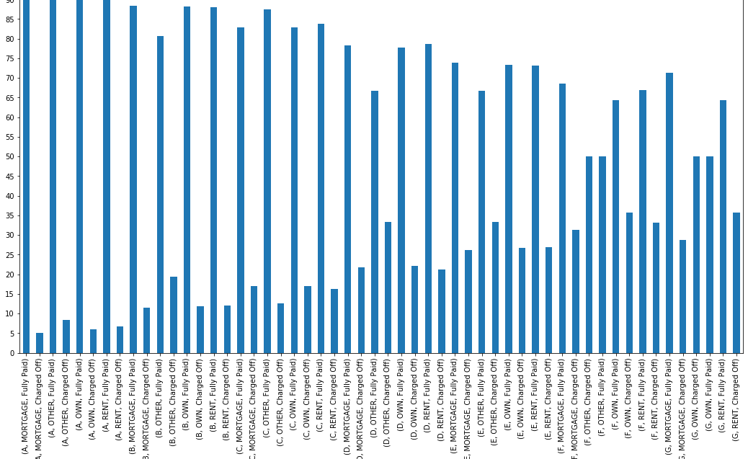
Analysis
Grade,Home Ownership vs loan status.
F grade with ‘other’ home ownership have 50% charged off people.
G with Own home ownership have 50% charged off people.

Slide 9
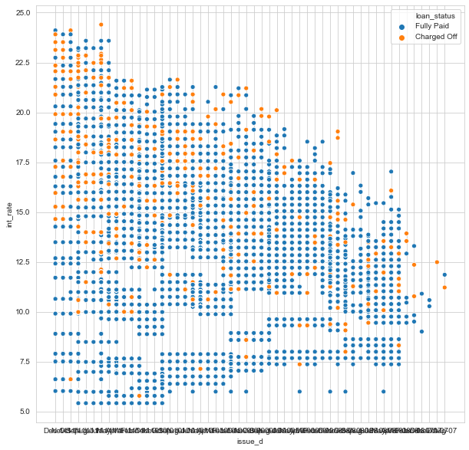
Analysis
Issue_date and int_rate.
As interest rate increases the charged off percentage increases.

Slide 10
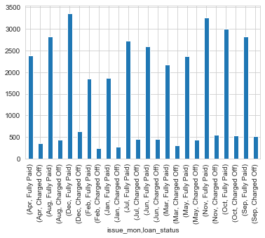
Analysis
Issue month and number of loans
More loans were given in the months October, November and December.

Slide 11
Conclusions
1
Top 3 Characters for a person who is likely default:
Grade is the most important factor .People with F and G are most likely to default.
Interest rate is one more important factor higher the interest rate more is the default rate.
Term is one other important factor . People with 60 months loan have higher default rate.
Other important Conclusions:
Small business people are more likely to default.
A group people are less likely to default.
A1 subgroup and with Home ownership as OWN has less than 1% chance of defaulting.
F grade with ‘other’ home ownership have 50% charged off people.
G with Own home ownership have 50% charged off people
F,G group people have around 40% chance of defaulting when interest rate is more than 20%.
More loans are issued in the months of October,November and December.

Slide 12
Conclusions
1
More loans are issued in the months of October, November and December.
Employee length has not much affect on default rate.
10+ employee length people have taken more loans.
2010 and 2011 have more number of loans issued.
Fully paid group people have median values of interest around 10-12.5% and charged off people have interest rates of around 12.5 to 15.
Recoveries and collection recovery fee is directly related to Charged off column but it is being ignored as it isknown only after the loan is issued.
Note:All the plots are not presented here because of size .Kindly refer for more plots in the python file.

