Slide 1



Slide 2

The first digital EMI in India
Enabling your customers to finance their online purchases anytime, in a simple and transparent way.
Without the need for a credit card

Slide 3
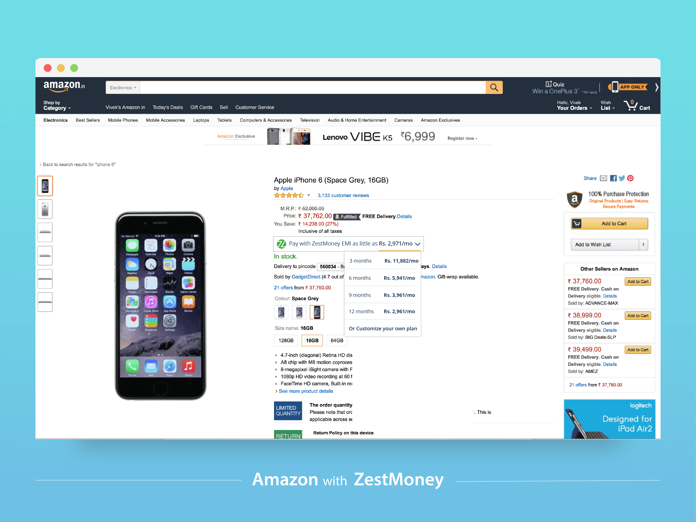

Slide 4
Minimal credit card penetration
Credit card vs. debit card issuance (m)
Debit card growth shows consumer comfortable with non-cash methods
20m credit cards in issuance in India, and less than 10m unique customers
Alternative offline credit solutions such as consumer durables and gold lending have filled some of the latent demand, but the young, urban digital consumer is still largely under-served

Slide 5
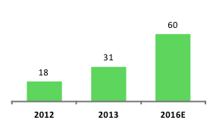
Why Zest?
Only 10m people have a credit card in India & growing at less than 1% per annum
As consumer demand grows, affordability is and will continue to be a problem for the Indian shopper
Indian consumer mind-set is changing, EMI is acceptable way to finance life…in fact preferable to traditional credit card or personal loan
Average order sizes will only increase if financing offered
Indian online shopping - average order value ($) needs to double by 2016
2015 US Average order value: $78

Slide 6

Zest boosts sales
Boosts conversions
Items become instantly affordable
Increases average order value
Higher value items affordable
Shoppers “upsize” their purchase
Attract a new segment
Customers who would previously go offline for deals can shop online
EMI appeals to a younger crowd who don’t want a credit card or personal loan
Retention tool
Solve a real pain point
Customers naturally increase loyalty to merchants who provide credit

Slide 7

Zest empowers customers, enabling them to spread the cost of high ticket items
Zest helps customers with time sensitive purchases, such as travel, special offers and discounts

Slide 8
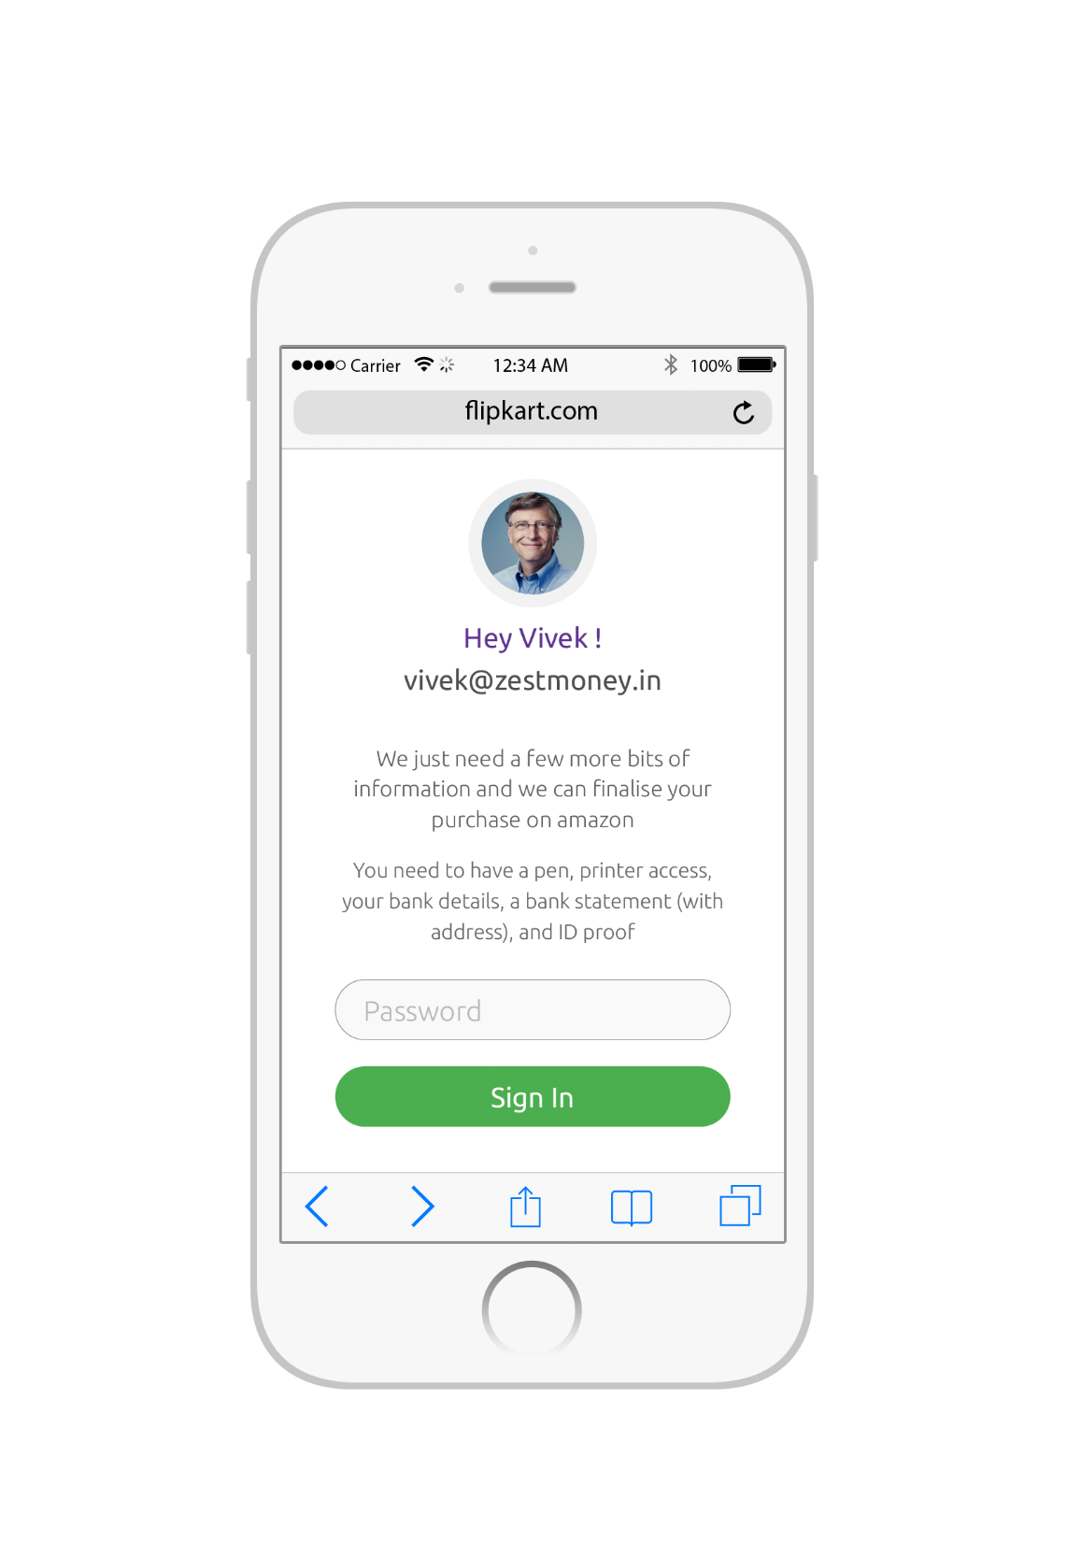
Zest delivers an awesome customer experience!
Instant easy check out
Easy to manage monthly payments

Slide 9
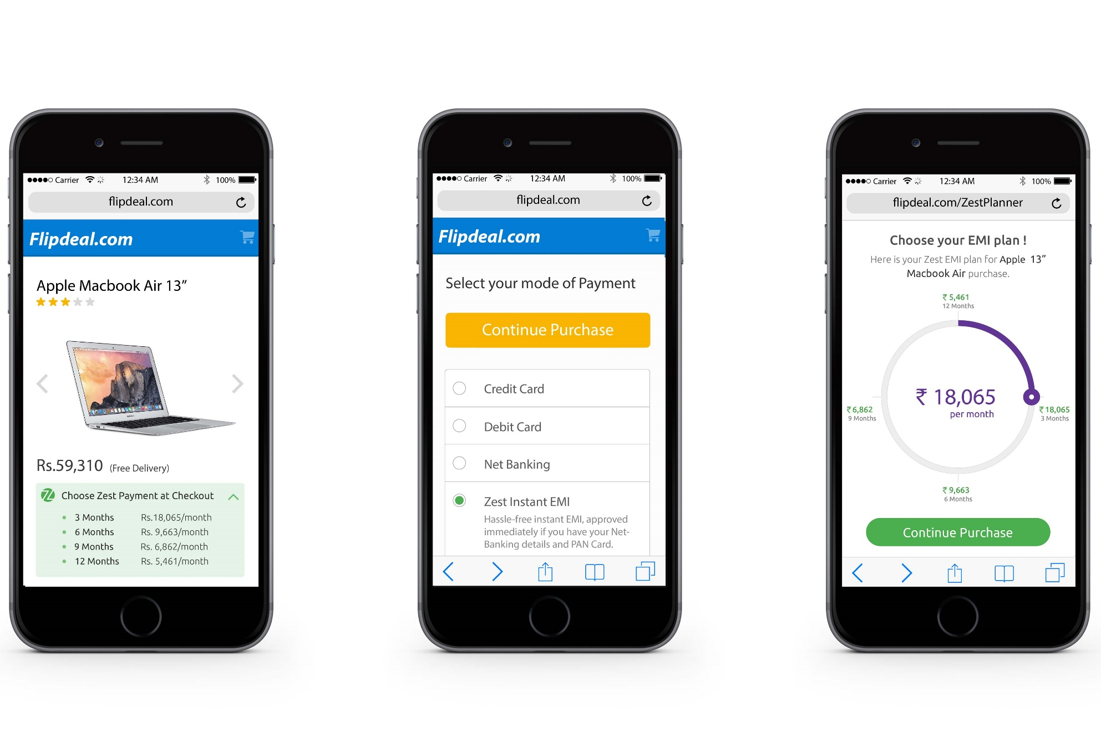
Simple user flow

Slide 10

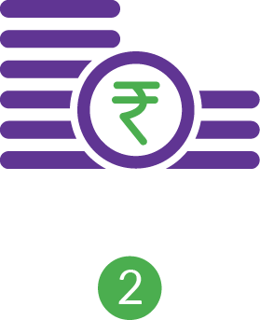

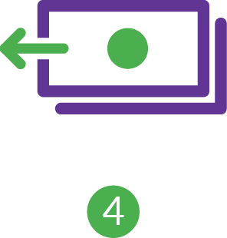
How it Works
Shop
Dynamic EMI pricing widget integrated on relevant product pages, shows exact monthly EMI, prompting high conversion.
Create EMI
Customer selects Zest at the checkout & designs their EMI (2-12m) via an interactive dial.
New customer enrolment happens via a simple web form and pre-accept/decline decision is real time.
Pre-accepted customer makes down-payment and submits bank details
Product ships
Pre-populated NACH mandate emailed to customer.
Customer submits this, plus KYC documents
Zest authorizes settlement with merchant within 24 hours. Product dispatched.
Monthly Repayment
Zest services loan directly with the customer via ECS (NACH).
Zest handles all collections, customer service

Slide 11
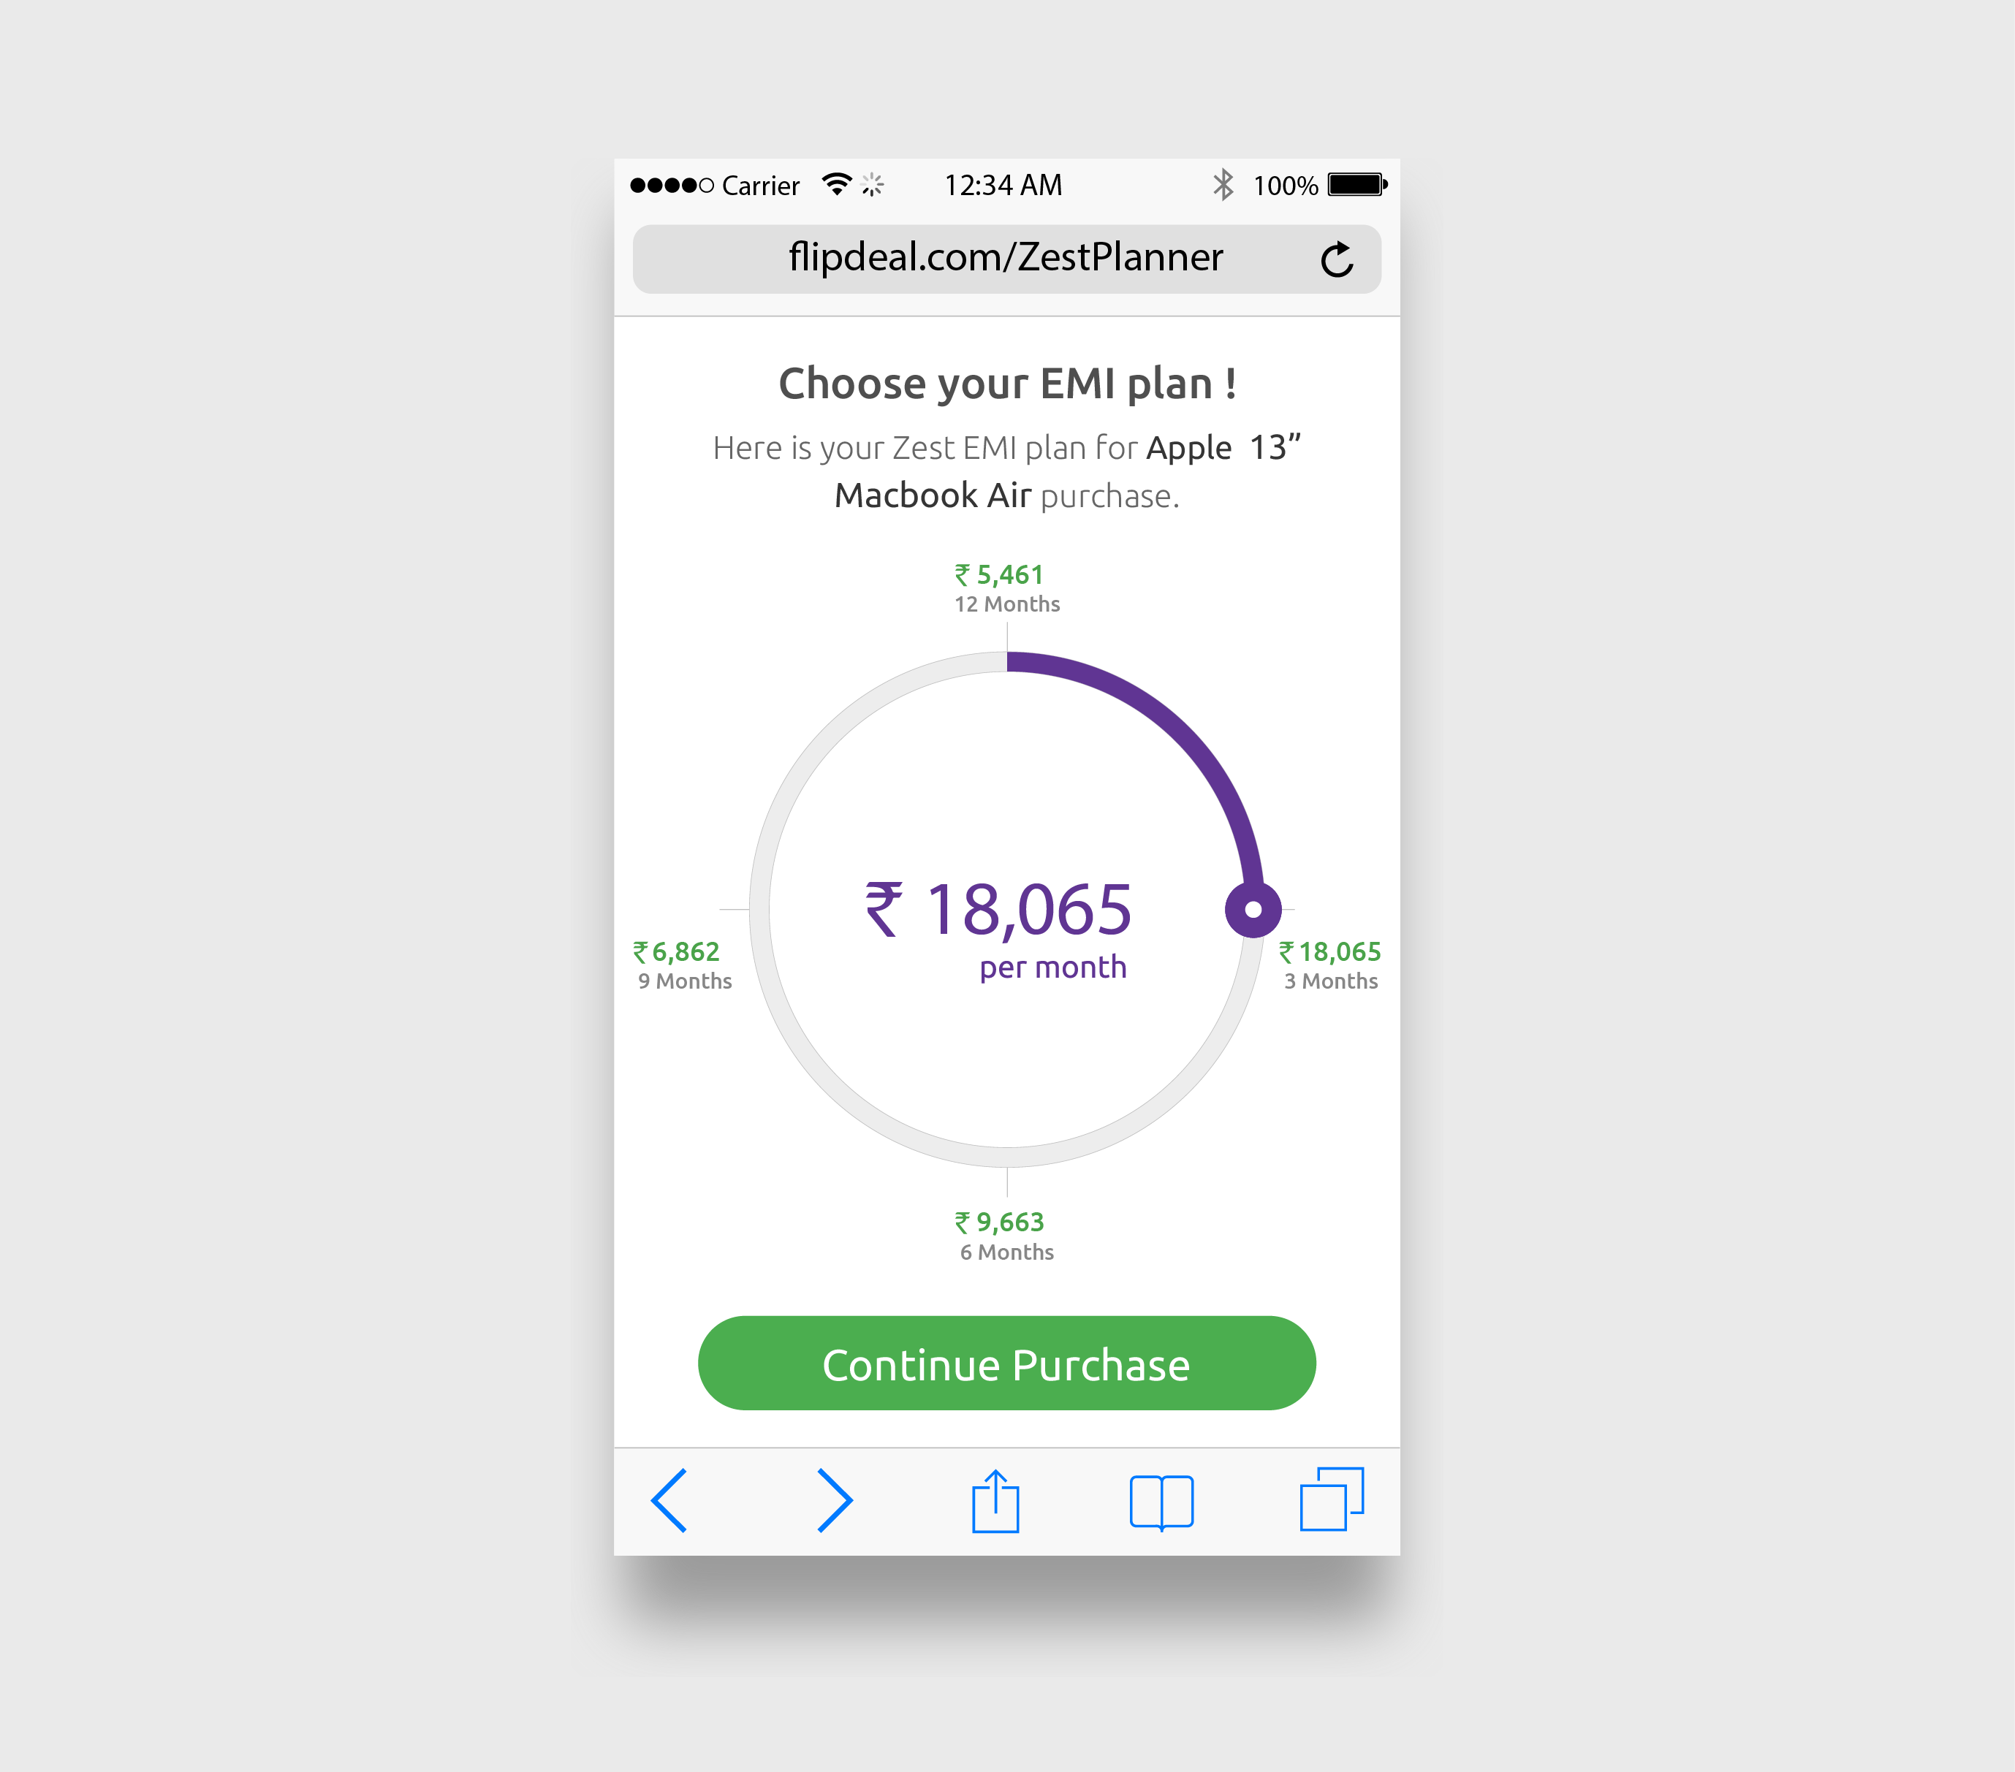
Hassle-free for merchants
Upfront Settlement
Zero customer credit risk
We handle customer collections
Refunds & returns? No problem
Full Customer Service

Slide 12
Zest product features; designed with customers and merchants in mind
 |  | Zest | NBFC EMI | Bank Credit Card EMI | New Digital players
Merchant Focused | Super-fast integration and merchant on-boarding | ✓
 | Dynamic pricing widget on product page | ✓
 | Checkout integration via simple API | ✓ | (✓) | (✓) | (✓)
 | Re-direct customer back to checkout if “Decline” | ✓ |  | (✓)
 | Same day refunds and top ups | ✓
 | High velocity platform, low latency | ✓ |  | (✓)
 | Configurable pricing, down payment, subvention | ✓ | ✓ |  | (✓)
 | Lending against basket (not individual product) | ✓
 | Instant account opening at checkout | ✓ | (✓) |  | (✓)
 | 50%+ approval rate | ✓
 | Fully licensed / Regulatory approval | ✓ | ✓ | ✓ | (✓)
 | 24 / 7 Customer Service and Merchant Support | ✓ | (✓) | (✓)
Consumer focused | Ticket size as low as Rs. 5k | ✓ |  | (✓) | (✓)
 | Instant approval at checkout | ✓ |  |  | (✓)
 | “My accounts” portal & app to easily manage loan | ✓
 | Completely flexible tenure (2-12 months) | ✓
 | Completely transparent pricing & terms | ✓ |  |  | (✓)
 | Penalty-free early repayment at any time | ✓
 | Multiple repayment options | ✓ | (✓)
12

Slide 13

Zest uses proprietary technology to create a faster sign up and under-writing process
We have a quantitative, data driven, novel approach to fraud and credit decision making

Slide 14
Pain-free integration
Proprietary risk platform
Zest has developed an innovative technology platform that automates the credit risk assessment process
The technology platform incorporates a predictive and continuously learning algorithm that decides in real time, whether we will lend to a customer
Unlike banks, who use traditional, non-digital data such as payslips to make credit decisions, we use a variety of digital data, and can make better decisions
We use industry standard encryption to safeguard personal and financial information
All our servers are hosted in the cloud, providing us full control on elasticity, scalability and high availability
A fully regulated NBFC is responsible for the underlying loan
We are backed by some of the best global financial technology investors
Customer Input Data
Merchant Data
APPROVE
$
funded amount
Traditional Credit Data
Zest Money Score
Behavioral Data
Social Data
DECLINE

Slide 15
Pain-free integration
Zest integration
A straightforward direct integration, supported by Zest’s Technology & Security team
Typically 2-4 days of integration work, depending on merchant resource allocation
Front End
Fully responsive product display with dynamic pricing module
Sign in or sign up integrated with your checkout
Customer enrolment delivered via a re-direct to Zest hosted page
Bespoke front end integration possible
API Integration Points
As part of the live transaction flow, when passing customer to transaction page:
Zest customer account confirm
Exchanging refunds messaging
Data Exchange
In live transaction flow; Unique transaction ID, Unique Merchant ID, Customer identifiers and Delivery info
Refund scenario; Unique transaction ID, Unique Merchant ID, Refund Amount, Event Code
API Protocols and Connections
Protocol is JSON/HTTP
Connect via an Untrusted Client Gateway that authenticates partner via a token
15

Slide 16
Thank You!

Slide 17
This document and the information contained herein is strictly confidential to Zest or Zest Money, operating names of Chalk Farm Ventures Private Limited (‘the Company’) and is subject to intellectual property protection, including copyright.
This document is to be used only for the purposes for which it has been supplied and information contained in it must not be disclosed or in any other way made available by the recipient, in whole or in part, to persons other than any employee, director, consultant or agent of the recipient who is required to see the information for the purposes for which it has been supplied and any other named firm, individual or company engaged in providing services directly to the recipient who has been previously approved in writing by the Company and who is under an equivalent obligation of confidentiality in respect of any information supplied to them by the recipient.
If this document has been received in error it should be permanently deleted from any computer and data storage system and the Company shall be notified of the same.
This document does not seek to override or vary any other Agreement that you have with Chalk Farm Ventures Private Limited.

