Slide 1

ANALYSIS

Slide 2
Team
Vivek Chaudhary
Prerit
Arnav Bansal

Slide 3
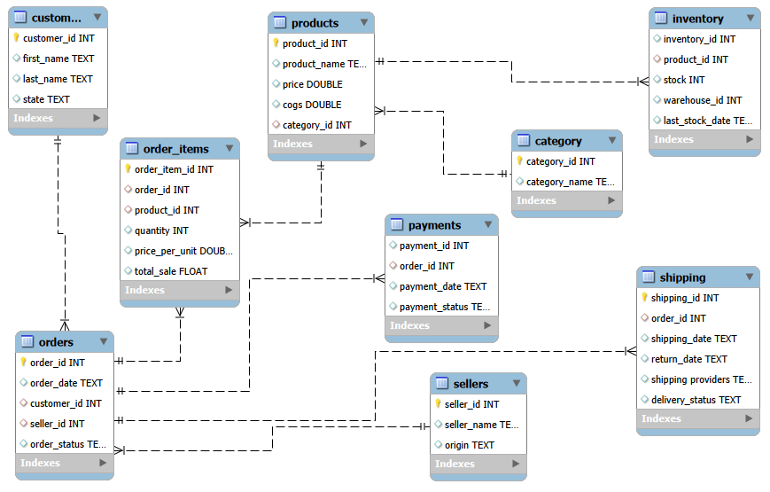
Dataset Overview
Entity-Relationship Diagram

Slide 4
Project Overview
Analyzed a dataset of over 20,000 sales records from an Amazon dataset(9 Tables) using MySQL. This project involved extensive querying to understand customer behavior, product performance and sales trends.

Slide 5
Objectives
The primary objective of this project is to showcase SQL proficiency through complex queries that address real-world e-commerce business challenges. The analysis covers various aspects of e-commerce operations

Slide 6
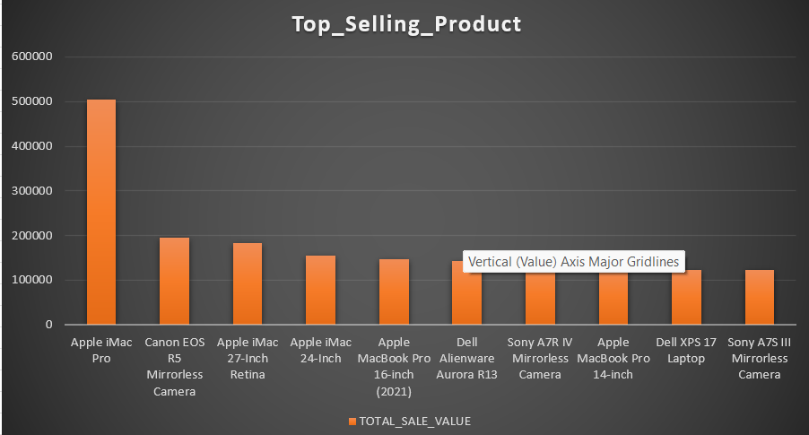
Top selling product

Slide 7
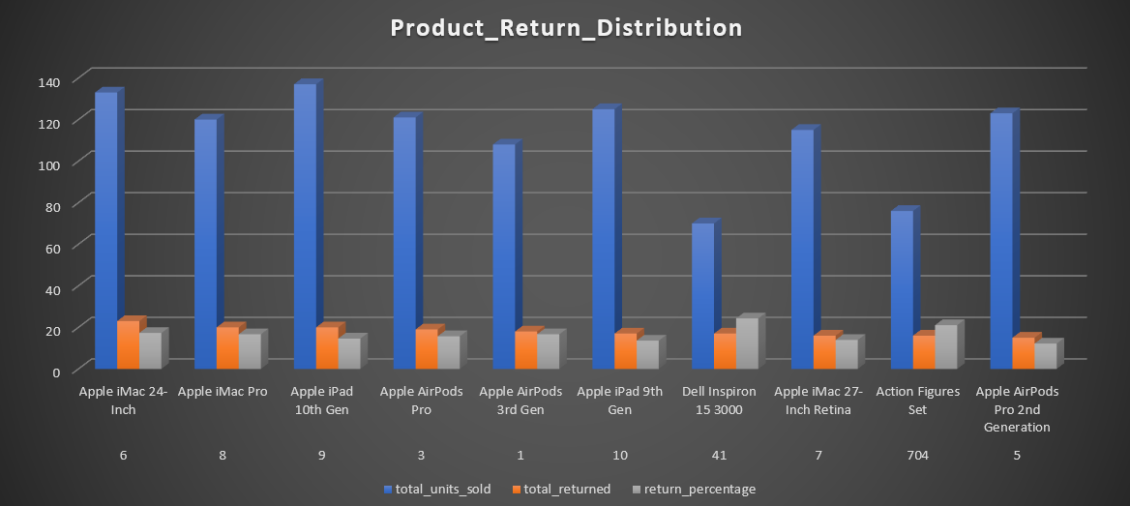
Product return distribution

Slide 8
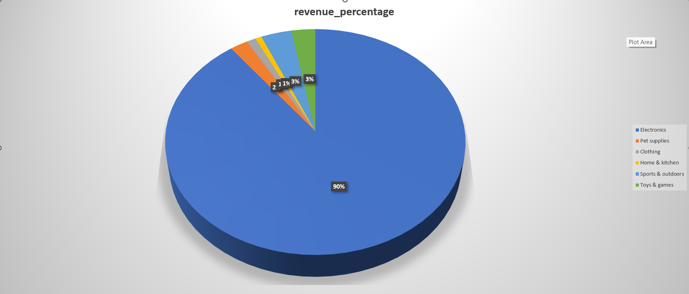
Revenue Distribution on product categories
Built with Excel

Slide 9
KEY INSIGHTS
Category with highest Revenue
#1 Selling Product
Most returned Product
Category with Lowest Revenue
Electronics
Apple iMac Pro
Apple iMac 24-inch
Home & Clothing

Slide 10



Tools & Technologies

Slide 11
SQL Concepts Used
Joins
Aggregations
CASE
Subqueries
Window Functions
Indexes

Slide 12
Challenges Faced
Null handling
FK conflicts
Column name error

Slide 13
Conclusion
SQL helped transform raw data into business insights.

Slide 14

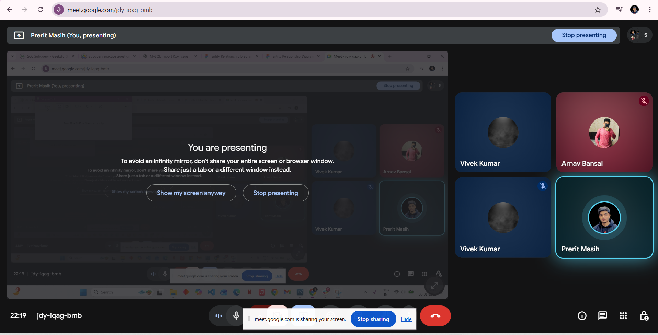
Efforts
MEET 1
04-01-2026
MEET 2
06-01-2026

