Slide 1

Air Quality Data management in
Indian Cities
Team 007
Team members : 19BIT085- Nandini Bhuva
19BIT087- Nidhay Pancholi
19BIT088- Nidhi Zala
19BIT115- Shambhavi Kumar
19BIT131- Vivek Devre

Slide 2
Project Description
Pollutant Data from 216 stations across India is being collected. A very high volume of data is being generated.
This data does not have a proper structure and is very difficult to interpret this data in the numeric form itself.
The data contains concentration of pollutants such as NOx gases, CO , SO2, PM2.5, PM10 ,O3,etc. but from these some pollutants data is not that essential as not much changes are reflected in it.
We filter the data of the pollutants that most affect human health and analyse it to conclude some things that would help in combating the Air pollution in the future.

Slide 3
Feature | Our Model | ANALYSIS AND PREDICTION OF AIR QUALITY INDEX IN INDIA DURING PRE AND POST COVID PANDEMIC USING MACHINE LEARNING ALGORITHMS | Air Pollution and Health in India: A review of the current evidence and opportunities for the future
Filtering data of pollutants to only analyse the most influential data.
Data is being collected using optical sensors.
Dashboard to visualize concentration of various pollutants at one glance.
Data of the potential renewable energy reserves is included to signify the future decrease in Air pollution because of increase in renewable energy usage.
Past history of purchase of petroleum product from each state has been included to relate the Petroleum products consumed and Pollution during that time.

Slide 4
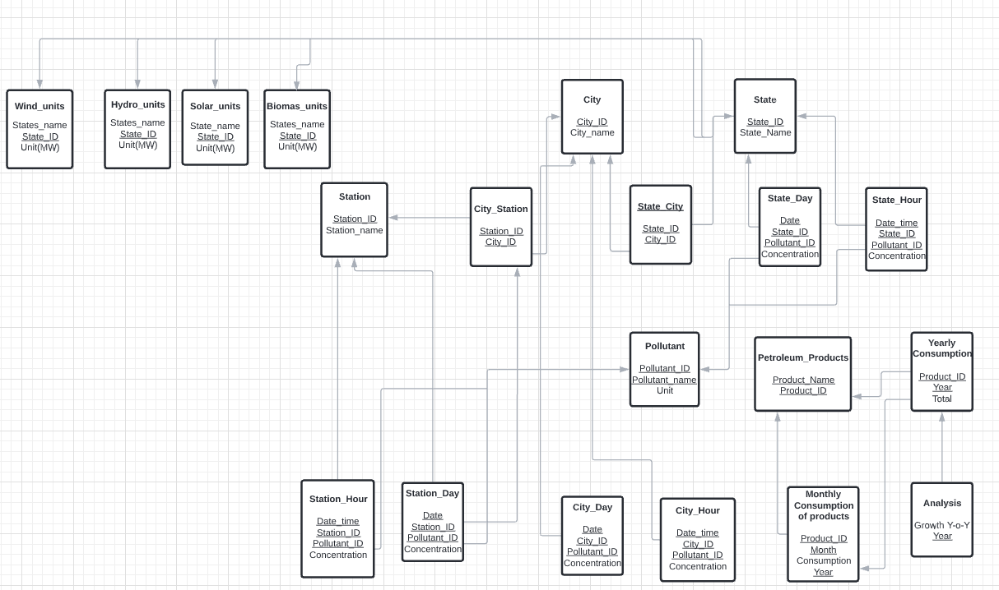
Relational Model
It represent how data is stored in relational databases. The relational database stores data in the form of relations(tables).

Slide 5
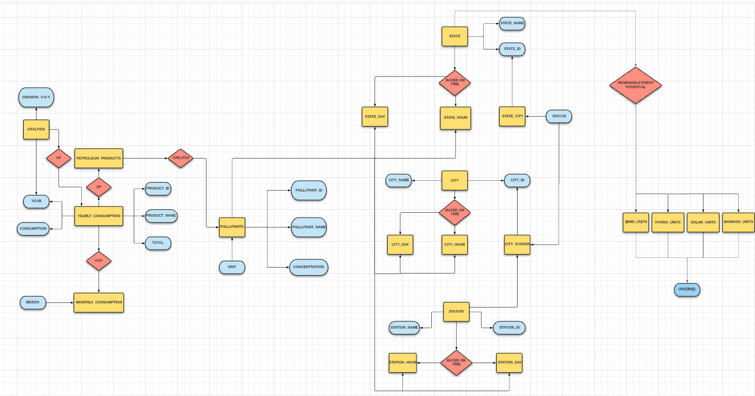
ER MODEL
ER-Diagram is a pictorial representation of data that describes how data is communicated and related to each other.

Slide 6
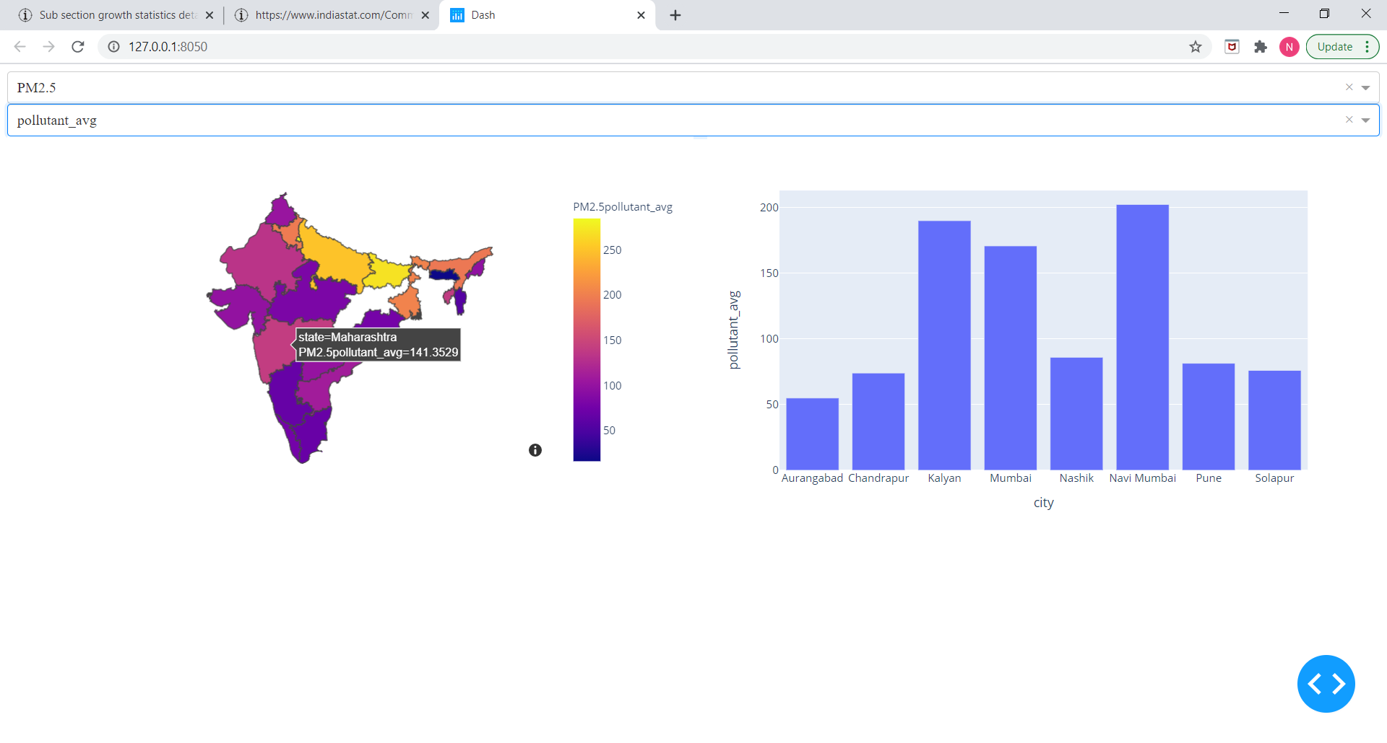
A Snapshot of the Live Dashboard we made

