Slide 1

Data Management
Of
Air Quality in Indian Cities
Team no. - 7
Team members : 19BIT085- Nandini Bhuva
19BIT087- Nidhay Pancholi
19BIT088- Nidhi Zala
19BIT115- Shambhavi Kumar
19BIT131- Vivek Devre

Slide 2

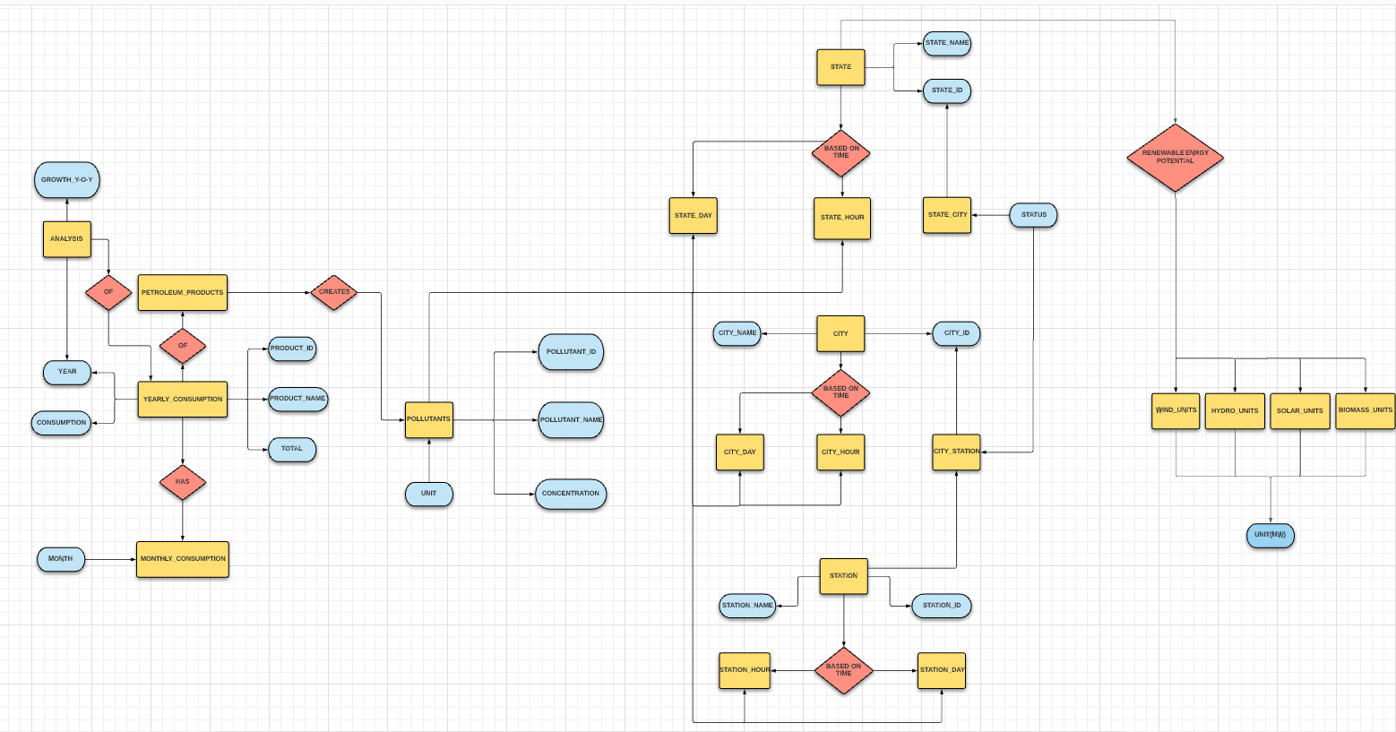
ER MODEL :
ER-Diagram is a pictorial representation of data that describes how data is communicated and related to each other.

Slide 3

FEATURES :
DESCRIPTION | OUR MODEL | EXISTING MODEL
1. Data from various fields like petroleum products and air pollutants combined together
2. Data of particulate matter has been collected using optical sensors
3. Dashboard representing analysis of all the states. Hence, easily readable.
4. Considered various particulate matter for better analysis
5. Consist data regarding renewable energy potential also

