Slide 1

Data Management
Of
Air Quality in Indian Cities
Team no. - 7
Team members : 19BIT085- Nandini Bhuva
19BIT087- Nidhay Pancholi
19BIT088- Nidhi Zala
19BIT115- Shambhavi Kumar
19BIT131- Vivek Devre

Slide 2
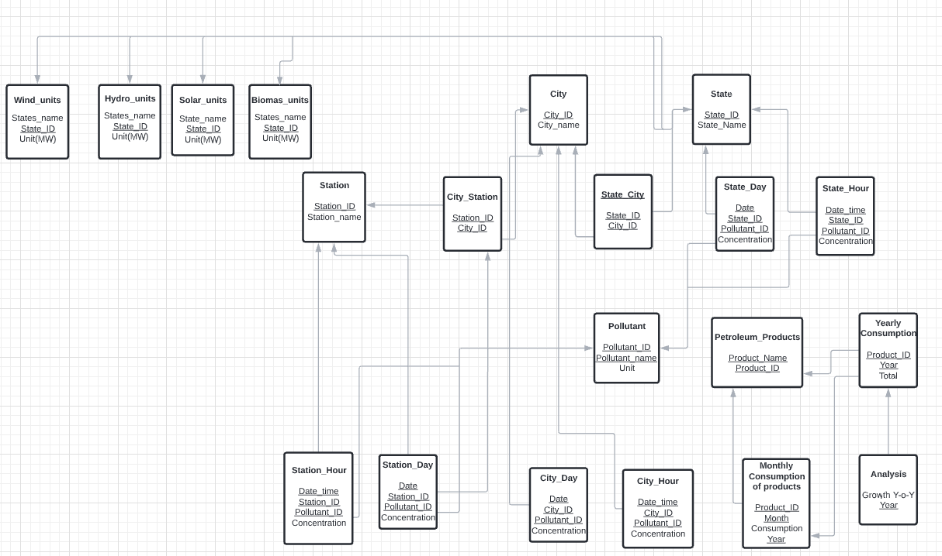

RELATIONAL MODEL :
It represent how data is stored in relational databases. The relational database stores data in the form of relations(tables).
After designing the conceptual model of Database using ER diagram, we need to convert the conceptual model in the relational model which can be implemented using any RDBMS languages.

Slide 3

FEATURES :
DESCRIPTION | OUR MODEL | EXISTING MODEL
1. Data from various fields like petroleum products and air pollutants combined together
2. Data of particulate matter has been collected using optical sensors
3. Dashboard representing analysis of all the states. Hence, easily readable.
4. Considered various particulate matter for better analysis
5. Consist data regarding renewable energy potential also

