Slide 1

C A S E S T U D Y 2 · F I N A L
Building and Validating a Metal–Organic Framework
Synthesis Knowledge Graph with Large Language Models
Devendra Singh Dhakad · Matriculation No. 100004684
M.Sc. Data Science and Artificial Intelligence
Supervisor: Prof. Dr. Mehrdad Jalali
SRH University of Applied Sciences Heidelberg
September 2026

Slide 2
1 The problem
• MOFs are porous crystals built from metal nodes and organic linkers. Over 100,000 synthesised structures are recorded in the CSD.
• Applications span CO2 capture, gas storage, catalysis, sensing and drug delivery.
• How any given MOF is actually made (precursor, linker, solvent, method, temperature, time) stays locked in the prose of tens of thousands of papers.
• Existing text-mined databases were built with rule-based systems whose own authors report that implicit synthesis routes are hard to extract.
The gap
No published study measures LLM MOF extraction field by field against both expert annotation and a rule-based baseline, while reporting what each configuration costs.
2

Slide 3
2 Research questions
• RQ1 Per-field accuracy: LLMs against a rule-based baseline built from the same domain vocabulary.
• RQ2 Which prompting strategy is most reliable: zero-shot, few-shot, schema-guided, chain-of-thought.
• RQ3 Where and why extractions disagree with the DigiMOF and SynMOF reference databases.
• RQ4 Open-weight models against commercial APIs on accuracy, cost and latency.
• RQ5 Can the resulting knowledge graph answer aggregation queries across hundreds of papers.
Answered: RQ1, RQ2, RQ4, RQ5. RQ3 could not be answered; the reason is on slide 12.
3

Slide 4
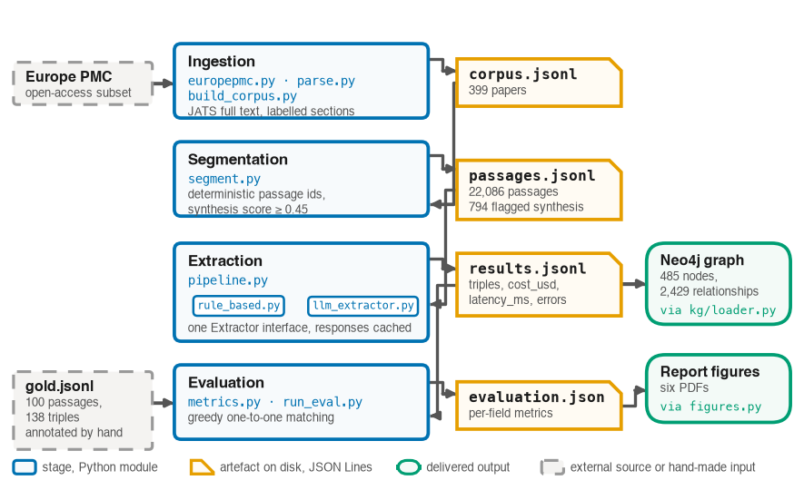
3 What was built
Six stages, each writing a JSON Lines file the next one reads. Any stage can be rerun without rerunning the others, and every intermediate is inspectable.
4

Slide 5
4 The gold standard
• 100 passages annotated by hand, yielding 138 triples. Drawn by a seeded stratified sample.
• 90 from the synthesis-flagged pool, plus 10 unflagged controls so the pre-filter's own miss rate is measurable rather than assumed.
• Annotation used an ontology-constrained interface: an invalid triple cannot be created.
Why it was not pre-filled by a model
The gold standard is the instrument the models are measured against. Generating it with a language model would make the evaluation circular: any error the models share would score as correct.
399
22,086
794
138
papers collected
passages segmented
flagged as synthesis
triples, annotated by hand
5

Slide 6
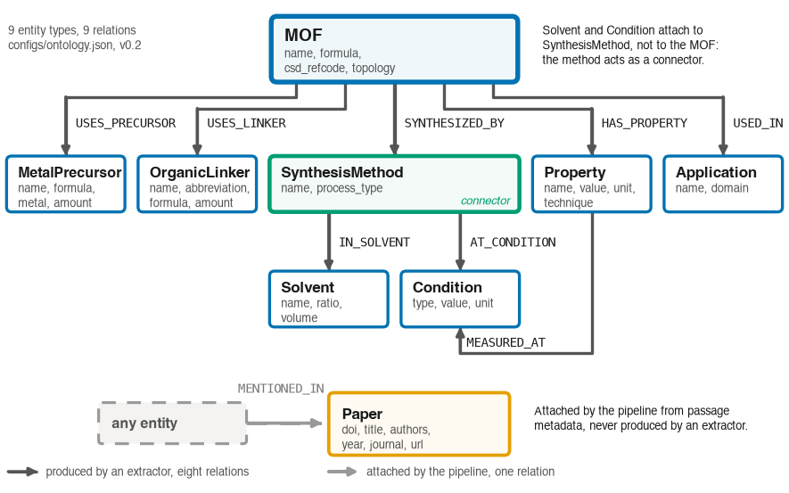
5 How accuracy was measured
• Matching is per passage and per relation, greedy one-to-one, so no gold triple is credited twice and nothing matches across passages.
• One concession is declared: IN_SOLVENT and AT_CONDITION are scored on the object alone, because an annotation-tool defect left the MOF name in the subject slot.
6

Slide 7
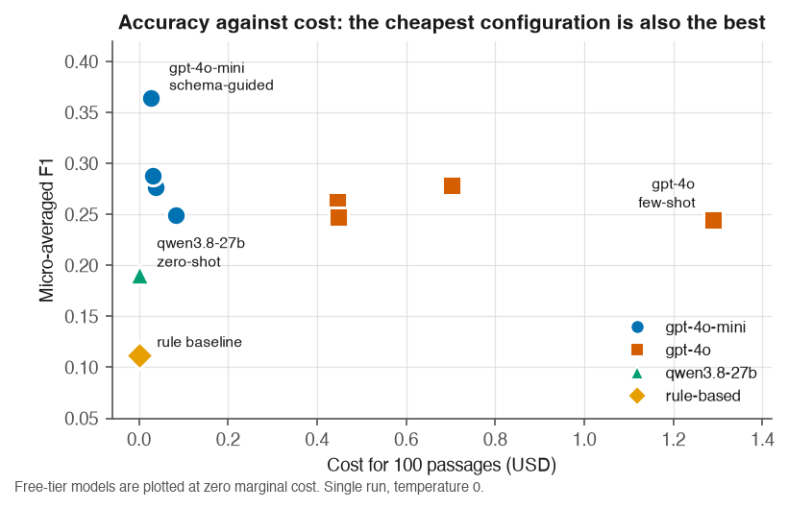
6 Results: ten configurations, 3.06 USD
• Every language-model configuration beats the rule-based baseline. The weakest scores 0.191 against the baseline's 0.112.
• The strongest configuration is also among the cheapest.
7

Slide 8
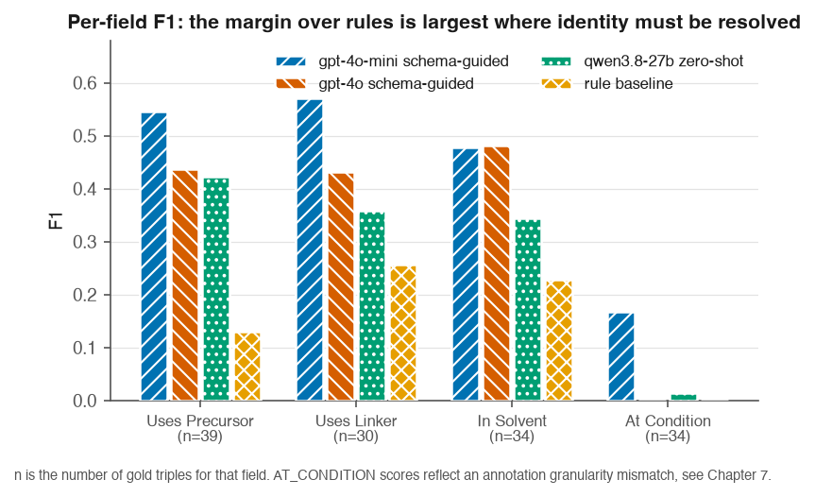
7 Per field, and a pre-registered prediction
Recorded before any model was run
“The LLM margin over the rule baseline should be largest on USES_PRECURSOR and USES_LINKER, and smallest on AT_CONDITION and IN_SOLVENT.”
Measured margins: +0.42, +0.31, +0.25, +0.17. The ordering matches exactly. The prediction was committed to the repository first, so this is a confirmation rather than a pattern found afterwards.
AT_CONDITION scores measure annotation granularity, not extraction quality, and are excluded from every conclusion. Excluding it, the best configuration averages about 0.53.
8

Slide 9
8 The cheap model beat the expensive one
0.364
0.245
47×
3.06
gpt-4o-mini, schema-guided
0.028 USD
gpt-4o, few-shot
1.289 USD
cost difference, in favour
of the weaker model
USD, every experiment
in this study
• My first explanation was that the larger model over-extracts, and that verbosity becomes false positives. I tested it by counting emitted triples.
• It is wrong, and wrong in the opposite direction. gpt-4o emits fewer triples than gpt-4o-mini in all four strategies, by 32, 29, 19 and 6 percent.
• The gap is recall, not precision. gpt-4o recovers 39 of 138 gold triples on schema-guided against gpt-4o-mini's 61, at near-identical precision.
• On dense synthesis text, caution costs more than it buys.
9

Slide 10
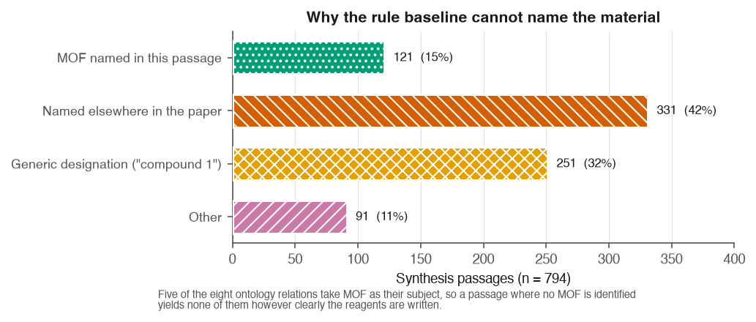
9 Why the rule baseline fails
• The baseline names a MOF in only 121 of 794 synthesis passages, about 15 percent. Five of the eight relations take MOF as their subject, so that one failure suppresses most of what it could otherwise extract.
• Neither dominant cause is a lexicon gap. The highest-leverage fix is coreference across a paper and table parsing, not a bigger dictionary.
10

Slide 11
10 The knowledge graph (RQ5)
485
2,429
182
0
distinct nodes
relationships
source papers
provenance violations
• Every entity carries a MENTIONED_IN edge to the paper it came from. Provenance is verified by query, not asserted: the violations query returns zero rows.
• Cross-paper aggregation works. Solvothermal appears in 61 papers across 30 MOFs, hydrothermal in 43 across 12.
An open question
DigiMOF reported more hydrothermal than solvothermal records and called that surprising. This corpus shows the opposite ordering. Recorded, not resolved.
11

Slide 12
11 What this cannot show
• RQ3 is not answered. DigiMOF and SynMOF are keyed by CSD refcode, this corpus by DOI and by the MOF name a paper uses, and joining them needs a licensed mapping. The overlap is undetermined, which is not the same as zero.
– What could be measured: the two databases agree on the metal 98.9 percent across the 509 MOFs they share.
• 0.364 micro-F1 is below the 0.80 target in the exposé, and is a lower bound: strict surface-form matching scores correct extractions as failures.
• The gold standard is 100 passages, not the 150 to 200 planned, and has a single annotator, so no inter-annotator agreement can be computed.
• Two open-weight configurations hit a free-tier daily cap and were deleted rather than scored. A partial run makes a rate-limited model look like a weak one.
• Every configuration ran once, so no variance is reported.
12

Slide 13
12 Conclusion
• Language models beat the rule baseline on every configuration tested, and by the largest margin exactly where a pre-registered prediction said they would.
• The cheaper model won, and the mechanism is under-extraction by the larger model, measured rather than assumed.
• An open-weight model reached about two thirds of the best commercial F1 at zero marginal cost.
• A provenance-complete knowledge graph, verified by query.
Future work
Obtain a name-to-refcode mapping and close RQ3.
Finish the error review: why gpt-4o declines to extract.
Repair the condition evaluation and add identifier resolution.
Enlarge the gold standard and add a second annotator.
13

