Slide 1
AN INTRODUCTION TO FACE DETECTION AND RECOGNITION
Guided by :Heena kausar madam
SUBMITTED BY : G Vivek
BCA 3rd Year

Slide 2
OUTLINE
Face Detection
  What is face detection?
  Importance of face detection
  Current state of research
  Different approaches
  One example
Face Recognition
  What is face recognition?
  Its applications
  Different approaches
  One example
A Video Demo

Slide 3
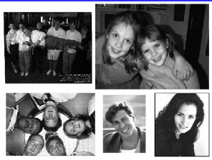
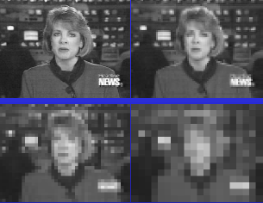
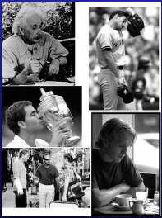
WHAT IS FACE DETECTION?
Given an image, tell whether there is any human face, if there is, where is it(or where they are).

Slide 4
IMPORTANCE OF FACE DETECTION
The first step for any automatic face recognition system system
First step in many Human Computer Interaction systems
  Expression Recognition
  Cognitive State/Emotional State Recogntion
First step in many surveillance systems
Tracking: Face is a highly non rigid object
A step towards Automatic Target Recognition(ATR) or generic object detection/recognition
Video coding……

Slide 5
FACE DETECTION: CURRENT STATE
State-of-the-art:
  Front-view face detection can be done at >15 frames per second on 320x240 black-and-white images on a 700MHz PC with ~95% accuracy.
  Detection of faces is faster than detection of edges!
Side view face detection remains to be difficult.

Slide 6
FACE DETECTION: CHALLENGES
Out-of-Plane Rotation: frontal, 45 degree, profile, upside down
Presence of beard, mustache, glasses etc
Facial Expressions
Occlusions by long hair, hand
In-Plane Rotation
Image conditions:
  Size
  Lighting condition
  Distortion
  Noise
  Compression

Slide 7
DIFFERENT APPROACHES
Knowledge-based methods:
  Encode what constitutes a typical face, e.g., the relationship between facial features
Feature invariant approaches:
  Aim to find structure features of a face that exist even when pose, viewpoint or lighting conditions vary
Template matching:
  Several standard patterns stored to describe the face as a whole or the facial features separately
Appearance-based methods:
  The models are learned from a set of training images that capture the representative variability of faces.

Slide 8
KNOWLEDGE-BASED METHODS
Top Top-down approach: Represent a face using a set of human-coded rules
Example:
  The center part of face has uniform intensity values
  The difference between the average intensity values of the center part and the upper part is significant
  A face often appears with two eyes that are symmetric to each other, a nose and a mouth
Use these rules to guide the search process

Slide 9
KNOWLEDGE-BASED METHOD: [YANG AND HUANG 94]
Level 1 (lowest resolution):
  apply the rule “the center part of the face has 4 cells with a basically uniform intensity” to search for candidates
Level 2: local histogram equalization followed by edge equalization followed by edge detection
Level 3: search for eye and mouth features for validation

Slide 10
KNOWLEDGE-BASED METHODS: SUMMARY
Pros:
  Easy to come up with simple rules
  Based on the coded rules, facial features in an input image are extracted first, and face candidates are identified
  Work well for face localization in uncluttered background
Cons:
  Difficult to translate human knowledge into rules precisely: detailed rules fail to detect faces and general rules may find many false positives
  Difficult to extend this approach to detect faces in different poses: implausible to enumerate all the possible cases

Slide 11
FEATURE-BASED METHODS
Bottom-up approach: Detect facial features (eyes, nose, mouth, etc) first
Facial features: edge, intensity, shape, texture, color, etc
Aim to detect invariant features
Group features into candidates and verify them

Slide 12
FEATURE-BASED METHODS: SUMMARY
Pros: Features are invariant to pose and orientation change
Cons:
  Difficult to locate facial features due to several corruption (illumination, noise, occlusion)
  Difficult to detect features in complex background

Slide 13
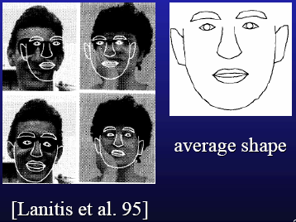
TEMPLATE MATCHING METHODS
Store a template
  Predefined: based on edges or regions
Deformable: based on facial contours (e.g., Snakes)
Templates are hand-coded (not learned)
Use correlation to locate faces

Slide 14
TEMPLATE-BASED METHODS: SUMMARY
Pros:
  Simple
Cons:
  Templates needs to be initialized near the face images
  Difficult to enumerate templates for different poses (similar to knowledge-based methods)

Slide 15
APPEARANCE-BASED METHODS: CLASSIFIERS
Neural network
  Multilayer Perceptrons
Princiapl Component Analysis (PCA), Factor Analysis
Support vector machine (SVM)
Mixture of PCA, Mixture of factor analyzers
Distribution Distribution-based method
Naïve Bayes classifier
Hidden Markov model
Sparse network of winnows (SNoW)
Kullback relative information
Inductive learning: C4.5
Adaboost 􀂄
􀂄 …

Slide 16
FACE AND NON-FACE EXEMPLARS
Positive examples:
  Get as much variation as possible
  Manually crop and normalize each face image into a standard size(e.g., 19×19
  Creating virtual examples [Poggio 94]
Negative examples: Fuzzy idea
  Any images that do not contain faces
  A large image subspace
  Bootstraping[Sung and Poggio 94]

Slide 17
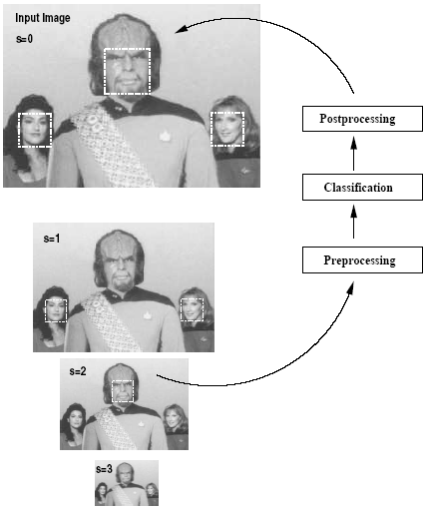
EXHAUSTIVE SEARCH
Across scales
Across locations

Slide 18
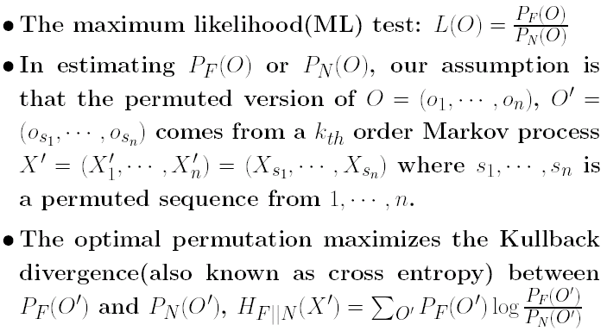
THEORY OF OUR ALGORITHM

Slide 19
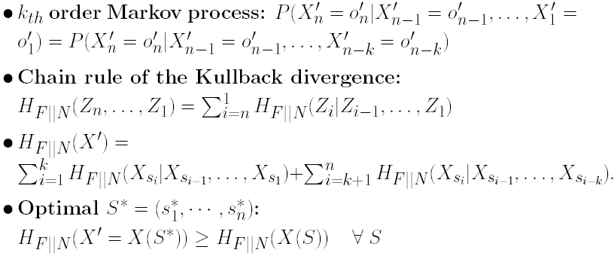
THEORY OF OUR ALGORITHM(2)

Slide 20
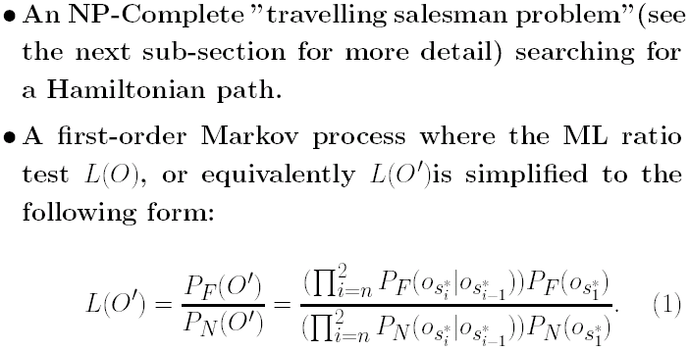
THEORY OF OUR ALGORITHM(3)

Slide 21
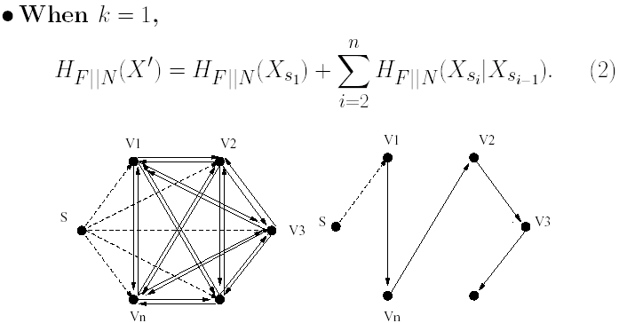
INSTANCE OF THE "TRAVELLING SALESMAN PROBLEM"

Slide 22
INTUITION OF PERMUTATION
When modelling face images as a k-th order Markov process, rows of the images are concatenated into long vectors. The pixels corresponding to the semantics(e.g, eyes, lips) will be scatted into different parts in the vectors. The Markovian property is not easy to be justified.
If some permutation can be found to re-group those scattered pixels(i.e, to put all the pixels corresponding to eyes together, those for lips together), then the Markov assumption is more reasonable.

Slide 23
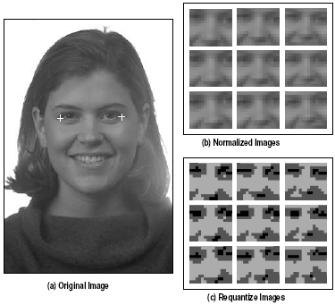
PREPROCESSING
Rotation
Scaling
Quantizing

Slide 24
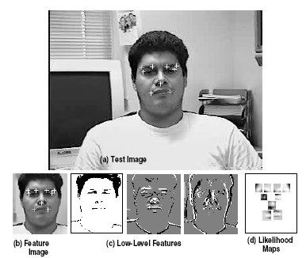
FACIAL FEATURES DETECTION
Region search

Slide 25
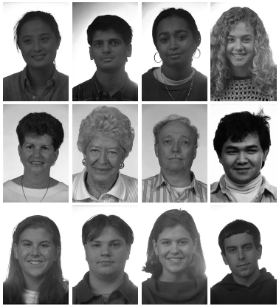
FERET DATABASE
Training data

Slide 26
FACE AND FACIAL FEATURE
DETECTION
The algorithm is also used to detect 9 facial features: 2 outer mouth corners, 2 outer eye corners, 2 outer eye-brow corners, 2 inner eye-brow corners and the center of the nostrils.

Slide 27
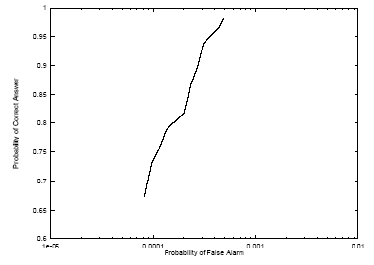
EVALUATIONS
ROC curve

Slide 28
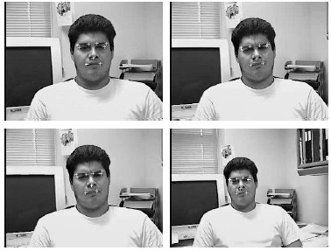
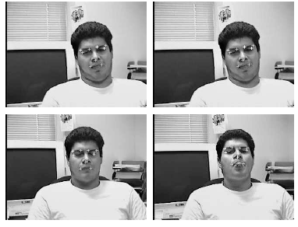
RESULTS

Slide 29
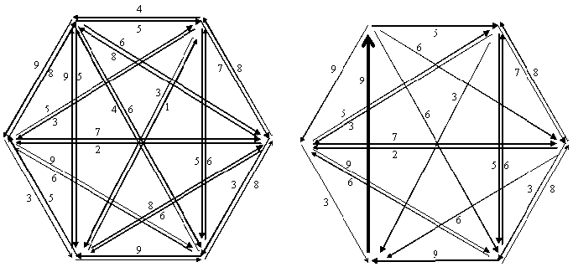
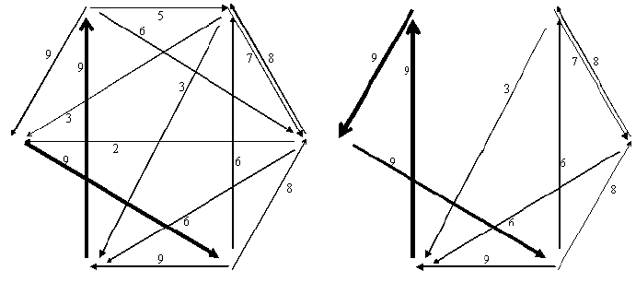
SEARCH STRATEGY
Kruskal

Slide 30
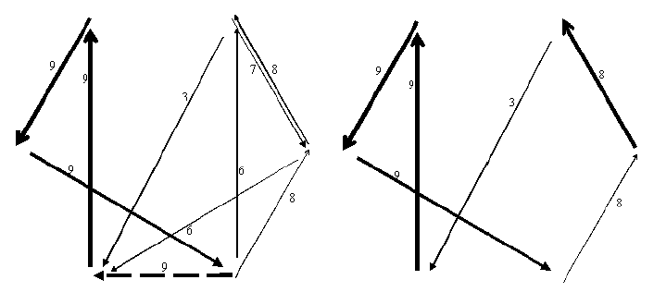
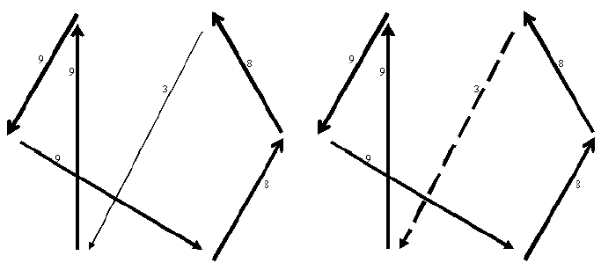
SEARCH STRATEGY
Kruskal

Slide 31
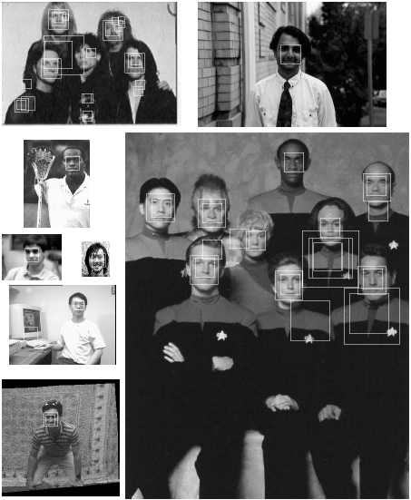
DETECTION RESULTS

Slide 32
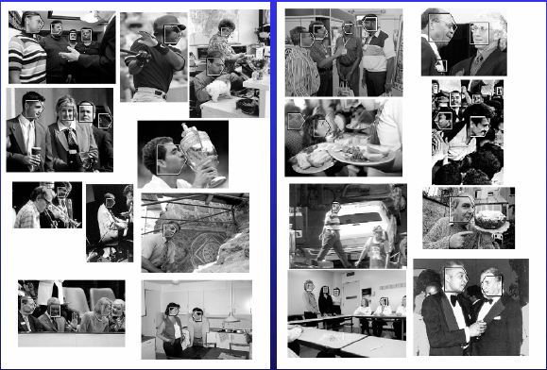
SIDE-VIEW FACE DETECTION

Slide 33
APPEARANCE-BASED METHODS: SUMMARY
Pros:
  Use powerful machine learning algorithms
  Has demonstrated good empirical results
  Fast and fairly robust
  Extended to detect faces in different pose and orientation
Cons:
  Usually needs to search over space and scale
  Need lots of positive and negative examples
  Limited view-based approach

Slide 34
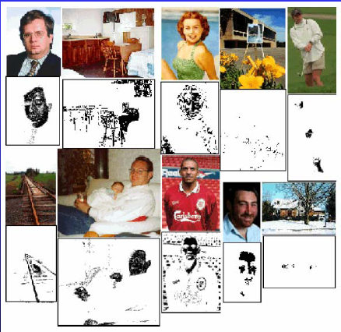
COLOR-BASED FACE DETECTOR
Pros:
  Easy to implement
  Effective and efficient in constrained environment
  Insensitive to pose, expression, rotation variation
Cons:
  Sensitive to environment and lighting change
  Noisy detection results (body parts, skin-tone line tone line regions)

Slide 35
WHAT IS FACE RECOGNITION?
A set of two task:
  Face Identification: Given a face image that belongs to a person in a database, tell whose image it is.
  Face Verification: Given a face image that might not belong to the database, verify whether it is from the person it is claimed to be in the database.

Slide 36
DIFFERENCE BETWEEN FACE DETECTION AND RECOGNITION
Detection – two-class classification
  Face vs. Non-face
Recognition – multi-class classification
  One person vs. all the others

Slide 37
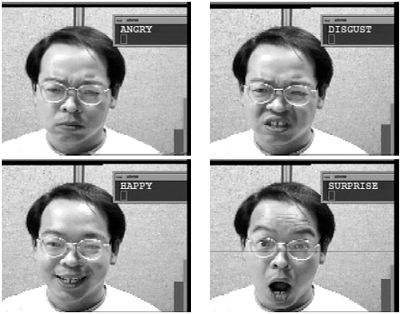
APPLICATIONS OF FACE RECOGNITION
Access Control
Face Databases
Face ID
HCI - Human Computer Interaction
Law Enforcement

Slide 38
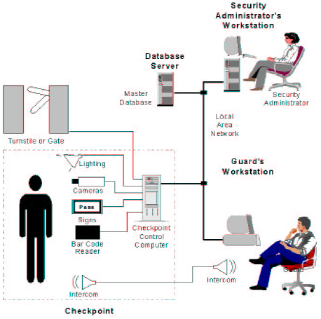
APPLICATIONS OF FACE RECOGNITION
Multimedia Management
Security
Smart Cards
Surveillance
Others

Slide 39
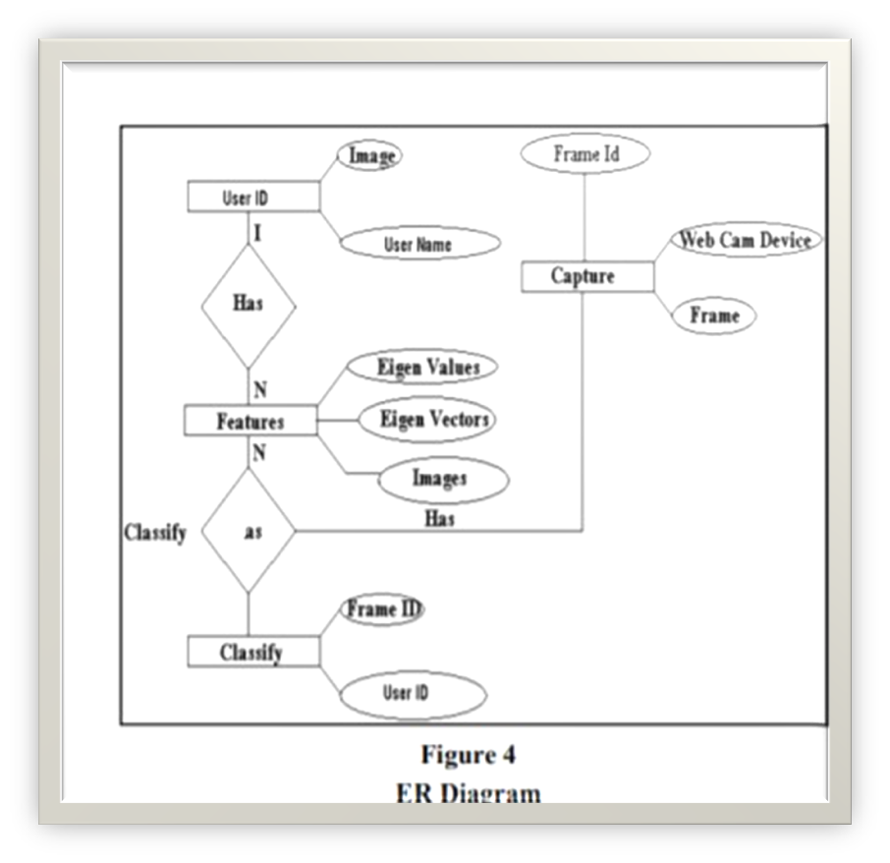
ER Diagram
The entity relation diagram, maps the relations between different entities of the system.

Slide 40
DIFFERENT APPROACHES
Features:
  Features from global appearance
    Principal Component Analysis(PCA)
    Independent Component Analysis(ICA)
  Features from local regions
    Local Feature Analysis(LFA)
    Gabor Wavelet
Similarity Measure
  Euclidian Distance
  Neural Networks
  Elastic Graph Matching
  Template Matching
  …

Slide 41

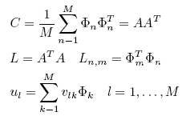

THE PCA APPROACH - EIGENFACE
The theory

Slide 42
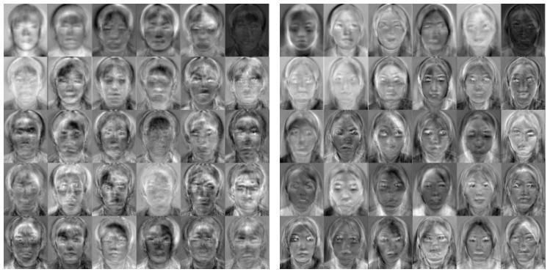
THE PCA APPROACH - EIGENFACE
Eigenfaces – an example

Slide 43
FACE DETECTION + RECOGNITION
Detection accuracy affects the recognition stage
Key issues:
  Correct location of key facial features(e.g. the eye corners)
  False detection
  Missed detection

