Slide 1
IBM University Engagement Project Submission
“Exploring the Power of Agentic AI with IBM Granite and IBM Bob”

Slide 2

Project Tile – [career-counseling-companion]
Domain of Project – [ Education /career Guidance]
Student Name | Recent Passport Photo | Email ID | Mobile number [WhatsApp]
Gundala vivek |  | vivekgundala550@gmail.com | 8688497536
Recommended font style and size:
Font Style: Arial
Font Size (Heading): 28
Font Size (Content): 20

Slide 3
Problem Statement - 15
Problem Statement – Agentic Career Counseling Companion
The Challenge
Students often struggle to make informed career decisions due to fragmented access to guidance, limited self-awareness of academic strengths, and rapidly evolving industry landscapes. Traditional counseling methods lack personalization and scalability, leading to missed opportunities and career mismatches. Students need an intelligent system that can understand their performance, interests, skills, and changing industry trends to provide suitable career guidance.
The Objective
Build an AI-powered Agentic Career Counseling Companion that delivers personalized career insights and guidance for students. The solution should:
• Student Profile Analysis – Analyze academic performance, skills, interests, and strengths.
• Career Recommendations – Suggest suitable career paths based on the student's profile.
• Skill Gap Analysis – Identify required skills and recommend areas for improvement.
• Career Roadmap – Provide personalized learning and career pathways.
• Industry Trend Analysis – Consider evolving job roles and industry requirements.
• Multi-Agent System –
Career Assessment Agent (analyzes student profile)
Career Recommendation Agent (suggests suitable careers)
Skill Gap Agent (identifies missing skills)
Career Roadmap Agent (creates personalized career plans)
• Personalized Guidance – Adapt recommendations based on changing student interests and performance.
• Future-Ready Decisions – Help students make confident and informed career decisions.

Slide 4
Proposed Solution - AI-Powered Career Counseling Companion
The proposed solution is a multi-agent AI-powered Career Counseling Companion built using IBM Bob, IBM watsonx.ai, and IBM Granite models to provide personalized, real-time career guidance. The system analyzes student performance, interests, skills, and industry trends to recommend suitable career pathways.
At its core, the solution uses Retrieval-Augmented Generation (RAG) to retrieve relevant career and industry information and provide reliable, context-aware recommendations.
The system consists of four key agents:
Career Assessment Agent analyzes academic performance, skills, interests, and strengths.
Career Recommendation Agent suggests suitable career options based on the student's profile.
Skill Gap Agent identifies missing skills and recommends areas for improvement.
Career Roadmap Agent creates a personalized learning and career development plan.
IBM Bob is used to orchestrate the agent workflows, while IBM watsonx.ai supports AI deployment and governance. IBM Granite models power reasoning, personalization, and career guidance.
Overall, the solution provides an intelligent and adaptive career counseling assistant that helps students make confident, informed, and future-ready career decisions.

Slide 5
Technology Used
• IBM Bob platform – For designing and orchestrating multi-agent career counseling workflows visually.
• IBM Granite model – For natural language understanding, reasoning, and personalized career recommendations.
• IBM Cloud – Provides the infrastructure to build, deploy, and scale the Career Counseling Agent efficiently.
• RAG – Retrieves relevant career, skill, and industry information first, then generates reliable and context-aware career guidance.
• IBM watsonx.ai – For model deployment, embeddings, and AI governance.
• Vector Database (FAISS/Chroma) – For RAG-based career and industry information retrieval.

Slide 6
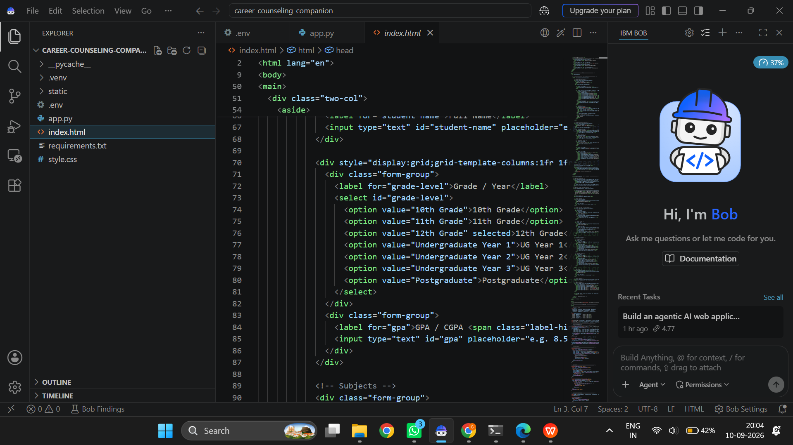
Required Files created using IBM bob -
App.py
Requirements.txt
Style.css
.env
Index.html

Slide 7
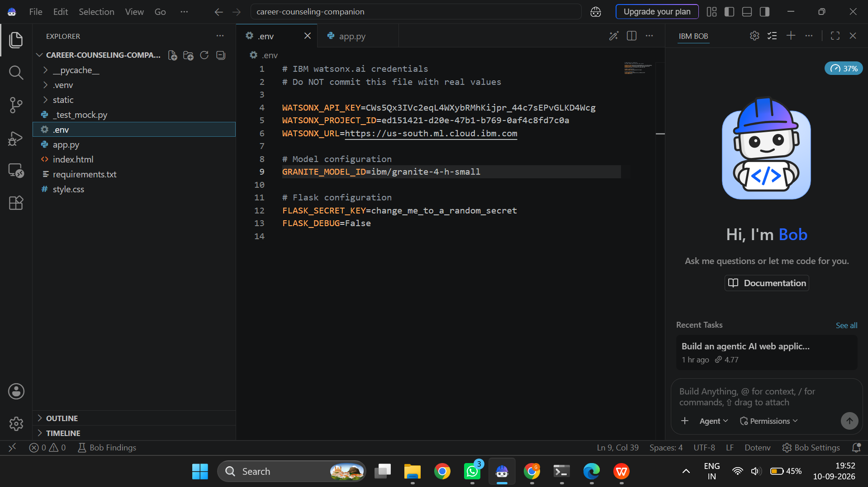
IBM Bob Screenshots:

Slide 8
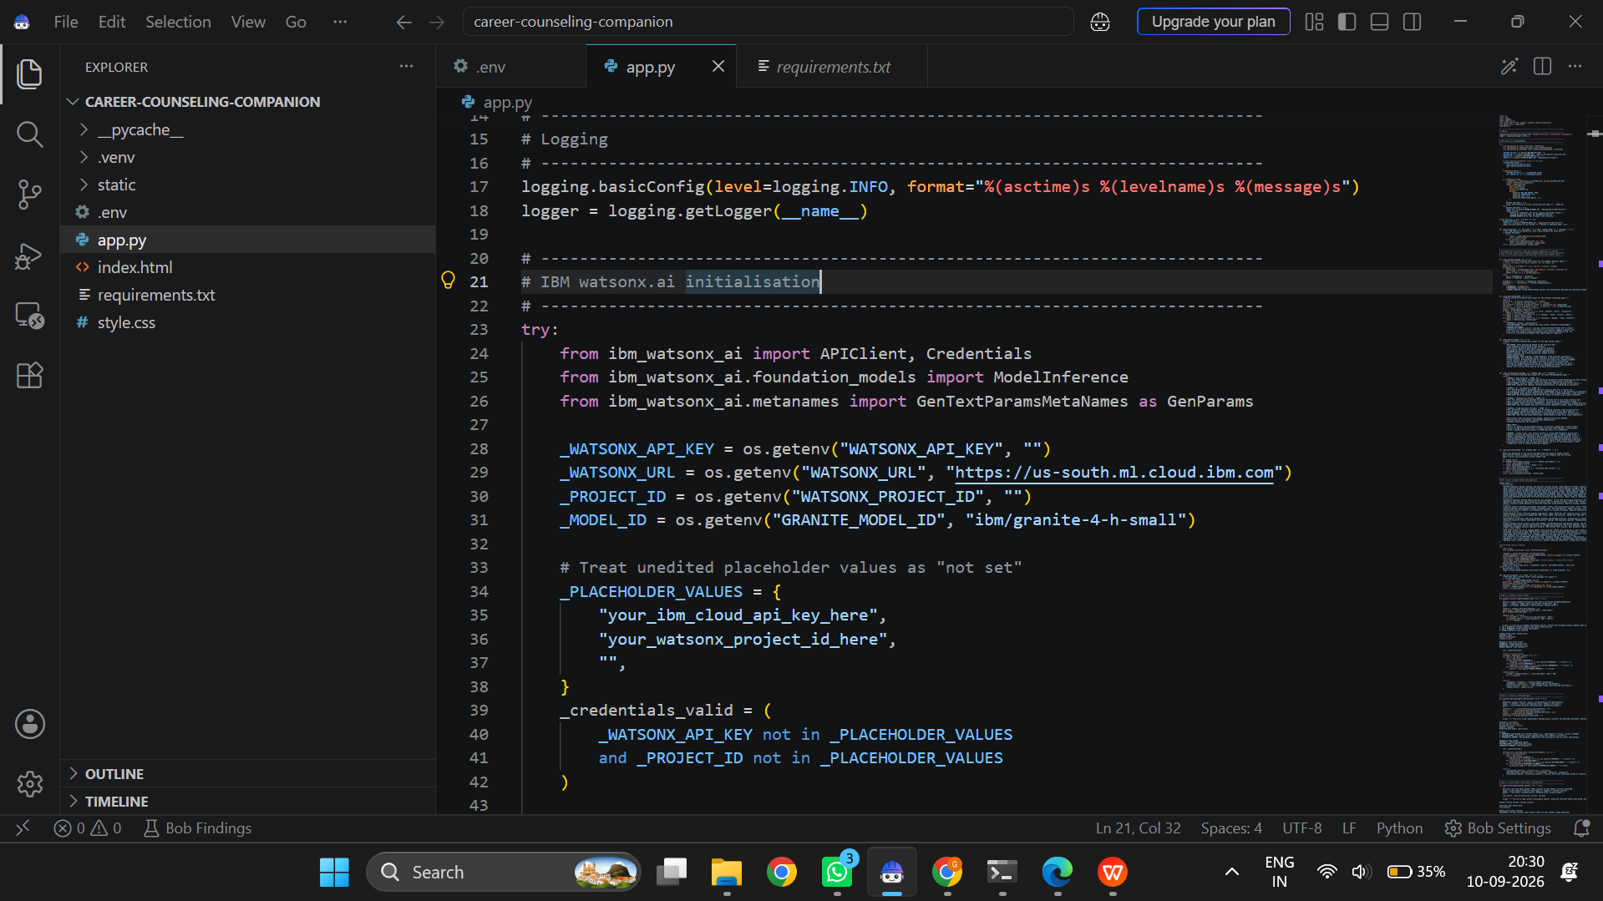

Slide 9
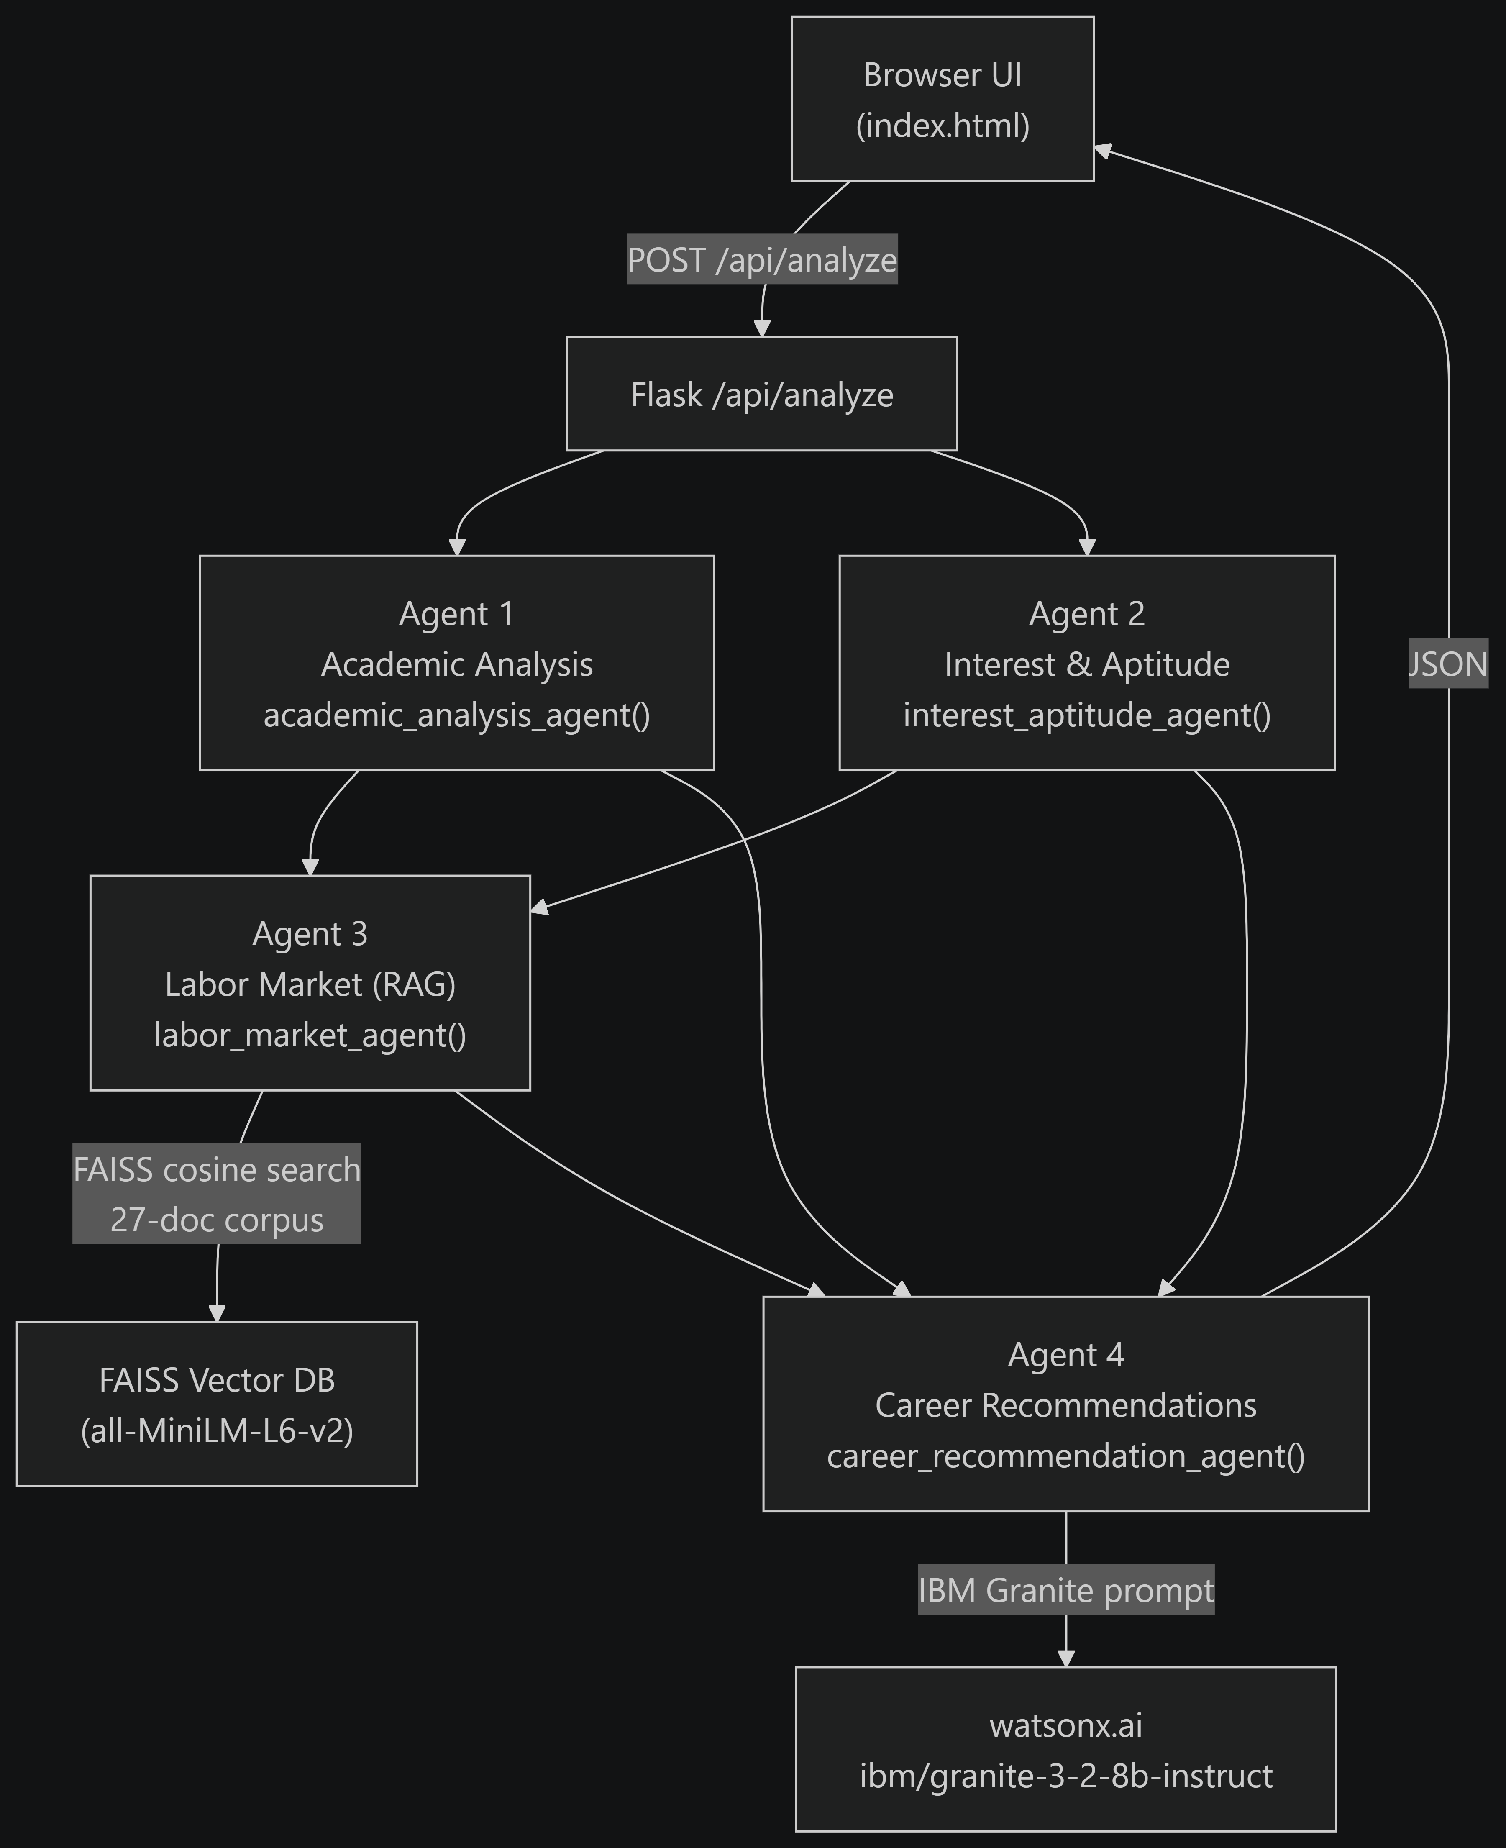
Architecture blueprint for IBM bob:

Slide 10

Role of Agentic AI in the solution
Role of Agentic AI in Career Counseling Companion
Agentic AI enables the Career Counseling Companion to function as an intelligent and autonomous system rather than a simple chatbot. Using IBM watsonx.ai and IBM Granite models, it coordinates specialized agents to provide personalized career guidance.
Each agent performs a specific role—such as analyzing academic performance, understanding interests and aptitude, analyzing labor-market information, and generating career recommendations—while working collaboratively. This multi-agent approach enables efficient task execution and better career decisions.
Agentic AI provides context awareness by understanding student details such as academic performance, skills, interests, and career goals to generate tailored recommendations. It also supports real-time adaptation by updating suggestions based on changing interests and industry trends.
Overall, Agentic AI makes the system proactive, personalized, and goal-driven, helping students make confident and future-ready career decisions.

Slide 11
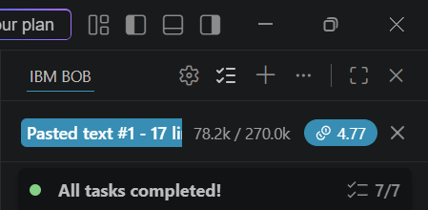
Token Usage

Slide 12
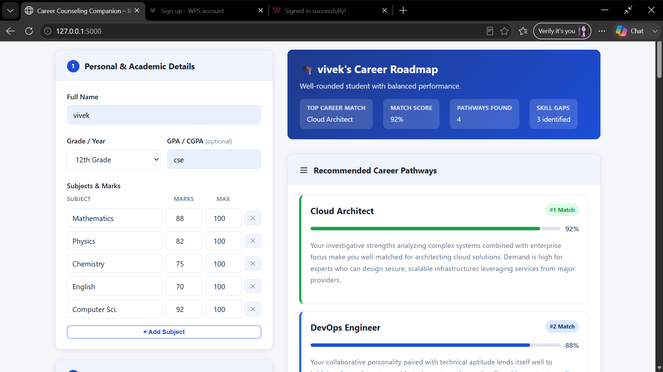
Project Output Screenshot
·
·
·

Slide 13
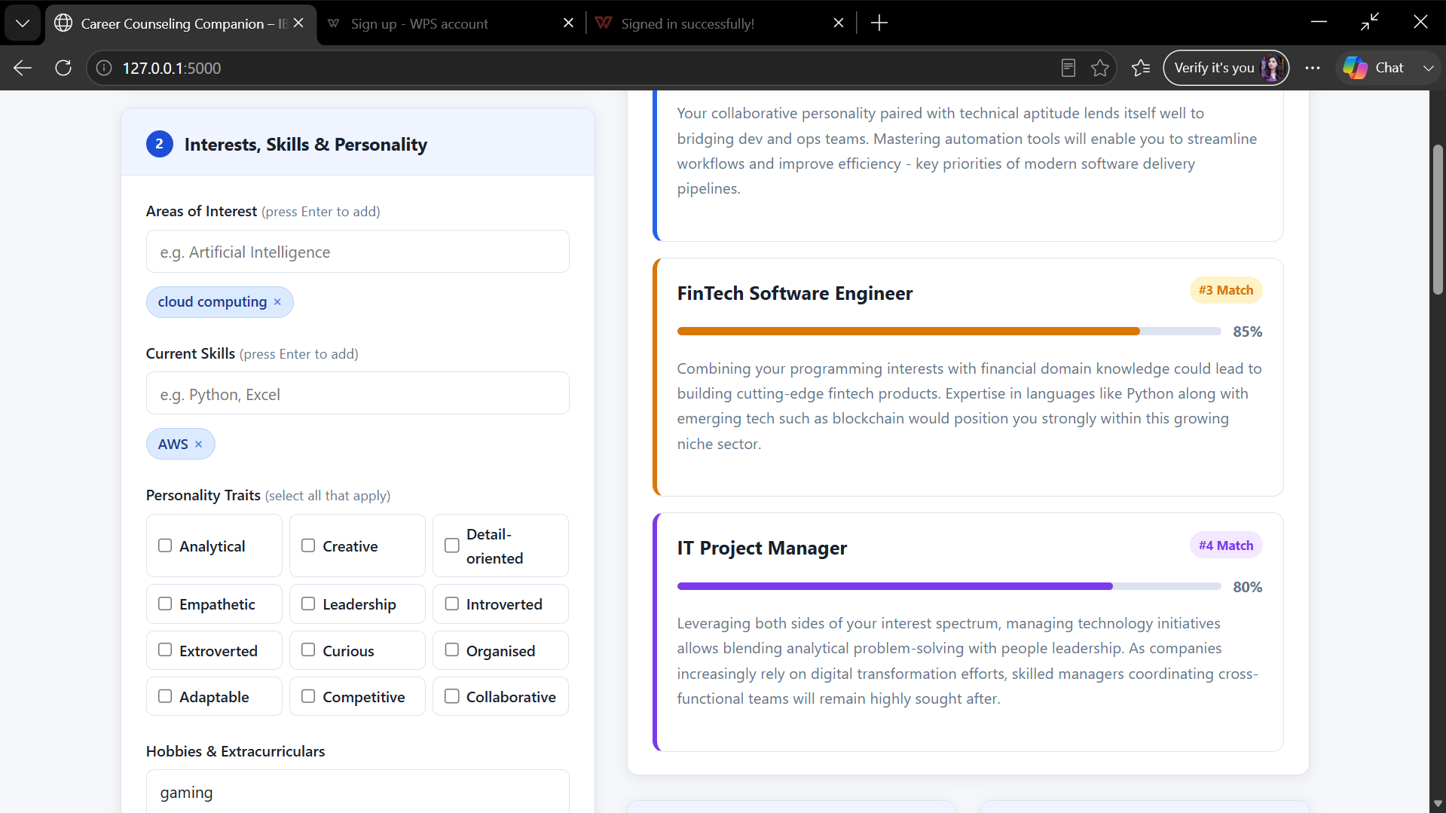
Project Output Screenshot

Slide 14
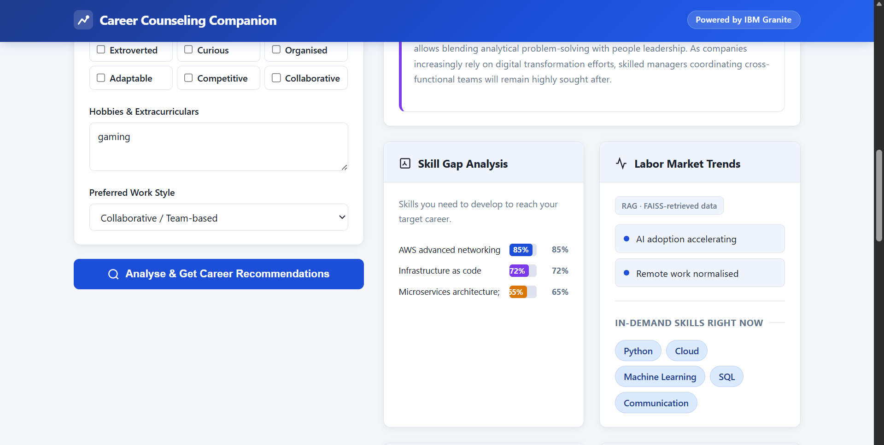
Project Output Screenshot
·
·
·

Slide 15
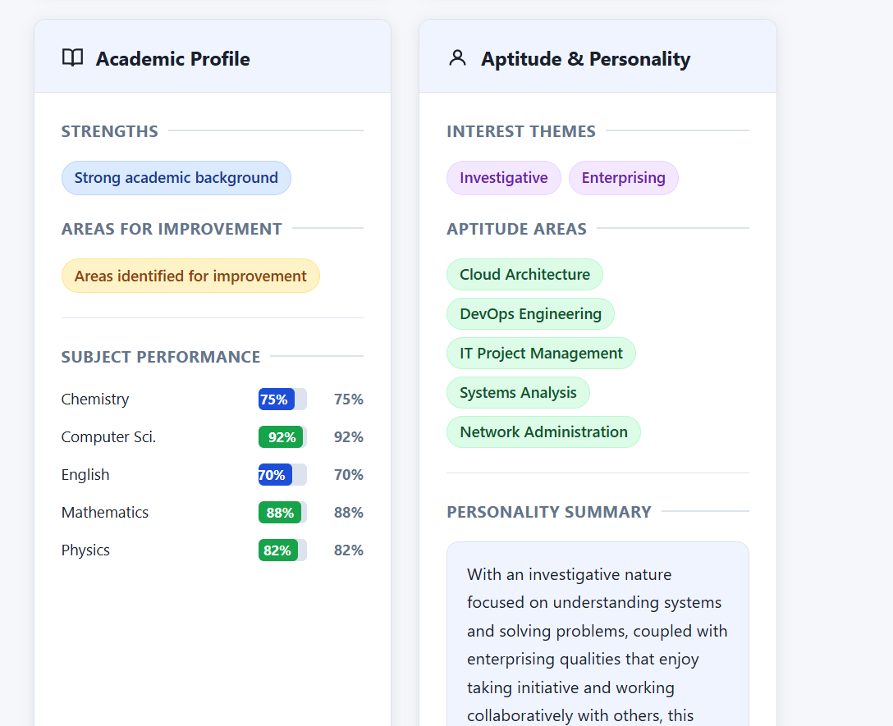
Project Output Screenshot

Slide 16
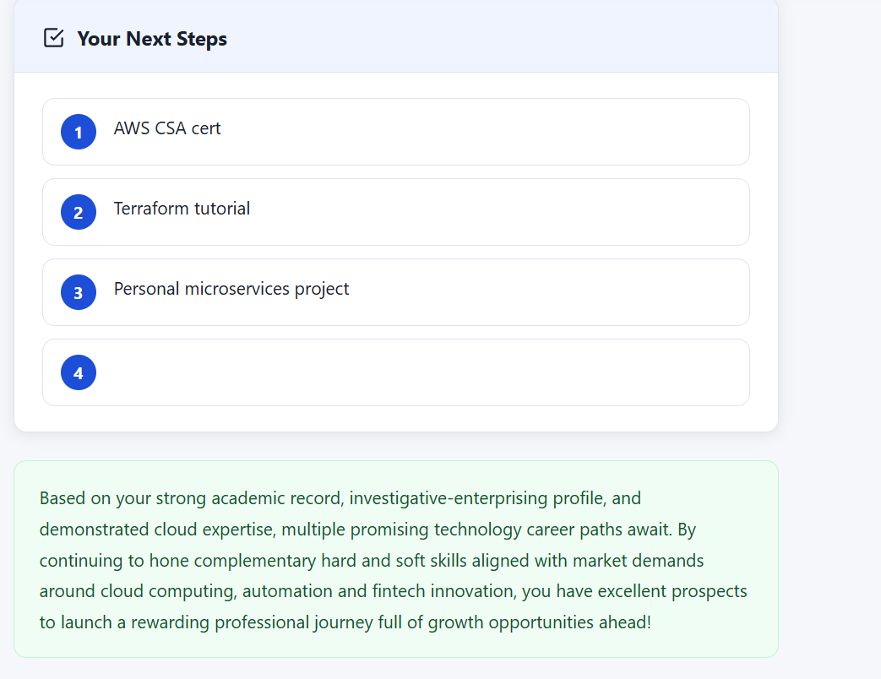
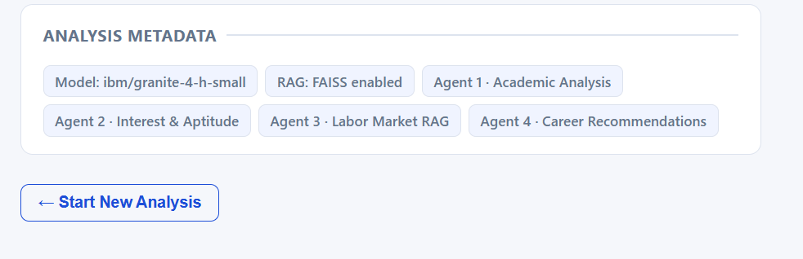
Project Output Screenshot

Slide 17
Novelty and Uniqueness
Novelty and Uniqueness
The proposed Career Counseling Companion stands out by combining Agentic AI, RAG, and personalization into a single intelligent system.
Multi-Agent Intelligence – Multiple specialized agents collaborate to provide accurate and context-aware career guidance.
RAG-Based Accuracy – Retrieves relevant career, skill, and industry information before generating recommendations.
Hyper-Personalization – Tailors career suggestions based on academic performance, skills, interests, and career goals.
Real-Time Adaptation – Updates recommendations based on changing student interests, performance, and industry trends.
Skill Gap Analysis – Identifies missing skills and suggests suitable learning areas to improve employability.
Career Roadmap – Provides personalized learning paths and actionable steps toward selected career goals.
Scalable & Enterprise-Ready – Built using IBM watsonx.ai and IBM Granite models for reliable and governed AI.
This makes the solution a smart, adaptive, and proactive career counseling assistant, not just a static career recommendation tool.

Slide 18
Git Hub Link :
https://github.com/vivekgoud2005/career-counseling-companion.git

Slide 19
Future Scope
1. Real-Time Job Market Integration –
The system can be integrated with live job-market data to track emerging job roles, required skills, salary trends, and industry demand. This will enable the Career Counseling Companion to provide more accurate and future-ready career recommendations.
2. AI-Powered Voice Assistant & Multilingual Support –
Enhancing the system with voice interaction and multiple languages will improve accessibility. Students can interact naturally in their preferred language, making career guidance more inclusive and easier to use.
·
·
·

Slide 20
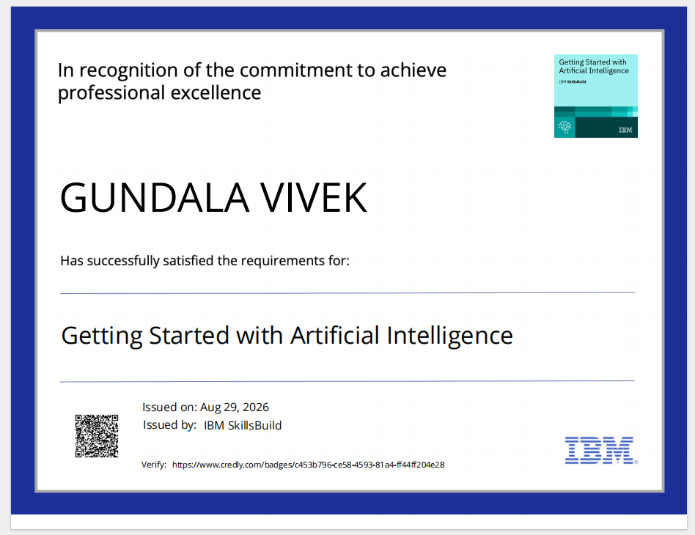
Certificates Earned:
Please add your credly certificate(Getting Started with Artificial Intelligence)

Slide 21
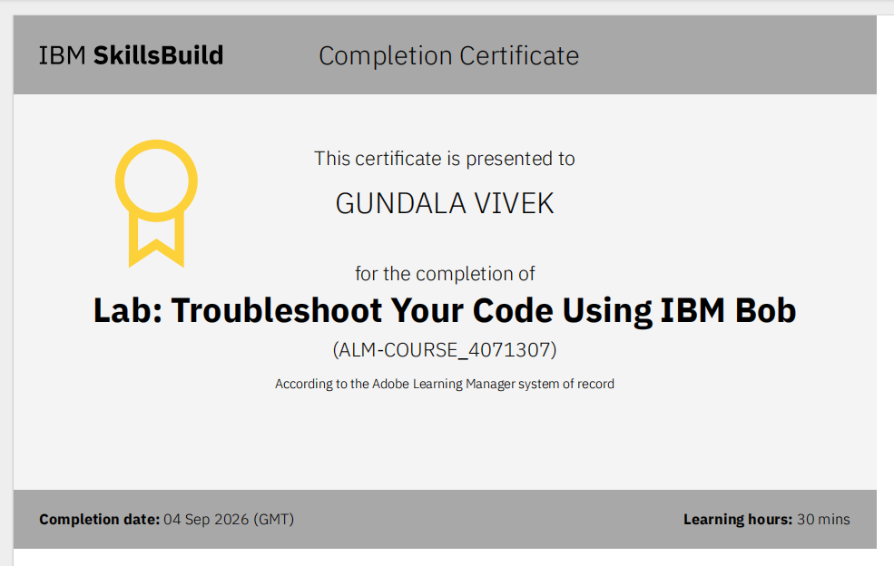
Certificates Earned:​
Add your IBM BOB Certificate

Slide 22


