Slide 1
ASP.NET Core Middleware
What is middleware?
Middleware is software that's assembled into an application pipeline to handle requests and responses.
Each component:
Chooses whether to pass the request to the next component in the pipeline.
Can perform work before and after the next component in the pipeline is invoked.
[works on a concepts of chaining]
Request delegates are used to build the request pipeline. The request delegates handle each HTTP request.
Each middleware component in the request pipeline is responsible for invoking the next component in the pipeline, or short-circuiting the chain if appropriate.

Slide 2
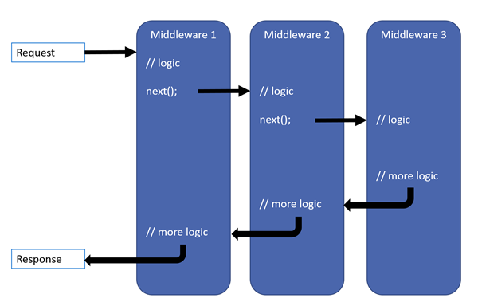
Each delegate can perform operations before and after the next delegate.
Exception-handling delegates should be called early in the pipeline, so they can catch exceptions that occur in later stages of the pipeline.

Slide 3
To understand this let’s write some code now

Slide 4
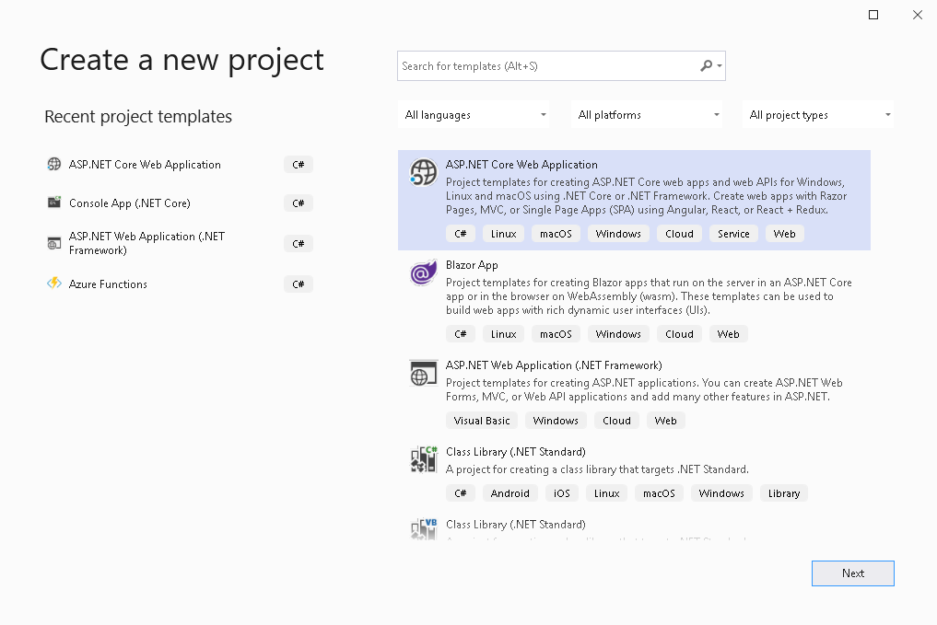

Slide 5
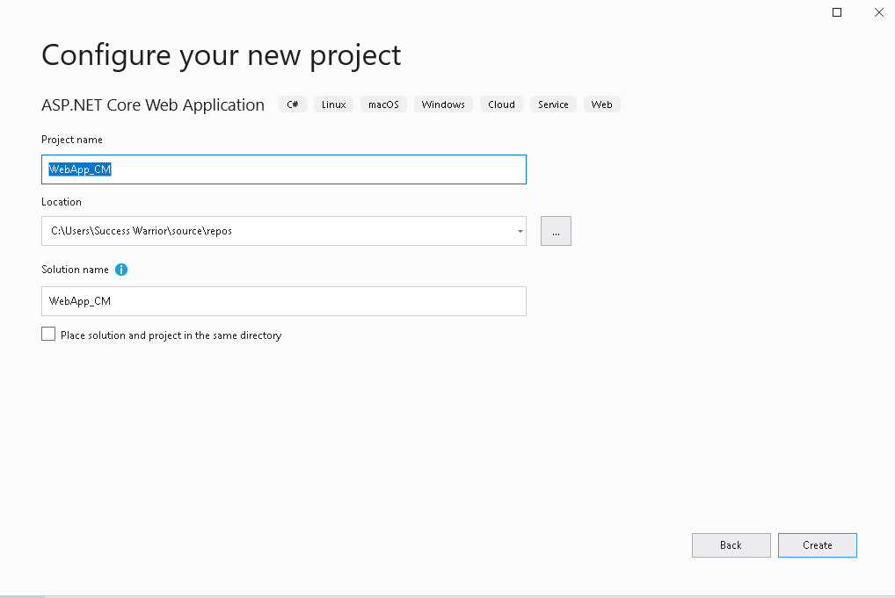

Slide 6
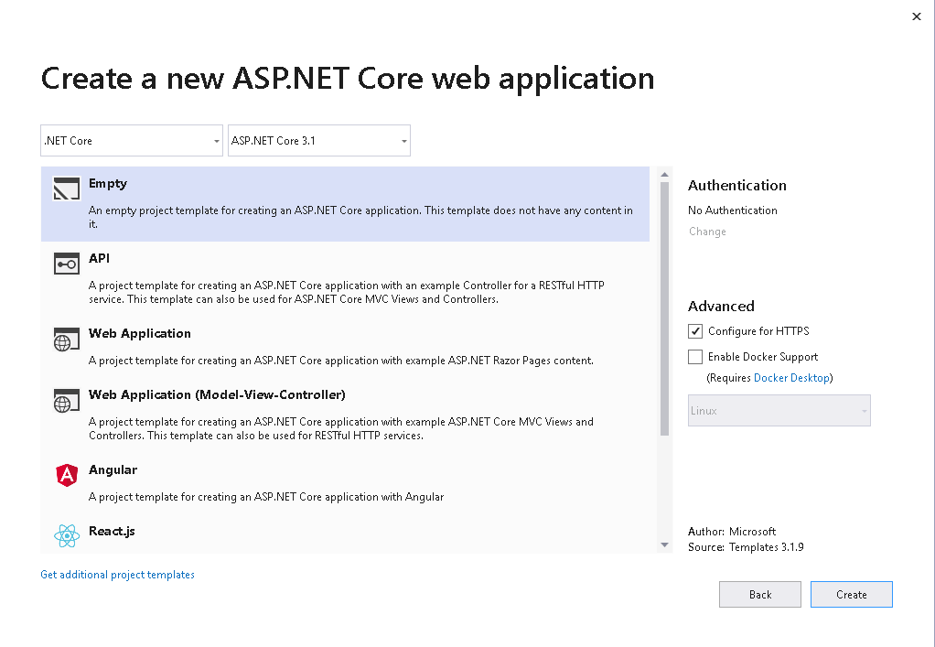

Slide 7
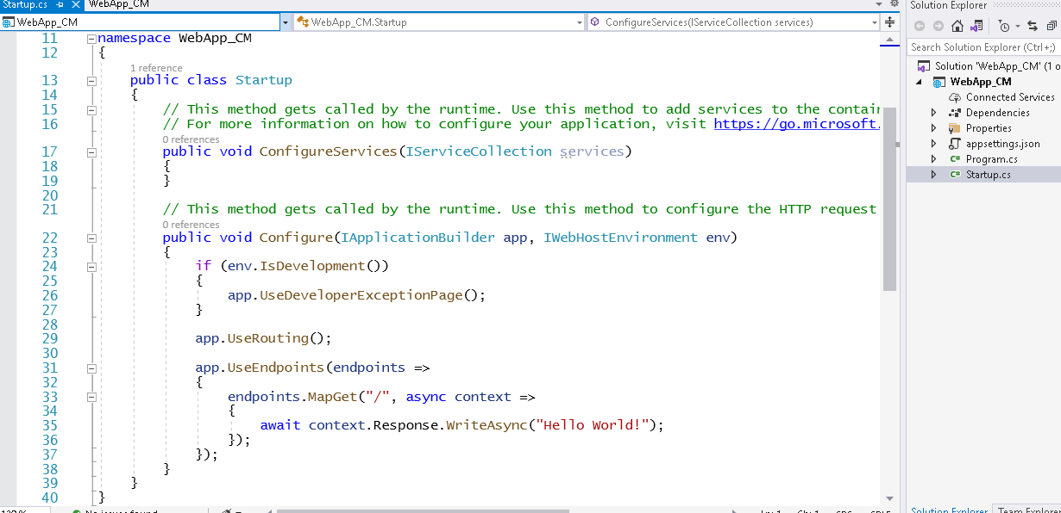

Slide 8
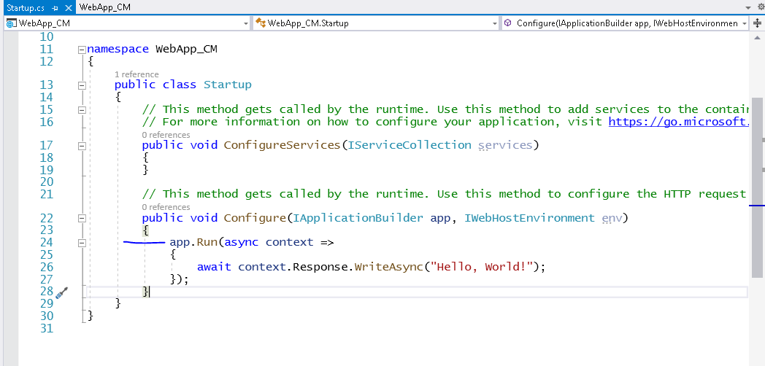

Slide 9
We used the app.Run method to register our first middleware, which displays the “Hello world”, when executed.
The app.Run method gets the instance of the Httpcontext. You can use the Responseobject from HttpContext to write out some message to HTTP Response
Just like as we did in Hello World

Slide 10
Configure Middleware with Use and Run
The Use and Run method extensions allow us to register the Inline Middlewares to the Request pipeline
The Run method adds the terminating middleware
The Use method adds the middleware, which may call the next middleware in the pipeline
Now let us add one more middleware using the app.Run

Slide 11
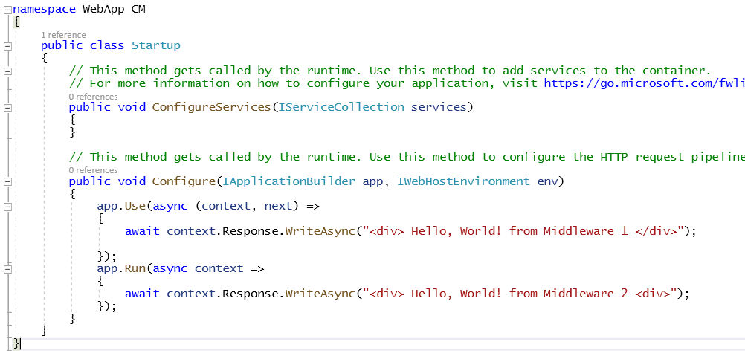

Slide 12
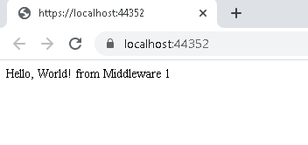

Slide 13
The app.Use gets two arguments. One is HttpContext and the second one is a RequestDelegate, which is basically the reference to the next middleware.
Now, run the code again.
The message “Hello world from the middleware 1” appears on the browser. The message from the second middleware does not appear
That is because it is the responsibility of the middleware to invoke the next middleware
We can invoke the next middleware by calling the invoke method of the next middleware, reference to which given to us in the constructor.
Now let’s modify the code to do that

Slide 14
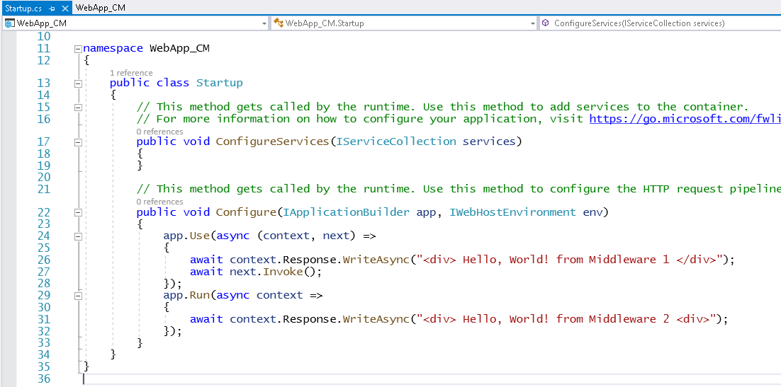

Slide 15
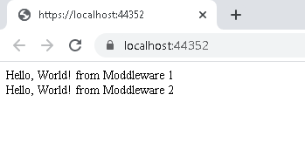

Slide 16
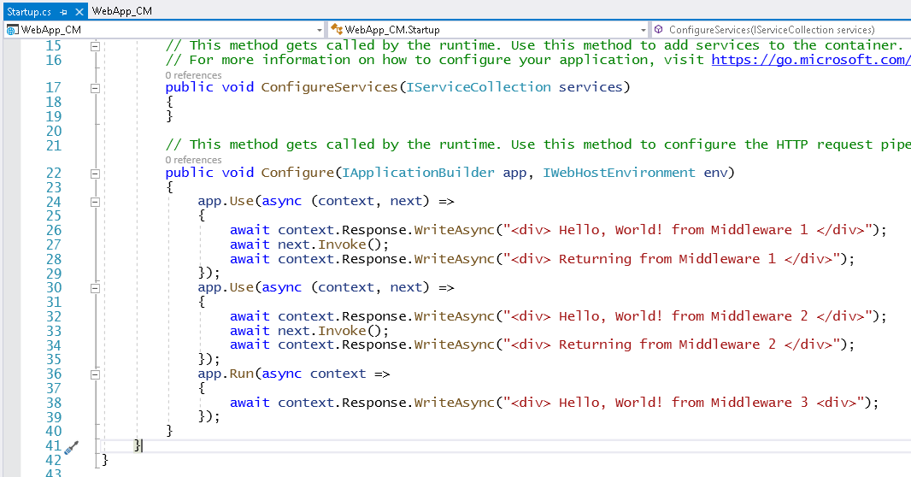
Now, let us add one more middleware and add a message after invoking the next middleware

Slide 17
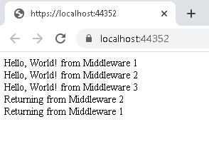
You will notice that Middlewares gets a second chance to look at the Request on the way back

Slide 18
Order Matters
Middleware is executed in the same order in which they are added in the pipeline.

Slide 19
Custom Middleware
In the above section, we created inline middlewares using the app.Use and the app.Run
The other way of creating the Middleware is by using classes.
The middleware class is not required to implement any interface or inherit from any class. However, there are two specific rules that you must follow.
1. The middleware class must declare a non-static public constructor with at least one parameter of type RequestDelegate
What actually you get here is the reference to the next middleware in the pipeline. When you invoke this RequestDelegate you are actually invoking the next middleware in the pipeline
2. The middleware class must define a public method named Invoke that takes an HttpContext and returns a Task.This is the method that gets invoked when the request arrives at the middleware

Slide 20
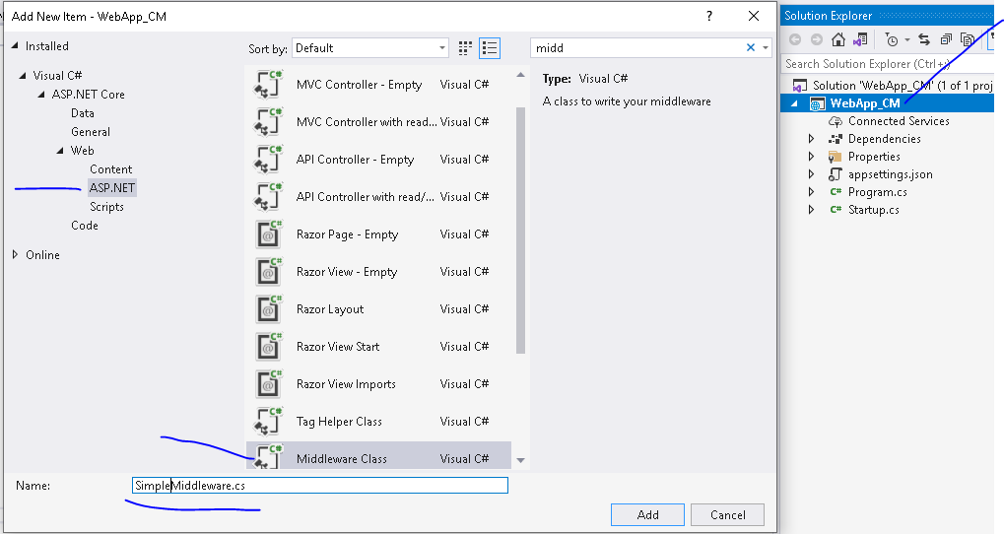

Slide 21
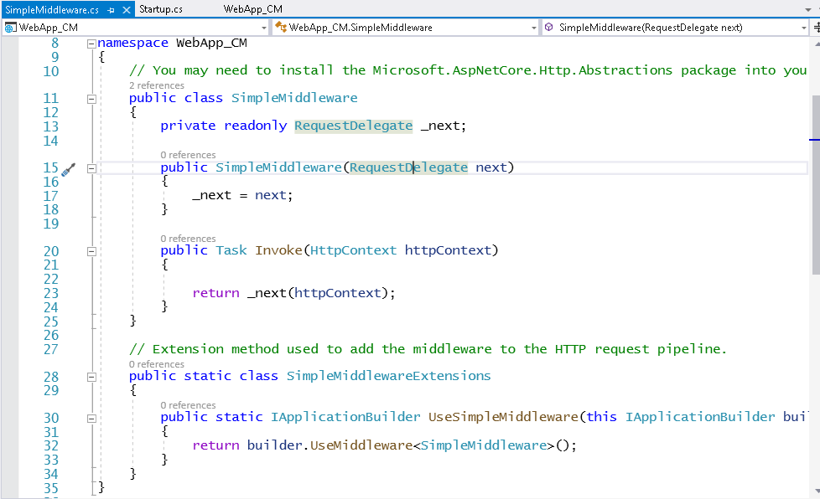

Slide 22
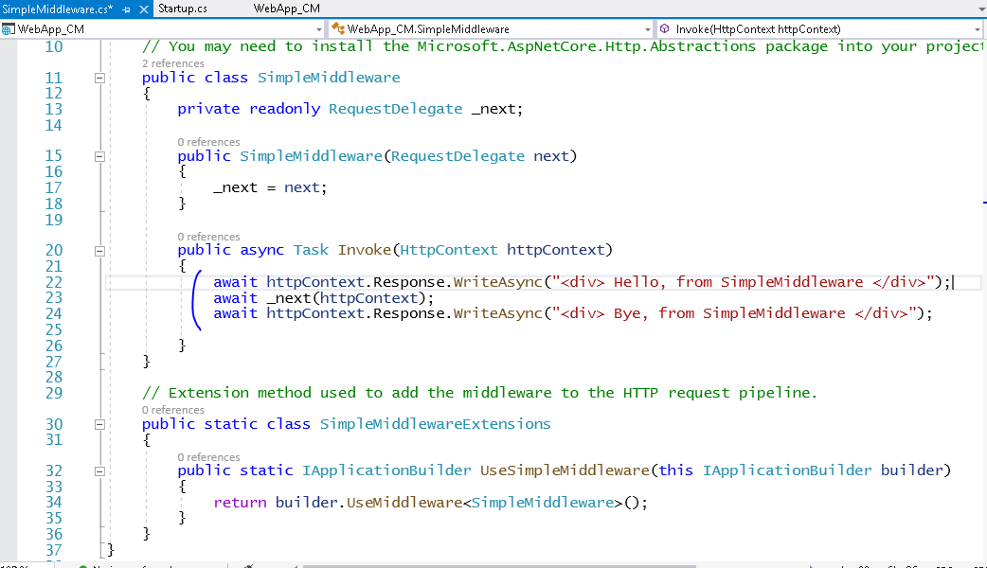

Slide 23
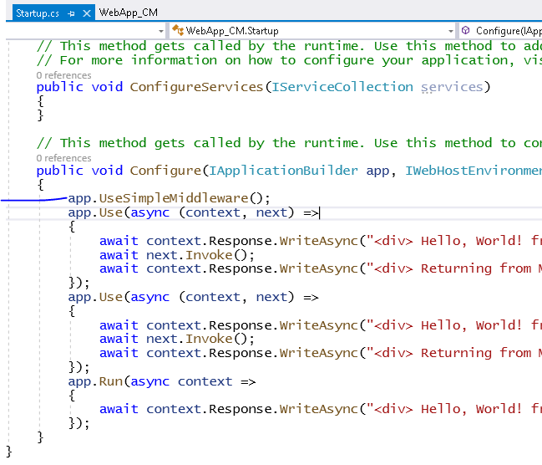

Slide 24
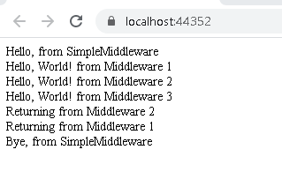

Slide 25
Conclusion:
The Middleware is software code, which processes the incoming requests. These Middlewares are chained together to form a request pipeline. We create Middleware and register in the configure method of the startup class

Slide 26
After Use and Run now it’s a time to learn Map

Slide 27
Map extensions are used as a convention for branching the pipeline. Map* branches the request pipeline based on matches of the given request path.
If the request path starts with the given path, the branch is executed.

Slide 28
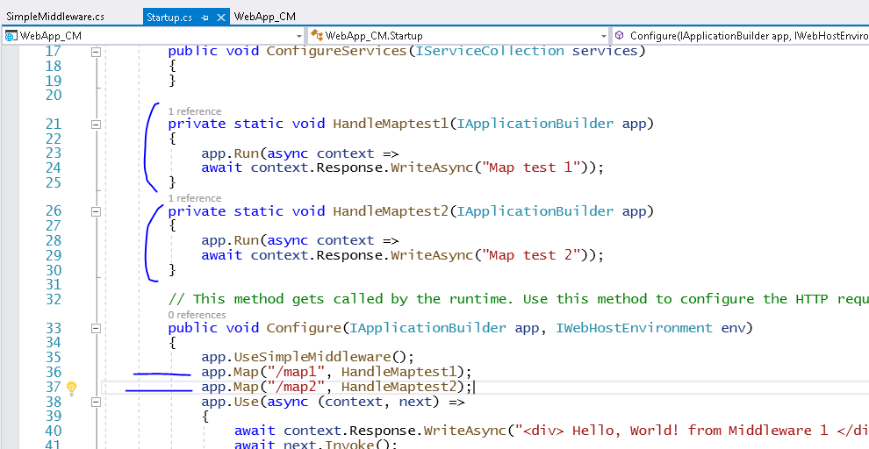

Slide 29
