Slide 1
Learning ASP.Net Core MVC

Slide 2
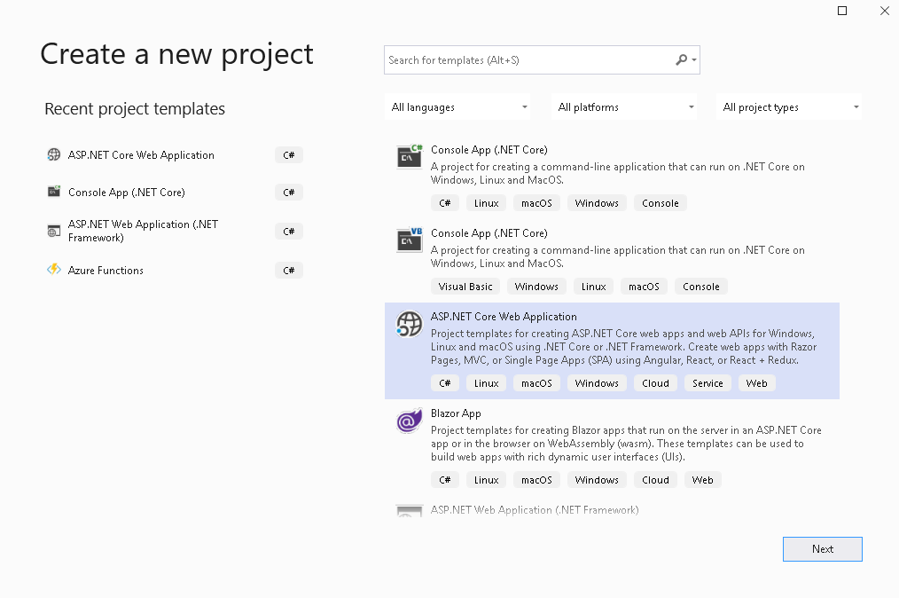

Slide 3
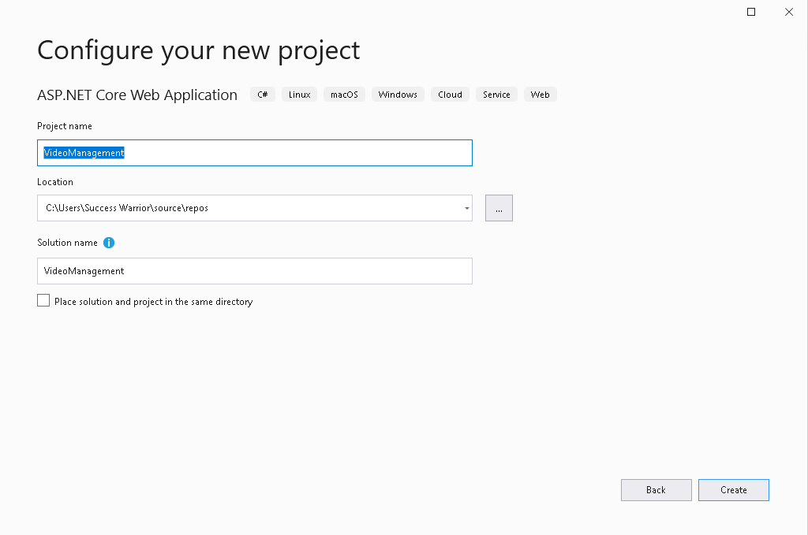

Slide 4
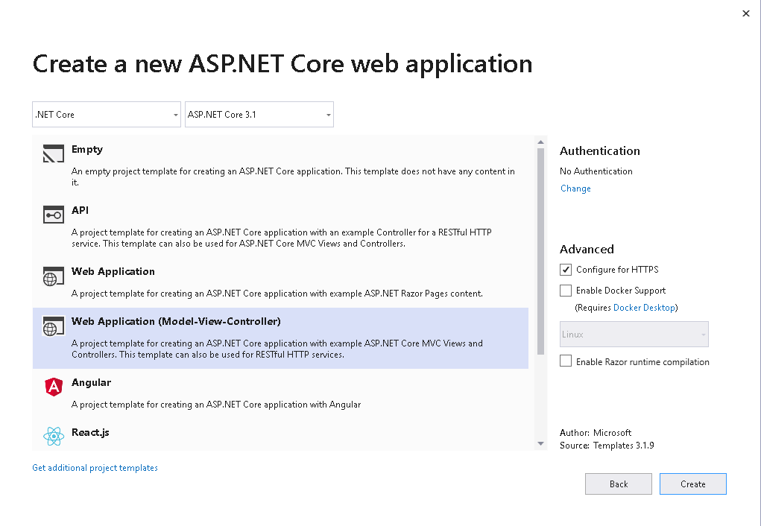

Slide 5
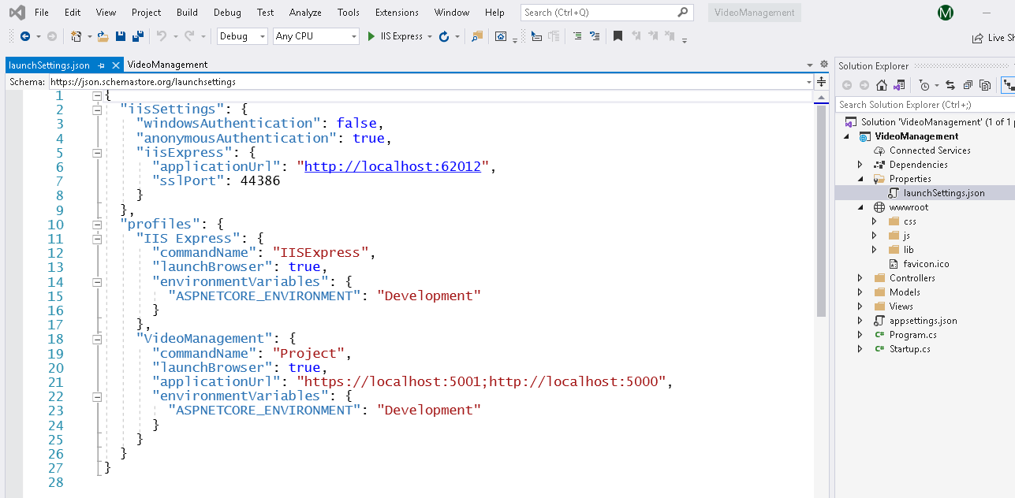

Slide 6
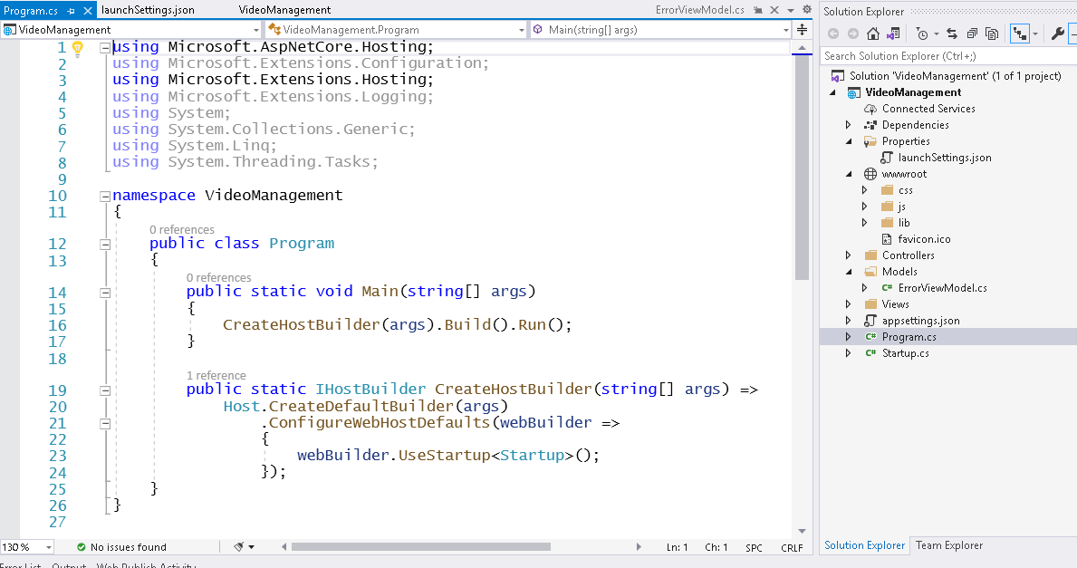

Slide 7
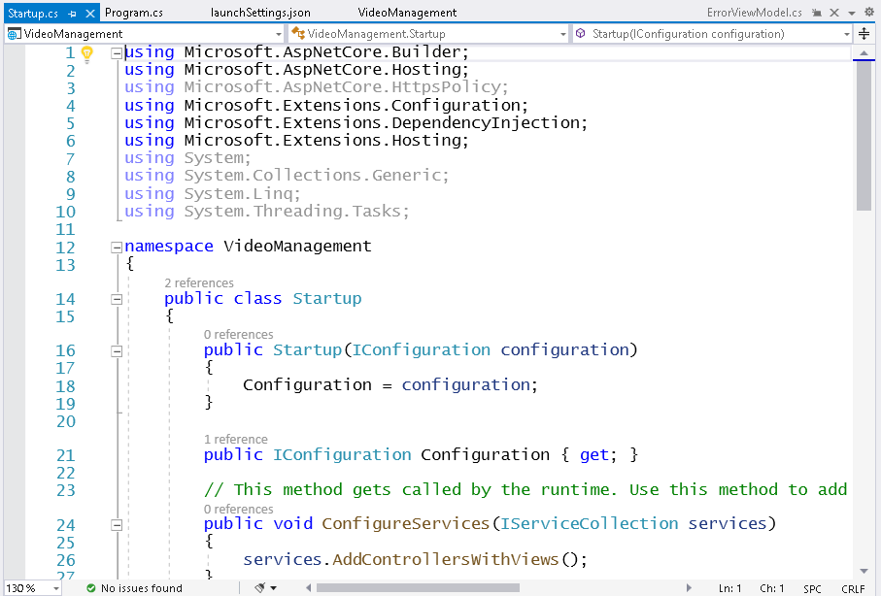
We always have DI implemented in core projects

Slide 8
Dependency injection (services)
A service is a component that's intended for common consumption in an app. Services are made available through dependency injection (DI).
ASP.NET Core includes a native Inversion of Control (IoC) container that supports constructor injection by default. You can replace the default native container if you wish. In addition to its loose coupling benefit, DI makes services available throughout your app.
ASP.NET Core includes a simple built-in container (represented by the IServiceCollection interface) that supports constructor injection by default, and ASP.NET makes certain services available through DI.

Slide 9
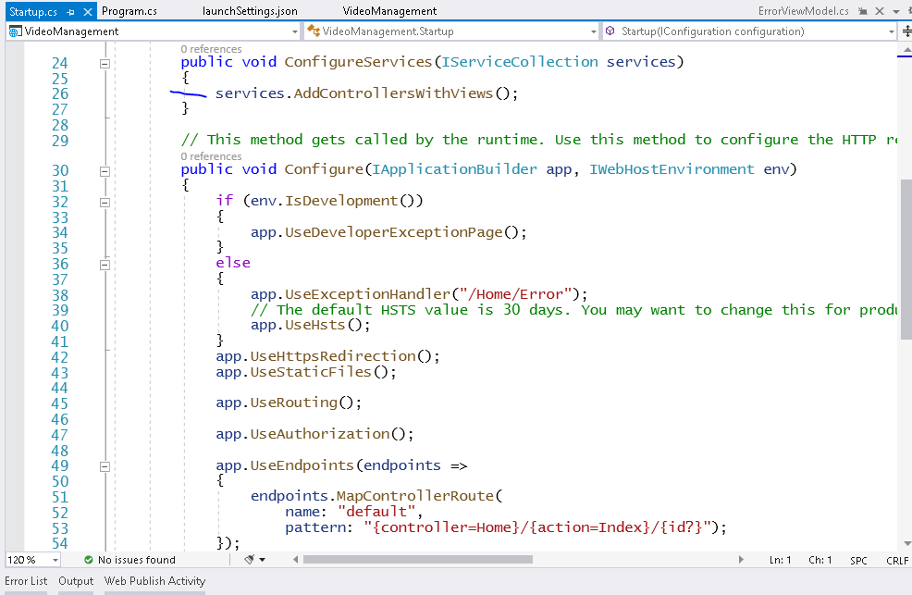

Slide 10
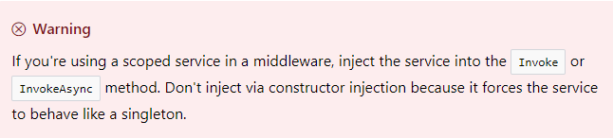
Service lifetimes and registration options
ASP.NET services can be configured with the following lifetimes:
Transient [something like percall]
Transient lifetime services are created each time they're requested. This lifetime works best for lightweight, stateless services.
Scoped [something like persession]
Scoped lifetime services are created once per request.

Slide 11
Singleton
Singleton lifetime services are created the first time they're requested (or when ConfigureServices is run if you specify an instance there) and then every subsequent request will use the same instance.
If your application requires singleton behavior, allowing the services container to manage the service's lifetime is recommended instead of implementing the singleton design pattern and managing your object's lifetime in the class yourself.

Slide 12
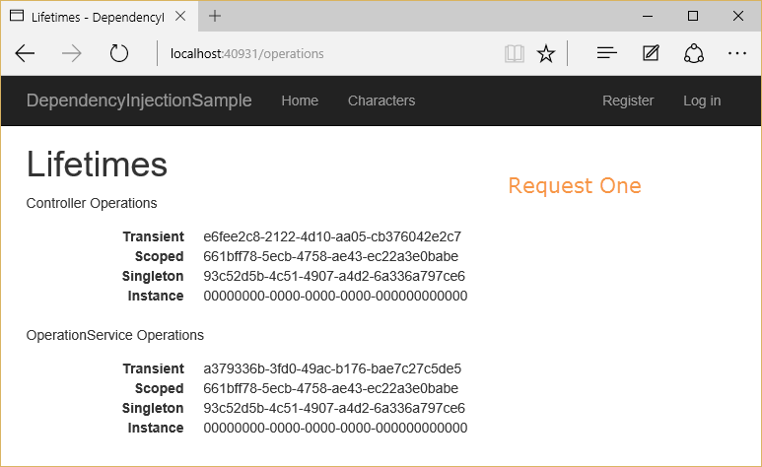
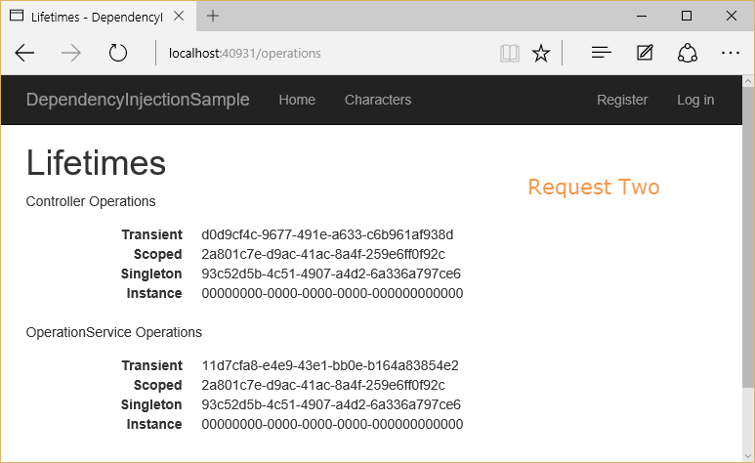

Slide 13
ASP.NET Core Middleware
What is middleware?
Middleware is software that's assembled into an application pipeline to handle requests and responses.
Each component:
Chooses whether to pass the request to the next component in the pipeline.
Can perform work before and after the next component in the pipeline is invoked.
[works on a concepts of chaining]
Request delegates are used to build the request pipeline. The request delegates handle each HTTP request.
Each middleware component in the request pipeline is responsible for invoking the next component in the pipeline, or short-circuiting the chain if appropriate.

Slide 14
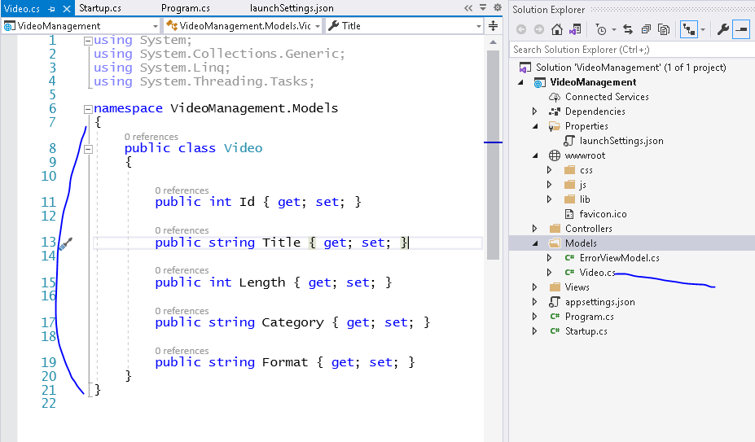

Slide 15
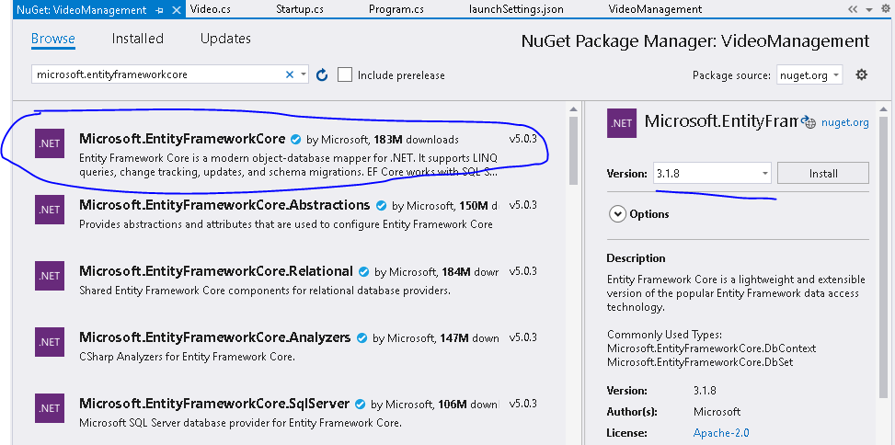

Slide 16
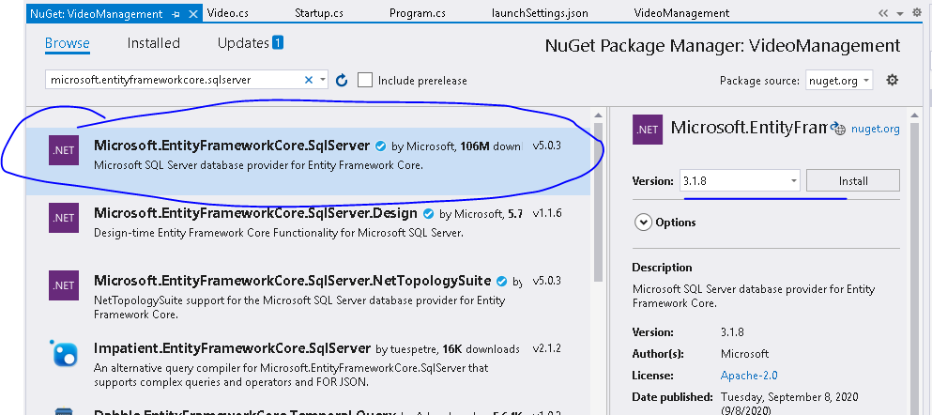

Slide 17
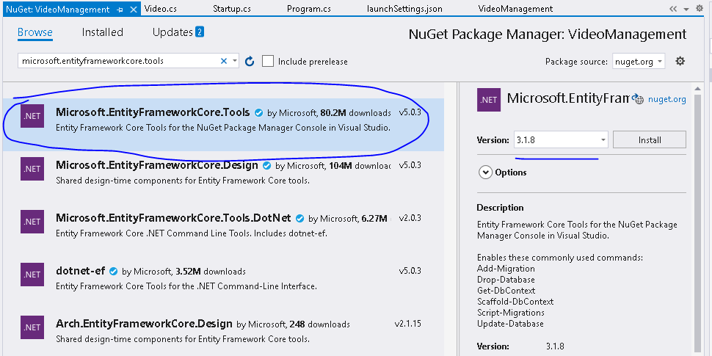

Slide 18
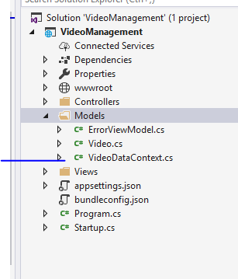

Slide 19
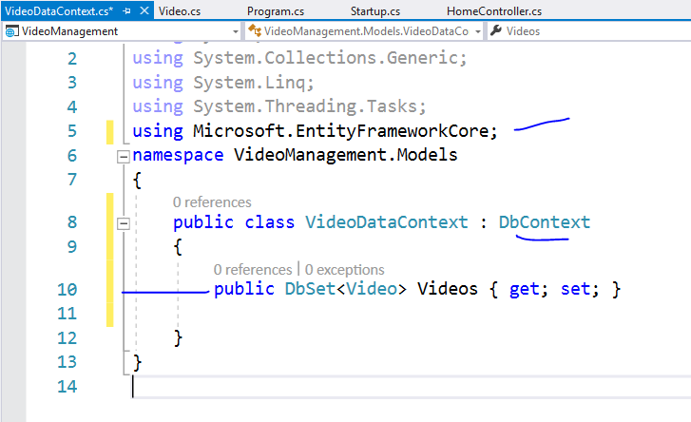

Slide 20
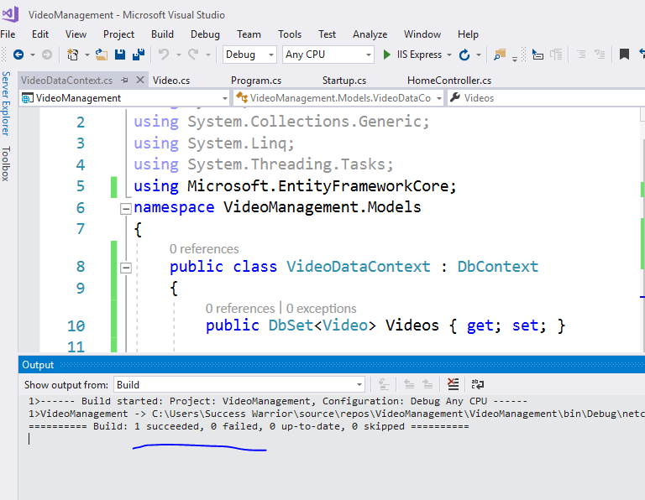

Slide 21
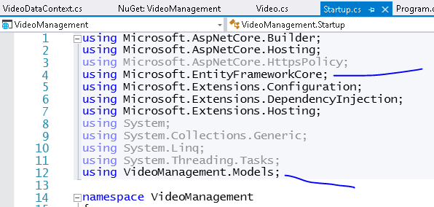

Slide 22
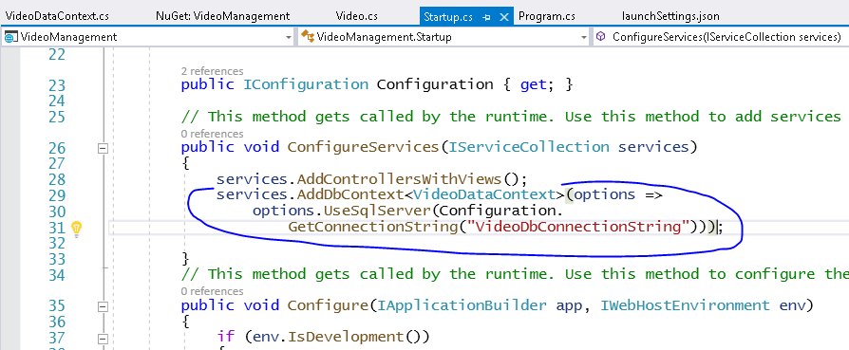

Slide 23
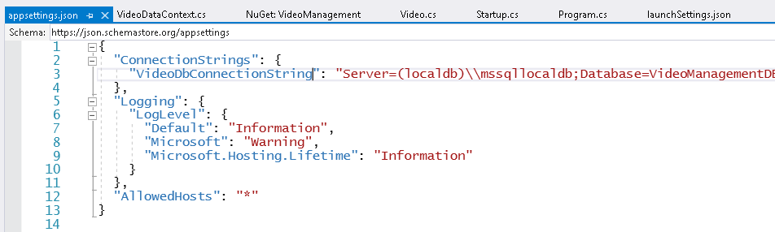

Slide 24
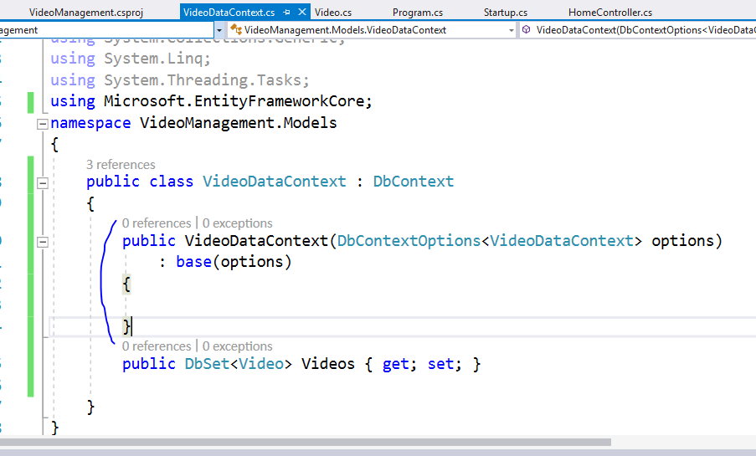

Slide 25
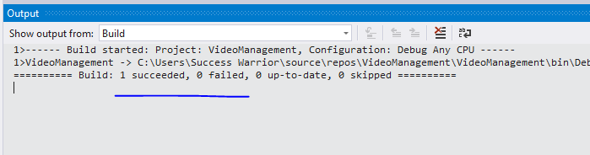

Slide 26
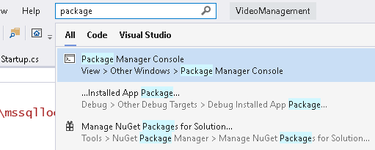

Slide 27
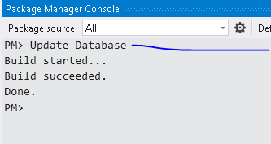

Slide 28
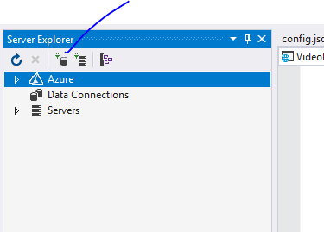
Now we should
Get database

Slide 29
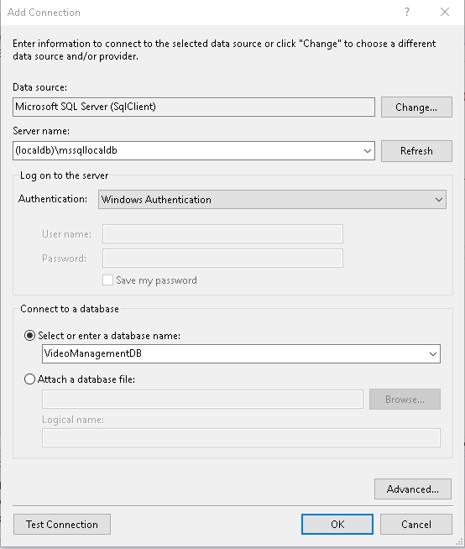

Slide 30
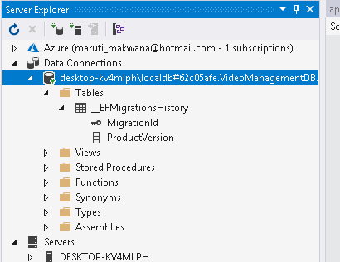
We got db
BUT
Where is our Table?

Slide 31
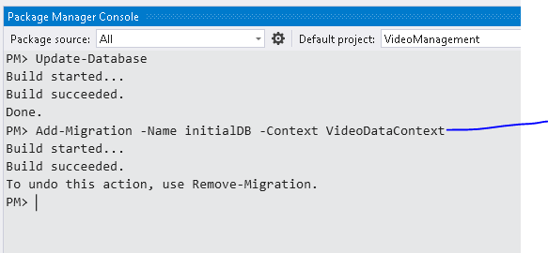

Slide 32
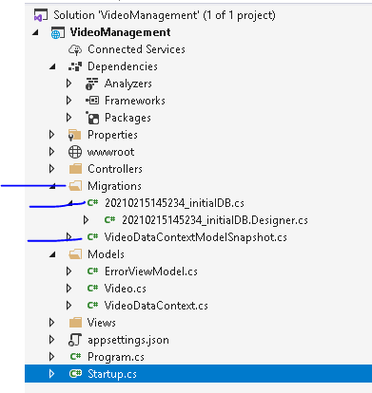
This will give us first migration
Context with our own table structure
But still we are not getting table in datbase

Slide 33
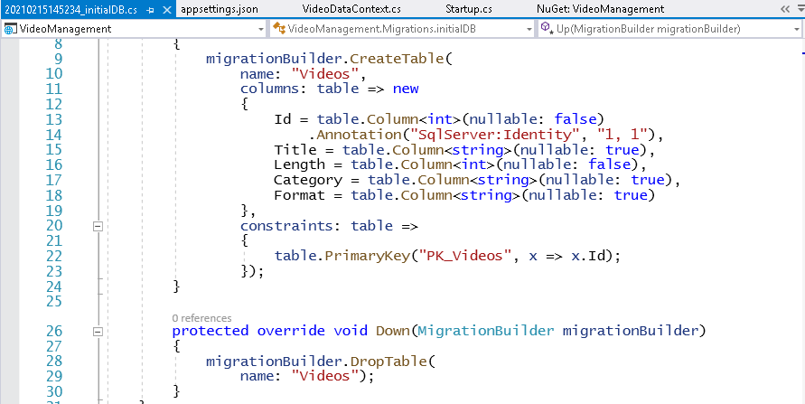

Slide 34
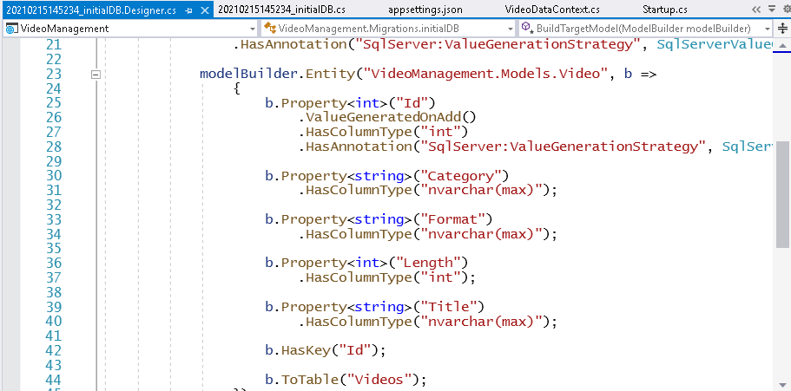

Slide 35
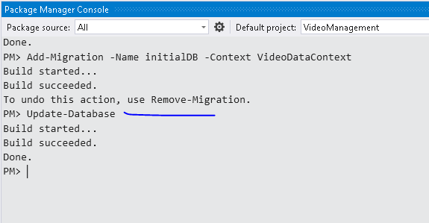

Slide 36
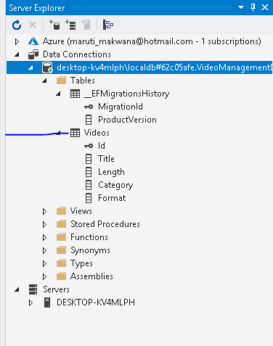

Slide 37
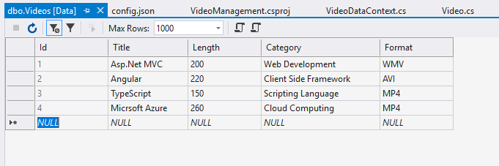
Lets add some dummy records in table

Slide 38
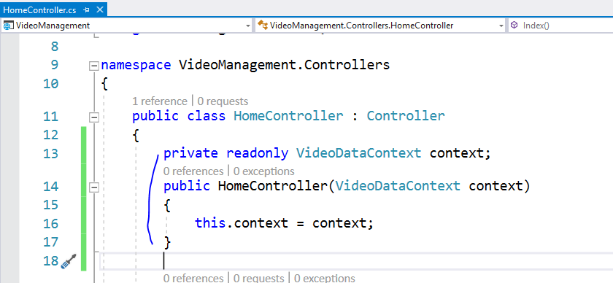

Slide 39
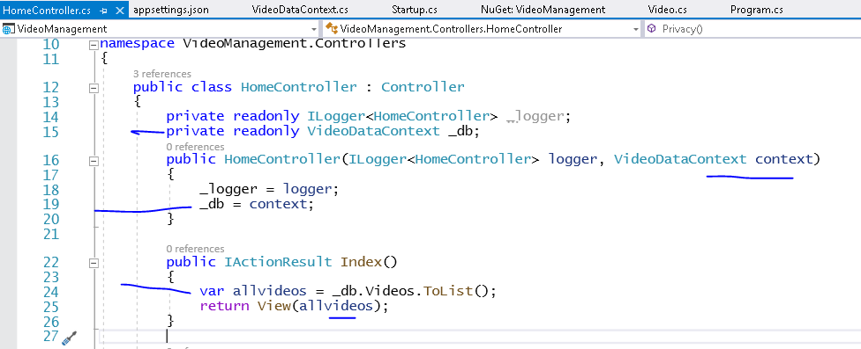

Slide 40
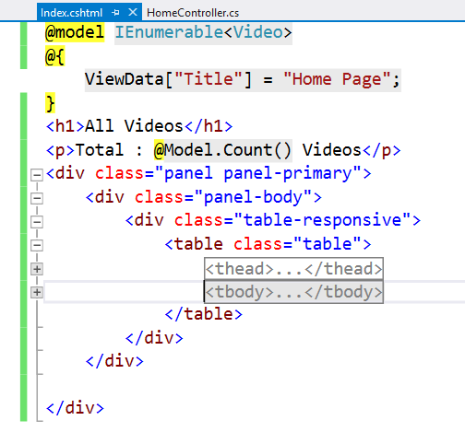

Slide 41
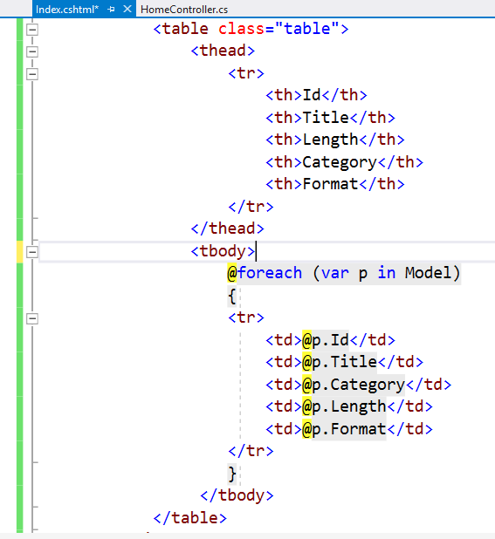

Slide 42
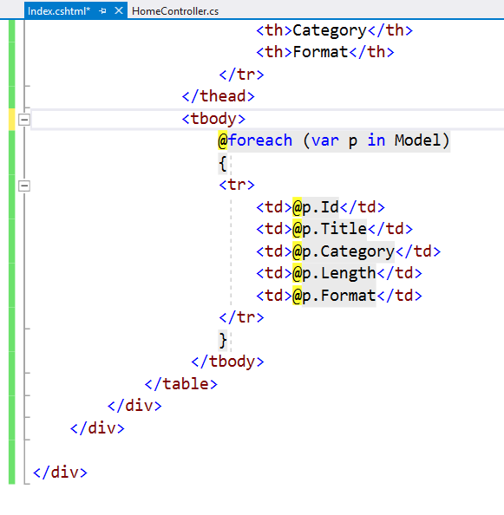

Slide 43
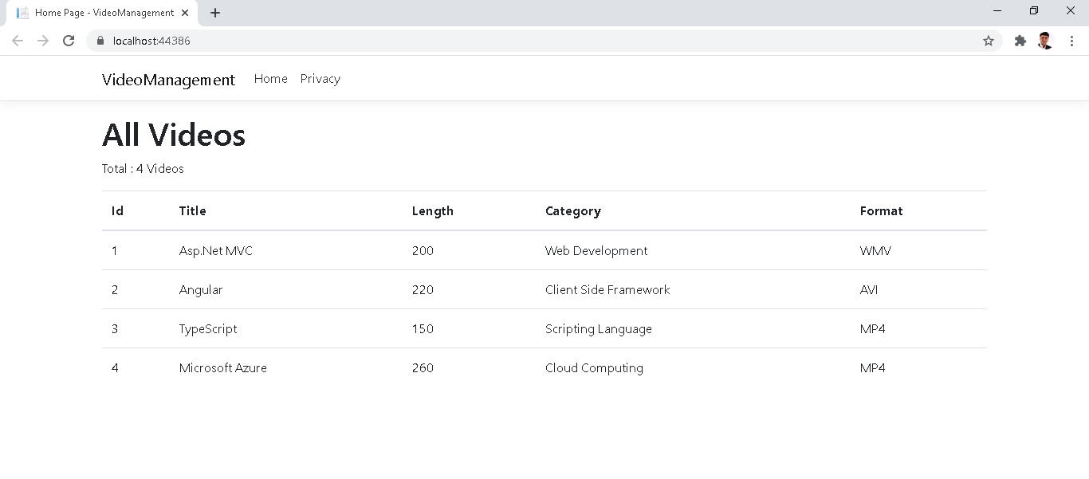

Slide 44
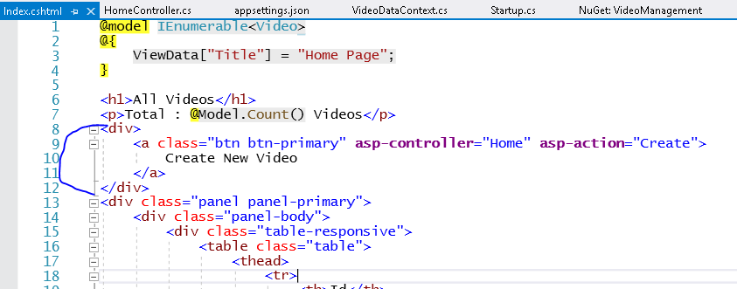

Slide 45
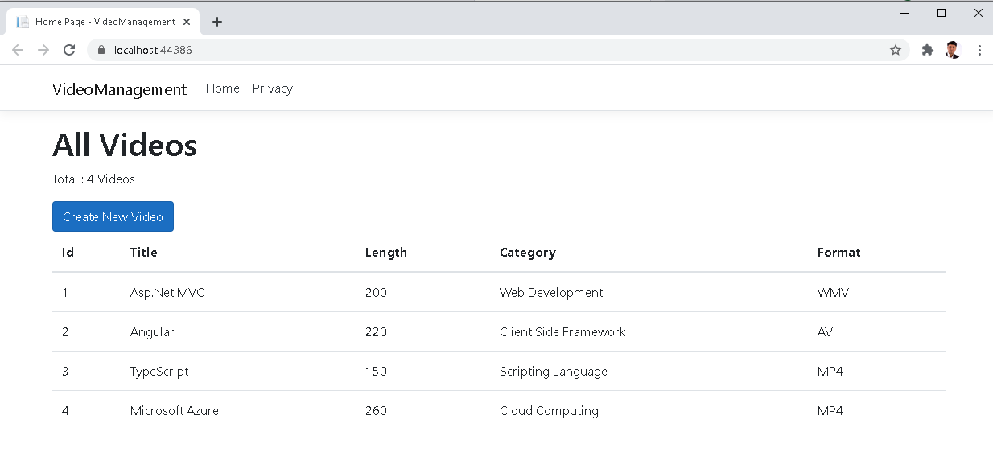

Slide 46
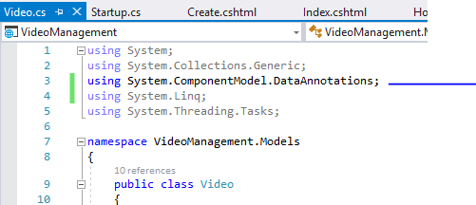

Slide 47
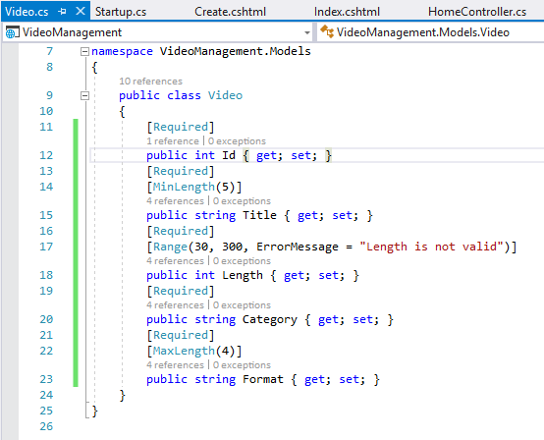

Slide 48
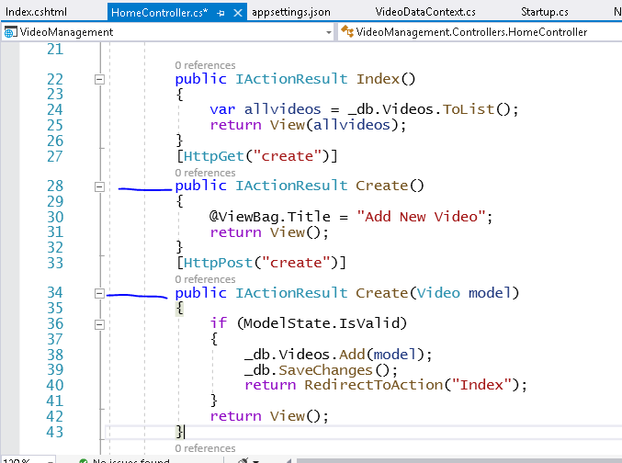

Slide 49
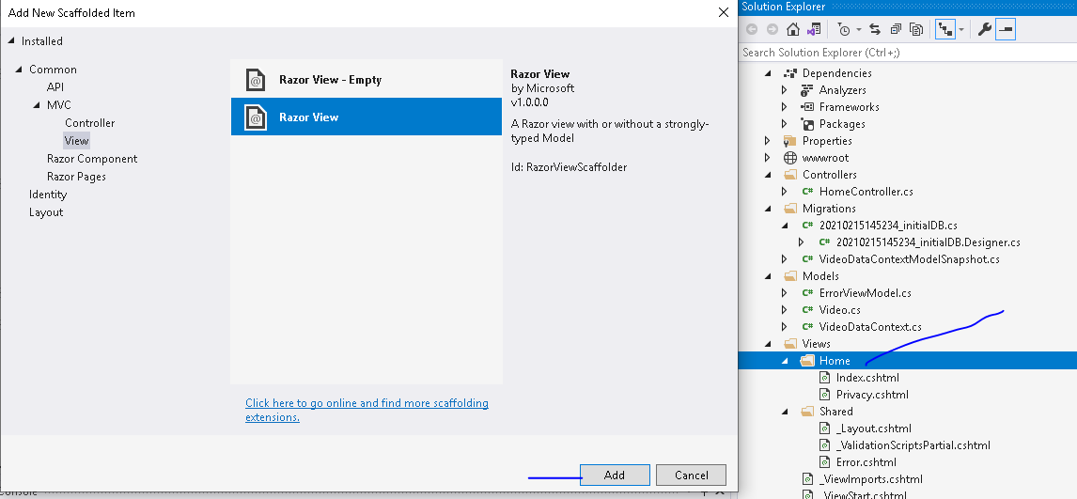

Slide 50
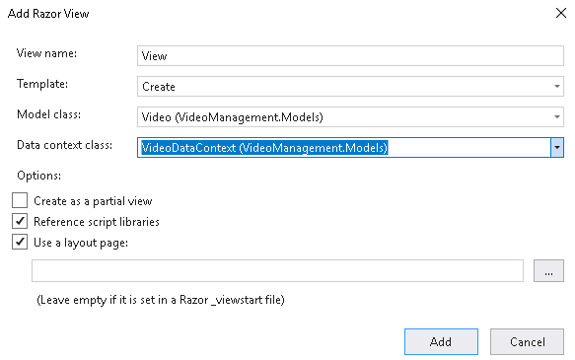


Slide 51
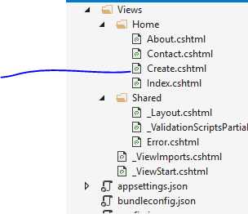

Slide 52
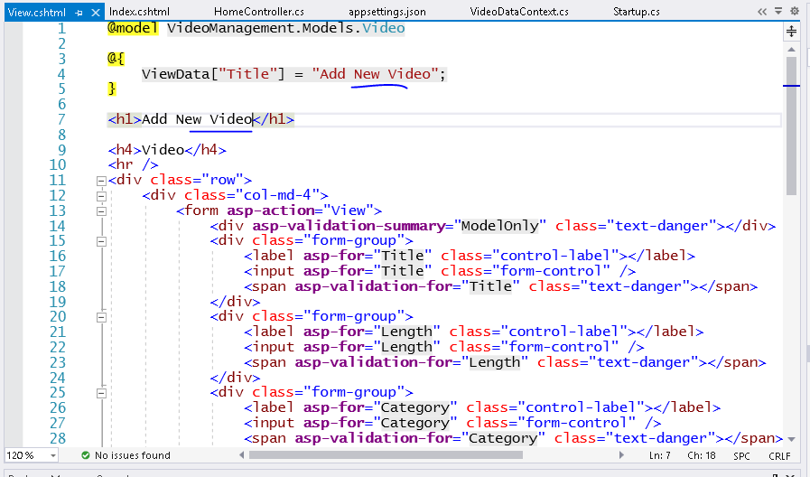

Slide 53
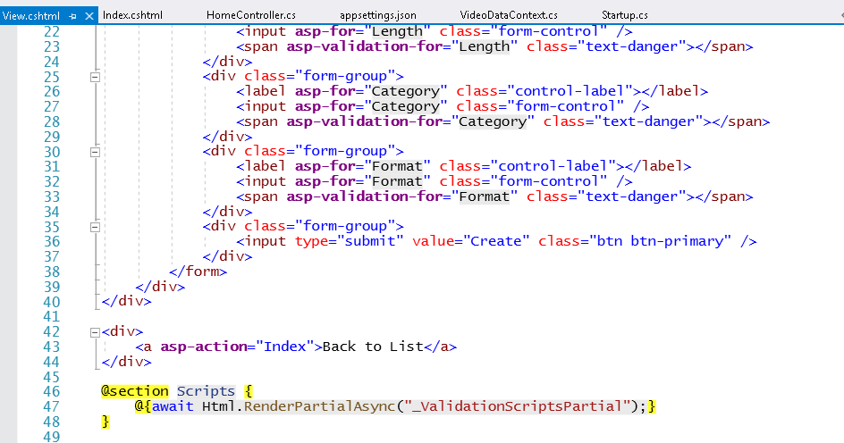

Slide 54


Slide 55



Slide 56


Slide 57


Slide 58
Now let’s implement repository pattern for this

Slide 59


Slide 60


Slide 61


Slide 62

This interface will help us in mocking while testing code and in services also and
when you create generic repository

Slide 63



Slide 64


Slide 65
Now let’s use this repository in Web API

Slide 66


Slide 67


Slide 68


Slide 69


Slide 70



