Slide 1

Welcome to Deep Learning Online Bootcamp
Day 3: Introduction to tf.Keras and Tensors

Slide 2

Learning Objectives
TensorFlow, Keras & tf.keras
Setting up TensorFlow
Tensors

Slide 3
TIP
You DON’T need to memorize the below jargons!
Notes:
What? - CPUs, GPUs, TPUs Why? Where? -

Slide 4
TensorFlow, Keras, tf.keras

Slide 5

What is TensorFlow?
As you are aware by now, Tensorflow, is a deep learning library/framework open-sourced by Google.
It has grown to become one of the most loved and widely adopted ML platforms in the world.
The TensorFlow community includes:
Researchers
Developers
Companies

Slide 6

What & Why Keras?
Keras is a deep learning API (a tool that enables two applications to exchange data among each other) written in Python.
It runs on top of TensorFlow.
It was developed with a focus on enabling fast experimentation. Being able to go from idea to result as fast as possible is the key to doing good research.

Slide 7
What & Why tf.Keras?
tf.keras is a Tensorflow specific implementation of Keras. The name pre-fix “tf” itself says it is specific to TensorFlow framework.
Since tf.keras is a specific implementation of TensorFlow, it has some advantages and support for many TensorFlow specific features.
History/context: Not so long ago, on September 30th, 2019, Tensorflow 2.0 was launched. After the launch, developers started promoting something called tf.Keras.

Slide 8

Keras vs tf.Keras
We would suggest using TensorFlow 2.0 and tf.keras for future projects.
Not only you will enjoy the added speed and optimization of TensorFlow 2.0, but you’ll also receive new feature updates — the latest release of the keras package (v2.3.0) will be the last release to support multiple backends and feature updates. Moving forward, the keras package will receive only bug fixes.

Slide 9
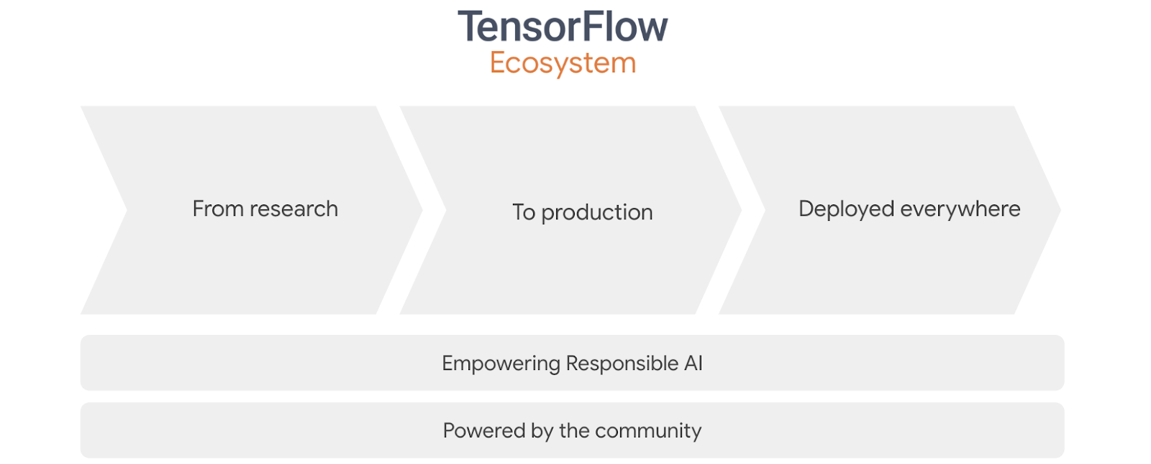
Tensorflow 2.0 Ecosystem & its use cases
Tensorflow 2.0 is not just a library, it’s an Ecosystem. Not only you have the ability to train your own models using TensorFlow 2.0 and tf.keras, but you can now use:
TensorFlow Lite: lightweight library for deploying models on mobile and embedded devices.
TensorFlow Extended: end-to-end platform for preparing data, training, validating, and deploying models in large production environments.

Slide 10
Now that we know why we’re using Tensorflow 2.0 and tf.keras, let’s get started with it!

Slide 11

Importing Tensorflow
Even if Tensorflow has been installed, we’ll always need to import it before use.
Within a Jupyter or Colab Notebook, you can import TensorFlow with a simple import statement. Just how we used np for numpy or pd for Pandas, we’ll be using tf for importing Tensorflow as shown below:
On running this cell, TensorFlow will be imported and available for your use!

Slide 12
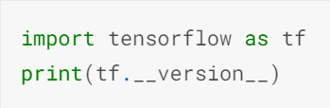
Check the version of Tensorflow
Open a Jupyter Notebook/Google Colab
In a cell type and execute the following command:
Make sure the displayed version starts with 2 i.e ensure Tensorflow 2 has been installed.
Google Colab uses TensorFlow 2 by default.

Slide 13
Tensors

Slide 14
Why should we study about Tensors?
Tensors are the primary data structures used by neural networks (the building blocks of Deep Learning).
And they are rather fascinating as well!
In neural networks transformations, input, output etc are performed via tensors.

Slide 15
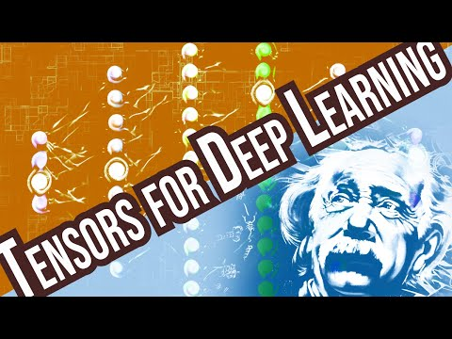
What are Tensors?

Slide 16
What are Tensors?
Tensors are multi-dimensional arrays with a uniform type (called a dtype).
If you're familiar with NumPy, tensors are (kind of) like np.arrays.
All tensors are immutable like Python numbers and strings i.e you can never update the contents of a tensor, only create a new one.

Slide 17
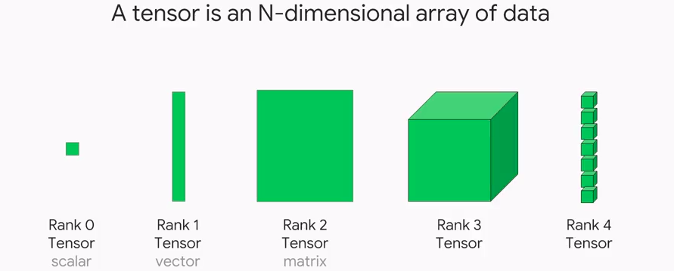
What are Tensors?
As you can see in the figure, the first 3 ranks of Tensors have special names that you might have encountered in the past.
Rank 0 tensor - Scalar
Rank 1 tensor - Vector
Rank 2 tensor - Matrix
The tensors with ranks more than 2 are simply called ‘ Tensor ’.

Slide 18
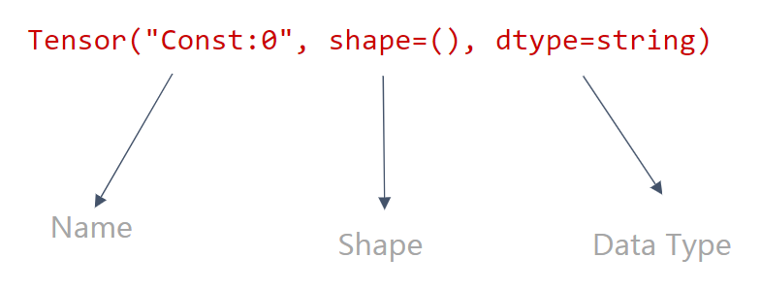
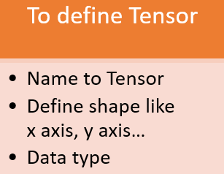
Understanding Tensor

Slide 19
How is the tensor shape important?
Our networks operate on tensors, after all, and this is why understanding a tensor’s shape and the available reshaping operations are super important.
Let’s learn about the shape and the methods of reshaping tensors in the next 2 videos.
Note: These videos involve some syntax of PyTorch but not to worry, the concepts remain the same regardless of the framework! We have added a practical implementation of it in tensorflow provided in the github repository.

Slide 20
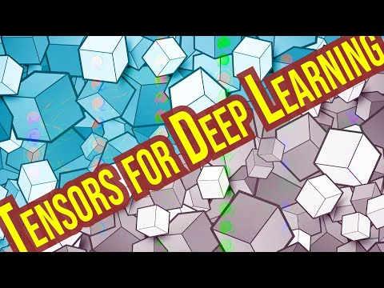
Rank, Axes and Shape

Slide 21
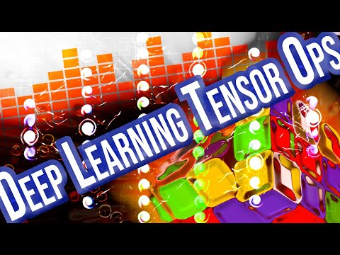
Reshape, Squeeze and Flatten

Slide 22
Additional Resources
On going through the below short resources from Tensorflow’s official documentation, you’ll notice the similarity between what you saw in the videos and what is implemented.
Tensorflow Reshape: https://docs.w3cub.com/tensorflow~python/tf/reshape/
Tensorflow Squeeze:
https://docs.w3cub.com/tensorflow~python/tf/squeeze/

Slide 23
Let’s Practice
Tensorflow Operations Notebook: https://github.com/dphi-official/Deep_Learning_Bootcamp/tree/master/Tensor_Operations

Slide 24
Slides Download Link
You can download this module from the below link:
https://docs.google.com/presentation/d/1aFh443T4jAy6LVUv5BwPFhlig7gAyq0IahAb4r-kd5Y/edit?usp=sharing

Slide 25
That’s it for the day. Thank you!
Feel free to post any queries in the #help channel on Slack

