Slide 1


ShopSphere E-Commerce Data Analysis

Slide 2


Project Objectives
Sales & Profitability
Measure revenue, AOV, margin
Monthly Trends
Compare 2024 vs 2025
Category Performance
Identify top contributors
Power BI Dashboard
Management-ready visuals

Slide 3
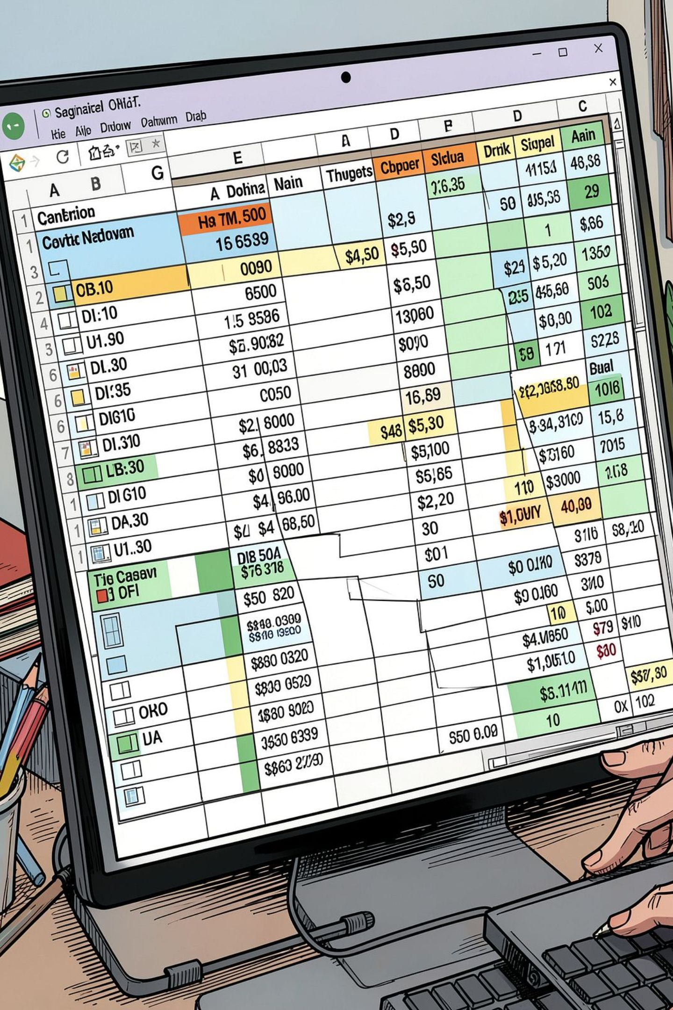
Dataset Overview
200K
Rows
Transactions
24
Columns
Fields per record
49K
Customers
Unique Customer_IDs
500
Products
Unique Product_IDs

Slide 4
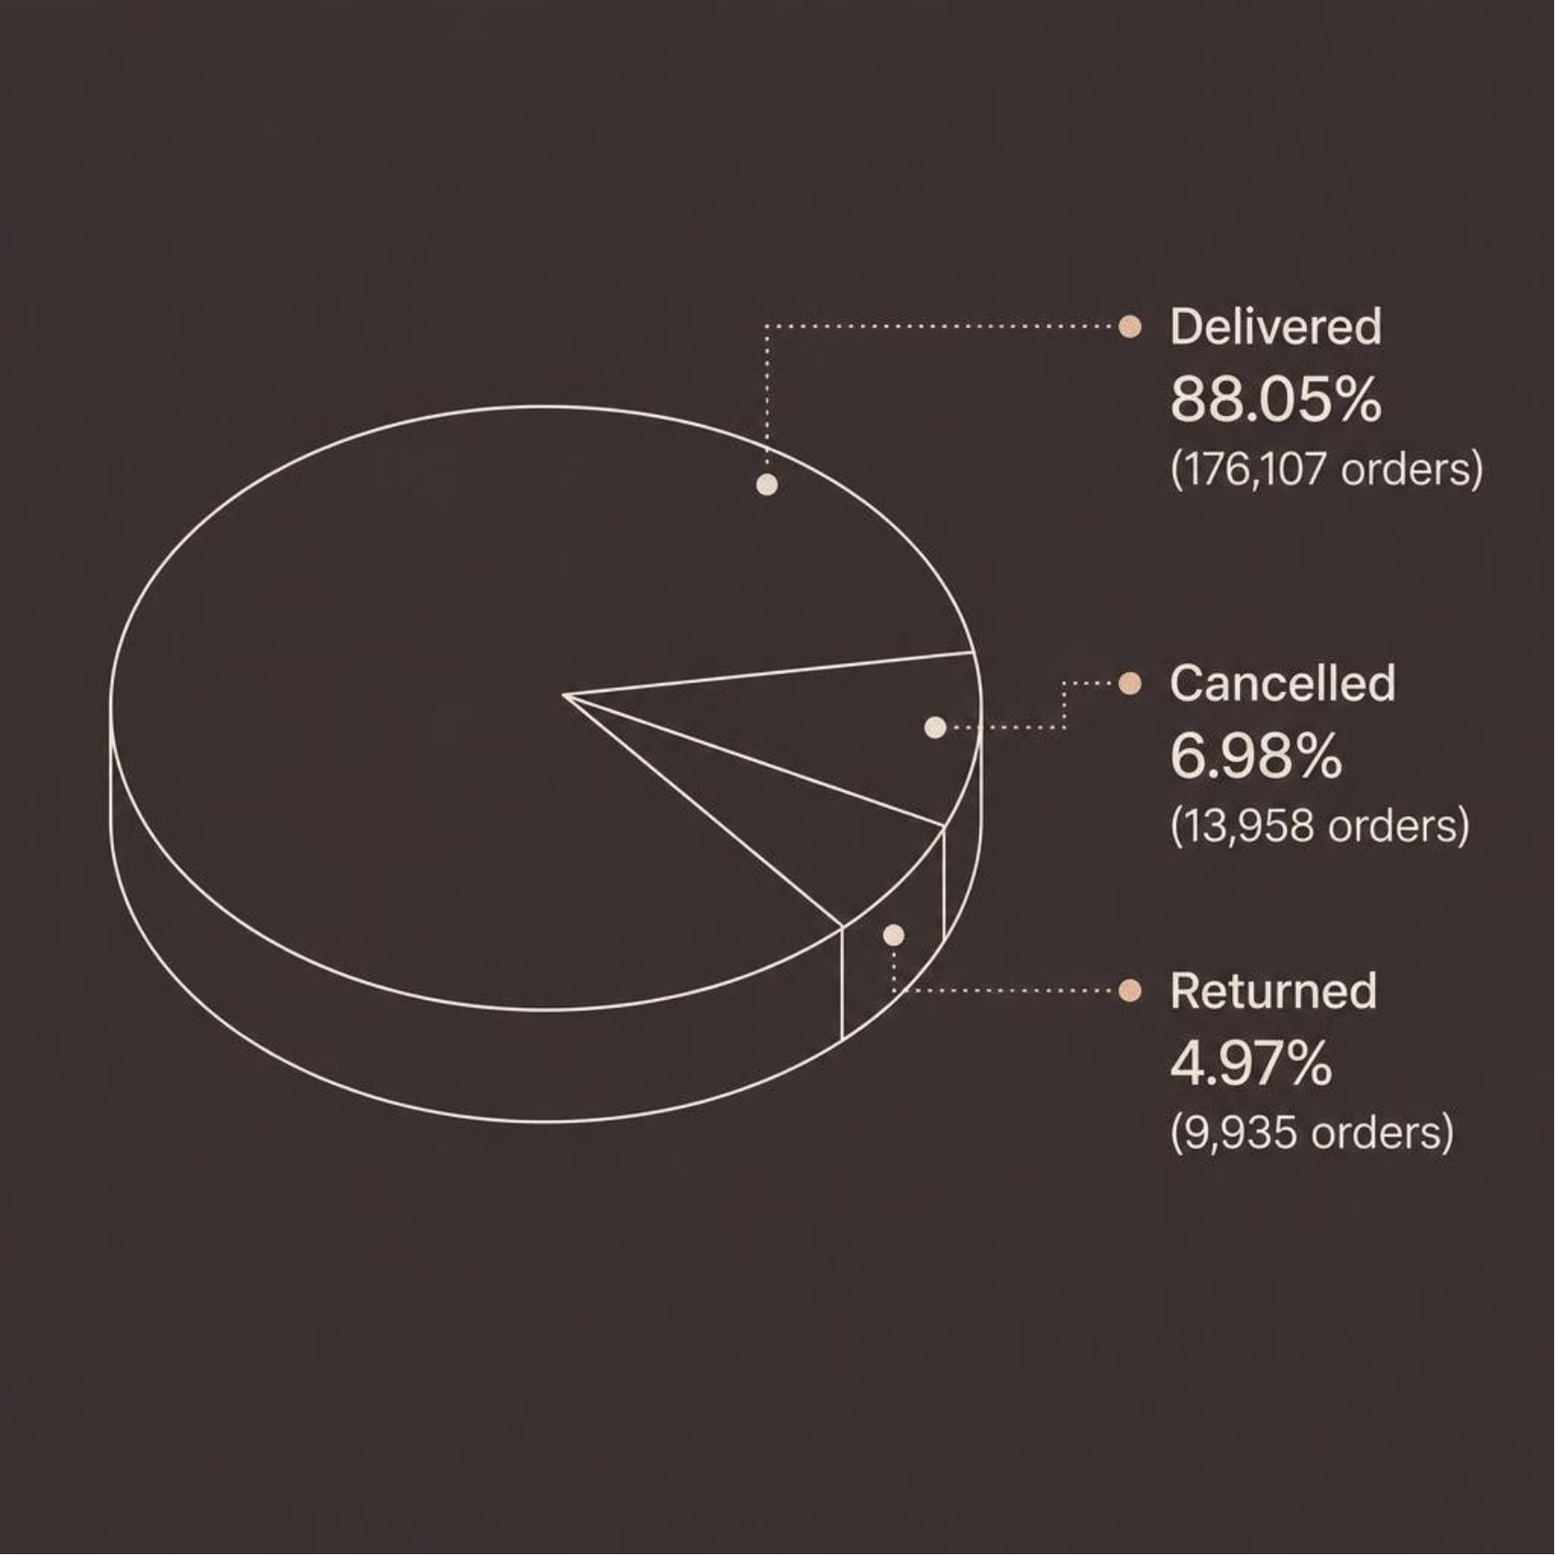
Data Quality: Clean & Validated
✅ Missing Values
✅ Duplicate Rows
Zero across all 24 columns
None found
✅ Unique Order_IDs
✅ Financial Checks
200,000 — all distinct
Revenue & Profit validated

Slide 5
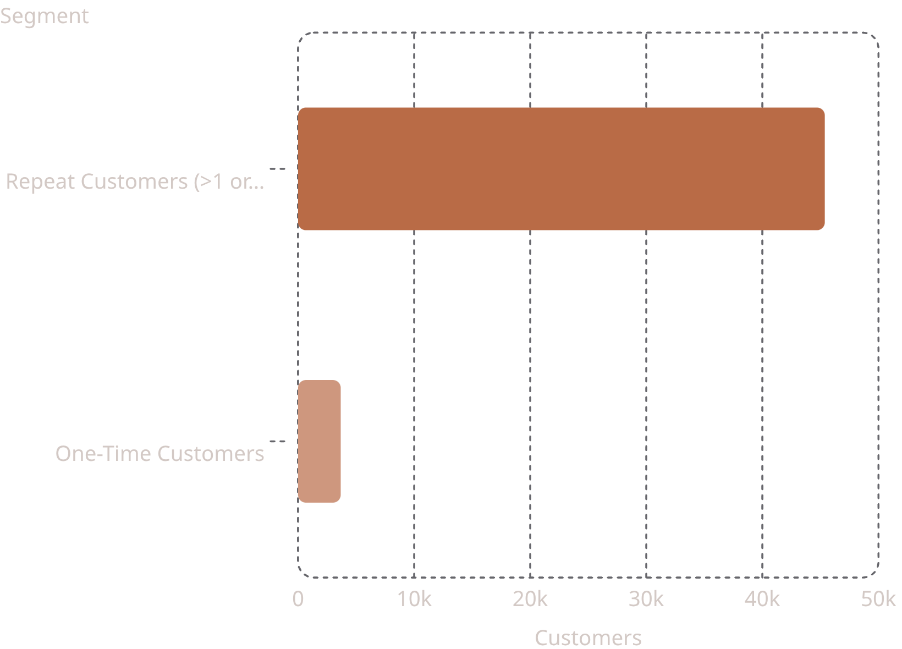
Customer Repeat Behavior
Key Findings
45,377 customers placed more than one order
Only 3,677 customers ordered once
Max orders by one customer: 14
Strong foundation for retention & loyalty analysis

Slide 6
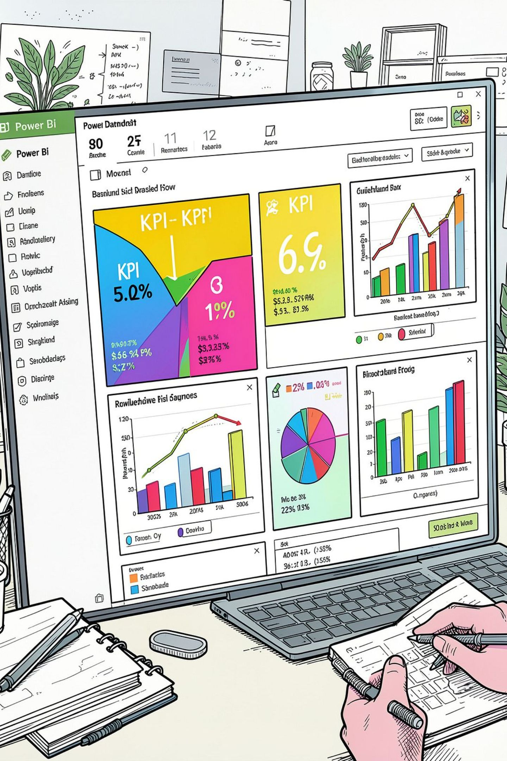
Power BI Data Modeling
DateTable
Key Measures
Date, Month, Year, Year-Month fields
Total Sales, Orders, AOV, Customers, Profit, Margin
Two Pages
Executive Dashboard + Sales Performance Analysis

Slide 7
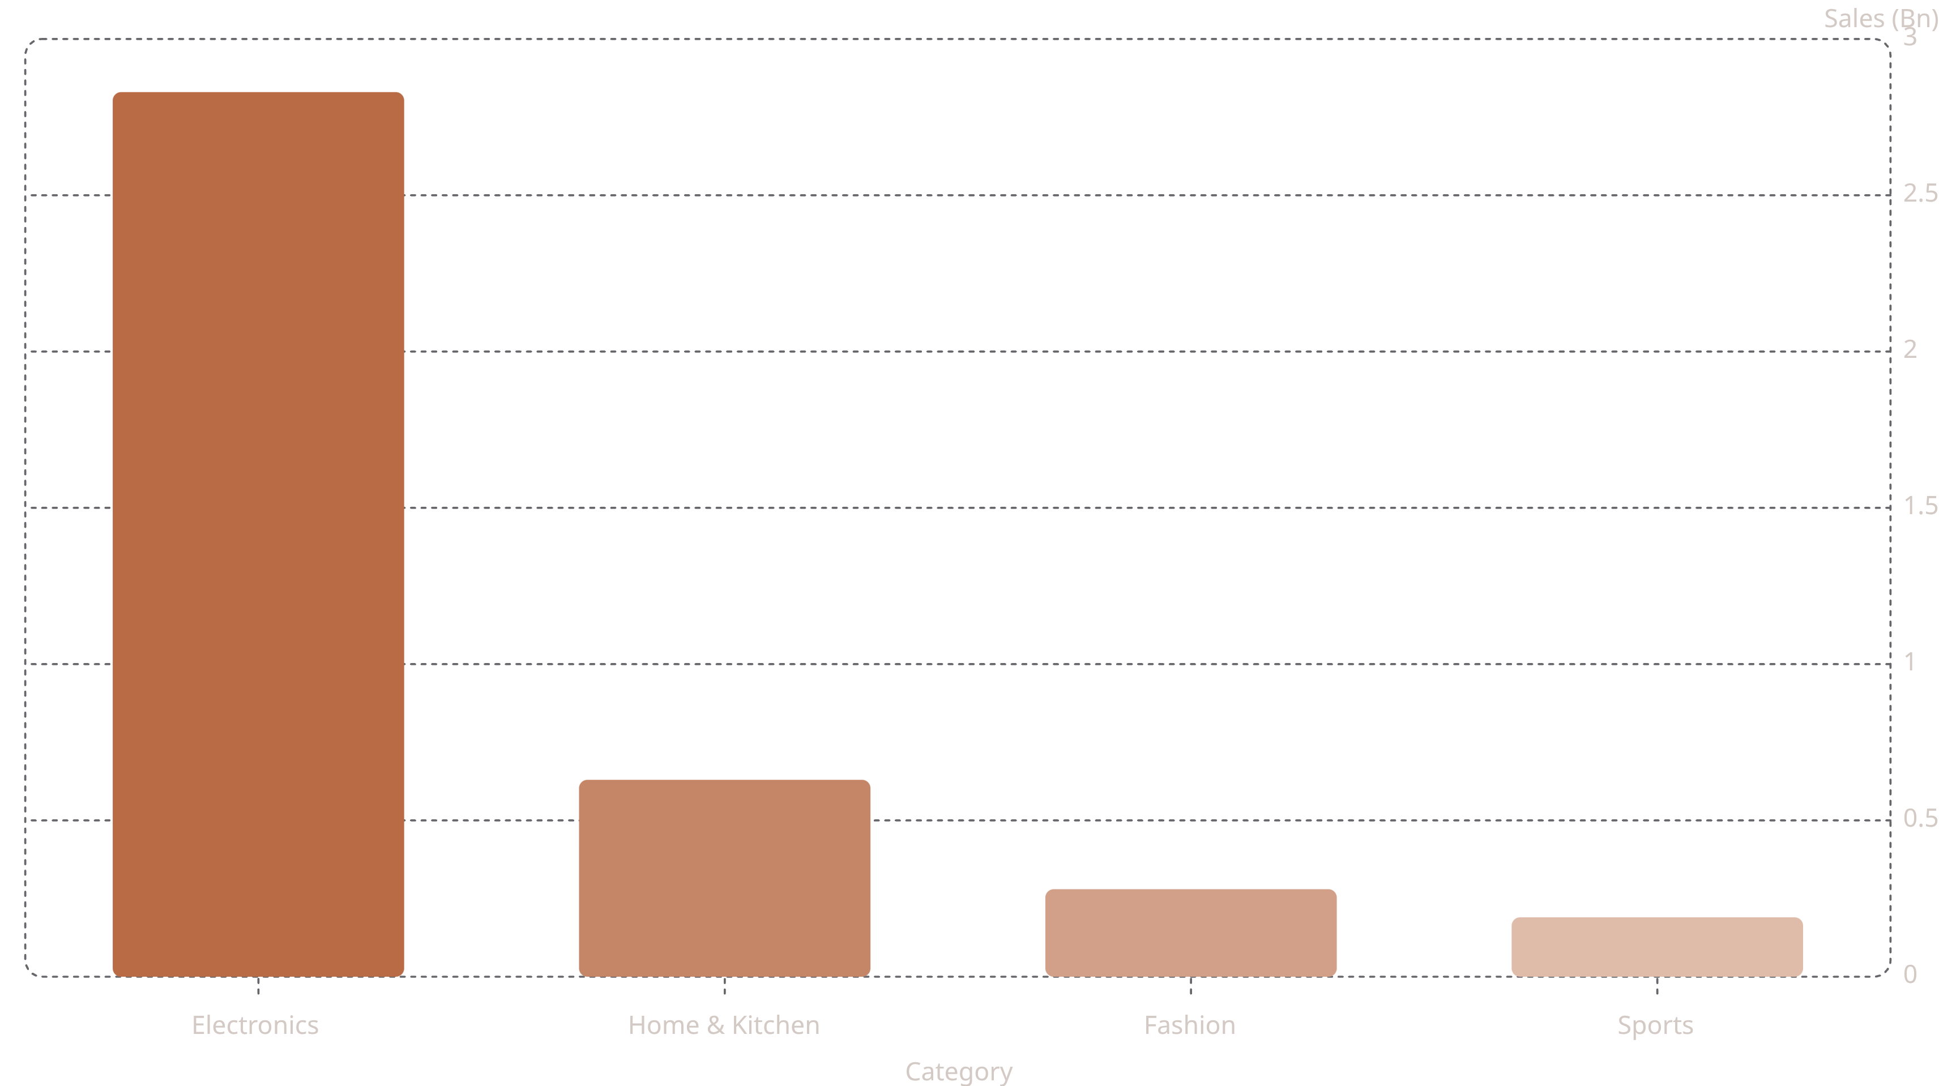
Executive Dashboard — Key KPIs
4.11B
1.23B
Total Sales
Profit
200K
49K
Orders
Customers
20.55K
30%
AOV
Margin

Slide 8
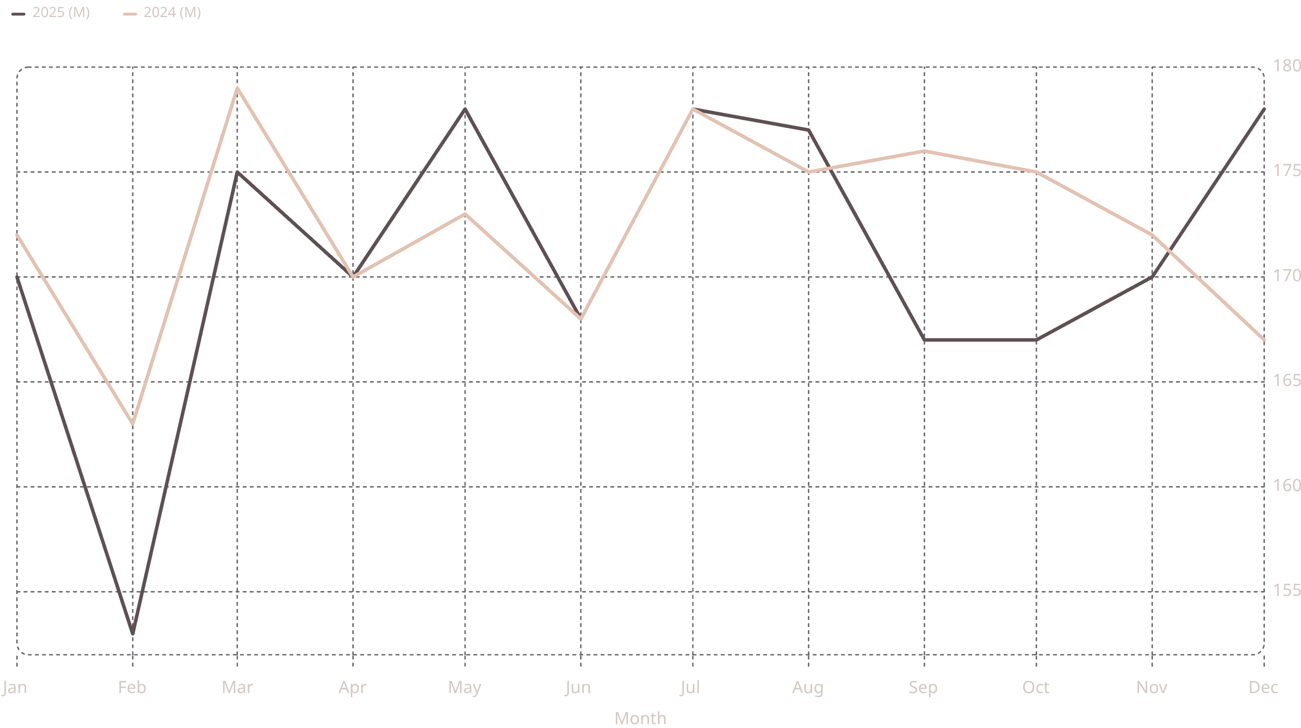
Sales Performance — 2024 vs 2025
Sales fluctuate between 153M–180M monthly. 2025 Dec peaks at 178M; Feb 2025 shows the lowest point at 153M.

Slide 9
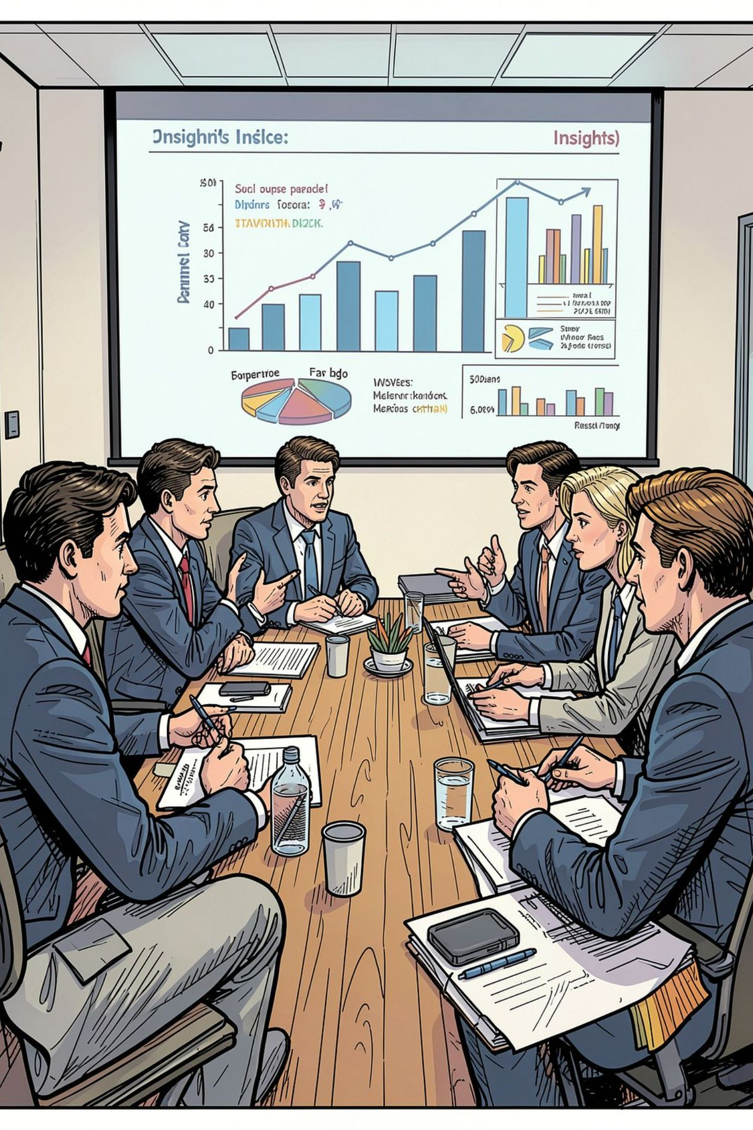

Business Insights
Strong Repeat Base
45K customers with >1 order — retention opportunity
Electronics Dominates
2.83B — ~69% of total category sales
Healthy Margin
30% overall profit margin on 4.11B sales
Monthly Volatility
Monitor dips — don't rely on annual totals alone

Slide 10
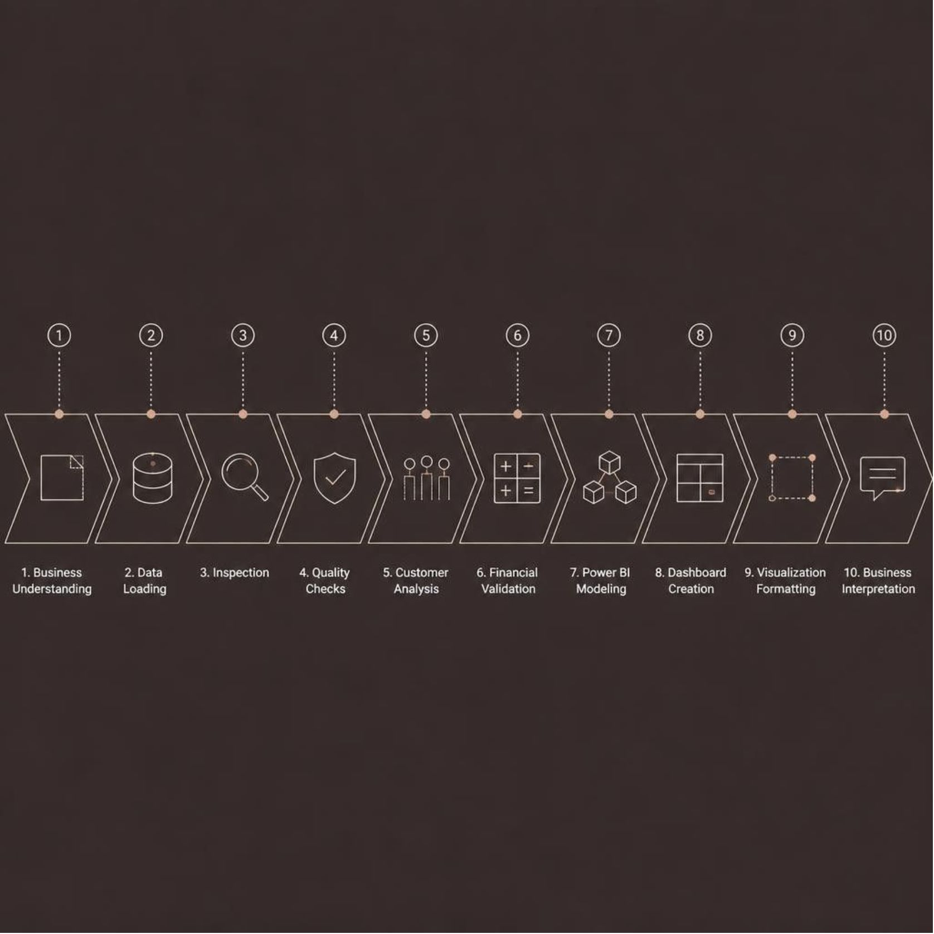
Recommendations & Workflow
Key Recommendations
1
Protect Electronics
Defend leading category
2
Grow Home & Kitchen
Close the gap
3
Build Loyalty
Personalized repeat offers
4
Validate on Refresh
Repeat checks each load

