Slide 1
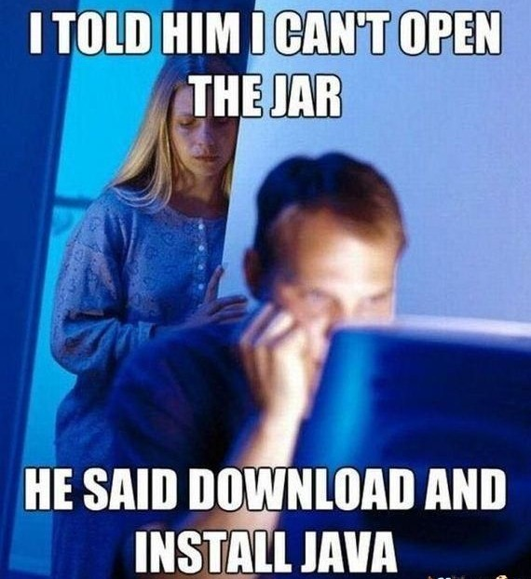
Introduction to Java

Slide 2
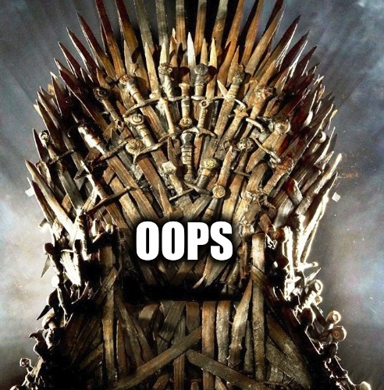
OOP Concepts (Object Oriented Programming)
Encapsulation
Abstraction
Inheritance
Polymorphism

Slide 3
Abstraction
Abstraction is a process of identifying the relevant qualities and behaviors an object should possess.
A Laptop consists of many things such as processor, motherboard, RAM, keyboard, LCD screen, wireless antenna, web camera, usb ports, battery, speakers etc. To use it, you don't need to know how internally LCD screens, keyboard, web camera, battery, wireless antenna, speakers works. You just need to know how to operate the laptop by switching it on. The intrinsic details are invisible.

Slide 4

Abstraction Cntd…

Slide 5
Encapsulation
Encapsulation is a method for grouping/hiding data to hide implementation details.
For example, the Laptop is an object that encapsulates many technologies/hardwares that might not be understood clearly by most people who use it.
Class : A template/blue print that defines the properties and behaviors that object of its type support.

Slide 6
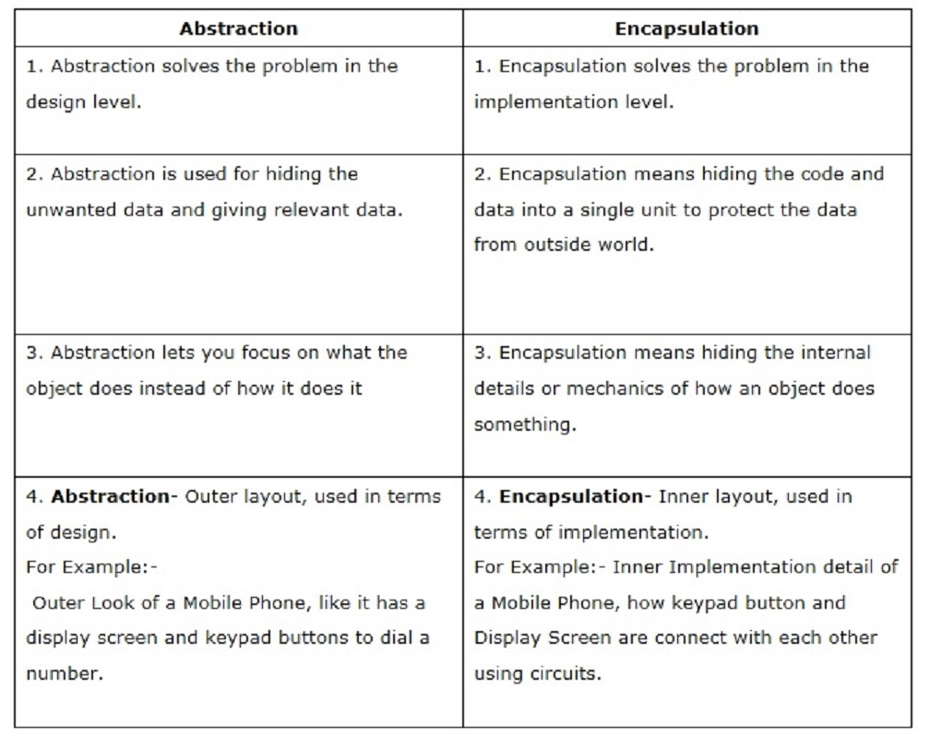

Slide 7
Encapsulation cntd...
public class Computer {
public Memory ram;
public Processor processor;
public void start() {
}
public void shutdown() {
}
}
Object : Objects exhibit the properties and behaviors defined by its class. Instance of class.
Computer myPC = new Computer();

Slide 8
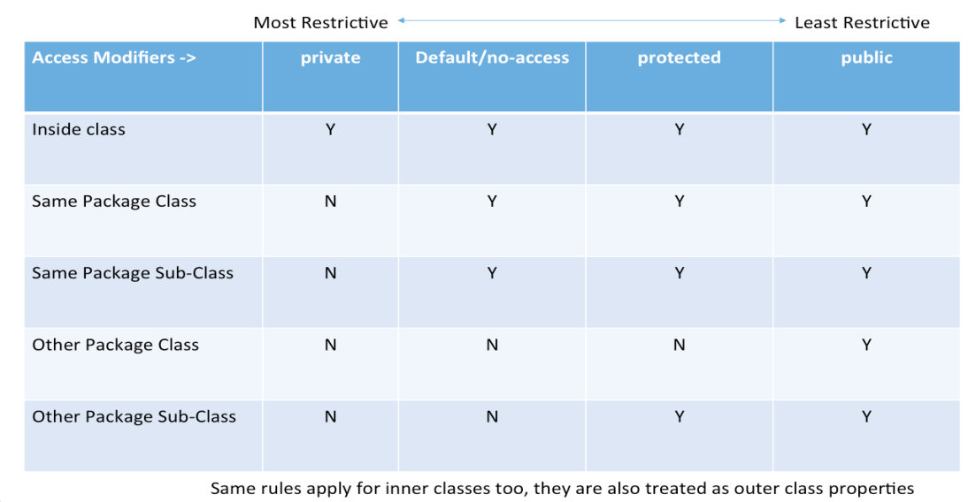
Access modifiers
Four access modifiers
public
protected
default
private
Access modifiers helps to implement the concept of encapsulation in OOPs.
Encapsulation helps to hide the data and behavior.
Access modifiers affect the accessibility at two levels
Class
Member(methods and instance variables)

Slide 9
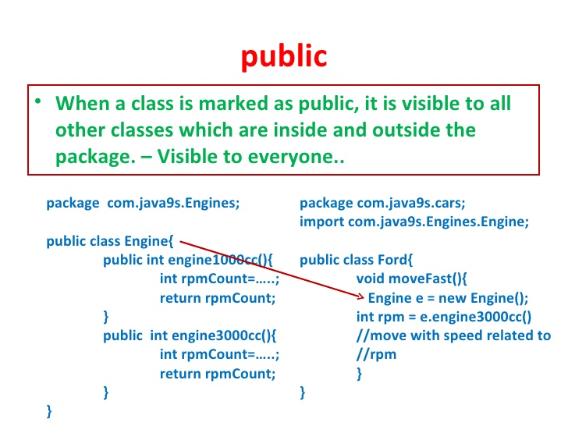
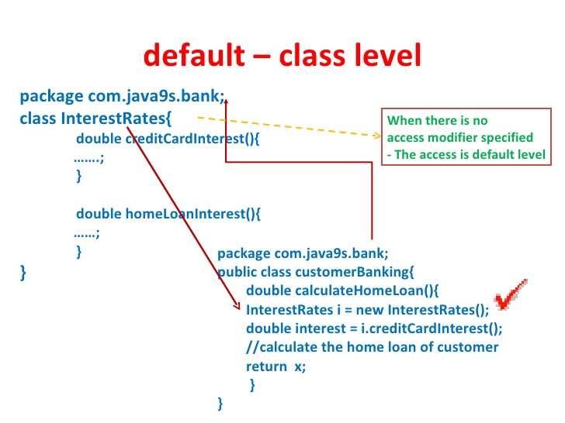
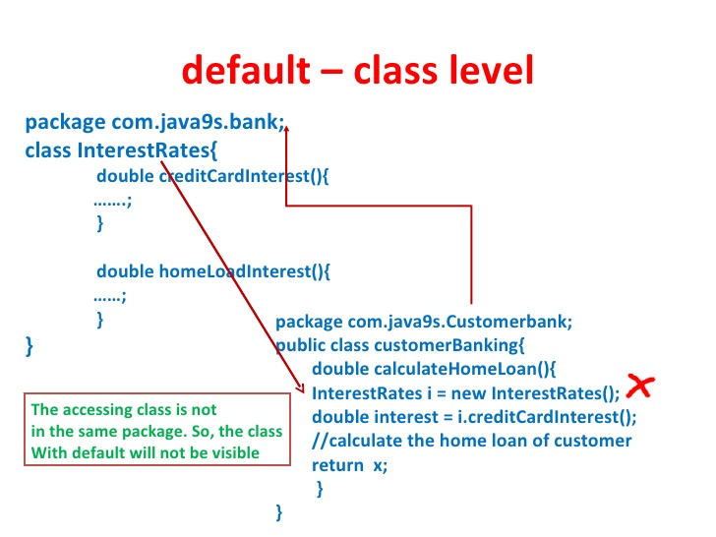
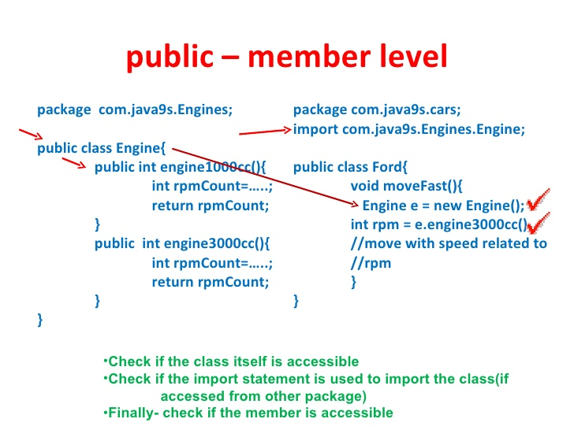
examples

Slide 10
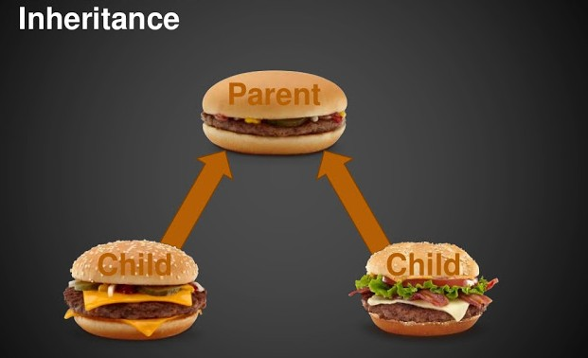
Inheritance

Slide 11
Inheritance Cntd…
Inheritance is the process wherein characteristics are inherited from ancestors.
In Java, classes may inherit or acquire the properties and methods of other classes.
A class derived from another class is called a subclass, whereas the class from which a subclass is derived is called a superclass. A subclass can have only one superclass, whereas a superclass may have one or more subclasses.
There are three types of inheritance supported in Java
Single Inheritance
Multilevel Inheritance
Hierarchical Inheritance
Multiple and Hybrid Inheritance is not supported in java
Notes:
Abstract class and Interfaces

Slide 12
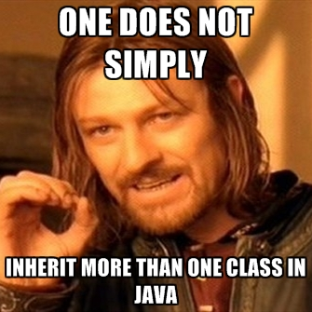
Inheritance Cntd…
Diamond Problem ?? Not a problem in java bcz
Notes:
Abstract class and Interfaces

Slide 13
Cntd…
class Calculation{
int z;
public void addition(int x, int y){
z = x+y;
System.out.println("The sum of the given numbers:"+z);
}
public void Subtraction(int x,int y){
z = x-y;
System.out.println("The difference between the given numbers:"+z);
}
}
public class My_Calculation extends Calculation{
public void multiplication(int x, int y){
z = x*y;
System.out.println("The product of the given numbers:"+z);
}
public static void main(String args[]){
int a = 20, b = 10;
My_Calculation demo = new My_Calculation();
demo.addition(a, b);
demo.Subtraction(a, b);
demo.multiplication(a, b);
}
}

Slide 14
Constructors
Default Constructor
Parameterized Constructor
super() - always the first statement in a constructor.
All classes extend java.lang.Object implicitly in java, if not inherited specifically.
public class Computer {
Computer() {
System.out.println(“Instantiating computer”);
}
}

Slide 15
Constructors Cntd.
public class Laptop extends Computer {
Laptop() {
//super(); implicit
System.out.println(“Instantiating Laptop”);
}
Laptop(String username) {
//super(); implicit
System.out.println(“Instantiating Laptop with username ” + username);
}
}

Slide 16
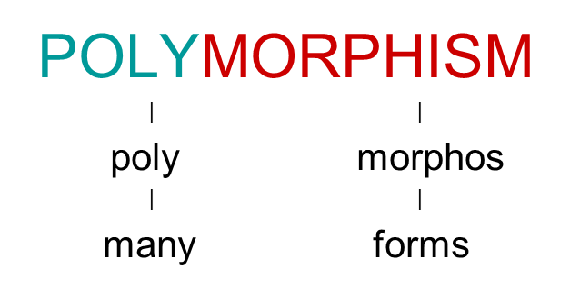
Method Binding
Determining the method to execute in response to a message.
Binding can be accomplished either statically or dynamically.
Static Binding –
Also known as “Early Binding” or Overloading
Resolved at compile time.
Resolution based on static type of the object(s).
Dynamic Binding –
Also known as “Late Binding” or Overriding
Resolved at run-time.
Resolution based on the dynamic type of the object(s).

Slide 17
Cntd…
class Calculation{
int z;
public void addition(int x, int y){
z = x+y;
System.out.println("The sum of the given numbers:"+z);
}
public void Subtraction(int x,int y){
z = x-y;
System.out.println("The difference between the given numbers:"+z);
}
}
public class My_Calculation extends Calculation{
public void multiplication(int x, int y){
z = x*y;
System.out.println("The product of the given numbers:"+z);
}
public static void main(String args[]){
int a = 20, b = 10;
My_Calculation demo = new My_Calculation();
demo.addition(a, b);
demo.Subtraction(a, b);
demo.multiplication(a, b);
}
}

Slide 18
Overloading
It can be done in two ways
Based on scope
Class SomeCards {
Draw() {…} // Paint the face of the card
}
Class SomeGame {
Draw() {…} // Remove a card from the deck of cards
}
Based on type signatures
Class Example {
Add(int a) { return a; }
Add(int a, int b) { return a + b; }
Add(int a, int b, int c) { return a + b + c; }
}
Methods cannot be overloaded based on differences in their return types alone.

Slide 19
Overriding
A method in child class overrides a method in parent class if they have the same name and type signature.
classes in which methods are defined must be in a parent-child relationship.
Type signatures must match.
The benefit of overriding is: ability to define a behaviour that's specific to the subclass type which means a subclass can implement a parent class method based on its requirement.
When invoking a superclass version of an overridden method the super keyword is used.
The access level cannot be more restrictive than the overridden method's access level. For example: if the superclass method is declared public then the overridding method in the sub class cannot be either private or protected.

Slide 20
Cntd…
class Calculation{
int z;
public void addition(int x, int y){
z = x+y;
System.out.println("The sum of the given numbers:"+z);
}
public void Subtraction(int x,int y){
z = x-y;
System.out.println("The difference between the given numbers:"+z);
}
}
public class My_Calculation extends Calculation{
public void multiplication(int x, int y){
z = x*y;
System.out.println("The product of the given numbers:"+z);
}
public static void main(String args[]){
int a = 20, b = 10;
My_Calculation demo = new My_Calculation();
demo.addition(a, b);
demo.Subtraction(a, b);
demo.multiplication(a, b);
}
}

Slide 21
Final keyword
What is final
The final keyword is used in several different contexts to define an entity that can only be assigned once.
Variations of Final keyword
A final class cannot be inherited.
A final method cannot be overridden.
A final variable.

Slide 22
Method call semantics(pass by value, pass by reference)
Call by Value
While Passing Parameters using call by value , xerox copy of original parameter is created and passed to the called function.
Any update made inside method will not affect the original value of variable in calling function.
As their scope is limited to only function so they cannot alter the values inside calling function.
Call by Reference
While passing parameter using call by address scheme , we are passing the actual address of the variable to the called function.
Any updates made inside the called function will modify the original copy since we are directly modifying the content of the exact memory location.

Slide 23
So what do you think how java works, pass-by-value or pass-by-reference??

Slide 24
Pass-by-value
Lets take one example and unerstand
public class Main{
public static void main(String[] args){
Foo f = new Foo("f");
changeReference(f); // It won't change the reference!
modifyReference(f); // It will modify the object that the reference variable "f" refers to!
}
public static void changeReference(Foo a){
Foo b = new Foo("b");
a = b;
}
public static void modifyReference(Foo c){
c.setAttribute("c");
}
}

Slide 25
Static keyword
What is static
The static keyword is used when a member variable of a class has to be shared between all the instances of the class.
All static variables and methods belong to the class and not to any instance of the class
When can we access static variable
When a class is loaded by the virtual machine all the static variables and methods are available for use.
Hence we don’t need to create any instance of the class for using the static variables or methods.
Variables which don’t have static keyword in the definition are implicitly non static.
The static can be variable, method, block, nested class

Slide 26
Cntd…
class Calculation{
int z;
public void addition(int x, int y){
z = x+y;
System.out.println("The sum of the given numbers:"+z);
}
public void Subtraction(int x,int y){
z = x-y;
System.out.println("The difference between the given numbers:"+z);
}
}
public class My_Calculation extends Calculation{
public void multiplication(int x, int y){
z = x*y;
System.out.println("The product of the given numbers:"+z);
}
public static void main(String args[]){
int a = 20, b = 10;
My_Calculation demo = new My_Calculation();
demo.addition(a, b);
demo.Subtraction(a, b);
demo.multiplication(a, b);
}
}

Slide 27
String
Immutable
String literal: JVM checks the string constant pool first. If the string already exists in the pool, a reference to the pooled instance is returned.
String s1="Welcome";
Using New Keyword :
String str1 = new String("Welcome");
StringBuffer
StringBuilder

Slide 28
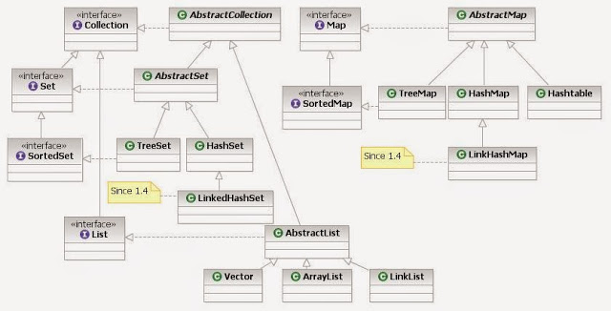
Collections
List
Map
Set

Slide 29

Exceptions

Slide 30
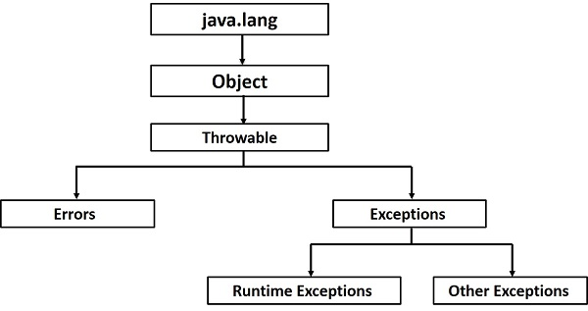
Exceptions...contd

Slide 31
Exceptions...contd
All exception types are subclasses of class Throwable.
The two subclasses of Throwable are Error and Exception.
There are two types of exceptions in class Exception:
Checked exceptions – When you call a method that throws a checked exception, you must tell the compiler what you are going to do about the exception if it is ever thrown.
Unchecked exceptions – The compiler does not require you to keep track of unchecked exceptions.

Slide 32
Exceptions...contd
try
catch
custom exceptions
finally
throw, throws
try with resources

Slide 33

Threads

Slide 34
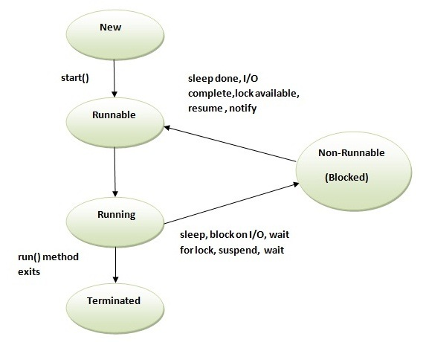
Threads

Slide 35
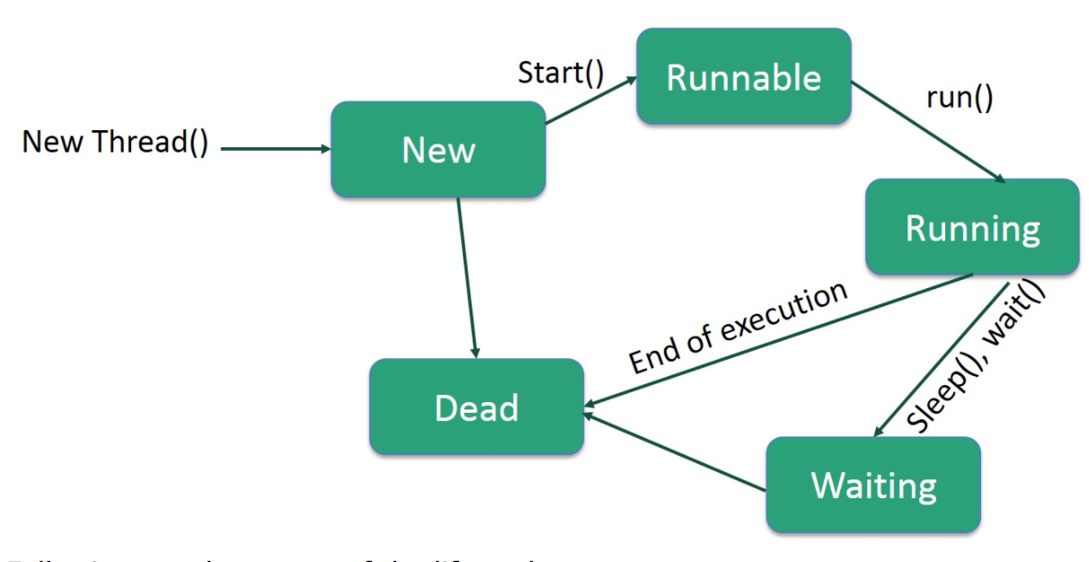
Threads (States)

Slide 36
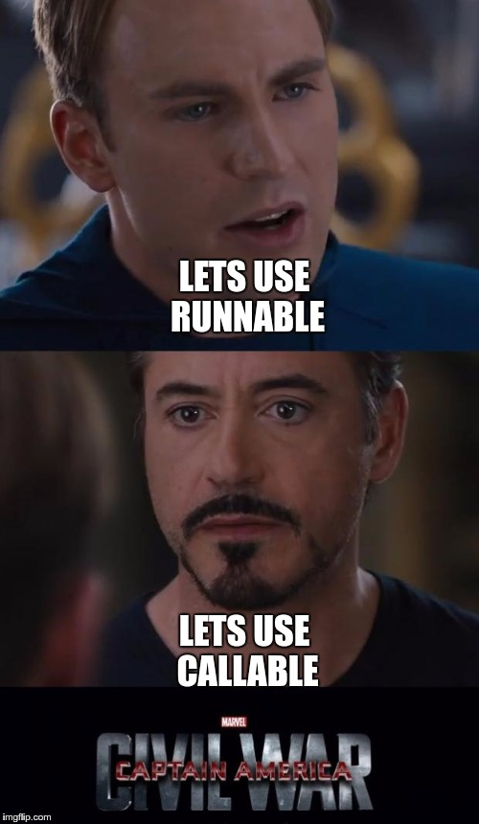
Threads...contd
How to implement a thread :
Runnable Interface
Callable Interface
Thread class
Methods in Thread :
yield
sleep
join
synchronized keyword

Slide 37
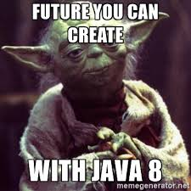
Threads...contd
Futures

Slide 38
Threads...contd
ExecutorServices
newFixedThreadPool(int nThreads)
newScheduledThreadPool(int corePoolSize)
newCachedThreadPool()
Methods
submit(Callable<T> task)
submit(Runnable task)
invokeAll(Collection<? extends Callable<T>> tasks)

Slide 39
Threads...contd
volatile keyword : In concurrent Java programs, changes made by multiple threads on instance variables is not visible to other in absence of any synchronizers e.g. synchronized keyword or locks. Volatile variable guarantees that a write will happen before any subsequent read

Slide 40

Garbage Collection

Slide 41
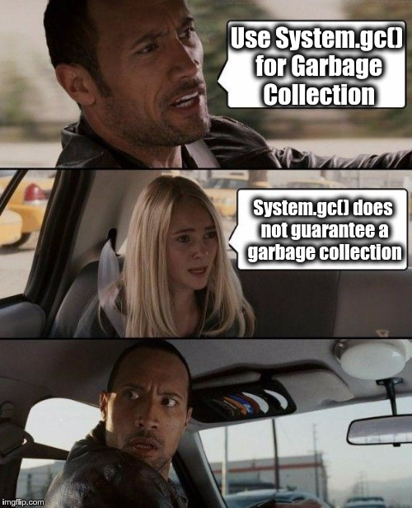
Garbage Collection...contd
System.gc()
finalize()

Slide 42
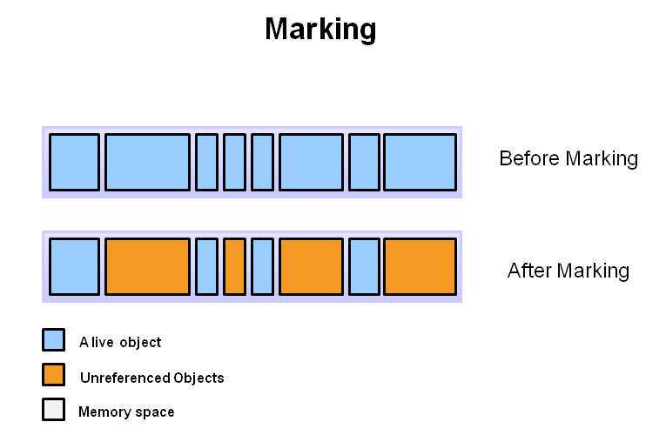
Garbage Collection...contd
Step 1: Marking
The first step in the process is called marking. This is where the garbage collector identifies which pieces of memory are in use and which are not.

Slide 43
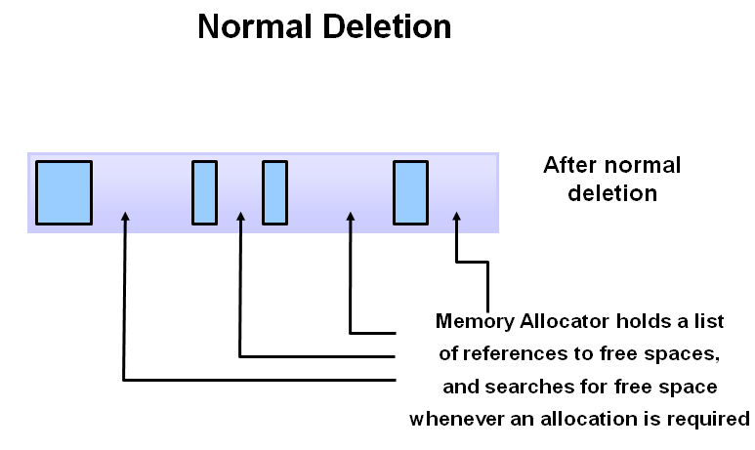
Garbage Collection...contd
Step 2: Normal Deletion
Normal deletion removes unreferenced objects leaving referenced objects and pointers to free space.

Slide 44
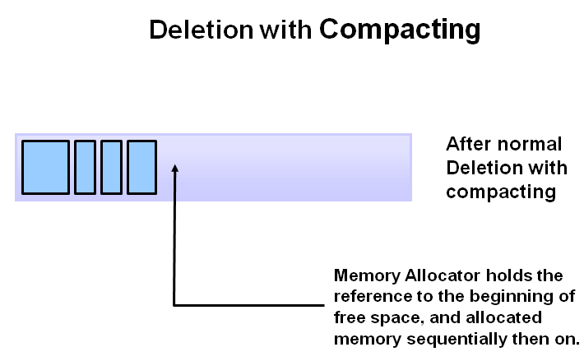
Garbage Collection...contd
Step 2a: Deletion with Compacting
By moving referenced object together, this makes new memory allocation much easier and faster.

Slide 45
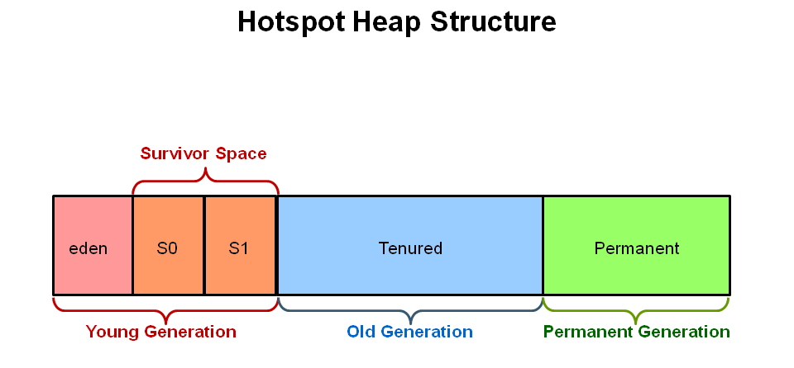
Garbage Collection...contd
Young Generation
Old Generation
Permanent Generation
Minor GC
Major GC
Stop the World Event

Slide 46
References
http://javarevisited.blogspot.in/2014/07/top-50-java-multithreading-interview-questions-answers.html
http://chiragkanzariya.blogspot.in/2012/11/oops-concept-with-real-world-example.html#sthash.aeApu0VT.dpuf
http://tutorials.jenkov.com/java-concurrency/volatile.html
https://dzone.com/articles/java-volatile-keyword-0
http://javarevisited.blogspot.com/2011/04/synchronization-in-java-synchronized.html#ixzz4EwzOJ4LL
http://tutorials.jenkov.com/java-concurrency/synchronized.html

