Slide 1
JS
console.log(“Hello World”);
Vedant Seta

Slide 2
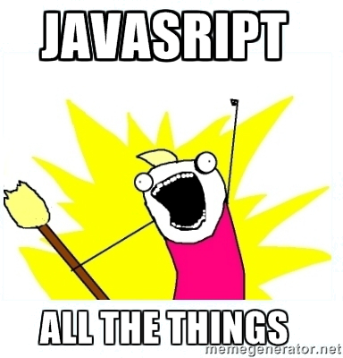
JS Everything
Client Side
Server Side
Desktop/Mobile Apps
Task Runners
Notes:
[1]
Sync programming background.
JS isnt like that

Slide 3
Challenge
a = 2;
var a;
console.log( a );
A. 2 B. null C. undefined D. throw Error

Slide 4
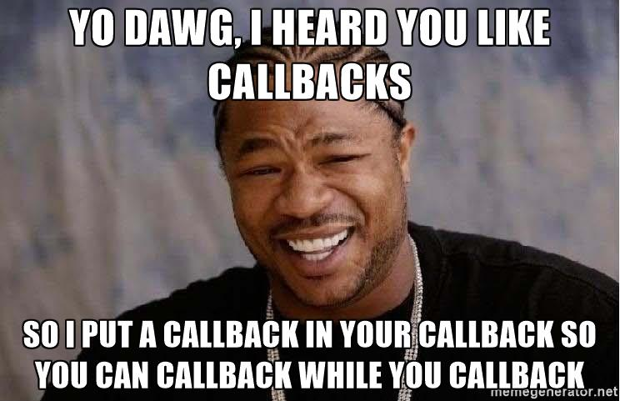
Callbacks
Executable code passed as an argument to a function
Is invoked within that function
Notes:
[5]
Show some examples
1st half 2nd half.defer 2nd half for later

Slide 5

Challenge
setTimeout(function(){
console.log('When will this run?');
}, 0);
console.log('Here');

Slide 6
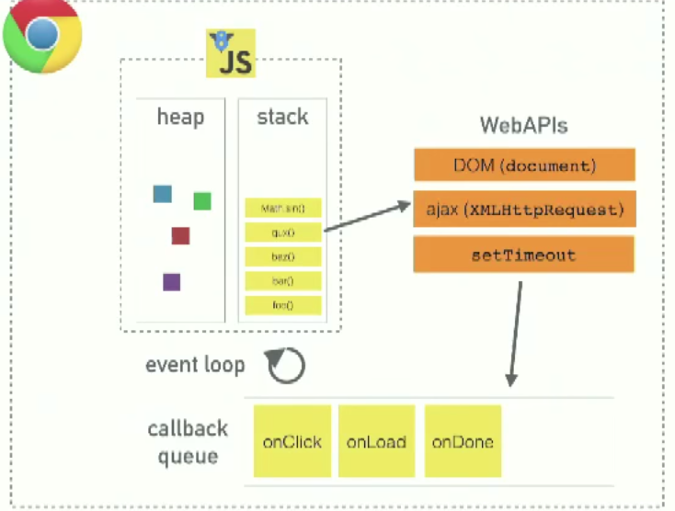
JS is
Single Threaded
Non Blocking APIs
Asynchronous
Concurrent
Call Stack
Web APIs
Callback queue
Event Loop
Notes:
Single THreaded : Single call stack : where in program we are
Blocking : things which are slow..give example of sync..cannt do anything ..its stuck..solution : async callbacks
http://www.presentation.com/syncjs.html
Js Runtime one thing at time
Browser does multiple things
Noed
Event loop

Slide 7

Scope
Well defined rules to store & find variables
Compiler declares a variable in Scope
Engine looks up for variable in Scope
Each Function creates a new Scope
Function Based Scope ..Not block scope
What if not found in Scope???
Notes:
store/retrieve values --->program state
Where are variables stored? Which varibale is called when? Compiled Language : lexical/parsing/code gen ast Engine, compiler, scope
A = 2 Var a;
console.log(a);

Slide 8

Nested Scope
If a variable isn’t found in current scope, it will look at parent till global scope is reached.
Notes:
Also this is not complied language which makes
execution context is created at runtime for funciton in HEAP not stack
the scope "object" is not accessible to JavaScript code. It's an inner part of the Engine's implementation.
function foo(a) { console.log( a + b ); } var b = 2; foo( 2 ); // ---------- function foo(a) { console.log( a + b ); b = a; } foo( 2 );
------ function foo(a) { var b = a * 2; function bar(c) { console.log( a, b, c ); } bar(b * 3); } foo( 2 ); // 2 4 12

Slide 9
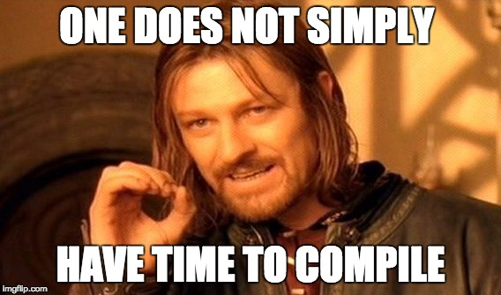
Hoisting
Declaration are Moved to the top of respective scope
Function expressions aren’t hoisted
Function statements are hoisted
It doesn’t look at branching
It doesn’t look at return statements
Notes:
var a = 1; function b() { a = 10; return; function a() {} } b(); alert(a);
// variable shadowing in js var e
// Garbage collected ..no reachibity
// no api to see back pointer

Slide 10
Hoisting
Declare all functions before you call
Declare all variables on top
Notes:
var a = 1; function b() { a = 10; return; function a() {} } b(); alert(a);

Slide 11
Question : Hoisting
var a = 1;
function b() {
a = 10;
return;
function a(){
}
}
b(); console.log(a);
A. 1 B. 10 C. undefined D. throw

Slide 12
Lunch Break.

Slide 13
Functions
are First Class Objects
Can be passed returned
Assigned to variable
Stored in array & object
Objects with callable property
Notes:
String,number,boolean,undefined,object,null
normal objects with callable property

Slide 14
Functions as
expression
statement
method
Constructor
closures

Slide 15
Function Expression
function fnName (parameters) {
// statements
return; or return expression;
}
// Call
fnName(params);
A function can appear anywhere that an expression can appear
Notes:
var defined inside is avaible everywhere, types arent specifed ,
Return expression
Otherwise undefined excpet for constructor which will return this

Slide 16
Question : Functions
function test() {
Var a = 10; return
a;
}
console.log(test());
Notes:
You cant have return and expression in different line
; insertion

Slide 17
Function Statement
function fnName (parameters) {
// statements
}
// Call
fnName(params);
var fnName = function(){
};
Expands to
var fnName = undefined;
fnName = function fnName() {
}
Notes:
var defined inside is avaible everywhere, types arent specifed ,
This is not hosited

Slide 18
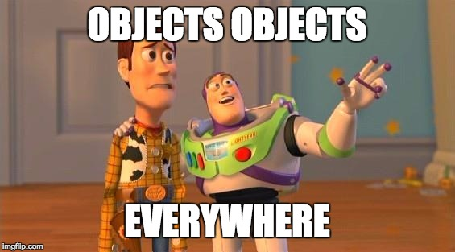
Functions as Object
They are objects
Can save name/value pairs
Simply call foo();
function Car(name) { return name; }; Car.noOfWheels = 4; Car(“honda”) // honda Car.noOfWheels // 4

Slide 19
Function as method
Since functions are values they can be stored in objects
A function in object is called method
var site = {}; site.test = function (string) {
console.log("Hello World! " + string);
site.string = string; } site.test("WoW!");

Slide 20
Function as constructor
new Object is returned
It sets constructor property to point to that function
function Employee(name) {
this.name = name; } var emp1 = new Employee(‘vedant’);

Slide 21
Closure
Scope which inner function enjoys even after the parent function has returned
Permanent link between function and its scope
Holds scope chain preventing garbage collection
Notes:
All the callbacks api has implicit closure
Be it settime, ajax call

Slide 22
Question : Closures
var a = {};
for(var i = 0; i < 3; i++) {
A[i] = function(){
console.log(i);
}
}
a[0]();
a[1]();
a[2]();

Slide 23
Functions call / invocation
If called with many arguments, then extra arguments are ignored
If called with missing arguments, then missing arguments are undefined
There is no implicit type checking on the arguments
Notes:
Special params called arguments
arguments.length

Slide 24
Functions call / invocation
Can be called 4 ways :
Function form - funcName(args)
Method form - obj.methodName(args); obj[‘methodName’](args);
Constructor Form - new funcName(args)
Apply Form : funcName.apply(thisObj, [args]);

Slide 25
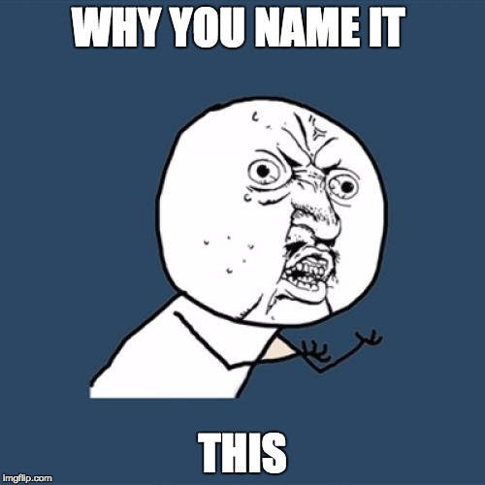
this
Not itself
Not author time binding
Not how it is declared
This is runtime binding.
Depends on how and from where
it is called (callsite) from call stack
Notes:
In typical object-oriented programming, we need a way of identifying and referring to the object that we’re currently working with
….current instance of class
In addition to establishing a scope chain, each execution context offers a keyword named this
Ecmascript def evaluates to the value of the ThisBinding of the current execution context;
this binding has nothing to do with where a function is declared, but has instead everything to do with the manner in which the function is called.
But the scope "object" is not accessible to JavaScript code. It's an inner part of the Engine's implementation.
When a function is invoked, execution context, is created.
execution context contains args, call stack reference, how function is invoked One such prop is this. Referecing to function's execution

Slide 26
this
Invocation form | this
function | callsite (Default Binding)
method | the object (Implicit Binding)
constructor | the new object
apply | arguments (Expicit Binding)
Notes:
When a function is invoked, execution context, is created.
execution context contains args, call stack reference, how function is invoked One such prop is this. Referecing to function's execution

Slide 27
TODO App
Notes:
http://www.mocky.io/v2/5961fc1d100000ee0abe34d5

Slide 28
Debugging
Let’s DEBUG what we implemented
Notes:
[10]
http://localhost/ruturaj/todo-ajax.html
http://localhost/ruturaj/todo-ajax.php
https://gist.github.com/ruturajv/45adb1caea2954b3d0bf (todo-ajax.html)
https://gist.github.com/ruturajv/243100f7e15e75f46fc9 (todo-ajax.php)
putting breakpoints
using debugger
using DOM manipulation breakpoints
ajax breakpoints

Slide 29
Object Returns
Javascript is class free
Every object inherits Object
var car = { wheels : 4 }
You can add methods here
car.getWheels = function(){ return this.wheels; }
Notes:
Global function called Object but the type is function
But since everything is object
It is called object as well Show in console Object Object()

Slide 30
Objects Linkage
Objects can be created with simple link to other objects
If access to member is failed, linked object is tried
car = {
name:'automobile', wheels:4,
getName: function(){return this.name}
}
honda = Object.create(car);
honda.name = ‘honda’

Slide 31
Objects - Linkage
honda
car
name = ‘honda’
name = ‘automobile’
getName = function
Notes:
Reference to same object
No instance is created
Add in car ..it will be avaible in honda

Slide 32
Inheritance
Class based inheritance
Prototype based inheritance
Notes:
A class defines all of the properties ..blue print of read world object
Object is Instance of that class
Prototype : everythign is objects
any object can be associated as the prototype for another objec

Slide 33
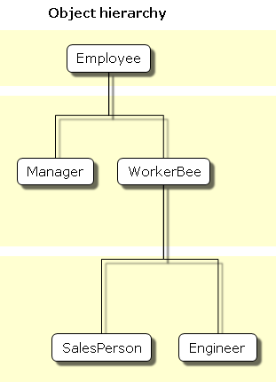
Example

Slide 34
Example
Employee JAVA
Employee JavaScript
public class Employee {
public String name = ‘’;
public String dept = ‘’;
public Employee(){
this.name = ‘’;
this.dept = ‘’;
}
}
function Employee(){
this.name = ‘’;
this.dept = ‘’;
}

Slide 35
Example
Manager JAVA
Manager JavaScript
public class Manager extends Employee {
public Employee[] reports;
public Manager() {
this.reports = new Employee[0]
}
}
function Manager(){
this.reports = [];
}
Manager.prototype = new Employee();
Manager.prototype.constructor = Manager;
Notes:
Prototype is used just to set new properties
emp1.__proto__ -> Employee.prototype

Slide 36
__proto__ vs prototype
Function has Prototype member
__proto__ points to Prototype member
__proto__ chain leads to Object.prototype
Constructor points to the Function
Notes:
function Car(){
this.name = 'automobile'
}
c = new Car();
c.__proto__ == Car.prototype
c.__proto__.__proto__ == Object.prototype
c.constructor == Car
c.constructor.constructor == Function

Slide 37
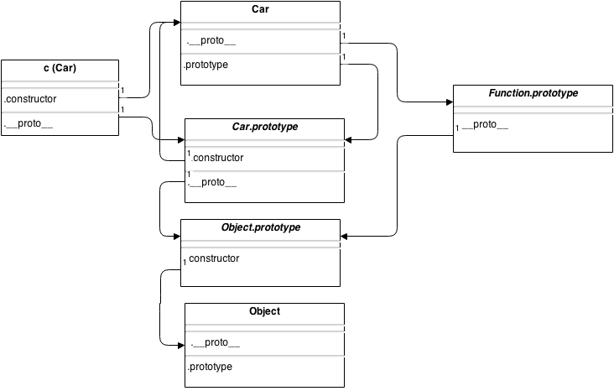
Everything at once

Slide 38
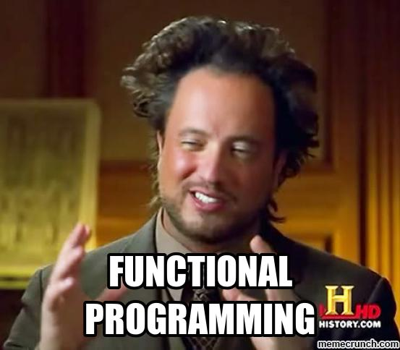
Array Functions
Map
Reduce
Filter

Slide 39
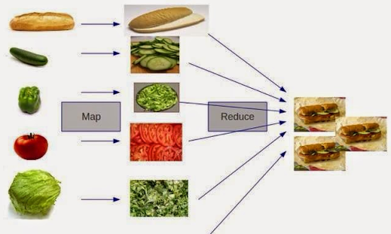

Slide 40
Object Functions
Assign
Keys
Values
Freeze
Create

Slide 41
JSON
Used for Serializing objects
Lighter than XML
JSON.parse()
JSON.stringify()

Slide 42
Some tools
Frameworks : Angular, React
Eslint
Node.js
Gulp

Slide 43
Thank you

Slide 44
More TODO

