Slide 1
Networking & NIO

Slide 2
SYN

Slide 3
whoami

Slide 4
Socket Programming
What is it ?
Why bother ?
Notes:
What is a socket?
Communication end point – IP + port. Address where an app is running.
Sockets are everywhere.
Where were sockets used in your twitter app?
Database connections
Browser to server calls
DNS resolutions to come to your server
All network communication happens over sockets – Some are encapsulated some are not – Examples where you will directly deal with sockets
Chat servers
Message queues
Video streaming
VOIP
RMI
Web crawlers
Web servers
DB drivers
Distributed computing(JPPF, Hadoop)
Which layers do these work on in OSI model
TCP/UDP – Transport layer
Http – App layer
IP – Network layer
statefull and stateless
http tcp IP ??? OSI layer

Slide 5
Basic
Interface for programming networks at transport level
It is communication end point
Used for inter process communication over network
Need IP address and port number
Popularly used in client-server computing
Connection oriented
– TCP – Phone system – Delivery is guaranteed
Connectionless
– UDP – Postal system – Delivery is not guaranteed

Slide 6
Ports
Represented by a positive (16 bit) integer
Some ports are reserved for common services
- FTP 21
- TELNET 23
- SMTP 25
- HTTP 80
User process generally use port value >= 1024
Heard of ephemeral ports ?

Slide 7
Code
YES ALREADY !!!
http://db.tt/HffcxZWF
whois/Whois

Slide 8
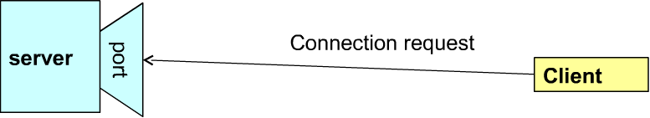
Socket communication
A server (program) runs on a specific computer and has a socket bound to that port. The server waits and listens to socket for a client to make a connection request
Notes:
What happens when another client tries to connect at the same time?

Slide 9
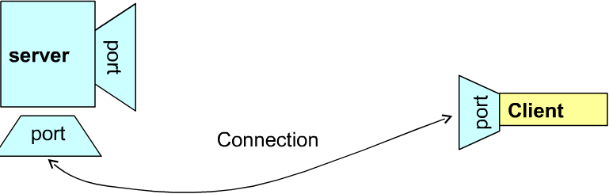
Socket Communication
Upon acceptance, the server gets a new socket bounds to a different port. It needs a new socket (different port number) so that it can continue to listen to the original socket for connection requests while serving the connected client.

Slide 10
Java socket library
Through the classes in java.net, program can use TCP / UDP to communicate over the internet
‘URL’, ‘URLConection’, ‘Socket’, ‘ServerSockets’ - TCP
‘DatagramSocket’ / ‘DatagramPacket’ - UDP
Raw Sockets and Unix Domain Sockets (No java native support ... have to use 3rd party JNI libs)

Slide 11
TCP / IP in java
Java.net.InetAddress: Represents an IP address (either IPv4 or IPv6 ) and has methods for performing DNS lookups
Java.net.Socket: Represents a TCP socket
Java.net.ServerSocket: Represents a server socket which is capable of writing for requests from clients

Slide 12
InetAddress
Used to encapsulate both the numerical IP address and domain name for that address
Factory methods to be used to create instance
- static InetAddress getLocalHost()
- static InetAddress getByName(String hostName)
- static InetAddress getAllByName(String hostName)
InetSocketAddress class (check it out)

Slide 13
code
ip/InetAddressTest

Slide 14
Client Socket
Java wraps OS sockets (over TCP) by the objects of class java.net.Socket
  Socket( String remoteHost, int remotePort )
Create TCP socket and connects it to the remote host on the remote port (hand shake)
Write and read using Streams:
  InputStream getInputStream()
  OutputStream getOutputStream()
  Using channel (nio ...)

Slide 15
Server Socket
This class implements server socket. A server socket waits for requests to come in over the network. It performs some operation based on that request, and possibly returns a result to the requester.
A server socket is technically not a socket: when a client connects to a server socket, a TCP connection is made, and a (normal) socket is created for each end point.

Slide 16
code
echo/EchoServer

Slide 17
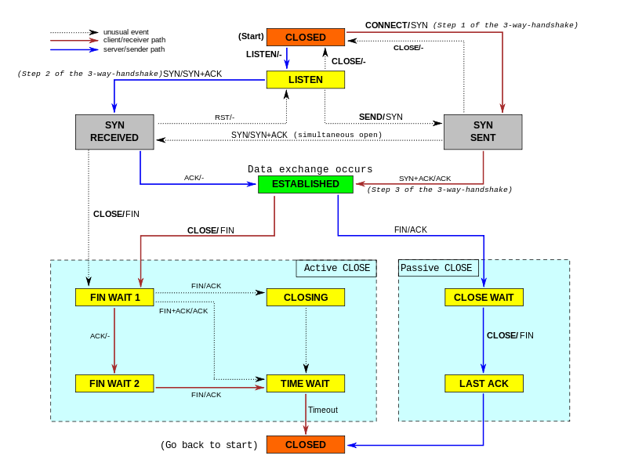

Slide 18
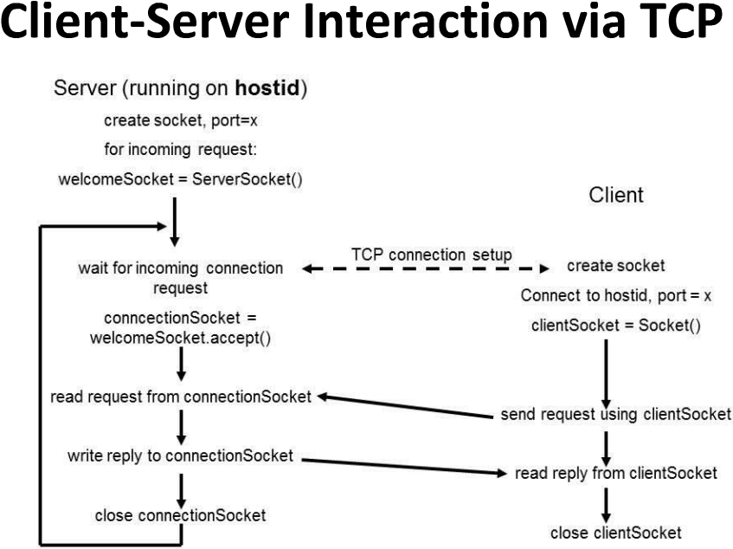
Implementing a server
Notes:
Order is not important in the above program. Send and receive anytime.

Slide 19
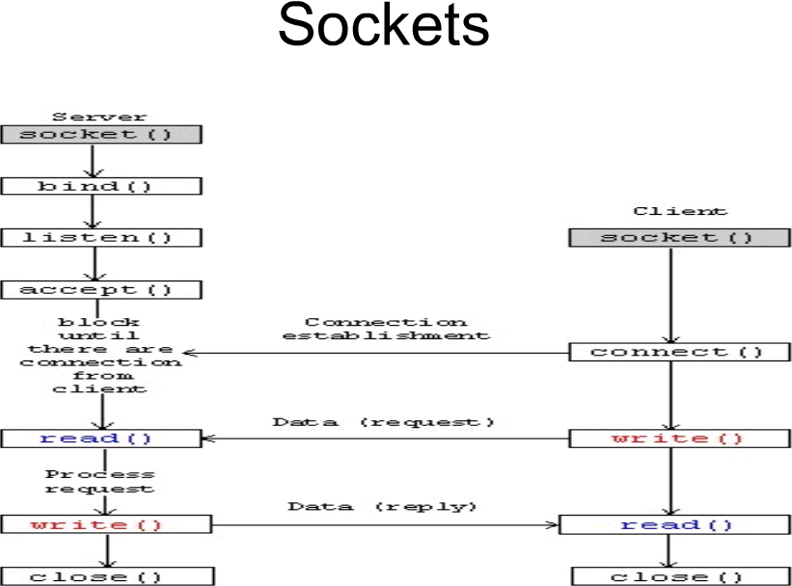

Slide 20
Server with Multithreading support
                Code
        knock/singleThread
        knock/multiThreded

Slide 21
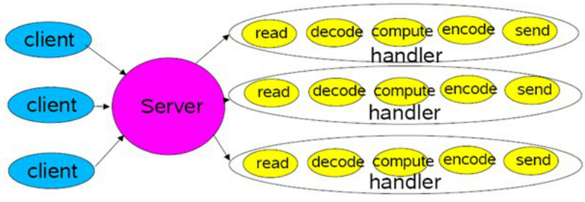
Each Handler starts in its own thread

Slide 22
Multithreaded model
synchronous: you handle one request at a time, each in turn.
pros: simple
cons: any one request can hold up all the other requests
fork: you start a new process to handle each request.
pros: easy
cons: does not scale well, hundreds of connections means hundreds of processes.
fork() is the Unix programmer's hammer. Because it's available, every problem looks like a nail. It's usually overkill
threads: start a new thread to handle each request.
pros: easy, and kinder to the kernel than using fork, since threads usually have much less overhead
cons: threaded programming can get very complicated very fast, with worries about controlling access to shared resources

Slide 23
I/O ???
I/O -- or input/output -- refers to the interface between a computer and the rest of the world, or between a single program and the rest of the computer.
It is such a crucial element of any computer system that the bulk of any I/O is actually built into the operating system. Individual programs generally have most of their work done for them.
In Java programming, I/O has until recently been carried out using a stream metaphor. All I/O is viewed as the movement of single bytes, one at a time, through an object called a stream. Stream I/O is used for contacting the outside world. It is also used internally, for turning objects into bytes and then back into objects.

Slide 24
NIO
NIO was created to allow Java programmers to implement high-speed I/O without having to write custom native code. NIO moves the most time-consuming I/O activities (namely, filling and draining buffers) back into the operating system, thus allowing for a great increase in speed.

Slide 25
HEADACHE !!!
public class HelloWorld
{
public static void main (String [] argv)
{
System.out.println ("Hello World");
}
}
import java.nio.ByteBuffer;
import java.nio.channels.WritableByteChannel;
import java.nio.channels.Channels;
public class HelloWorldNio
{
public static void main (String [] argv)
throws Exception
{
String hello = "Hello World" + System.getProperty ("line.separator");
ByteBuffer bb = ByteBuffer.wrap (hello.getBytes ("UTF-8"));
WritableByteChannel wbc = Channels.newChannel (System.out);
wbc.write (bb);
wbc.close();
}
}

Slide 26
Aur kya deti hain ?
New Abstractions
    Buffers
    Channels
    Selectors
New I/O Capabilities
    Non-Blocking Sockets
    Readiness Selection
    File Locking
    Memory Mapped Files
New Non-I/O Features
    Regular Expressions
    Pluggable Charset Transcoders

Slide 27
Kaise deti hain ?
Buffers
    Data container objects
Channels
    Transfer data between buffers and I/O services
    Channels and Buffers are the central objects in NIO, and are used for just about every I/O operation. Channels are analogous to streams in the original I/O package. All data that goes anywhere (or comes from anywhere) must pass through a Channel object. A Buffer is essentially a container object. All data that is sent to a channel must first be placed in a buffer; likewise, any data that is read from a channel is read into a buffer.
Selectors
    Provide status information about channels
Regular Expressions (DIY)
    Perform pattern matching against character sequences
Character Set Coding (DIY)
    Perform encoding/decoding of character sequences to/from byte streams

Slide 28
Buffer
  A Buffer is an object, which holds some data, that is to be written to or that has just been read from.
  The addition of the Buffer object in NIO marks one of the most significant differences between the new library and original I/O. In stream-oriented I/O, you wrote data directly to, and read data directly from, Stream objects.
  In the NIO library, all data is handled with buffers. When data is read, it is read directly into a buffer. When data is written, it is written into a buffer. Anytime you access data in NIO, you are pulling it out of the buffer.
  A buffer is essentially an array. Generally, it is an array of bytes, but other kinds of arrays can be used. But a buffer is more than just an array. A buffer provides structured access to data and also keeps track of the system's read/write processes.

Slide 29
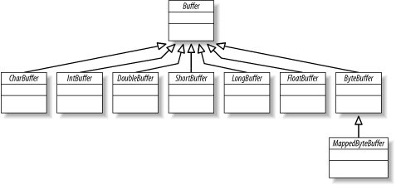
Buffer Types

Slide 30
code
buffer/CreateBuffer
buffer/TypesInByteBuffer
buffer/FastCopyFile

Slide 31
Channel
  A Channel is an object from which you can read data and to which you can write data. Comparing NIO with original I/O, a channel is like a stream. As previously mentioned, all data is handled through Buffer objects.
  You never write a byte directly to a channel; instead you write to a buffer containing one or more bytes. Likewise, you don't read a byte directly from a channel; you read from a channel into a buffer, and then get the bytes from the buffer.
  Channels differ from streams in that they are bi-directional. Whereas streams only go in one direction (a stream must be a subclass of either InputStream or OutputStream), a Channel can be opened for reading, for writing, or for both.
  Because they are bi-directional, channels better reflect the reality of the underlying operating system than streams do. In the UNIX model in particular, the underlying operating system channels are bi-directional.

Slide 32
code
nio/channel/ReadAndShow
nio/channel/WriteSomeBytes

Slide 33
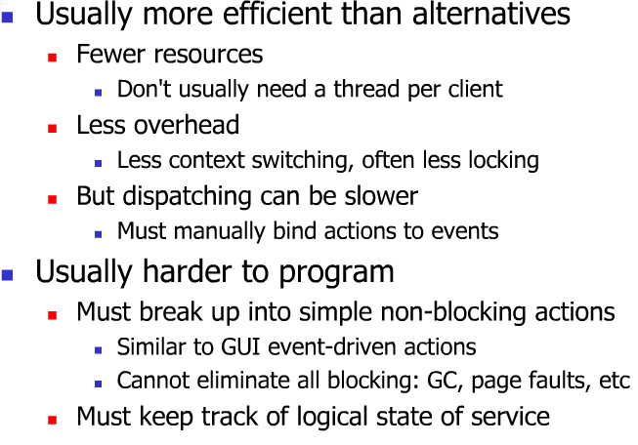
Event Driven Model
Notes:
I/O-bound versus CPU-bound processes
A process that is I/O bound is one that performs more I/O than processing. A CPU-bound process does more processing than I/O

Slide 34
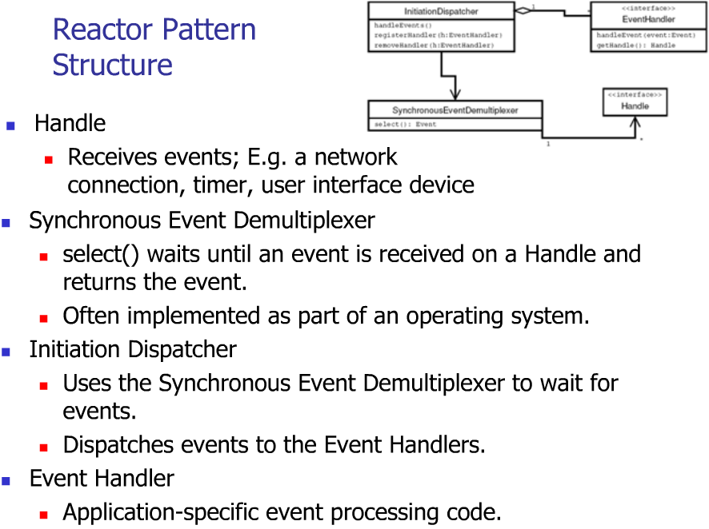

Slide 35
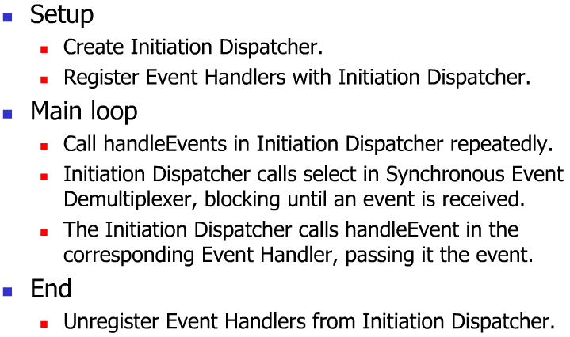

Slide 36
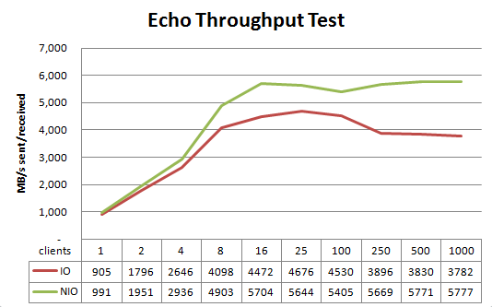
Small benchmark

Slide 37
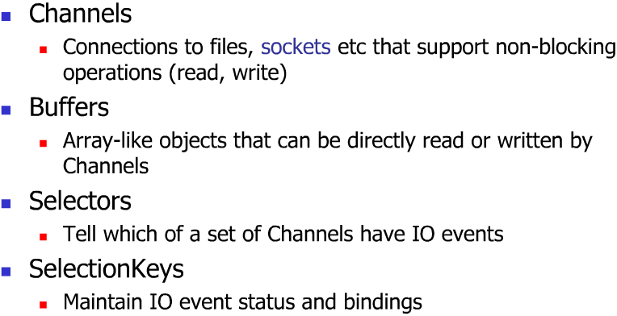
Non-blocking Socket Implementation

Slide 38
code
nio/ConnectAsync

Slide 39
Non-blocking System Model
Server: the application receiving requests.
Client: the set of applications sending requests to the server.
Socket channel: the communication channel between client and server. It is identified by the server IP address and the port number. Data passes through the socket channel by buffer items.
Selector: the main object of all non-blocking technology. It monitors the recorded socket channels and serializes the requests, which the server has to satisfy.
Keys: the objects used by the selector to sort the requests. Each key represents a single client sub-request and contains information to identify the client and the type of the request.

Slide 40
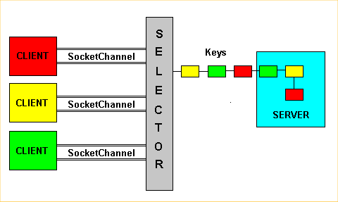
Non-blocking socket architecture
Notes:
client applications simultaneously perform requests to the server. The selector collects them, creates the keys, and sends them to the server. This may seem like a blocking system, because the requests are processed one at a time; actually, it is not like that. In fact, each key doesn't represent the entire information stream a client sends to a server, but just a part. We don't have to forget the selector divides the client-data in sub-requests identified by the keys. Consequently, if more clients continuously send data to the server, the selector will create more keys, which will be processed according to a time-sharing policy

Slide 41
code
nio/EchoServer
      nc localhost 12345
                ...pto

Slide 42
Channels
They can operate in non-blocking mode and are selectable
Channel represents specific connection to a specific I/O service and encapsulates the state of that connection
Buffers are the internal endpoints used by channel to send and receive data
Notes:
ServerSocketChannel class is channel based socket listener.
SocketChannel acts as the client, initiating the connection to a listening server.
Newly created SocketChannel is open but not connected the socket can be connected by calling connect()
When connect() is invoked in non blocking mode; it initiate a connection to the requested address then returns immediately
Show them ConnectAsync Program

Slide 43
Selectors
This class manages information about a set of registered channels and their readiness status
Each instance of Selector can monitor more socket channels, and thus more connections
When something interesting happens on the channel, the selector informs the application to process the request
Notes:
The main object of all non blocking technology. It monitors the recorded socket channels and serializes the requests, which the server has to satisfy

Slide 44
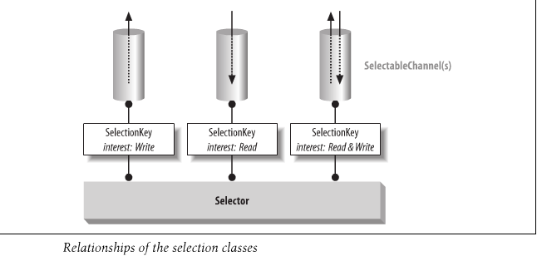

Slide 45
Code test
Are selectors working ???
nc `whatsmyip` 12345
  Bomb away

Slide 46
Selection keys
Key represents the registration of particular channel object with a particular selector object.
Interest
  OP_READ
  OP_WRITE
  OP_CONNECT
  OP_ACCEPT
Notes:
Selection key remembers what you are interested in for each channel.

Slide 47
The Selection Process
Registered key set
  Set of currently registered keys associated with selector
Selected key set
  key whose associated channel was determined to be ready for at least one of the operations in the key’s interest
Cancelled key set
  Keys whose cancel() method have been called

Slide 48
The Selection Process
Selector class’s select() method
  Public abstract int select() throws IOException;
    This call block indefinitely if no channels are ready but it can return 0 if the wakeup() method of the selector is invoked by another thread
  Public abstract int select ( long timeout ) throws IOException;
    Limit the amount of time a thread will wait for a channel to become ready
  Public abstract int selectNow() throws IOException;
    This is totally non-blocking, If no channel is currently ready, it immediately returns 0

Slide 49
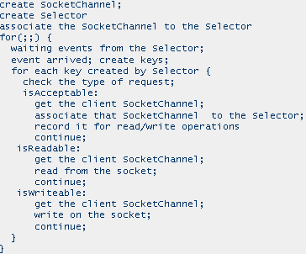
General algo of non-blocking server
Notes:
Show Examples

Slide 50
‘Event-driven' model
pros:
  efficient and elegant
  scales well - hundreds of connections means only hundreds of socket/state objects, not hundreds of threads or processes.
cons:
  more complex - you may need to build state machines.
  requires a fundamentally different approach to programming that can be confusing at first

Slide 51
Use kab karoon ?
Move large amounts of data efficiently
  NIO is primarily block oriented – java.io uses streams
  Direct buffers to do raw, overlapped I/O – bypassing the JVM
Multiplex large numbers of open sockets
  NIO sockets can operate in non-blocking mode
  One thread can manage huge numbers of socket channels
  Better resource utilization
Use OS-level file locking or memory mapping
  Locking: Integration with legacy/non-Java applications
  Mapped Files: Non-traditional I/O model - leverages virtual memory
Do custom character set Transcoding
  Control translation of chars to/from byte streams

Slide 52
Efficiency – The Need For Speed
  Byte/char-oriented pipelines are flexible but relatively inefficient
  The OS provides high-performance I/O services - the JVM gets in the way
Scalability – Livin' Large
  Big applications have big appetites, they consume large amounts of data
  Traditional method of handling large numbers of I/O streams does not scale
  Multiplexing can only be done effectively with OS support
Reliability – Less Code Written = Fewer Bugs
  These I/O needs are generic and should be provided by the Java platform
  Application programmers should write application code, not infrastructure
No Longer CPU Bound
  Moving data has become the bottleneck, not bytecode execution speed
JSR 51 (http://www.jcp.org/en/jsr/detail?id=51)
  Requested I/O features widely available on most OSs but missing from Java

Slide 53
Java NIO Projects
Netty - http://netty.io/
      Brilliant abstractions for NIO
Mina - http://mina.apache.org/
Grizzly - http://grizzly.java.net/

Slide 54
Listening ..... aNy-I/O

Slide 55
code
Write a chat bot using NIO !!!

Slide 56
FIN/ACK ?

