Slide 1


Slide 2


Slide 3
Big Data
Extremely large data sets
Analysed to reveal
patterns
trends and
associations especially relating to human behaviour and interactions.

Slide 4
Big Data Everywhere...
Lots of data is being collected and warehoused
Web data, e-commerce
purchases at department/grocery stores
Bank/Credit Card transactions
Social Network
etc

Slide 5


Slide 6
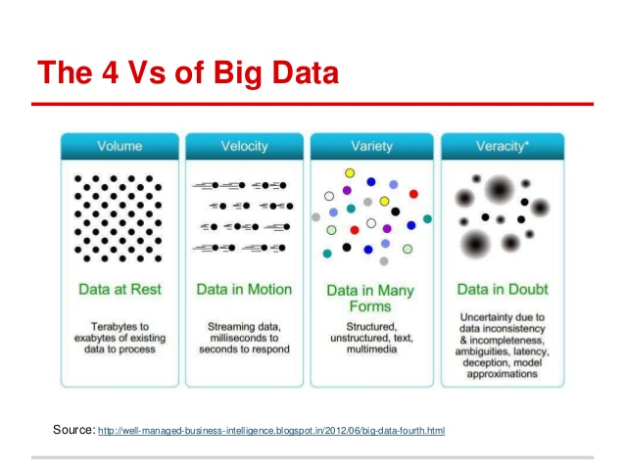

Slide 7
Challenges in handling Big Data
Massive Volumes
Data Security
Downtime
Diverse format or variety
Costs

Slide 8
Traditional Data Systems
Traditional data systems, such as relational databases and data warehouses, have been the primary way businesses and organizations have stored and analyzed their data
Traditional systems are designed from the ground up to work with data that has primarily been structured data.

Slide 9
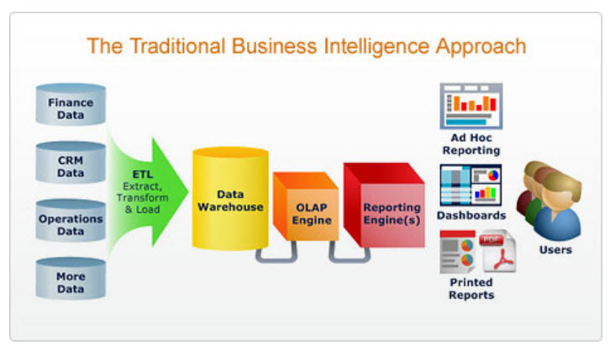

Slide 10
Structured Data
Ex: Library Catalogues (date, author, place, subject, etc) , Census records (birth, income, employment, place etc.) , telephone directory , databases
Semi Structured Data
Ex: NoSQL databases,xml,json
Unstructured Data
Ex: emails , spreadsheets , audio ,video etc
80 % of the data is unstructured data

Slide 11
Limitations of traditional systems
The data size has increased tremendously to the range of petabytes. RDBMS finds it challenging to handle such huge data volumes. To address this, RDBMS added more central processing units (or CPUs) or more memory to the database management system to scale up vertically.
RDBMS cannot handle unstructured data.They’re designed and structured to accommodate structured data
data is generated at a very high velocity. RDBMS lacks in high velocity because it’s designed for steady data retention rather than rapid growth. Even if RDBMS is used to handle and store big data, it will turn out to be very expensive.

Slide 12
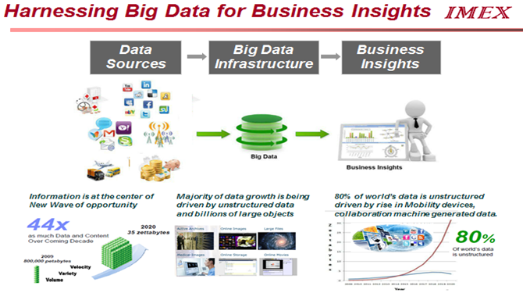

Slide 13


Slide 14
Hadoop
Hadoop is an open-source software framework for storing data and running applications on clusters of commodity hardware.
It provides massive storage for any kind of data, enormous processing power and the ability to handle many concurrent tasks or jobs.

Slide 15
Benefits
Computing power. Its distributed computing model quickly processes big data. The more computing nodes you use, the more processing power you have.
Flexibility. Unlike traditional relational databases, you don’t have to preprocess data before storing it. You can store as much data as you want and decide how to use it later. That includes unstructured data like text, images and videos.

Slide 16
Fault tolerance. Data and application processing are protected against hardware failure. If a node goes down, jobs are automatically redirected to other nodes to make sure the distributed computing does not fail. And it automatically stores multiple copies of all data.
Scalability. You can easily grow your system simply by adding more nodes. Little administration is required.
Low cost. The open-source framework is free and uses commodity hardware to store large quantities of data.

Slide 17
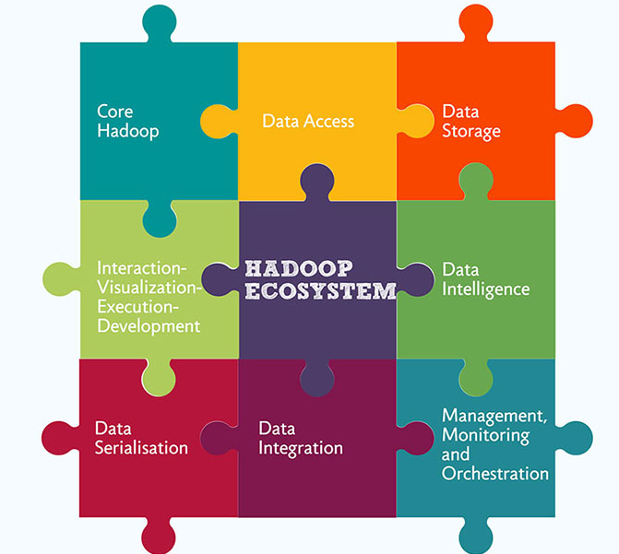
Notes:
http://www.edupristine.com/blog/hadoop-ecosystem-and-components

Slide 18
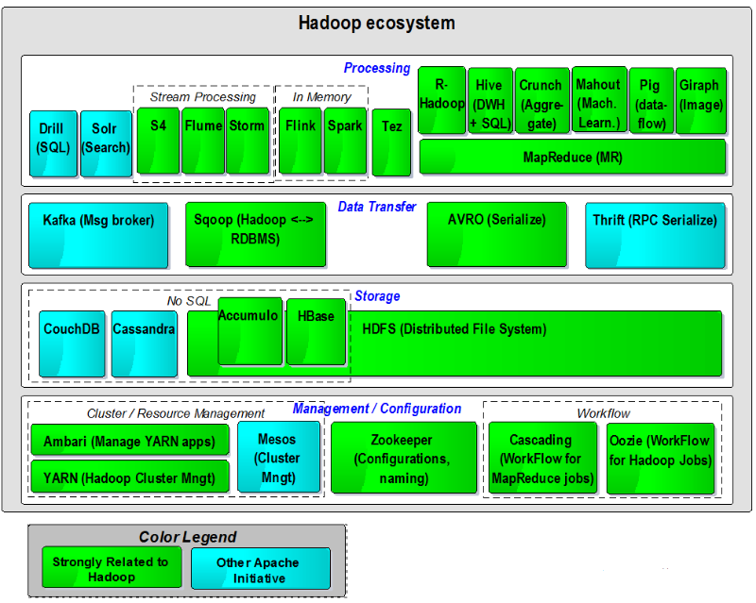

Slide 19
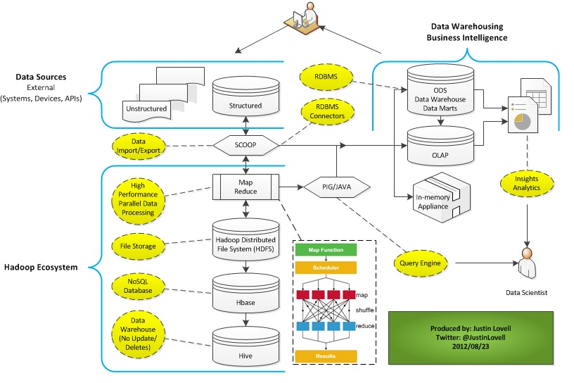

Slide 20
What Hadoop is not
not a substitute for a database
Hadoop stores data in files, and does not index them. If you want to find something, you have to run a MapReduce job going through all the data. This takes time, and means that you cannot directly use Hadoop as a substitute for a database
There is a high performance column-table database that runs on top of Hadoop HDFS: Apache HBase.

Slide 21
What Hadoop is not
not for small data sets
Hadoop framework is not recommended for small-structured datasets as you have other tools available in market which can do this work quite easily and at a fast pace than Hadoop like MS Excel, RDBMS etc. For a small data analytics, Hadoop can be costlier than other tools.

Slide 22
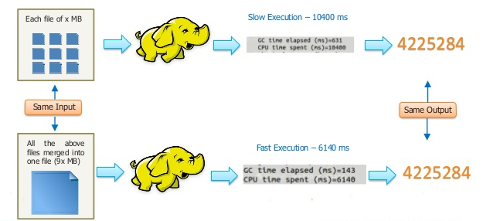

Slide 23
BREAK

Slide 24
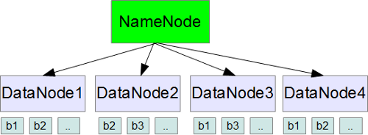
HDFS
HDFS stands for Hadoop Distributed File System, which is the storage system used by Hadoop.

Slide 25
HDFS Write Operation

Slide 26
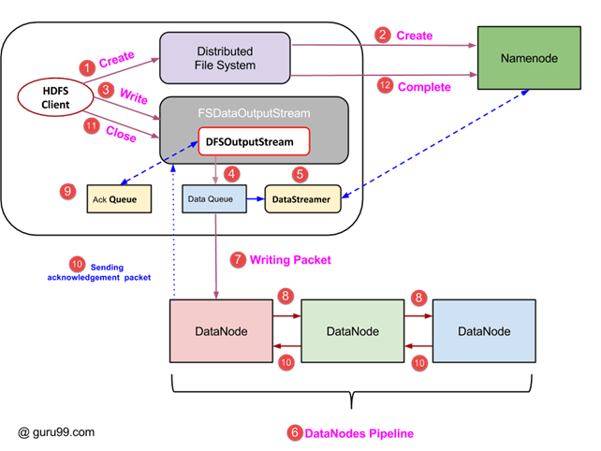

Slide 27
Steps
Steps for hdfs write

Slide 28
HDFS Read Operation

Slide 29
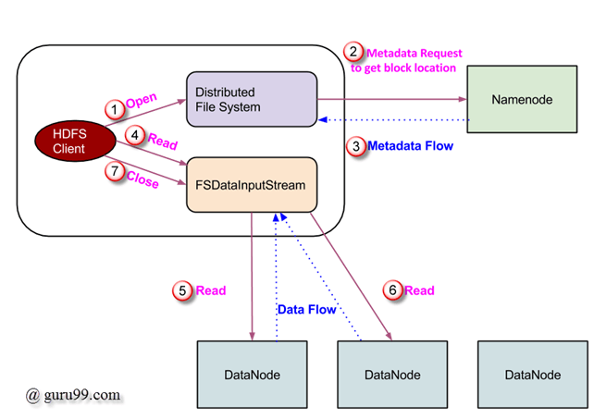

Slide 30
Steps
Steps for hdfs read

Slide 31
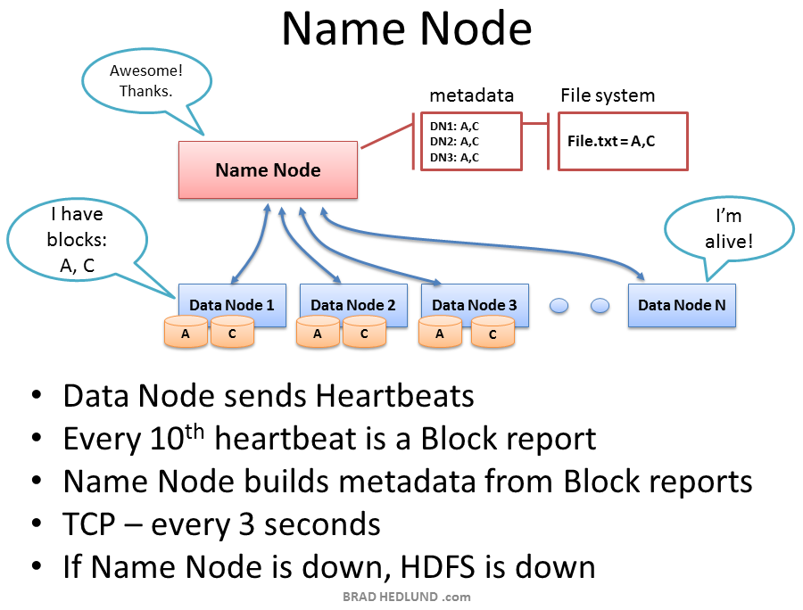

Slide 32
HDFS Blocks
Hadoop distributed file system also stores the data in terms of blocks. However the block size in HDFS is very large.
The default size of HDFS block is 64MB. The files are split into 64MB blocks and then stored into the hadoop filesystem.

Slide 33
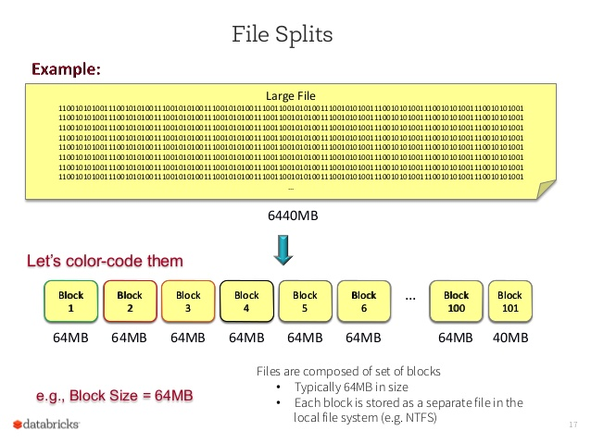

Slide 34
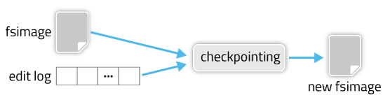
HDFS Checkpointing
HDFS metadata can be thought of consisting of two parts: the base filesystem table (stored in a file called fsimage) and the edit log which lists changes made to the base table (stored in a file called edits)
Checkpointing is a process of reconciling fsimage with edits to produce a new version of fsimage. There are two benefits arising out of this: a more recent version of fsimage, and a truncated edit log
Notes:
https://www.youtube.com/watch?v=CsYdlAwwGtE&index=7&list=PLjOv0CBS0xcLhG2xvM-Un2Hxji1g0ScrN

Slide 35
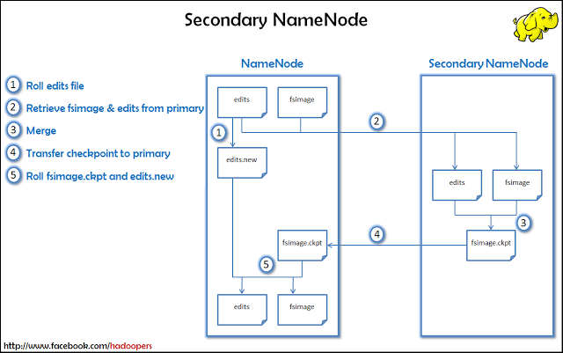

Slide 36
Hdfs Checkpointing
fs.checkpoint.period: controls how often this reconciliation will be triggered. 3600 means that every hour fsimage will be updated and edit log truncated. Checkpiont is not cheap, so there is a balance between running it too often and letting the edit log grow too large. This parameter should be set to get a good balance assuming typical filesystem use in your cluster.
fs.checkpoint.size: is a size threshold, which, if reached by edits, will trigger an immediate checkpoint regardless of time elapsed since the last checkpoint. This is insurance from edit log getting too large under unusually heavy write traffic to the filesystem metadata.

Slide 37
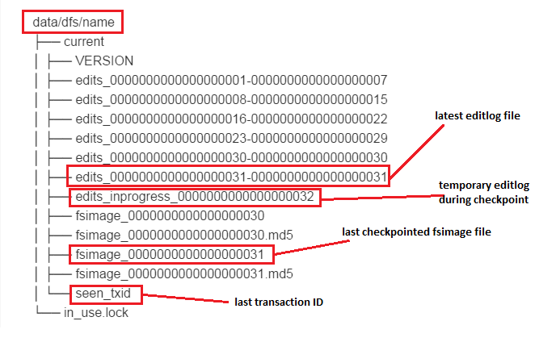
Fsimage and editlogs directories

Slide 38
HDFS Failure scenarios
Edit Log Failures
The NameNode’s function is to store metadata. In filesystem jargon, metadata is “data about data”– things like the owners of files, permission bits, and so forth. HDFS stores its metadata on the NameNode in two main places: the FSImage, and the edit log.
It is a good practice to configure your NameNode to store multiple copies of its metadata.It is stored in journal nodes
Note: There must be at least 3 JournalNode daemons, since edit log modifications must be written to a majority of JNs. This will allow the system to tolerate the failure of a single machine. You may also run more than 3 JournalNodes, but in order to actually increase the number of failures the system can tolerate, you should run an odd number of JNs, (i.e. 3, 5, 7, etc.). Note that when running with N JournalNodes, the system can tolerate at most (N - 1) / 2 failures and continue to function normally.

Slide 39
NameNode failures
NameNode Daemon Crash : Solution: Just restart the Namenode process
Host is Down where the Name Node is running.
Solution:
Start the namenode in a different host with a empty dfs.name.dir
Point the dfs.name.dir to the NFS mount where we have copy of the meta data. OR
Use --importCheckpoint option while starting namenode after pointing fs.checkpoint.dir to checkpoint directory from Secondary NameNode
Change the fs.default.name to the backup host name URI and restart the cluster with all the slave IP's in slaves file.
Note - We may miss the edit that might have happened after the last checkpoint.

Slide 40
NameNode High Availability
To set up High Availability in Hadoop cluster you have to use Zookeeper
Two separate machines are configured as NameNodes. At any point in time, one of the NameNodes is in an Active state, and the other is in a Standby state. The Active NameNode is responsible for all client operations in the cluster, while the Standby is simply acting as a slave, maintaining enough state to provide a fast failover if necessary.
Daemon called Failover Controller will be running on the two namenodes which help monitoring health of namenodes

Slide 41
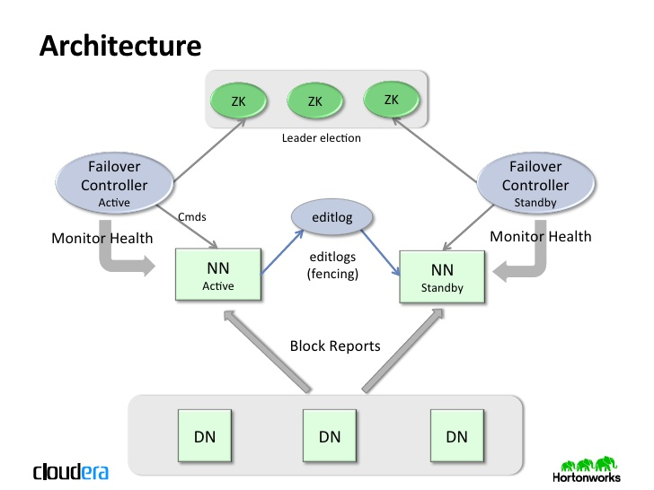

Slide 42
Automatic Failover architecture
Failover Controller Responsibilities:
Monitor health of associated namenode
Participate in leader election of namenode
Fences the other namenodes if it wins the election
http://stackoverflow.com/a/33313804 -> architecture

Slide 43
DataNode Failures
NameNode periodically receives a Heartbeat and a Block report from each of the DataNodes in the cluster. Receipt of a Heartbeat implies that the DataNode is functioning properly.
A Blockreport contains a list of all blocks on a DataNode.
When NameNode notices that it has not received a heartbeat message from a data node after a certain amount of time, the data node is marked as dead. Since blocks will be under replicated the system begins replicating the blocks that were stored on the dead DataNode.
The NameNode Orchestrates the replication of data blocks from one DataNode to another. The replication data transfer happens directly between DataNode and the data never passes through the NameNode.

Slide 44
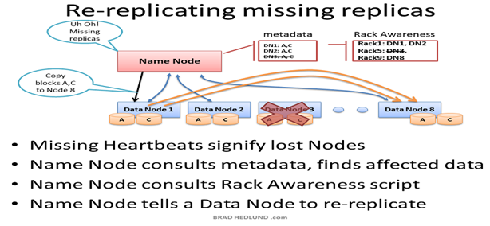

Slide 45
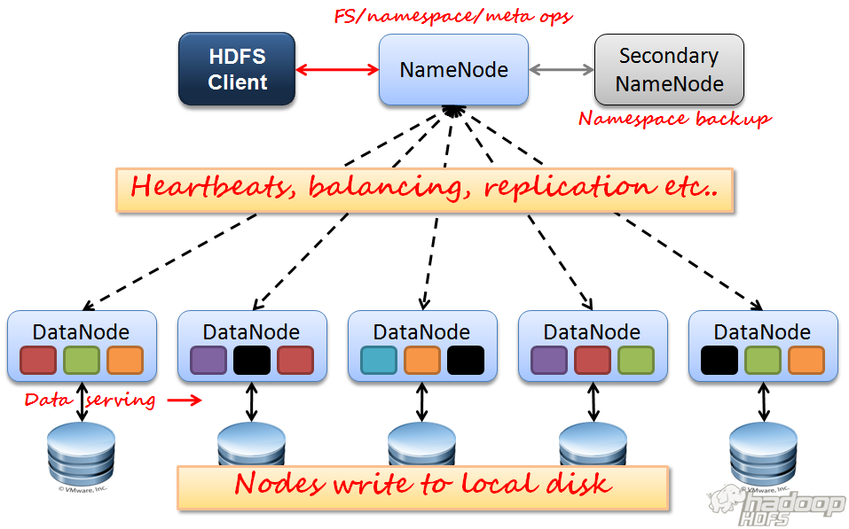

Slide 46
YARN

Slide 47
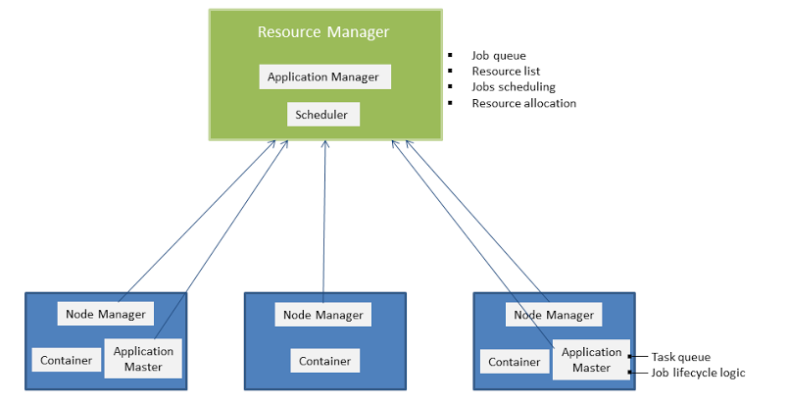
YARN(Yet Another Resource Negotiator)

Slide 48
YARN Components
Scheduler:
responsible for allocating resources to the various running applications
it performs no monitoring or tracking of status for the application
it offers no guarantees about restarting failed tasks either due to application failure or hardware failures
The current schedulers such as the CapacityScheduler and theFairScheduler
Application Manager:
responsible for accepting job-submissions
Responsible for negotiating the first container for executing the application specific ApplicationMaster
provides the service for restarting the ApplicationMaster container on failure

Slide 49
NodeManager is the per-machine framework agent who is responsible for containers, monitoring their resource usage (cpu, memory, disk, network) and reporting the same to the ResourceManager/Scheduler.
Application Master:
The Application Master is itself a container, albeit a special one, sometimes called container 0
responsible for launching subsequent containers as required by the job
Handling of failure of containers and application master:
The Application Manager handles failures of the Application Master
Application Master handles failures of job containers

Slide 50
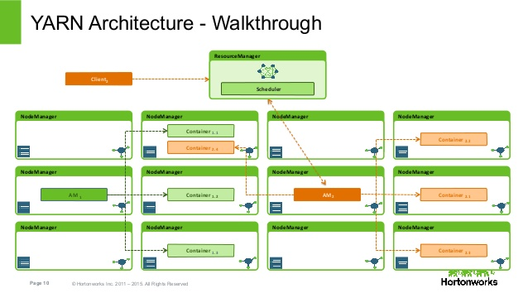

Slide 51
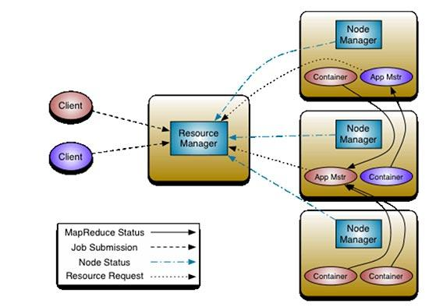

Slide 52
Schedulers
Capacity scheduler:
The CapacityScheduler is designed to allow sharing a large cluster while giving each organization a minimum capacity guarantee.
The central idea is that the available resources in the Hadoop Map-Reduce cluster are partitioned among multiple organizations who collectively fund the cluster based on computing needs
There is an added benefit that an organization can access any excess capacity no being used by others. This provides elasticity for the organizations in a cost-effective manner.

Slide 53
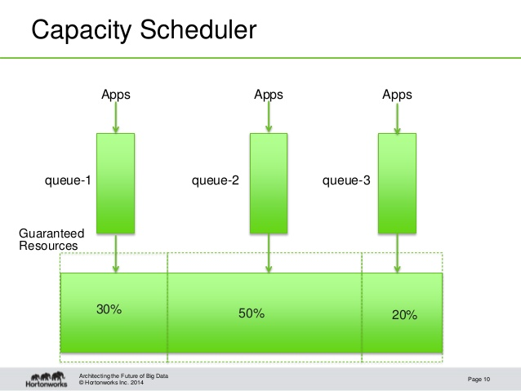

Slide 54
Schedulers
Fair Share Scheduler:
Fair scheduling is a method of assigning resources to jobs such that all jobs get, on average, an equal share of resources over time
When there is a single job running, that job uses the entire cluster. When other jobs are submitted, tasks slots that free up are assigned to the new jobs, so that each job gets roughly the same amount of CPU time
Unlike the default Hadoop scheduler, which forms a queue of jobs, this lets short jobs finish in reasonable time while not starving long jobs

Slide 55
It is also a reasonable way to share a cluster between a number of users.
Finally, fair sharing can also work with job priorities - the priorities are used as weights to determine the fraction of total compute time that each job should get.

Slide 56
MAP REDUCE

Slide 57
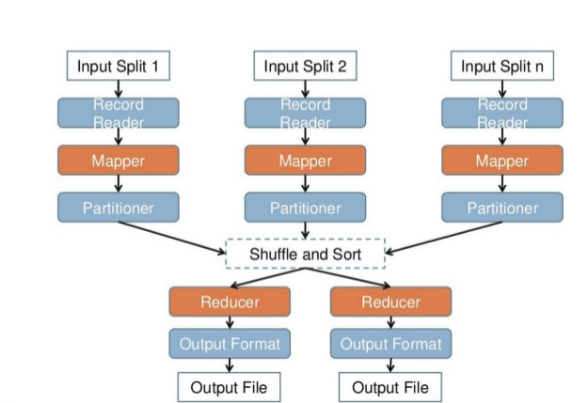

Slide 58
Word Count Example

Slide 59
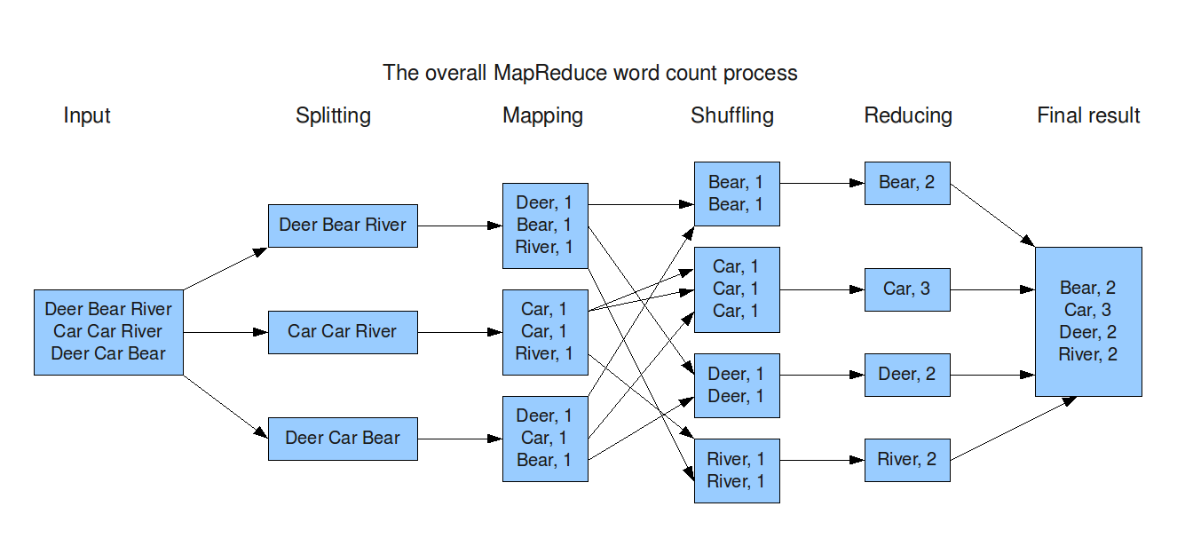

Slide 60
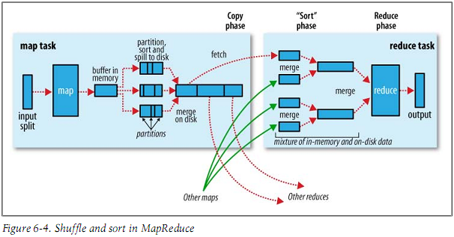
Mapreduce Internals

Slide 61
HBase

Slide 62
Column Oriented Databases
A columnar database is a database that stores data in columns instead of rows
The goal of a columnar database is to efficiently write and read data to and from hard disk storage in order to speed up the time it takes to return a query
In a columnar database, all the column 1 values are physically together, followed by all the column 2 values, etc.

Slide 63
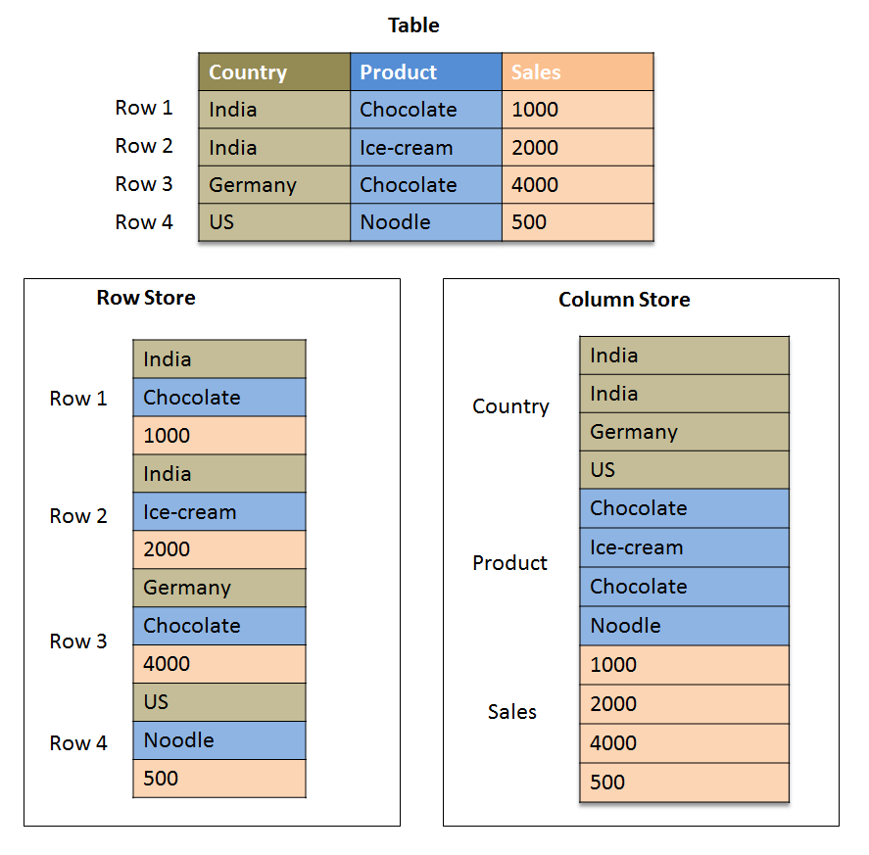

Slide 64
Benefits of column oriented databases
Analytical Queries:
for many analytical queries only a small number of columns are needed for any particular query.
Operations like MIN, MAX, SUM, COUNT and AVG— to be performed very rapidly. This means that dramatically less data needs to be read from disk, scanned by the cpu, and cached in memory
Compression:
when you arrange data by column, there are some very simple compression techniques that are enormously effective, basically taking advantage of the fact that the values in a column are often very similar
Having data compressed gives enormous performance advantages because less data must be read from disk, and more records can be cached in memory

Slide 65
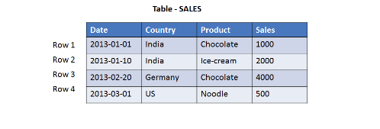
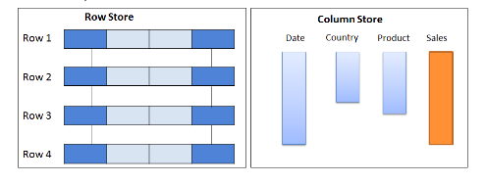
Select sum(sales) from sales

Slide 66
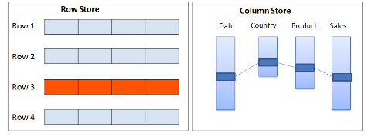
Select * from sales

Slide 67
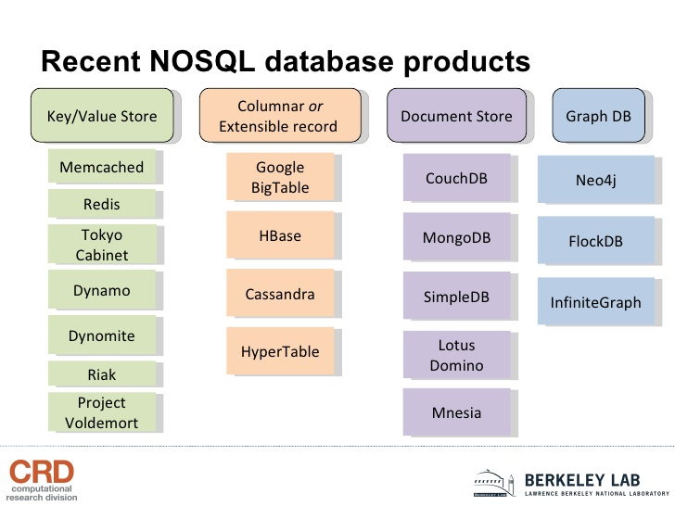

Slide 68
HBase
HBase is a distributed column-oriented database built on top of the Hadoop file system.
Terminologies
Table is a collection of rows.
Row is a collection of column families.
Column family is a collection of columns.
Column is a collection of key value pairs.

Slide 69
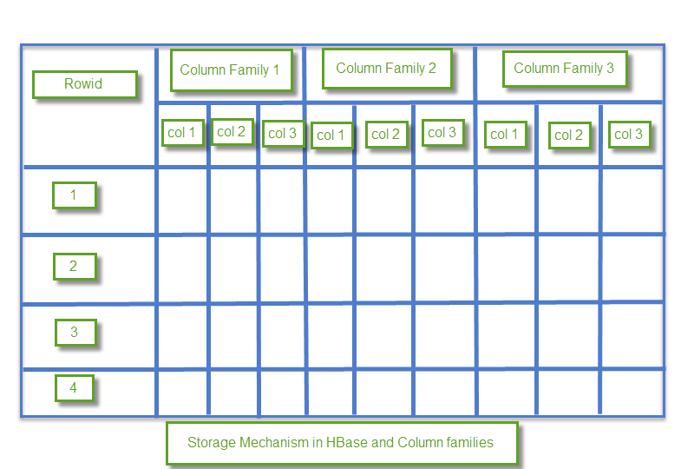

Slide 70
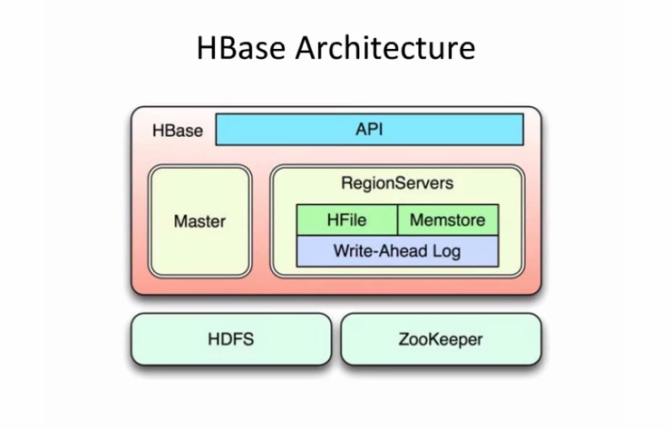

Slide 71
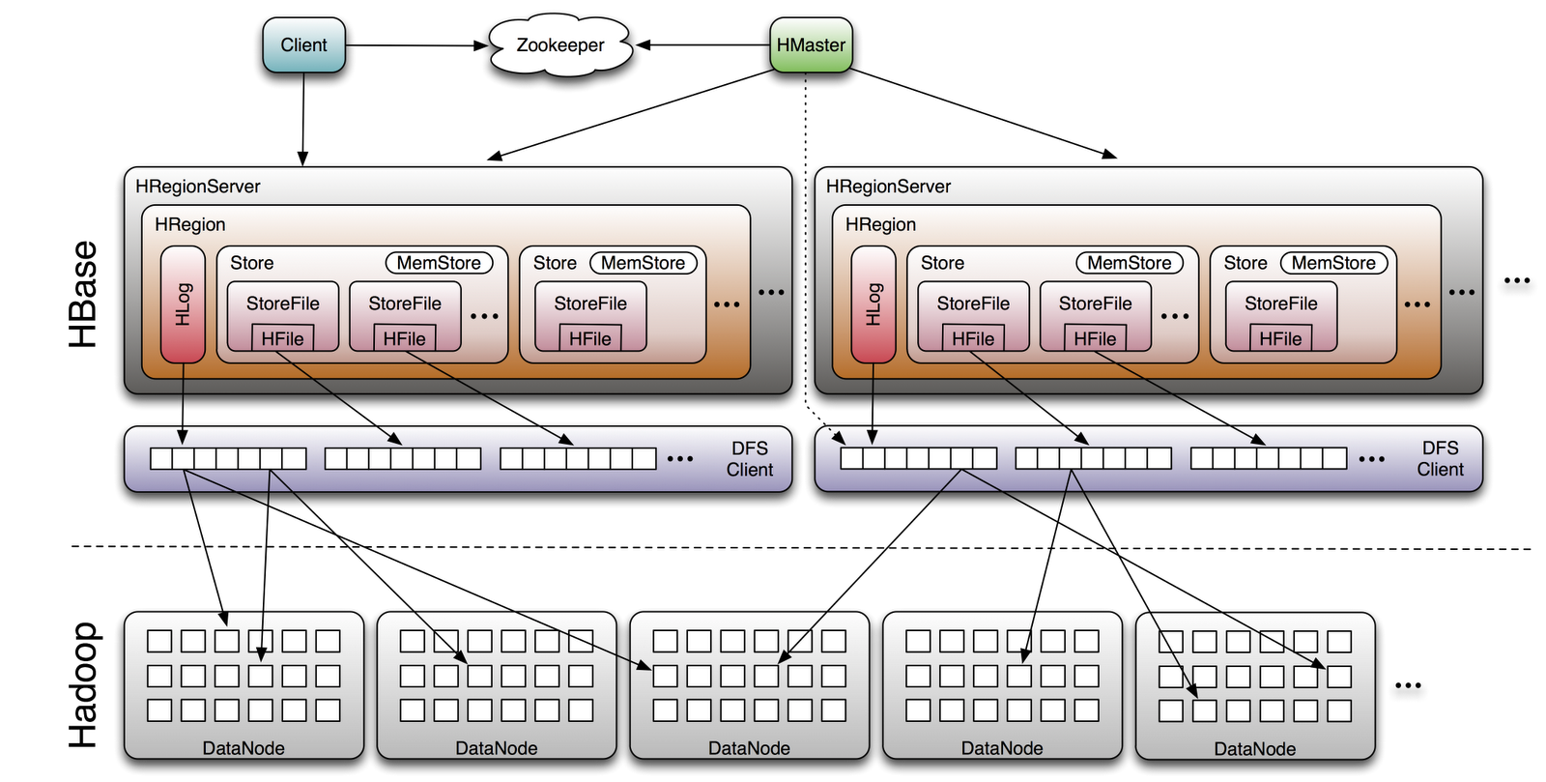

Slide 72
HMaster
Assigns regions to the region servers and takes the help of Apache ZooKeeper for this task.
Handles load balancing of the regions across region servers. It unloads the busy servers and shifts the regions to less occupied servers.
Is responsible for schema changes and other metadata operations such as creation of tables and column families
Regions
Regions are nothing but tables that are split up and spread across the region servers

Slide 73
Region server
Communicate with the client and handle data-related operations.
Handle read and write requests for all the regions under it.
Decide the size of the region by following the region size thresholds.

Slide 74
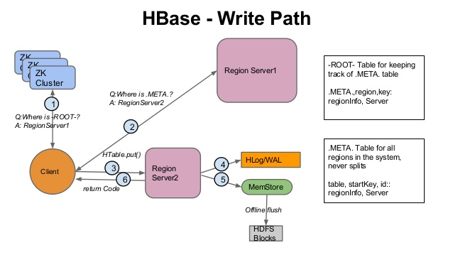

Slide 75
HBase write
When a write is made, by default, it goes into two places:
write-ahead log (WAL), HLog, and
in-memory write buffer, MemStore
Clients don't interact directly with the underlying HFiles during writes, rather writes goes to WAL & MemStore in parallel. Every write to HBase requires confirmation from both the WAL and the MemStore.

Slide 76
HBase Memstore
The MemStore is a write buffer where HBase accumulates data in memory before a permanent write.
Its contents are flushed to disk to form an HFile when the MemStore fills up.
It doesn't write to an existing HFile but instead forms a new file on every flush.
The HFile is the underlying storage format for HBase.
HFiles belong to a column family(one MemStore per column family). A column family can have multiple HFiles, but the reverse isn't true.
size of the MemStore is defined in hbase-site.xml called hbase.hregion.memstore.flush.size.

Slide 77
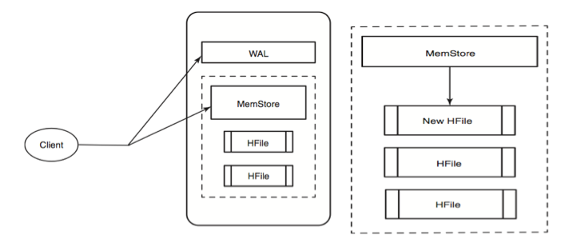

Slide 78
What happens, when the server hosting a MemStore that has not yet been flushed crashes?
Every server in HBase cluster keeps a WAL to record changes as they happen. The WAL is a file on the underlying file system.A write isn't considered successful until the new WAL entry is successfully written, this guarantees durability
If HBase goes down, the data that was not yet flushed from the MemStore to the HFile can be recovered by replaying the WAL, taken care by Hbase framework

Slide 79
HBase read
A read against HBase must be reconciled between the HFiles, MemStore & BLOCKCACHE.The BlockCache is designed to keep frequently accessed data from the HFiles in memory so as to avoid disk reads
Each column family has its own BlockCache.BlockCache contains data in form of 'block', as unit of data that HBase reads from disk in a single pass
The HFile is physically laid out as a sequence of blocks plus an index over those blocks. This means reading a block from HBase requires only looking up that block's location in the index and retrieving it from disk

Slide 80
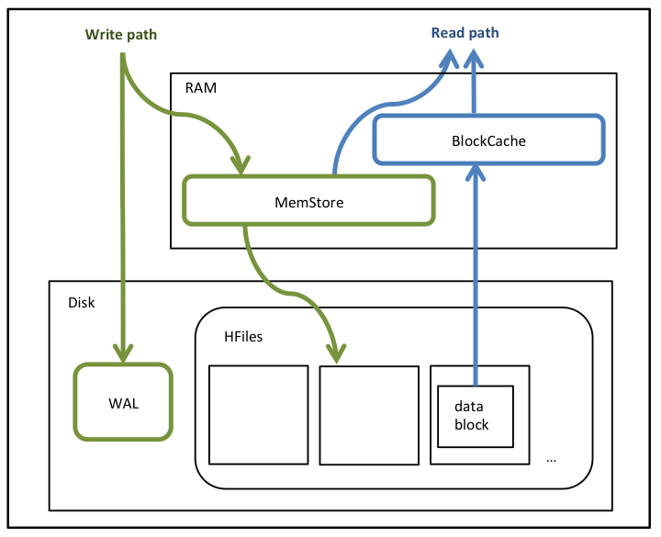

Slide 81
Hive

Slide 82
Hive
Hive is a data warehousing infrastructure based on Apache Hadoop
Hive is designed to enable easy data summarization, ad-hoc querying and analysis of large volumes of data.
It provides SQL which enables users to do ad-hoc querying, summarization and data analysis easily.

Slide 83
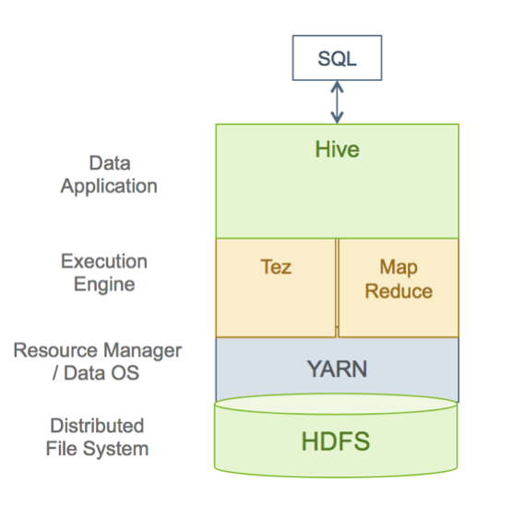

Slide 84
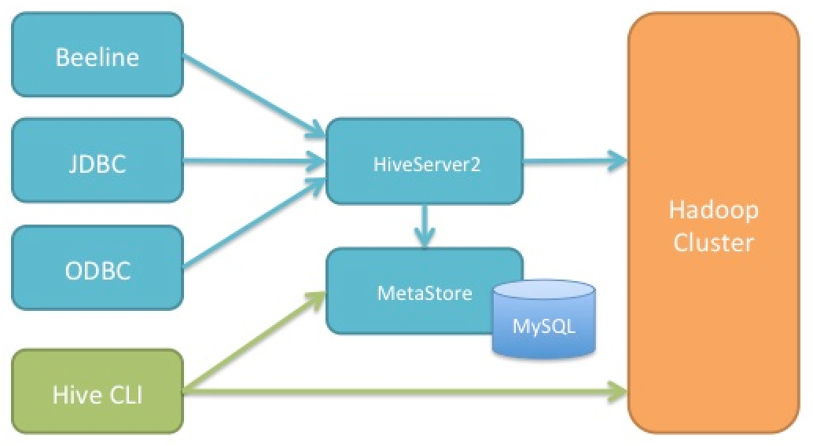

Slide 85
Hive Components
Driver: The component which receives the queries. This component implements the notion of session handles and provides execute and fetch APIs modeled on JDBC/ODBC interfaces.
Query compiler: It compiles HiveQL into graph of map reduce tasks.
Execution engine: It executes the tasks produces by compiler.
Thrift server: It provides an interface to connect to other applications like MySQL, Oracle, Excel, etc. through JDBC/ODBC drivers.

Slide 86
Command line interface: It is also called Hive shell. It is used for working with data either interactively or batch data processing.
Web Interface: It is a visual structure on Hive used for interaction with data.
Metastore – The component that stores all the structure information of the various tables and partitions in the warehouse including column and column type information, the serializers and deserializers necessary to read and write data and the corresponding HDFS files where the data is stored.

Slide 87
Compiler – The component that parses the query, does semantic analysis on the different query blocks and query expressions and eventually generates an execution plan with the help of the table and partition metadata looked up from the metastore.

Slide 88
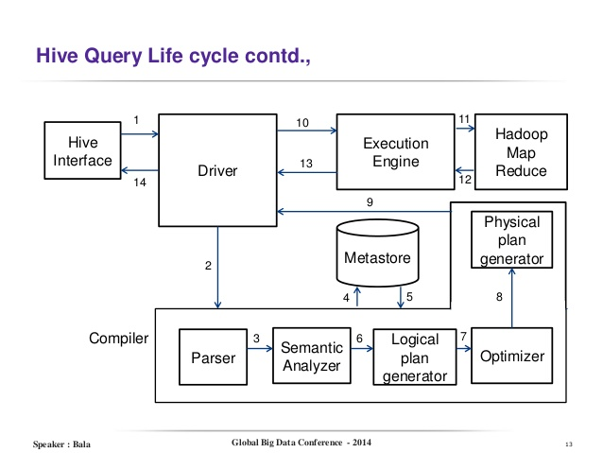

Slide 89
Hive Data Model
Data in Hive is organized into:
Tables
Partitions
Buckets

Slide 90
Tables:
These are analogous to Tables in Relational Databases.
Tables can be filtered, projected, joined and unioned.
Additionally all the data of a table is stored in a directory in HDFS
Partitions:
Each Table can have one or more partition keys which determine how the data is stored, for example a table T with a date partition column ds had files with data for a particular date stored in the <table location>/ds=<date> directory in HDFS

Slide 91
Partitions allow the system to prune data to be inspected based on query predicates, for example a query that is interested in rows from T that satisfy the predicate T.ds = '2016-07-28' would only have to look at files in <table location>/ds=2008-07-28/ directory in HDFS.
Buckets:
Data in each partition may in turn be divided into Buckets based on the hash of a column in the table.
Each bucket is stored as a file in the partition directory. Bucketing allows the system to efficiently evaluate queries that depend on a sample of data (these are queries that use the SAMPLE clause on the table).

Slide 92
Internal and External tables in Hive
External tables:
External table stores files on the HDFS server but tables are not linked to the source file completely
If you delete an external table the file still remains on the HDFS server
The file and the table link is there but read only.
External table files are accessible to anyone who has access to HDFS file structure and therefore security needs to be managed at the HDFS file/folder level.

Slide 93
Internal Tables:
Stored in a directory based on settings in the following file: hive.metastore.warehouse.dir
by default internal tables are stored in the following directory “ /user/hive/warehouse” you can change it by updating the location in the config file mentioned above.
When you drop an internal table, it drops the data, and it also drops the metadata.
Security needs to be managed within HIVE, probably at the schema level (depends on organisation to organisation). HDFS security is out of scope in this case.

Slide 94
Use external table if you:
Want to manage the data outside HIVE e.g. you are planning to use an ETL tool to load/merge data files etc.
Want to load the latest information to the table but still want to retain old dataset in a file on HDFS for regulatory/legal purposes.
Are not planning to create a table from another table schema e.g. Create table1 as (Select * from table2)
Use internal table if you:
Want to store the data temporary.
Want to use HIVE to manage the lifecycle of tables and data.

