Slide 1
Kidney Disease Prediction Using Machine Learning
Sai Ghule, Rohit Khedkar, Vivek Jadhav, Vishal Jadhav, Sarthak Bhangade
Department of CSE (AI & DS), Sanjivani University

Slide 2
Abstract :
CKD is a serious health problem and needs early detection.
We use Machine Learning to study patient health data.
Best model gives fast and accurate results for doctors & patients.
Data is cleaned, main features selected, and models tested.

Slide 3
Introduction
CKD = 'Silent Killer', affects millions globally
Early stages often undiagnosed → dialysis/transplant needed
Early prediction improves survival & reduces healthcare burden
Machine Learning helps in early diagnosis using patient data

Slide 4
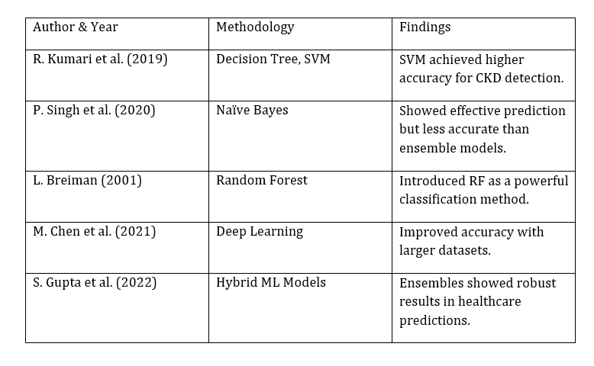
Literature Review

Slide 5
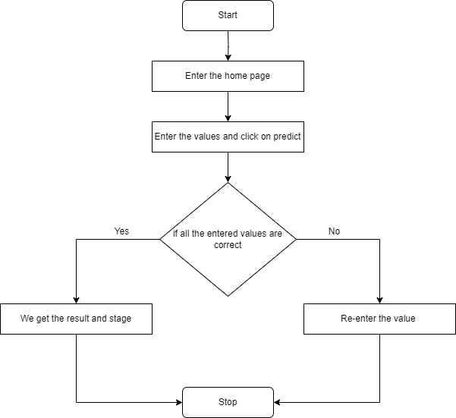
Proposed System Workflow
Step 1: Data Collection (clinical, demographic, biochemical attributes)
Step 2: Data Preprocessing (handle missing values, normalize, remove outliers)
Step 3: Feature Selection (identify most important parameters)
Step 4: Model Training (LR, DT, RF, SVM, KNN, ANN)
Step 5: Evaluation (accuracy, precision, recall, F1-score)
Step 6: Deployment in simple application

Slide 6
Results & Discussion
Logistic Regression → 94% correct
Decision Tree → 95% correct
Random Forest → 98% correct (best)
SVM → 96%, ANN → 97%, KNN → 93%
Random Forest works best, but Logistic Regression & Decision Tree are easy for doctors to understand

Slide 7
Conclusion & Future Scope
ML can predict CKD accurately (Random Forest best performer)
Helps in early diagnosis, treatment planning & cost reduction
Future Work: Use Deep Learning (CNN, RNN) for higher accuracy
Deploy as web/mobile application
Integrate with IoT devices for real-time monitoring

Slide 8
REFERENCES
Sneha J., Tharani V., Preetha D. “Chronic Kidney Disease Prediction Using Data Mining.” JETIR Journal, 2021.
Revathy S., Bharathi B., Ramesh M. “Chronic Kidney Disease Prediction Using Machine Learning Models.” IJETT, 2022
Chittora P., Chaurasia S., Kumawat G. “Prediction of Chronic Kidney Disease – A Machine Learning Perspective.” Springer, 2022.
Dritias E., Trigka M. “ML Techniques for Chronic Kidney Disease Risk Prediction.” Elsevier, 2023.
Raj S., Babu A. “KNN and Naïve Bayes for Kidney Disease Prediction.” IJCSIT, 2023.
Wang Y., et al. “Deep Learning Models for CKD Prediction.” Nature Digital Medicine, 2023.
Gupta A., et al. “Hybrid Ensemble Approaches for CKD.” IEEE Access, 2022.
Al-Taie H., et al. “CKD Risk Prediction Using SVM and Random Forest.” Healthcare Informatics Journal, 2022.
World Health Organization. “Global Burden of Chronic Kidney Disease Report.” WHO, 2023.
Li X., et al. “Deep Neural Networks for Kidney Disease Prediction.” BMC Medical Informatics, 2021.

Slide 9
Participation, Publication & Certification
Participation
Actively took part in research work and project development
Worked on data collection, preprocessing, and model testing
Publication
Research paper on “Kidney Disease Prediction using Machine Learning”
Submitted to IJRAR Journal for publication

