Slide 1
始めに Symfony and Epark

Slide 2
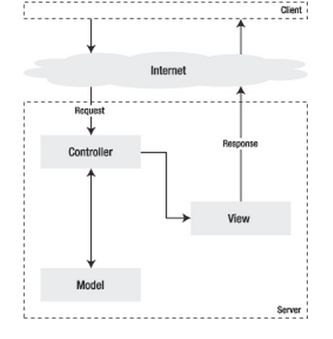
MVC architecture
Model part contains Data on which action is performed.
View part displays the response to the user.
Controller part accept request and perform necessary action on View and Model part.
In symfony the request is send by the URL.

Slide 3
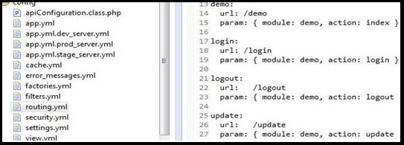
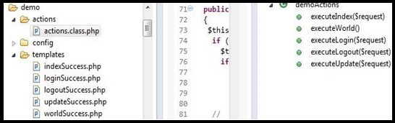
MVC architecture of Symfony
/config/routing.yml
Request(url) : /config/routing.yml
Controller: /actions/actions.class.php/ executeXxx(request)
Model: /lib/model/epark
(Peer Class)
View: /templates/ xxxSuccess.php
Action and View
Database

Slide 4
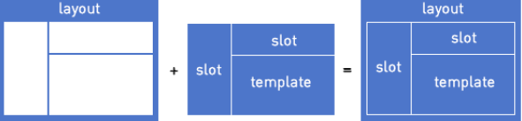
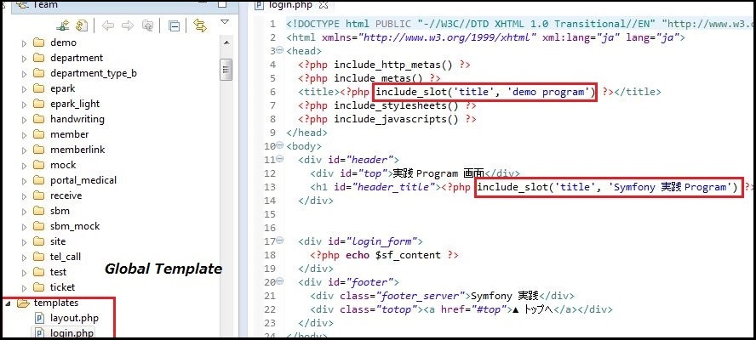
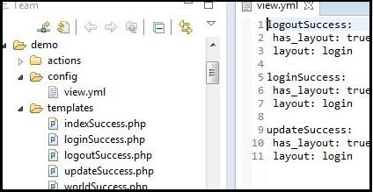
Symfony Template (View)
/api/templates
/api/demo/config/view.yml

Slide 5
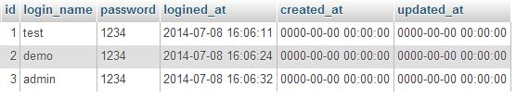
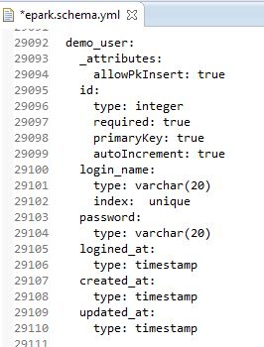
Model Building
1. Create or Update Table in Database (e.g. Here created new Table demo_user)
2. Add Table Definition to epark/config/epark.schema.yml

Slide 6
Model Building
3. Configure Schema Update with the Project
This command auto generates ORM (Object Relation Mapping) between the Table and the project.
This generates 2 Base class (class name same as TableName)in lib/model/epark/orm
BaseDemoUser
BaseDemoUserPeer
A Peer class is generated in lib/model/epark
3. DemoUserPeer

Slide 7
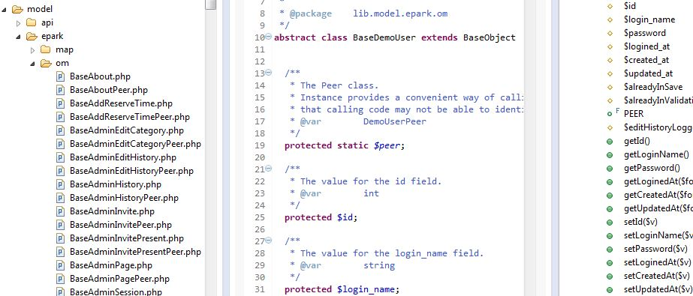
BaseDemoUser
These class defines the Table Column as variables and defines get and set function for each Table Column.
The benefit of this class is that any operation can be performed on Database using concept of object oriented programming.

Slide 8
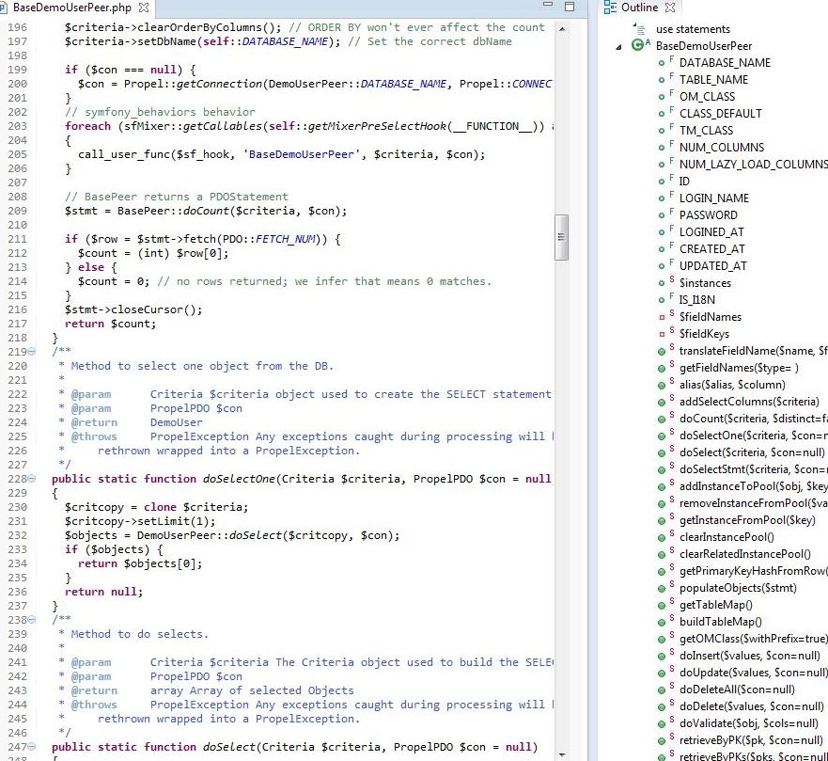
BaseDemoUserPeer
This Class contains the predefined function like doSelect(), doInsert(), doUpdate() etc.
These functions perform operation on database such as Read, Insert, Update etc.

Slide 9
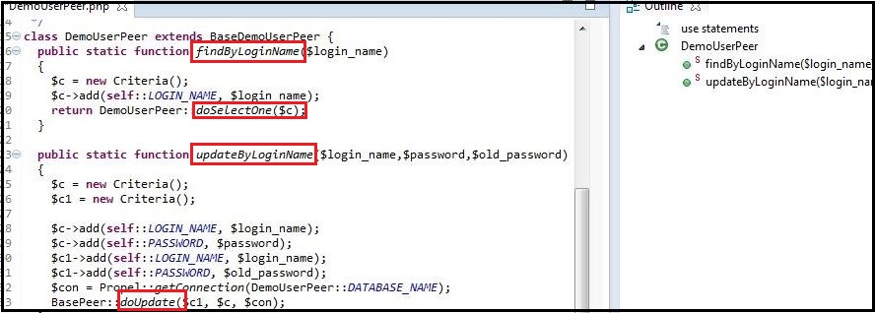
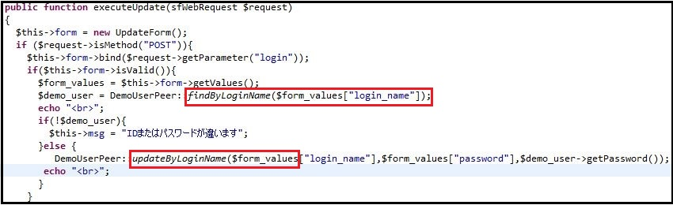
DemoUserPeer
In this class programmer can write there own functions which are required to send proper Response to the users.
In these functions we use the auto defined functions within BaseDemoUser and BaseDemoUserPeer to get the proper result.
These defined functions now used in Controller (action.class.php) to display the result using paired template.

Slide 10
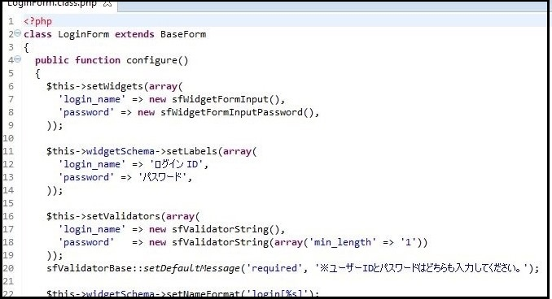
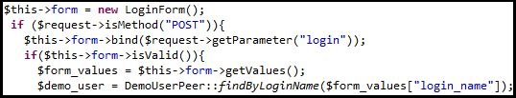
Forms
The form in Symfony is defined as a class. In a single class we can define Fields, Labels, Validators.
The benefit of defining form as class is that it can be used as an object.
Also a single form can be used independently various times.
In controller the form object is created and its value can be easily retrieved.
In template this can easily be displayed by <?php echo $form ?>
To set default value in a form
$this->form->setdefault (‘wiget_name’ ,$value);

Slide 11
$form->isvalid();
Returns false and this doesnot allow to get form values.
To solve this within form we define
$this->disableLocalCsrfProtection();
To disable csrf check.

Slide 12

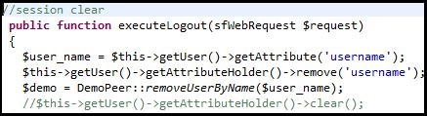
Session
Sessions easily created by setting an attribute using getUser() function
Session can be cleared by attribute name using remove() method.
./symfony cc
This command is used to reflect the changes made.
This is used after Database Build, Create and Update Template adding new routing.

Slide 13
app.yml
In config/app.yml we define constants
all:
mail:
abc=xyz
Is called by
sfconfig::get(app_mail_abc)
To send Mail we use sendMail function of lib/epMailFacade.class.php

Slide 14
Task
Create Task
$ php symfony generate:task doNothing
Run Task
$ ./symfony namespace:task_name
Tasks are stored in lib/task

Slide 15
Cron Job
For cron functionality we use TASK.
We define cron on terminal
* * * * * /usr/local/bin/php /home/schaurasia/epark/symfony epark:DailyMail
For Server Cron defination
/usr/local/bin/php /var/www/epark/symfony epark:pay-member-payment-end-docomo-sp
Cron Commands
Crontab -h
Crontab –l
Crontab –e
Crontab –r

Slide 16
component
If we use include_component() then we define components.class.php in actions folder.
Include_partial()
The include_slot(‘name’) is defined within global templates/ folder.
To include these slot in a template we use <?php slot(‘name’,template)?> for slot we have to define _template.php in local template.

Slide 17
routing.yml
mem_change_status:
url: /mem/changeStatus
class: sfPropelRoute
options: {model: IMemInfoMlRep, type: object}
param: {module: meminfo_mail, action: changeStatus}
This will call IMemInfoMlRep.php in
lib/model where const is defined
If this routing is used we use this command
$row = $this->getRoute()->getObject();
To get the Table Objects.

Slide 18
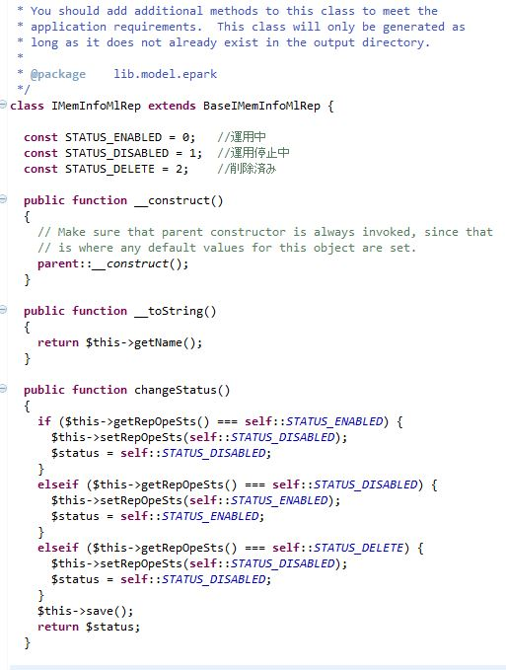
DemoUser
This class is used for defining constants It is mainly used with the routings as defined above which sends the object of Variables as defined in this class.

Slide 19
return self::doSelectstmt($criteria)
This returns the sql statement that the criteria holds.
$row = $shop_info->fetch()
This is used to fetch data from this statement.
To add a new row to the Table -
$q = new IMemInfoMlRep();
$q->setShopId($this->shop->getId());
$q->setGroupId(NULL);
$q->setRepLstNm($form_values["lst_nm"]);
$q->setRepFstNm($form_values["fst_nm"]);
$q->setRepPos($form_values["pos"]);
$q->setRepEmail($form_values["email"]);
$q->setRepOpeSts(1);
$q->save();

Slide 20
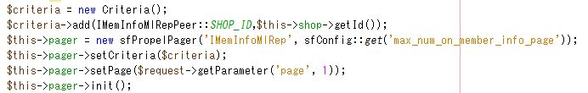
Pager
On action pager
created with query.
In template values can be fetched using pager.

Slide 21
To get only one value from returned object of table row we use get function
<?php $shop = $sf_user->getShop() ?>
<?php $group = GroupShopPeer::getGroupByShopId($shop->getId()); ?>
<?php $pointsts = GroupConfigPeer::getGroupPointStatus($group->getGroupId()); ?>
<?php $pointsts->getShopPointStatus(); ?>

Slide 22
BaseFormPropel : In Forms
BaseForm
sfForm
lib/form/epark
lib/form/epark/base
options: { model: Shop, type: object }
Pager object
Flash object

Slide 23
Transaction in symfony 1.4
$conPdoWrite = Propel::getConnection(self::DATABASE_NAME, Propel::CONNECTION_WRITE); // 書き込み用
try {
// トランザクション開始
$conPdoWrite->beginTransaction();
BasePeer::doUpdate($where, $update, $conPdoWrite); // 会員ランクの一括更新
ShopMemberRankHistoryPeer::insertRankBelowHistotry($members, $newRank); // 会員ランク変更履歴の一括登録
// コミット
$conPdoWrite->commit();
$return = true;
}
catch (PropelException $e) {
// ロールバック
$conPdoWrite->rollBack();
$return = false;
}
For Reference see – ShopMemberCardPeer.php

Slide 24
To write sql stmt as string without using propel criteria
$sql = "SELECT * FROM " . self::TABLE_NAME . " WHERE " . self::LOCK_NAME . " = :lockName FOR UPDATE ";
$stmt = $con->prepare($sql);
$stmt->bindParam(':lockName', $lockName, PDO::PARAM_STR);
$stmt->execute();

Slide 25
$obj = $capaObj_arr[$i];
$fc = new FutureCapa();
$fc->fromArray($obj->toArray());
$fc->save();
//this will insert a new row to the table, taking values from the objects.
Difference between these two -
$capaObj = $this->formList[$i]->updateObject();
$capaObj = $this->formList[$i]->getObject();

