Slide 1
Surveillance Deck
Vivek Jason

Slide 2
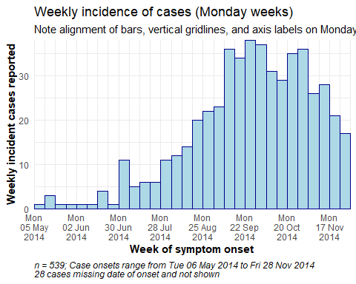
Epi curve

Slide 3
Outbreak details
Outbreak peaks with almost 40 cases on the week of September 22, 2014
The outbreak began the week of May 5, 2014
Deaths by Age
## age_cat Death Recover NA_ ## 0-9 43.9% 38.2% 17.9% ## 10-19 46.5% 31.0% 22.5% ## 20-29 50.0% 29.4% 20.6% ## 30-39 37.0% 37.0% 26.1% ## 40-49 35.0% 35.0% 30.0% ## 50-59 40.0% 20.0% 40.0% ## 60-69 33.3% 66.7% 0.0% ## 70+ - - - ## <NA> 66.7% 33.3% 0.0% ## Total 44.9% 34.5% 20.6%

Slide 4
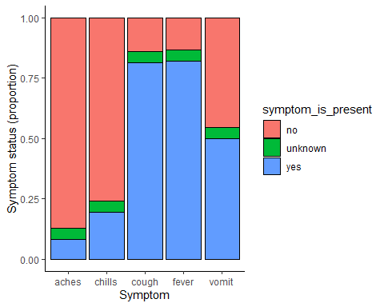
Table by Hospital

