Slide 1



Capstone Project
Employee Management System
Submitted by : Vivek Sunil Jeswani
Submission type : Individual
Name: Vivek Sunil Jeswani
Batch : HDFC BANK API Developer
LMS Id : vivekjeswani3@gmail.com
Date: 28/04/2023

Slide 2


Table of contents
Introduction
Project Overview
Architecture Design
User Interface Design
Back-end Development
Front-end Development
Testing
Deployment
Conclusion
Future Work
References
Appendices

Slide 3
Introduction
These projects necessitate the development of the following tasks:
A database table with three fields are EmployeeID, EmployeeName, and DateOfBirth.
Java code to query a single record based on EmployeeID and display an error message if the ID does not exist
Jenkins is used to deploy the code to an application server such as Tomcat, which is stored in a Git repository.
The code is then altered so that it can function as an HTTP web service that accepts EmployeeID and returns all three fields.
Each call will be logged with a date and time stamp, and the log file will be rotated if it exceeds 1 MB.
To call the service, the curl command is also written.
The DateOfBirth field is encrypted using AES.

Slide 4
Project Overview
The project entails constructing a database table with three columns: EmployeeID, EmployeeName, and DateOfBirth. Java code is developed to query a single record based on the EmployeelD, with an invalid EmployeelD error returned. The code is stored in a repository on Git and delivered to an application server such as Tomcat or WebLogic using Jenkins.
Next, the Java code is modified to expose the query functionality as an HTTP web service that accepts an EmployeeID and returns all three fields of the corresponding employee. The web service also creates a log file with a date and time stamp for every call and will rotate the log file if its size exceeds 1 MB.
These web services are then tested by calling them from Postman. Then, the web service is updated to use HTTPS and a self-signed certificate and tested again with Postman. Also, a CURL command is written to call the web service.
To access the web service, a separate Java client program is created. The web service is modified to use AES to encrypt the DateOfBirth, and the client program is changed to decrypt this encrypted value.

Slide 5
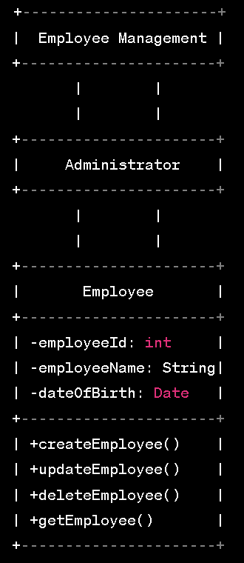
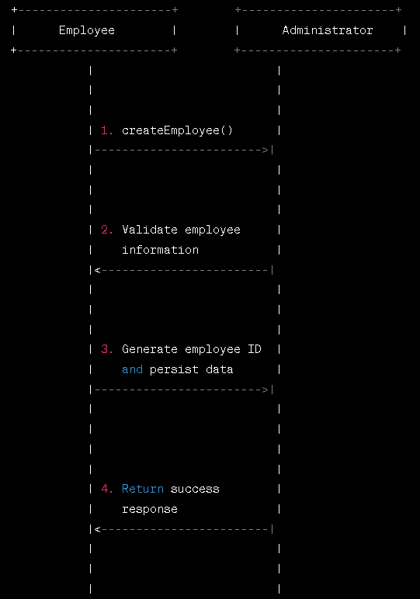
Architecture Design
USECASE DIAGRAM
SEQUENCE DIAGRAM

Slide 6
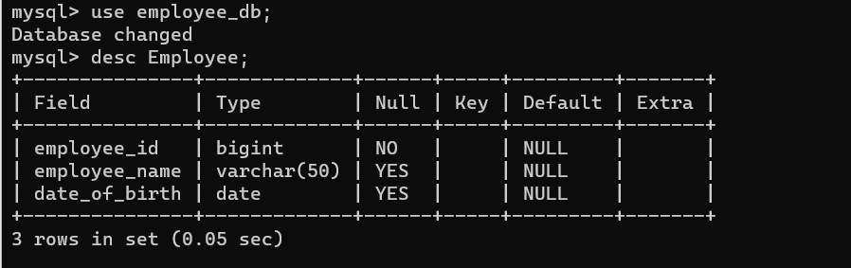
Architecture Design
Database:
MySQL is used for this project to create & store employee data.
3 columns given below figure shows.

Slide 7
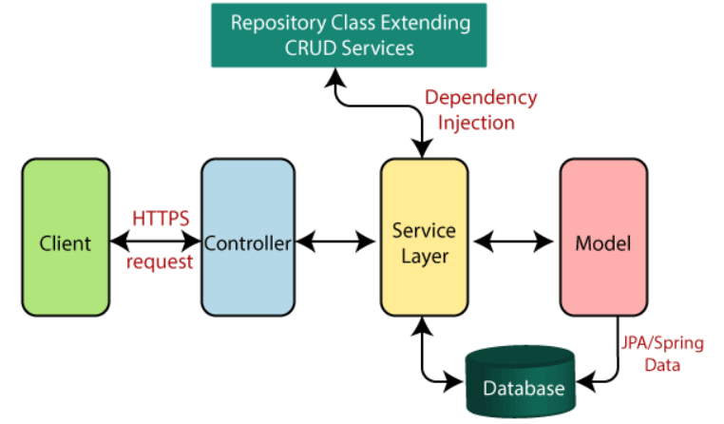
Architecture Design
Spring Boot Flow Architecture:

Slide 8
Architecture Design
Database Server
(Starting Point)
Spring Boot App
Git Repo
Jenkins
WebServer
HTTPs
Postman
Logging
HTTP Web Service
AES Encryption
Docker Container
Kubernetes
Java Client

Slide 9



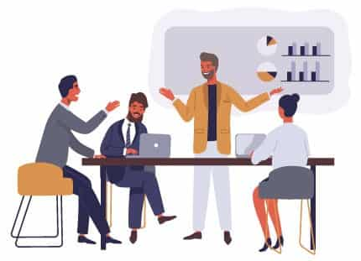

Deployment Architecture
CI/Copy & Build & test Code
Docker image pull
Commit Code
Employee Sys Application
Deploy Docker Image To Kubernetes Cluster

Slide 10
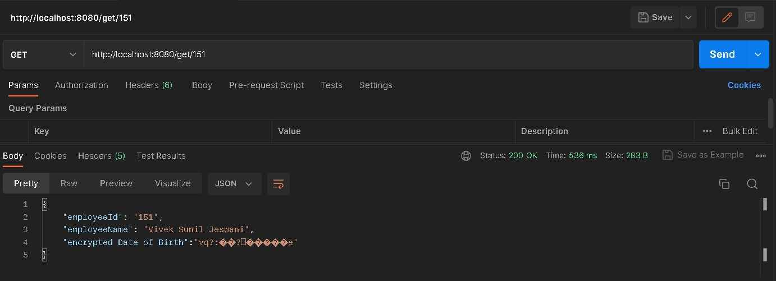
Deployment

Slide 11
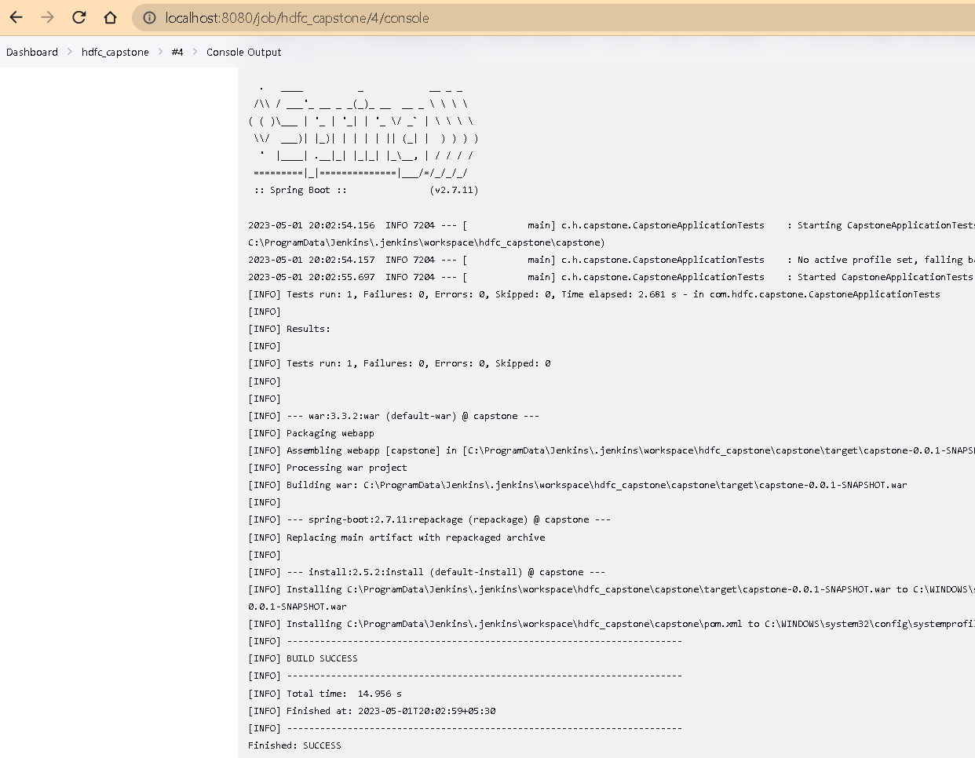
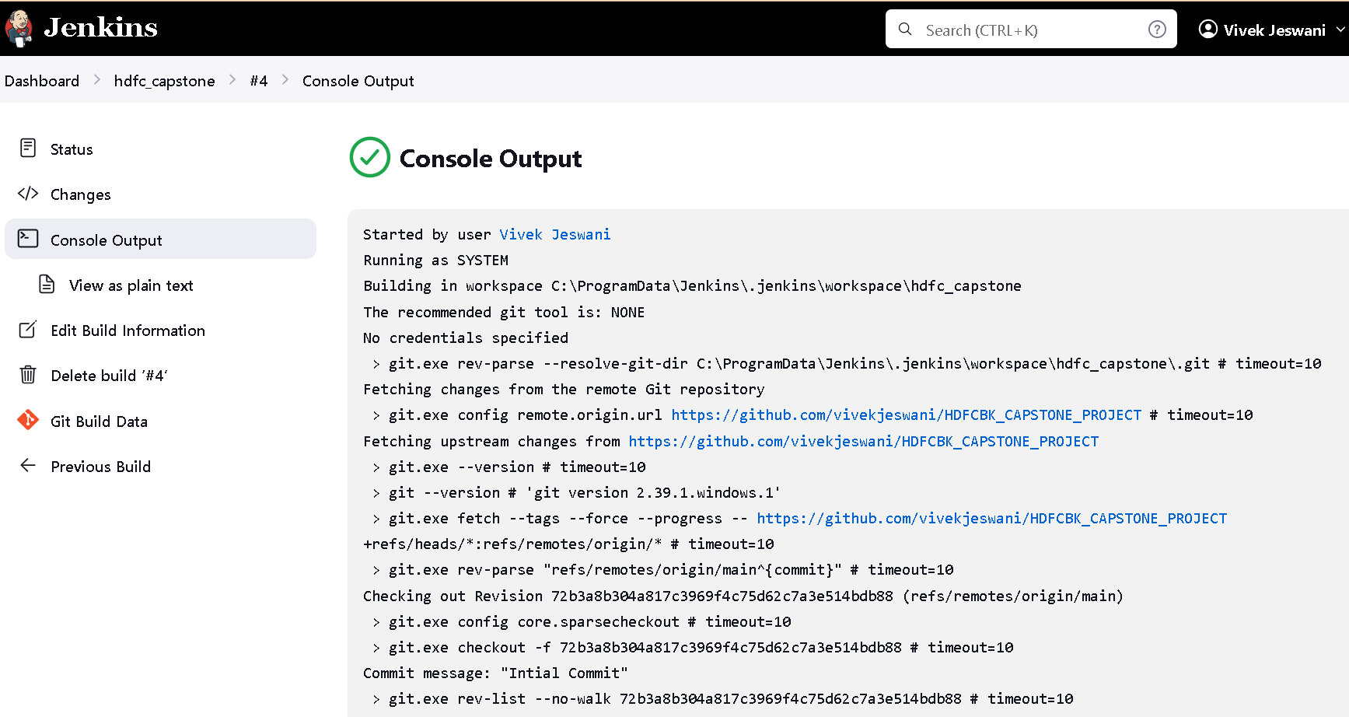
Deployment

Slide 12
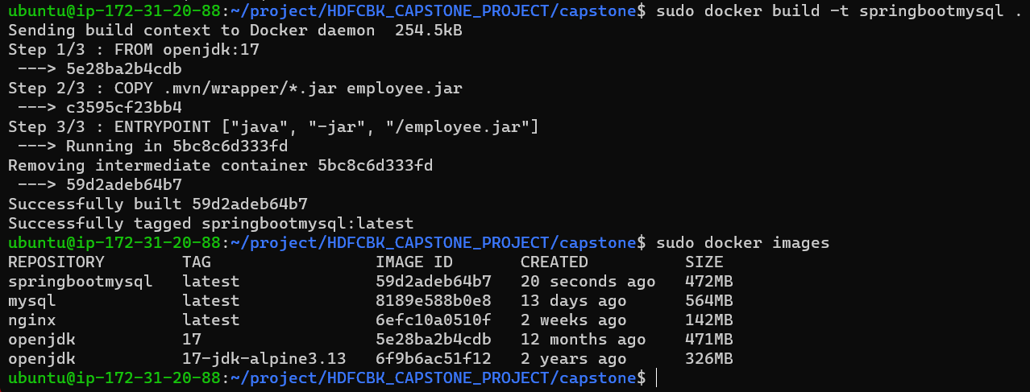
Deployment

Slide 13
Conclusion
The Employee web service project, in conclusion, is a comprehensive solution that enables users to query employee information by ID, exposes the web service as an HTTPS endpoint with a self-signed certificate, encrypts sensitive data, and containerizes the service for deployment on Kubernetes.
This project demonstrates the development of a full-stack solution using modern technologies such as Spring Boot, Java, Kubernetes, and Jenkins. It also demonstrates the value of testing, particularly unit testing and API testing, during the development process.
Overall, this project offers a real-world illustration of how to create a reliable and secure web service that can be used in a variety of fields, such as human resources, payroll administration, and employee performance assessment.

Slide 14
Future Work
Authorization and Authentication: The web service currently lacks any authorization or authentication procedures. Using authentication and permission would improve service security by ensuring that only authorized users have access to sensitive employee data.
Caching: By lowering the number of database queries, caching can be implemented to the web service to increase speed. This would help to minimize response time and improve service scalability.
Authorization and Authentication: The web service currently lacks any authorization or authentication procedures. Using authentication and permission would improve service security by ensuring that only authorized users have access to sensitive employee data.
API Documentation: Creating detailed documentation for the online service. APIs can help developers understand and use a service more easily. This can improve public key infrastructure (PKI) and digital certificates, which can provide more robust and scalable security mechanisms than SSL. PKI can provide secure authentication and encryption of data in transit, as well as a way for confirming the server and client identities.
Overall, these future work areas can improve the Employee web service's functionality, usability, and scalability, making it a more valuable tool for enterprises and organizations.

Slide 15
References
Spring Boot Documentation: https://spring.io/projects/spring-boot
MySQL Documentation: https://dev.mysql.com/doc/
CURL Documentation: https://curl.se/docs/
Apache Tomcat Documentation: https://tomcat.apache.org/tomcat-9.0-doc/index.html
OpenSSL Documentation: https://www.openssl.org/docs/
Postman Documentation: https://learning.postman.com/docs/getting-started/introduction/
Git Documentation: https://git-scm.com/doc
Jenkins Documentation: https://www.jenkins.io/doc/
Docker Documentation: https://docs.docker.com/
Kubernetes Documentation: https://kubernetes.io/docs/home/

Slide 16
Thank you

