Slide 1

Department of Computer Science & Engineering
CS3CO39 DBMS (IV)
Session: Jan-Jun 2025
Transaction Processing System
Presented By:
Dr. Kailash C. Bandhu
Professor, CSE ₁

Slide 2
Unit-4
Database Transactions Processing: Introduction to Transaction Processing, Transaction Concepts, Desirable Properties of Transactions, Schedules, Concepts of Recoverability and Serializability, Concurrency control: introduction, locking protocols.

Slide 3
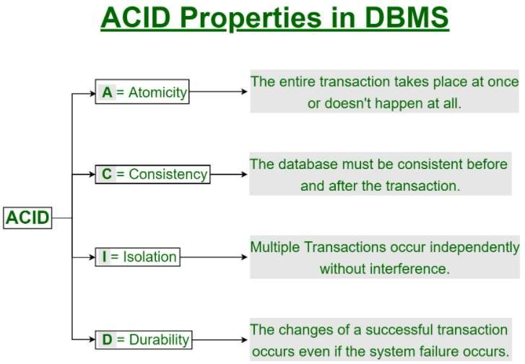
What is Transaction?
A transaction is a single logical unit of work which accesses and possibly
modifies the contents of a database.
Transactions access data using read and write operations.
In order to maintain consistency in a database, before and after the transaction,
certain properties are followed. These are called ACID properties.

Slide 4
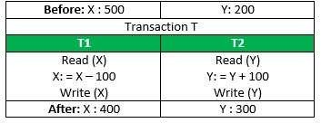
Transaction ACID Properties:
Atomicity
By this, we mean that either the entire transaction takes place at once or doesn’t happen
at all. There is no midway i.e. transactions do not occur partially.
It involves the following two operations.
—Abort: If a transaction aborts, changes made to database are not visible.
—Commit: If a transaction commits, changes made are visible.
Atomicity is also known as the ‘All or nothing rule’.
Consider the following transaction T consisting of T1 and T2: Transfer of 100 from
account X to account Y.
If the transaction fails after completion of T1
but before completion of T2.
( say, after write(X) but before write(Y)),
then amount has been deducted from X but
not added to Y. This results in an inconsistent database state.

Slide 5
Transaction ACID Properties:
Consistency:
This means that integrity constraints must be maintained so that the database is
consistent before and after the transaction. It refers to the correctness of a database.
Isolation:
This property ensures that multiple transactions can occur concurrently without leading
to the inconsistency of database state.
Changes occurring in a particular transaction will not be visible to any other transaction until that particular change in that transaction has been committed.
Durability:
This property ensures that once the transaction has completed execution, the updates and modifications to the database are stored in and written to disk and they persist even if a system failure occurs.
These updates now become permanent and are stored in non-volatile memory.

Slide 6
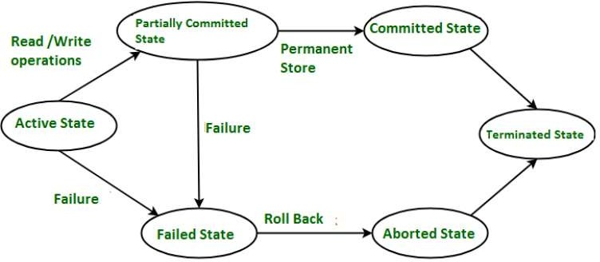
Transaction States in DBMS
States through which a transaction goes during its lifetime.
These states specify about the current state of the Transaction and also specify that how
we will process the transactions.
These states govern the rules which decide that whether a transaction will commit or
abort.

Slide 7
Transaction States in DBMS
Active State –When the instructions of the transaction is running then the transaction is
in active state.
Partially Committed –After completion of all the read and write operation the changes are made in main memory or local buffer. If the changes are made permanent on the Data Base then state will change to “committed state” and in case of failure it will go to “failed state”.
Failed State –When any instruction of the transaction fails it goes to “failed state”.
Aborted State –After having any type of failure the transaction goes from “failed state” to “aborted state” and in before states the changes are only made to local buffer or main memory and hence these changes are deleted or rollback.
Committed Stage –It is the stage when the changes are made permanent on the Data
Base and transaction is complete and therefore terminated in “terminated state”.
Terminated State –If there is any roll back or the transaction come from “committed
state” then the system is consistent and ready for new transaction and the old transaction
is terminated.

Slide 8
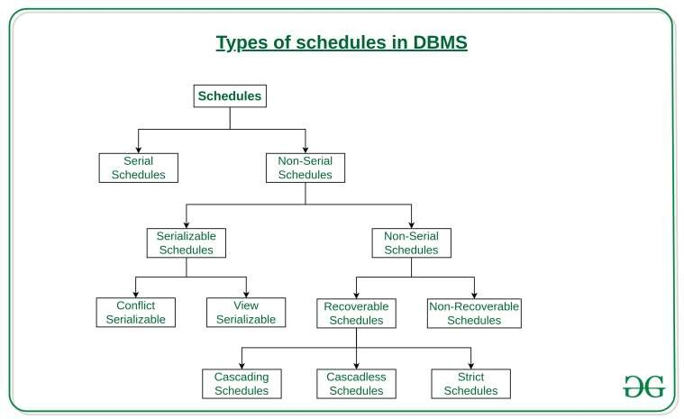
Types of Schedules

Slide 9
Serial Schedules:
A serial schedule is one in which no transaction starts until a running transaction has
ended are called serial schedules.
For example, if T1 and T2 are two transactions in a schedule then either T1 is followed
by T2 or T2 is followed by T1 then it is called Serial Schedule.
Example: Consider the following schedule involving two transactions T1 and T2.
T1 | T2
R(A)
A=A-50
W(A)
R(B)
B=B+50
W(B)
 | R(A)
 | A=A-100
 | W(A)
 | R(B)
 | B=B+100
 | W(B)
A | B
2000 | 2000
1950 | 2050
1850 | 2150
A | T1 | B |  | T2 A | B
2000 |  | 2000 |  | 1950 | 2050
1950 |  | 2050 |  | 1850 | 2150

Slide 10
Concurrent Schedules in DBMS
This is a type of Scheduling where the operations of multiple transactions are interleaved.
Means there are no sequences among the operations of T1 & T2 i.e. sometimes T1 is followed by T2 or sometimes T2 is followed by T1 randomly then it is called Concurrent Transactions.
This might lead to a rise in the concurrency problem and concurrency always leads to
inconsistency.
Unlike the serial schedule where one transaction must wait for another to complete all its operation, in the non-serial schedule, the other transaction proceeds without waiting for the previous transaction to complete.
It can be of two types namely, Serializable and Non-Serializable Schedule.

Slide 11
Concurrent Schedules in DBMS
T1 | T2
R(A)
A=A-50
W(A)
 | R(A)
 | A=A-100
 | W(A)
R(B)
B=B+50
W(B)
 | R(B)
 | B=B+100
 | W(B)
T1 | T2
R(A)
A=A-50
 | R(A)
 | A=A-100
 | W(A)
W(A)
R(B)
B=B+50
W(B)
 | R(B)
 | B=B+100
 | W(B)
Serializable Concurrent Schedule
Non Serializable Concurrent Schedule
A | B
2000 | 2000
1950 | 2050
1850 | 2150
A | B
2000 | 2000
1900 | 2050
1950 | 2150
T1
T2
T1
T2
A 2000
B
2000
A
1950
B
2050
A 2000
B
2000
A
2000
B
2050
1950
2050
1850
2150
2050
1900
2150

Slide 12
Serializable Concurrent Schedules
The Non-Serial Schedule can be divided further into Serializable and Non-Serializable.
Serializable:
The non-serial schedule is said to be in a serializable schedule only when it is equivalent to the serial schedules.
This is used to maintain the consistency of the database. It is mainly used in the Non-
Serial scheduling to verify whether the scheduling will lead to any inconsistency or not.
A serializable schedule helps in improving both resource utilization and CPU throughput.
These are of two types:
Conflict Serializable: A schedule is called conflict serializable if it can be transformed
into a serial schedule by swapping non-conflicting operations.
View Serializable: A Schedule is called view serializable if it is view equal to a serial
schedule (no overlapping transactions).

Slide 13
Non Serializable Concurrent Schedules
Recoverable Schedule:
T1 | T2
R(X)
X=X-100
W(X)
 | R(X)
 | X=X+50
 | W(X)
Commit
 | Commit
This is a recoverable schedule since T1 commits before T2, that makes the value read by T2 correct.

Slide 14
Non Serializable Concurrent Schedules
Irrecoverable Schedule:
T1 | T2
R(X)
X=X-100
W(X)
 | R(X)
 | X=X+50
 | W(X)
 | Commit
(Fail)
T2 read the value of A written by T1, and committed. T1 later aborted, therefore the value read by T2 is wrong, but since T2 committed, this schedule is non-recoverable.

Slide 15
Conflict Serializability in DBMS
As discussed that serial schedules have less resource utilization and low throughput.
To improve it, two or more transactions are run concurrently. But concurrency of
transactions may lead to inconsistency in database.
To avoid this, we need to check whether these concurrent schedules are serializable or
not. For this, we have two methods:
  1. Conflict Serializability
  2. View Serializability
Conflict Serializable: A schedule is called conflict serializable if it can be transformed into a serial schedule by swapping non-conflicting operations.
Conflicting operations: Two operations are said to be conflicting if all conditions satisfy:
  Each operation is a part of different transactions.
  Both operations get performed on the same data item.
  One of the performed must be a write operation.

Slide 16
Conflict Serializability in DBMS
Let's consider two different transactions, Ti​ and Tj​. Then considering the above conditions, the following table follows:
Transaction i | Transaction j | IsConflicting
Readi (X) | Readj (X) | Non-conflicting
Readi (X) | Writej (X) | Conflicting
Writei (X) | Readj (X) | Conflicting
Writei (X) | Writej (X) | Conflicting

Slide 17
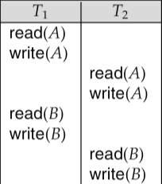
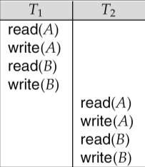
Conflict Serializability
If a schedule S can be transformed into a schedule S´ by swapping of non-conflicting
instructions, we say that S and S´ are conflict equivalent.
We say that a schedule S is conflict serializable if it is conflict equivalent to a serial schedule.
Schedule S Schedule S`
Schedule S can be transformed into Schedule S`, a serial schedule where T2 follows T1, by series of swaps of non-conflicting instructions. Therefore Schedule S is conflict serializable.

Slide 18
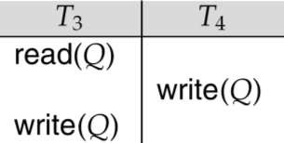
Conflict Serializability
Example of a schedule that is not conflict serializable:
We are unable to swap instructions in the above schedule to obtain either the
serial schedule < T₃, T₄ >, or the serial schedule < T₄, T₃ >.

Slide 19
Testing conflict serializability of a schedule
For each transaction Ti participating in schedule S, create a node in graph.
For each case where Ti Write(X) then Tj Read(X) , create an edge from Ti to Tj
For each case, where Ti Read(X) then Tj Write(X) , create an edge from Ti to Tj
For each case, where Ti Write(X) then Tj Write(X) , create an edge from Ti to Tj
The schedule S is serializable, if and only if there is no cycle in graph.

Slide 20
Testing conflict serializability of a schedule
T1 | T2
R(X)
X=X-50
 | R(X)
 | X=X-100
W(X)
R(Y)
 | W(X)
Y=Y+50
W(Y)
T1 executes W(X) after T2
executes R(X), then edge T2->T1
T1
T2
T2 executes W(X) after T1
executes W(X), then edge T1->T2
Cycle is created in graph, so given schedule is non serializable concurrent schedule. Hence we can not convert it into equivalent serial schedule.

Slide 21


Testing conflict serializability of a schedule
T1 | T2
R(X)
X=X-50
 | R(X)
 | X=X-100
W(X)
R(Y)
 | W(X)
Y=Y+50
W(Y)
Step1- First, remove all statements except R & W
T1 T2
Can not be interchanged, since R(X) and W(X) are not compatible
R(X)
R(X)
W(X)
R(Y)
W(X)
Can not be interchanged, since W(X) and W(X)
are not compatible
W(Y)
Step2- Try to convert this given schedule into its equivalent serial schedule by swapping
all instructions of a transactions at one place.
Step3- Since, operations can not be interchanged, so given schedule is non serializable concurrent schedule.

Slide 22
View Serializability:
A schedule will be view serializable if it is view equivalent to a serial schedule.
If a schedule is conflict serializable, then it will be view serializable.
View Equivalent-
Two schedules S1 and S2 are said to be view equivalent if they satisfy the
following 3 conditions:
  Initial Read (First Read)
  Final Write (Last Write)
  Updated Read

Slide 23

View Serializability Cont.…:
1. Initial Read
An initial read of both schedules must be the same.
Suppose two schedule S1 and S2. In schedule S1, if a transaction T1 is reading
the data item A, then in S2, transaction T1 should also read A.
Above two schedules are view equivalent because Initial read operation in S1 is
done by T1 and in S2 it is also done by T1.

Slide 24
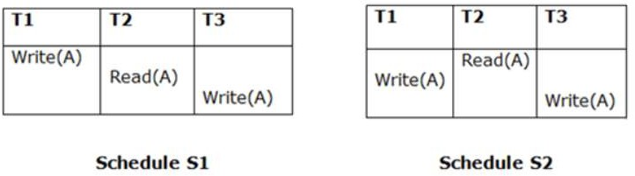
View Serializability Cont.…:
2. Final Write
A final write must be the same between both the schedules.
In schedule S1, if a transaction T1 updates A at last then in S2, final writes
operations should also be done by T1.
Above two schedules is view equal because Final write operation in S1 is done
by T3 and in S2, the final write operation is also done by T3.

Slide 25
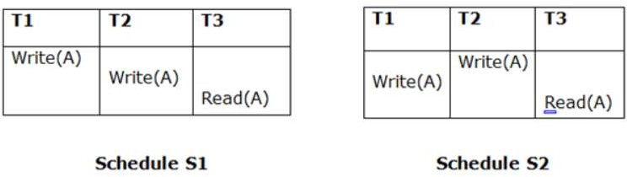
View Serializability Cont.…:
3. Updated Read
In schedule S1, if Ti is reading A which is updated by Tj then in S2 also, Ti
should read A which is updated by Tj.
Above two schedules are not view equal because, in S1, T3 is reading A
updated by T2 and in S2, T3 is reading A updated by T1.

Slide 26
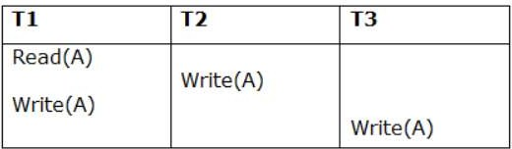
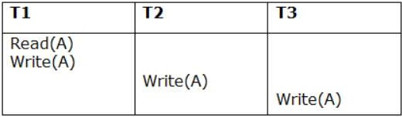
View Serializability Example 1:
Consider a schedule S, check whether it is view equivalent or not-
Schedule S
First convert it into its equivalent schedule S1
Schedule S1

Slide 27
View Serializability Example 1 cont.…:
Schedule S
Schedule S1
Step 1: Initial Read
The initial read operation in S is done by T1 and in S1, it is also done by T1.
Step 2: Final Write
The final write operation in S is done by T3 and in S1, it is also done by T3. So, S and S1 are view Equivalent.
Step 3: Final update on data items
In both schedules S and S1, there is no read except the initial read that's why we don't
need to check that condition.
The schedule S1 satisfies all 3 conditions. Hence, view equivalent serial schedule is:
T1 → T2 → T3

Slide 28

Outline
Concurrency Control Techniques
Lock-Based Protocols
Timestamp-Based Protocols
Validation-Based Protocols
©Silberschatz, Korth and Sudarshan15.27Database System Concepts - 6th Edition

Slide 29



Lock-Based Protocols
A lock is a mechanism to control concurrent access to a data
item
Data items can be locked in two modes :
  exclusive (X) mode. Data item can be both read as well as
written. X-lock is requested using lock-X instruction.
  shared (S) mode. Data item can only be read. S-lock is
requested using lock-S instruction.
Lock requests are made to the concurrency-control manager by the programmer. Transaction can proceed only after request is granted.
©Silberschatz, Korth and Sudarshan15.27Database System Concepts - 6th Edition

Slide 30

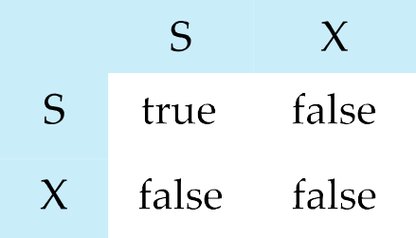
Lock-Based Protocols (Cont.)
Lock-compatibility matrix
A transaction may be granted a lock on an item if the requested lock is compatible with locks already held on the item by other transactions
Any number of transactions can hold shared locks on an item,
  But if any transaction holds an exclusive on the item no other
transaction may hold any lock on the item.
If a lock cannot be granted, the requesting transaction is made to wait till all incompatible locks have been released.
©Silberschatz, Korth and Sudarshan15.27Database System Concepts - 6th Edition

Slide 31


The Two-Phase Locking Protocol
read_lock(x)
B: if lock(x)=“unlocked”
then, lock(x)= “readlock” no_of_reads(x) 1 end;
else if lock(x)= “readlock” then, no_of_reads(x) end;
else
no_of_reads(x) +1
wait (until lock(x)=“unlocked”) and lock manager wakeup
transaction
goto B; end;
©Silberschatz, Korth and Sudarshan15.27Database System Concepts - 6th Edition

Slide 32
The Two-Phase Locking Protocol
write_lock(x)
B: if lock(x)=“unlocked”
then, lock(x)= “writelock”
end;
else
wait (until lock(x)=“unlocked”) and lock manager wakeup
transaction
goto B;
end;
©Silberschatz, Korth and Sudarshan15.27Database System Concepts - 6th Edition

Slide 33
The Two-Phase Locking Protocol
unlock(x)
B: if lock(x)=“writelock”
then, lock(x)= “unlocked”
end;
else if lock(x)= “readlock”
then, no_of_reads(x) if (no_of_reads(x) =0)
then lock(x)= “unlocked”
no_of_reads(x) -1
wakeup one of the waiting transaction, if any end;
end;
©Silberschatz, Korth and Sudarshan15.27Database System Concepts - 6th Edition

Slide 34
The Two-Phase Locking Protocol
This protocol ensures conflict-serializable schedules.
Phase 1: Growing Phase
  In this phase a transaction can only acquire locks but cannot
release any lock.
Phase 2: Shrinking Phase
  Transaction may release locks
  Transaction may not obtain locks
The protocol assures serializability.
©Silberschatz, Korth and Sudarshan15.27Database System Concepts - 6th Edition

Slide 35
The Two-Phase Locking Protocol
Problems in 2 phase locking
Advantage- Always ensures serializability
Disadvantages-
  Not free from deadlock
  Not free from cascading rollback
  May not free from irrecoverable schedule
©Silberschatz, Korth and Sudarshan15.27Database System Concepts - 6th Edition

Slide 36

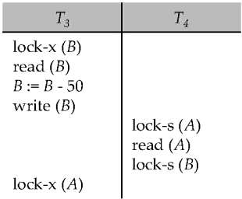
Deadlocks
Consider the partial schedule
Neither T₃ nor T₄ can make progress — executing lock-S(B) causes T₄ to wait for T₃ to release its lock on B, while executing lock-X(A) causes T₃ to wait for T₄ to release its lock on A.
Such a situation is called a deadlock.
  To handle a deadlock one of T₃ or T₄ must be rolled back
and its locks released.
©Silberschatz, Korth and Sudarshan15.27Database System Concepts - 6th Edition

Slide 37



Strict & Rigorous two-phase locking
To avoid this, a modified protocol called strict two-phase locking -- a transaction must hold all its exclusive locks till it commits/aborts.
Rigorous two-phase locking is even stricter. Here, all locks are held till commit/abort. In this protocol transactions can be serialized in the order in which they commit.
©Silberschatz, Korth and Sudarshan15.27Database System Concepts - 6th Edition

Slide 38


Timestamp-Based Protocols
Each transaction is issued a timestamp when it enters the system. If an old transaction T_{i} has time-stamp TS(T_{i}), a new transaction T_{j} is assigned time-stamp TS(T_{j}) such that TS(T_{i}) <TS(T_{j}).
The protocol manages concurrent execution such that the time-stamps determine the serializability order.
In order to assure such behavior, the protocol maintains for each data
Q two timestamp values:
  W-timestamp(Q) is the largest time-stamp of any transaction that executed write(Q) successfully.
  R-timestamp(Q) is the largest time-stamp of any transaction that executed read(Q) successfully.
©Silberschatz, Korth and Sudarshan15.27Database System Concepts - 6th Edition

Slide 39



Timestamp-Based Protocols (Cont.)
Suppose a transaction T_{i} issues a read(Q)
  If TS(T_{i}) ≤ W-timestamp(Q), then T_{i} needs to read a value of Q
that was already overwritten.
    Hence, the read operation is rejected, and T_{i} is rolled back because some another younger transaction is having large timestamp than T_{i.} .
  If TS(T_{i}) ≥ W-timestamp(Q), then the read operation is executed, and R-timestamp(Q) is set to max(R-timestamp(Q), TS(T_{i})).
©Silberschatz, Korth and Sudarshan15.27Database System Concepts - 6th Edition

Slide 40
Timestamp-Based Protocols (Cont.)
Suppose that transaction T_{i} issues write(Q).
  If TS(T_{i}) < R-timestamp(Q), then T_{i} is aborted and rollbacked because some another younger transaction is having large timestamp than T_{i.}
    Hence, the write operation is rejected, and T_{i} is rolled back.
  If TS(T_{i}) < W-timestamp(Q), then T_{i} is attempting to write an
obsolete(old) value of Q.
    Hence, this write operation is rejected, and T_{i} is rolled back.
  Otherwise, the write operation is executed, and W-timestamp(Q)
is set to TS(T_{i}).
©Silberschatz, Korth and Sudarshan15.27Database System Concepts - 6th Edition

Slide 41


Validation-Based Protocol
Also called certification method.
No checking is done while transaction is executing.
Means updates are not directly applied to the database until transaction
reaches to its end.
During the transaction, all the updates are applied to a local copy of
database.
At the end of the transaction, a validation phase checks whether any of
the transaction updates violates serializability or not.
If it is not violated then transaction is committed otherwise it is aborted.
©Silberschatz, Korth and Sudarshan15.27Database System Concepts - 6th Edition

Slide 42
Validation-Based Protocol
Execution of transaction T_{i} is done in three phases.
  Read and execution phase: Transaction T_{i} writes only to temporary local variables
  Validation phase: Transaction T_{i} performs a ''validation test'' to determine if local variables can be written without violating serializability.
  Write phase: If T_{i} is validated, the updates are applied to the database; otherwise, T_{i} is rolled back.
The three phases of concurrently executing transactions can be interleaved, but each transaction must go through the three phases in that order.
Also called as optimistic concurrency control since transaction
executes fully in the hope that all will go well during validation
©Silberschatz, Korth and Sudarshan15.27Database System Concepts - 6th Edition

Slide 43

Transaction Recovery
Recovery means that the database is restored to the most recent consistent
state just before the time of failure.
A non-serializable schedule is not guaranteed to produce the same effect as
produced by some serial schedule on any consistent database.
Characteristics of Non-serializable schedules-
may or may not be consistent- Conflict & View Serializability
may or may not be recoverable
A Concurrent Schedule may be-
  Recoverable Schedule
  Irrecoverable Schedule
©Silberschatz, Korth and Sudarshan15.27Database System Concepts - 6th Edition

Slide 44


Irrecoverable Schedule:
A transaction performs a dirty read operation from an uncommitted transaction and commits before the transaction from which it has read the value then such a schedule is known as an Irrecoverable Schedule.
T1 | T2
R(X)
X=X-100
W(X)
 | R(X)
 | X=X+50
 | W(X)
 | Commit
(Fail)
Database System Concepts - 6th Edition 15.43 ©Silberschatz, Korth and Sudarshan

Slide 45

Recoverable Schedule:
A transaction performs a dirty read operation from an uncommitted transaction and its commit operation is delayed till the uncommitted transaction either commits or roll backs then such a schedule is known as a Recoverable Schedule.
T1 | T2
R(X)
X=X-100
W(X)
 | R(X)
 | X=X+50
 | W(X)
Commit
 | Commit
©Silberschatz, Korth and Sudarshan15.44Database System Concepts - 6th Edition

Slide 46

Checking Whether a Schedule is Recoverable or Irrecoverable-
Method-01:
Check whether the given schedule is conflict serializable or not.
If the given schedule is conflict serializable, then it is surely recoverable.
Stop and report your answer.
If the given schedule is not conflict serializable, then it may or may not be
recoverable. Go and check using other methods.
©Silberschatz, Korth and Sudarshan15.44Database System Concepts - 6th Edition

Slide 47
Checking Whether a Schedule is Recoverable or Irrecoverable-
Method-02:
Check if there exists any dirty read operation.
If there is no any dirty read operation, then the schedule is surely
recoverable. Stop and report your answer.
If there exists any dirty read operation, then the schedule may or may not
be recoverable.
Case-01:
If the commit operation of the transaction performing the dirty read occurs before the commit or abort operation of the transaction which updated the value, then the schedule is irrecoverable.
Case-02:
Prepared and compiled by
Bhupendra Panchal, Asst. Professor, CSE
©Silberschatz, Korth and Sudarshan15.46Database System Concepts - 6th Edition• If the commit operation of the transaction performing

Slide 48


Types of Recoverable Schedules-
A recoverable schedule may be any one of these kinds-
Cascading Schedule
Cascade less Schedule
Strict Schedule
©Silberschatz, Korth and Sudarshan15.47Database System Concepts - 6th Edition

Slide 49
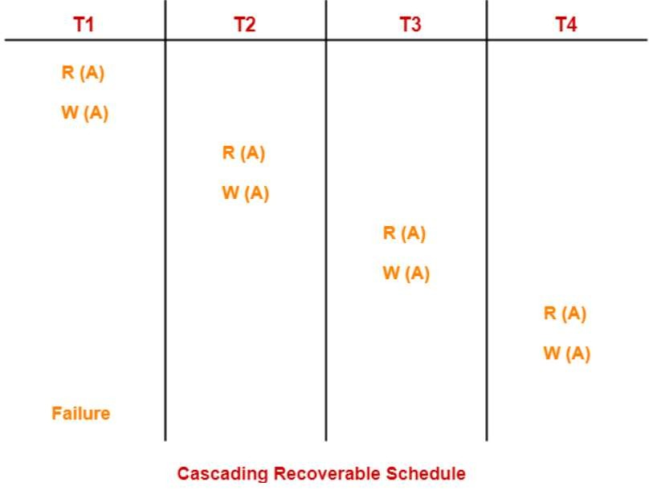
1. Cascading Schedule
Types of Recoverable Schedules-
If in a schedule, failure of one transaction causes several other dependent transactions to rollback or abort, then such a schedule is called as a Cascading Schedule or Casc
ading Rollback or Cascading Abort.
the wastage of CPU time. In this schedule,
It simply leads to
The failure of transaction T1 causes the transaction T2 to rollback.
The rollback of transaction T2 causes the transaction T3 to rollback.
The rollback of transaction T3 causes the transaction T4 to rollback.
Such a rollback is called as
a Cascading Rollback.
©Silberschatz, Korth and Sudarshan15.47Database System Concepts - 6th Edition

Slide 50
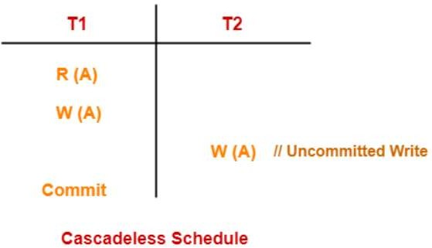
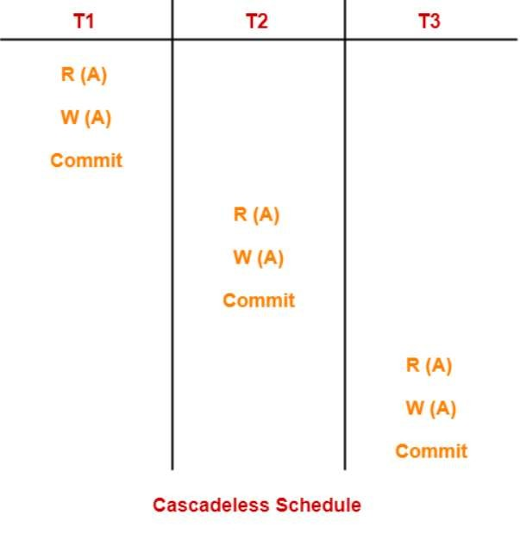
2. Cascade less Schedule
Types of Recoverable Schedules-
If in a schedule, a transaction is not allowed to read a data item until the last transaction that has written it is committed or aborted, then such a schedule is called as a Cascade less Sc
hedule.
nly committed read ime.
In other words, it allows o
operations and save CPU t
However, it allows uncommitted
write operations.
©Silberschatz, Korth and Sudarshan15.47Database System Concepts - 6th Edition

Slide 51
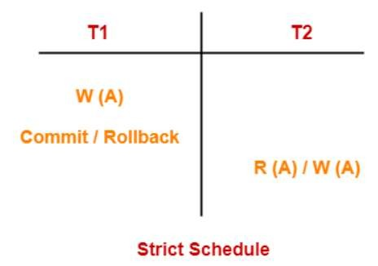
3. Strict Schedule
Types of Recoverable Schedules-
If in a schedule, a transaction is neither allowed to read nor write a data item until the last transaction is committed or aborted, then such a schedule is called as a Strict Sc
In other word nly
committed re
hedule.
s, Strict schedule allows o ad and write operations.
©Silberschatz, Korth and Sudarshan15.47Database System Concepts - 6th Edition

Slide 52
Failure Classification
Transaction failure :
  Logical errors: transaction cannot complete due to some internal error
condition
  System errors: the database system must terminate an active transaction
due to an error condition (e.g., deadlock)
System crash: a power failure or other hardware or software failure causes
the system to crash.
Disk failure: disk failure destroys all or part of disk storage
Physical Problems: including fire, power failure, theft, overwriting disks/taps
etc.
©Silberschatz, Korth and Sudarshan15.47Database System Concepts - 6th Edition

Slide 53
Database Recovery Concepts
Recovery means that the database is restored to the most recent consistent state
just before the time of failure.
For this, system keeps update information that are made to database into a
system log.
System log contains information about start and end of each transaction and any
updates which occur in the transaction.
This information is needed to recover from transaction failure.
  If a system is physically damaged such as disk crash, then a past copy of
database is restored.
  If system becomes inconsistent due to other failure then reverse the
changes by undoing operations.
©Silberschatz, Korth and Sudarshan15.47Database System Concepts - 6th Edition

Slide 54
Undo and Redo Operations
Undo of a log record <T_{i}, X, V₁, V₂> writes the old value V₁ to X
  undo(T_{i}) restores the value of all data items updated by T_{i} to their
old values, going backwards from the last log record for T_{i}
Redo of a log record <T_{i}, X, V₁, V₂> writes the new value V₂ to X
  redo(T_{i}) sets the value of all data items updated by T_{i} to the new
values, going forward from the first log record for T_{i}
©Silberschatz, Korth and Sudarshan15.47Database System Concepts - 6th Edition

Slide 55
Database Recovery Techniques
1. Undoing –
If a transaction crashes, then the recovery manager may undo transactions i.e.
reverse the operations of a transaction.
This involves examining a transaction for the log entry write_item (T, X, V1, V2)
and setting the value of item x in the database to old-value.
There are two major techniques for recovery from transaction failures:
Deferred update
Immediate update
©Silberschatz, Korth and Sudarshan15.47Database System Concepts - 6th Edition

Slide 56

Deferred Update
This technique does not physically update the database on disk until a
transaction has reached its commit point.
Before reaching commit, all transaction updates are recorded in the
local transaction workspace.
If a transaction fails before reaching its commit point, it will not have
changed the database in any way so UNDO is not needed.
If a transaction reaches to its commit point then it is necessary to REDO the effect of the operations that are recorded in the local transaction workspace, because their effect may not yet have been written in the database.
Hence, a deferred update is also known as the No-undo/Redo
algorithm
©Silberschatz, Korth and Sudarshan15.47Database System Concepts - 6th Edition

Slide 57

Immediate Update
In the immediate update, the database may be updated by some operations of a transaction before the transaction reaches its commit point.
However, these operations are recorded in a log on disk before they are
applied to the database, making recovery still possible.
If a transaction fails to reach its commit point, the effect of its operation must be undone i.e. the transaction must be rolled back hence we require both undo and redo.
This technique is known as undo/redo algorithm.
©Silberschatz, Korth and Sudarshan15.47Database System Concepts - 6th Edition

Slide 58
Thank You
57

