Slide 1

Course Code: CS3CO39
Course Name: Database Management System
Text Books:
F.R. Mcfadden, J. Hoffer, M.Prescott, Modern Database Management, Addison Wesley.
Elmasri, Navathe, Fundamentals of Database System, Pearson Education Asia.
Reference Books:
C.J. Date, An Introduction to Database Systems, Pearson Education Asia.
Henry F Korth, Abraham Silbershatz, Database System Concepts, Mc Graw Hill.

Slide 2
Unit-1 Basic Concepts
Data Vs Information
Definition of Database
Advantages of Database Systems
Components of DBMS
DBMS Architecture
Data Independence
Data modelling
Entity Relationship Model
Relational, Network
Hierarchical and Object-Oriented Models
Data Modelling Using the Entity Relationship Model.
CO1 | Have a broad understanding of database concepts and database management system software

Slide 3
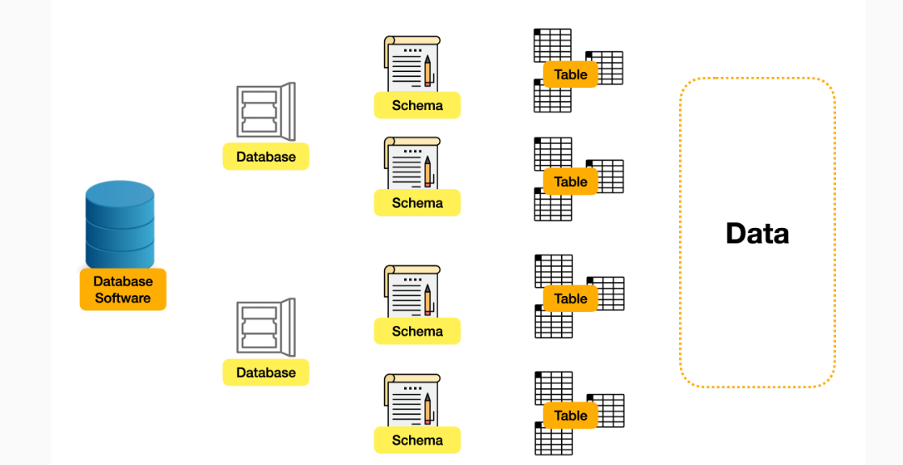
Database System Architecture: From Software to Data

Slide 4
Database Software: It can be regarded as common database software, such as MySQL, Postgre SQL, MsSQL, etc. We will use MySQL/Oracle here because it's one of the most widely used database software in the world.
Database: Represents individual databases created within the DBMS. Each database is a logical collection of data organized for specific purposes.

Slide 5
Schema: A schema defines the structure of the data within a database. It specifies how the data is organized, including tables, relationships, constraints, and more. But in some database software, such as MySQL, Schema and Database are integrated into one.
Table: The key section of the database. Tables record different data entities, such as users, products, etc. Each table is responsible for recording the column size, type, and default value... of each row data in the database.
Data: The most valuable part of the database is the data itself. Different types of data can be stored.

Slide 6
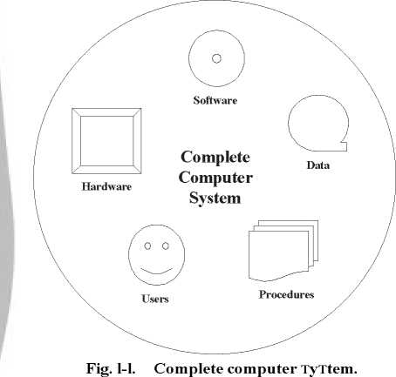

Slide 7
Data and Information
Usually, the terms “data” and “information” are used interchangeably. However, there is a subtle difference between the two.
In a nutshell, data can be a number, symbol, character, word, codes, graphs, etc. On the other hand, information is data put into context. Information is utilised by humans in some significant way (such as to make decisions, forecasts etc).
A basic example of information would be a computer. A computer uses programming scripts, formulas, or software applications to turn data into information.
Let us have a detailed look at the difference between data and information in a tabular column below:

Slide 8
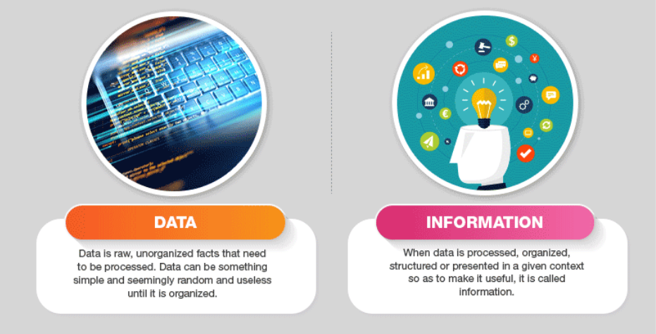
Difference between Data and Information

Slide 9
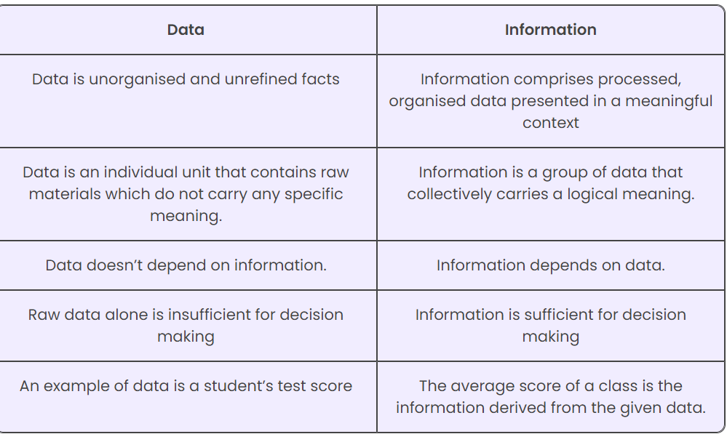

Slide 10
Definition of Database
What is a Database?
A collection of related pieces of data:
Representing/capturing the information about a real-world enterprise or part of an enterprise.
Collected and maintained to serve specific data management needs of the enterprise.
Activities of the enterprise are supported by the database and continually update the database.

Slide 11
An Example
University Database:
Data about students, faculty, courses, research- laboratories, course registration/enrollment etc.
Reflects the state of affairs of the academic aspects of the university.
Purpose:To keep an accurate track of the academic activities of the university.

Slide 12
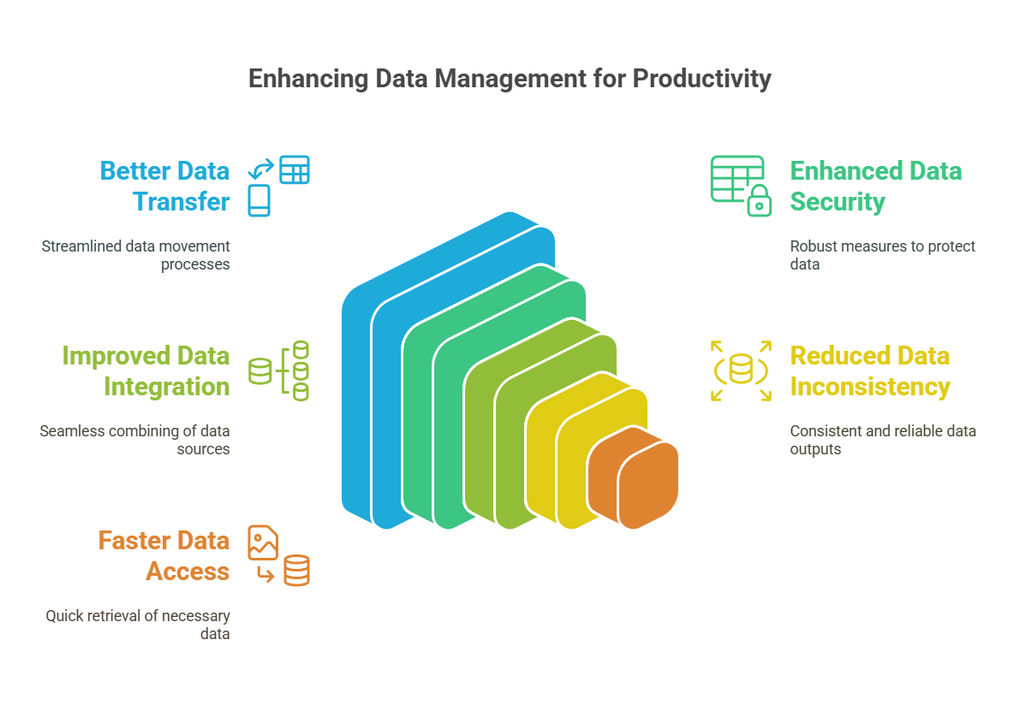
Advantages of Database Systems

Slide 13
Advantages of Database Management System over Traditional File System
Data Integrity and Security: DBMS provides a centralized approach to data management that ensures data integrity and security. DBMS allows defining constraints and rules to ensure that data is consistent and accurate.
Reduced Data Redundancy: DBMS eliminates data redundancy by storing data in a structured way. It allows sharing data across different applications and users, reducing the need for duplicating data.
Improved Data Consistency: DBMS ensures data consistency by enforcing data validation rules and constraints. This ensures that data is accurate and consistent across different applications and users.
Improved Data Access and Availability: DBMS provides efficient data access and retrieval mechanisms that enable quick and easy data access. It allows multiple users to access the data simultaneously, ensuring data availability.

Slide 14
Advantages of Database Management System over Traditional File System
Data Integrity and Security: DBMS provides a centralized approach to data management that ensures data integrity and security. DBMS allows defining constraints and rules to ensure that data is consistent and accurate.
Reduced Data Redundancy: DBMS eliminates data redundancy by storing data in a structured way. It allows sharing data across different applications and users, reducing the need for duplicating data.
Improved Data Consistency: DBMS ensures data consistency by enforcing data validation rules and constraints. This ensures that data is accurate and consistent across different applications and users.
Improved Data Access and Availability: DBMS provides efficient data access and retrieval mechanisms that enable quick and easy data access. It allows multiple users to access the data simultaneously, ensuring data availability.

Slide 15
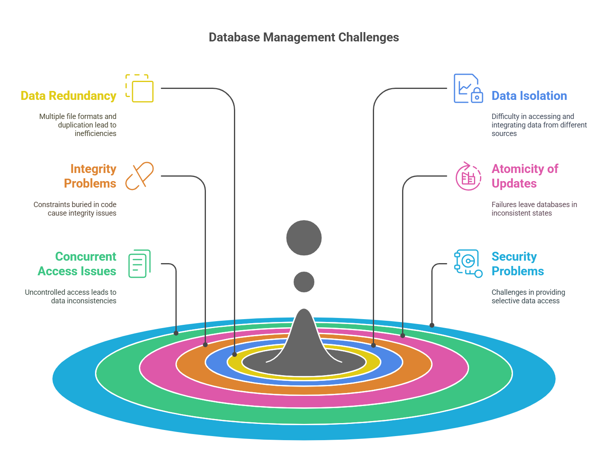
Drawbacks of using file systems to store data

Slide 16
Architecture of Database Management System :
Database Engine
A database system is partitioned into modules that deal with each of the responsibilities of the overall system.
The functional components of a database system can be divided into
The Disk Storage,
The storage manager,
The query processor component,
The Users and its interaction.
Notes:
16

Slide 17
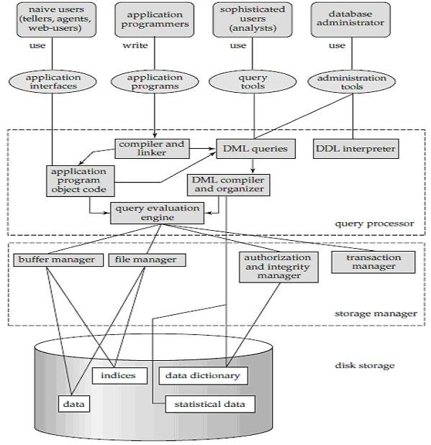
Architecture of Database Management System

Slide 18
1. The disk Storage
The disk storage or physical storage is use for storing the data. In many big enterprises,the database range in size from hundred of gigabytes to terabytes of data. The main memory is not so largeer that it holds that much information and data. so we needed a larger disk storage for the database.
It contains DATA , Statistical Dta,Data Dictionary and Indices.

Slide 19
The disk Storage(Cont.)
The storage manager implements several data structures as part of the physical system implementation:
  Data files -- store the database itself
  Data dictionary -- stores metadata about the structure of the database, in particular the schema of the database.
  Indices -- can provide fast access to data items. A database index provides pointers to those data items that hold a particular value.
Notes:
19

Slide 20
2. Storage Manager
A program module that provides the interface between the low-level data stored in the database and the application programs and queries submitted to the system.
The storage manager is responsible to the following tasks:
  Interaction with the OS file manager
  Efficient storing, retrieving and updating of data
The storage manager components include:
  _Buffer manager
  File manager
  Authorization and integrity manager
  Transaction manager
Notes:
20

Slide 21
3. Query Processor
The query processor components include:
  DDL interpreter -- interprets DDL statements and records the definitions in the data dictionary.
  DML compiler -- translates DML statements in a query language into an evaluation plan consisting of low-level instructions that the query evaluation engine understands.
    The DML compiler performs query optimization; that is, it picks the lowest cost evaluation plan from among the various alternatives.
  Query evaluation engine -- executes low-level instructions generated by the DML compiler.
Notes:
21

Slide 22
Query Processing
1. Parsing and translation
2. Optimization
3. Evaluation
Notes:
22

Slide 23
Transaction Management
A transaction is a collection of operations that performs a single logical function in a database application
Transaction-management component ensures that the database remains in a consistent (correct) state despite system failures (e.g., power failures and operating system crashes) and transaction failures.
Concurrency-control manager controls the interaction among the concurrent transactions, to ensure the consistency of the database.
Notes:
23

Slide 24
Transaction Management
A transaction is a collection of operations that performs a single logical function in a database application
Transaction-management component ensures that the database remains in a consistent (correct) state despite system failures (e.g., power failures and operating system crashes) and transaction failures.
Concurrency-control manager controls the interaction among the concurrent transactions, to ensure the consistency of the database.
Notes:
24

Slide 25
View of Data
A database system is a collection of interrelated data and a set of programs that allow users to access and modify these data.
A major purpose of a database system is to provide users with an abstract view of the data.
  Data models
    A collection of conceptual tools for describing data, data relationships, data semantics, and consistency constraints.
  Data abstraction
    Hide the complexity of data structures to represent data in the database from users through several levels of data abstraction.
Notes:
25

Slide 26
Levels of Abstraction
Physical level: describes how a record (e.g., instructor) is stored.
Logical level: describes What data stored in database, and the relationships among the data.
View level: application programs hide details of data types. Views can also hide information (such as an employee’s salary) for security purposes.
Notes:
26

Slide 27
Instances and Schemas
A collection of information stored in the database at a particular moment is called an instance of database. And the overall design/structure of database is called the database schema.
Similar to types and variables in programming languages
Logical Schema – the overall logical structure of the database
  Example: The database consists of information about a set of customers and accounts in a bank and the relationship between them
    Analogous to type information of a variable in a program
Physical schema – the overall physical structure of the database
Instance – the actual content of the database at a particular point in time
  Analogous to the value of a variable
Notes:
27

Slide 28
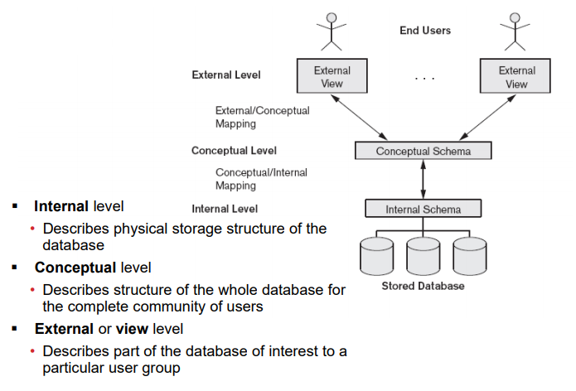
Three Level Schema Architecture of Database

Slide 29
Database Architecture
Centralized databases
  One to a few cores, shared memory
Client-server,
  One server machine executes work on behalf of multiple client machines.
Parallel databases
  Many core shared memory
  Shared disk
  Shared nothing
Distributed databases
  Geographical distribution
  Schema/data heterogeneity
Notes:
29

Slide 30
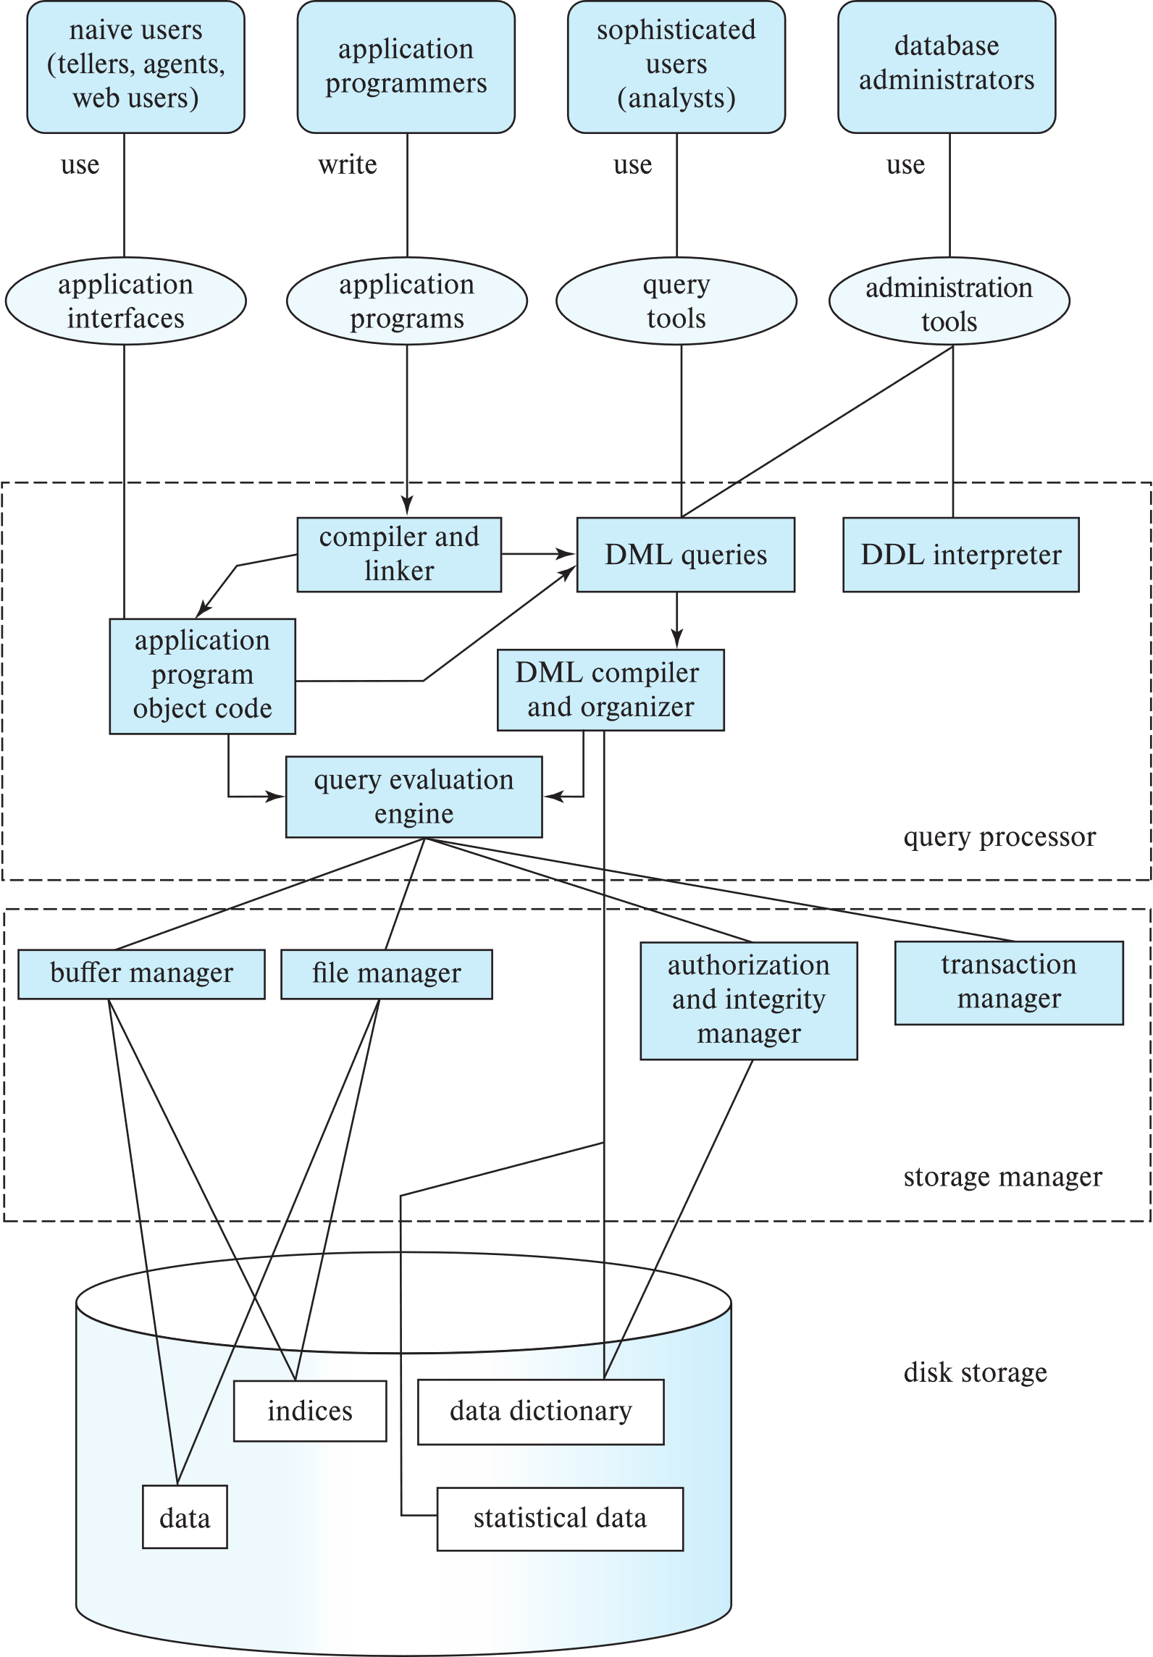
DBMS Architecture (Centralized/Shared-Memory)
USER

Slide 31
Database Users
Notes:
31

Slide 32
Database Applications
Database applications are usually partitioned into two or three parts
Two-tier architecture -- the application resides at the client machine, where it invokes database system functionality at the server machine
Three-tier architecture -- the client machine acts as a front end and does not contain any direct database calls.
  The client end communicates with an application server, usually through a forms interface.
  The application server in turn communicates with a database system to access data.
Notes:
32

Slide 33
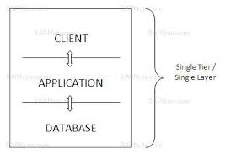
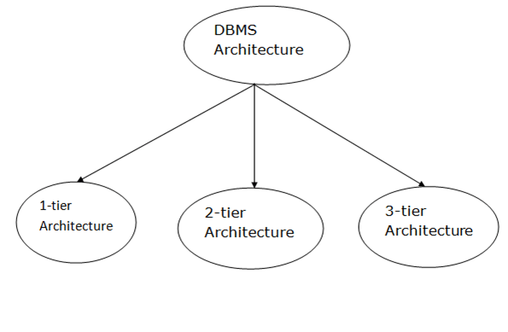
DBMS architectures
1-tier architecture

Slide 34
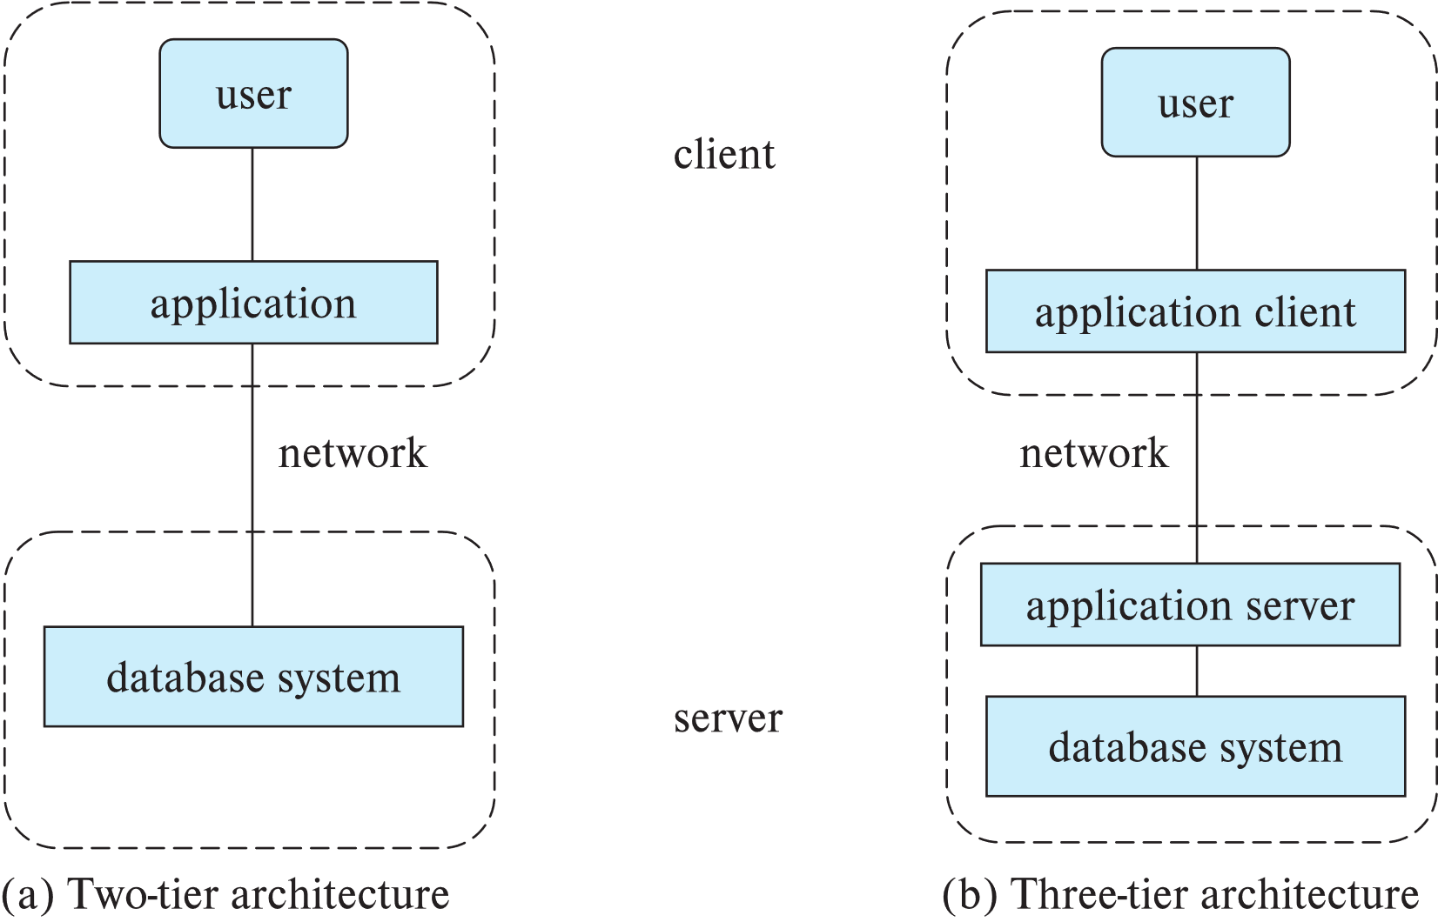
Two-tier and three-tier architectures
Notes:
34

Slide 35
Database Administrator
A person who has central control over the system is called a database administrator (DBA). Functions of a DBA include:
Schema definition
Storage structure and access-method definition
Schema and physical-organization modification
Granting of authorization for data access
Routine maintenance
Periodically backing up the database
Ensuring that enough free disk space is available for normal operations, and upgrading disk space as required
Monitoring jobs running on the database
Notes:
35

Slide 36
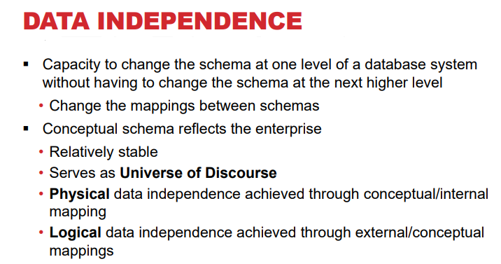

Slide 37
Physical Data Independence
Physical Data Independence – the ability to modify the physical schema without changing the logical schema
  Applications depend on the logical schema
  In general, the interfaces between the various levels and components should be well defined so that changes in some parts do not seriously influence others.
Notes:
37

Slide 38
Data Models
A data model is a collection of concepts for describing data, its relationships, and its constraints
  Provides a clearer and more accurate description and representation of data
  Standard platform that enables database designers and end-users to communicate

Slide 39
Components of Data Models
Structure Part: Consisting of set of rules according to which databases can be constructed.
Manipulative Part: Define the types of operation that are allowed on the data.
Set of Integrity Rules: Which ensures that data is accurate.

Slide 40
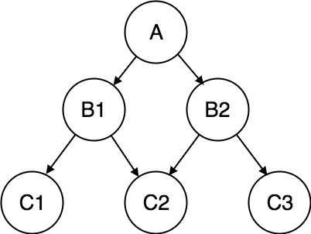
NETWORK DATA MODEL

Slide 41
NETWORK DATA MODEL
Advantages of Network Model
The data can be accessed faster as compared to the hierarchical model. This is because the data is more related in the network model and there can be more than one path to reach a particular node. So the data can be accessed in many ways.
As there is a parent-child relationship so data integrity is present. Any change in parent record is reflected in the child record.
Disadvantages of Network Model
As more and more relationships need to be handled the system might get complex. So, a user must be having detailed knowledge of the model to work with the model.
Any change like updation, deletion, insertion is very complex.

Slide 42
c. Hierarchical Data Model
This database model organizes data into a tree-like-structure, with a single root, to which all the other data is linked. The hierarchy starts from the Root data, and expands like a tree, adding child nodes to the parent nodes.
In this model, a child node will only have a single parent node.
This model efficiently describes many real-world relationships like index of a book, recipes etc.
In hierarchical model, data is organised into tree-like structure with one one-to-many relationship between two different types of data, for example, one department can have many courses, many professors and of-course many students.

Slide 43
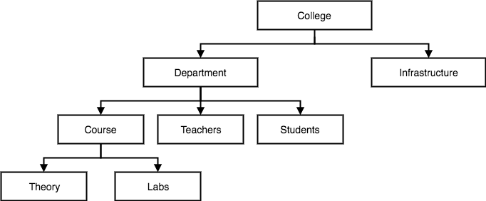
Hierarchical Data Model

Slide 44
Hierarchical Data Model
Advantages of Hierarchical Model
It is very simple and fast to traverse through a tree-like structure.
Any change in the parent node is automatically reflected in the child node so, the integrity of data is maintained.
Disadvantages of Hierarchical Model
Complex relationships are not supported.
As it does not support more than one parent of the child node so if we have some complex relationship where a child node needs to have two parent node then that can't be represented using this model.
If a parent node is deleted then the child node is automatically deleted.

Slide 45
Database Administrator (DBA)
A Database Administrator (DBA) in Database Management System (DBMS) is an IT professional who works on creating, maintaining, querying, and tuning the database of the organization.
Role and Duties of Database Administrator (DBA) :
Decides hardware
Database design
Manages data integrity and security
Database implementation
Query processing performance

Slide 46
Types of Object Based Data Models
Entity Relationship
Object Oriented
Semantic
Functional

Slide 47
a. Entity-Relationship Data Model
The entity-relationship model has emerged as one of the most popular and widely used techniques in today's databases
  Describes data in the form of an E-R diagram:
    Entities are rectangles (“Student” and “Department”)
    Relationships are diamonds (“Belongs to”)
    Attributes are ovals (“SSN”, “Name”)
    Cardinalities are constraints on relationships (“>” and “|”)

Slide 48
ER DATA MODEL
In this database model, relationships are created by dividing object of interest into entity and its characteristics into attributes.
Different entities are related using relationships.
E-R Models are defined to represent the relationships into pictorial form to make it easier for different stakeholders to understand.
This model is good to design a database, which can then be turned into tables in relational model.
Let's take an example, If we have to design a School Database, then Student will be an entity with attributes name, age, address etc. As Address is generally complex, it can be another entity with attributes street name, pincode, city etc, and there will be a relationship between them.
Relationships can also be of different types.

Slide 49
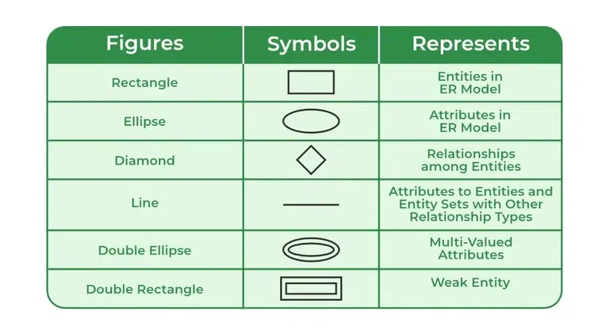

Slide 50
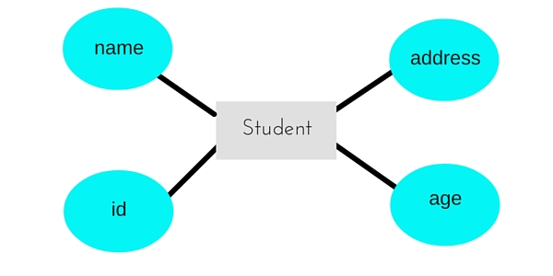
ER DATA MODEL
Entity
Attribute

Slide 51
STUDENT TABLE
NAME | ID | AGE | ADRRESS
MANAS | 123 | 22 | INDORE

Slide 52
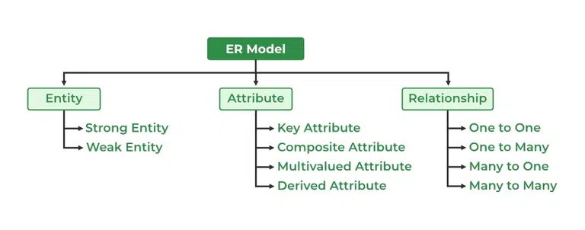

Slide 53
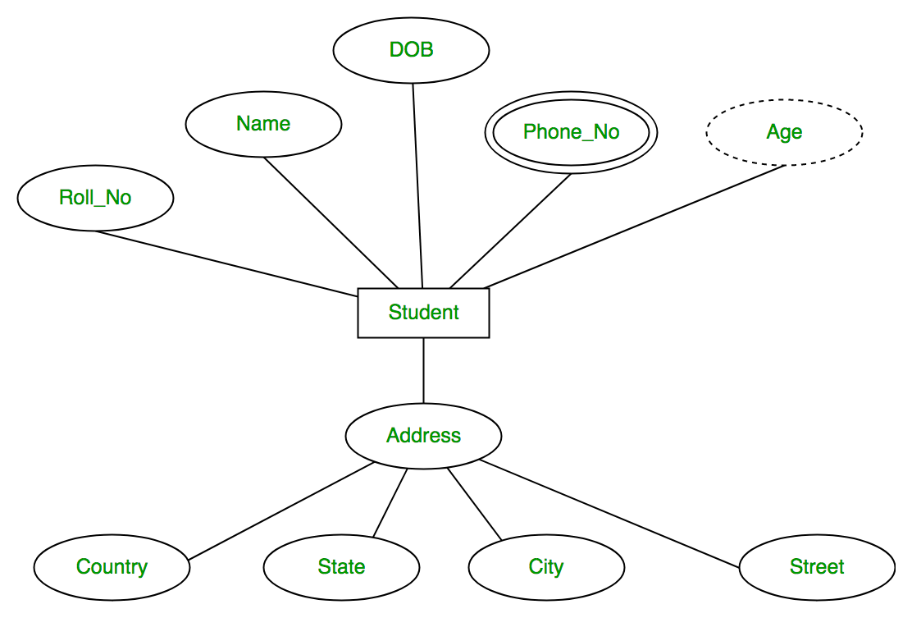
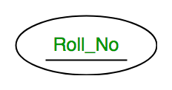
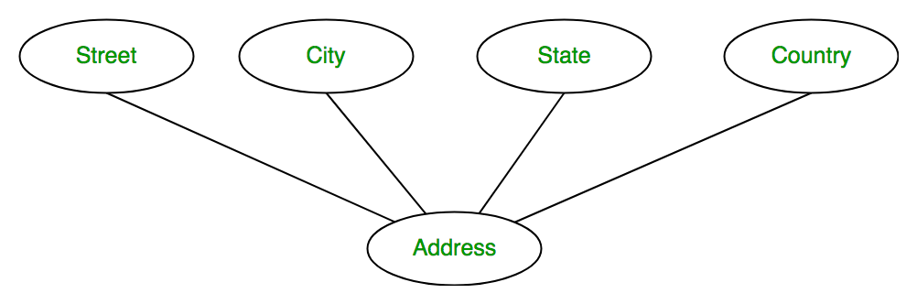
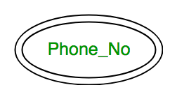
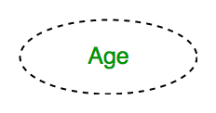
KEY ATTRIBUTE
COMPOSITE ATTRIBUTE
MULTI VALUED ATTRIBUTE
DERIVED ATTRIBUTE

Slide 54
ER DATA MODEL
Advantages of ER Model
Simple: Conceptually ER Model is very easy to build. If we know the relationship between the attributes and the entities we can easily build the ER Diagram for the model.
Effective Communication Tool: This model is used widely by the database designers for communicating their ideas.
Easy Conversion to any Model: This model maps well to the relational model and can be easily converted relational model by converting the ER model to the table. This model can also be converted to any other model like network model, hierarchical model etc.
Disadvantages of ER Model
No industry standard for notation: There is no industry standard for developing an ER model. So one developer might use notations which are not understood by other developers.
Hidden information: Some information might be lost or hidden in the ER model. As it is a high-level view so there are chances that some details of information might be hidden.

Slide 55
How to Draw ER Diagram
The very first step is Identifying all the Entities, and place them in a Rectangle, and labeling them accordingly.
The next step is to identify the relationship between them and pace them accordingly using the Diamond, and make sure that, Relationships are not connected to each other.
Attach attributes to the entities properly.
Remove redundant entities and relationships.
Add proper colors to highlight the data present in the database.

Slide 56
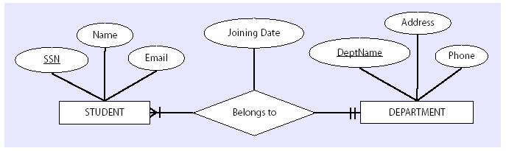
Entity-Relationship Model

Slide 57
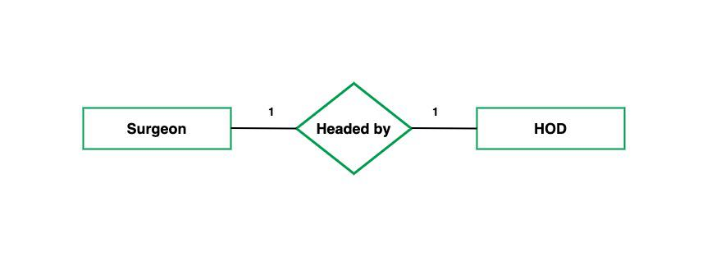
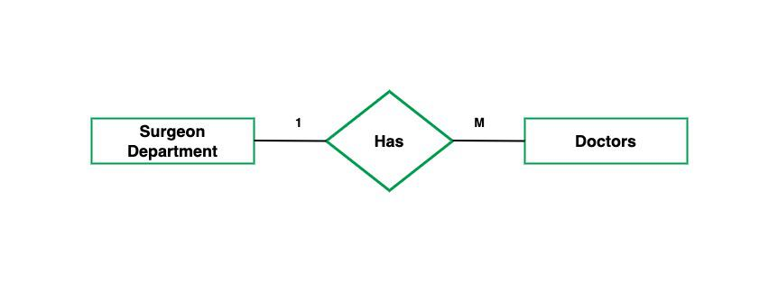
Types of Cardinality
one to one cardinality
many to many cardinality

Slide 58
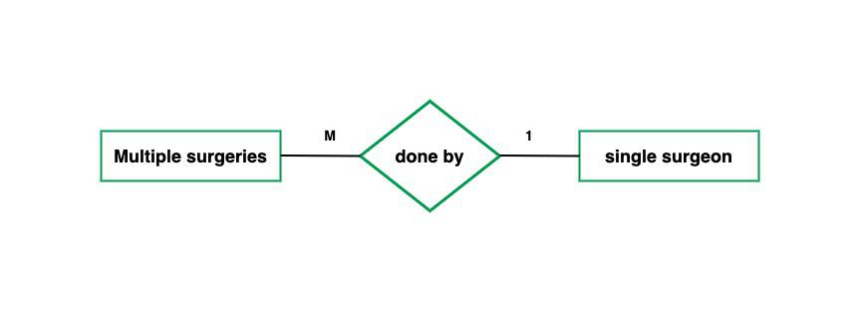
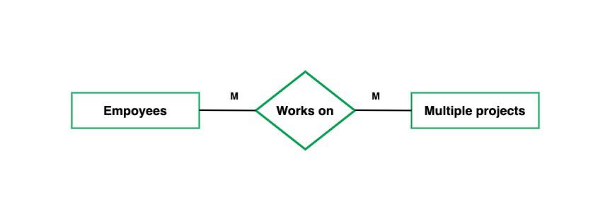
many to one cardinality
many to many cardinality

Slide 59
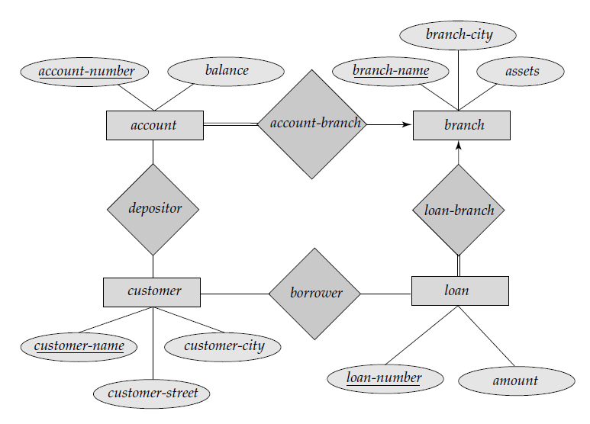
E-R diagram for the Banking Enterprise

Slide 60
b. Object-Oriented Data Model
The real-world problems are more closely represented through the object-oriented data model. In this model, both the data and relationship are present in a single structure known as an object.
We can store audio, video, images, etc in the database which was not possible in the relational model(although you can store audio and video in relational database, it is adviced not to store in the relational database).
In this model, two are more objects are connected through links. We use this link to relate one object to other objects.

Slide 61
Object-Oriented Data Model.........
In the above example, we have two objects Employee and Department. All the data and relationships of each object are contained as a single unit. The attributes like Name, Job_title of the employee and the methods which will be performed by that object are stored as a single object. The two objects are connected through a common attribute i.e the Department_id and the communication between these two will be done with the help of this common id.

Slide 62
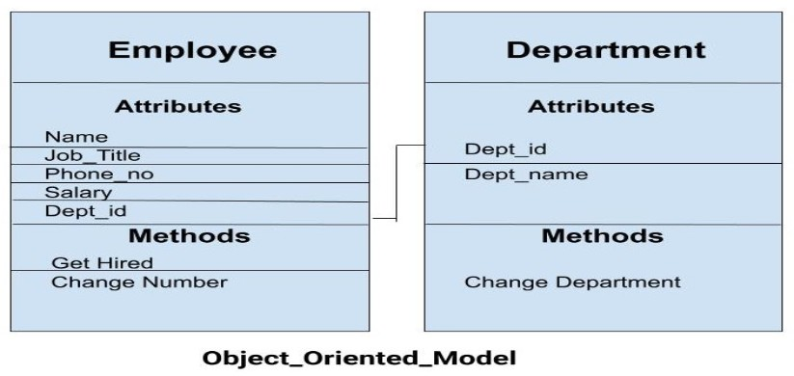
Object-Oriented Data Model

Slide 63
3. Physical Data Models
A physical data model is a database-specific model that represents relational data objects (for example, tables, columns, primary and foreign keys) and their relationships.
A physical data model can be used to generate DDL statements which can then be deployed to a database server.
It describe how data is stored in the computer, representing information such as record structures, record ordering and access paths.
Less no. of models are there.

Slide 64
3. Physical Data Models.
Using the workbench, you can create a physical data model in several ways:
Create a blank physical model by using a wizard
Create a physical model from a template by using a wizard
Reverse engineer a physical model from a database or a DDL file by using a wizard or by dragging data objects from the Data Source Explorer
Import a physical data model file from the file system
Create a physical model by transforming from a logical data model
Structured Query Language (SQL) is used to practically implement Relational Algebra.

Slide 65
3. Physical Data Models.......
This Data Model describes HOW the system will be implemented using a specific DBMS system. This model is typically created by DBA and developers. The purpose is actual implementation of the database.
Characteristics of a physical data model:
The physical data model describes data need for a single project or application though it maybe integrated with other physical data models based on project scope.
Data Model contains relationships between tables that which addresses cardinality and nullability of the relationships.
Developed for a specific version of a DBMS, location, data storage or technology to be used in the project.
Columns should have exact datatypes, lengths assigned and default values.
Primary and Foreign keys, views, indexes, access profiles, and authorizations, etc. are defined

Slide 66
2. Record-Based Data Models
Record-based data models use records to present data
  A record is a structure that contains a fixed number of fields to hold a piece of information.
  It is used to specify the overall logical structure of the database and to provide a higher-level description of the implementation. Structured database in fixed formats.
There are three main types of record-based data models:
  Relational data models
  Hierarchical data models
  Network data models

Slide 67
a. Relational Data Model
In this model, data is organised in two-dimensional tables and the relationship is maintained by storing a common field.
This model was introduced by E.F Codd in 1970, and since then it has been the most widely used database model, infact, we can say the only database model used around the world.
The basic structure of data in the relational model is tables. All the information related to a particular type is stored in rows of that table.
Hence, tables are also known as relations in relational model.

Slide 68
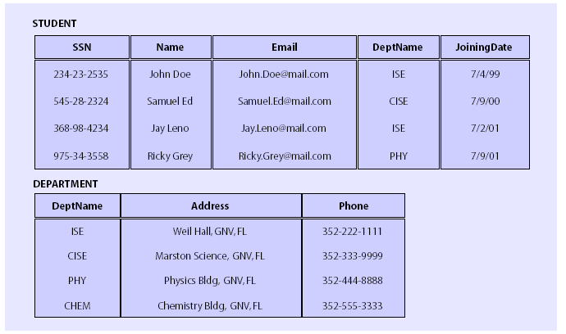
a. Relational Data Models
Each table consists of a fixed number of named columns (attributes) and an arbitrary number of unnamed rows (records)

Slide 69
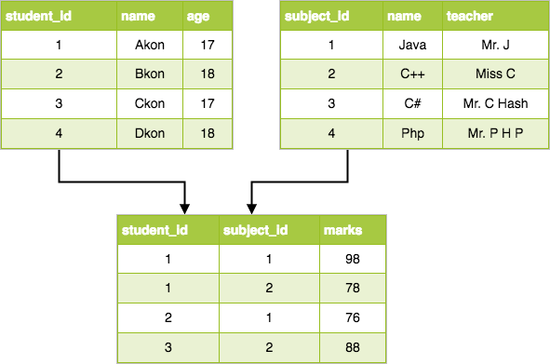
Relational Data Model

Slide 70
Relational Data Model
Advnatages of Relational Model
Simple: This model is more simple as compared to the network and hierarchical model.
Scalable: This model can be easily scaled as we can add as many rows and columns we want.
Structural Independence: We can make changes in database structure without changing the way to access the data. When we can make changes to the database structure without affecting the capability to DBMS to access the data we can say that structural independence has been achieved.
Disadvantages of Relational Model
Hardware Overheads: For hiding the complexities and making things easier for the user this model requires more powerful hardware computers and data storage devices.
Bad Design: As the relational model is very easy to design and use. So the users don't need to know how the data is stored in order to access it. This ease of design can lead to the development of a poor database which would slow down if the database grows.

Slide 71
Relational Data Model
But all these disadvantages are minor as compared to the advantages of the relational model. These problems can be avoided with the help of proper implementation and organisation.

Slide 72
b.Hierarchical Data Model
The hierarchical Model is one of the oldest models in the data model which was developed by IBM, in the 1950s. In a hierarchical model, data are viewed as a collection of tables, or we can say segments that form a hierarchical relation.
This database model organizes data into a tree-like-structure, with a single root, to which all the other data is linked. The hierarchy starts from the Root data, and expands like a tree, adding child nodes to the parent nodes.
In this model, a child node will only have a single parent node.
This model efficiently describes many real-world relationships like index of a book, recipes etc.

Slide 73
Hierarchical Data Model
In hierarchical model, data is organised into tree-like structure with one one-to-many relationship between two different types of data, for example, one department can have many courses, many professors and of-course many students.

Slide 74
Hierarchical Data Model
Advantages of Hierarchical Model
It is very simple and fast to traverse through a tree-like structure.
Any change in the parent node is automatically reflected in the child node so, the integrity of data is maintained.
Disadvantages of Hierarchical Model
Complex relationships are not supported.
As it does not support more than one parent of the child node so if we have some complex relationship where a child node needs to have two parent node then that can't be represented using this model.
If a parent node is deleted then the child node is automatically deleted.

Slide 75
c. NETWORK DATA MODEL
This is an extension of the Hierarchical model. In this model data is organised more like a graph, and are allowed to have more than one parent node.
The Network Model was formalized by the Database Task group in the 1960s. Mostly, there exists a many-to-many logical association between any of the two segments.
In this database model data is more related as more relationships are established in this database model. Also, as the data is more related, hence accessing the data is also easier and fast. This database model was used to map many-to-many data relationships.
This was the most widely used database model, before Relational Model was introduced.

Slide 76
NETWORK DATA MODEL

Slide 77
NETWORK DATA MODEL
Advantages of Network Model
The data can be accessed faster as compared to the hierarchical model. This is because the data is more related in the network model and there can be more than one path to reach a particular node. So the data can be accessed in many ways.
As there is a parent-child relationship so data integrity is present. Any change in parent record is reflected in the child record.
Disadvantages of Network Model
As more and more relationships need to be handled the system might get complex. So, a user must be having detailed knowledge of the model to work with the model.
Any change like updation, deletion, insertion is very complex.

Slide 78
Converting ER Diagrams to Tables-
Following rules are used for converting an ER diagram into the tables-
Rule-01: For Strong Entity Set With Only Simple Attributes-
A strong entity set with only simple attributes will require only one table in relational model.
Attributes of the table will be the attributes of the entity set.
The primary key of the table will be the key attribute of the entity set.

Slide 79
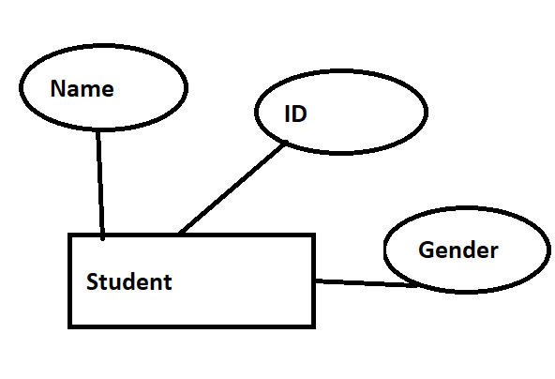
Name | ID | Gender
Schema: Student(Name,ID,Gender)

Slide 80
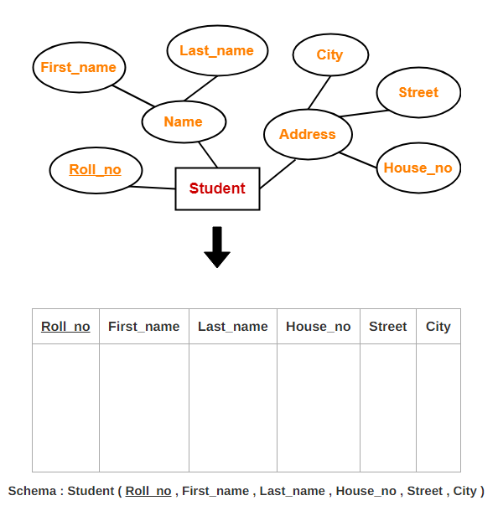
Rule-02: For Strong Entity Set With Composite Attributes-
A strong entity set with any number of composite attributes will require only one table in relational model.
While conversion, simple attributes of the composite attributes are taken into account and not the composite attribute itself.

Slide 81
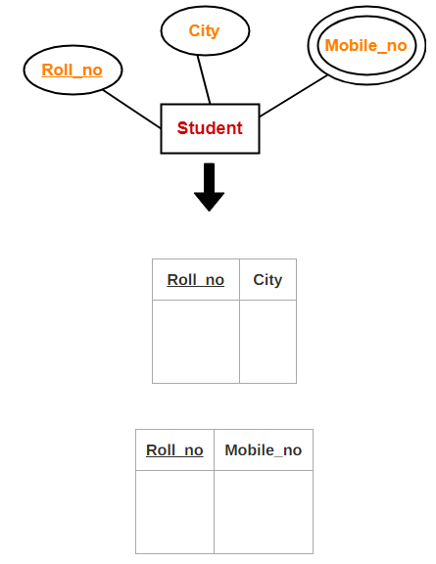
Rule-03: For Strong Entity Set With Multi Valued Attributes-
A strong entity set with any number of multi valued attributes will require two tables in relational model.
One table will contain all the simple attributes with the primary key.
Other table will contain the primary key and all the multi valued attributes.

Slide 82
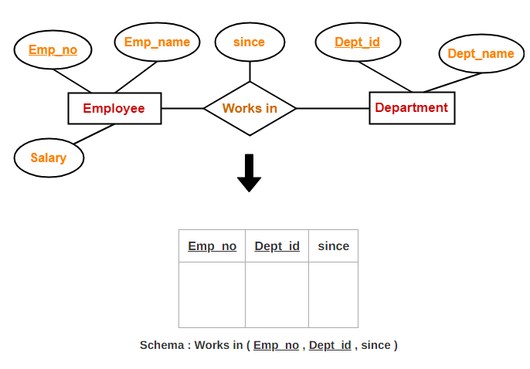
Rule-04: Translating Relationship Set into a Table-
A relationship set will require one table in the relational model.
Attributes of the table are-
Primary key attributes of the participating entity sets
Its own descriptive attributes if any.
Set of non-descriptive attributes will be the primary key.

Slide 83
NOTE-
If we consider the overall ER diagram, three tables will be required in relational model-
One table for the entity set “Employee”
One table for the entity set “Department”
One table for the relationship set “Works in”
Rule-05: For Binary Relationships With Cardinality Ratios-
The following four cases are possible-
Case-01: Binary relationship with cardinality ratio m:n
Case-02: Binary relationship with cardinality ratio 1:n
Case-03: Binary relationship with cardinality ratio m:1
Case-04: Binary relationship with cardinality ratio 1:1

Slide 84
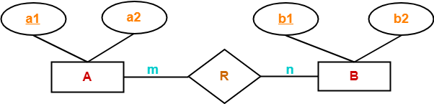
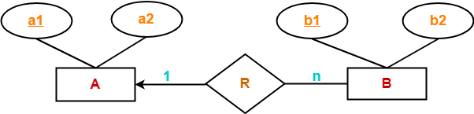
Case-01: For Binary Relationship With Cardinality Ratio m:n
Here, three tables will be required-
A ( a1 , a2 )
R ( a1 , b1 )
B ( b1 , b2 )
Case-02: For Binary Relationship With Cardinality Ratio 1:n
Here, two tables will be required-
A ( a1 , a2 )
BR ( a1 , b1 , b2 )
NOTE- Here, combined table will be drawn for the entity set B and relationship set R.

Slide 85
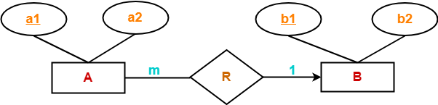
Case-03: For Binary Relationship With Cardinality Ratio m:1
Here, two tables will be required-
AR ( a1 , a2 , b1 )
B ( b1 , b2 )
NOTE- Here, combined table will be drawn for the entity set A and relationship set R.

Slide 86
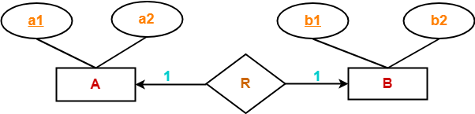
Case-04: For Binary Relationship With Cardinality Ratio 1:1
Here, two tables will be required. Either combine ‘R’ with ‘A’ or ‘B’
Way-01:
AR ( a1 , a2 , b1 )
B ( b1 , b2 )
Way-02:
A ( a1 , a2 )
BR ( a1 , b1 , b2 )

Slide 87
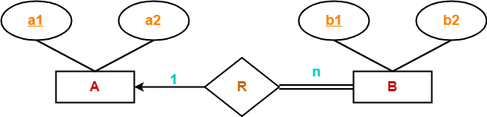
Rule-06: For Binary Relationship With Both Cardinality Constraints and Participation Constraints-
Cardinality constraints will be implemented as discussed in Rule-05.
Because of the total participation constraint, foreign key acquires NOT NULL constraint i.e. now foreign key can not be null.
Case-01: For Binary Relationship With Cardinality Constraint and Total Participation Constraint From One Side-
Because cardinality ratio = 1 : n , so we will combine the entity set B and relationship set R.
Then, two tables will be required-
A ( a1 , a2 )
BR ( a1 , b1 , b2 )
Because of total participation, foreign key a1 has acquired NOT NULL constraint, so it can’t be null now.

Slide 88
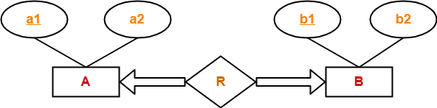
Case-02: For Binary Relationship With Cardinality Constraint and Total Participation Constraint From Both Sides-
If there is a key constraint from both the sides of an entity set with total participation, then that binary relationship is represented using only single table.
Here, Only one table is required.
ARB ( a1 , a2 , b1 , b2 )

Slide 89
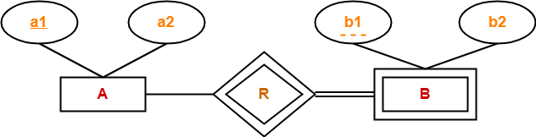
Rule-07: For Binary Relationship With Weak Entity Set-
Weak entity set always appears in association with identifying relationship with total participation constraint.
Here, two tables will be required-
A ( a1 , a2 )
BR ( a1 , b1 , b2 )

