Slide 1

Course Code: CS3CO39
Course Name: Database Management System
Text Books:
F.R. Mcfadden, J. Hoffer, M.Prescott, Modern Database Management, Addison Wesley.
Elmasri, Navathe, Fundamentals of Database System, Pearson Education Asia.
Reference Books:
C.J. Date, An Introduction to Database Systems, Pearson Education Asia.
Henry F Korth, Abraham Silbershatz, Database System Concepts, Mc Graw Hill.

Slide 2
Unit-2
Relational Database:
Relational Algebra
Relational Algebra Operation
Tuple Relational Calculus
Domain Relational Calculus
Data Definition with SQL: Inserts,Delete, Update Statements in SQL
Views Data Manipulation with SQL
PL/ SQL constructs: Triggers, Cursors etc
CO2 | Have a high-level understanding of major DBMS components and their function

Slide 3
Relational Model
Basic Notions
Fundamental Relational Algebra Operations
Additional Relational Algebra Operations
Extended Relational Algebra Operations
Null Values
Modification of the Database
Views

Slide 4
Basic Structure
Formally, given sets D₁, D₂, …. D_{n} a relation r is a subset of
D₁ x D₂ x … x D_{n}
Thus, a relation is a set of n-tuples (a₁, a₂, …, a_{n}) where each a_{i} ∈ D_{i}
Example:
customer_name = {Jones, Smith, Curry, Lindsay}
customer_street = {Main, North, Park}
customer_city = {Harrison, Rye, Pittsfield}
Then r = { (Jones, Main, Harrison),
(Smith, North, Rye),
(Curry, North, Rye),
(Lindsay, Park, Pittsfield) }
is a relation over
customer_name , customer_street, customer_city

Slide 5
Attribute Types
Each attribute of a relation has a name
The set of allowed values for each attribute is called the domain of the attribute
Attribute values are (normally) required to be atomic; that is, indivisible
  Note: multivalued attribute values are not atomic ({secretary. clerk}) is example of multivalued attribute position
  Note: composite attribute values are not atomic
The special value null is a member of every domain
The null value causes complications in the definition of many operations
  We shall ignore the effect of null values in our main presentation and consider their effect later

Slide 6
Relation Schema
A₁, A₂, …, A_{n} are attributes
R = (A₁, A₂, …, A_{n} ) is a relation schema
Example:
Customer_schema = (customer_name, customer_street, customer_city)
r(R) is a relation on the relation schema R
Example:
customer (Customer_schema)

Slide 7
Relation Instance
The current values (relation instance) of a relation are specified by a table
An element t of r is a tuple, represented by a row in a table
attributes
(or columns)
customer_name
customer_street
customer_city
Jones
Smith
Curry
Lindsay
Main
North
North
Park
Harrison
Rye
Rye
Pittsfield
tuples
(or rows)
customer

Slide 8
Database
A database consists of multiple relations
Information about an enterprise is broken up into parts, with each relation storing one part of the information
account : stores information about accounts
depositor : stores information about which customer
owns which account
customer : stores information about customers
Storing all information as a single relation such as
bank(account_number, balance, customer_name, ..)
results in repetition of information (e.g., two customers own an account) and the need for null values (e.g., represent a customer without an account)

Slide 9
Query Languages
Language in which user requests information from the database.
Categories of languages
  Procedural
  Non-procedural, or declarative
“Pure” Procedural languages:
  Relational algebra
  Tuple relational calculus
  Domain relational calculus
Pure languages form underlying basis of query languages that people use.

Slide 10
What is “algebra”
Mathematical model consisting of:
  Operands --- Variables or values;
  Operators --- Symbols denoting procedures that construct new values from a given values
Relational Algebra is algebra whose operands are relations and operators are designed to do the most commons things that we need to do with relations

Slide 11
Basic Relational Algebra Operations
Select
Project
Union
Set Difference (or Substract or minus)
Cartesian Product

Slide 12
Select Operation
Notation: σ _{p}(r)
p is called the selection predicate
Defined as:
σ_{p}(r) = {t | t ∈ r and p(t)}
Where p is a formula in propositional calculus consisting of terms connected by : ∧ (and), ∨ (or), ¬ (not)
Each term is one of:
<attribute> op <attribute> or <constant>
where op is one of: =, ≠, >, ≥. <. ≤
Example of selection:
Account(account_number, branch_name,balance)
σ _{branch-name=“Delhi”}(account)

Slide 13
Select Operation – Example
Relation r
A
B
C
D
α
α
β
β
α
β
β
β
1
5
12
23
7
7
3
10
σ_{A=B ^ D > 5} (r)
A
B
C
D
α
β
α
β
1
23
7
10

Slide 14
Project Operation
Notation:
∏_{A1, A2, …, Ak} (r)
where A₁, A₂ are attribute names and r is a relation.
The result is defined as the relation of k columns obtained by erasing the columns that are not listed
Duplicate rows removed from result, since relations are sets
E.g. to eliminate the branch-name attribute of account
∏_{account-number, balance} (account)
If relation Account contains 50 tuples, how many tuples contains ∏_{account-number, balance} (account) ?
If relation Account contains 50 tuples, how many tuples contains
∏_{, balance} (account) ?

Slide 15
Project Operation – Example
A
B
C
α
α
β
β
10
20
30
40
1
1
1
2
Relation r:
A
C
A
C
∏_{A,C} (r)
That is, the projection of
a relation on a set of
attributes is a set of tuples
α
α
β
β
1
1
1
2
α
β
β
1
1
2
=

Slide 16
Union Operation
Consider relational schemas:
Depositor(customer_name, account_number)
Borrower(customer_name, loan_number)
For r ∪ s to be valid.
1. r, s must have the same number of attributes
2. The attribute domains must be compatible (e.g., 2nd column of r deals with the same type of values as does the 2nd column of s)
Find all customers with either an account or a loan
∏_{customer-name} (depositor) ∪ ∏_{customer-name} (borrower)

Slide 17
Union Operation
Notation: r ∪ s
Defined as:
r ∪ s = {t | t ∈ r or t ∈ s}

Slide 18
Union Operation – Example
A
B
A
B
α
α
β
1
2
1
α
β
2
3
Relations r, s:
s
r
A
B
α
α
β
β
1
2
1
3
r ∪ s:

Slide 19
Set Difference Operation
Notation r – s
Defined as:
r – s = {t | t ∈ r and t ∉ s}
Set differences must be taken between compatible relations.
  r and s must have the same number of attributes
  attribute domains of r and s must be compatible

Slide 20
Set Difference Operation – Example
A
B
A
B
α
α
β
1
2
1
α
β
2
3
Relations r, s:
s
r
A
B
α
β
1
1
r – s:

Slide 21
Cartesian-Product Operation
Notation r x s
Defined as:
r x s = {t q | t ∈ r and q ∈ s}
Assume that attributes of r(R) and s(S) are disjoint. (That is, R ∩ S = ∅ ).
If attributes of r(R) and s(S) are not disjoint, then renaming must be used.

Slide 22
Cartesian-Product Operation-Example
A
B
C
D
E
Relations r, s:
α
β
1
2
α
β
β
γ
10
10
20
10
a
a
b
b
r
s
r x s:
A
B
C
D
E
α
α
α
α
β
β
β
β
1
1
1
1
2
2
2
2
α
β
β
γ
α
β
β
γ
10
10
20
10
10
10
20
10
a
a
b
b
a
a
b
b

Slide 23
Composition of Operations
Can build expressions using multiple operations
Example: σ_{A=C}(r × s)
r × s
σ_{A=C}(r × s)
A
B
C
D
E
α
α
α
α
β
β
β
β
1
1
1
1
2
2
2
2
α
β
β
γ
α
β
β
γ
10
10
20
10
10
10
20
10
a
a
b
b
a
a
b
b
A
B
C
D
E
α
β
β
1
2
2
α
β
β
10
20
20
a
a
b

Slide 24
Rename Operation
Allows us to name, and therefore to refer to, the results of relational-algebra expressions.
Allows us to refer to a relation by more than one name.
Example:
ρ _{X} (E)
returns the expression E under the name X
If a relational-algebra expression E has arity n, then
ρ _{(A1, A2, …, An)} (E)
returns the result of expression E under the name X, and with the attributes renamed to A1, A2, …., An.
x

Slide 25
Banking Example
branch (branch-name, branch-city, assets)
customer (customer-name, customer-street, customer-city)
account (account-number, branch-name, balance)
loan (loan-number, branch-name, amount)
depositor (customer-name, account-number)
borrower (customer-name, loan-number)

Slide 26
What is “algebra”
The Relational Algebra
Mathematical model consisting of:
  Operands --- Variables or values;
  Operators --- Symbols denoting procedures that construct new values from a given values
Relational Algebra is algebra whose operands are relations and operators are designed to do the most commons things that we need to do with relations

Slide 27
The Relational Algebra.........
The relational algebra is a procedural query language. It consists of a set of operations that take one or two relations as input and produce a new relation as their output.
The fundamental operations in the relational algebra are:
Rename
Union
Intersection
Set difference
Cartesian product and
1. Select
2. Project
3. Join
Basic operations Set Theory operations
Relational DB operations

Slide 28
Fundamental Operations
The select, project, and rename operations are called unary operations, because they operate on one relation.
The other three operations operate on pairs of relations and are, therefore, called binary operations.
In addition to the fundamental operations, there are several other operations—namely:
Set intersection
Natural join
Division and
Assignment

Slide 29
For example: LOAN Relation
BRANCH_NAME | LOAN_NO | AMOUNT
Downtown | L-17 | 1000
Redwood | L-23 | 2000
Perryride | L-15 | 1500
Downtown | L-14 | 1500
Mianus | L-13 | 500
Roundhill | L-11 | 900
Roundhill | L-11 | 900
Perryride | L-16 | 1300

Slide 30
1. Select Operation
The select operation selects subsets of tuples/rows that satisfy a given predicate. We use the lowercase Greek letter sigma (σ) to denote selection. The predicate appears as a subscript to σ.
Notation: σ p(r)
σ is used for selection prediction(select operation)r is used for relation(table name)
p is used as a propositional logic formula (any condition)which may use connectors like: AND OR and NOT. These relational can use as relational operators like =, ≠, ≥, <, >, ≤.
Each term is one of:
<attribute> op <attribute> or <constant>
The argument relation is in parentheses after the σ. Thus, to select those tuples of the loan relation where the branch is “Perryridge,” we write
σ_{branch-name} _{=“Perryridge”} (loan)
BRANCH_NAME | LOAN_NO | AMOUNT
Perryride | L-15 | 1500
Perryride | L-16 | 1300

Slide 31
Select Operation........
In general, we allow comparisons using =, ≠ , < , ≤ , >, ≥ in the selection predicate.
We can find all tuples in which the loan amount is more than 1200Rs. by writing
σ_{amount>1200} (loan)
a relation with All rows are display those have more than 1200 amount
Furthermore, we can combine several predicates into a larger predicate by using the connectives and (∧), or (∨) and not (￢).
Find those tuples pertaining to loans of more than 1200Rs. made by the Perryridge branch, we write
σ_{branch-name} _{=“Perryridge”∧ amount>1300} (loan)
BRANCH_NAME | LOAN_NO | AMOUNT
Perryride | L-15 | 1500

Slide 32
Select Operation – Example
Relation r
A
B
C
D
α
α
β
β
α
β
β
β
1
5
12
23
7
7
3
10
σ_{A=B ^ D > 5} (r)
A
B
C
D
α
β
α
β
1
23
7
10

Slide 33
2. Project Operation
The project operation is a unary operation that returns its argument relation, with certain attributes left out.
Projection always work in distinct form.
It gives only unique value result.
It select all the attributes/Columns of the relation.
In this operation, any duplicate rows are eliminated.
Projection is denoted by the uppercase Greek letter pi (Π).
Notation: ∏ A1, A2, An (r)
A1, A2, A3 is used as an attribute name of relation r.
We list those attributes that we wish to appear in the result as a subscript to Π. The argument relation follows in parentheses.
If relation Account contains 50 tuples, how many tuples contains ∏account-number, balance (account) ?
If relation Account contains 50 tuples, how many tuples contains
∏, balance (account) ?

Slide 34
Write the query to list all loan numbers and the amount of the loan.
Π_{loan-number, amount}(loan)
LOAN_NO | AMOUNT
L-17 | 1000
L-23 | 2000
L-15 | 1500
L-14 | 1500
L-13 | 500
L-11 | 900
L-16 | 1300
L-11in relation are Two times but here it shows only one time means distinct value

Slide 35
Project Operation..........
if we have relation borrower and depositor
Find the names of all customers with a loan in the bank.
Π_{customer_name}(borrower )
Find the names of all customers with an account in the bank.
Π_{customer_name}(depositor)

Slide 36
Project Operation – Example
A
B
C
α
α
β
β
10
20
30
40
1
1
1
2
Relation r:
A
C
A
C
∏_{A,C} (r)
That is, the projection of
a relation on a set of
attributes is a set of tuples
α
α
β
β
1
1
1
2
α
β
β
1
1
2
=

Slide 37
Composition of Relational Operations
The result of a relational operation is itself a relation.
Since the result of a relational-algebra operation is of the same type (relation) as its inputs, relational-algebra operations can be composed together into a relational-algebra expression.
For Ex: Find those customers who live in Indore.
Π_{customer_name}(σ_{customer-city =“Indore”}(customer))

Slide 38

Composition of Operations...
Can build expressions using multiple operations
Example: σ_{A=C}(r × s)
r × s
σ_{A=C}(r × s)
A
B
C
D
E
α
α
α
α
β
β
β
β
1
1
1
1
2
2
2
2
α
β
β
γ
α
β
β
γ
10
10
20
10
10
10
20
10
a
a
b
b
a
a
b
b
A
B
C
D
E
α
β
β
1
2
2
α
β
β
10
20
20
a
a
b

Slide 39
3. Union Operation
Find the names of all bank customers who have either an account or a loan or both .
To answer the query, we need the union of two sets; that is, we need all customer names that appear in either or both of the two relations.
We find these data by the binary operation union, denoted, as in set theory, by ∪.
Notation: r ∪ s
Defined as:
r ∪ s = {t | t ∈ r or t ∈ s}

Slide 40
Union Operation......
Consider relational schemas:
Depositor(customer_name, account_number)
Borrower(customer_name, loan_number)
For r ∪ s to be valid.
1. r, s must have the same number of attributes
2. The attribute domains must be compatible (e.g., 2nd column of r deals with the same type of values as does the 2nd column of s)
So the expression needed is
Π_{customer_name}(borrower) ∪ Π_{customer_name}(depositor)

Slide 41
Union Operation – Example
A
B
A
B
α
α
β
1
2
1
α
β
2
3
Relations r, s:
s
r
A
B
α
α
β
β
1
2
1
3
r ∪ s:

Slide 42
Union Operation......
For a union operation r ∪ s to be valid, we require that two conditions hold:
The relations r and s must be of the same arity. That is, they must have the same number of attributes.
2. The domains of the i^{th} attribute of r and the i^{th} attribute of s must be the same, for all i.
Note that r and s can be, in general, temporary relations that are the result of relational algebra expressions.

Slide 43
4. Set Difference Operation
The set-difference operation, denoted by − , allows us to find tuples that are in one relation but are not in another.
Notation r – s
Defined as:
r – s = {t | t ∈ r and t ∉ s}
Set differences must be taken between compatible relations.
  r and s must have the same number of attributes
  attribute domains of r and s must be compatible
The expression r − s produces a relation containing those tuples in r but not in s.
We can find all customers of the bank who have an account but not a loan.
Π_{customer-name}(depositor) − Π_{customer-name}(borrower )

Slide 44
Set Difference Operation – Example
A
B
A
B
α
α
β
1
2
1
α
β
2
3
Relations r, s:
s
r
A
B
α
β
1
1
r – s:

Slide 45
Set Difference Operation...
As with the union operation, we must ensure that set differences are taken between compatible relations. Therefore, for a set difference operation r − s to be valid, If,
The relations r and s be of the same arity, and
The domains of the i^{th} attribute of r and the i^{th} attribute of s be the same.

Slide 46
5. Cartesian-Product Operation
The Cartesian-product operation, denoted by a cross (×), allows us to combine information from any two relations.
Notation r x s
Defined as:
r x s = {t q | t ∈ r and q ∈ s}
Assume that attributes of r(R) and s(S) are disjoint. (That is, R ∩ S = ∅ ).
If attributes of r(R) and s(S) are not disjoint, then renaming must be used.
We write the Cartesian product of relations r1 and r2 as ...r1 × r2
However, since the same attribute name may appear in both r1 and r2, we need to devise a naming schema to distinguish between these attributes.
We do so here by attaching to an attribute the name of the relation from which the attribute originally came.

Slide 47
Cartesian-Product Operation....
For example, the relation schema for r = borrower × loan is (borrower.customer_name,borrower.loan_number, loan.loan_number, loan.branch_name, loan.amount)
With this schema, we can distinguish borrower.loan-number from loan.loan-number.
For those attributes that appear in only one of the two schemas, we shall usually drop the relation-name prefix. This simplification does not lead to any ambiguity.
We can then write the relation schema for r as (customer_name, borrower.loan_number, loan.loan_number, branch_name, amount)

Slide 48

Cartesian-Product Operation-Example
A
B
C
D
E
Relations r, s:
α
β
1
2
α
β
β
γ
10
10
20
10
a
a
b
b
r
s
r x s:
A
B
C
D
E
α
α
α
α
β
β
β
β
1
1
1
1
2
2
2
2
α
β
β
γ
α
β
β
γ
10
10
20
10
10
10
20
10
a
a
b
b
a
a
b
b

Slide 49
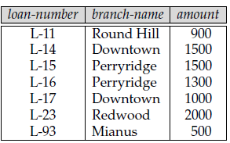
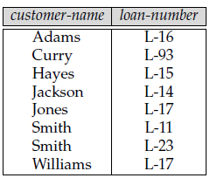
Cartesian-Product Operation Example 2....
Find the names of all customers who have a loan at the Perryridge branch. We write,
σ_{branch_name =“Perryridge”}(borrower × loan)

Slide 50
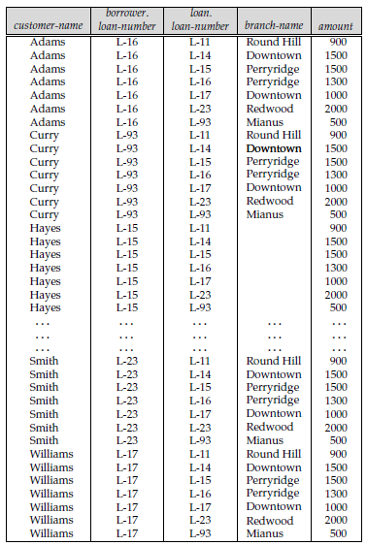
Result of borrower × loan

Slide 51
Result of borrower × loan Explainantion
The customer-name column may contain customers who do not have a loan at the Perryridge branch. (Because the Cartesian product takes all possible pairings of each tuple from borrower with each tuple of loan.)
Since the Cartesian-product operation associates every tuple of loan with every tuple of borrower, we know that, if a customer has a loan in the Perryridge branch, then there is some tuple in borrower×loan that contains his name, and borrower.loan_number= loan.loan_number. So, if we write
σborrower.loan_number=loan.loan_number(σ_{branch_name=“Perryridge”}(borrower×loan))
we get only those tuples of borrower × loan that pertain to customers who have a loan at the Perryridge branch.

Slide 52

Finally, since we want only customer-name, we do a projection:
Π_{customer_name} (σborrower.loan_number =loan.loan_number
(σ_{branch_name =“Perryridge”}(borrower × loan)))
The result of this expression, shown in Figure.

Slide 53
6. Rename Operation
The rename operator, denoted by the lowercase Greek letter rho (ρ).
For example, consider a relational-algebra expression E, the expression
ρ_{x}(E)
returns the result of expression E under the name x.
A relation r by itself is considered a relational-algebra expression. Thus, we can also apply the rename operation to a relation r to get the same relation under a new name.
A second form of the rename operation is as follows.
Assume that a relational algebra expression E has arity n. Then, the expression ρ_{x(A1,A2,...,An)}(E)
returns the result of expression E under the name x, and with the attributes renamed to A1,A2, . . .,An.

Slide 54
Example
Find the names of all customers who live on the same street and in the same city as Smith.
Π_{customer_street, customer_city} (σ_{customer_name = “Smith”}(customer))
However, in order to find other customers with this street and city, we must reference the customer relation a second time. In the following query, we use the rename operation on the preceding expression to give its result the name smith-addr, and to rename its attributes to street and city, instead of customer-street and customer-city.
Π_{customer.customer_name}(σcustomer.customer_street=smith_addr.street ∧ customer.customer_city=smith_addr.city(customer × ρ_{smith_addr(street,city)} (Π_{customer_street, customer_city} (σ_{customer_name = “Smith”}(customer)))))

Slide 55
Additional Operations
We define additional operations that do not add any power.
to the relational algebra, but that simplify common queries.
Set intersection
Natural join
Division
Assignment

Slide 56
1. Set-Intersection Operation
Set intersection operation denoted by symbol (∩).
Suppose that we wish to find all customers who have both a loan and an account.
Notation: r ∩ s
Defined as:
r ∩ s ={ t | t ∈ r and t ∈ s }
Assume:
  r, s have the same arity
  attributes of r and s are compatible
Note: r ∩ s = r - (r - s)
Using set intersection, we can write
Π_{customer_name} (borrower ) ∩ Π_{customer_name} (depositor)

Slide 57
Set-Intersection Operation - Example
Relation r, s:
r ∩ s
A B
A B
α
α
β
1
2
1
α
β
2
3
r
s
A B
α 2

Slide 58
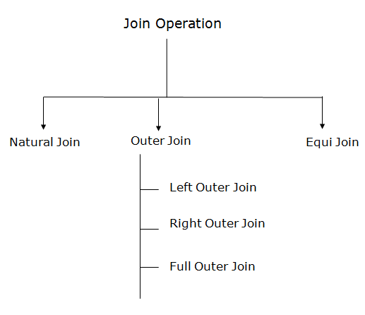
2. Join Operation
Join operation allows us to combine certain selections .
It is denoted by the “join” symbol

Slide 59
Natural-Join Operation
The natural join is a binary operation that allows us to combine certain selections and a Cartesian product into one operation.
It is denoted by the “join” symbol
Let r and s be relations on schemas R and S respectively.
Then, r s is a relation on schema R ∪ S obtained as follows:
  Consider each pair of tuples t_{r} from r and t_{s} from s.
  If t_{r} and t_{s} have the same value on each of the attributes in R ∩ S, add a tuple t to the result, where
    t has the same value as t_{r} on r
    t has the same value as t_{s} on s
Notation: r s

Slide 60
Natural-Join Operation.....
Example:
  R = (A, B, C, D)
  S = (E, B, D)
  Result schema = (A, B, C, D, E)
  r s is defined as:
  ∏_{r.A, r.B, r.C, r.D, s.E} (σ_{r.B = s.B} ∧ _{r.D = s.D} (r x s))
The natural-join operation forms a Cartesian product of its two arguments, performs a selection forcing equality on those attributes that appear in both relation schemas, and finally removes duplicate attributes.
Find the names of all customers who have a loan at the bank, and find the amount of the loan.
Πcustomer_name, loan_number, amount (borrower loan)

Slide 61
Natural Join Operation – Example
Relations r, s:
A
B
C
D
B
D
E
α
β
γ
α
δ
1
2
4
1
2
α
γ
β
γ
β
a
a
b
a
b
1
3
1
2
3
a
a
a
b
b
α
β
γ
δ
∈
r
s
r s
A
B
C
D
E
α
α
α
α
δ
1
1
1
1
2
α
α
γ
γ
β
a
a
a
a
b
α
γ
α
γ
δ

Slide 62
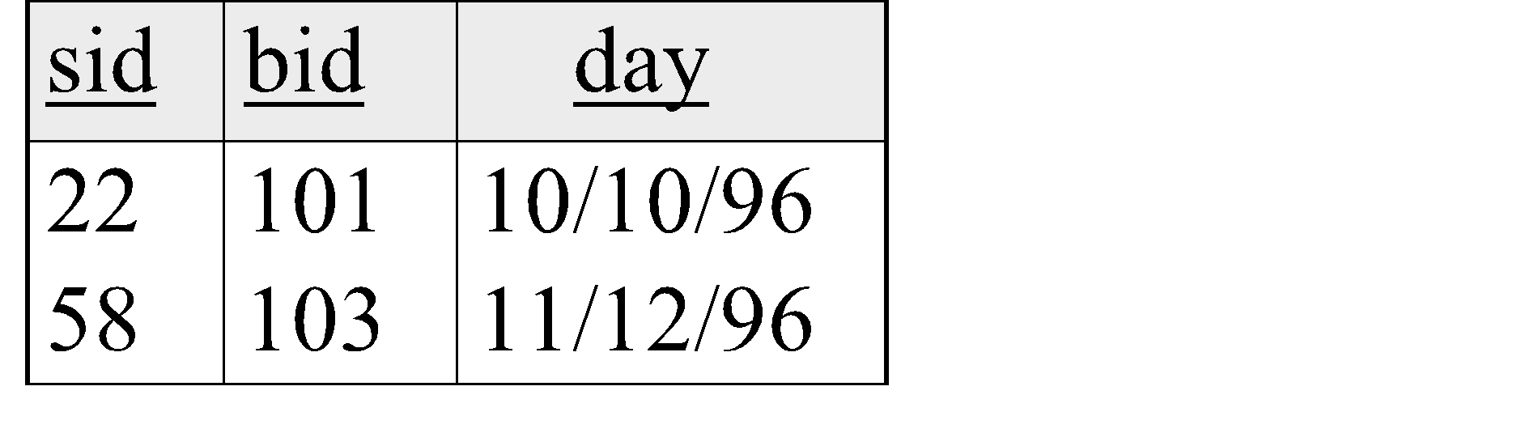
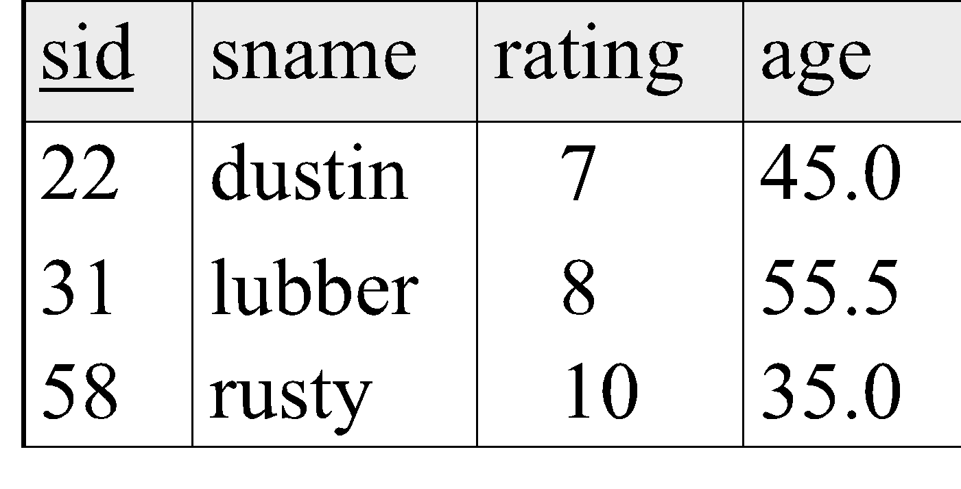
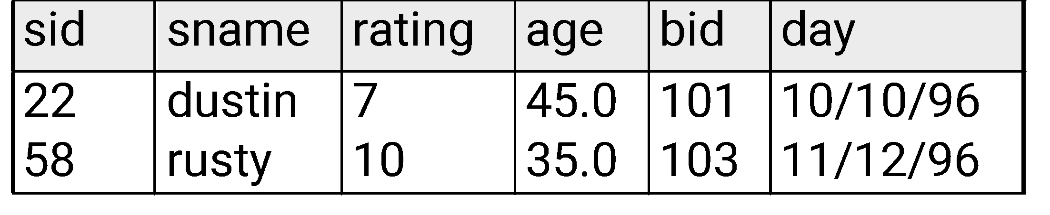
Natural Join Example2.....
R1
S1
R1 S1 =

Slide 63
Natural-Join Operation......
Usually, a query that involves a Cartesian product includes a selection operation on the result of the Cartesian product.
Consider the query “Find the names of all customers who have a loan at the bank, along with the loan number and the loan amount.”

Slide 64
Natural-Join Operation....
To solve this query, we first form the Cartesian product of the borrower and loan relations. Then, we select those tuples that pertain to only the same loan-number, followed by the projection of the resulting customer-name, loan-number, and amount.
Πcustomer_name, loan.loan_number, amount (σborrower.loan_number =loan.loan_number(borrower × loan))

Slide 65
Example
Relations :-
customer(customer_id,customer name,customer_city, aadhar_number) ,
account(customer name, branch_name,account_number,account_type),
depositor(customer name,account _number,amount)
Find the names of all branches with customers who have an account in the bank and who live in Indore.

Slide 66
Example
Find the names of all branches with customers who have an account in the bank and who live in Indore.
Π_{branch_name}(σ_{customer_city=“Indore”}(customer account depositor))

Slide 67

Other Types of Joins
Condition Join (or “theta-join”):
Result schema same as that of cross-product.
May have fewer tuples than cross-product.
Equi-Join: Special case: condition c contains only conjunction of equalities.

Slide 68
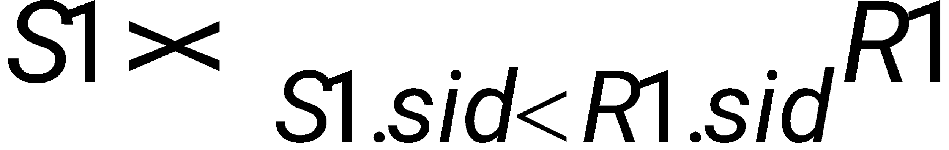
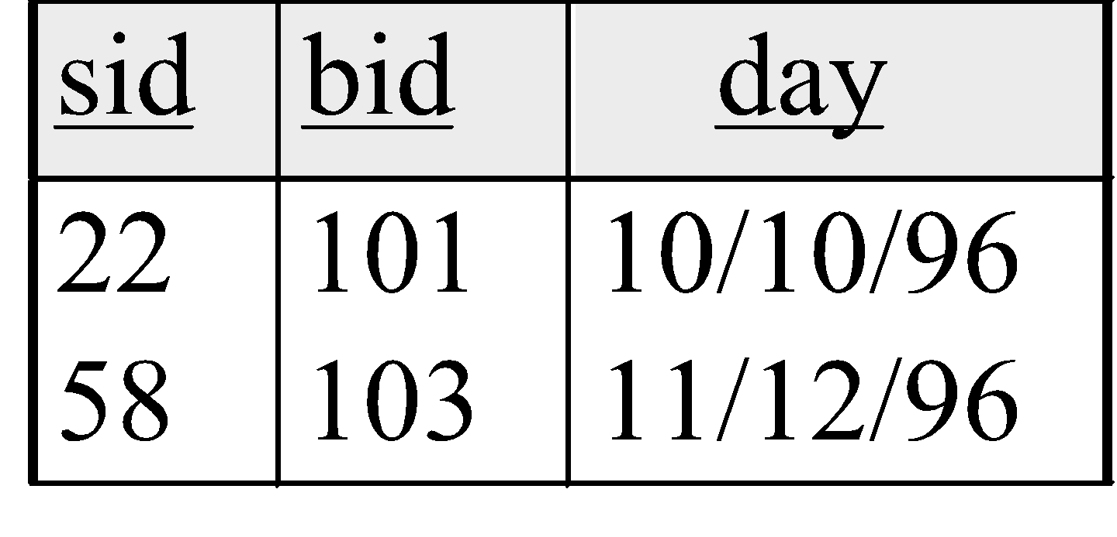
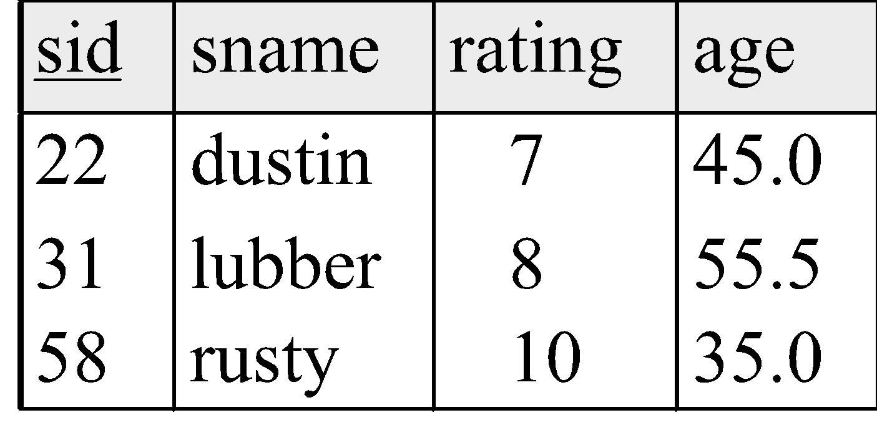
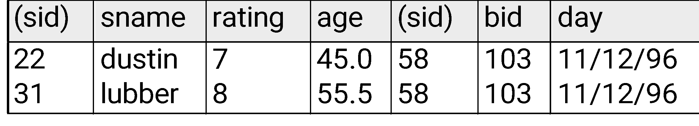
“Theta” Join Example
R1
S1
=

Slide 69
3. Division Operation
Notation:
r ÷ s
Suited to queries that include the phrase “for all”.
Let r and s be relations on schemas R and S respectively where
  R = (A₁, …, A_{m}, B₁, …, B_{n})
  S = (B₁, …, B_{n})
  The result of r ÷ s is a relation on schema
  R – S = (A₁, …, A_{m})
  r ÷ s = { t | t ∈ ∏ _{R-S}(r) ∧ ∀ u ∈ s ( tu ∈ r ) }

Slide 70
Division Operation – Example
A
B
Relations r, s:
B
α
α
α
β
γ
δ
δ
δ
∈
∈
β
1
2
3
1
1
1
3
4
6
1
2
1
2
s
A
r ÷ s:
r
α
β

Slide 71
Another Division Example
Relations r, s:
A
B
C
D
E
D
E
α
α
α
β
β
γ
γ
γ
a
a
a
a
a
a
a
a
α
γ
γ
γ
γ
γ
γ
β
a
a
b
a
b
a
b
b
1
1
1
1
3
1
1
1
a
b
1
1
s
r
r ÷ s:
A
B
C
α
γ
a
a
γ
γ

Slide 72
Division Operation
Definition in terms of the basic algebra operation
Let r(R) and s(S) be relations, and let S ⊆ R
r ÷ s = ∏_{R-S} (r) –∏_{R-S} ( (∏_{R-S} (r) x s) – ∏_{R-S,S}(r))
To see why
  ∏_{R-S,S}(r) simply reorders attributes of r
  ∏_{R-S}(∏_{R-S} (r) x s) – ∏_{R-S,S}(r)) gives those tuples t in
  ∏_{R-S} (r) such that for some tuple u ∈ s, tu ∉ r.

Slide 73
Extended Relational-Algebra Operations
Generalized Projection
Outer Join
Aggregate Functions

Slide 74
1. Generalized Projection
The generalized-projection operation extends the projection operation by allowing arithmetic functions to be used in the projection list.
The generalized projection operation has the form
Π_{F1,F2,...,Fn}(E)
where E is any relational-algebra expression, and each of F1, F2, . . . , Fn is an arithmetic expression involving constants and attributes in the schema of E.

Slide 75
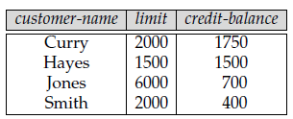
Generalized Projection.....
For example, suppose we have a relation credit-info, which lists the credit limit and expenses so far (the credit-balance on the account).
If we want to find how much more each person can spend, we can write the following expression:
Πcustomer_name, limit , credit_balance (credit_info)

Slide 76
Generalized Projection.....
The attribute resulting from the expression limit − credit_balance does not have a name. We can apply the rename operation to the result of generalized projection in order to give it a name. As a notational convenience, renaming of attributes can be combined with generalized projection as illustrated below:
Πcustomer_name, (limit − credit_balance) as credit_available (credit_info)

Slide 77
2. Aggregate Functions
Aggregate functions take a collection of values and return a single value as a result.
For example, the aggregate function sum takes a collection of values and returns the sum of the values.
The aggregate function avg returns the average of the values.
The aggregate function count returns the number of the elements in the collection.
Aggregate functions min and max, return the minimum and maximum values in a collection.
The relational-algebra operation signifies that aggregation is to be applied, and its subscript specifies the aggregate operation to be applied.
The symbol is the letter G in calligraphic font; read it as “calligraphic G.”

Slide 78
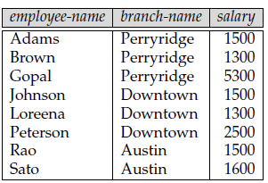
Aggregate Functions
To illustrate the concept of aggregation, we shall use the pt-works relation for part-time employees.
Suppose that we want to find out the total sum of salaries of all the part-time employees in the bank.
The relational-algebra expression for this query is:
_{sum(salary)}(pt-works)

Slide 79
Aggregate Functions
Suppose we want to find the total salary sum of all part-time employees at each branch of the bank separately, rather than the sum for the entire bank.
To do so, we need to partition the relation pt-works into groups based on the branch, and to apply the aggregate function on each group.
The following expression using the aggregation operator G achieves the desired result:
_{branch_name} _{sum(salary)}(pt-works)
In the expression, the attribute branch_name in the left-hand subscript of indicates that the input relation pt-works must be divided into groups based on the value of branch-name.

Slide 80
Aggregate Functions and Operations
Aggregation function takes a collection of values and returns a single value as a result.
avg: average value
min: minimum value
max: maximum value
sum: sum of values
count: number of values
Aggregate operation in relational algebra
_{G1, G2, …, Gn} g _{F1( A1), F2( A2),…, Fn( An)} (E)
  E is any relational-algebra expression
  G₁, G₂ …, G_{n} is a list of attributes on which to group (can be empty)
  Each F_{i} is an aggregate function
  Each A_{i} is an attribute name

Slide 81
Aggregate Operation – Example
A
B
C
Relation r:
α
α
β
β
α
β
β
β
7
7
3
10
sum-C
g _{sum(c)} (r)
27

Slide 82
Aggregate Operation – Example
Relation account grouped by branch-name:
branch-name
account-number
balance
Perryridge
Perryridge
Brighton
Brighton
Redwood
A-102
A-201
A-217
A-215
A-222
400
900
750
750
700
_{branch-name} g _{sum(balance)} (account)
branch-name
balance
Perryridge
Brighton
Redwood
1300
1500
700

Slide 83
Aggregate Functions..
Result of aggregation does not have a name
  Can use rename operation to give it a name
  For convenience, we permit renaming as part of aggregate operation
_{branch-name} g _{sum(balance) as sum-balance} (account)

Slide 84
Outer Join
An extension of the join operation that avoids loss of information.
Computes the join and then adds tuples form one relation that does not match tuples in the other relation to the result of the join.
Uses null values:
  null signifies that the value is unknown or does not exist
  All comparisons involving null are (roughly speaking) false by definition.
    We shall study precise meaning of comparisons with nulls later

Slide 85
Outer Join.....
The outer-join operation is an extension of the join operation to deal with missing information.
Suppose that we have the relations with the following schemas, which contain data on full-time employees:
employee (employee-name, street, city)
ft-works (employee-name, branch-name, salary)
Consider the employee and ft-works relations in Figure(next slide).

Slide 86
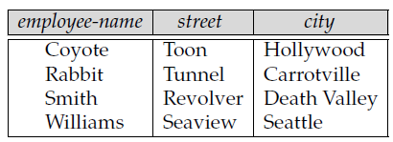
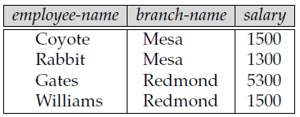
Outer Join....
Suppose that we want to generate a single relation with all the information (street, city, branch name, and salary) about full-time employees.
A possible approach would be to use the natural join operation as follows:
employee
ft-works

Slide 87
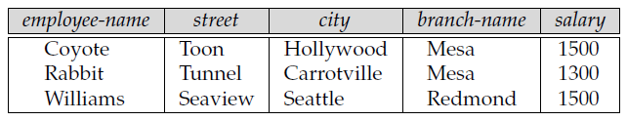
Outer Join....
Notice that we have lost the street and city information about Smith, since the tuple describing Smith is absent from the ft-works relation;
similarly, we have lost the branch name and salary information about Gates, since the tuple describing Gates is absent from the employee relation.

Slide 88
Outer Join....
We can use the outer-join operation to avoid this loss of information.
There are actually three forms of the operation: left outer join, denoted by , right outer join denoted by and full outer join, denoted by
All three forms of outer join compute the join, and add extra tuples to the result of the join.

Slide 89
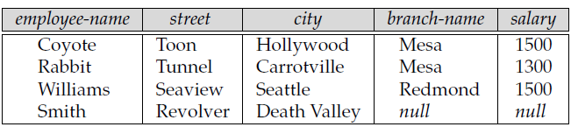

Left Outer Join
The left outer join takes all tuples in the left relation that did not match with any tuple in the right relation, pads the tuples with null values for all other attributes from the right relation, and adds them to the result of the natural join.
All information from the left relation is present in the result of the left outer join.

Slide 90
Left Outer Join Example2...
Join
loan Borrower
loan-number
branch-name
amount
customer-name
L-170
L-230
Downtown
Redwood
3000
4000
Jones
Smith
Left Outer Join
loan Borrower
loan-number
branch-name
amount
customer-name
L-170
L-230
L-260
Downtown
Redwood
Perryridge
3000
4000
1700
Jones
Smith
null

Slide 91
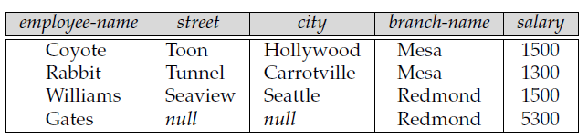

Right Outer Join
The right outer join is symmetric with the left outer join: It pads tuples from the right relation that did not match any from the left relation with nulls and adds them to the result of the natural join.
All information from the right relation is present in the result of the right outer join.

Slide 92
Right Outer Join, Full Outer Join
Right Outer Join
loan borrower
loan-number
branch-name
amount
customer-name
L-170
L-230
L-155
Downtown
Redwood
null
3000
4000
null
Jones
Smith
Hayes
    Outer Join
loan borrower
loan-number
branch-name
amount
customer-name
L-170
L-230
L-260
L-155
Downtown
Redwood
Perryridge
null
3000
4000
1700
null
Jones
Smith
null
Hayes

Slide 93
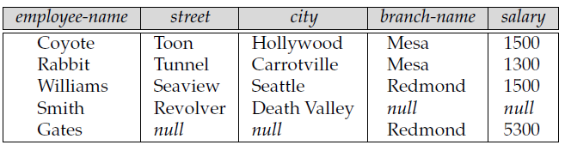

Full Outer Join
The full outer join does both of those operations, padding tuples from the left relation that did not match any from the right relation, as well as tuples from the right relation that did not match any from the left relation, and adding them to the result of the join.

Slide 94
Full Outer Join Example2 ...
loan borrower
loan-number
branch-name
amount
customer-name
L-170
L-230
L-260
L-155
Downtown
Redwood
Perryridge
null
3000
4000
1700
null
Jones
Smith
null
Hayes

Slide 95
Null Values
It is possible for tuples to have a null value, denoted by null, for some of their attributes
null signifies an unknown value or that a value does not exist.
The result of any arithmetic expression involving null is null.
Aggregate functions simply ignore null values
For duplicate elimination and grouping, null is treated like any other value, and two nulls are assumed to be the same

Slide 96
Null Values
Comparisons with null values return the special truth value unknown
  If false was used instead of unknown, then not (A < 5)
  would not be equivalent to A >= 5
Three-valued logic using the truth value unknown:
  OR: (unknown or true) = true,
  (unknown or false) = unknown
  (unknown or unknown) = unknown
  AND: (true and unknown) = unknown,
  (false and unknown) = false,
  (unknown and unknown) = unknown
  NOT: (not unknown) = unknown
Result of select predicate is treated as false if it evaluates to unknown

Slide 97
Relational Calculus
There is an alternate way of formulating queries known as Relational Calculus.
Relational calculus is a non-procedural query language.
In the non-procedural query language, the user is concerned with the details of how to obtain the end results.
The relational calculus tells what to do but never explains how to do.
Most commercial relational languages are based on aspects of relational calculus including SQL-QBE and QUEL.
It is based on Predicate calculus, a name derived from branch of symbolic language.
A predicate is a truth-valued function with arguments. On substituting values for the arguments, the function result in an expression called a proposition. It can be either true or false.
It is a tailored version of a subset of the Predicate Calculus to communicate with the relational database.

Slide 98
Relational Calculus
A calculus expression specifies “what to retrieve” rather than “how to retrieve”. This makes relational calculus different from relational algebra.
A calculus expression may be written in different ways, but the way it is written has no bearing on how a query should be evaluated.
In relational calculus, a query is solved by defining a solution relation in a single step.
Relational calculus is mainly based on the well-known propositional calculus, which is a method of calculating with sentences or declarations. That's why it is also known as declarative language

Slide 99
Relational Calculus.....
Many of the calculus expressions involves the use of Quantifiers. There are two types of quantifiers:
Universal Quantifiers: The universal quantifier denoted by ∀ is read as for all which means that in a given set of tuples exactly all tuples satisfy a given condition.
Existential Quantifiers: The existential quantifier denoted by ∃ is read as for all which means that in a given set of tuples there is at least one occurrences whose value satisfy a given condition.

Slide 100
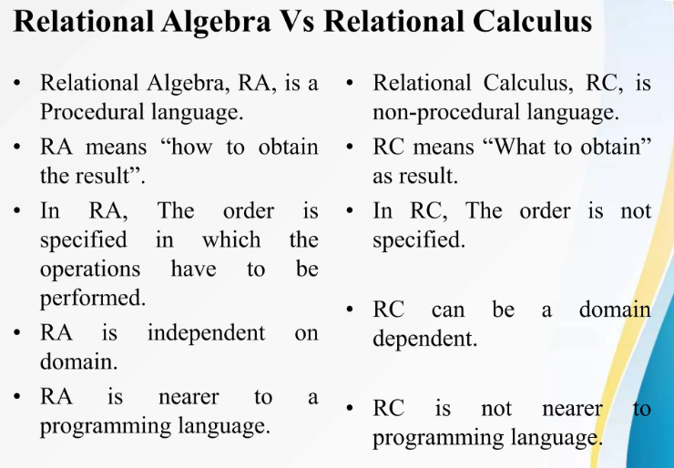

Slide 101
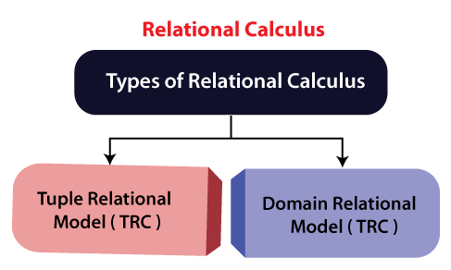
Types of Relational calculus:

Slide 102
1. Tuple Relational Calculus (TRC)
It is a non-procedural query language which is based on finding a number of tuple variables also known as range variable for which predicate holds true.
It describes the desired information without giving a specific procedure for obtaining that information.
The tuple relational calculus is specified to select the tuples in a relation.
In TRC, filtering variable uses the tuples of a relation.
The result of the relation can have one or more tuples.
Each tuple variable usually ranges over a particular database relation i.e. the variable may take as its value any individual tuple from that relation.

Slide 103
Tuple Relational Calculus (TRC)...
Notation:
A Query in the tuple relational calculus is expressed as following notation
{T | P (T)} or {T | Condition (T)}
Where
T is the resulting tuples
P(T) is the condition used to fetch T.P(t) is a condition (Boolean) expression involving t that evaluates to either TRUE or FALSE for different assignments of tuples to the variable t.
The result of such a query is the set of all tuples t that evaluate P(t) to TRUE i.e. these tuples t satisfy the condition.

Slide 104
For example:
{ T.name | Author(T) AND T.article = 'database' }
Output: This query selects the tuples from the AUTHOR relation. It returns a tuple with 'name' from Author who has written an article on 'database'.
TRC (tuple relation calculus) can be quantified.
In TRC, we can use Existential (∃) and Universal Quantifiers (∀).
For example:
{ R| ∃T ∈ Authors(T.article='database' AND R.name=T.name)}
Output: This query will yield the same result as the previous one.

Slide 105
Expression and Formula in TRC
Let Rel → be a relation name; R, S → be the tuple variables; a → an attribute of R, b → an attribute of S; op → operator in the set {<, ≤,>, ≥,=, != }.
Rule 1: An Atomic formula is one of the following:
R ∈Rel
R.a op S.b •R.a op Constant or Constant op R.a.
Rule 2: A formula or boolean condition is made up of one or more atoms connected via the logical operators AND, OR, and NOT i.e. If F1 and F2 are formulas, then so are F1 AND F2, F1 OR F2, NOT(F1) or NOT(F2).

Slide 106
The Existential and Universal Quantifiers
• To represent the join and division operation of relational algebra by relational calculus, we need quantifiers such like Existential quantifier (∃) for join and Universal quantifier(∀) for division.
A tuple variable t is bound if it is quantified i.e. the tuple t appears in an (∃t)or(∀t) clause; otherwise it is free.
Rule 3: If F is a formula, then so is (∃t)(F), where t is a tuple variable. The formula (∃t)(F) is TRUE if F evaluates to TRUE for at least one tuple assigned to free occurences of t in F; otherise the formula (∃t)(F)is FALSE.
Rule 4: If F is a formula then so is (∀t)(F), where t is a tuple variable. This formula (∀t)(F) is TRUE if F evaluates to TRUE for ALL the tuples assigned to free occurences of t in F; otherise the formula (∀t)(F)is FALSE.

Slide 107
An Example
Sailor (sid, sname, rating, age) –
Query 1: Find all the sailors with a rating above 4 {s | SAILOR(s) AND s.rating > 4}
Here, the condition SAILOR(s) specifies that the range relation of tuple variable s is SAILOR.
Each SAILOR tuple s that satisfies the condition s.rating>4 will be retrieved.
This query will retrieve all attribute value for each selected SAILOR tuple s. To retrive only some of the attributes, we need to write the specific attribute name in the format “tuple.attribute

Slide 108
More Examples
Query 2: Retrieve the details of the employees whose salary is greater than 50000.
{e | EMPLOYEE(e) AND e.salary > 50000}
Here, if we need only some attributes like Emp_ID and Fname then we can write:
{e.Emp_ID, e.Fname | EMPLOYEE(e) AND e.salary > 50000}
Query 3: Retrieve the birth date and address of the employee whose name is John B. Smith.
{e.dob, e.address | EMPLOYEE(e) AND e.Fname='John' AND e.Minit='B' AND e.Lname='Smith'}

Slide 109
. Domain Relational Calculus (DRC)
In tuple relational calculus, the variables range over the tuples whereas in domain relational calculus, the variables range over the domains.
The domain variables are the ones which range over the underlying domains instead of over the relations .
The domain relational calculus query has the form: {<x1, x2, ... xn > | P(x1, x2, ... xn )} – where xi is either a domain variable or a constant and P(x1, x2,xn ) is the domain relational calculus formula whose only free variables are the variables among the xi, 1 ≤ i ≤ n .
The result of this query is the set of all domains <x1, x2, ... xn > for which the formula evaluates to TRUE

Slide 110
. Domain Relational Calculus (DRC)....
Expression and Formula in DRC
Let Rel → be a relation name; X, Y → be the domain variables; op → operator in the set {<, ≤,>, ≥,=, != }.
Rule 1: An Atomic formula is one of the following:
<x1, x2, ... xn > ∈Rel •X op Y •X op Constant or Constant op X
Rule 2: A formula is recursively defined by using the following rules:
Any atomic formula

Slide 111
. Domain Relational Calculus (DRC)....
If p(x) is a formula that contains x as a free domain variable, then∃x(p(x)) and ∀x(p(x)) are also formulae.
If p and q are formulae, then ¬p, p ∧q, p ∨q are also formulae.
Rule 3: The quantifiers ∃& ∀are said to bind the domain variable X. Whereas a variable is said to be free in a formula if the formula does not contain an occurrence of a quantifier that binds it.

Slide 112
Queries on DRC Consider the following relational schema:
Queries on DRC Consider the following relational schema:
Sailor Database Sailors(sid, sname, rating, age) Boats(bid, bname, color)
Reserves(sid, bid, day)
Query 1: Find all sailors with a rating above 7 .
{<Is, N, R,A> | <Is, N, R, A> ∈Sailors ∧R >7}
Query 2: Find the names of sailors who reserved boat 111.
{<N> | ∃<Is,R , A> ( <Is, N, R,A> ∈Sailors ∧∃ <Ir, Br, D> ∈Reserves ( Ir=Is ∧Br=111 ))}

Slide 113
Difference between Tuple Relational Calculus (TRC) and Domain Relational Calculus (DRC) :
1. Definition
The Tuple Relational Calculus (TRC) is used to select tuples from a relation. The tuples with specific range values, tuples with certain attribute values, and so on can be selected.
The Domain Relational Calculus (DRC) employs a list of attributes from which to choose based on the condition. It’s similar to TRC, but instead of selecting entire tuples, it selects attributes.
2. Representation of variables
In TRC, the variables represent the tuples from specified relations.
In DRC, the variables represent the value drawn from a specified domain.
3. Tuple/ Domain
A tuple is a single element of relation. In database terms, it is a row.
A domain is equivalent to column data type and any constraints on the value of data.
4. Filtering
This filtering variable uses a tuple of relations.
This filtering is done based on the domain of attributes.
5. Return Value
The predicate expression condition associated with the TRC is used to test every row using a tuple variable and return those tuples that met the condition.
DRC takes advantage of domain variables and, based on the condition set, returns the required attribute or column that satisfies the criteria of the condition.
5. Membership condition
The query cannot be expressed using a membership condition.
The query can be expressed using a membership condition.
6. Query Language
The QUEL or Query Language is a query language related to it,
The QBE or Query-By-Example is query language related to it.

Slide 114
7. Similarity
It reflects traditional pre-relational file structures.
It is more similar to logic as a modeling language.
8. Syntax
Notation: {T | P (T)} or {T | Condition (T)}
Notation: { a1, a2, a3, …, an | P (a1, a2, a3, …, an)}
9. Example
{T | EMPLOYEE (T) AND T.DEPT_ID = 10}
{ | < EMPLOYEE > DEPT_ID = 10 }
10. Focus
Focuses on selecting tuples from a relation
Focuses on selecting values from a relation
11. Variables
Uses tuple variables (e.g., t)
Uses scalar variables (e.g., a1, a2, …, an)
12. Expressiveness
Less expressive
More expressive
13. Ease of use
Easier to use for simple queries.
More difficult to use for simple queries.
14. Use case
Useful for selecting tuples that satisfy a certain condition or for retrieving a subset of a relation.
Useful for selecting specific values or for constructing more complex queries that involve multiple relations.

Slide 115
Modification of the Database
The content of the database may be modified using the following operations:
  Deletion
  Insertion
  Updating
All these operations are expressed using the assignment operator.

Slide 116
Deletion
A delete request is expressed similarly to a query, except instead of displaying tuples to the user, the selected tuples are removed from the database.
Can delete only whole tuples; cannot delete values on only particular attributes
A deletion is expressed in relational algebra by:
r ← r – E
where r is a relation and E is a relational algebra query.

Slide 117
Deletion Examples
Delete all account records in the Perryridge branch.
account ← account – σ _{branch_name = “Perryridge”} (account )
Delete all loan records with amount in the range of 0 to 50
loan ← loan – σ _{amount ≥ 0 and amount ≤ 50} (loan)
Delete all accounts at branches located in Needham.
r₁ ← σ _{branch_city = “Needham”} (account branch )
r₂ ← ∏branch_name, account_number, balance (r₁)
r₃ ← ∏ _{customer_name, account_number} (r₂ depositor)
account ← account – r₂
depositor ← depositor – r₃

Slide 118
Insertion
To insert data into a relation, we either:
  specify a tuple to be inserted
  write a query whose result is a set of tuples to be inserted
in relational algebra, an insertion is expressed by:
r ← r ∪ E
where r is a relation and E is a relational algebra expression.
The insertion of a single tuple is expressed by letting E be a constant relation containing one tuple.

Slide 119
Insertion Examples
Insert information in the database specifying that Smith has $1200 in account A-973 at the Perryridge branch.
account ← account ∪ {(“Perryridge”, A-973, 1200)}
depositor ← depositor ∪ {(“Smith”, A-973)}
Provide as a gift for all loan customers in the Perryridge
branch, a $200 savings account. Let the loan number serve
as the account number for the new savings account.
r₁ ← (σ_{branch_name = “Perryridge”} (borrower loan))
account ← account ∪ ∏_{branch_name, loan_number,200} (r₁)
depositor ← depositor ∪ ∏_{customer_name, loan_number} (r₁)

Slide 120
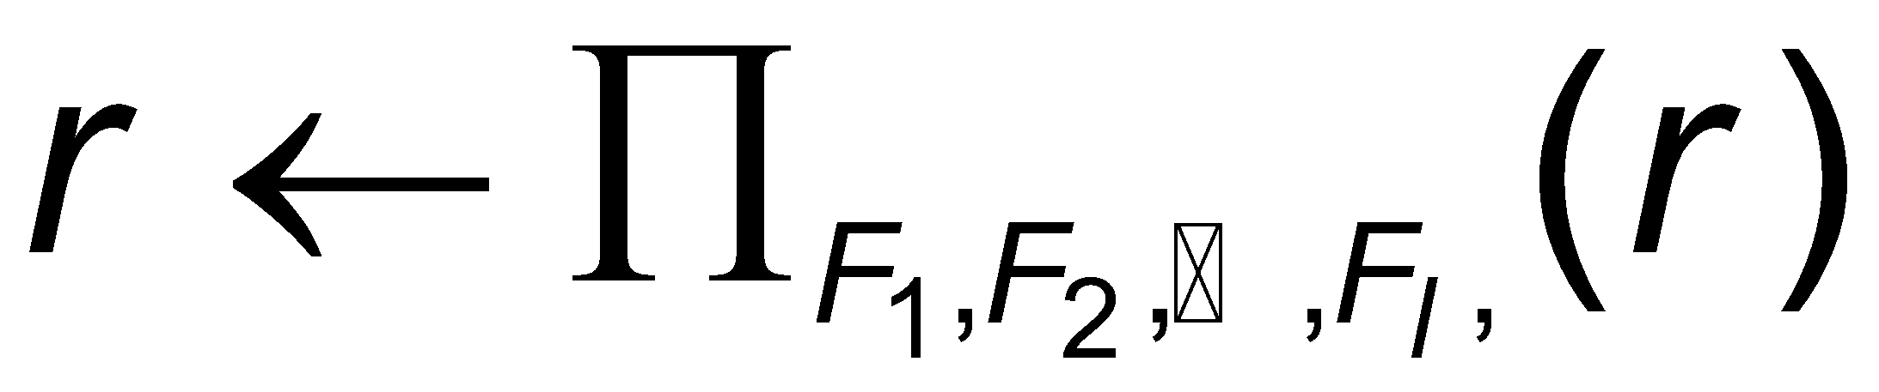
Updating
A mechanism to change a value in a tuple without changing all values in the tuple
Use the generalized projection operator to do this task
Each F_{i} is either
  the i ^{th} attribute of r, if the i^{th} attribute is not updated, or,
  if the attribute is to be updated F_{i} is an expression, involving only constants and the attributes of r, which gives the new value for the attribute

Slide 121
Update Examples
Make interest payments by increasing all balances by 5 percent.
account ← ∏ account_number, branch_name, balance * 1.05 (account)
Pay all accounts with balances over $10,000 6 percent interest
and pay all others 5 percent
account ← ∏ account_number, branch_name, balance * 1.06 (σ _{BAL > 10000} (account ))
∪ ∏ account_number, branch_name, balance * 1.05 (σ_{BAL ≤ 10000} (account))

Slide 122
Example Queries
Find the names of all customers who have a loan at the Perryridge branch.
∏_{customer-name} (σ_{branch-name=“Perryridge”}
(σborrower.loan-number = loan.loan-number(borrower x loan)))
Find the names of all customers who have a loan at the
Perryridge branch but do not have an account at any branch of the
bank.
∏_{customer-name} (σ_{branch-name = “Perryridge”}
(σborrower.loan-number = loan.loan-number(borrower x loan))) –
∏_{customer-name}(depositor)

Slide 123
Example Queries
Find the largest account balance
1. Rename account relation as d
2. The query is:
∏_{balance}(account) - ∏_{account.balance}
(σ_{account.balance < d.balance} (account x ρ_{d} (account)))

Slide 124
Example Queries
Find all customers who have an account from the “Downtown” and the Uptown” branches.
  Query 1
    ∏_{CN}(σ_{BN=“Downtown”}(depositor account)) ∩
    ∏_{CN}(σ_{BN=“Uptown”}(depositor account))
  where CN denotes customer-name and BN denotes
  branch-name.

Slide 125
Example Queries
Find all customers who have an account at all branches located in Brooklyn city.
∏_{customer-name, branch-name} (depositor account)
÷ ∏_{branch-name} (σ_{branch-city = “Brooklyn”} (branch))

Slide 126
Exercises
Works
Company
Employee(ename,str,city)
Works(ename,cname,sal)
Company(cname,city)
Manages(ename,mname)
Joe GE 30K
Mike GE 100K
Lucy GE 60K
Sean GE 40K
Carol GE 70K
Matt GE 40K
GE Cleveland
IBM NYC
Employee
Joe Pine Kent
Mike Pine Canton
Carol
Oak Kent
Matt Main Cleveland
Lucy Pine Kent
Sean Pine Kent
Manages
Joe Lucy
Mike Lucy
Carol Matt
Lucy Matt
Sean Lucy

Slide 127
Find names of employees that live in the same city and the same street as their managers
Employee Manages:
Joe Pine Kent Lucy
Mike Pine Canton Lucy
Carol Oak Kent Matt
Lucy Pine Kent Matt
Sean Pine Kent Lucy
(Employee Manages) Employee2
Where mname=employee2.ename & street =employee2.street & city=employee2.street
Joe Pine Kent Lucy Pine Kent
Mike Pine Canton Lucy Pine Kent
Carol Oak Kent Matt Main Cleveland
Lucy Pine Kent Matt Main Cleveland
Sean Pine Kent Lucy Pine Kent
Joe Pine Kent Lucy Pine Kent
Sean Pine Kent Lucy Pine Kent
Project on ename: Joe
Sean

Slide 128
Find Employees that make more than their managers
Works Manages:
Joe GE 30K Lucy
Mike GE 100K Lucy
Carol GE 70K Matt
Lucy GE 60K Matt
Sean GE 40K Lucy
(Works Manages) Works2
Where mname=works2.ename &salary >works2.salary
Joe GE 30K Lucy GE 60K
Mike GE 100K Lucy GE 60K
Carol GE 70K Matt GE 40K
Lucy GE 60K Matt GE 40K
Sean GE 40K Lucy GE 60K
Mike GE 100K Lucy GE 60K
Carol GE 70K Matt GE 40K
Lucy GE 60K Matt GE 40K
Project on ename: Mike
Carol
Lucy

Slide 129
Find all employees who make more money than any other employee
Project Works on ename: Joe
Lucy
Sean
Carol
Mike
Matt
Works Works2
Joe GE 30K Mike GE 100K
Joe GE 30K Carol GE 70K
Joe GE 30K Lucy GE 60K
Joe GE 30K Sean GE 40K
Joe GE 30K Matt GE 40K
Lucy GE 60K Carol GE 70K
Lucy GE 60K Mike GE 100K
Sean GE 40K Mike GE 100K
Sean GE 40K Carol GE 70K
Sean GE 40K Lucy GE 60K
Carol GE 70K Mike GE 100K
Matt GE 40K Mike GE 100K
Matt GE 40K Carol GE 70K
Matt GE 40K Lucy GE 60K
Where sal<works2.sal
Project on ename: Joe
Lucy
Sean
Carol
Matt
Substract from first projection the second one: Mike

Slide 130
Find all employees that live in the same city as their company
Project on ename: Matt
Works Company Employee
Cname=company.cname & ename=employee.ename & city=works.city
Matt GE 40K Cleveland Main Cleveland

Slide 131
Introduction to Database Triggers
Triggers in Databases
Triggers are special types of stored procedures in a database management system (DBMS).
They are automatically executed or fired in response to specified events or conditions occurring in the database.

Slide 132
Key Points:
Automated Actions: Triggers enable automatic execution of predefined actions when specific events occur in the database, such as INSERT, UPDATE, or DELETE operations on a table.
Event-Driven: Triggers are event-driven, meaning they are activated by certain database events, such as data modification, schema changes, or user actions.

Slide 133
Enhancing Data Integrity and Consistency: Triggers are commonly used to enforce data integrity constraints, maintain data consistency, and implement business rules within the database.

Slide 134
Types of Triggers: There are various types of triggers, including DML triggers (data manipulation language triggers) that respond to data manipulation operations, and DDL triggers (data definition language triggers) that respond to changes in the database schema.

Slide 135
CREATE TABLE main_table (
id INT PRIMARY KEY,
name VARCHAR(50),
age INT
);
CREATE TABLE log_table (
log_id INT PRIMARY KEY AUTO_INCREMENT,
action VARCHAR(50),
timestamp TIMESTAMP DEFAULT CURRENT_TIMESTAMP
);

Slide 136
DELIMITER $$
CREATE TRIGGER main_table_insert_trigger AFTER INSERT ON main_table
FOR EACH ROW
BEGIN
INSERT INTO log_table (action) VALUES ('New record inserted into main_table');
END;
$$
DELIMITER ;

Slide 137
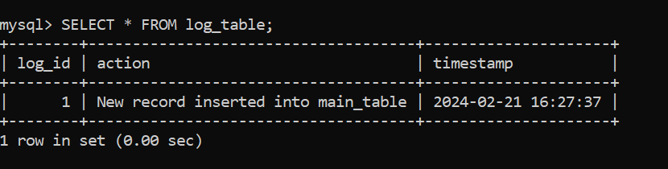
INSERT INTO main_table (id, name, age) VALUES (1, 'John', 30);
SELECT * FROM log_table;

Slide 138
Purpose: Why are triggers used in databases?
Maintaining Data Integrity: Triggers are often used to enforce referential integrity, ensuring that relationships between tables remain consistent. For example, a trigger can prevent the deletion of a parent record if it has associated child records, thus preserving data integrity.
Automating Tasks: Triggers can automate tasks or actions based on certain events or conditions. For example, a trigger might send an email notification when a new record is inserted into a table, or update related records when a certain field is modified.
Overall, triggers provide a powerful mechanism for enforcing data integrity, implementing complex business logic, automating tasks, and enhancing security within a database system.

Slide 139
Types of Triggers (e.g., DML triggers, DDL triggers)
DML Triggers (Data Manipulation Language Triggers):
INSERT Triggers: These triggers fire after an INSERT operation is performed on a table.
UPDATE Triggers: These triggers fire after an UPDATE operation is performed on a table.
DELETE Triggers: These triggers fire after a DELETE operation is performed on a table.
DDL Triggers (Data Definition Language Triggers):
CREATE Triggers: These triggers fire after a CREATE operation is performed, such as creating a table, view, or index.
ALTER Triggers: These triggers fire after an ALTER operation is performed, such as altering the structure of a table or view.
DROP Triggers: These triggers fire after a DROP operation is performed, such as dropping a table, view, or index.

