Slide 1
The Technical Evaluation and Choosing NoSQL
NoSQL Database
CS3EL17
Dr. Latika Jindal

Slide 2
Unit 2- Evaluating NoSQL
The Technical Evaluation, Choosing NoSQL
Search Features, Scaling NoSQL
Keeping Data Safe, Visualizing NoSQL
Extending Data Layer,Business Evaluation
Deploying Skills,Deciding Open Source versus commercial software
Business critical features
Security

Slide 3
Learning Objectives
Understand the key technical criteria used to evaluate NoSQL database systems.
Explain how data model fit, query patterns, and consistency requirements guide database selection.
Analyze performance benchmarking methods used to compare NoSQL systems under realistic workloads.
Evaluate operational factors, such as maintainability, community support, and ecosystem maturity, in the selection process.
Apply a structured decision framework to choose an appropriate NoSQL database for a given application scenario.
Assess the risks and trade-offs involved in migrating from a relational database to a NoSQL solution.

Slide 4
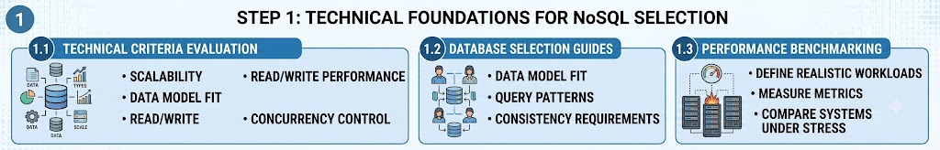
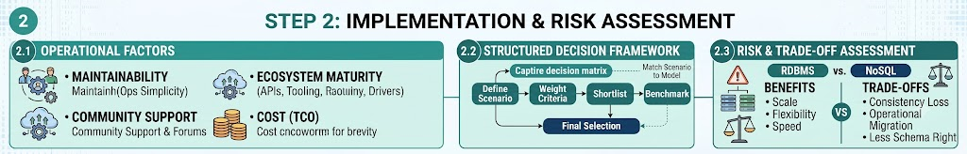
key technical criteria used to evaluate NoSQL database systems.

Slide 5
1.1 Technical Criteria Evaluation: Evaluate based on scalability, data models (Document, Key-Value, Graph, Wide-Column), and read/write performance.
1.2 Selection Guides: Match the database to specific data models, query patterns (CRUD, aggregation), and consistency needs (Strong vs. Eventual).
1.3 Performance Benchmarking: Define realistic workloads and use standardized tools like YCSB to compare systems under stress
2.1 Operational Factors: Account for maintainability, community support, ecosystem maturity, and total cost of ownership.
2.2 Structured Decision Framework: Use a logic tree to capture scenarios, weight criteria, shortlist, and benchmark for final selection.
2.3 Risk & Trade-Off Assessment: Compare RDBMS vs. NoSQL, balancing clear benefits (Scale, Flexibility, Speed) against necessary trade-offs (Consistency Loss, Operational Complexity, Migration effort).

Slide 6
Why Technical Evaluation Matters
Selecting a NoSQL database is a long-term architectural decision that significantly affects application performance, scalability, and maintainability.
Unlike relational databases, which share a common SQL foundation, NoSQL systems vary widely in data model, query language, and consistency guarantees.
A structured technical evaluation reduces the risk of costly migrations later, when an initial database choice proves poorly suited to actual workloads.
Evaluation should consider both current requirements and anticipated future growth in data volume, velocity, and complexity.
Organizations that skip rigorous evaluation often discover mismatches between database capabilities and application needs only after production deployment.

Slide 7
Key Technical Evaluation Criteria
Data model fit assesses whether key-value, document, column-family, or graph structures naturally represent the application's core entities and relationships.
Query pattern analysis examines whether the database efficiently supports the specific reads, writes, and aggregations the application requires.
Consistency and availability requirements, guided by the CAP theorem, determine whether a CP or AP-oriented system better serves the use case.
Scalability characteristics, including support for sharding, replication, and horizontal growth, must align with expected data and traffic growth.
Latency and throughput requirements, especially for real-time applications, should be tested under conditions resembling production load.

Slide 8
Benchmarking and Performance Testing
Standardized benchmarking frameworks, such as the Yahoo Cloud Serving Benchmark (YCSB), allow consistent performance comparison across NoSQL systems.
Benchmarks should test realistic workload mixes, including read-heavy, write-heavy, and mixed operation patterns relevant to the target application.
Latency percentiles, such as p95 and p99, often matter more than average latency, since they reveal worst-case performance experienced by users.
Testing under simulated node failures and network partitions reveals how a system behaves during real-world operational disruptions.
Benchmarks conducted only under ideal conditions can be misleading, since production environments introduce variability that idealized tests may miss.

Slide 9
Operational and Ecosystem Considerations
Community support, documentation quality, and the availability of skilled engineers significantly affect long-term maintainability of a chosen database.
Vendor support options, including managed cloud services, can reduce operational burden but may introduce vendor lock-in risks.
Tooling for monitoring, backup, and disaster recovery should be evaluated alongside raw database performance characteristics.
Licensing models, whether open-source, freemium, or fully commercial, directly affect total cost of ownership over time.
Integration compatibility with existing infrastructure, such as analytics pipelines and application frameworks, influences ease of adoption.

Slide 10
Real-World Example: Technical Evaluation at Pinterest
Pinterest evaluated multiple NoSQL options before selecting HBase for storing pin and board data at massive scale.
Engineers benchmarked write throughput and read latency under production-like traffic before committing to a specific column-family store.
The evaluation process included testing failover behavior to ensure the system could maintain availability during node failures.
Pinterest's engineering blog documented how community support and operational tooling maturity factored into the final decision alongside raw performance.
This case illustrates how a structured technical evaluation process, not just theoretical suitability, guided a major production database choice.

Slide 11
Real-World Example: Choosing NoSQL at Airbnb
Airbnb's engineering team evaluated document, key-value, and relational options before choosing a combination of MySQL and NoSQL systems for different services.
The decision process weighed schema flexibility needs for evolving listing data against strong consistency needs for booking and payment records.
Airbnb's evaluation explicitly considered operational maturity, choosing systems with strong community support to minimize long-term maintenance risk.
Prototype testing with production-representative data volumes helped validate assumptions about scalability before full migration.
This example demonstrates that choosing NoSQL is rarely all-or-nothing; evaluation often results in a deliberate mix of technologies matched to specific needs.

Slide 12
Building a Decision Framework for Choosing NoSQL
A structured decision framework begins by cataloging data types, access patterns, and consistency requirements across the application's core use cases.
Weighted scoring models can help teams objectively compare candidate databases across criteria such as performance, cost, and ecosystem maturity.
Proof-of-concept implementations, tested against realistic sample workloads, reduce the risk of committing to a database that underperforms in production.
Migration risk assessment should account for the cost of retraining staff, rewriting queries, and potential downtime during a transition.
Ultimately, choosing NoSQL should be driven by a documented, evidence-based evaluation process rather than by technology trends or popularity alone.

Slide 13
Summary
Technical evaluation of NoSQL databases involves assessing data model fit, query patterns, consistency needs, and scalability requirements.
Standardized benchmarks like YCSB provide objective performance comparisons, but testing should reflect realistic production conditions.
Operational factors, including community support, tooling, and licensing, are as important as raw technical performance in database selection.
Real-world cases at Pinterest and Airbnb show how structured evaluation processes guide major production database decisions.
A documented decision framework, including proof-of-concept testing, reduces the risk of costly database migrations after deployment.
Choosing NoSQL is often not a single decision but a deliberate mix of technologies matched to specific application requirements.

Slide 14
Discussion Questions
What risks might an organization face by choosing a NoSQL database based primarily on popularity rather than a structured technical evaluation?
Why might latency percentiles, such as p99, be more important than average latency when evaluating a database for a real-time application?
How should a team balance the benefits of a highly performant but operationally immature NoSQL database against a more established but slightly slower alternative?

Slide 15
References
Sadalage, P. J., & Fowler, M. (2013). NoSQL Distilled: A Brief Guide to the Emerging World of Polyglot Persistence. Addison-Wesley.
Cooper, B. F., Silberstein, A., Tam, E., Ramakrishnan, R., & Sears, R. (2010). Benchmarking Cloud Serving Systems with YCSB. Proceedings of the 1st ACM Symposium on Cloud Computing, 143-154.
Moniruzzaman, A. B. M., & Hossain, S. A. (2013). NoSQL Database: New Era of Databases for Big Data Analytics - Classification, Characteristics and Comparison. International Journal of Database Theory and Application, 6(4), 1-14.
Han, J., Haihong, E., Le, G., & Du, J. (2011). Survey on NoSQL Database. 2011 6th International Conference on Pervasive Computing and Applications, 363-366.
Stonebraker, M. (2010). SQL Databases v. NoSQL Databases. Communications of the ACM, 53(4), 10-11.

Slide 16
THANK YOU
We hope this lecture was insightful and engaging.

Slide 17
Search Features and Scaling NoSQL
NoSQL Database
CS3EL17
Dr. Latika Jindal

Slide 18
Learning Objectives
Understand the search features commonly built into or layered on top of NoSQL databases.
Explain how indexing strategies enable efficient search and retrieval in NoSQL systems.
Describe the core techniques used to scale NoSQL databases, including sharding and replication.
Analyze the trade-offs between vertical and horizontal scaling in distributed NoSQL environments.
Evaluate how load balancing and auto-scaling support NoSQL systems under variable demand.
Apply scaling and search optimization principles to design a NoSQL architecture for a high-traffic application.

Slide 19
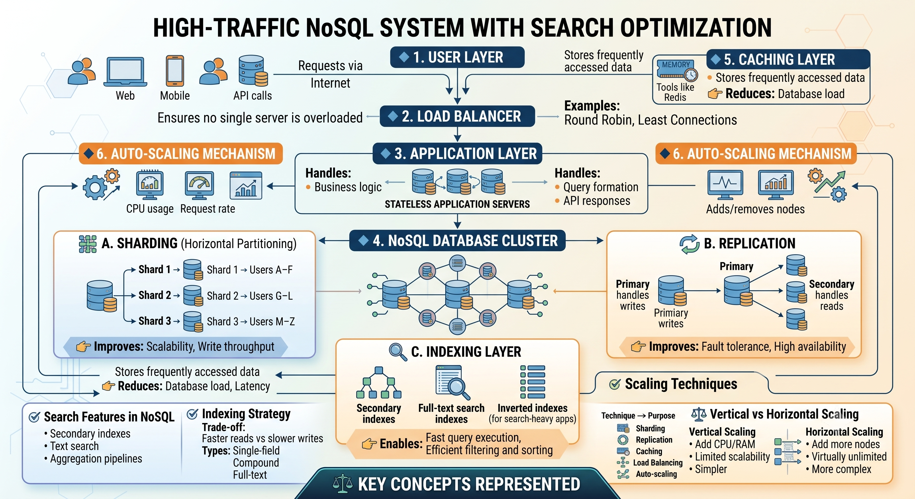

Slide 20
High-Traffic NoSQL System with Search Optimization
High-Traffic NoSQL System with Search Optimization, showcasing how data flows from a user to a distributed database cluster, along with the core scaling and indexing techniques involved.

Slide 21
The Request Flow (Top to Bottom)
1. User Layer: Multiple client types (Web apps, Mobile devices, and API calls) initiate requests that travel over the internet.
2. Load Balancer: This acts as the traffic cop. It accepts incoming requests and distributes them evenly across multiple application servers using algorithms like Round Robin or Least Connections to prevent any single server from becoming a bottleneck.
3. Application Layer: A pool of Stateless Application Servers handles the core business logic, query formation, and API responses. Because they are stateless, this layer can easily scale out (add more servers) when traffic spikes.
4. Caching Layer (Redis): Frequently accessed data is cached here. Before hitting the main database, the system checks the cache. This drastically reduces database load and lowers query latency.
5. Auto-Scaling Mechanism: This layer continuously monitors metrics like CPU usage and request rates. If traffic surges, it automatically spins up new nodes in the application and database layers; when traffic drops, it removes them to save costs.

Slide 22
The NoSQL Database Cluster (Core Architecture)
A. Sharding (Horizontal Partitioning): Instead of storing the entire database on one massive server, the data is broken up horizontally. For example, User data is split alphabetically: Shard 1 holds users A–F, Shard 2 holds G–L, and Shard 3 holds M–Z. This vastly improves write throughput and scalability.
B. Replication: To prevent data loss and ensure high availability, each shard has copies (replicas). The Primary node handles data writes, which are then copied to Secondary nodes that handle read requests. If a primary node fails, a secondary node takes over (Fault Tolerance).
C. Indexing Layer: To make searches instantaneous, the system builds specialized indexes:
Secondary Indexes: For filtering data by attributes other than the primary key.
Full-Text & Inverted Indexes: Essential for search-heavy applications (like searching for keywords within text fields) to avoid scanning the entire database.

Slide 23
Key Concepts & Trade-offs (Bottom Panels)
Search Features: Modern NoSQL systems use secondary indexes, text search capabilities, and aggregation pipelines to process complex queries efficiently.
The Indexing Trade-off: While indexes dramatically speed up reads, they slow down writes because the index must be updated every time data is modified.
Vertical vs. Horizontal Scaling:
Vertical scaling means buying a bigger machine (more CPU/RAM), which has physical limitations.
Horizontal scaling means adding more standard nodes to the cluster, offering virtually unlimited scalability but increasing architectural complexity.

Slide 24
Search Features in NoSQL Databases
Many NoSQL databases provide built-in secondary indexes, allowing efficient queries on fields beyond the primary key.
Document databases like MongoDB support compound indexes, text indexes, and geospatial indexes to accelerate diverse query types.
Full-text search capabilities, either native or via integration with engines like Elasticsearch, enable relevance-ranked search across large text fields.
Faceted search allows applications to filter and narrow results by categories, commonly used in e-commerce and content discovery platforms.
Search feature design must balance query flexibility against the performance and storage overhead introduced by additional indexes.

Slide 25
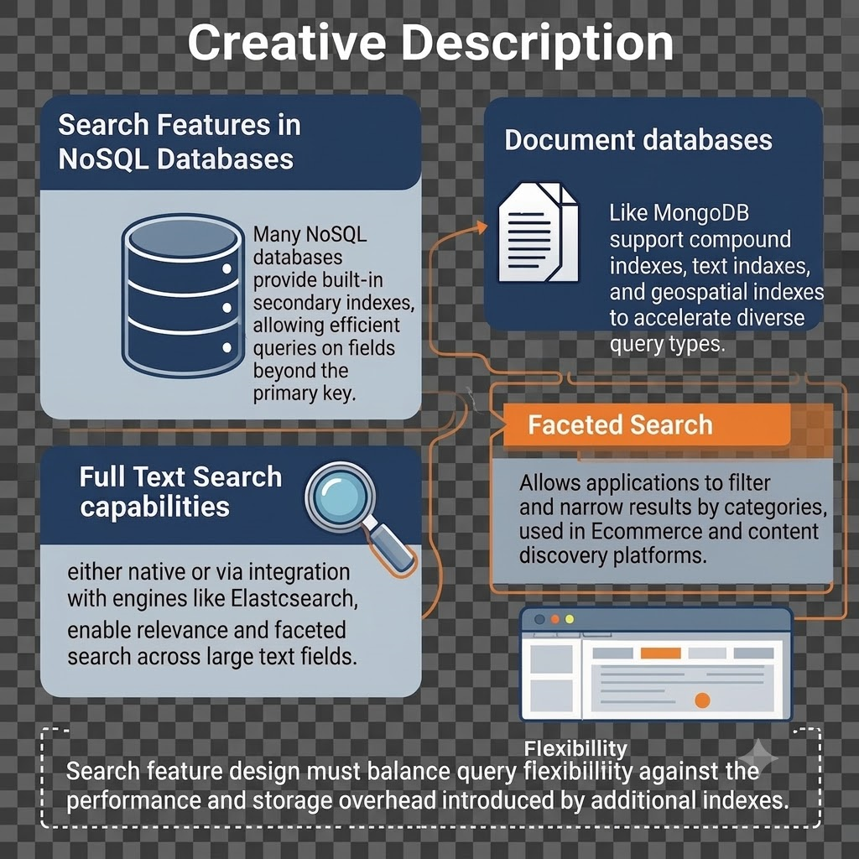

Slide 26
Indexing Strategies for Efficient Search
Primary indexes, typically based on a document or row key, provide the fastest possible lookup path in most NoSQL systems.
Secondary indexes trade additional write overhead and storage for the ability to query on non-key fields efficiently.
Composite indexes combine multiple fields, supporting queries that filter or sort on more than one attribute simultaneously.
Inverted indexes, used by search engines, map terms to documents, enabling fast full-text search across massive text collections.
Index selectivity and cardinality analysis help determine which fields benefit most from indexing without introducing excessive overhead.

Slide 27
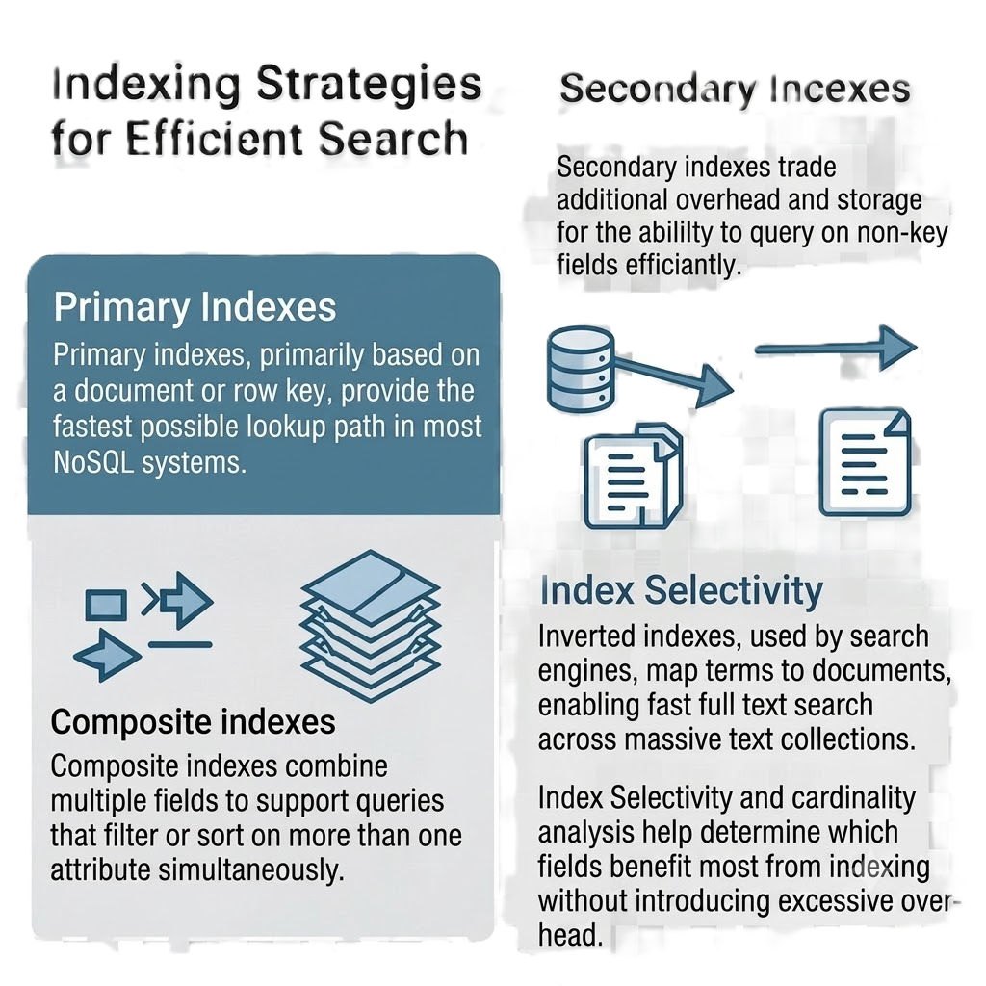

Slide 28
Core Techniques for Scaling NoSQL
Horizontal scaling, or scaling out, adds more commodity servers to a cluster, distributing data and load across many machines.
Sharding partitions data across multiple nodes based on a shard key, ensuring no single node bears the full weight of the dataset.
Replication creates multiple copies of data across nodes, improving both fault tolerance and read throughput.
Consistent hashing distributes data evenly across nodes and minimizes data movement when nodes are added or removed from the cluster.
Auto-scaling in cloud-managed NoSQL services dynamically adjusts cluster capacity in response to real-time traffic patterns.

Slide 29
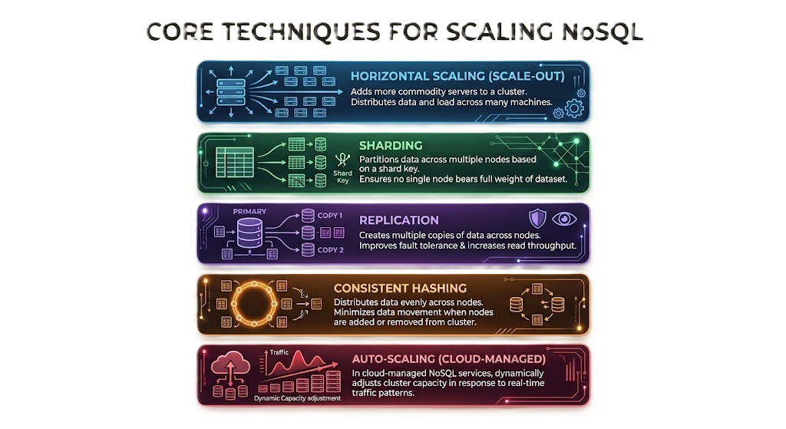

Slide 30
Vertical vs Horizontal Scaling Trade-offs
Vertical scaling increases the resources of a single server, such as CPU or memory, but eventually hits hardware and cost limitations.
Horizontal scaling distributes load across many servers, offering near-limitless growth potential but introducing distributed systems complexity.
NoSQL databases are architected from the ground up for horizontal scaling, unlike many traditional relational systems designed primarily for vertical growth.
Horizontal scaling requires careful shard key selection to avoid hotspots, where uneven data distribution overloads specific nodes.
Organizations must weigh the operational complexity of managing a distributed cluster against the scalability benefits it provides.

Slide 31
Real-World Example: Scaling Search at eBay
eBay uses a distributed search infrastructure to index hundreds of millions of active listings, enabling fast, relevance-ranked product search.
Sharding the search index across many nodes allows eBay to handle massive query volumes during peak shopping events without performance degradation.
Faceted search features let buyers filter results by price, category, and condition, improving discovery across an enormous product catalog.
Near real-time indexing ensures new listings become searchable within seconds of being posted by sellers.
This case demonstrates how search feature design and horizontal scaling work together to support a high-traffic e-commerce platform.

Slide 32
Real-World Example: Scaling NoSQL at Discord
Discord migrated its message storage to Cassandra, and later ScyllaDB, to handle trillions of messages across millions of concurrent users.
Horizontal scaling through sharding allowed Discord to distribute message storage across many nodes as its user base grew exponentially.
Consistent hashing helped minimize data rebalancing overhead as new nodes were added to the cluster during periods of rapid growth.
Discord's engineering blog detailed how replication strategies were tuned to balance read latency against write throughput for chat history.
This example illustrates how a rapidly growing platform applies core NoSQL scaling techniques to sustain performance at massive scale.

Slide 33
Advanced Topics: Combining Search and Scaling Strategies
Distributed search engines must apply the same sharding and replication principles as core NoSQL databases to scale index size and query throughput.
Load balancers distribute incoming queries across search and database nodes, preventing any single node from becoming a bottleneck.
Caching layers, such as Redis, reduce load on primary NoSQL clusters by serving frequently accessed search results or data directly from memory.
Multi-region replication introduces additional complexity in maintaining search index consistency across geographically distributed data centers.
Ongoing research explores adaptive sharding strategies that automatically rebalance data based on observed access patterns rather than static shard keys.

Slide 34
Summary
NoSQL search features rely on secondary, composite, and inverted indexes to enable efficient, flexible querying beyond simple key lookups.
Scaling NoSQL databases primarily relies on horizontal techniques, including sharding, replication, and consistent hashing.
Vertical scaling offers simplicity but hits hardware limits, while horizontal scaling provides near-limitless growth at the cost of added complexity.
Real-world platforms like eBay and Discord demonstrate how search and scaling strategies combine to support massive, high-traffic systems.
Auto-scaling and load balancing help NoSQL systems adapt dynamically to variable traffic without manual intervention.
Effective NoSQL architecture requires jointly optimizing search indexing strategy and horizontal scaling techniques for the target workload.

Slide 35
Discussion Questions
Why do NoSQL databases generally favor horizontal scaling over vertical scaling, and what challenges does this introduce?
How does shard key selection influence the risk of creating hotspots in a horizontally scaled NoSQL cluster?
In what ways might a caching layer, such as Redis, reduce the load on a primary NoSQL database and its associated search index?

Slide 36
References
Sadalage, P. J., & Fowler, M. (2013). NoSQL Distilled: A Brief Guide to the Emerging World of Polyglot Persistence. Addison-Wesley.
DeCandia, G., Hastorun, D., Jampani, M., et al. (2007). Dynamo: Amazon's Highly Available Key-value Store. Proceedings of the 21st ACM SIGOPS Symposium on Operating Systems Principles.
Gormley, C., & Tong, Z. (2015). Elasticsearch: The Definitive Guide. O'Reilly Media.
Lakshman, A., & Malik, P. (2010). Cassandra: A Decentralized Structured Storage System. ACM SIGOPS Operating Systems Review, 44(2), 35-40.
Karger, D., Lehman, E., Leighton, T., et al. (1997). Consistent Hashing and Random Trees: Distributed Caching Protocols for Relieving Hot Spots on the World Wide Web. Proceedings of the 29th Annual ACM Symposium on Theory of Computing, 654-663.

Slide 37
THANK YOU
We hope this lecture was insightful and engaging.

Slide 38
Keeping Data Safe and Visualizing NoSQL
NoSQL Database
CS3EL17
Dr. Latika Jindal

Slide 39
Learning Objectives
Understand the core strategies used to keep data safe within distributed NoSQL environments.
Explain how replication, backups, and disaster recovery protect against data loss and downtime.
Describe common security threats facing NoSQL databases and the mechanisms used to mitigate them.
Analyze the role of data visualization tools in understanding and monitoring NoSQL database performance.
Evaluate techniques for visualizing complex data structures, such as graphs and document hierarchies.
Apply data safety and visualization principles to design a well-monitored, resilient NoSQL deployment.

Slide 40
Foundations of Data Safety in NoSQL
Data safety in distributed NoSQL systems involves protecting against node failures, data corruption, and unauthorized access simultaneously.
Replication creates multiple copies of data across nodes or data centers, ensuring availability even if individual nodes fail.
Regular backups, whether full or incremental, provide a recovery path in cases where replication alone cannot prevent data loss, such as accidental deletion.
Disaster recovery planning defines procedures and recovery time objectives for restoring service after major outages or catastrophic failures.
Data safety strategies must be tested regularly through simulated failure scenarios to confirm recovery procedures work as intended.

Slide 41
Replication Strategies and Fault Tolerance
Master-slave replication designates one primary node for writes, with changes propagated to secondary replicas for read scaling and redundancy.
Multi-master replication allows writes to multiple nodes simultaneously, improving availability but requiring conflict resolution mechanisms.
Cross-region replication protects against data center-level outages by maintaining copies of data in geographically separate locations.
Quorum-based replication requires a minimum number of nodes to acknowledge a write before it is considered successful, balancing consistency and durability.
Replication factor, the number of copies maintained for each piece of data, directly influences the trade-off between storage cost and fault tolerance.

Slide 42
Security Considerations for NoSQL Databases
Authentication and role-based access control restrict which users and applications can read or modify specific data within a NoSQL cluster.
Encryption at rest protects stored data from unauthorized access if physical storage media is compromised or stolen.
Encryption in transit, typically using TLS, protects data as it moves between application servers and the database cluster.
Injection attacks, while different from traditional SQL injection, remain a risk in NoSQL systems through improperly sanitized query parameters.
Auditing and logging mechanisms track access patterns, helping detect unauthorized activity and supporting regulatory compliance requirements.

Slide 43
Visualizing NoSQL Data and Performance
Monitoring dashboards, such as those built with Grafana or Prometheus, visualize cluster health metrics like latency, throughput, and node status.
Graph visualization tools, such as Neo4j Bloom, render nodes and relationships visually, making complex connected data easier to explore and understand.
Document structure visualizers help developers inspect nested JSON hierarchies without manually parsing raw data.
Heatmaps and time-series charts reveal patterns in read and write activity, helping identify hotspots or capacity planning needs.
Effective visualization transforms raw operational metrics into actionable insights for database administrators and application developers.

Slide 44
Real-World Example: Data Safety at Netflix
Netflix replicates Cassandra data across multiple AWS regions, ensuring service continuity even if an entire region experiences an outage.
The company's Chaos Monkey tool deliberately introduces failures into production systems to continuously test the resilience of its data safety mechanisms.
Automated backup and recovery pipelines allow Netflix to restore data quickly in the rare event that replication alone cannot prevent data loss.
Access control policies restrict which internal services can read or modify sensitive subscriber and billing data.
This case illustrates how proactive failure testing and multi-region replication combine to keep data safe at massive operational scale.

Slide 45
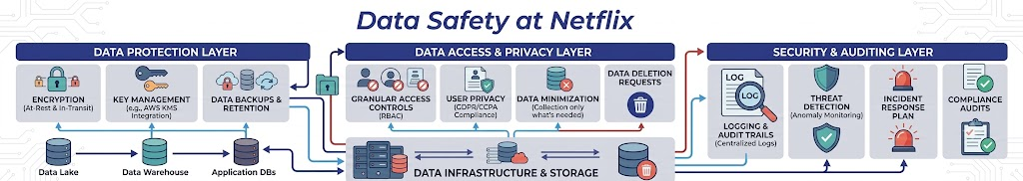

Slide 46
Real-World Example: Visualizing Graph Data at LinkedIn
LinkedIn uses graph visualization tools internally to help engineers explore and debug its professional network's connection data.
Visual representations of nodes and edges make it easier to identify anomalies, such as unexpected clusters or disconnected components in the graph.
Dashboards tracking query latency and node health allow LinkedIn's operations teams to proactively identify performance degradation before it affects users.
Interactive visualizations help both engineers and non-technical stakeholders understand how features like 'People You May Know' traverse the underlying graph.
This example shows how visualization tools support both operational monitoring and deeper understanding of complex, connected NoSQL data.

Slide 47
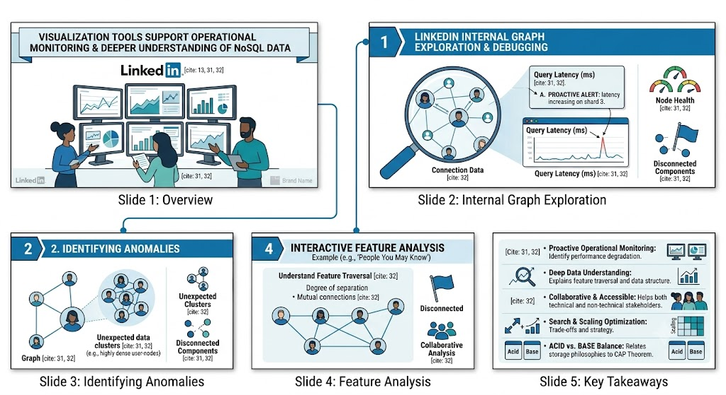

Slide 48
Advanced Topics: Emerging Practices in Data Safety and Visualization
Immutable backup strategies, including write-once storage, help protect against ransomware attacks that target and encrypt live database backups.
Zero-trust security models increasingly apply to NoSQL deployments, requiring continuous verification rather than relying solely on network perimeter defenses.
Real-time visualization pipelines increasingly incorporate anomaly detection, automatically flagging unusual data access or performance patterns.
Interactive, browser-based visualization tools are making complex graph and document data more accessible to non-technical business stakeholders.
Ongoing research explores automated, AI-assisted monitoring systems that predict potential data safety issues before they cause outages.

Slide 49
Summary
Data safety in NoSQL systems relies on a combination of replication, regular backups, and tested disaster recovery procedures.
Security practices, including authentication, encryption, and auditing, protect NoSQL databases from unauthorized access and data breaches.
Visualization tools transform raw metrics and complex data structures into actionable insights for developers and administrators.
Graph and document visualizers make it easier to understand and debug highly connected or deeply nested NoSQL data.
Real-world examples from Netflix and LinkedIn demonstrate how data safety and visualization practices operate together at scale.
Emerging practices, such as immutable backups and AI-assisted monitoring, continue to strengthen data safety and observability in NoSQL systems.

Slide 50
Discussion Questions
How does quorum-based replication balance the trade-off between write durability and system availability in a distributed NoSQL cluster?
Why might graph visualization tools be particularly valuable for debugging and understanding data in a graph database compared to raw query output?
What role does proactive failure testing, such as Netflix's Chaos Monkey, play in ensuring the long-term reliability of a data safety strategy?

Slide 51
References
Sadalage, P. J., & Fowler, M. (2013). NoSQL Distilled: A Brief Guide to the Emerging World of Polyglot Persistence. Addison-Wesley.
DeCandia, G., Hastorun, D., Jampani, M., et al. (2007). Dynamo: Amazon's Highly Available Key-value Store. Proceedings of the 21st ACM SIGOPS Symposium on Operating Systems Principles.
Robinson, I., Webber, J., & Eifrem, E. (2015). Graph Databases: New Opportunities for Connected Data (2nd ed.). O'Reilly Media.
Basiri, A., Behnam, N., de Rooij, R., et al. (2016). Chaos Engineering. IEEE Software, 33(3), 35-41.
OWASP Foundation. (2024). NoSQL Injection Prevention Cheat Sheet. https://cheatsheetseries.owasp.org/

Slide 52
THANK YOU
We hope this lecture was insightful and engaging.

Slide 53
Extending the Data Layer and Business Evaluation of NoSQL
NoSQL Database
CS3EL17
Dr. Latika Jindal

Slide 54
Learning Objectives
Understand the concept of extending the data layer beyond a single NoSQL database to support complex applications.
Explain how caching, event streaming, and API layers augment core NoSQL database functionality.
Describe how microservices architectures interact with and extend distributed data layers.
Analyze the business criteria used to evaluate the return on investment of adopting NoSQL technology.
Evaluate the total cost of ownership considerations involved in extending and maintaining a NoSQL-based data layer.
Apply business evaluation frameworks to justify data layer architecture decisions to non-technical stakeholders.

Slide 55
What It Means to Extend the Data Layer
Extending the data layer refers to augmenting a core NoSQL database with additional components that enhance its capabilities beyond basic storage and retrieval.
As applications grow in complexity, a single database rarely satisfies every requirement for caching, search, analytics, and event processing.
Extended data layers often combine a primary NoSQL store with caching systems, message queues, and search indexes working together.
This layered approach allows each component to specialize in what it does best, rather than forcing one database to handle every workload.
Designing an extended data layer requires careful attention to data synchronization and consistency across the additional components.

Slide 56
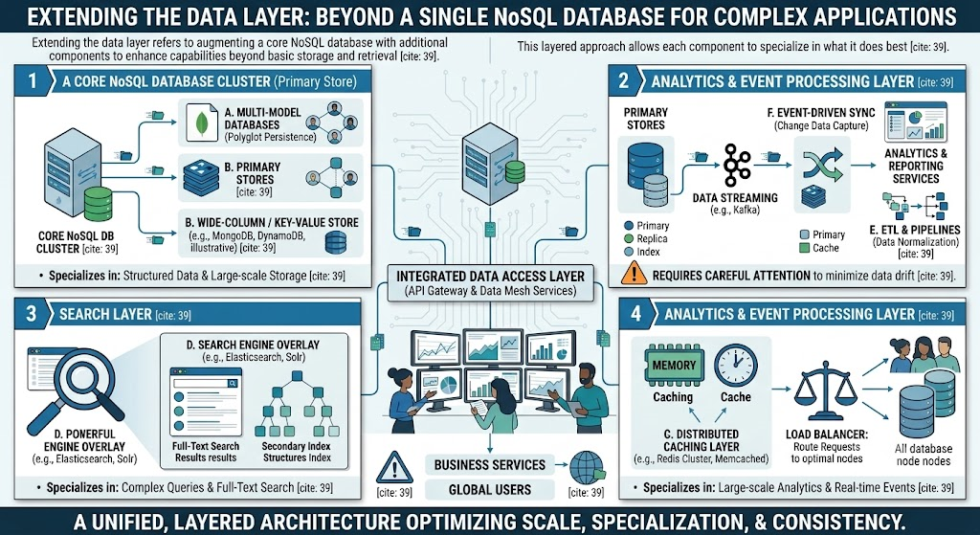

Slide 57
Caching and Event Streaming Layers
In-memory caching systems, such as Redis or Memcached, reduce load on primary NoSQL databases by serving frequently accessed data with minimal latency.
Cache invalidation strategies, such as time-to-live expiration or write-through caching, keep cached data reasonably synchronized with the underlying database.
Event streaming platforms, such as Apache Kafka, capture changes to data as a continuous stream, enabling real-time processing and integration across services.
Change data capture (CDC) pipelines propagate updates from a NoSQL database to downstream systems, such as search indexes or analytics platforms.
Together, caching and streaming layers transform a single NoSQL database into a responsive, real-time data ecosystem supporting multiple application needs.

Slide 58
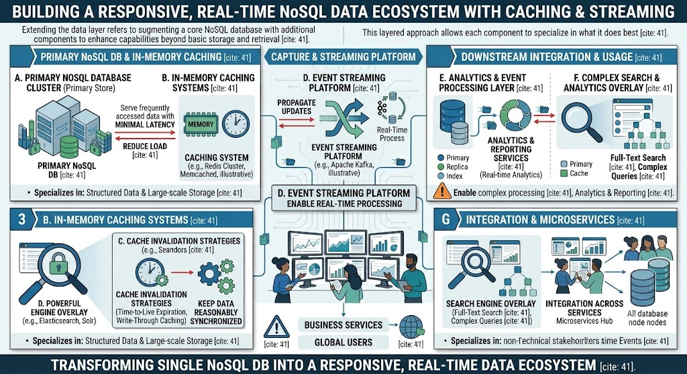

Slide 59
Microservices and the Extended Data Layer
In microservices architectures, each service often owns its own data store, extending the overall data layer across multiple specialized NoSQL databases.
API gateways and data access layers abstract the complexity of multiple underlying databases from client applications.
Service-to-service communication, often via events or APIs, replaces direct database JOINs, extending data relationships across service boundaries.
This distributed approach increases architectural flexibility but requires careful handling of eventual consistency across services.
Extending the data layer in a microservices context demands strong governance to prevent duplicated or conflicting data across services.

Slide 60
Business Evaluation of NoSQL Adoption
Business evaluation of NoSQL adoption should quantify expected benefits, such as reduced infrastructure costs, faster development cycles, and improved scalability.
Total cost of ownership analysis must include licensing, infrastructure, staffing, training, and ongoing operational expenses, not just initial setup costs.
Return on investment calculations should weigh migration costs against long-term savings and revenue opportunities enabled by improved performance.
Risk assessment should consider vendor lock-in, talent availability, and the maturity of the chosen NoSQL ecosystem.
Business stakeholders typically require evaluation results translated into concrete metrics, such as reduced downtime or faster time-to-market for new features.

Slide 61
Real-World Example: Extending the Data Layer at Twitter
Twitter extended its data layer by combining Manhattan, its distributed key-value store, with caching layers and real-time event streaming for timeline delivery.
Caching frequently accessed timeline data significantly reduced load on the core distributed database during high-traffic events.
Event streaming pipelines propagate new tweets in real time to followers' timelines, extending the data layer beyond simple database reads and writes.
This layered architecture allows Twitter to serve billions of timeline requests daily while maintaining acceptable latency for users.
This case illustrates how extending a core NoSQL data layer with caching and streaming components enables massive real-time scale.

Slide 62
Real-World Example: Business Evaluation at Capital One
Capital One conducted a formal business evaluation before migrating select workloads from relational databases to NoSQL and cloud-native data platforms.
The evaluation weighed regulatory compliance requirements against the scalability and cost benefits of adopting distributed NoSQL technologies.
Total cost of ownership analysis included staff retraining costs alongside projected infrastructure savings from moving to open-source, horizontally scalable systems.
Business stakeholders required documented evidence of improved system resilience before approving the migration of customer-facing services.
This example demonstrates how formal business evaluation processes, not just technical merit, drive major NoSQL adoption decisions in regulated industries.

Slide 63
Advanced Topics: Justifying and Governing Extended Data Layers
Data mesh architectures propose treating each extended data domain as a product, with clear ownership and quality standards across the organization.
Governance frameworks increasingly define standards for schema evolution, access control, and data quality across extended, multi-component data layers.
Cost monitoring tools help organizations track the ongoing expense of maintaining caching, streaming, and search components alongside core NoSQL databases.
Business evaluation increasingly incorporates sustainability metrics, such as energy efficiency, alongside traditional cost and performance criteria.
As data layers grow more complex, organizations increasingly rely on cross-functional evaluation teams combining technical, financial, and business expertise.

Slide 64
Summary
Extending the data layer involves augmenting a core NoSQL database with caching, event streaming, and search components to meet complex application needs.
Microservices architectures often extend the data layer across multiple specialized databases, each owned by an individual service.
Business evaluation of NoSQL adoption requires analyzing total cost of ownership, return on investment, and associated risks like vendor lock-in.
Real-world cases at Twitter and Capital One show how extended data layers and formal business evaluation processes support large-scale, real-world decisions.
Effective governance is essential when extending data layers, to maintain consistency and data quality across multiple integrated components.
Ultimately, both technical design and business justification must align to support a sustainable, extended NoSQL data architecture.

Slide 65
Discussion Questions
What risks does an organization take on when extending its data layer with multiple specialized components, such as caching and event streaming, rather than a single database?
How should a business evaluation process weigh regulatory compliance requirements against the scalability benefits of adopting a NoSQL solution?
Why might total cost of ownership analysis for NoSQL adoption need to include staff retraining costs, not just infrastructure expenses?

Slide 66
References
Sadalage, P. J., & Fowler, M. (2013). NoSQL Distilled: A Brief Guide to the Emerging World of Polyglot Persistence. Addison-Wesley.
Kleppmann, M. (2017). Designing Data-Intensive Applications. O'Reilly Media.
Newman, S. (2021). Building Microservices: Designing Fine-Grained Systems (2nd ed.). O'Reilly Media.
Dehghani, Z. (2022). Data Mesh: Delivering Data-Driven Value at Scale. O'Reilly Media.
Apache Software Foundation. (2024). Apache Kafka Documentation. https://kafka.apache.org/documentation/

Slide 67
THANK YOU
We hope this lecture was insightful and engaging.

Slide 68
Deploying Skills and Deciding Open Source versus Commercial Software
NoSQL Database
CS3EL17
Dr. Latika Jindal

Slide 69
Learning Objectives
Understand the skill sets required to successfully deploy and operate NoSQL database systems in production.
Explain the roles of database administrators, developers, and site reliability engineers in NoSQL deployments.
Describe the key differences between open source and commercial NoSQL database offerings.
Analyze the trade-offs organizations face when choosing between open source and commercial NoSQL solutions.
Evaluate licensing models, support structures, and community ecosystems as decision-making criteria.
Apply a structured framework to decide between open source and commercial NoSQL options for a given organizational context.

Slide 70
Skills Required for Deploying NoSQL Systems
Successful NoSQL deployment requires a combination of database administration, distributed systems knowledge, and application development expertise.
Database administrators must understand cluster configuration, replication setup, and performance tuning specific to the chosen NoSQL technology.
Developers need familiarity with the query language and data modeling patterns appropriate to the selected data model, such as document or graph structures.
Site reliability engineers focus on monitoring, alerting, and incident response to maintain uptime and performance in production environments.
Cross-functional collaboration between these roles is essential, since NoSQL deployment decisions affect both application design and operational stability.

Slide 71
Building Organizational NoSQL Expertise
Organizations often invest in formal training programs or certifications to build internal expertise in specific NoSQL technologies.
Hiring experienced NoSQL engineers accelerates deployment but can be challenging given the relative scarcity of specialized distributed systems talent.
Internal knowledge-sharing practices, such as documentation and post-incident reviews, help teams build institutional expertise over time.
Vendor-provided training and managed service options can supplement internal skills, particularly during initial adoption phases.
A skills gap analysis before deployment helps organizations identify where additional training or hiring is needed to support a successful rollout.

Slide 72
Open Source NoSQL: Characteristics and Considerations
Open source NoSQL databases, such as Apache Cassandra and MongoDB Community Edition, are freely available and can be modified to suit specific needs.
Open source projects benefit from community-driven innovation, with contributions from a broad base of developers and organizations worldwide.
Support for open source systems often relies on community forums, documentation, and optionally paid third-party support contracts.
Organizations adopting open source software assume greater responsibility for operational management, security patching, and troubleshooting.
Open source licensing, such as Apache 2.0 or various source-available licenses, affects how freely the software can be modified, redistributed, or commercially used.

Slide 73
Commercial NoSQL: Characteristics and Considerations
Commercial NoSQL offerings, such as MongoDB Atlas or Amazon DynamoDB, provide managed services with guaranteed support and service level agreements.
Commercial vendors typically handle operational tasks like patching, scaling, and backups, reducing the burden on internal engineering teams.
Licensing costs for commercial software or managed services must be weighed against the reduced operational overhead they provide.
Vendor lock-in is a key risk with commercial offerings, particularly when proprietary APIs or extensions are used extensively.
Commercial support agreements often include guaranteed response times for critical issues, which can be valuable for mission-critical applications.

Slide 74
Real-World Example: Deploying Skills at Airbnb
Airbnb invested heavily in internal training programs to build expertise in operating its self-managed MySQL and NoSQL infrastructure at scale.
The company established dedicated platform engineering teams responsible for database reliability, freeing application developers to focus on product features.
Airbnb's engineering blog documents how internal tooling and runbooks were developed to standardize incident response across its data infrastructure.
This investment in skills and tooling allowed Airbnb to manage complex, large-scale database operations without relying entirely on external vendors.
This case illustrates how deliberate investment in deployment skills directly supports an organization's ability to operate NoSQL systems reliably at scale.

Slide 75
Real-World Example: Open Source vs Commercial at a Growing Startup
Many early-stage startups begin with open source NoSQL databases, such as self-hosted MongoDB or Cassandra, to minimize initial licensing costs.
As the startup grows, operational complexity often prompts a transition to commercial managed services, such as MongoDB Atlas, to reduce staffing requirements.
This shift trades increased licensing and service costs for reduced operational burden, allowing smaller engineering teams to focus on product development.
Decision points typically include factors such as available in-house expertise, growth rate, and the criticality of guaranteed uptime service level agreements.
This pattern, common across many technology companies, illustrates how the open source versus commercial decision often evolves as an organization matures.

Slide 76
Advanced Topics: Hybrid Strategies and Future Considerations
Many organizations adopt hybrid strategies, using open source software for non-critical workloads and commercial managed services for mission-critical systems.
Multi-cloud and cloud-agnostic deployment strategies can reduce vendor lock-in risk associated with proprietary commercial NoSQL offerings.
Total cost of ownership modeling should account for the full lifecycle cost of skills development, not just software licensing fees.
Emerging source-available licensing models attempt to balance open collaboration with sustainable commercial revenue for NoSQL vendors.
Organizations increasingly evaluate open source versus commercial decisions on a per-workload basis rather than adopting a single organization-wide policy.

Slide 77
Summary
Successfully deploying NoSQL systems requires coordinated skills across database administration, application development, and site reliability engineering.
Organizations build NoSQL expertise through training, hiring, internal documentation, and vendor-provided resources.
Open source NoSQL databases offer flexibility and lower upfront costs but require greater internal operational responsibility.
Commercial NoSQL offerings provide managed operations and guaranteed support, often at higher licensing or subscription cost.
Real-world examples from Airbnb and growing startups show how skills investment and open source versus commercial decisions evolve with organizational maturity.
Many organizations adopt hybrid strategies, selecting open source or commercial solutions on a workload-by-workload basis rather than a single blanket policy.

Slide 78
Discussion Questions
What organizational factors would most strongly influence a company's decision to invest in internal NoSQL deployment skills versus relying on a commercial managed service?
How does vendor lock-in risk differ between adopting an open source NoSQL database and a proprietary commercial offering?
In what circumstances might a hybrid strategy, combining open source and commercial NoSQL solutions, be more appropriate than committing entirely to one approach?

Slide 79
References
Sadalage, P. J., & Fowler, M. (2013). NoSQL Distilled: A Brief Guide to the Emerging World of Polyglot Persistence. Addison-Wesley.
Kleppmann, M. (2017). Designing Data-Intensive Applications. O'Reilly Media.
Rosen, L. (2004). Open Source Licensing: Software Freedom and Intellectual Property Law. Prentice Hall.
MongoDB, Inc. (2024). MongoDB Community vs Enterprise vs Atlas. https://www.mongodb.com/products
Apache Software Foundation. (2024). Apache License, Version 2.0. https://www.apache.org/licenses/LICENSE-2.0

Slide 80
THANK YOU
We hope this lecture was insightful and engaging.

Slide 81
Business Critical Features of NoSQL Databases
NoSQL Database
CS3EL17
Instructor: Dr. Latika Jindal

Slide 82
Learning Objectives
Understand what constitutes a business critical feature in the context of NoSQL database selection.
Explain how high availability and fault tolerance protect mission-critical business operations.
Describe the role of disaster recovery and backup features in maintaining business continuity.
Analyze how performance guarantees and service level agreements support business critical applications.
Evaluate security and compliance features required for handling sensitive business data.
Apply an assessment framework to identify which business critical features matter most for a given application.

Slide 83
Defining Business Critical Features
Business critical features are database capabilities whose failure would directly disrupt core operations, revenue, or regulatory compliance.
These features extend beyond basic performance to include reliability, security, and operational guarantees that protect the business as a whole.
Not every feature is equally critical; organizations must prioritize based on the specific risks facing their application and industry.
Business critical evaluation requires input from both technical teams and business stakeholders to align priorities with organizational risk tolerance.
Identifying these features early in the database selection process prevents costly gaps from surfacing only after a production incident.

Slide 84
High Availability and Fault Tolerance
High availability ensures a database remains accessible and operational even when individual components, such as servers or network links, fail.
Replication across multiple nodes and data centers protects against single points of failure that could otherwise halt business operations.
Automatic failover mechanisms detect node failures and redirect traffic to healthy replicas without requiring manual intervention.
Uptime service level agreements, often expressed as a percentage such as 99.99 percent, quantify the availability guarantees a business can expect.
For businesses like e-commerce platforms, even brief downtime can translate directly into significant lost revenue, making availability a top priority.

Slide 85
Disaster Recovery and Business Continuity
Disaster recovery planning defines how quickly and completely a business can restore data and service after a catastrophic failure or outage.
Recovery point objective (RPO) specifies the maximum acceptable amount of data loss, measured in time, following an incident.
Recovery time objective (RTO) specifies the maximum acceptable duration of downtime before service must be restored.
Geographically distributed backups protect against regional disasters that could otherwise destroy both primary and local backup data simultaneously.
Regular disaster recovery testing validates that documented procedures actually achieve the RPO and RTO targets required by the business.

Slide 86
Performance Guarantees and Service Level Agreements
Business critical applications often require guaranteed latency thresholds, ensuring consistent user experience even under heavy load.
Service level agreements formalize performance and availability commitments between a database vendor and the business relying on it.
Auto-scaling capabilities help maintain performance guarantees during unexpected traffic spikes, such as flash sales or viral events.
Monitoring and alerting systems provide early warning when performance metrics approach thresholds that could violate business commitments.
Penalties or credits within SLAs incentivize vendors to maintain the performance and availability levels businesses depend on.

Slide 87
Real-World Example: Business Critical Availability at Amazon
Amazon's DynamoDB was designed from the outset to guarantee high availability for the shopping cart service, since downtime directly impacts sales.
Multi-region replication ensures that even a full regional outage does not prevent customers in other regions from completing purchases.
Amazon's internal service level objectives prioritize availability over strict consistency, reflecting the direct business cost of cart failures.
Automatic failover and self-healing infrastructure minimize the need for manual intervention during infrastructure failures.
This case demonstrates how a business critical requirement, never losing a sale due to downtime, directly shaped core database design decisions.

Slide 88
Real-World Example: Compliance and Security at a Financial Services Firm
Financial services organizations require NoSQL databases to support strict access controls and detailed audit logging to meet regulatory requirements.
Encryption at rest and in transit is mandatory for protecting sensitive customer financial data from unauthorized access or interception.
Compliance frameworks, such as PCI DSS for payment data, often dictate specific technical controls that a chosen NoSQL database must support.
Data residency requirements may mandate that certain data remain within specific geographic boundaries, influencing replication and backup design.
This example illustrates how business critical features extend beyond availability and performance to include regulatory compliance and data governance.

Slide 89
Advanced Topics: Evolving Business Critical Requirements
As businesses increasingly operate globally, multi-region active-active architectures are becoming a business critical requirement rather than an optional feature.
Zero-downtime upgrade and maintenance capabilities are increasingly essential for businesses that cannot tolerate scheduled outages.
Observability features, including detailed tracing and anomaly detection, are becoming business critical for quickly diagnosing production issues.
Emerging regulations around data privacy continue to expand the scope of what counts as a business critical compliance feature.
Organizations increasingly reassess business critical feature priorities on a regular basis as application scale and regulatory landscapes evolve.

Slide 90
Summary
Business critical features are database capabilities whose failure would directly harm core business operations, revenue, or compliance standing.
High availability and fault tolerance protect against downtime that could otherwise result in significant lost business.
Disaster recovery planning, guided by RPO and RTO targets, ensures a business can recover quickly and completely from major incidents.
Performance guarantees and service level agreements formalize the reliability commitments businesses depend on from their database vendors.
Real-world cases at Amazon and financial services firms show how availability, security, and compliance requirements directly shape database architecture.
Business critical feature priorities evolve over time and require ongoing reassessment as organizations scale and regulations change.

Slide 91
Discussion Questions
How should an organization determine which database features are truly business critical versus merely beneficial for a given application?
Why might recovery point objective and recovery time objective targets differ significantly between an e-commerce platform and an internal analytics system?
What trade-offs might a financial services firm face when balancing strict compliance requirements against the performance benefits of a less regulated NoSQL configuration?

Slide 92
References
Sadalage, P. J., & Fowler, M. (2013). NoSQL Distilled: A Brief Guide to the Emerging World of Polyglot Persistence. Addison-Wesley.
DeCandia, G., Hastorun, D., Jampani, M., et al. (2007). Dynamo: Amazon's Highly Available Key-value Store. Proceedings of the 21st ACM SIGOPS Symposium on Operating Systems Principles.
Kleppmann, M. (2017). Designing Data-Intensive Applications. O'Reilly Media.
PCI Security Standards Council. (2024). Payment Card Industry Data Security Standard (PCI DSS) Requirements and Testing Procedures.
Vogels, W. (2009). Eventually Consistent. Communications of the ACM, 52(1), 40-44.

Slide 93
THANK YOU
We hope this lecture was insightful and engaging.

Slide 94
Security in NoSQL Databases
NoSQL Database
CS3EL17
Instructor: Dr. Latika Jindal

Slide 95
Learning Objectives
Understand the unique security challenges introduced by the distributed nature of NoSQL databases.
Explain authentication and authorization mechanisms used to control access to NoSQL systems.
Describe encryption techniques used to protect data at rest and in transit within NoSQL environments.
Analyze common attack vectors targeting NoSQL databases, including injection and misconfiguration risks.
Evaluate auditing and monitoring practices used to detect and respond to security incidents.
Apply security best practices to design a hardened NoSQL deployment for a production environment.

Slide 96
Security Challenges Unique to NoSQL
The distributed architecture of NoSQL databases introduces a larger attack surface, spanning multiple nodes, data centers, and network links.
Many early NoSQL systems were designed with a focus on performance and scalability, sometimes leaving security as a secondary consideration.
Default configurations in some NoSQL databases historically lacked authentication, leaving publicly exposed instances vulnerable to unauthorized access.
Schema-less data models can complicate consistent application of field-level security policies compared to structured relational tables.
Securing a NoSQL deployment requires attention to network security, application-level controls, and the database configuration itself simultaneously.

Slide 97
Authentication and Authorization
Authentication verifies the identity of users or applications attempting to connect to a NoSQL database, typically through credentials or certificates.
Role-based access control (RBAC) assigns permissions based on defined roles, limiting users to only the actions necessary for their function.
Attribute-based access control extends RBAC by granting permissions based on dynamic attributes, such as time of access or data sensitivity level.
Integration with centralized identity providers, such as LDAP or OAuth systems, simplifies consistent authentication across an organization's infrastructure.
Principle of least privilege should guide authorization design, ensuring users and services have only the minimum access required to perform their tasks.

Slide 98
Encryption and Data Protection
Encryption at rest protects stored data files from unauthorized access in the event that physical storage media is compromised or stolen.
Encryption in transit, typically implemented using TLS, protects data as it travels between clients, application servers, and database nodes.
Field-level encryption allows organizations to encrypt specific sensitive fields, such as social security numbers, independently of the broader dataset.
Key management systems securely store and rotate encryption keys, reducing the risk of key compromise undermining overall data protection.
Data masking and tokenization techniques further protect sensitive information by replacing it with non-sensitive placeholders in non-production environments.

Slide 99
Common Attack Vectors and Mitigations
NoSQL injection attacks exploit improperly sanitized query parameters, similar in principle to SQL injection but targeting NoSQL query syntax.
Misconfigured databases exposed directly to the public internet without authentication have historically led to large-scale data breaches.
Denial-of-service attacks can overwhelm a NoSQL cluster's resources, disrupting availability for legitimate users and applications.
Insider threats, including misuse of legitimate credentials, require monitoring and access controls beyond simple perimeter defenses.
Regular security audits and penetration testing help identify vulnerabilities before they can be exploited by malicious actors.

Slide 100
Real-World Example: MongoDB Ransomware Attacks
In 2017, tens of thousands of publicly exposed MongoDB instances were compromised in a wave of ransomware attacks due to missing authentication.
Attackers deleted data from unprotected databases and demanded payment for its return, exposing the risks of default insecure configurations.
This incident prompted MongoDB and other NoSQL vendors to enable authentication by default in subsequent versions of their software.
The event highlighted the importance of secure default configurations rather than relying solely on administrators to enable security features manually.
This case demonstrates how a single configuration oversight, publicly exposed databases without authentication, can lead to widespread security incidents.

Slide 101
Real-World Example: Security Practices at Financial Institutions
Financial institutions deploying NoSQL databases typically implement multi-factor authentication for all administrative access to production systems.
Comprehensive audit logging tracks every data access and modification, supporting both security monitoring and regulatory compliance requirements.
Network segmentation isolates database clusters from public-facing systems, limiting the potential blast radius of a compromised application server.
Regular third-party security audits and penetration testing validate that security controls remain effective as the system evolves.
This example illustrates how regulated industries apply layered, defense-in-depth security practices to protect sensitive data in NoSQL systems.

Slide 102
Advanced Topics: Emerging Security Practices
Zero-trust architecture principles are increasingly applied to NoSQL deployments, requiring continuous verification rather than implicit trust within a network perimeter.
Automated configuration scanning tools help detect insecure default settings before databases are exposed to production traffic.
Behavioral anomaly detection uses machine learning to identify unusual access patterns that may indicate a compromised account or insider threat.
Confidential computing techniques aim to protect data even while it is being processed in memory, extending protection beyond rest and transit encryption.
As NoSQL adoption grows, security research continues to focus on standardizing best practices across the fragmented landscape of NoSQL technologies.

Slide 103
Summary
NoSQL databases face unique security challenges stemming from their distributed architecture and historically permissive default configurations.
Authentication and role-based authorization are foundational controls for restricting access to only legitimate users and applications.
Encryption at rest and in transit, along with field-level encryption, protects sensitive data from unauthorized access or interception.
NoSQL injection, misconfiguration, and denial-of-service attacks represent common threats requiring proactive mitigation strategies.
The 2017 MongoDB ransomware incidents illustrate the real-world consequences of insecure default configurations at scale.
Layered, defense-in-depth security practices, as seen in financial institutions, combine authentication, encryption, monitoring, and auditing to protect NoSQL systems.

Slide 104
Discussion Questions
What lessons from the 2017 MongoDB ransomware attacks should inform how organizations configure new NoSQL database deployments today?
How does the principle of least privilege apply differently in a schema-less NoSQL environment compared to a traditional relational database?
Why might a zero-trust security model be particularly well suited to the distributed, multi-node architecture of modern NoSQL databases?

Slide 105
References
OWASP Foundation. (2024). NoSQL Injection Prevention Cheat Sheet. https://cheatsheetseries.owasp.org/
Sadalage, P. J., & Fowler, M. (2013). NoSQL Distilled: A Brief Guide to the Emerging World of Polyglot Persistence. Addison-Wesley.
Kleppmann, M. (2017). Designing Data-Intensive Applications. O'Reilly Media.
Cimpanu, C. (2017). MongoDB Databases Hit by Massive Ransomware Attacks. Reported widely across security industry publications.
PCI Security Standards Council. (2024). Payment Card Industry Data Security Standard (PCI DSS) Requirements and Testing Procedures.

Slide 106
THANK YOU
We hope this lecture was insightful and engaging.

