Slide 1


NASA NTRS Text Analysis: Legacy Challenge 2022
By Team Neon_Hackers Madhu Raut & Vivek Kanna Jayaprakash

Slide 2
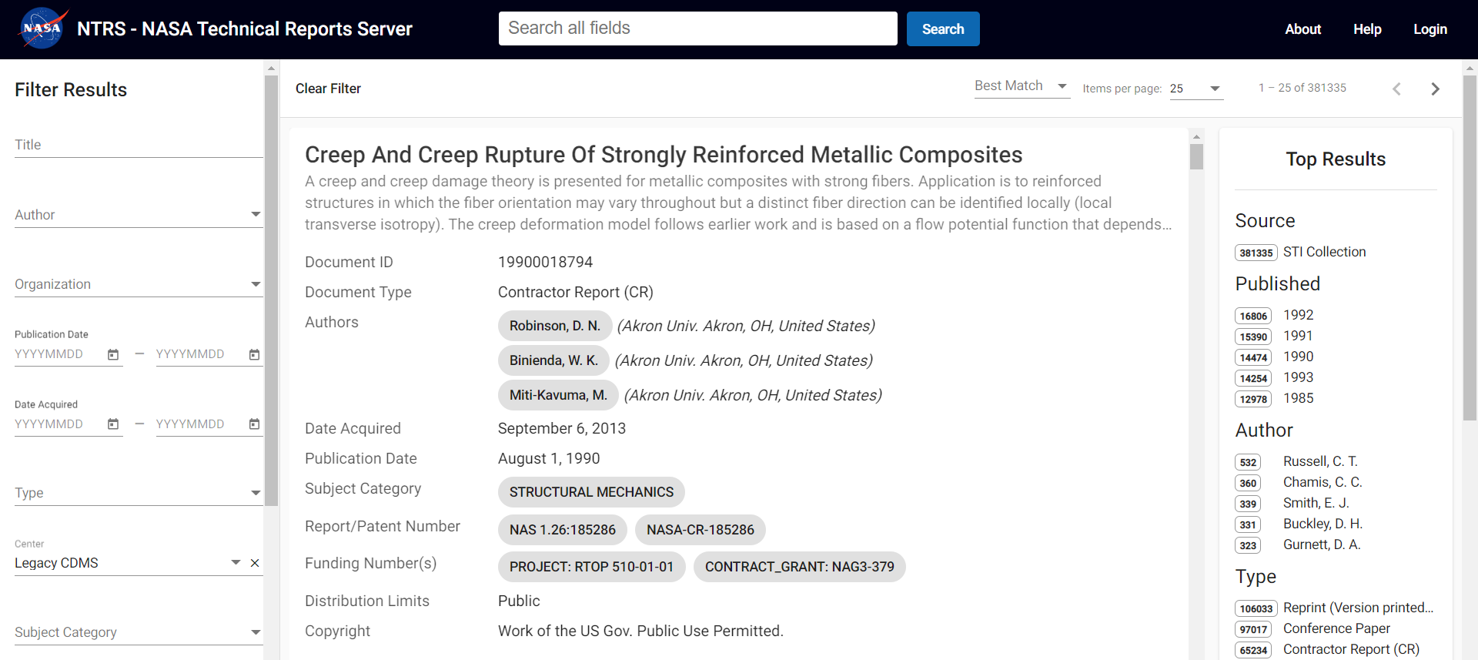
1. Downloading all the required PDFs using the NASA NTRS API

Slide 3
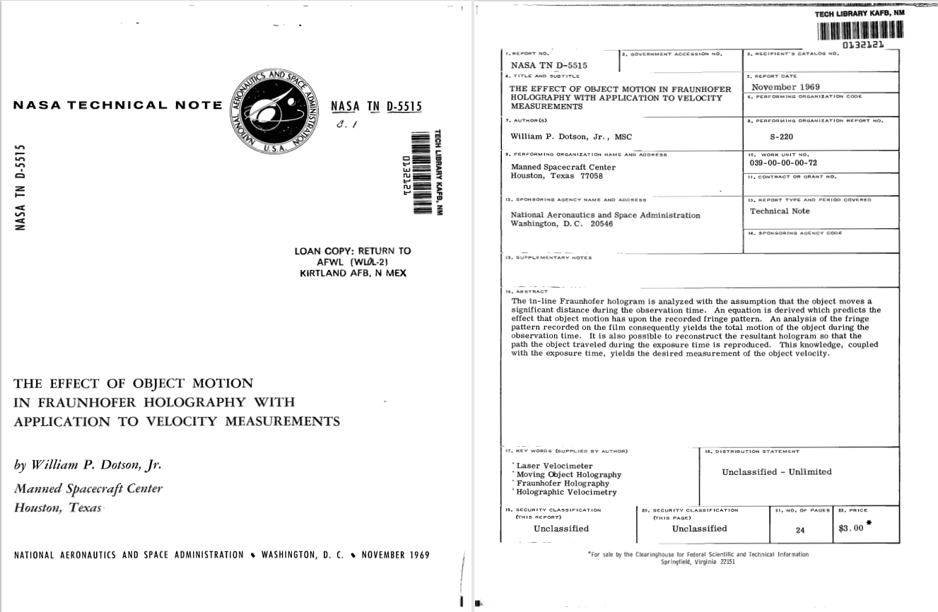
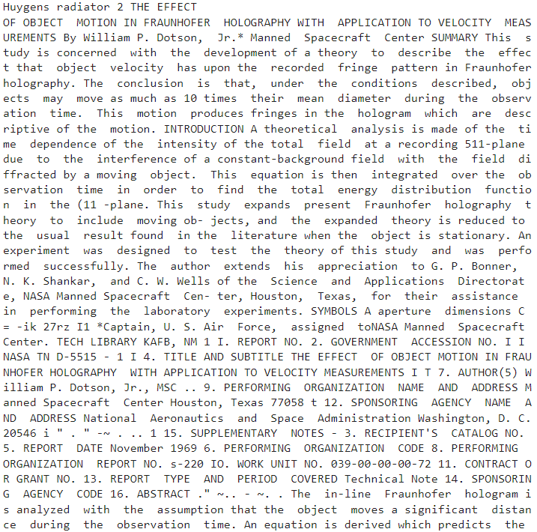
2. Extraction of text from PDFs and creating a Corpus

Slide 4
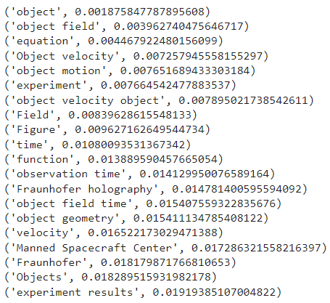
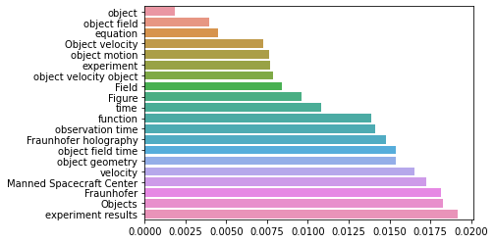
3. Keyword Extraction and Frequency Plot

Slide 5
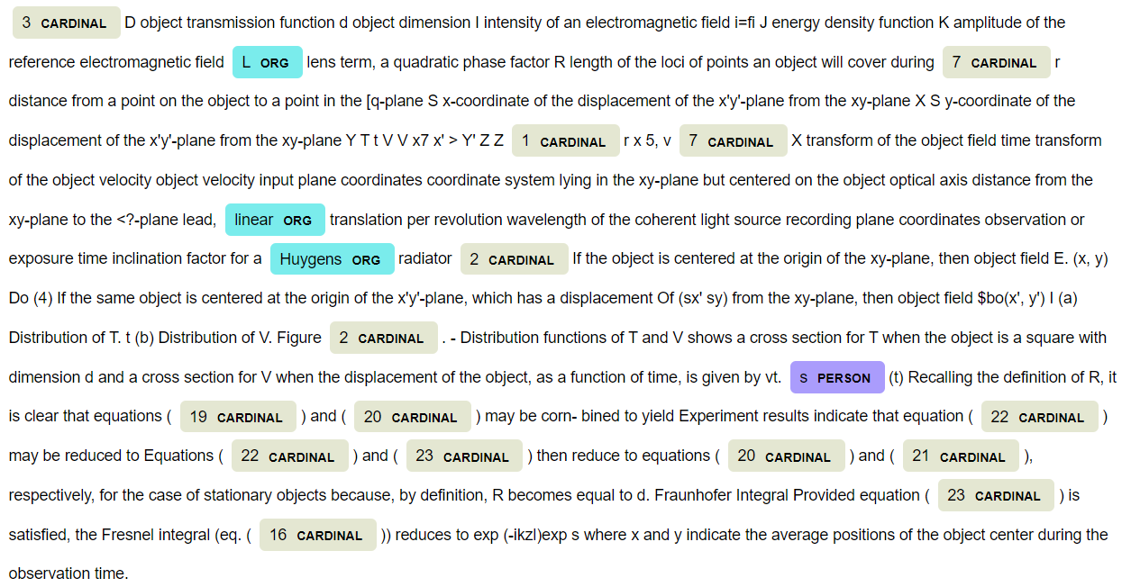
4. Document Summarization with Named Entity Recognition

Slide 6
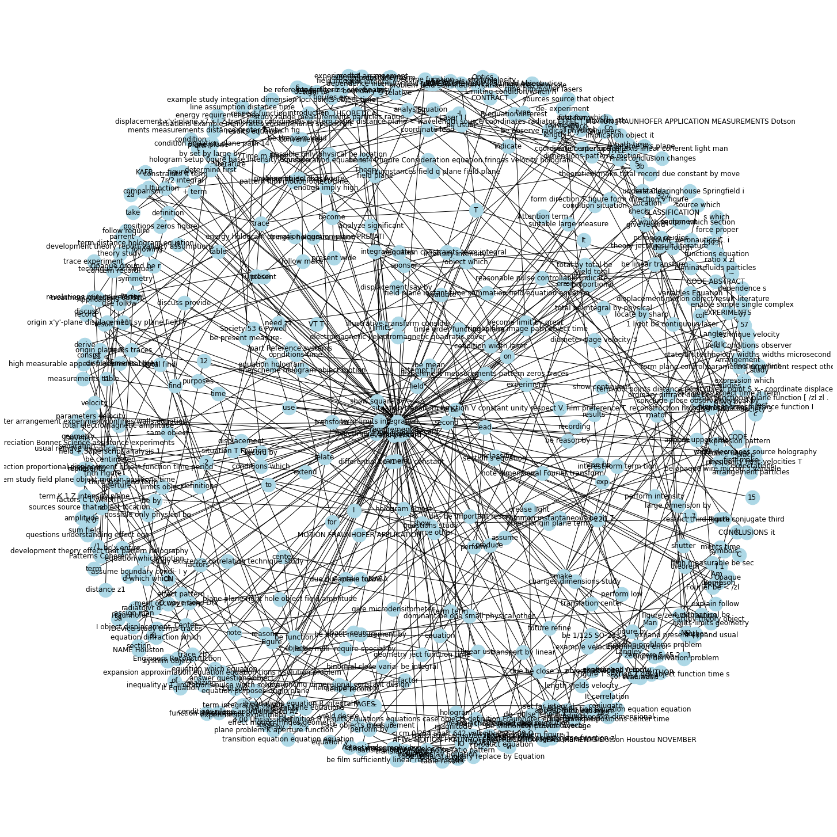
5. Knowledge Graph Construction

Slide 7
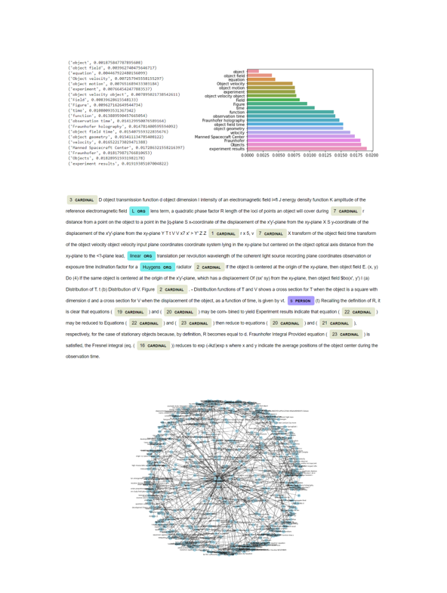
6. Report Generation with Keywords, Summary and Knowledge Graph

