Slide 1


Single page MOBILE RESPONSIVE
RESUME
A Course Based Project for Web Technology (R1UC602C)
Presented By
VIVEK DAGAR
21SCSE1410040

Slide 2
PROBLEM STATEMENT
Create a single-page, mobile-responsive resume website to address challenges in
today's job market. Traditional resumes lack interactivity and mobile optimization,
limiting visibility to employers. This project aims to offer job
seekers a dynamic platform to showcase qualifications and skills, enhancing online
presence and engagement with potential employers.
Name of the student: Vivek Dagar Program : Bachelor of Technology in Computer Science Engineering (AI)

Slide 3
Functional Requirements:
- Contact Information Section: Display individual's name prominently with social media links, email, phone number, and location.
- Education Section: List educational qualifications in reverse order with institution name, degree, study duration, and academic performance.
- Projects Section: Highlight significant projects with titles, descriptions, dates, and key features.
- Skills Section: List technical and soft skills.
- Additional Information: Include language proficiency, relevant certifications, and courses.
Non-Functional Requirements:
- Responsiveness: Ensure correct rendering on desktop, tablet, and smartphone screens.
- Usability: Ensure easy navigation with clear section headings and logical flow.
PROJECT REQUIREMENTS
Name of the student: Vivek Dagar Program : Bachelor of Technology in Computer Science Engineering (AI)

Slide 4
IMPLEMENTATION
● HTML Elements: Various HTML elements are utilized to create sections
for different components of the resume, ensuring clear and organized
Presentation.
● CSS Styling: CSS is employed to style the layout, fonts, colors, and
responsiveness of the website, adapting to different screen sizes using
media queries.
● Font Awesome Icons: Font Awesome icons are included to enhance
visual elements and provide links to social media profiles.
Source code is available at https://github.com/vivekkdagar/single-page-resume
Name of the student: Vivek Dagar Program : Bachelor of Technology in Computer Science Engineering (AI)

Slide 5
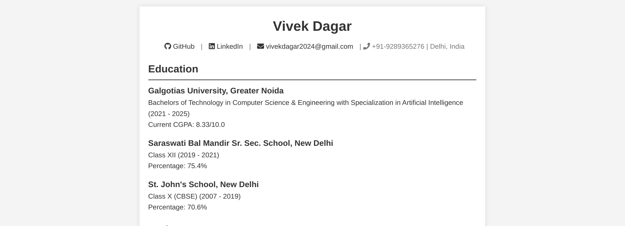
DEMO
HOSTED AT -> https://vivekkdagar.github.io/single-page-resume/
Name of the student: Vivek Dagar Program : Bachelor of Technology in Computer Science Engineering (AI)

Slide 6
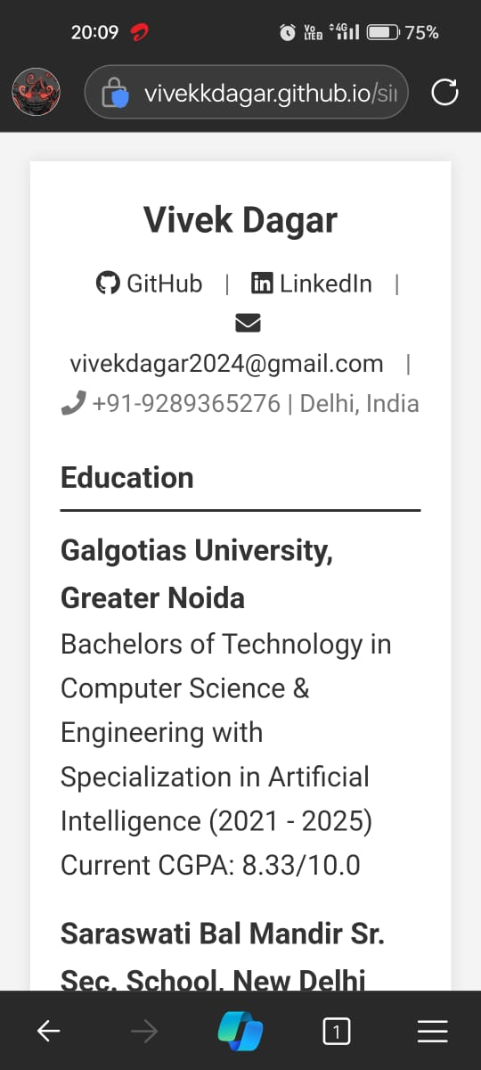
DEMO (ON MOBILE SCREEN)
Name of the student: Vivek Dagar Program : Bachelor of Technology in Computer Science Engineering (AI)

Slide 7
In summary, the creation of this single-page, mobile-responsive resume website effectively addresses challenges in today's job market. By utilizing HTML elements, CSS styling, and Font Awesome icons, we've developed a dynamic platform that enhances online visibility and engagement with potential employers. Moving forward, this project underscores the importance of innovation and technology in empowering individuals to stand out in the digital space. Thank you.
CONCLUSION
Name of the student: Vivek Dagar Program : Bachelor of Technology in Computer Science Engineering (AI)

Slide 8
THANK YOU

