Slide 1
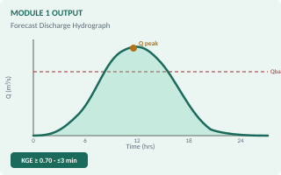
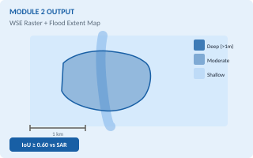
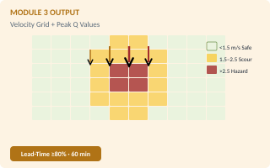
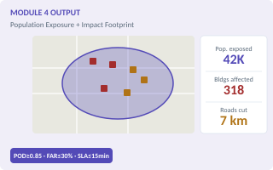
USE CASE: FLOOD HAZARD MONITORING & EARLY WARNING
EAS Layer
Hydrological & Hydraulic Modeling + AI/ML-Based Prediction
1
DATA INPUTS
2
PHYSICAL MODELING
3
PHYSICAL MODEL OUTPUTS
4
OUTPUTS & ALERTS
River Water Level Sensors
[200 Sensors]
Rainfall-Runoff & Watershed Hydrology
MODULE 1 OUTPUT · Forecast Discharge Hydrograph
FUTURE AI / ML ENHANCEMENT
Range: 0.1–30+ m
HEC-HMS (SCS-CN) / WFLOW_sbm · van Verseveld et al., 2024
LSTM Neural Networks (flood forecasting)
Normal <3m · Warning 3–5m · Danger >5m
KPI
KGE ≥ 0.70 · Run ≤3 min
Random Forest susceptibility mapping
KGE = 1−√((r−1)²+(α−1)²+(β−1)²)
MCDM-AHP risk assessment scoring
Stable:
Rainfall <50 mm · API <90th pct
Flash flood predictive model (real-time)
Rainfall Gauges (Intensity)
[200 Sensors]
Alert:
Rainfall 50–100 mm · C >0.50
FUTURE ROADMAP
Range: 0–300 mm/hr
Alarm:
Rainfall >100 mm/day · C >0.70
AI/ML integration in Phase 2 — augmenting deterministic models with predictive intelligence. Starting ~3 months post sensor data availability.
Low <20 · Moderate 20–50 · Extreme >100
River Hydraulics & Inundation Modeling
MODULE 2 OUTPUT · Flood Extent & WSE Raster
Flood Extent & Inundation Map
HEC-RAS 2D / LISFLOOD-FP · Bates et al., 2010
GeoTIFF / GeoJSON · Updated every 60 min
Population Density Data
KPI
IoU ≥ 0.60 vs Sentinel-1 SAR
Range: <5 to 10,000+ sq km
Range: 1–50,000 ppl/sq km
Shallow Water Eq. (Local Inertial form.)
Minor
Moderate
Severe
Sparse / Dense / Highly Dense
Stable:
h < h_bank · Freeboard >1.0 m
Alert:
h_bank−0.5m ≤ h < h_bank (Siaga 2)
Population & Infrastructure Exposure
Alarm:
h ≥ h_bank OR coastal backwater reversal
CSV / GeoJSON · Per-event exposure index
Building Footprints, Roads & Infrastructure
Range: 100 – millions affected
Roads, bridges, buildings
Water Discharge & Flow Velocity
MODULE 3 OUTPUT · Velocity Grid + Peak Q Values
Low
Medium
Critical
Low / Medium / High Exposure
Manning's Eq. / Kinematic Wave Routing
Forecast Discharge Hydrographs
KPI
Lead-time ≥80% alerts ≥60 min pre-peak
JSON time-series · Every 60 min at sub-basin
Q = A·R^(2/3)·S^(1/2)/n | dh/dt ≥0.10 m/15min
Range: 1 – 100,000 m³/s
Satellite Topography (UAV, DEM)
Stable:
V <1.5 m/s · Q <2-yr return
Range: 1–30m spatial res.
Alert:
1.5≤V<2.5 m/s · Q at 5-yr return
Normal
Elevated
Flood
Flat / Moderate / Steep Terrain
Alarm:
V ≥2.5 m/s OR P(Q>Q25yr)>0.8 → Siaga 1
Evacuation Safe Zone Analysis
Depth=0 zones + velocity <0.3 m/s routes
Flood Depth Simulation | Impact Footprint
MODULE 4 OUTPUT · Population & Exposure Footprint
Range: 1–20 km radius
Geospatial Exposure Intersect · WorldPop / OSM / FABDEM
Safe
Restricted
Unsafe
KPI
POD ≥0.85 · FAR ≤30% · SLA ≤15 min
Depth(x,y) = WSE(x,y) − DEM(x,y)
Pre-Disaster Warning Information
Stable:
Flood depth = 0.0 m · Zero critical assets
Pillar 1 EAS Integration
Alert:
Depth 0.1–0.3 m (genangan) · Mobility disrupted
Range: Seconds – minutes
Pillar 3
Alarm:
>0.3 m residential OR >0.1 m at vital infra
Advisory
Watch
Warning
Emergency
Pillar 1
⚠ Data Requirement Note: Large-scale historical and predictive analysis will be performed using geospatial AI and ML-based approaches integrated with satellite imagery, remote sensing, terrain data, river flow parameters, time-series data, and socio-economic datasets. | © 2026 Straive · www.straive.com
4

Slide 2
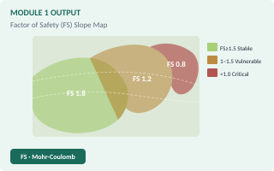
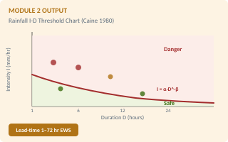
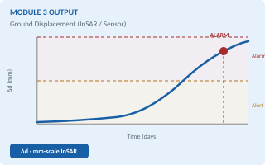
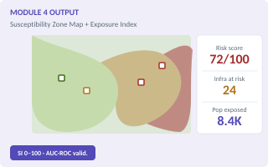
USE CASE: LANDSLIDE HAZARD MONITORING & EARLY WARNING
EAS Layer
Landslide Susceptibility Mapping + AI/ML-Based Prediction
1
DATA INPUTS
2
GEOSPATIAL MODELING
3
PHYSICAL MODEL OUTPUTS
4
OUTPUTS & ALERTS
IoT Landslide Sensors
[200 Sensors]
Geospatial Slope Stability Analysis
MODULE 1 OUTPUT · Factor of Safety (FS) Slope Map
FUTURE AI / ML ENHANCEMENT
Range: 0–500 mm displacement
Mohr-Coulomb / Janbu / Bishop · TRIGRS / SINMAP
SVM landslide susceptibility mapping
Stable / Minor Movement / Critical Shift
KPI
Factor of Safety (FS) · Range 0–3
XGBoost / Gradient Boosting classification
FS = c'+(γz cosα−u) tanφ' / γz sinα
SAR Interferometry (InSAR) displacement
Stable:
FS ≥ 1.5 · No movement detected
Rainfall I-D prediction model
SMAP Soil Moisture Data
Alert:
1.0 < FS < 1.5 · Minor movement trend
FUTURE ROADMAP
Range: 0–100% moisture
Alarm:
FS < 1.0 · Critical shift · Imminent failure
AI/ML integration in Phase 2 — augmenting deterministic models with predictive intelligence. Starting ~3 months post sensor data availability.
Dry / Saturated / Critical Saturation
Dynamic Debris & Mudflow Routing
MODULE 2 OUTPUT · Rainfall I-D Threshold Chart
Landslide Susceptibility Zone Map
FLO-2D / DebrisFlow · Rickenmann (1999)
GeoTIFF / GeoJSON · Risk index 0–100
Rainfall Data
KPI
Flow distance 0–50 km · Impact radius
Range: 0–500 mm index scale
Range: 0–350 mm/hr
V_debris = k · (S·R)^0.5 (hydraulic routing)
Low
Medium
High
Severe
Low / Moderate / Extreme Rainfall
Stable:
Flow velocity <1 m/s · Runout <5 km
Alert:
1–3 m/s velocity · Runout 5–20 km
Ground Deformation Detection
Alarm:
>3 m/s OR reaches infrastructure corridor
InSAR / Sensor · mm-scale precision
Population Density & Buildings
Range: 0–500 mm shift
Range: 1–50,000 ppl/sq km
Ground Displacement Detection
MODULE 3 OUTPUT · Ground Displacement Time-Series
Stable
Active
Failure Risk
Sparse / Dense / Highly Dense
GNSS / IoT Tiltmeter / SAR Interferometry (InSAR)
Population Exposure Analysis
KPI
Δd (mm) · Velocity deformation mm/day
CSV / GeoJSON · Per-event composite
Δd = sensor reading (mm) · v_def = Δd/Δt
Range: 100 – millions · Infra 0–1000+
Satellite Topography (UAV, DEM)
Stable:
Δd < 10 mm · No active movement
Range: 1–30m spatial res.
Alert:
10 mm ≤ Δd < 50 mm · Active trend
Low
Medium
Critical
Flat / Moderate / Steep Terrain
Alarm:
Δd ≥ 50 mm OR rapid acceleration
Road Blockage + Debris Flow Map
Debris flow reach 45–100+ km
Susceptibility Mapping & Risk Scoring
MODULE 4 OUTPUT · Susceptibility Zone + Exposure Map
Range: 0–1000+ assets affected
Slope & Terrain Curvature Data
DEM Derivation + Curvature · SHALSTAB / SINMAP
Accessible
High Risk
Blocked
Range: 0–80° slope
KPI
SI 0–100 · Multi-factor composite score
Stable / Vulnerable / Critical
SI = f(slope, soil, Ksat, rainfall, aspect)
Early Warning & Emergency Priority
Stable:
Risk score 0–30 · Low susceptibility
Seconds – minutes · 1–20 km evac radius
Alert:
Score 30–70 · Vulnerable zone
Shelter: 0–100% occupancy
Pillar 3
Alarm:
Score >70 · Critical · Evacuation buffer
Advisory
Watch
Warning
Emergency
Pillar 1
⚠ Data Requirement Note: Large-scale landslide hazard assessment will be performed using geospatial AI and slope stability modeling integrated with satellite imagery, remote sensing, terrain morphology, soil moisture, rainfall data, and other geospatial datasets. | © 2026 Straive · www.straive.com
5

