Slide 1
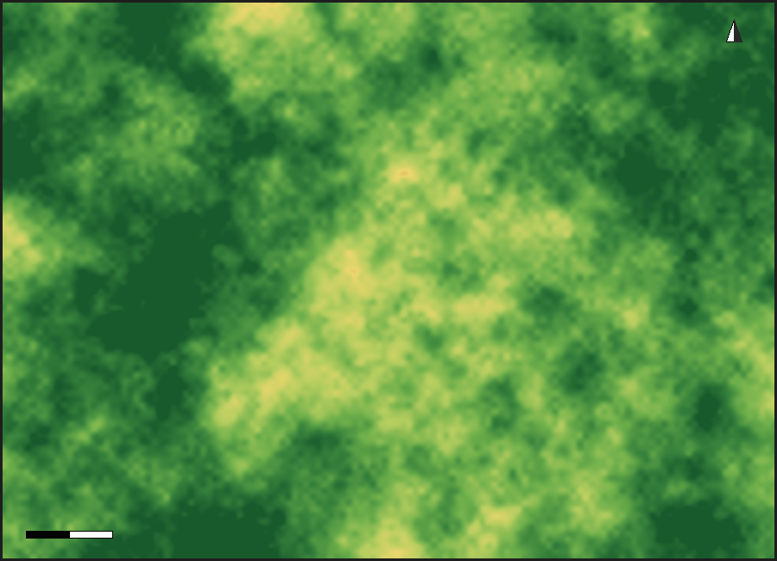
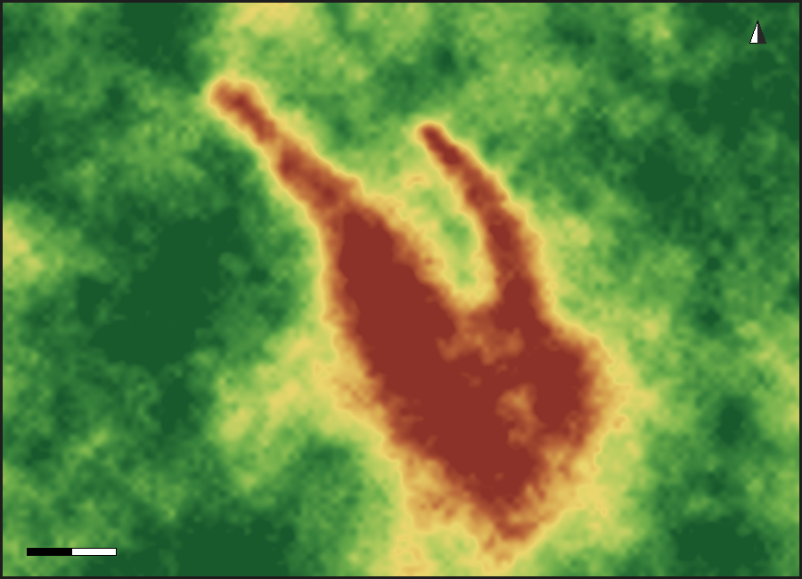
FLOOD • LANDSLIDE
NDVI Loss: Vegetation Stripped by Debris Flow
Sentinel-2 NDVI comparison reveals the spatial footprint of vegetation lost when intense rainfall triggered a hillslope failure and debris flow.
KEY FINDINGS
BEFORE — Mar 2024
AFTER — Aug 2024
86,000 m²
of land mass displaced along the debris-flow corridor
~8 km
length of vegetation scar from source to deposition fan
DRIVERS
Extreme short-duration rainfall
Steep, saturated forest slopes
Loss of root cohesion & soil anchoring
Dense canopy, NDVI ≈ 0.75–0.85
Bare scar exposed, NDVI drops below 0.1
NDVI
Bare / Loss
Sparse
Moderate
Dense vegetation
Reference scenario based on Wayanad, Kerala (Jul 2024) — debris flow ~8 km, ~86,000 m² area displaced. Methodology: Sentinel-2 NDVI change detection.

