Slide 1
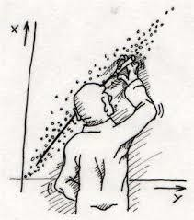
Regression Modelling

Slide 2
Interesting Hypothesis
•Vegetarians miss fewer flights.
•Women use camera phone more than men.
•Left handed men earn more money!
•Smokers are better sales people.
•Those who whistle at work place are more efficient.

Slide 3
Regression enables us to test few of these Hypotheses

Slide 4
What is Regression?
Regression is a tool for finding existence of an association relationship between a dependent
variable (Y) and one or more independent variables(X1,X2,…,Xn) in a study.
The relationship can be linear or non-linear.
Mathematical relationship is an exact relationship.
Y = β0+ β1X
Statistical relationship is not an exact relationship.
Y = β0+ β1X + e
(This is the Population Regression Function)

Slide 5
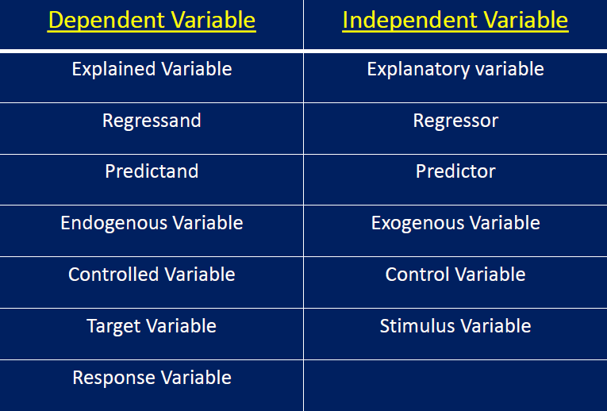
Regression Nomenclatures

Slide 6
Dependent and Independent Variables
Terms dependent and independent does not necessarily imply a causal relationship between two variables.
Regression is not designed to capture causality.
Purpose of regression is to predict the value of dependent variable given the value(s) of independent variable(s).

Slide 7
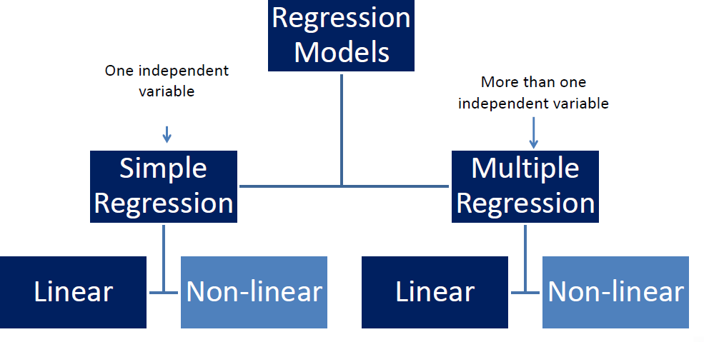
Types of Regression

Slide 8
Types of Linear Regression
Simple Linear Regression: Y=B₀ +B₁ X + e
Multiple Linear Regression: Y=B₀ +B₁ X + B₂ X₁ + B₃ X₂ + …….+ B_{k} X_{k} +e

Slide 9
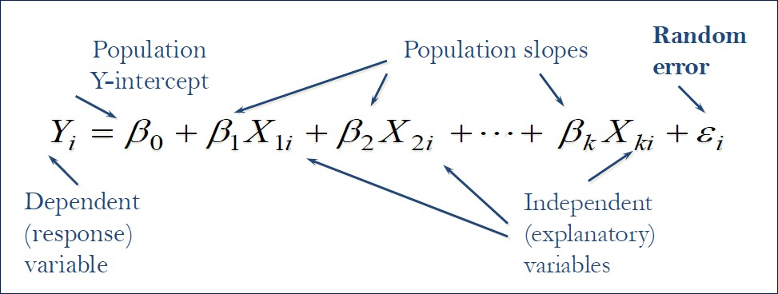
Multiple Linear Regression Model (MLRM)
Relationship between 1 dependent & 2 or more independent variables is a linear function.

Slide 10
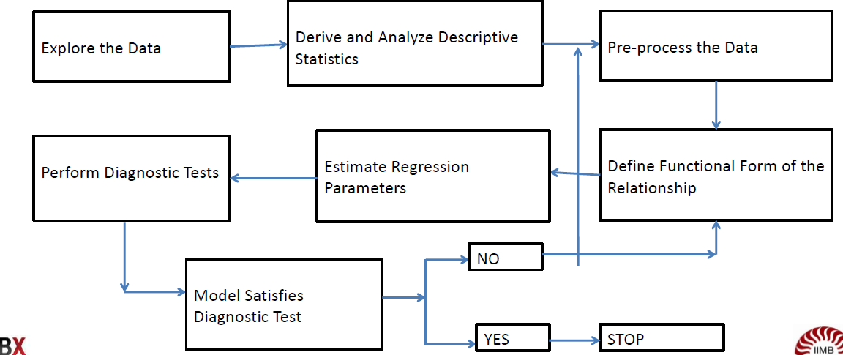
MLRM Development Prcoess

Slide 11

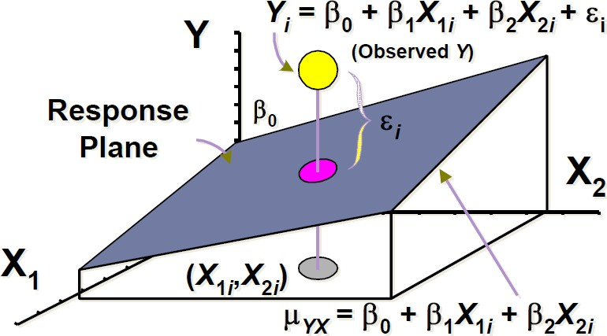
MLRM Prediction Equation

Slide 12
MLRM Model Assumptions
The error term, e_{i}, follows a normal distribution.
For different values of X, the variance of e_{i} is constant(Homoscedasticity).
There is no Multi-collinearity (no perfect linear relationship among explanatory variables).
There is no autocorrelation between two e_{i} values.

Slide 13
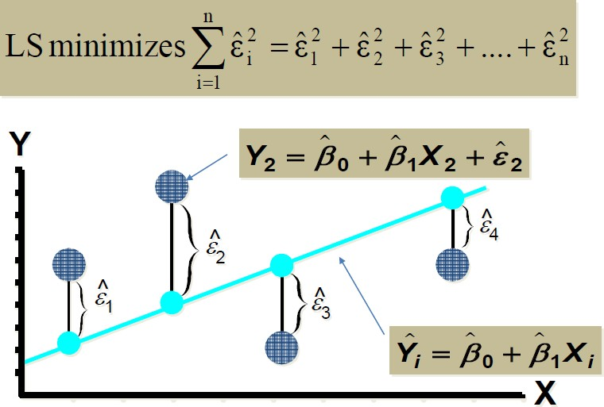
MLRM Methodology
Ordinary Least Square (OLS) Methodology, minimizes the sum of square of errors.

Slide 14
Interpretation of MLRM Coefficients
The intercept,0, is the mean value of the dependent variable Y, when the independent
variable X=0
The slope, Bi, is the change in the value of the dependent variable, Y, for unit change in the independent variable Xi, keeping all other Xs constant (controlled).

Slide 15
MLRM Model Diagnostics
Test for overall model fitness (R-Square and Adjusted R-Square)
Test for overall model statistical significance (F test test)
Test for statistical significance of individual explanatory variables (t test)
Test for Normality and Homoscedasticity of residuals
Test for Multi-collinearity and Auto Correlation

Slide 16
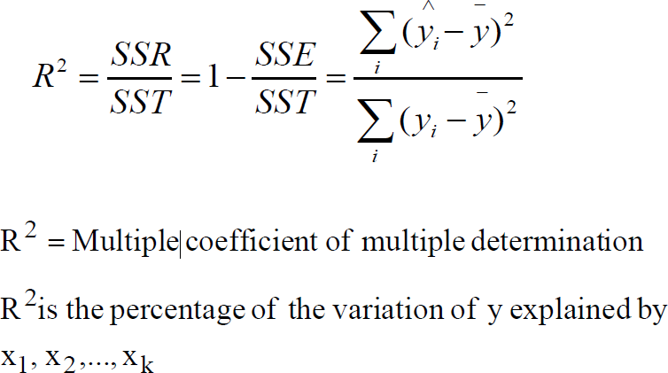
Test for overall Model Fitness:
Coefficient of Multiple Determination R²
R Square ranges from 0 to 1

Slide 17
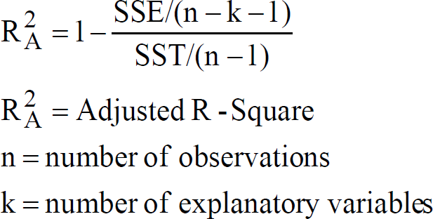
Test for overall Model Fitness: Adjusted R²
Inclusion of additional explanatory variables will increase the R² value
By introducing an additional explanatory variable, we increase the numerator of the expression for R2 while the denominator remains the same.
To correct this defect, we adjust the R2 by taking into account the degrees of freedom

Slide 18
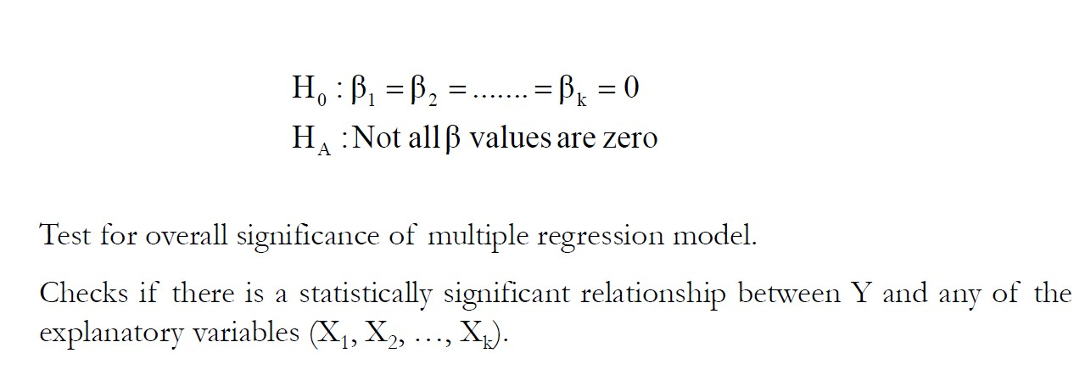
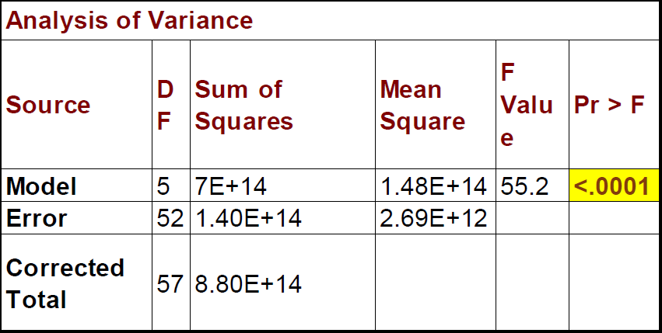
Test for overall Model Significance: F-Test

Slide 19
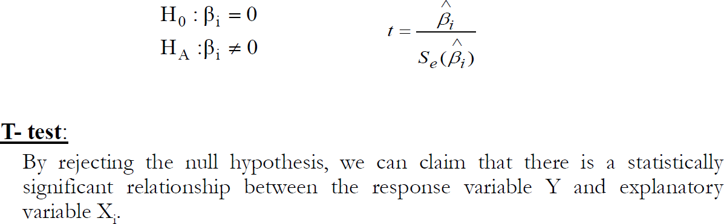
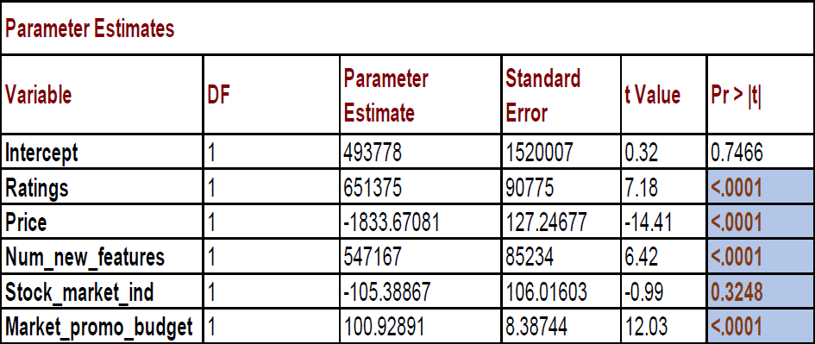
Test for individual explanatory variables (t-test)

Slide 20
Test for Normality and Homoscedasticity of Residuals
Normality: The errors should be normally distributed, we test for normality of residuals and the p-value should be more than 0.05 (we accept Ho)
Test: Anderson-Darling (AD) Test, Shapiro-Wilk normality test
Homoscedasticity: At each level of the predictor variables, the variance of the residual term should be constant and the p-value should be more than 0.05 (we accept Ho)
Test: Breusch-Pagan Test, Cook-Weisberg Test

Slide 21
Test for Multicollinearity
Multicollinearity: High correlation between explanatory variables is called Multi-collinearity
- Test: Variance Inflation Factor (VIF), is a relative increase in variance in S.E. of beta because of collinearity , VIF should be less than 1.7. To reduce the Multicollinearity, one of the ideal measures is to drop the variable causing multi-collinearity

Slide 22
Test for Auto-Correlation
Auto Correlation: For any two observations of Yi, error terms should be not correlated
- Test: Durbin Watson Test, test statistic ranges from 0-4. When DW=2, no auto-correlation exists. Values away from 2, show that auto-correlation exists.

Slide 23

Mean Absolute Percentage Error (MAPE)
The mean absolute percentage error (MAPE), also known as mean absolute percentage deviation (MAPD), is a measure of prediction accuracy of a forecasting method in statistics. For example, if the MAPE is 5, on average, the forecast is off by 5%. The equation is:
where y_{t} equals the actual value,
equals the fitted value, and n equals the number of observations.

Slide 24
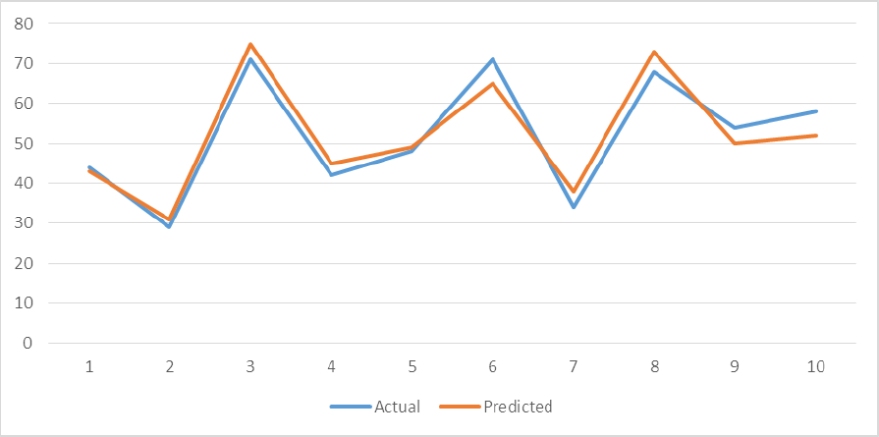
Actual Vs Predicted

Slide 25
Thank You

