Slide 1
Watsonx ElderCare AI Assistant
Enhancing Quality of Life for the Elderly with AI
Team : Bits & Bytes

Slide 2

Project Overview
The Watsonx ElderCare AI Assistant is a voice-activated AI system designed to enhance the quality of life for elderly individuals, particularly those with cognitive impairments. It provides personalized support to ensure safety, comfort, and mental stimulation.

Slide 3



Key Features: Assistance and Support
Voice Interaction: Simple and intuitive voice commands for seamless interaction. Text-to-Speech (TTS) for reading out information, reminders, and notifications.
Reminders and Alerts: Timely alerts for medication schedules and dosages. Notifications for appointments, social activities, and important dates. Assistance with daily routines, including meal times and exercise.
Emergency Assistance: Quick access to emergency services and designated family members. Integration with health devices to monitor vital signs and alert caregivers.

Slide 4



Key Features: Personalization and Connectivity
COGNITIVE SUPPORT: HELPS RECALL PERSONAL INFORMATION, RECENT ACTIVITIES, AND FREQUENTLY ASKED QUESTIONS. ENGAGES USERS WITH BRAIN GAMES AND ACTIVITIES TO STIMULATE COGNITIVE FUNCTIONS.
PERSONALIZED INTERACTION: TAILORS INTERACTIONS BASED ON INDIVIDUAL PREFERENCES AND NEEDS.ADAPTS TO THE USER’S BEHAVIOR AND PREFERENCES OVER TIME.
SOCIAL CONNECTIVITY: FACILITATES VIDEO COMMUNICATION WITH FAMILY AND FRIENDS. KEEPS USERS INFORMED ABOUT LOCAL SOCIAL EVENTS AND ACTIVITIES.

Slide 5


Key Features: Interaction and Reminders
Health and Wellness Monitoring: Monitors physical activity and suggests appropriate exercises. Provides nutritional advice and meal planning support.
Environmental Control: Controls smart home devices for a safer and more comfortable living environment.

Slide 6
Innovation and Impact
The Watsonx ElderCare AI Assistant simplifies daily tasks, provides emotional support, cognitive stimulation, and social connectivity. It fosters independence and enhances the well-being of elderly users, revolutionizing senior care. Its adaptive learning capabilities ensure it evolves with the user's needs, making it a reliable companion for the aging population.

Slide 7
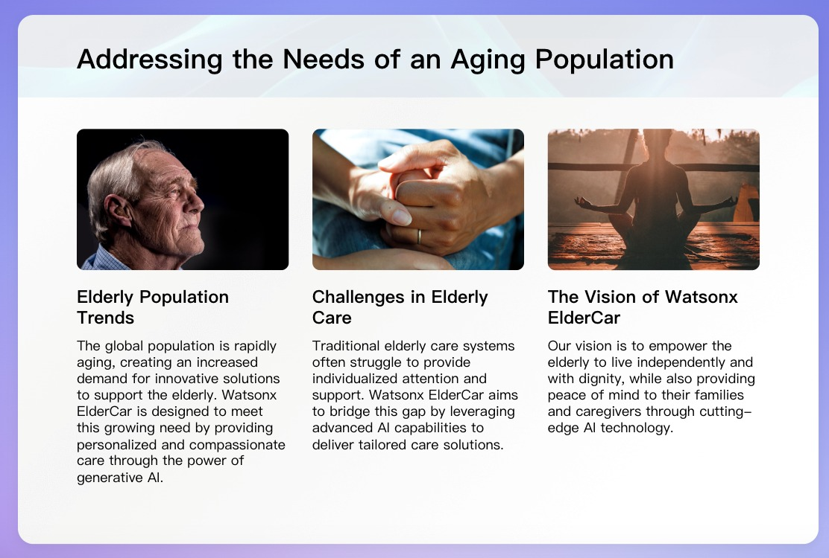

Slide 8
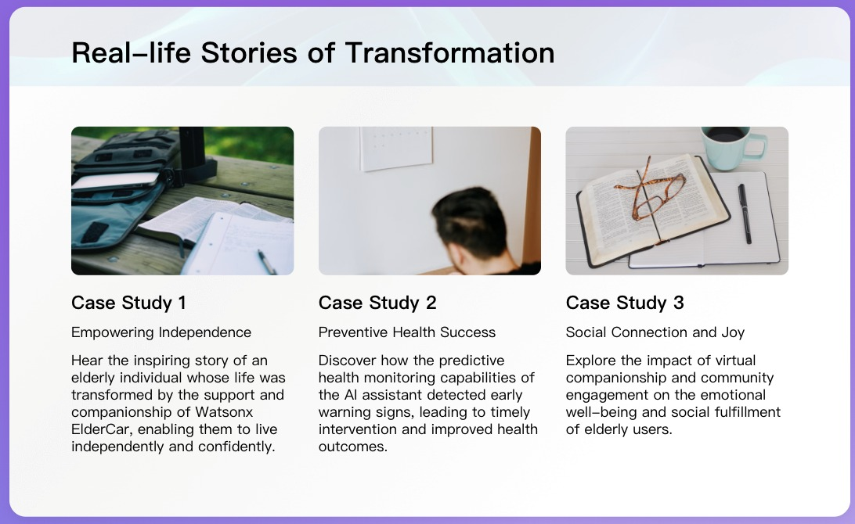

Slide 9
Societal Impact and Future Possibilities
Empowering
Aging
Communities
Explore the broader societal impact of Watsonx ElderCare in promoting inclusive and age-friendly communities, redefining the narrative around aging and care.
Call
to
Action
Join us in our mission to harness the power of Al for positive social impact, advocating for the well-being and dignity of the elderly through innovative care solutions.
Future
Possibilities
Delve into the potential of Gen Al in
revolutionizing elderly care, envisioning future advancements, partnerships, and possibilities for
enhancing the lives of the elderly.

Slide 10
Conclusion
The Watsonx ElderCare AI Assistant leverages AI to address the unique challenges faced by the elderly. Through intuitive design, advanced AI technology, and compassionate care, it makes a meaningful difference in the lives of seniors, promoting dignity, independence, and a higher quality of life.

