Slide 1
Kubernetes Cluster Health Checker
and Auto-Healing
Capstone project | Go self-healing agent + Prometheus, Grafana, Alertmanager on k3s (Azure)
Team: Aparna Peri, Vivek Pathak, Vilas Elavande, Sailaja

Slide 2
Problem statement and project goals
Manual cluster monitoring does not scale: small DevOps teams lose time to failed pods, unresponsive nodes and downtime. An automated checker with self-healing keeps availability high with minimal intervention.
1
2
3
4
Monitor
Self-heal
Alert
Dashboard
Node health, pod status, resource use
Restart or reschedule pods, scale if needed
Real-time Slack/Teams notifications
Live health, history, healing logs

Slide 3
Requirement coverage by sprint
Sprint | Requirement | Delivered
1 | Setup, cluster access, Prometheus | k3s on Azure VM, kubectl, Helm, kube-prometheus-stack running
2 | Node and pod checks, Grafana, alerts | Pod health checks in Go; CPU, memory, network panels; Alertmanager running
3 | Pod recovery, cleanup, audit log | CrashLoopBackOff pods deleted and recreated; every action logged
4 | Scaling and balancing | Design: HPA, Cluster Autoscaler or KEDA (enhancement path)
5 | Alerting and notifications | Prometheus rules, Alertmanager routing to Slack via webhook Secret
6 | Dashboard and documentation | Grafana panels, Go dashboard ledger, setup and troubleshooting guide

Slide 4
Architecture and reconciliation loop
Kubernetes cluster
(pods, nodes, events)
Go self-healing agent
(client-go, kube-system)
Observe pod state every cycle
Compare with desired healthy state
Delete CrashLoopBackOff pods; controller recreates them
Expose metrics and alerts
Prometheus +
Alertmanager
Grafana
dashboard
Slack / Teams
(webhook)
Pod recovery relies on the Deployment controller recreating deleted pods.

Slide 5
Sprint 1: Environment, local to Azure k3s
Item | Local prototype (phases 1-5) | Cloud stack (current evidence)
Cluster | Docker Desktop + Minikube | k3s on an Ubuntu 24.04 Azure VM
Language | Python test_check.py (kubernetes SDK) | Go agent (client-go v0.31.0)
Monitoring | Helm + kube-prometheus-stack | Same chart in the monitoring namespace
Image | k8s-self-healer:v1 via minikube docker-env | Multi-stage build, imported into k3s containerd
Sizing | Laptop memory | At least 2 vCPU / 4 GB RAM to avoid OOM

Slide 6
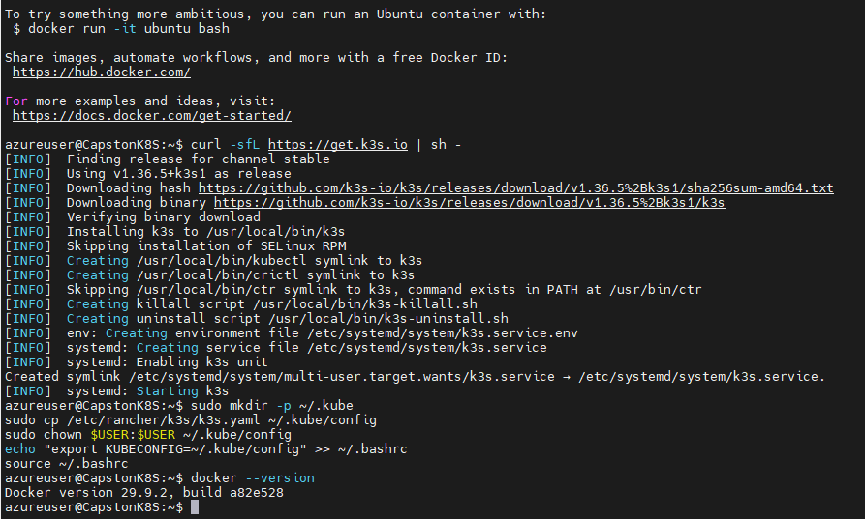
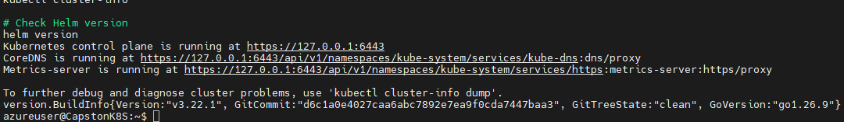
Sprint 1: Docker, k3s and Helm
Node Ready (control-plane)
Cluster info and Helm v3.22.1
Docker and k3s installed
kubeconfig copied to ~/.kube/config. Restrict it with chmod 600 (see security).

Slide 7
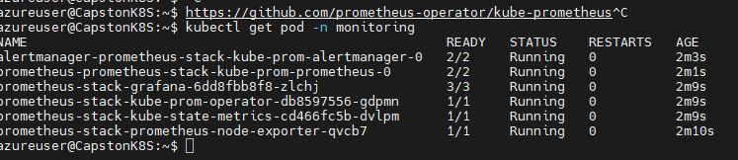
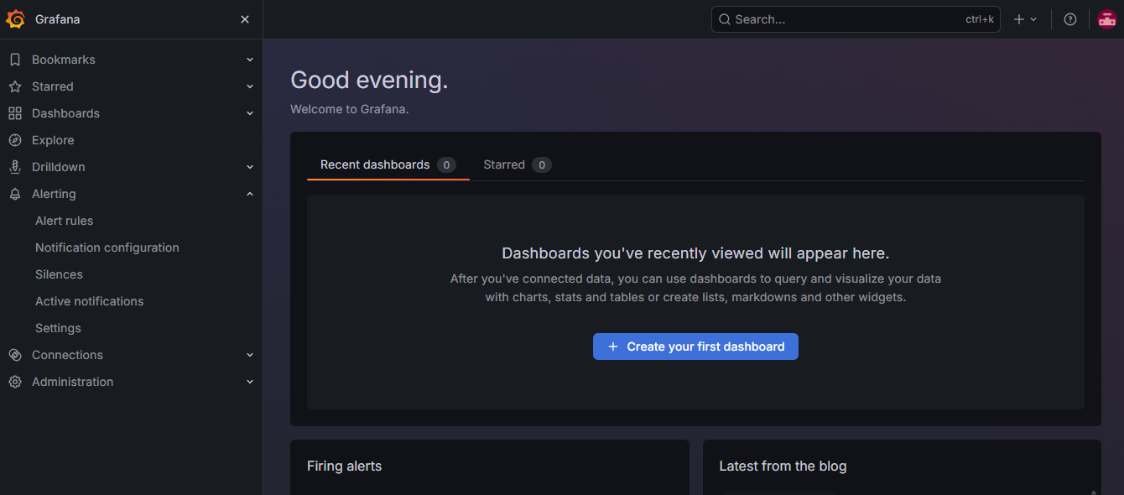
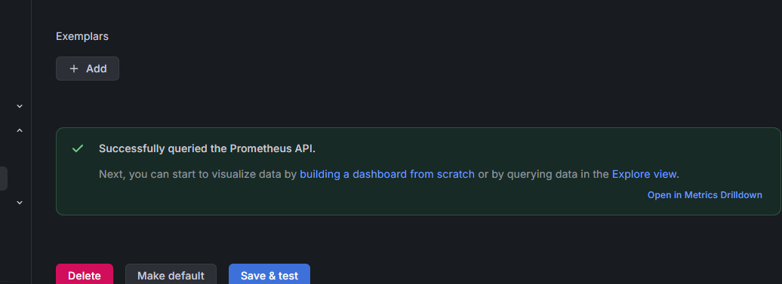
Sprint 1: Prometheus stack and Grafana
All monitoring pods Running
Grafana home
Chart installed in the monitoring namespace: Prometheus, Alertmanager, Grafana, node-exporter, kube-state-metrics.
Prometheus data source: query OK

Slide 8
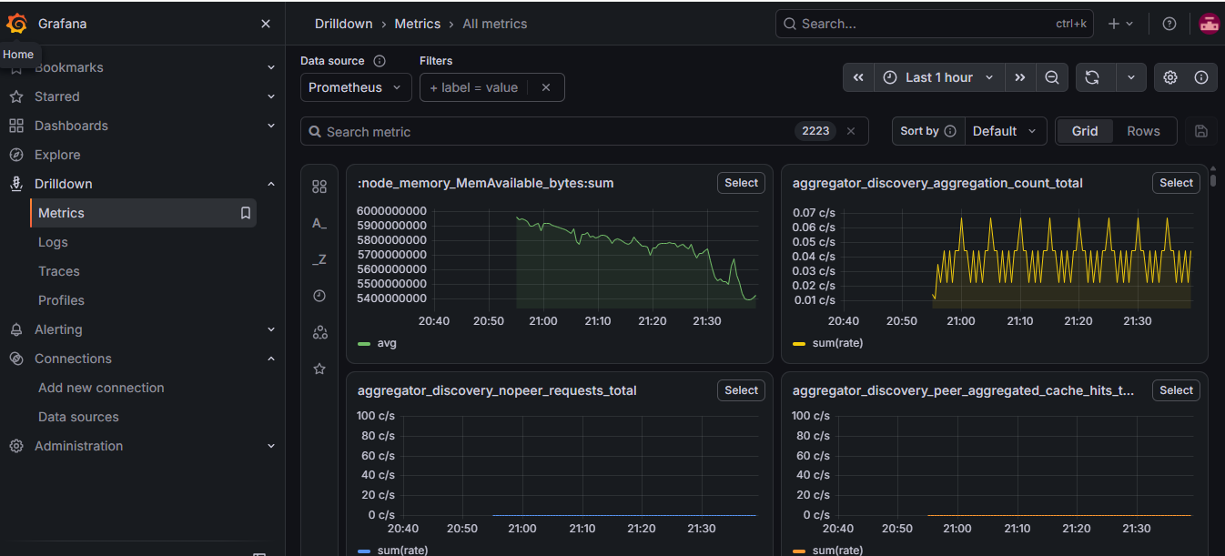
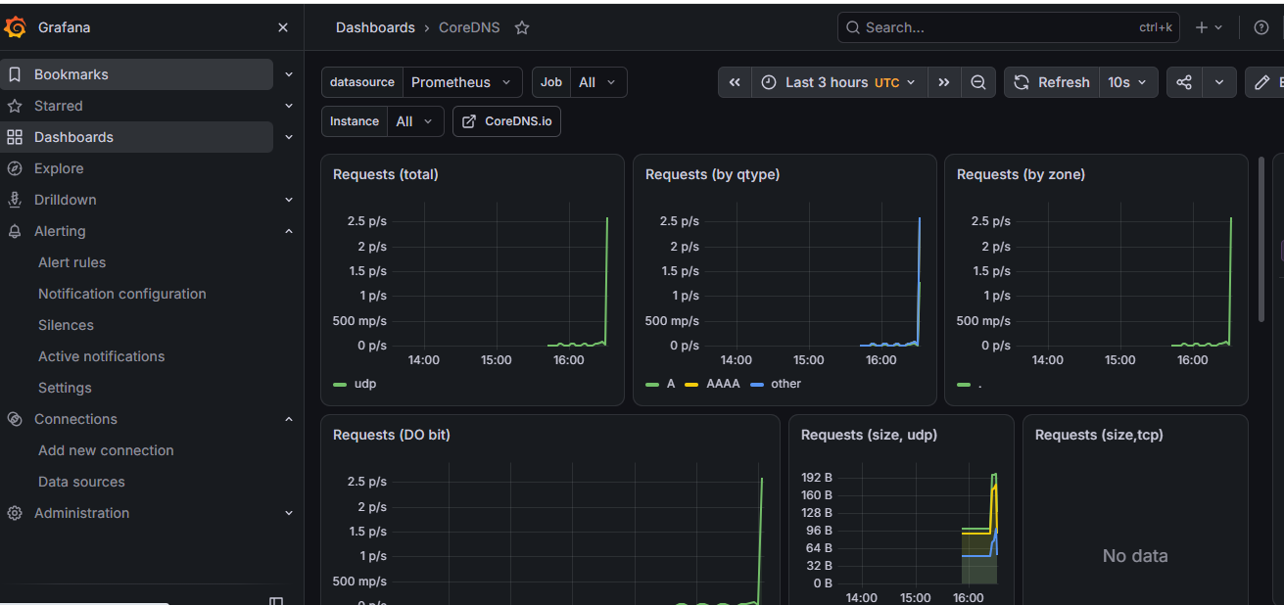
Sprint 2: metrics explorer and CoreDNS dashboard
Metrics drilldown (2,223 series)
CoreDNS dashboard on Prometheus

Slide 9
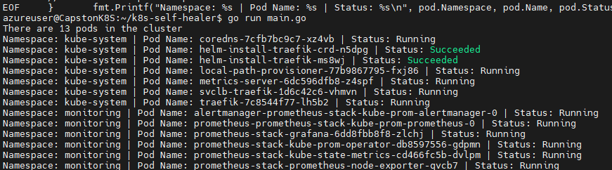
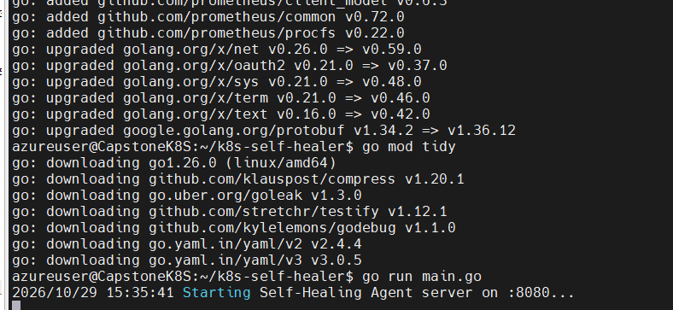

Sprint 3: building the Go self-healing agent
go run main.go lists 13 pods
Agent server and metrics on :8080
client-go in-cluster config
Multi-stage Dockerfile, small runtime image
Image saved and imported into k3s
Image local-registry/k8s-self-healer:v1.0

Slide 10
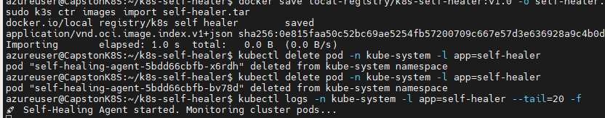
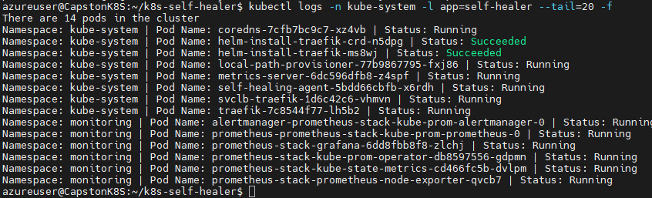
Sprint 3: agent deployed in kube-system
Import image, redeploy, tail logs
Agent pod self-healing-agent is listed (14 pods)
Runs as a Deployment, label app=self-healer
Logs: "Self-Healing Agent started. Monitoring cluster pods..."

Slide 11
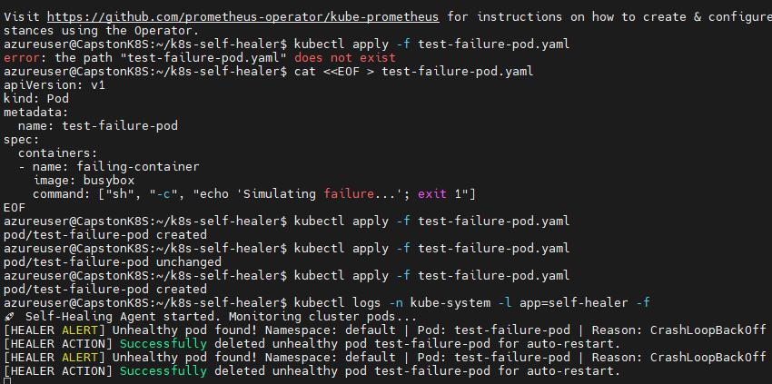
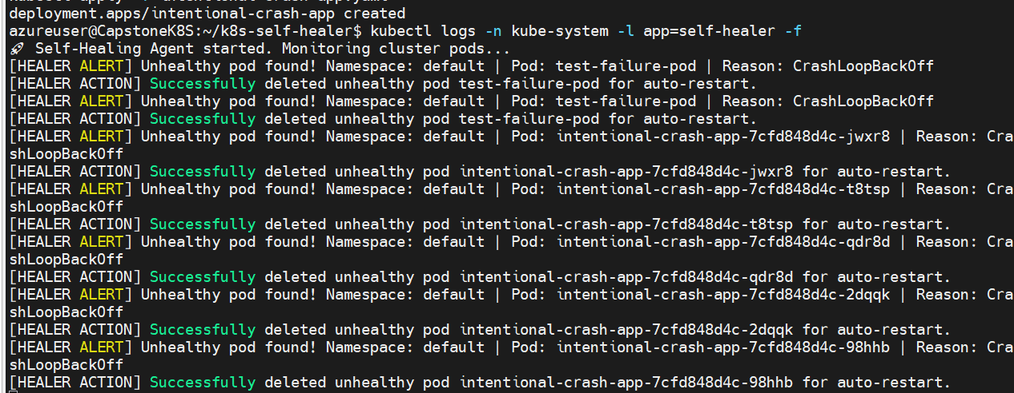
Sprint 3: chaos test and auto-healing proof
intentional-crash-app healed repeatedly
test-failure-pod (busybox, exit 1)
The agent detected CrashLoopBackOff, deleted the pod and logged an ALERT and an ACTION entry; the Deployment controller recreates the pod.

Slide 12
Sprint 4: Scaling and resource balancing design
Mechanism | Purpose | Tool
Pod autoscaling | Add replicas when CPU or memory is high | Horizontal Pod Autoscaler
Node scaling | Add or remove nodes with demand | Cluster Autoscaler or Karpenter
Event-driven scaling | Scale on queue or alert signals | KEDA
Resource balancing | Spread pods evenly across nodes | Topology spread constraints, descheduler
Validation plan: simulated load, then watch replica and node counts in Grafana.

Slide 13
Sprint 4: Cost optimization
Lever | How it applies here
Lightweight control plane | k3s on one VM instead of a managed control plane fee for a demo environment
Right-size compute | 2 vCPU / 4 GB meets the monitoring stack; resize from Prometheus usage
Schedule shutdown | Auto-stop the VM outside demo and test hours; tag resources and set budget alerts
Cut monitoring cost | Short Prometheus retention, longer scrape interval, drop unused series
Pod requests and limits | Prevent noisy neighbours and enable bin-packing
Autoscaling later | HPA plus Cluster Autoscaler or KEDA to scale down idle capacity

Slide 14
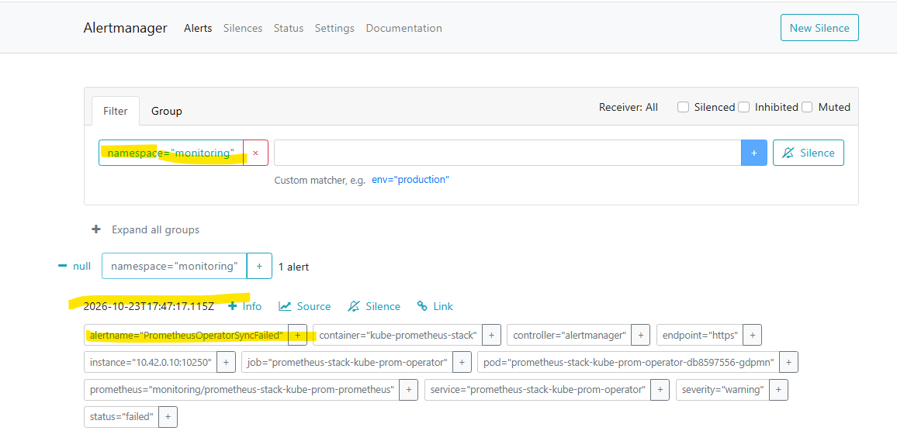
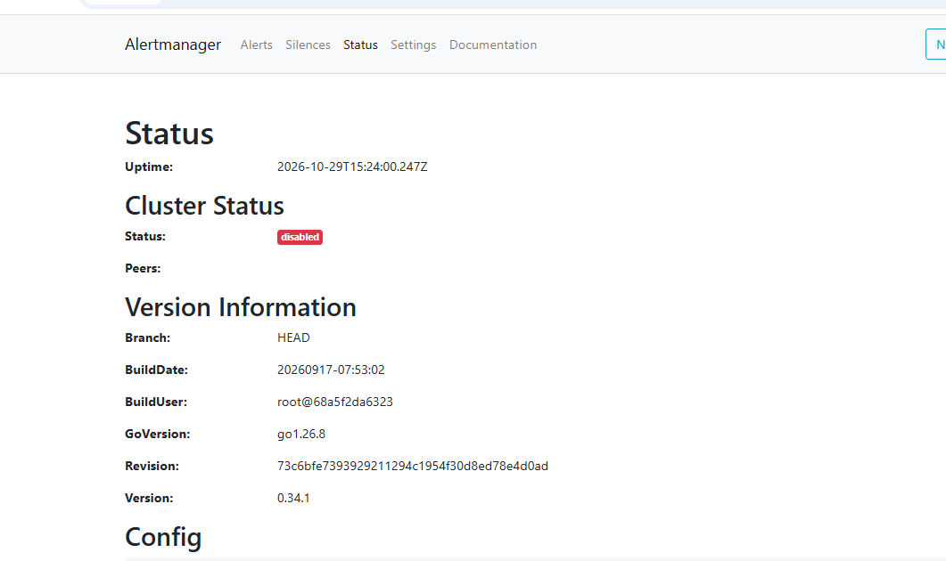
Sprint 5: Alertmanager and Slack routing
Alertmanager: PrometheusOperatorSyncFailed
Alertmanager status (v0.34.1)
Alerts are captured and grouped in Alertmanager
Slack delivery: webhook stored as a Secret, receiver set in alertmanager-config.yaml, applied with helm upgrade

Slide 15
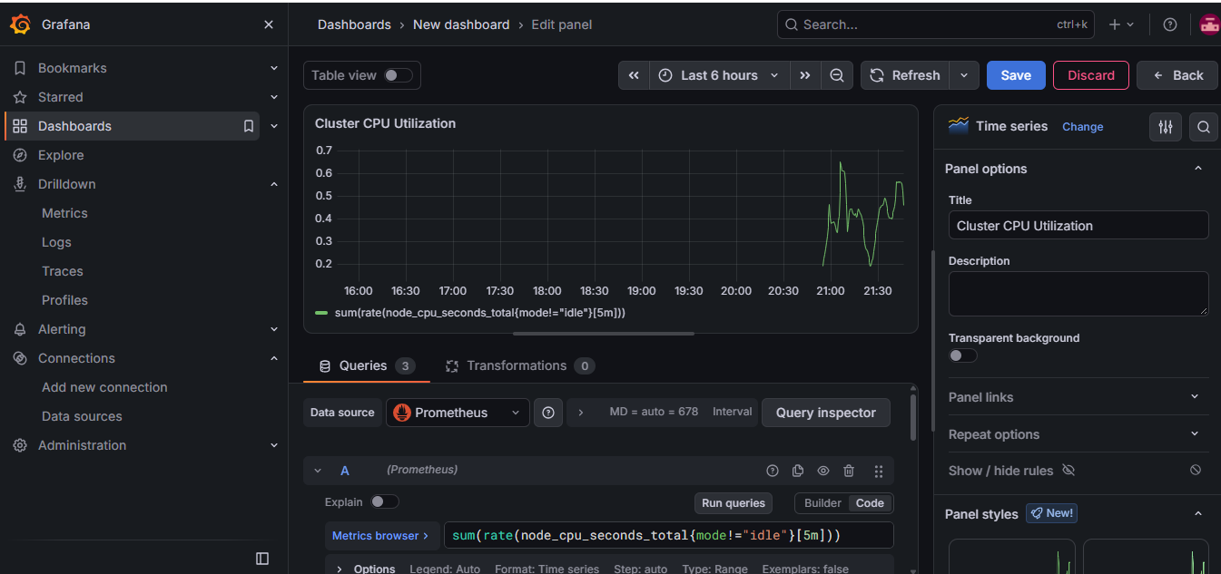
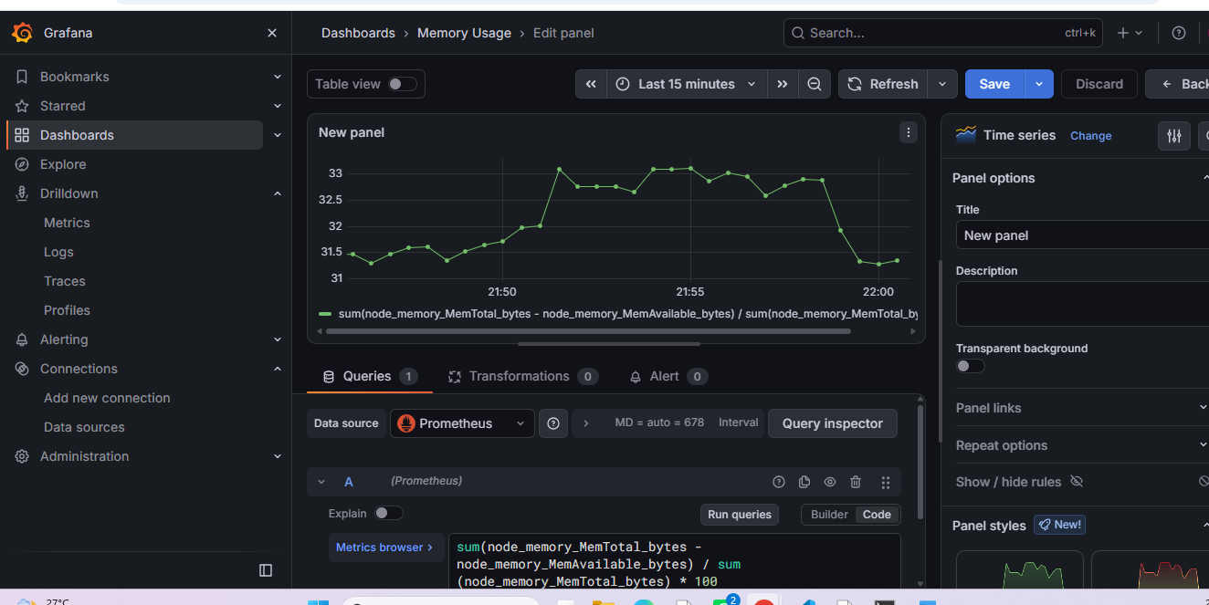
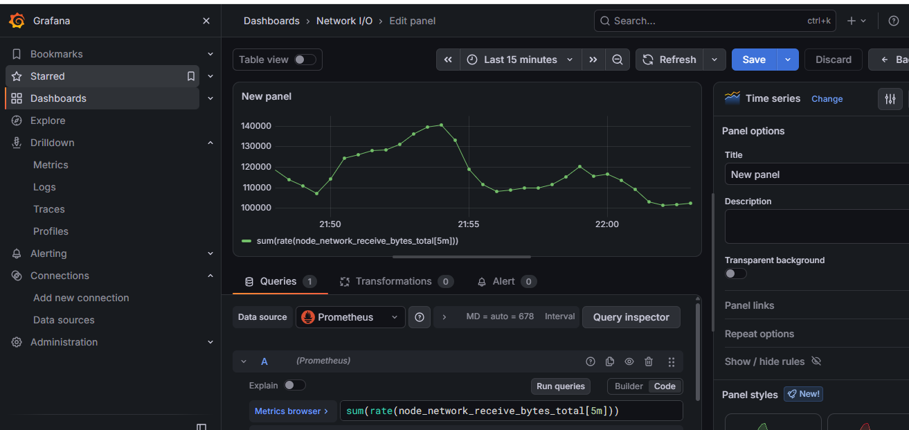
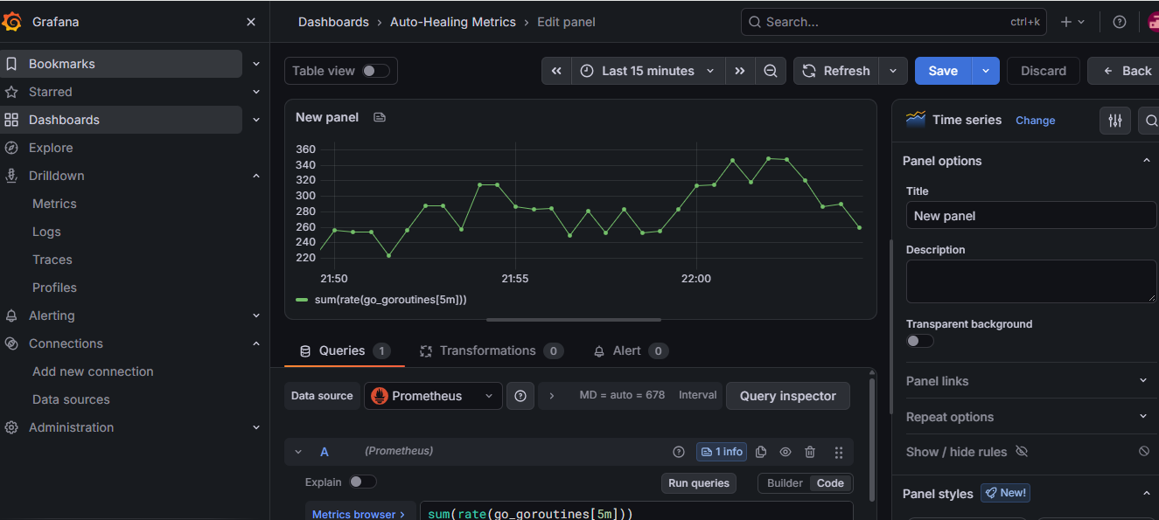
Sprint 6: Grafana panels (PromQL)
Cluster CPU: sum(rate(node_cpu_seconds_total{mode!="idle"}[5m]))
Memory usage %
Network I/O (receive bytes rate)
Agent runtime panel (Go metrics)

Slide 16
Sprint 6: Code structure and CI/CD
k8s-self-healing-stack/
+-- .github/workflows/deploy.yml
+-- cmd/healer/
| +-- main.go
| `-- templates/index.html
+-- internal/controller/
| `-- controller.go
+-- deployments/k8s/
| +-- self-healing-agent.yaml
| `-- test-failure-pod.yaml
+-- deployments/monitoring/
| +-- alertmanager-config.yaml
| `-- prometheus-alerts.yaml
+-- scripts/ (k3s, monitoring)
+-- Dockerfile, go.mod, go.sum
`-- README.md
Informers watch pods and nodes
Heals CrashLoopBackOff, ErrImagePull and Evicted pods
Guardrails: namespace allowlist, owner check, heal limit
Dashboard, /metrics and /healthz on :8080
CI: test, build, vulnerability and image scan

Slide 17
Security best practices
Area | Practice | Why
RBAC | Dedicated ServiceAccount; read cluster-wide, delete only in target namespaces; exclude kube-system | Limits blast radius of the healer
Network exposure | Close 3000, 9090, 9093, 6443 in the NSG; use SSH tunnel or HTTPS ingress | Dashboards have no public login
Secrets | Slack webhook and Grafana password in Secrets or a vault; never in Git | Prevents credential leaks
Healer guardrails | Dry-run mode, cooldown, retry cap, namespace allowlist, skip bare pods | Stops delete loops and data loss
Container hardening | Non-root, read-only filesystem, drop capabilities, requests and limits | Reduces escape and abuse risk
Supply chain | Pin image tags or digests; scan with Trivy in CI | Catches vulnerable dependencies

Slide 18
Hardened RBAC and pod security
apiVersion: v1
kind: ServiceAccount
metadata: {name: self-healer, namespace: kube-system}
---
kind: ClusterRole
metadata: {name: healer-read}
rules:
- apiGroups: [""]
resources: ["pods","nodes","events"]
verbs: ["get","list","watch"]
---
kind: Role # one per target namespace
metadata: {name: healer-delete, namespace: apps}
rules:
- apiGroups: [""]
resources: ["pods"]
verbs: ["delete"]
spec:
serviceAccountName: self-healer
automountServiceAccountToken: true
securityContext:
runAsNonRoot: true
seccompProfile: {type: RuntimeDefault}
containers:
- name: engine
image: k8s-self-healer:v1.0 # pin
securityContext:
allowPrivilegeEscalation: false
readOnlyRootFilesystem: true
capabilities: {drop: ["ALL"]}
resources:
requests: {cpu: 50m, memory: 64Mi}
limits: {cpu: 200m, memory: 128Mi}
Add a NetworkPolicy so only Prometheus can reach :8080.

Slide 19
Roadmap and enhancements
Step | Enhancement | Sprint
1 | Enable Slack webhook and test with a manual alert | 5
2 | Export auto_healing_actions_total and replace the go_goroutines panel | 6
3 | Add node health checks (NotReady) and cordon; clean up Evicted pods | 2-3
4 | Add HPA and Cluster Autoscaler; run a load test | 4
5 | Apply hardened RBAC, secrets handling and NSG rules | All
6 | Write setup, usage and troubleshooting guide | 6

Slide 20
Conclusion
Working: k3s, full Prometheus/Grafana/Alertmanager stack, Go agent healing CrashLoopBackOff pods with audit logs
Roadmap: node scaling, healing-count metric, hardened RBAC

