Slide 1
Kubernetes Cluster Health Checker
and Auto-Healing
Capstone project | Go self-healing agent + Prometheus, Grafana, Alertmanager on k3s (Azure)
Batch-16A
Team: Aparna Peri, Vivek Pathak, Vilas Elavande

Slide 2
Problem statement and project goals
Manual cluster monitoring does not scale: small DevOps teams lose time to failed pods, unresponsive nodes and downtime. An automated checker with self-healing keeps availability high with minimal intervention.
1
2
3
Monitor
Self-heal
Dashboard
Node health, pod status, resource use
R estart or reschedule pods, scale if needed
Live health, history, healing logs

Slide 3
Requirement coverage by sprint
Sprint | Requirement | Delivered
1 | Setup, cluster access, Prometheus | k3s on Azure VM, kubectl, Helm, kube-prometheus-stack running
2 | Node and pod checks, Grafana, alerts | Pod health checks in Go; CPU, memory, network panels; Alertmanager running
3 | Pod recovery, cleanup, audit log | CrashLoopBackOff pods deleted and recreated; every action logged
4 | Scaling and balancing | Design: HPA, Cluster Autoscaler or KEDA (enhancement path)
5 | Dashboard and documentation | Grafana panels, Go dashboard ledger, setup and troubleshooting guide

Slide 4
Architecture and reconciliation loop
Kubernetes cluster
(pods, nodes, events)
Go self-healing agent
(client-go, kube-system)
Observe pod state every cycle
Compare with desired healthy state
Delete CrashLoopBackOff pods; controller recreates them
Expose metrics and alerts
Prometheus +
Alertmanager
Grafana
dashboard
Pod recovery relies on the Deployment controller recreating deleted pods.

Slide 5
Sprint 1: Environment, local to Azure k3s
Item | Local prototype (phases 1-5) | Cloud stack (current evidence)
Cluster | Docker Desktop + Minikube | k3s on an Ubuntu 24.04 Azure VM
Language | Python test_check.py (kubernetes SDK) | Go agent (client-go v0.31.0)
Monitoring | Helm + kube-prometheus-stack | Same chart in the monitoring namespace
Image | k8s-self-healer:v1 via minikube docker-env | Multi-stage build, imported into k3s containerd
Sizing | Laptop memory | At least 2 vCPU / 4 GB RAM to avoid OOM

Slide 6
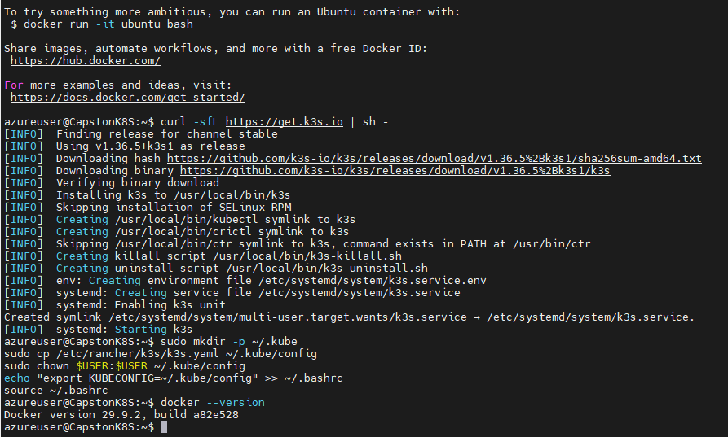
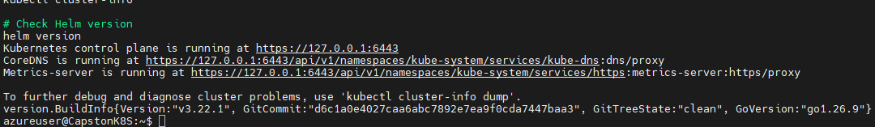
Sprint 1: Docker, k3s and Helm
Node Ready (control-plane)
Cluster info and Helm v3.22.1
Docker and k3s installed
kubeconfig copied to ~/.kube/config. Restrict it with chmod 600 (see security).

Slide 7
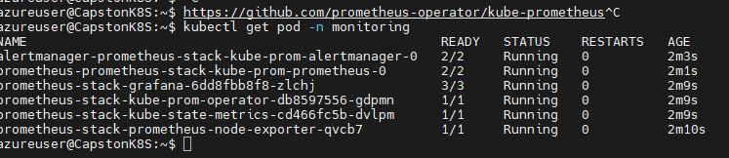
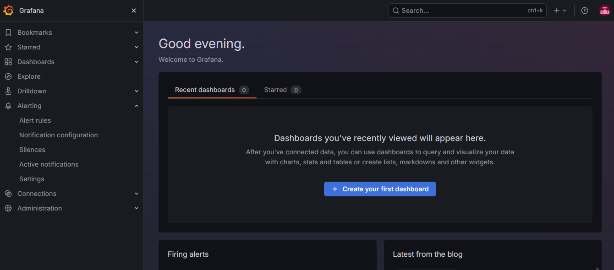
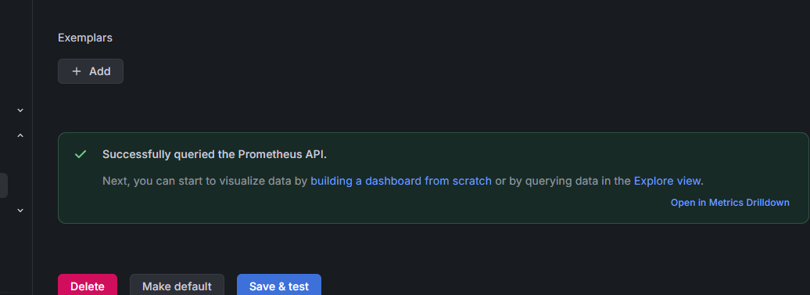
Sprint 1: Prometheus stack and Grafana
All monitoring pods Running
Grafana home
Chart installed in the monitoring namespace: Prometheus, Alertmanager, Grafana, node-exporter, kube-state-metrics.
Prometheus data source: query OK

Slide 8
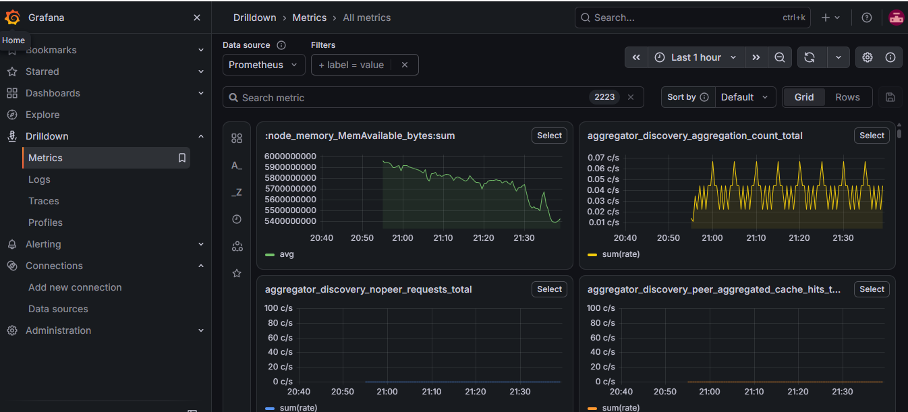
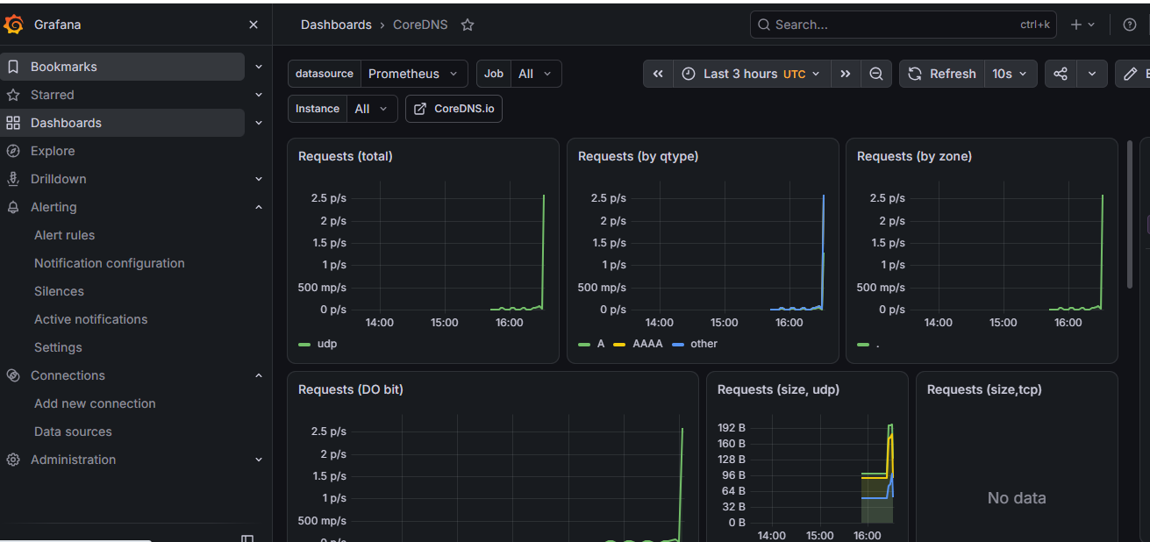
Sprint 2: metrics explorer and CoreDNS dashboard
Metrics drilldown (2,223 series)
CoreDNS dashboard on Prometheus

Slide 9
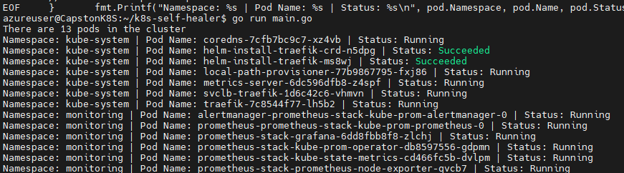
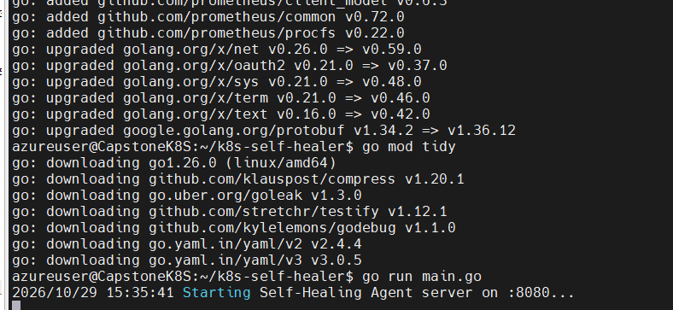

Sprint 3: building the Go self-healing agent
go run main.go lists 13 pods
Agent server and metrics on :8080
client-go in-cluster config
Multi-stage Dockerfile, small runtime image
Image saved and imported into k3s
Image local-registry/k8s-self-healer:v1.0

Slide 10
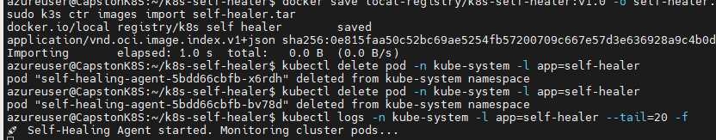
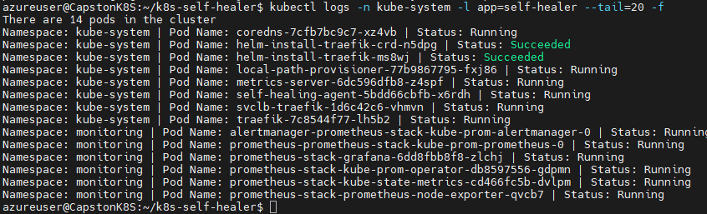
Sprint 3: agent deployed in kube-system
Import image, redeploy, tail logs
Agent pod self-healing-agent is listed (14 pods)
Runs as a Deployment, label app=self-healer
Logs: "Self-Healing Agent started. Monitoring cluster pods..."

Slide 11
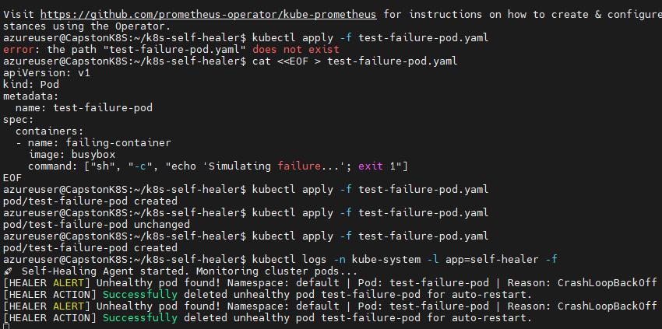
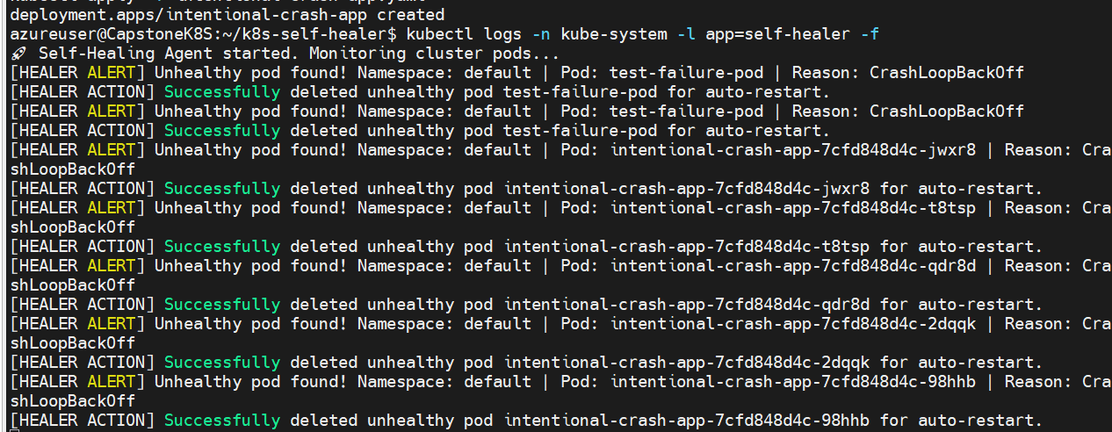
Sprint 3: chaos test and auto-healing proof
intentional-crash-app healed repeatedly
test-failure-pod (busybox, exit 1)
The agent detected CrashLoopBackOff, deleted the pod and logged an ALERT and an ACTION entry; the Deployment controller recreates the pod.

Slide 12
Sprint 4: Scaling and resource balancing design
Mechanism | Purpose | Tool
Pod autoscaling | Add replicas when CPU or memory is high | Horizontal Pod Autoscaler
Node scaling | Add or remove nodes with demand | Cluster Autoscaler or Karpenter
Event-driven scaling | Scale on queue or alert signals | KEDA
Resource balancing | Spread pods evenly across nodes | Topology spread constraints, descheduler
Validation plan: simulated load, then watch replica and node counts in Grafana.

Slide 13
Sprint 4: Cost optimization
Lever | How it applies here
Lightweight control plane | k3s on one VM instead of a managed control plane fee for a demo environment
Right-size compute | 2 vCPU / 4 GB meets the monitoring stack; resize from Prometheus usage
Schedule shutdown | Auto-stop the VM outside demo and test hours; tag resources and set budget alerts
Cut monitoring cost | Short Prometheus retention, longer scrape interval, drop unused series
Pod requests and limits | Prevent noisy neighbours and enable bin-packing
Autoscaling later | HPA plus Cluster Autoscaler or KEDA to scale down idle capacity

Slide 14
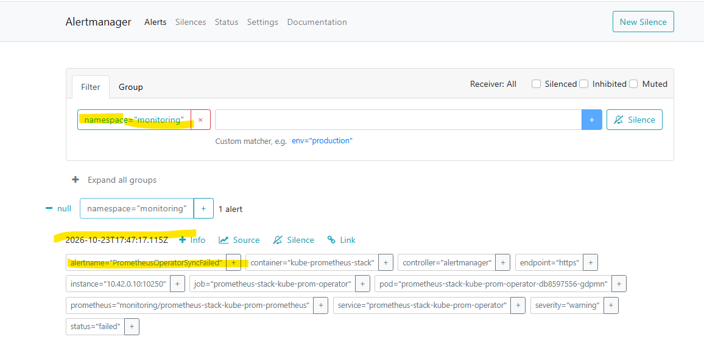
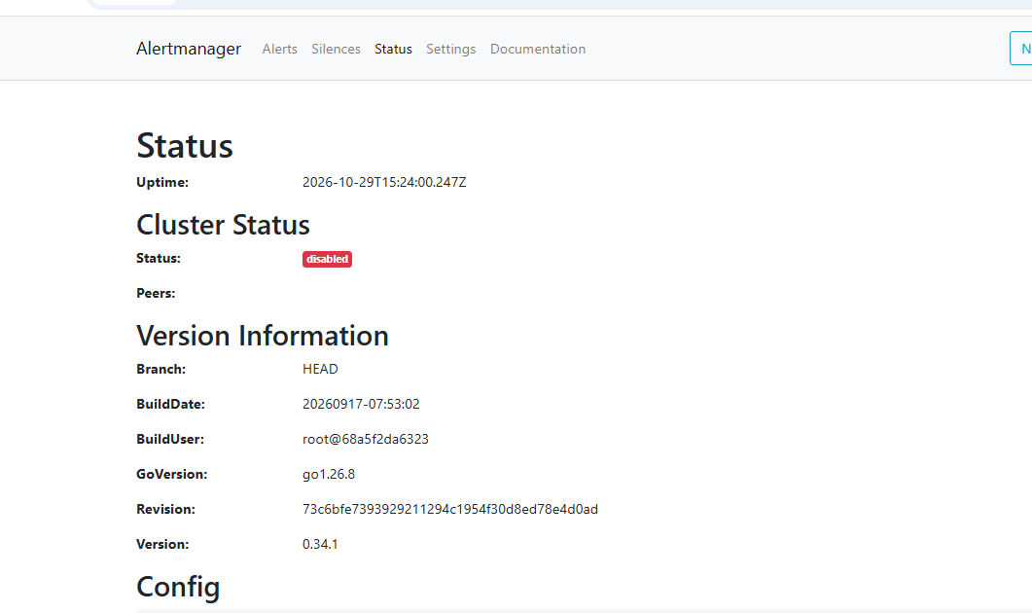
Sprint 5: Alertmanager
Alertmanager: PrometheusOperatorSyncFailed
Alertmanager status (v0.34.1)
Alerts are captured and grouped in Alertmanager

Slide 15
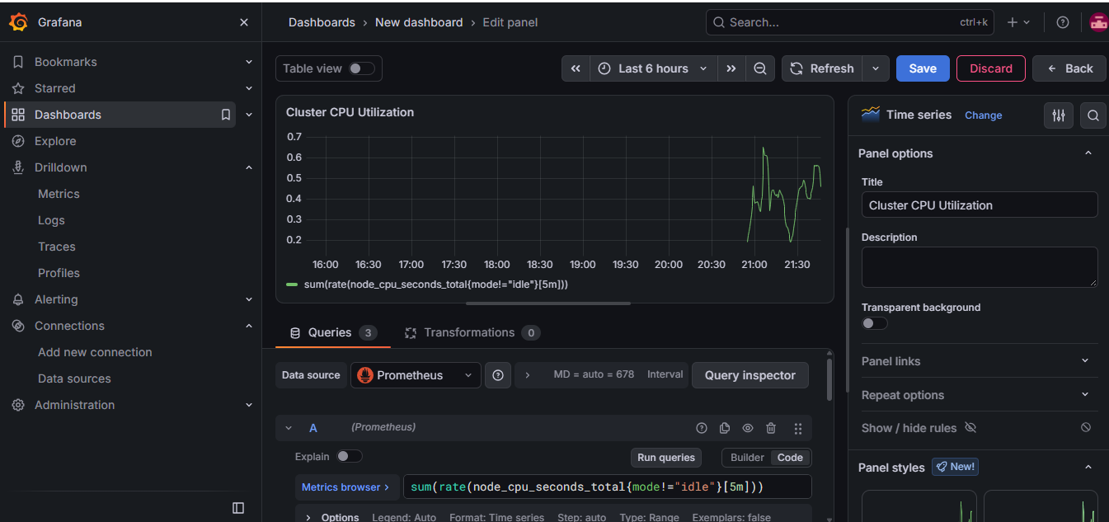
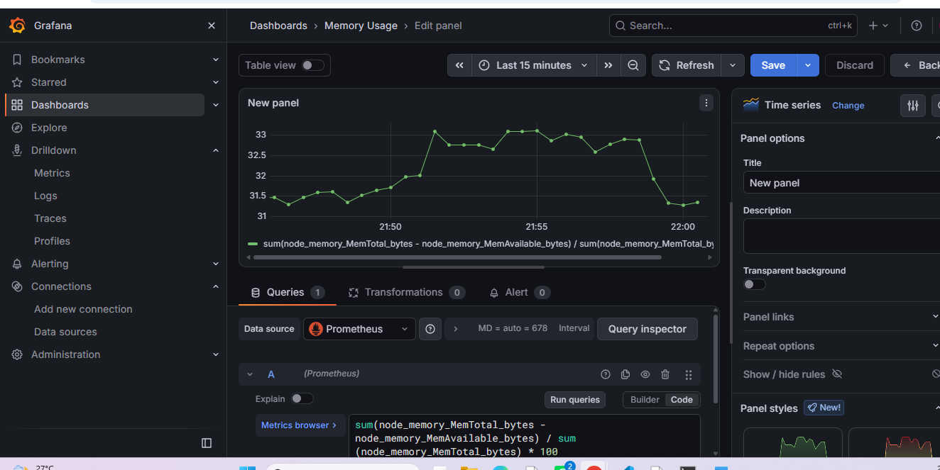
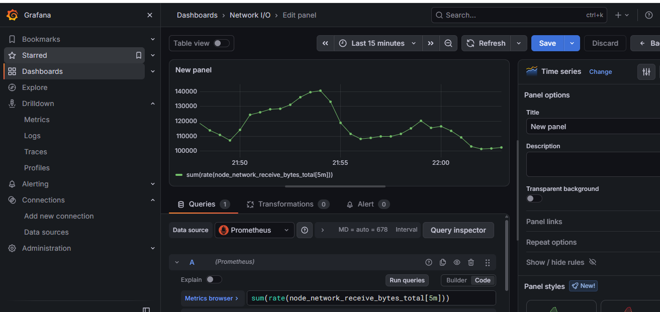
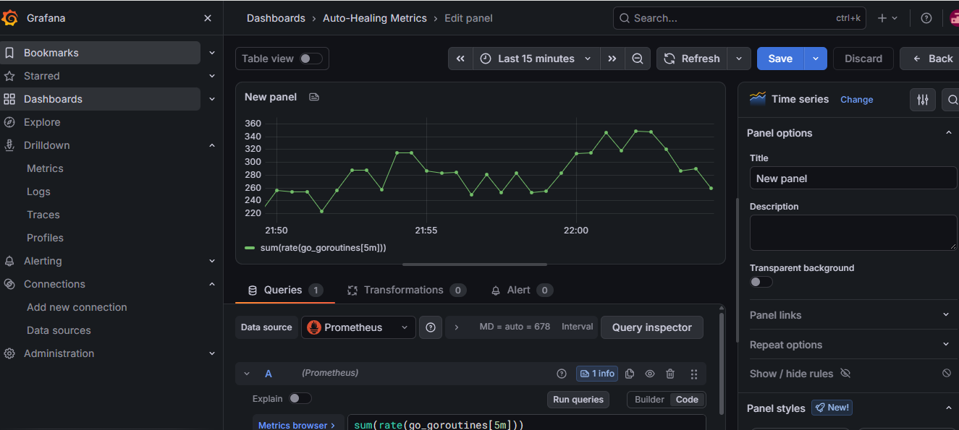
Sprint 6: Grafana panels (PromQL)
Cluster CPU: sum(rate(node_cpu_seconds_total{mode!="idle"}[5m]))
Memory usage %
Network I/O (receive bytes rate)
Agent runtime panel (Go metrics)

Slide 16
Sprint 6: Code structure and CI/CD
k8s-self-healing-stack/
+-- .github/workflows/deploy.yml
+-- cmd/healer/
| +-- main.go
| `-- templates/index.html
+-- internal/controller/
| `-- controller.go
+-- deployments/k8s/
| +-- self-healing-agent.yaml
| `-- test-failure-pod.yaml
+-- deployments/monitoring/
| +-- alertmanager-config.yaml
| `-- prometheus-alerts.yaml
+-- scripts/ (k3s, monitoring)
+-- Dockerfile, go.mod, go.sum
`-- README.md
Informers watch pods and nodes
Heals CrashLoopBackOff, ErrImagePull and Evicted pods
Guardrails: namespace allowlist, owner check, heal limit
Dashboard, /metrics and /healthz on :8080
CI: test, build, vulnerability and image scan

Slide 17
Security best practices
Area | Practice | Why
RBAC | Dedicated ServiceAccount; read cluster-wide, delete only in target namespaces; exclude kube-system | Limits blast radius of the healer
Network exposure | Close 3000, 9090, 9093, 6443 in the NSG; use SSH tunnel or HTTPS ingress | Dashboards have no public login
Secrets | Grafana password in Secrets or a vault; never in Git | Prevents credential leaks
Healer guardrails | Dry-run mode, cooldown, retry cap, namespace allowlist, skip bare pods | Stops delete loops and data loss
Container hardening | Non-root, read-only filesystem, drop capabilities, requests and limits | Reduces escape and abuse risk
Supply chain | Pin image tags or digests; scan with Trivy in CI | Catches vulnerable dependencies

Slide 18
Hardened RBAC and pod security
apiVersion: v1
kind: ServiceAccount
metadata: {name: self-healer, namespace: kube-system}
---
kind: ClusterRole
metadata: {name: healer-read}
rules:
- apiGroups: [""]
resources: ["pods","nodes","events"]
verbs: ["get","list","watch"]
---
kind: Role # one per target namespace
metadata: {name: healer-delete, namespace: apps}
rules:
- apiGroups: [""]
resources: ["pods"]
verbs: ["delete"]
spec:
serviceAccountName: self-healer
automountServiceAccountToken: true
securityContext:
runAsNonRoot: true
seccompProfile: {type: RuntimeDefault}
containers:
- name: engine
image: k8s-self-healer:v1.0 # pin
securityContext:
allowPrivilegeEscalation: false
readOnlyRootFilesystem: true
capabilities: {drop: ["ALL"]}
resources:
requests: {cpu: 50m, memory: 64Mi}
limits: {cpu: 200m, memory: 128Mi}
Add a NetworkPolicy so only Prometheus can reach :8080.

Slide 19
Roadmap and enhancements
Step | Enhancement | Sprint
1 | Test with a manual alert | 5
2 | Export auto_healing_actions_total and replace the go_goroutines panel | 6
3 | Add node health checks (NotReady) and cordon; clean up Evicted pods | 2-3
4 | Add HPA and Cluster Autoscaler; run a load test | 4
5 | Apply hardened RBAC, secrets handling and NSG rules | All
6 | Write setup, usage and troubleshooting guide | 6

Slide 20
Conclusion
Working: k3s, full Prometheus/Grafana/Alertmanager stack, Go agent healing CrashLoopBackOff pods with audit logs
Roadmap: node scaling, healing-count metric, hardened RBAC
Kubernetes Cluster Health Monitoring using k3s on Azure.
Implemented a Go-based Self-Healing Agent for automated recovery.
Integrated Prometheus, Grafana, and Alertmanager for monitoring and alerting.
Demonstrated automatic recovery of CrashLoopBackOff pods.
Leveraged the Kubernetes Deployment Controller to recreate unhealthy pods.
Identified future enhancements:
Node health monitoring and auto-scaling.
Dedicated healing-count metrics.
Security hardening and improvements.
Reduced manual intervention and improved system visibility and auditability.

